Slide 1

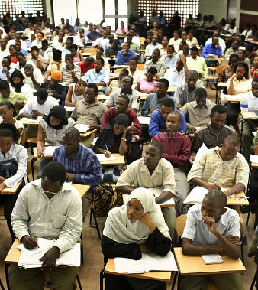
Widening Participation in Higher
Education in Ghana and Tanzania
Diversity, Democratisation and Difference: Theories and Methodologies
Professor Fiona Leach
Professor Louise Morley
University of Sussex, UK
www.sussex.ac.uk/education/cheer

Slide 2
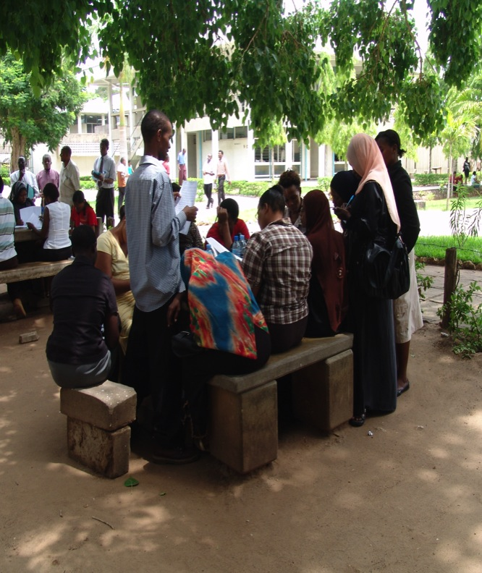
Researching Absences and Silences
Measuring:
Gender, age, socio-economic status (SES)
In Relation to:
Access, retention and achievement.
And:
4 Programmes of Study per university.
2 Public and 2 private universities.
Quantitative Data
100 Equity Scorecards
Qualitative Data
200 interviews/ students
200/ staff and policymakers.
Both private universities = non-profit (www.sussex.ac.uk/education/cheer/wphegt)

Slide 3
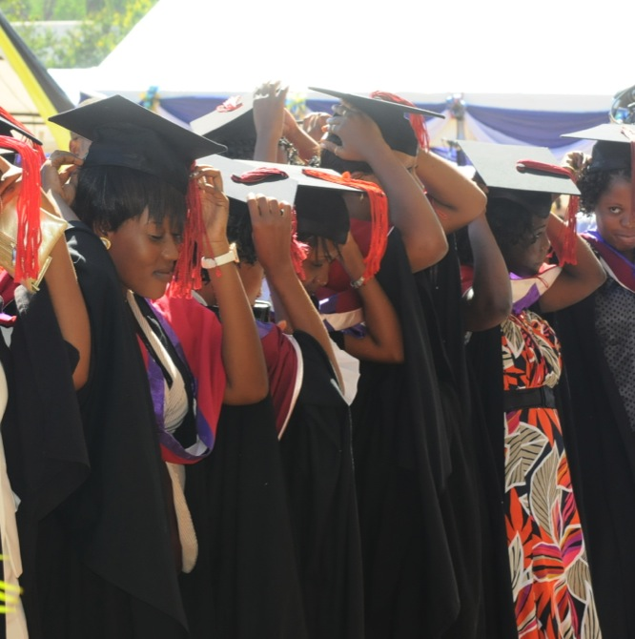
African Higher Education: Policy Priorities
Quality/ Massification
flood of students into increasingly dysfunctional institutions
(World Bank, 2009: 110).
Completion Rates
Despite rising enrolment in tertiary-level institutions, the numbers of students graduating are pitifully small
(World Bank, 2009: x).
Poverty/ Human Capital
Women and poorer communities not participating.
Economic Growth
Competitiveness/ diversification of African economies.
HE as Public/ Private Good
Increase in private universities (450 + in SSA) (Morley, 2014, 2015)

Slide 4
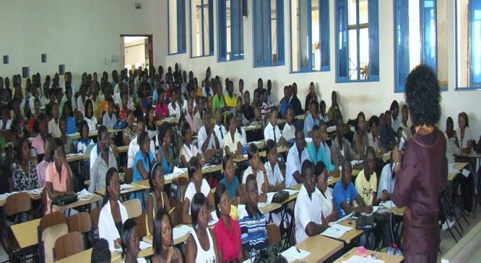
Conceptual, Contextual and Theoretical Considerations
Intersectionality, rather than fractured identities (Davis, 2008).
Sociology of absences (Santos, 1999).
Don’t study the poor and powerless, because everything you say about them will be used against them (Nader, 1972: 295).
Extending the knowledge society to the Global South (Appadurai, 2004).
Hybridisation of public/private provision (Ball, 2008).
Power and privilege = undertheorised.

Slide 5
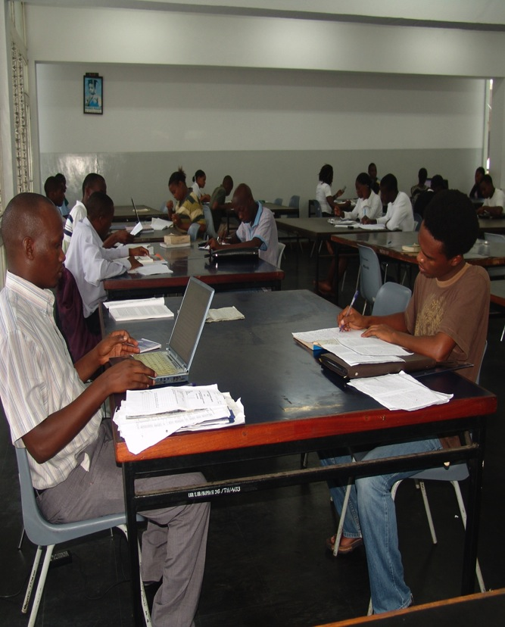
Methodological Challenges
Lack of Management Information Data
Student Gender = only protected characteristic recorded.
Raw Data for the Equity Scorecards
Gender in HE Policy = women’s access, disadvantage and remediation.
Quantitative Change/ Counting More Women in = Gender Equality
Diverse definitions of SES.

Slide 6
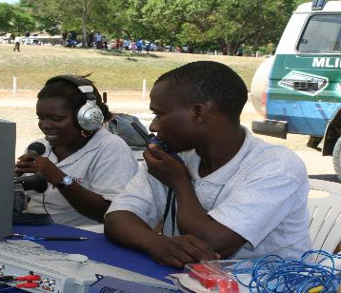
Student Life History Interviews
Narratives of growing up/entering/ experiencing HE suggested the need to develop:
Student-centred services and practices
e.g. transparency in assessment
Quality learning environments
e.g. resources, effective pedagogy
Lecturer professionalism and accountability
Student support e.g. disabilities, gender-based violence.
Students saw the impact of HE in terms of:
Identity transformation/ ‘Becoming a somebody’
An escape route from poverty
Enhanced self-efficacy and self-esteem
National economic/ social development.

Slide 7
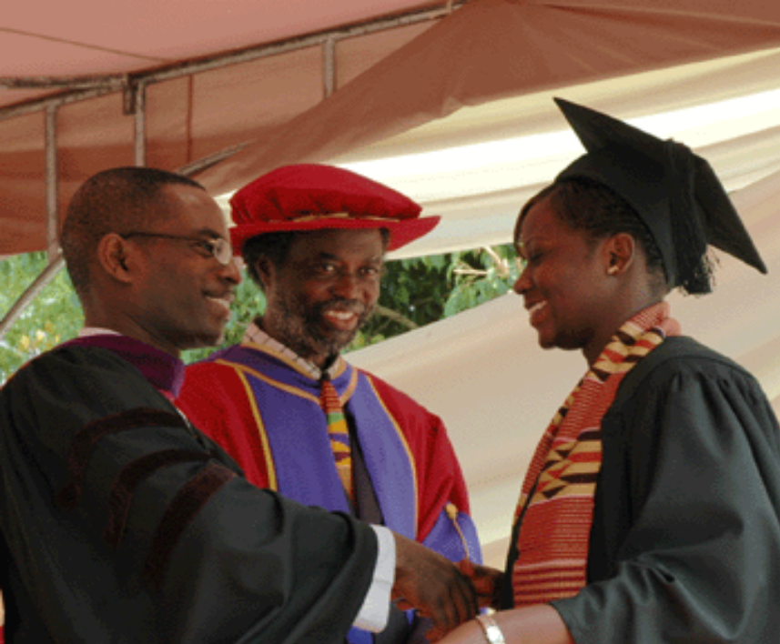
Staff and Policymaker Interviews
Indicated the need to address:
Monitoring/evaluation/ management information
Impact of poverty on participation
Fairness of loans systems
Effectiveness of affirmative action
Capacity challenges
Integrating Education for All policies and Millennium Development Goals (MDGs) into HE (now SDGs)
WP should mean more than increasing the number of women in science.

Slide 8
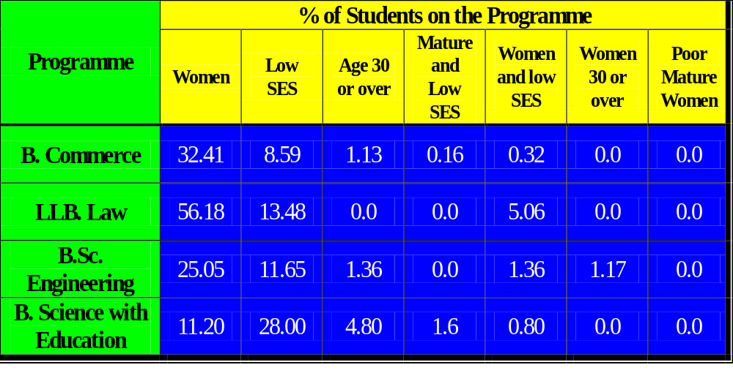
Equity Scorecard: Access to Level 200 on 4 Programmes at a Public University in Tanzania According to Age, Gender and Socio Economic Status

Slide 9
Equity Scorecard: Access to Level 200 on 4 Programmes at a Public University in Ghana According to Age, Gender and Socio Economic Status (2009)
Programme | % of Students on the Programme
 | Women | Low SES | Age 30 or over | Mature and Low SES | Women and low SES | Women 30 or over | Poor Mature Women
B.Commerce | 29.92 | 1.66 | 5.82 | 0.00 | 1.11 | 0.28 | 0.00
B. Management Studies | 47.06 | 2.94 | 6.30 | 0.00 | 1.68 | 3.36 | 0.00
B.Education (Primary) | 36.36 | 8.08 | 65.66 | 8.08 | 2.02 | 21.21 | 2.02
B.Sc. Optometry | 30.77 | 0.00 | 0.00 | 0.00 | 0.00 | 0.00 | 0.00

Slide 10
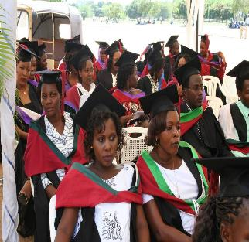
Equity Scorecards Revealed
Most programmes enrolled very few (or no) low SES students
Low SES students tended to be on programmes with low exchange rates in the labour market
Fewer low SES students withdrew/ performed as well as, and sometimes better than, other groups
Mature students most at risk of withdrawal
Women, especially low SES and mature women, under-represented on science programmes
More women entering private, than public universities.

Slide 11
Project Impact: Policy, Conceptual and Instrumental
Ghana
Students’ Union established funding for disadvantaged students.
UCC Student Council organised student representation in cases of sexual harassment.
Students’ Union initiated a zero-tolerance campaign.
Counselling Centre took up the campaign in its Seven-Year Strategic Document.
Admissions Office developed data maintenance system at private university.
Research findings on sexual harassment generated a public debate in the media e.g. Daily Graphic – Sexual Harassment in Tertiary Institutions 11th February 2010.

Slide 12
Project Impact: Policy, Conceptual and Instrumental
Tanzania
Tanzanian Commission for Universities (TCU) revised admissions system.
University of Dar es Salaam (UDSM) developed:
Quality Assurance Unit
Policy for disabled students
Equity Scorecards transformed universities’ and NGOs’ conceptions of participation rates e.g. CAMFED’s initiative for scholarships for poor women was informed by findings on low SES students.
Media attention e.g. Mlimani TV (9th November 2010).

Slide 13
Project Impact: Internationally
World Bank - Findings reported in:
Review of Equity of Access and Success in Tertiary Education: A Global Study (2009-2011)
Literature Review on Equity and Access to Tertiary Education in the Africa Region (2009)
Policy Briefings
Oketch M, McCowan T, Schendel R (2014) The Impact of Tertiary Education on
Development: A Rigorous Literature Review. Department for International Development.
Ng, C., Newman, C. and Pacque-Margolis, S. (2012): Transforming the Health Worker Pipeline:
Interventions to eliminate gender discrimination in preservice education.
John Hopkins Bloomberg School of Public Health.
19th Commonwealth Conference of Education Ministers
Morley, L. (2015) Quality and Equality in African Private Higher Education:
Contradictions and Challenges. In Commonwealth Education Partnerships.
Cambridge: Nexus Strategic Partnerships.
Media Coverage
Times Higher Education (2011) East and West, African sector a middle-class fortress, 17 Nov.
Times Higher Education (2010) Sex for Grades in Africa's Academy, 21 Jan.
The Guardian (2010) Women students stick to traditional subjects, 13 July.
Capacity Development
2 Doctoral Scholars; Research Training for Ghana and Tanzania; Co-authorship/Co-presentations
Keynote Conference and Seminar Presentations (Policymakers, NGOs, Practitioners, Scholars)
Australia, Austria, Belgium Canada, Finland, France, Germany, Greece, Hong Kong, Japan,
New Zealand (Universities New Zealand), Norway, Portugal, Sri Lanka, Sweden, Taiwan, UK, USA.

Slide 14
Impact Challenges
Conceptual
Linear logic: cause/effect/ stimulus/response
Attribution - of policy changes, professional practices
Policy Priorities
UK Impact Policy Agenda strengthened post project
Pre 2014 REF - Performance Indicators were Dissemination and Esteem
Impact not such a priority in the partner countries.
Operational
Collecting evidence (at a distance) post project, with no budget e.g. asking former collaborators to assemble data for no payment
Multiple requests: ESRC, DFID, the UK Research Excellence Framework/ Major time commitment
Sustainability of auditable change

Slide 15
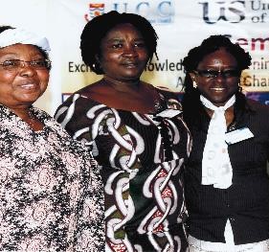
User Engagement
Advisory Groups in Ghana and Tanzania (NGOs, Policymakers, University Leaders, Student Unions)
Regular Dissemination/ Knowledge Exchange events throughout the project in Ghana, Tanzania and the UK.
Policymakers’ written responses (Paul Effah, Ghana, Daniel Mkude, Tanzania)

Slide 16
Publications
Special Issue of Research in Comparative and International Education 2011 6 (4) on African Higher Education: Researching Absences, Equalities and Aspirations
Morley, L. (2011): African Higher Education: Researching absences, Equalities and Aspirations. Research in Comparative and International Education 6 (4): 341-347
Singh, M. (2011): Equity and Quality in the Revitalisation of African Higher Education: Trends and Challenges. Research in Comparative and International Education 6 (4): 348-365
Mkude, D. (2011): Higher Education as an Instrument of Social Integration in Tanzania: Challenges and Prospects. Research in Comparative and International Education 6 (4): 366-373
Effah, P. (2011): A Ghanaian Response to Study on 'Widening Participation in Higher Education in Ghana and Tanzania: Developing an Equity Scorecard'. Research in Comparative and International Education 6 (4): 374-382
Morley, L. and Croft, A. (2011): Agency and Advocacy: Disabled Students in Higher Education in Ghana and Tanzania. Research in Comparative and International Education 6 (4): 383-399
Adu-Yeboah, C. and Dzama Forde, L. (2011): Returning to Study in Higher Education in Ghana: Experiences of Mature Undergraduate Women. Research in Comparative and International Education 6 (4): 400-414
Mwaipopo, R., Lihamba, A. and Njewele, D. (2011): Equity and Equality in Access to Higher Education: The experiences of students with disabilities in Tanzania. Research in Comparative and International Education 6 (4): 415-429
David, M. (2011): Learning from Innovative International Research on Higher Education: How to conceptualise equity for policy, practice and pedagogies in higher education. Research in Comparative and International Education 6 (4): 430-443

Slide 17
Publications
Morley, L. (2015) Quality and Equality in African Private Higher Education: Contradictions and Challenges. In, Silvester, K. (ed) Commonwealth Education Partnerships. Cambridge: Nexus Strategic Partnerships: 102-104.
Morley, L. (2014) Inside African Private Higher Education. In, D. Araya, & Marber, P. (eds) Higher Education in the Global Age: Education Policy and Emerging Societies London, Routledge: 140-159.
Morley, L. (2014) Inside African Private Higher Education: Contradictions and Challenges International Higher Education 76 (also published in Russian - http://ihe.hse.ru/2014--76.html).
Morley, L. (2012) Experiencing Higher Education in Ghana and Tanzania: The Symbolic Power of Being a Student. In, T. Hinton-Smith (ed) Issues in Higher Education Widening Participation: Casting the Net Wide. London: Palgrave: 245-262.
Morley, L. (2012). "Researching Absences and Silences in Higher Education: Data for Democratisation." Higher Education Research and Development 31(3): 353-368.
Morley, L. (2012). Widening Participation in Higher Education in Ghana and Tanzania." International Higher Education 67(Spring): 21-23.
Morley, L. (2011). "Sex, Grades and Power in Higher Education in Ghana and Tanzania." Cambridge Journal of Education 41(1): 101-115.
Morley, L. (2011) African Higher Education: Researching Absences, Equalities and Aspirations. Research in Comparative and International Education 6(4): 341-347.
Morley, L. (2011) Misogyny Posing as Measurement: Disrupting the Feminisation Crisis Discourse. Contemporary Social Science 6 (2): 163-175.
Morley, L. (2010). "Gender Mainstreaming: Myths and Measurement in Higher Education in Ghana and Tanzania." Compare: A Journal of Comparative Education 40(4): 533-550.
Morley, L., and Lussier, K., (2009). "Intersecting Poverty and Participation in Higher Education in Ghana and Tanzania." International Studies in Sociology of Education 19(2): 71-85.
Morley, L and Lugg, R. (2009) Mapping Meritocracy: Intersecting Gender, Poverty and Higher Educational Opportunity Structures. Higher Education Policy 22(1): 37-60.
Morley, L., Leach, F., and Lugg, R., (2008). "Democratising Higher Education in Ghana and Tanzania: Opportunity Structures and Social Inequalities." International Journal of Educational Development 29(1): 56-64.
Morley, L., and Lugg, R., (2008). Democratising Higher Education in Ghana and Tanzania: Opportunity Structures and Social Processes. Journal of the World Universities Forum 1(6): 51-60.
Morley, L., and Lugg, R., (2008). Gender Equity in African Higher Education. International Studies in Education 9: 11-16.

Slide 18
Widening Participation in Higher Education in Ghana and Tanzania:
Developing an Equity Scorecard. An ESRC/DFID Poverty Reduction Programme Research Project (RES-167-25-0078)
Project Director
Professor Louise Morley
Centre for Higher Education and Equity Research (CHEER),
University of Sussex, UK.
l.morley@sussex.ac.uk
Co-Director
Professor Fiona Leach, University of Sussex
f.e.leach@sussex.ac.uk
Lead Researcher, Tanzania
Professor Amandina Lihamba
University of Dar es Salaam
amandina@uccmail.co.tz
Lead Researcher, Ghana
Dr Linda Dzama Forde,
University of Cape Coast.
peaceoddoye26@yahoo.com
See the project website:
www.sussex.ac.uk/education/
cheer/wphegt for:
Project Report and Executive Summary
Project publications
Videos of dissemination events
Resources on WP
Equity Scorecards
Case Studies

