Slide 1
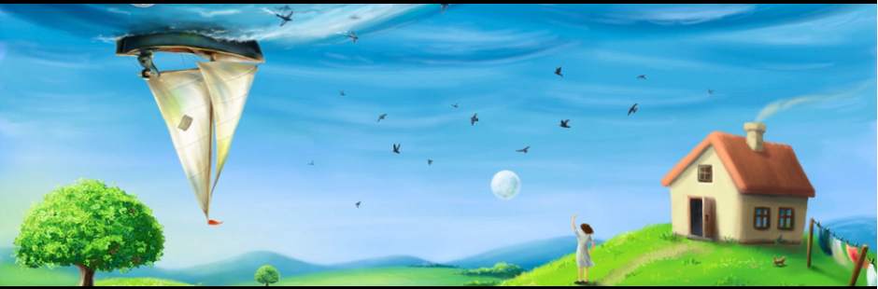
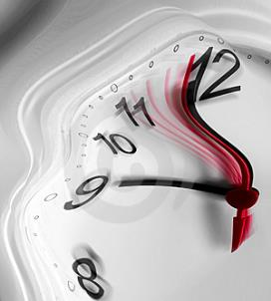
relativistic quantum
technologies
Ivette Fuentes
University of Nottingham

Slide 2

http://rqinottingham.weebly.com/
Relativistic quantum information and metrology
postdocs
Mehdi Ahmadi
Jason Doukas
Andrzej Dragan (now in Warsaw)
Carlos Sabin
Angela White (now in Newcastle)
Antony Lee
PhD students
Tupac Bravo Ibarra
Nicolai Friis (now in Innsbruck)
John Kogias (joint with Adesso)
Dominik Safranek
project student
Kevin Truong
Bartosz Regula (with C. Sabin)
Collaborators
Gerardo Adesso (Nottingham)
David Bruschi (Leeds)
Per Delsing (Chalmers)
Daniele Faccio (Herriot-Watt)
Thomas Jennewein (Waterloo)
Marcus Huber (Bristol/Barcelona)
Göran Johansson (Chalmers)
Jorma Louko (Nottingham)
Daniel Oi (Strathclyde)
Mohsen Razavi (Leeds)
Enrique Solano (Bilbao)
Tim Ralph (Queensland)
FUNDING: EPSRC (THANKS!!!!)

Slide 3
OUTLINE
Motivation
Technical tools
  quantum metrology
  covariance matrix formalism
  QFT on a BEC
Results
  exploiting relativity in quantum measurement technologies
  phononic gravitational wave detector
  estimating the Earth’s space-time parameters

Slide 4
motivation
and
background
3. The output

Slide 5
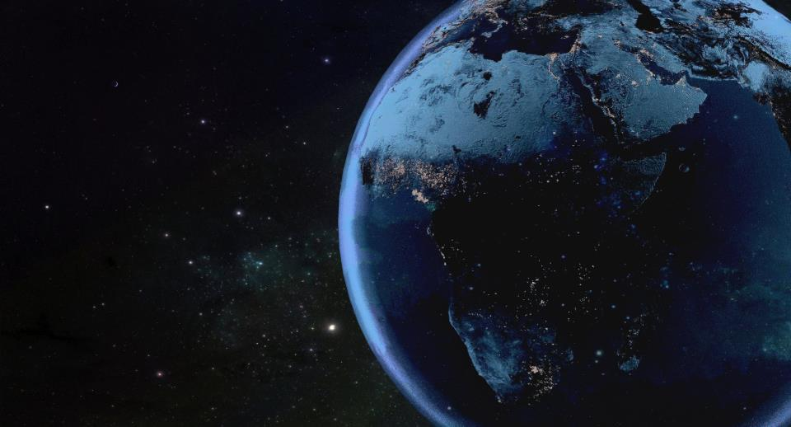
The quantum era is
reaching relativistic regimes
Practical aspects (necessary corrections)
Innovation: new technologies
Fundamental aspects

Slide 6
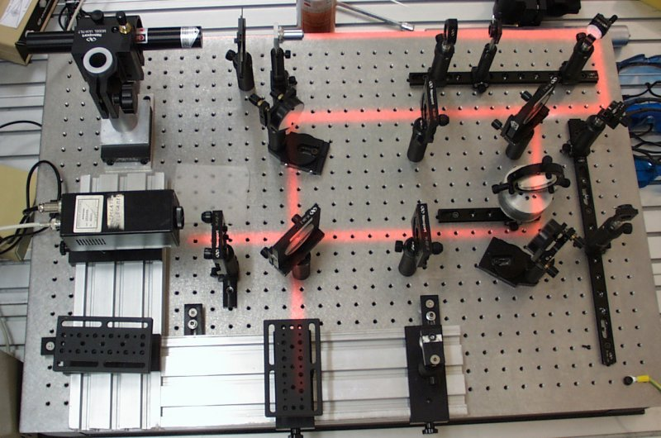
Real world experiments

Slide 7
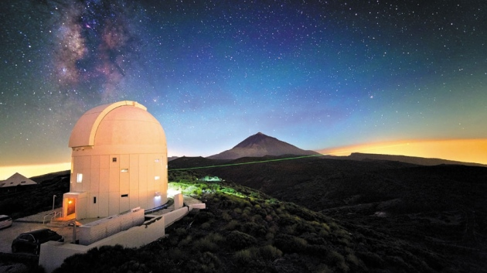
Real world experiments
144 km
Space-QUEST project: distribute entanglement from the International Space Station.
X.-S. Ma, et. al Nature 2012

Slide 8
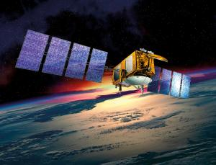
First quantum transmission sent through space
2600 km
Vallone et. al arXiv:1406.4051 2014

Slide 9
Future experiments
Space-QUEST project: distribute entanglement from the International Space Station.
Space Optical Clock project
QUANTUS: quantum gases in microgravity
STE-QUEST: Space-Time Explorer and Quantum Equivalence Principle Space Test

Slide 10
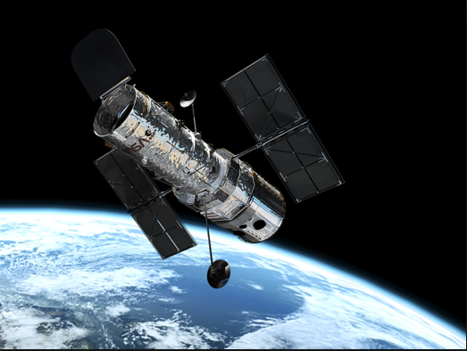
Relativistic regimes
GPS:
At these regimes relativity
kicks in!
What are the effects of gravity and motion on quantum properties?

Slide 11
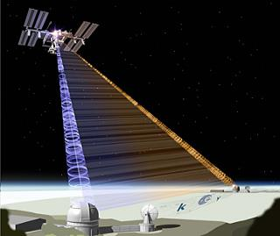
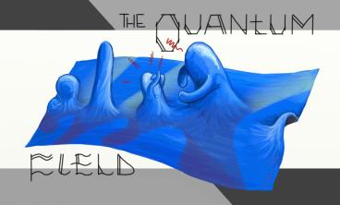
Quantum metrology
Enables ultrasensitive devices for measuring fields, frequencies, time
Quantum clocks and sensors are being sent to space… relativity cannot be ignored
Used to measure gravitational
parameters…
gravitational field strengths
accelerations

Slide 12
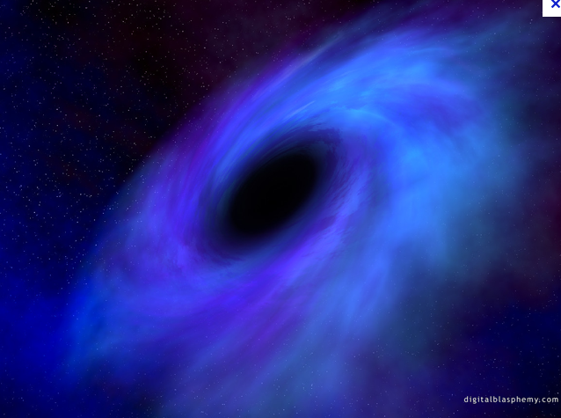
Quantum field theory in curved spacetime
Classical spacetime+ quantum fields
Incorporates Lorentz invariance
Combines quantum mechanics with relativity at scales reachable by near-future experiments
First experimental demonstrations!
Hawking radiation (Unruh, Faccio, Koenig, Steinhauer)
Unruh effect
Dynamical Casimir effect (Delsing)
Expanding Universe (Westbrook)

Slide 13
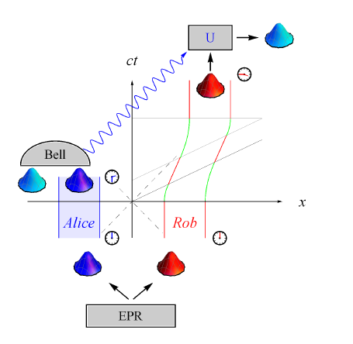

Quantum communications go relativistic
Friis, Lee, Truong, Sabin, Solano, Johansson & Fuentes PRL 2013
Bruschi, Ralph, Fuentes, Jennewein, Razavi, quantph PRD 2014
observable effects in
satellite-based quantum
communications
teleportation is affected by motion
corrections: local rotations and trip planning
Earth-based demonstration: superconducting circuits

Slide 14
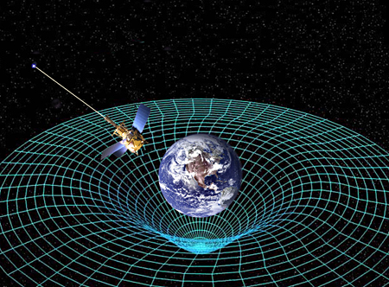
Future relativistic quantum technologies
Deepen our understanding of the overlap of quantum theory and relativity
Can relativistic effects help?
Gravimeters, sensors, clocks

Slide 15
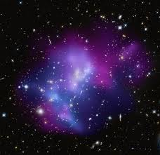
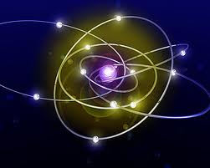
Our understanding of nature
QUANTUM PHYSICS
RELATIVITY

Slide 16
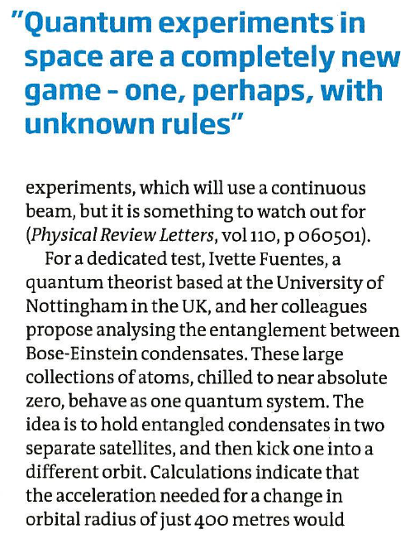
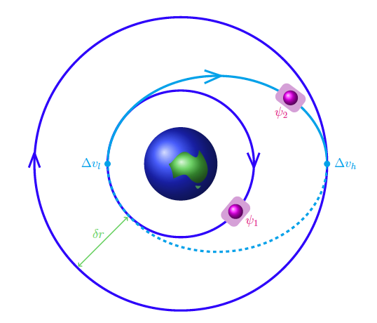
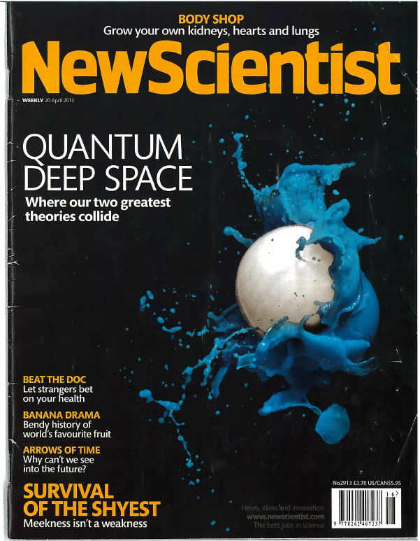
Space-based experiments
Bruschi, Sabin, White, Baccetti, Oi, Fuentes
New J. Phys. (2014)
Effects of gravity and
motion on
entanglement

Slide 17
Technical tools
3. The output

Slide 18
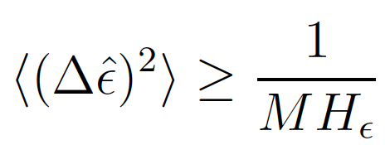
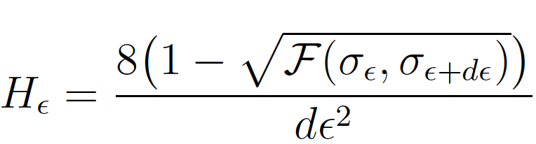

Quantum Metrology
Exploit quantum properties to estimate with high precision parameters in the theory (not observables: time, temperature, etc.)
parameter
3. The output
Error
Quantum Fisher information
M: number of measurements
state
Fidelity

Slide 19



Quantum field theory basics
field equation: Klein Gordon
determinant of the metric
solutions
metric
creation and annihilation operators

Slide 20

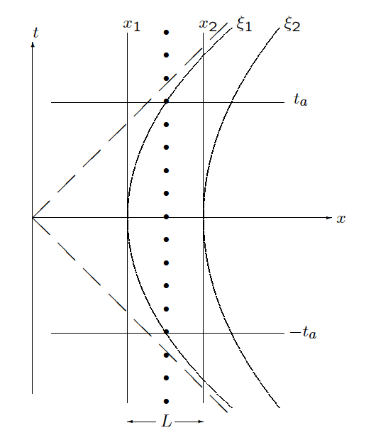
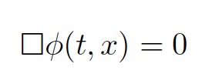
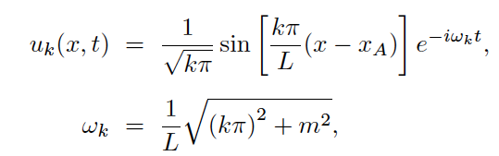


Example: inertial cavity
Minkowski coordinates
field equation
solutions: plane waves+ boundary
creation and annihilation operators

Slide 21
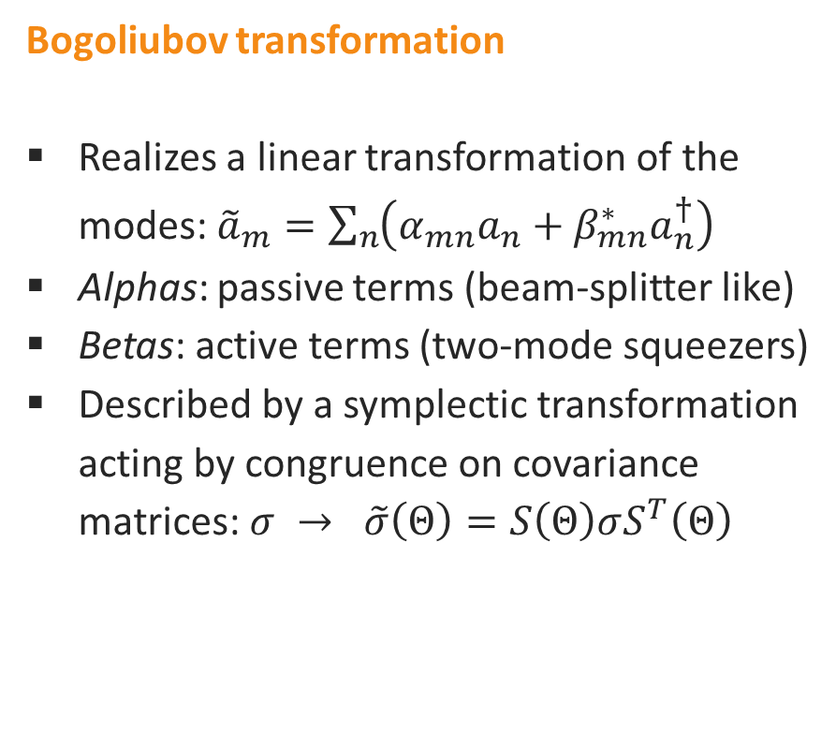
Bogoliubov transformations
2. The transformation
Q
Q
(transmittivity)
(squeezing)
BEAM SPLITTER
PARAMETRIC
AMPLIFIER
Examples: change of observer, space-time dynamics, moving cavity

Slide 22




covariance matrix formalism
covariance matrix: information about the state
symplectic matrix: evolution
computable measures of
bipartite and multipartite entanglement, metrology
techniques

Slide 23
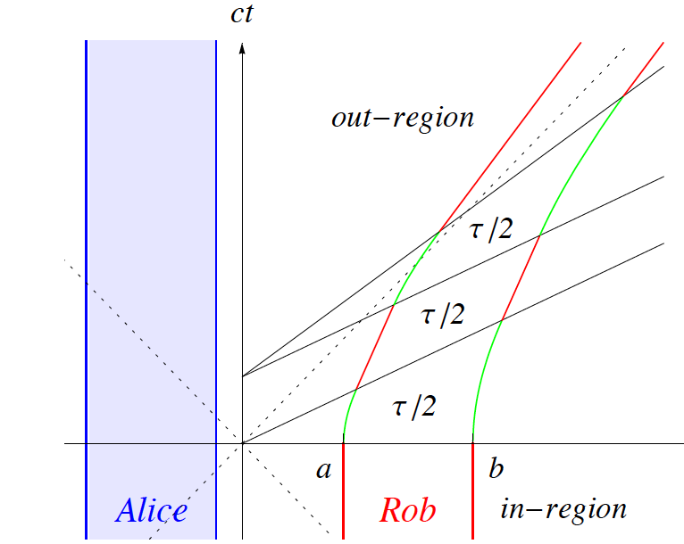

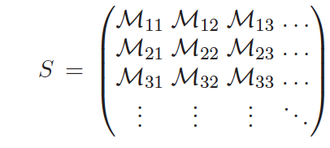
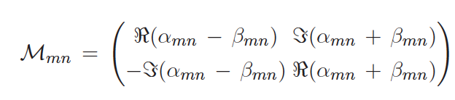
QFT in the symplectic formalism
Friis and Fuentes JMO (invited) 2012
general symplectic matrix

Slide 24
very recent results
3. The output

Slide 25
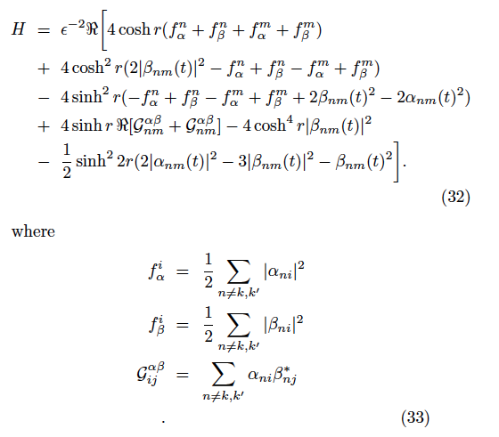
General framework for RQM
Ahmadi, Bruschi, Sabin, Adesso, Fuentes, Nature Sci. Rep. 2014
Ahmadi, Bruschi, Fuentes PRD 2014
Fisher information in QFT:
Analytical formulas in terms of
general Bogoliubov coefficients
Single-mode
Two-mode channels
for small parameters

Slide 26
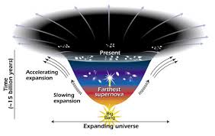
Relativistic Quantum Metrology
Use entanglement to estimate the expansion of the Universe [Ball, Fuentes-Schuller, Schuller PLA 2006]
Phase estimation techniques to measure the Unruh effect [Aspachs, Adesso, Fuentes, PRL 2010]
3. The output
Limits in measuring spacetime parameters [Downes, Milburn Caves quant-ph 1108.1907]
General framework (M Ahmadi) and new applications (C Sabin and this talk)

Slide 27
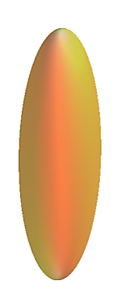


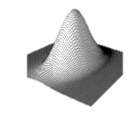

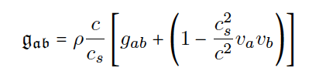
BEC in spacetime
mean field
quantum fluctuations
effective metric
Fagnocchi et. al NJP 2010
Visser & Molina-Paris NJP 2010
analogue metric
real spacetime metric

Slide 28
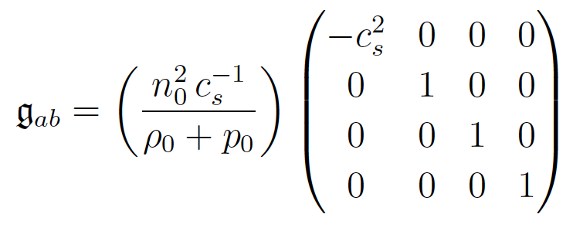
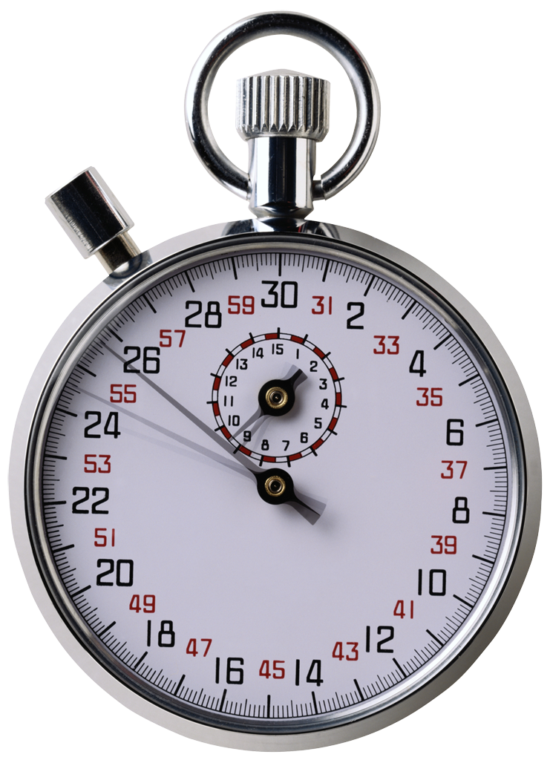
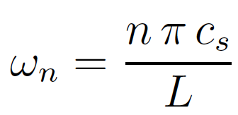
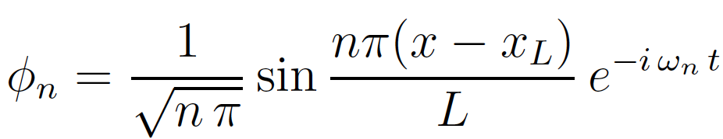
BEC in flat spacetime
Minkowski with speed of sound
phonons in a cavity-type 1-dimensional trap
spectrum
solutions

Slide 29
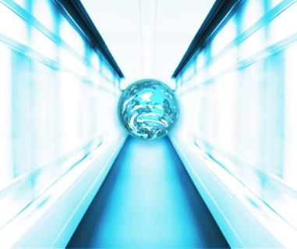
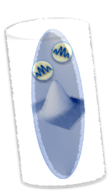
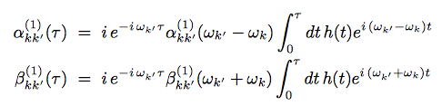
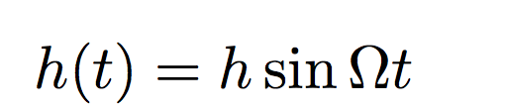
Application: phononic accelerometer
Ahmadi, Bruschi, Sabin, Adesso, Fuentes, Nature Sci. Rep. 2014
Example
Bruschi, Louko, Faccio & Fuentes NJP 2013
Particle creation resonance
acceleration
inertial-uniformly accelerated

Slide 30
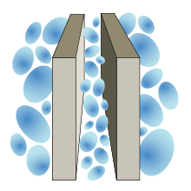
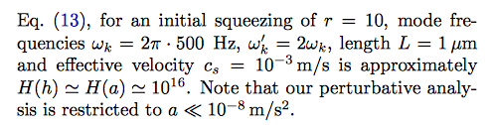

Relativity: exploited in measurement technologies
Ahmadi, Bruschi, Sabin, Adesso, Fuentes, Nature Sci. Rep. 2014
we have used a relativistic effect to measure accelerations. In principle, this technique can
improve the state of the art.
Example
time
wave number of the atomic hyperfine transition
particle creation

Slide 31
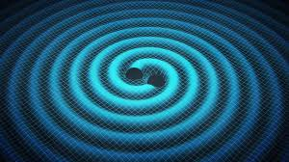
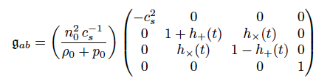


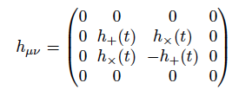
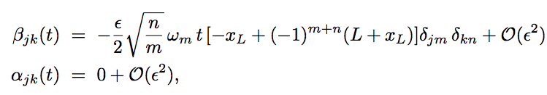
Gravitational wave spacetime
BEC in a 1-dimensional box with fixed boundary conditions

Slide 32
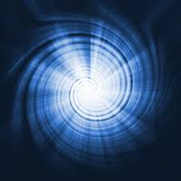

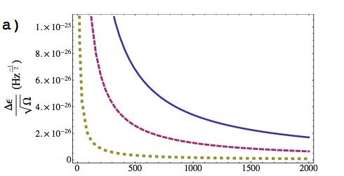
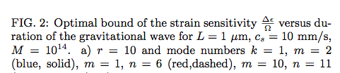

Application: phononic gravitational wave detector
Sabin, Bruschi, Ahmadi, and Fuentes, Special Issue Gravitational Quantum Physics NJP 2014
LIGO
Carlos Sabin, The Conversation,
The next big deal: detecting gravitational
waves at your desk

Slide 33
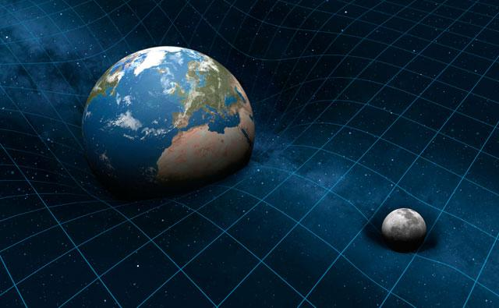
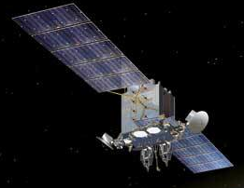

Application: measuring Earth’s spacetime parameters
Example
Bruschi, Datta, Ursin, Ralph, and Fuentes, arXiv:1409.0234 (2014)
Estimate the distance between the sender and the satellite, the radius of the Earth (mass) and the Schwarzschild radius

Slide 34


Conclusions
Quantum theory + Relativity
new devices and technologies
These technologies can help deepen our understanding of the overlap of this theories
Package your presentation
for easy sharing

