Slide 1


ALTMETRIC EXPLORER
FOR INSTITUTIONS
clientsupport@altmetric.com
@altmetric
How to browse, monitor and report on the reach of your research with EFIv2

Slide 2

TODAY’S SESSION
A clear understanding of altmetrics and how to use them
How to use Altmetric Explorer for Institutions
Practical ideas and examples of using altmetrics data
Know where to get further help

Slide 3

Some definitions
What are altmetrics? What do they track?

Slide 4
Altmetrics are non-traditional indicators proposed as an alternative to more traditional citation impact metrics, such as impact factor and h-index.

Slide 5
Alternative, web-based metrics are…
Any trace or indicator of online behavior surrounding research
Commentary on social media
Coverage in news media/blogs
Sharing/downloading/saving
Citations in non-journal sources (grey lit, policy, Wikipedia)
Research output (article, dataset, clinical trial etc.)
Web analytics
Engagement on scholarly platforms (F1000, peer review sites)

Slide 6
alt + metrics
Complementary to traditional citation metrics
Score is an indicator and the underlying, qualitative data tells you who’s saying what about research.

Slide 7
Why altmetrics?
What are the benefits of using altmetrics data?

Slide 8








1. RESEARCH IS MORE ACCESSIBLE
Altmetric help you track online attention to your research from various audiences.
Government & Policy Makers
Mainstream
Media
General Public
Academia
Practitioners
Education
Industry
Special Interest Groups

Slide 9
2. TRACK ATTENTION IN REAL-TIME
Altmetric help you track research attention as soon as it’s published online.
TRADITIONAL METRICS
Often slow to accrue
ALTMETRICS
Immediate

Slide 10
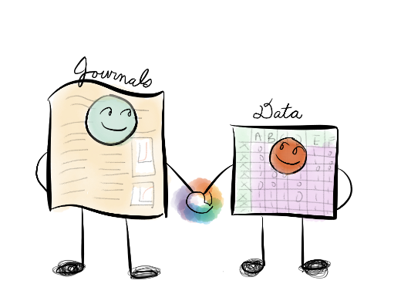
3. RESEARCH IS MORE THAN THE ARTICLE
Altmetric track any digital object produced in the research life-cycle

Slide 11

4. DEMONSTRATING RESEARCH ENGAGEMENT
Altmetric help you meet reporting requirements and showcase your research.
@jean_draws
REPORTING
Grant applications
Funder reporting
Reputation management
Benchmarking and KPIs
Recruitment & review
SHOWCASING
Identifying research to share
Integration in profiles/IRs
Impact on public policy
Identifying key researchers
Recognizing ECRs
DISCOVERY
Finding trending research
Identifying collaborators
Collection development
Encourage IR/CRIS deposit
Liaison - share top mentions

Slide 12

5. LIMITATIONS
Altmetrics don’t tell the whole story
A complement, not a replacement for things like informed peer review.
Like any metric, there’s potential for gaming
Providers have measures in place to identify gaming. Look at the underlying qualitative data.
Altmetrics are relatively new
We’re learning a lot about how often research is shared online, we don’t know much about why – more research is needed.

Slide 13
How does it work at Altmetric?

Slide 14
TRACKING A RESEARCH OUTPUT
An identifier attached to the output (DOI, PMID, etc)
Mentions in a source
An output (journal article, dataset, etc)

Slide 15
News outlets & Blogs
Over 2000 news sites
Global coverage
9,000+ Blogs
Post-publication peer review
Publons
Pubpeer
Policy documents
NICE Evidence
Intergovernmental Panel on Climate Change
Many more…
Reference
managers
Mendeley, Citeulike etc
Reader counts
Other sources
Syllabi
Scopus Citations
Wikipedia
Youtube
Reddit
F1000
Q&A
Social media
Twitter, Facebook, Google+,
Public posts only

Slide 16
SCHOLARLY IDENTIFIERS TRACKED:
MORE THAN DOIs
DOIs | General
PubMed ID | Health Sciences
arXiv ID | Physics, Mathematics & Computer Sciences
ADS ID | Astrophysics data system
SSRN ID | Social Sciences
RePEC ID | Economics
ISBNs | General
Handles | General
ClinicalTrials.gov Records | Medicine/biomedical
URN | General
Research Outputs

Slide 17
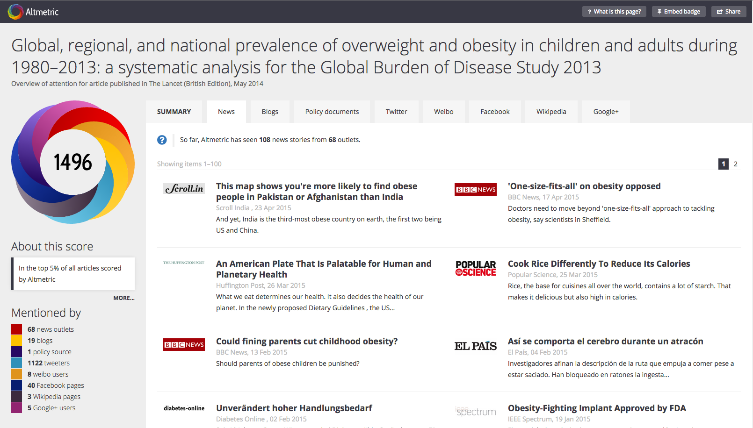
CAPTURING ATTENTION
Follow a list of domains.
E.g. nature.com, lse.ac.uk, figshare.com
Search for links to those domains in attention sources.
E.g. blogs, news, policy documents, social media.
Collate attention.
Disambiguation across different versions.
Display data in
Altmetric Details Pages.

Slide 18

ALTMETRIC ATTENTION SCORE
Provides an indicator of the attention surrounding a research output.
Volume | Sources | Authors
The score for an article rises as more people mention it. | Each source category contributes a different base amount to the final score. | How often the author of each mention talks about scholarly articles influences the contribution of the mention.
Read more about the score here: altmetric.com/blog/scoreanddonut/
Notes:
The Altmetric score is intended to provide an indicator of the attention surrounding a research output. Although it may be straightforward enough to monitor the attention surrounding one research output, for example, it becomes harder to identify where to focus your efforts when looking at a larger set. The number alone can of course not tell you anything about what prompted the attention, where it came from, or what people were saying, but it does at least give you a place to start – “is there online activity around this research output that would be worth investigating further?”
The Altmetric score is an automatically calculated, weighted algorithm. It is based on 3 main factors:
1. The volume of the mentions (how many were there?)
2. The source of the mentions (were they high-profile news stories, re-tweets, or perhaps a Wikipedia reference?)
3. The author of the mentions (was it the journal publisher, or an influential academic?)
Combined, the score represents a weighted approximation of all the attention we’ve picked up for a research output, rather than a raw total of the number of mentions.

Slide 19
Always look at what people are saying
And not just at the numbers
Attention doesn’t = quality

Slide 20
Altmetric Explorer for Institutions
Search, filter, sort, save, analyze and export altmetrics data

Slide 21

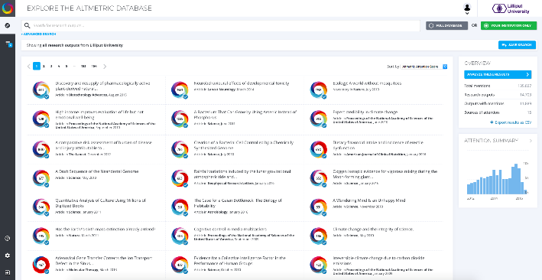
WELCOME TO EXPLORER FOR INSTITUTIONS!

Slide 22
WELCOME TO EXPLORER FOR INSTITUTIONS!
Prominent search bar
Find research outputs
Results analysis
Report on key achievements
Detailed search results
Discover Altmetric insights

Slide 23
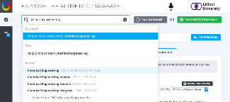
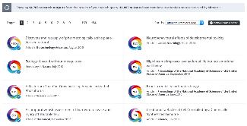
OVERVIEW OF KEY FEATURES
Browse altmetrics for your institution and search across the entire database
Filter by your authors and departments
Search by item type: articles, data sets, books, etc.
Save searches and export data
Sort results by Altmetric Attention Score, mention source, or publication date
Analyze results

Slide 24
1. SEARCH + BROWSE

Slide 25
HOW TO SEARCH, SORT & FILTER
Quickly find what you need using our powerful search
SEARCH
Start in central search bar
You can enter keywords, author name, department name, journal name, publication title, or DOI
SORT
Sort results by Altmetric Attention Score, publication date or specific attention sources, e.g. Mendeley readers or news
FILTER
Build complex queries and refine with Advanced Search
Filter by identifier, mention timeframe, output type, author, department, etc.

Slide 26
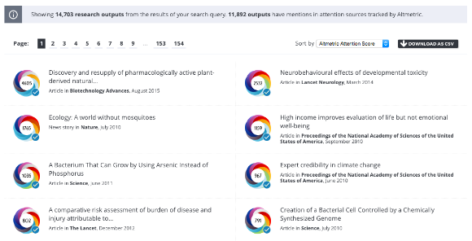
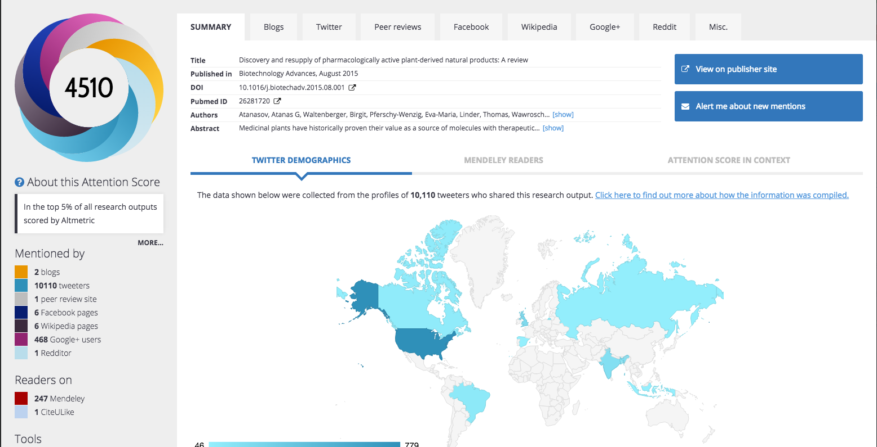

HOW TO BROWSE ALTMETRIC DATA
Explore research outputs and view Altmetric Details Pages
Donuts with a blue tick in the screenshot above indicate a verified institutional output. These outputs were added to the database as part of your data implementation. Keep an eye out for the blue ticks when searching across the entire database as they help identify your institutional outputs!
Hint!

Slide 27
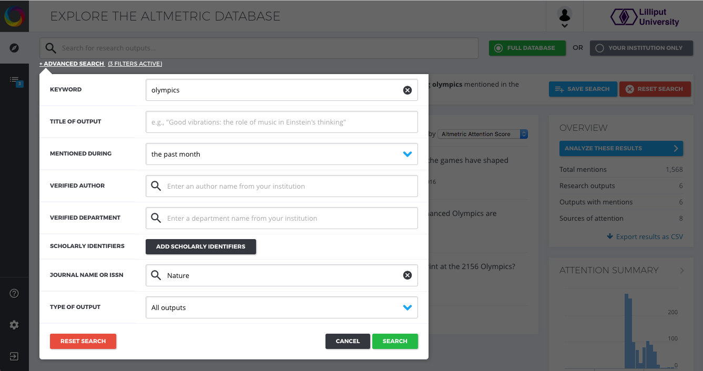
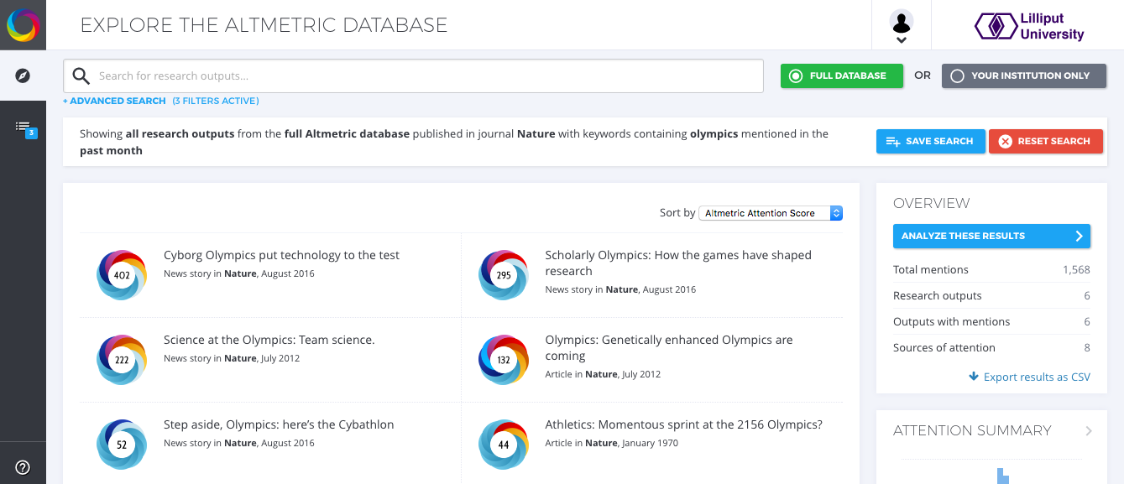
HOW TO USE ADVANCED SEARCH
Build complex queries in advanced search and save for later
1. Construct your advanced search
2. Browse results, sort and save

Slide 28
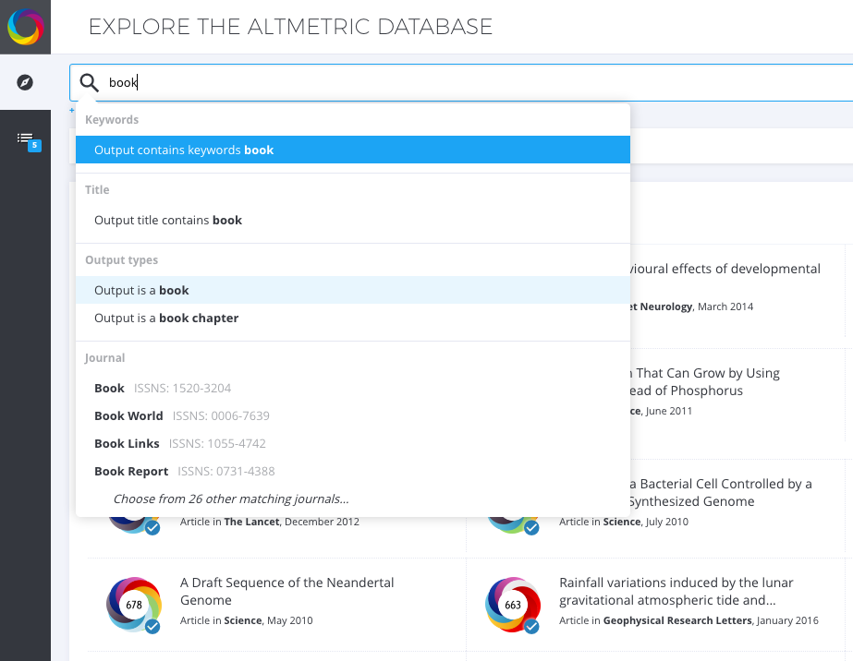

HOW TO SEARCH BY ITEM TYPE
E.g. journal article, data set, book, book chapter, clinical trial
Enter output type, e.g. “book” or “article” or filter in advanced search

Slide 29
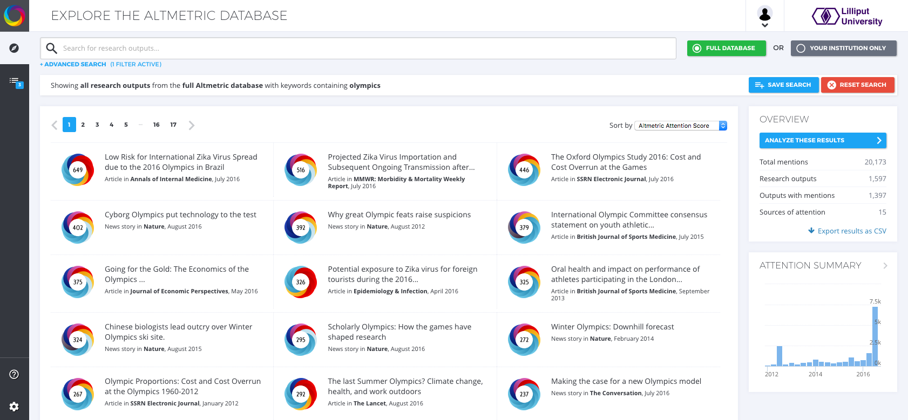
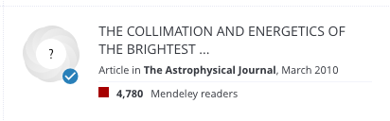
HOW TO SORT RESULTS
You can sort results by score, publication date or attention source
Try sorting by:
Altmetric Attention Score to see outputs with high attention
Publication date for recently published items
Mendeley readers to see outputs with high academic readership
In EFI, you might see transparent donuts with a ? in the center, as in the example on the right. This is indicates a research output without an Altmetric Attention Score but was added to the database during your data implementation. These donuts might still have underlying data, e.g. Mendeley and Scopus, that do not contribute to the score. The donut will light up when it gets a score!
Hint!

Slide 30
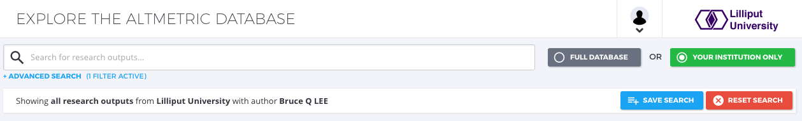
HOW TO TOGGLE BETWEEN DATABASES
Switch between the institutional view and entire Altmetric database.
Select Full Database to search all outputs Altmetric has ever tracked
Select Your Institution Only to search across your verified research outputs

Slide 31
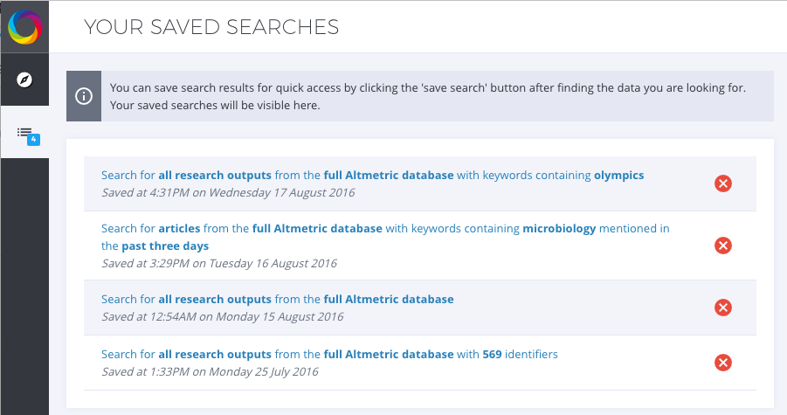
HOW TO SAVE SEARCHES
1. Hit Save Search for any query
2. View your Saved Searches via the sidebar

Slide 32
2. ANALYZE RESULTS

Slide 33
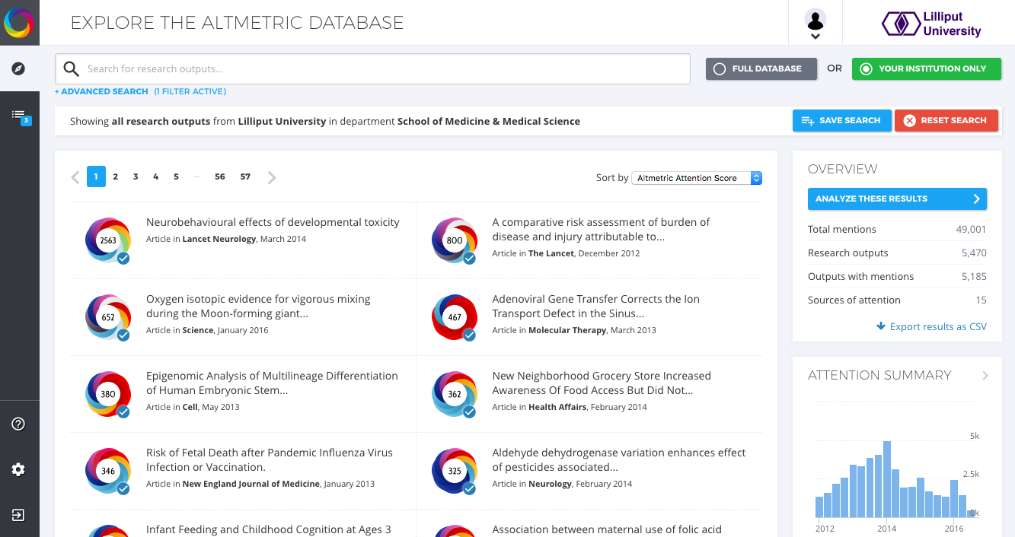
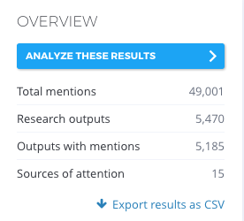
ANALYZING ALTMETRIC DATA
Analyze and report on attention to your research

Slide 34
ANALYZING ALTMETRIC DATA
Analyze and report on attention to your research
Summary: Monitor online engagement with research outputs over time.
Highlights: Follow research that’s making headlines, and see which contributors from your institution are making the biggest splash.
Demographics: Discover the global reach of your research outputs on Twitter.
Mentions: Focus on specific attention source types and browse through the mentions.

Slide 35
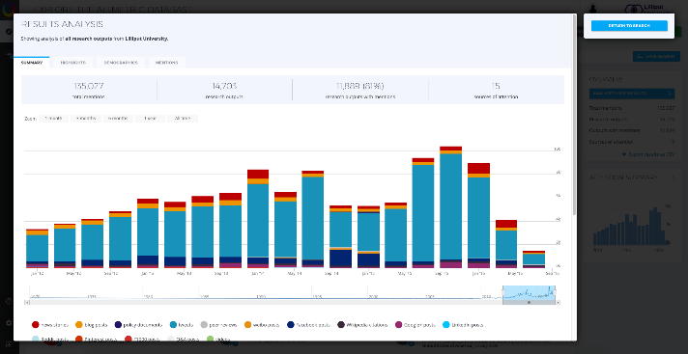
HOW TO TRACK ATTENTION OVER TIME
a) Track mentions over time in the analysis Summary
Browse the Summary tab, which includes total counts and attention over time for research outputs in your results list.

Slide 36
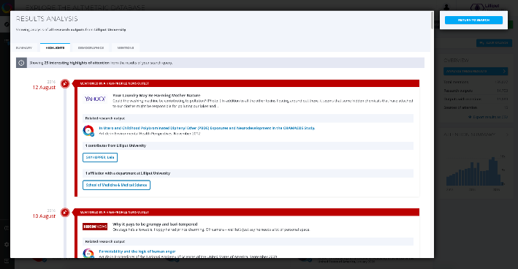
HOW TO FIND ATTENTION HIGHLIGHTS
b) View Attention Highlights in your search results
View attention highlights of outputs in your results list.

Slide 37
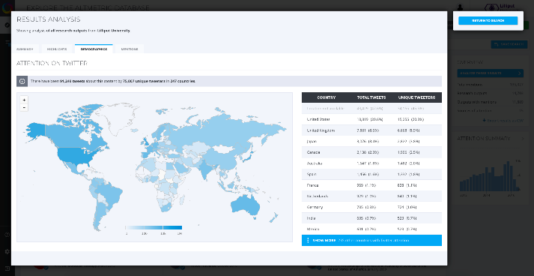
HOW TO VIEW GLOBAL REACH
c) View visualizations in the Demographics tab
View a Twitter demographics visualization and total tweets by country.

Slide 38
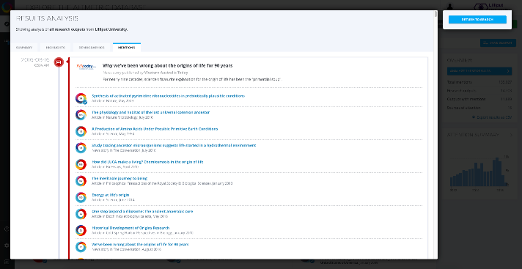
HOW TO VIEW MENTION ACTIVITY
d) View a chronological attention breakdown in the Mentions tab
View a latest feed of attention activity by individual mention, sorted by date mentioned.

Slide 39
HOW TO EXPORT DATA
Choose Export results as .csv for any search and the file download will begin.
You can now view authors from your institution & department names in the export.

Slide 40
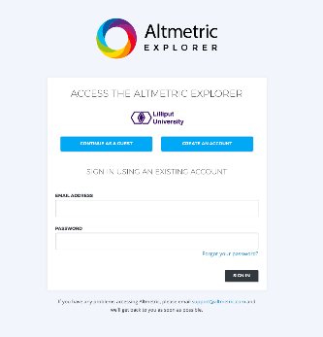
HOW TO ACCESS EXPLORER FOR INSTITUTIONS
Go to www.altmetricexplorer.com for institutional IP access
Create an account using the sign-in option in the top of the page
Updated XXX

Slide 41
Demo!

Slide 42

Altmetric Explorer for Institutions in Practice

Slide 43

Who should use Altmetric Explorer for Institutions?
Researchers who want to…
Assess the reach, engagement, and influence of their own research outputs…
Demonstrate evidence of engagement and influence in tenure and funding applications…

Slide 44
Who should use Altmetric Explorer for Institutions?
Who should use Altmetric Explorer for Institutions?
Librarians who want to…
Support researchers by identifying the immediate response to their work…
Monitor and report on the performance of their institution's research outputs…

Slide 45
Who should use Altmetric Explorer for Institutions?
Research administrators who want to…
Compare the performance and achievements of groups in their institution…
Demonstrate the key achievements of their institution to external stakeholders…

Slide 46
Top tips for sharing your research
Include links wherever possible
Don’t be afraid to engage! There’s nothing wrong with making your research more visible
Figure out which channels work best for the audiences you want to reach
Start thinking about the impacts you hope your work might have early on - what are you trying to achieve?

Slide 47
THANKS!
Any questions?
You can find us at:
altmetric.com
@altmetric
clientsupport@altmetric.com
All illustrations by Jean Liu @jean_draws

