Slide 1
Early warning systems to end hunger
The role of communication in achieving SDGs
Filippo Osella and Max Martin, School of Global Studies

Slide 2
Introduction
Insights from two research initiatives and a local community service in south India:
Tools for safe and sustainable artisanal fishing – SSRP 2018-’19
Forecasting with fishers: Co-producing weather knowledge for safe and sustainable artisanal fishing in south India – Royal Geographical Society 2019
Radio Monsoon: fishers’ online and phone-in marine weather service supported by Sussex Innovation, Research Office and SSRP

Slide 3
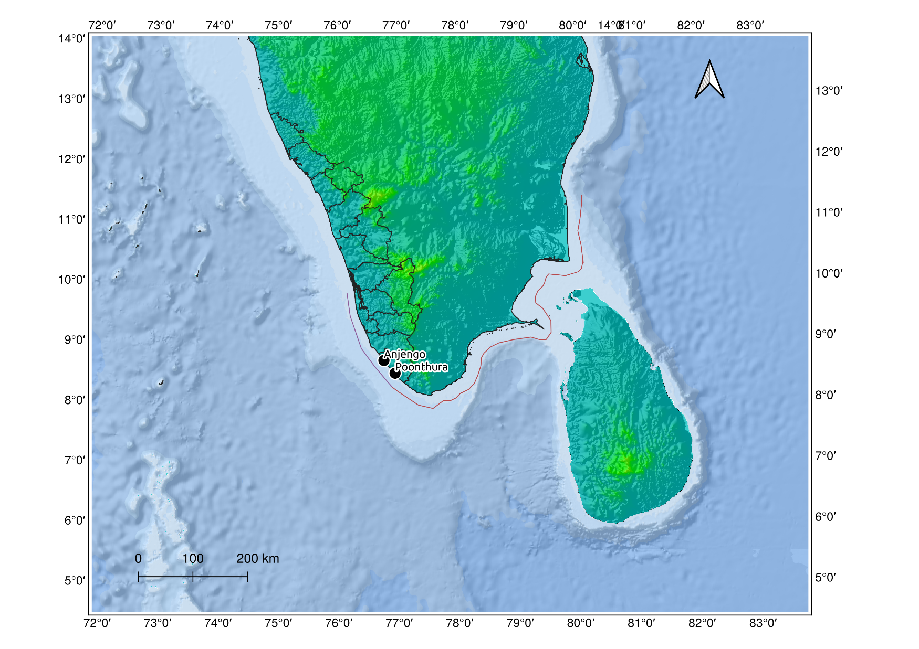
Place and context
Region: South India
District: Thiruvananthapuram, Kerala state
Coast: 76km, 42 fishing villages
Field sites: Anjengo and Poonthura villages
People: Artisanal fishers using nets and
lines, on board 30 to 34-feet boats with
outboard engines
Fishers live on the margins of the society,
many of them impoverished.
Development interventions since the 1950s;
Still safety issues are largely unaddressed.
India
Thiruvananhapuram
Kanyakumari

Slide 4
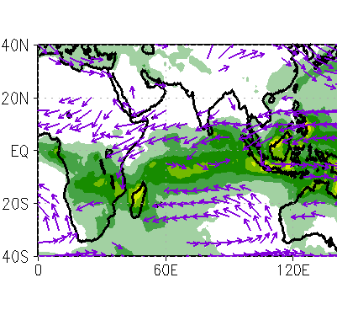
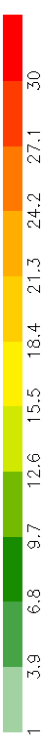
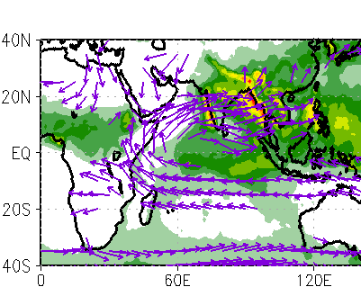
Monsoon
NE Monsoon
Northeastern: October – December
Southwestern: June – September
Rainfall (mm/day)
SW Monsoon

Slide 5
A background of high exposure to risk
Fishers face frequent accidents in the sea, due to large waves, and high wind during the monsoon season
There appears to be a new trend of extreme weather events in the Arabian sea
Cyclone Ockhi of 2017 killed 365 fishers in the sea – most of them from Thiruvananthapuram and Kanyakumari districts.
In 2018 monsoon floods (the worst in a century) in Kerala state killed 483 people, and displaced a million. Floods in 2019 claimed 121 lives.
Marine weather forecasts can save lives – however their uptake is limited amongst the fishers.

Slide 6
Tools for safe and sustainable artisanal fishing
Objectives:
Study hazard risks, using local knowledge, forecasts and in situ and remote instrument observations
Understand the decision-making process involved in fishing mediated by local risk cultures, using ethnographic methods
Co-produce risk communication with fishers and forecasters, contributing to accurate, accessible, actionable forecasts and advisories through workshops, and focus groups.
The RGS study is a follow up focusing on weather trends and fishing decisions of diverse artisanal fishing groups; Radio Monsoon tests ways to co-produce weather knowledge with fishers.

Slide 7
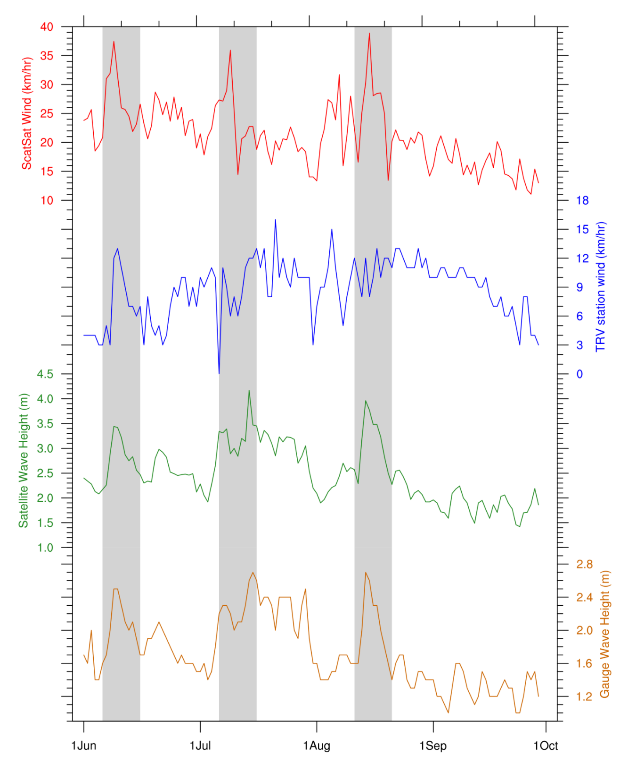
We selected 3 high wind and large wave periods based on instrument observations as highlighted the figure.

Slide 8
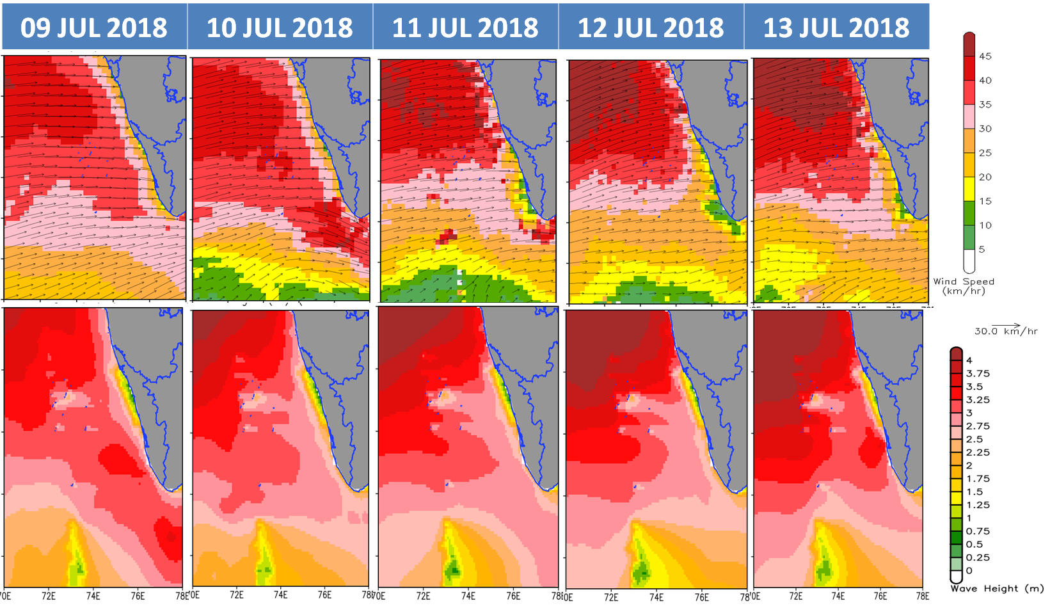
Observed Wind
(Scatterometer-SCATSAT)
Observed Wave
(Satellite)
IMD Alert/ Wind forecast | NIL (35-45kmph) | NIL (35-45 kmph) | NIL (35-45 kmph) | NIL (35-40 kmph) | NIVIS (35-45 kmph)
INCOIS | High waves | High waves | High waves | High waves | High waves
Fishers response | Went to fish | Went to fish | Did not go | Went to fish | Did not go

Slide 9
Fishers’ response to high wind and large waves
Fishing decisions determined by several factors – forecasts, experiences, “peer pressure”, and FISH
The fishers played safe, by fishing often within about five km from the shore
They launched from harbours considered safe
Preferred to fish in relatively calm areas, especially coastal waters with sandy beaches (where they can land if there is an emergency)
Still on days with more fish (as they perceived), the fishers took more risks

Slide 10
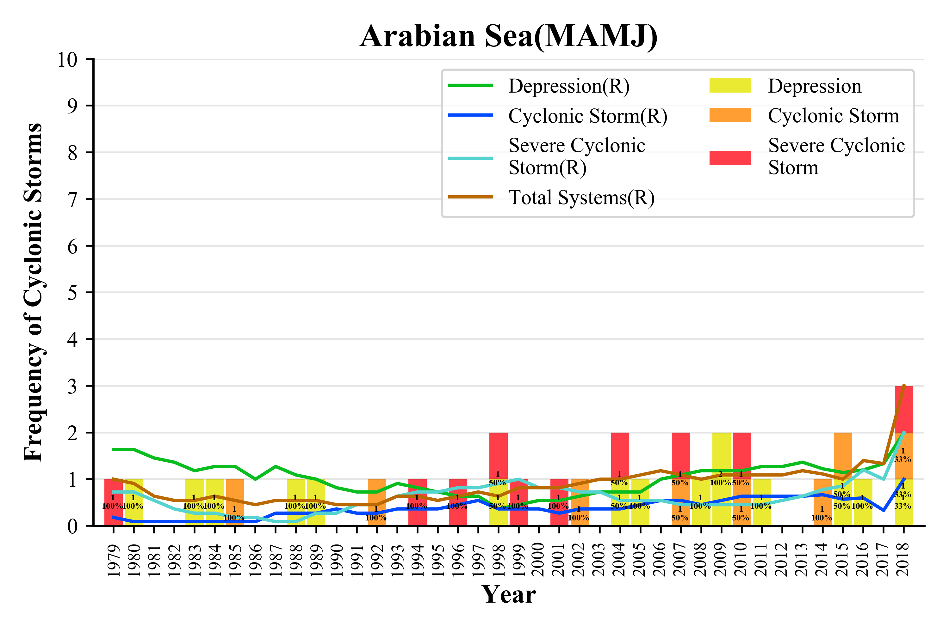
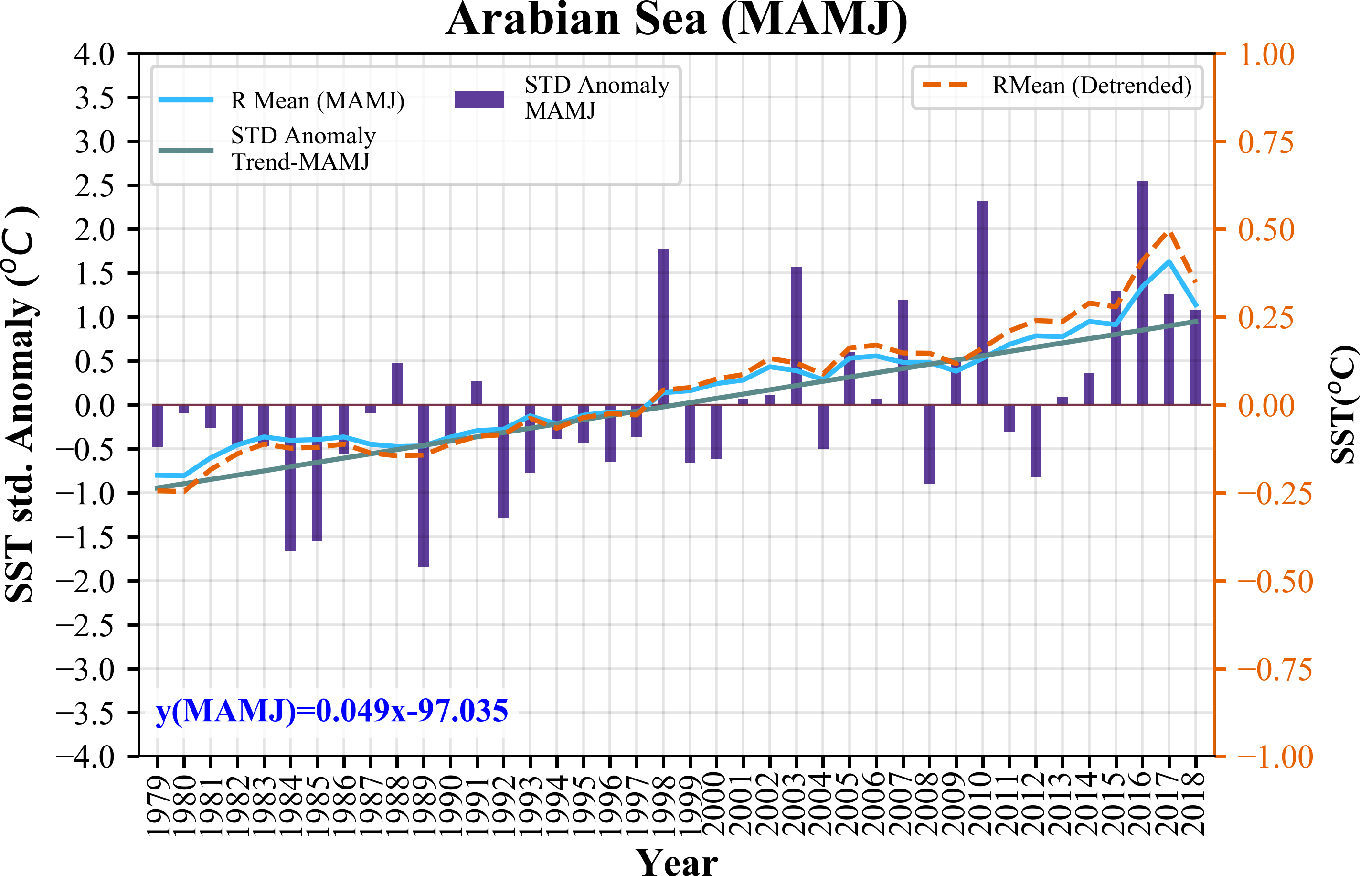
Storms and sea surface temperature

Slide 11
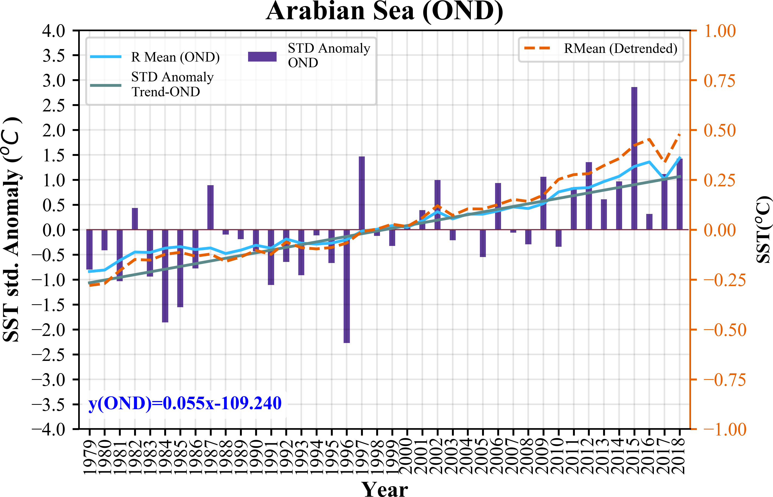
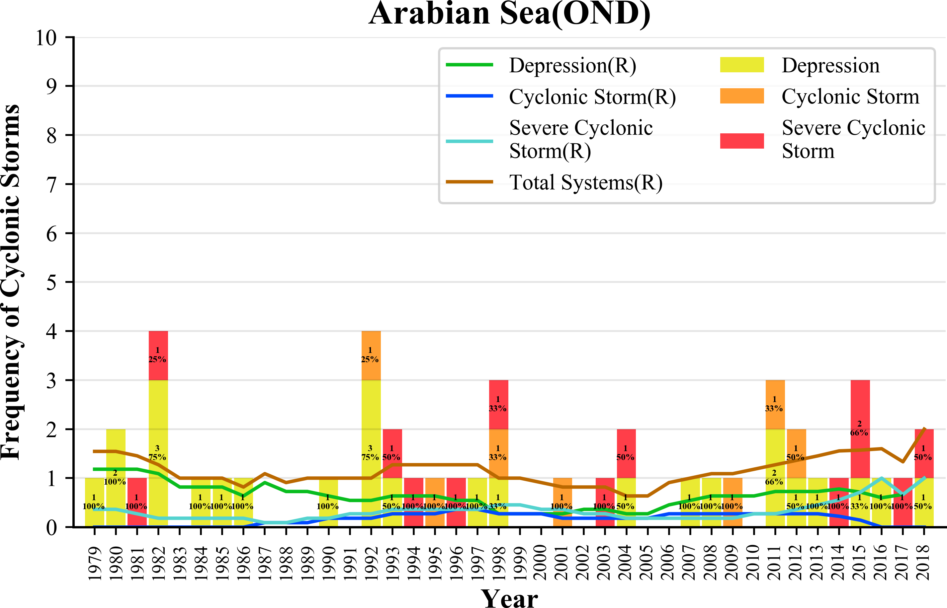
Storms and sea surface temperature

Slide 12
Storm trends
A trend of intensification of storms in the pre-monsoon period, the storm season of the Arabian Sea
A less pronounced trend in the north-eastern monsoon period, the storm season of the Bay of Bengal
Intensification of storms appears to correlate with sea surface temperature rise (we have yet to test it)
This possible trend has got future implications in a changing climate

Slide 13
Key findings
Risks appear to be on the rise: Growing financial pressures and extreme weather events over the Arabian Sea make fishing livelihoods more precarious and dangerous than ever.
Forecasts inadequate: Fishers seek and use multiple forecast sources even when they are not always easily accessible. Forecasts, however, are often generic and inadequate. The fishers compare forecasts with their traditional knowledge and direct observation of the sea and the sky.
False alarms: Upto 72 per cent of the forecasts issued are accurate. While forecasters rarely miss major weather events, they often issue false alarms, restricting fishing.
Fishers fish when there is fish: Fishing decisions seem to be driven by the availability (and scarcity) of fish more than anything else; and fish are abundant on some days during the monsoon season.

Slide 14
SDG1 - No Poverty; SDG2 – No Hunger
In uncertain weather, fishing is risky or restricted, with impacts on local livelihoods and food security.
Forecasts can make fishing safer – at the same time false alarms unnecessarily stop work and interfere with livelihood and food security.
Issues:
  How to make forecasts more relevant and reliable?
  Is there a way to ensure fishers’ income when the weather is bad?

Slide 15
SDG 14: Ocean Conservation
As fish stock is decreasing in the coastal waters, more fishers go to fish in the deep waters without adequate precautions (such as lifejackets or wireless communication systems).
Paradoxically, fish is abundant on some days of the monsoon season – due to low water temperature, and presence of nutrients and algae
Issues:
  Can ocean conservation contribute to better fish stock?
  Are there other solutions to conserve/ enhance stock ?
  Is there a way to ensure fishers’ income when the weather is bad?

Slide 16
SDG 13: Climate Action
Understanding changing weather patterns of the Arabian Sea
Ensuring local and timely forecasts and early warning
Better forecast dissemination over multiple channels (mobile phones, the Internet, and VHF/FM radio)
Better weather observation networks and early warning systems
Co-production of weather knowledge – forecasters and fishers need to interact closely to share experiences, knowledge and challenges they face.

Slide 17
SDG 8: Decent Work and Economic Growth
Better weather environmental knowledge systems and follow up action can contribute to better forecasts for safe and sustainable fishing.

Slide 18
Thanks
Our team: Sussex – F Osella (PI) & R Stirrat (anthropology), K Howland (Informatics), P Rowhani & M Martin (geography). Indian collaborators: IMD – S Balachandran & NT Niyas (meteorology). CUSAT – S Abhilash & Vijayakumar P (atmospheric sciences). INCOIS – R Harikumar (ocean sciences). Independent expert V Salagrama (fisheries). SDMA – SL Kuriakose (disaster management). Field work facilitated by B Chiramel SJ (sociology) and colleagues at Sneharam, Anjengo.

