Slide 1
SDGs at the intersection of financial crises, poverty, and environmental sustainability
Dr Andreas Antoniades
(Department of International Relations,
University of Sussex)
SSRP 2nd Annual Symposium
Session D. Impacts of economic globalization on the SDGs
Wednesday 18 September
SSRP Project team: Dr Alexander Antonarakis (co-PI); Dr Indra Widiarto; Dr Patrick Schroeder; Dr Lucia Pacca

Slide 2
Structure
Introduction: the context of the SDGs implementation and implications for LIC
Aims and main findings from our SSRP Project
Conclusions
Beyond conclusions

Slide 3
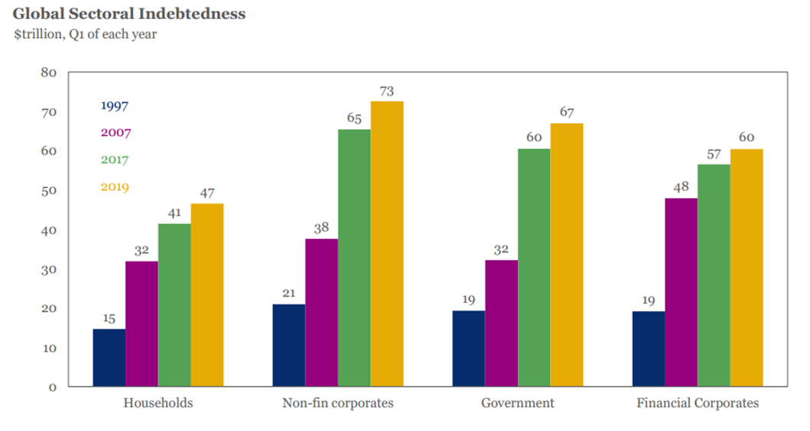
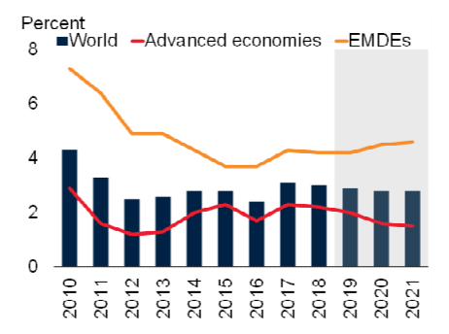
Introduction: the context of SDGs implementation
SDGs: the devise, the potential, the deadline, assumptions
Context: To assess how realistic are SDGs
The post-GEC environment: between a rock and a hard place
Source: IIF, 2019
Global Growth
Source: WB, 2019

Slide 4
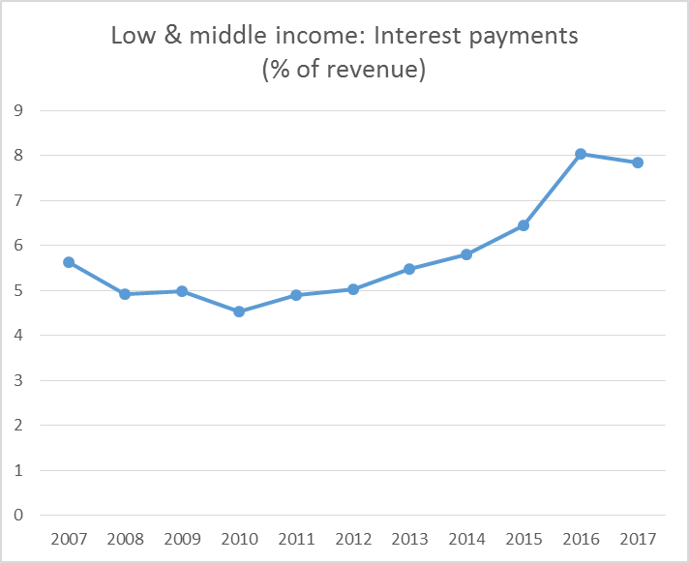
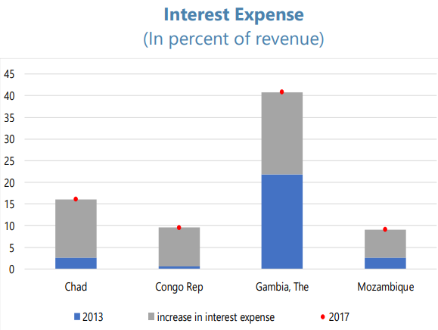
Implications for Developing and Low-Income Countries
Debt vulnerabilities
  In LICs median government debt has risen by about 20% of GDP since 2013 (UNCTAD, 2018)
  In poorer economies, interest payments (% of revenue ) more than doubled from 5.7% in 2008 to 14% in 2017, and to 18.5% in sub-Saharan Africa, exceeding 30% in some cases (UNCTAD, 2018)
  Across 126 developing countries debt repayments have increased by 60 percent between 2014 and 2017 (JDC 2018)
WB data
IMF, 2018
Notes:
Afghanistan Benin Burkina Faso Central African Republic Chad Democratic Republic of the Congo Ethiopia Gambia Guinea-Bissau Guinea Haiti Liberia Madagascar Mali Mozambique Nepal Rwanda Sierra Leone Tajikistan Tanzania Togo Uganda

Slide 5
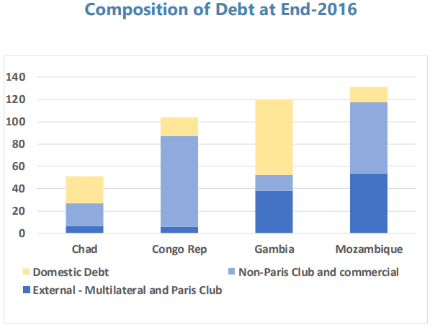
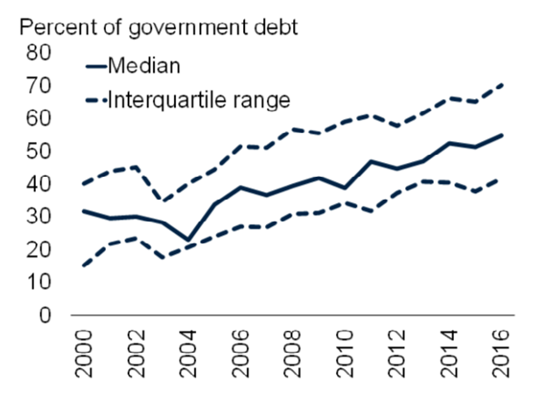
Implications for Developing and Low-Income Countries
Changes in debt profile: Increase in debt from non-concessional and private sources
  E.g. >50% in Zimbabwe, Congo Rep.
US-denominated debt and depreciating local currency
(Developing countries debt denomination: 79% in US$, 13% in Euro, 4% local & other)
Non-concessional debt
IMF, 2018
WB,2019

Slide 6
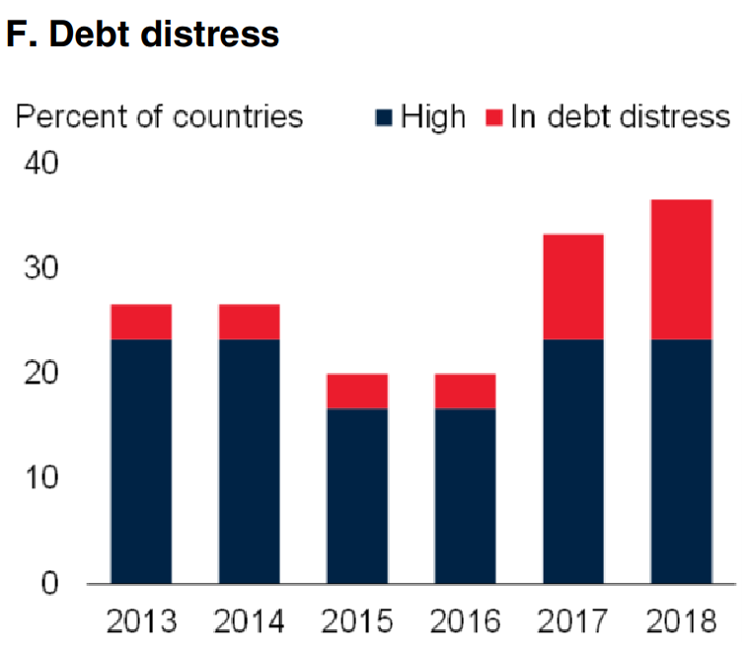
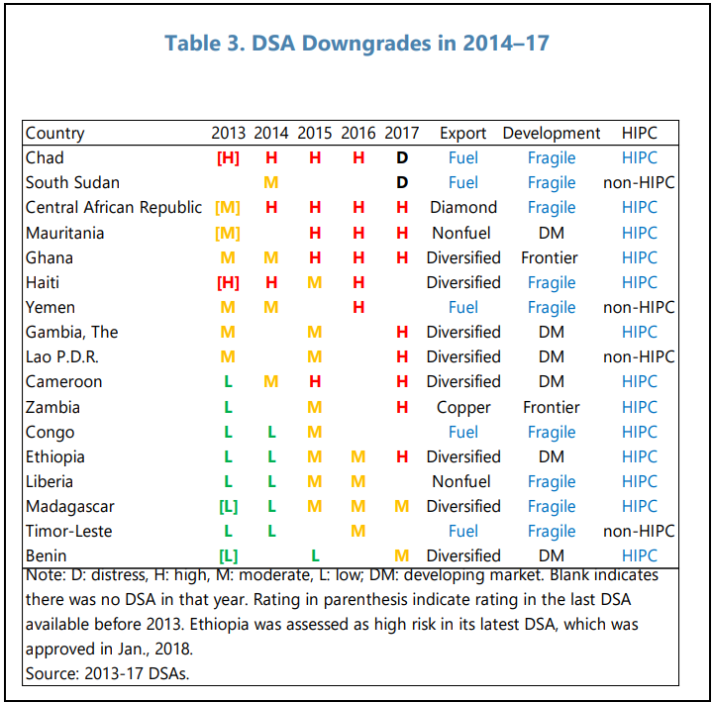
Implications for Developing and Low-Income Countries
WB, 2019
In 2018, Gambia, Mozambique and Zimbabwe were classified as in debt distress (IMF–World Bank DSF).
IMF, 2018

Slide 7
Project aim: What does all this mean for the implementation of SDGs
Project aim: (a) Can we estimate/quantify the magnitude of the crisis hit in key SDG areas; (b) Can we model/capture dynamic linkages and feedback loops between SDGs in conditions of financial distress
  Cost of action/inaction
  Dynamic Linkages
Beyond nominal targets

Slide 8
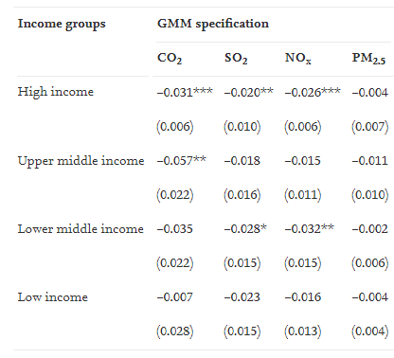
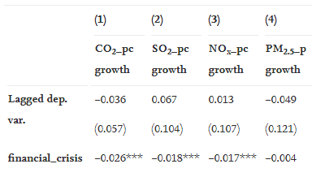
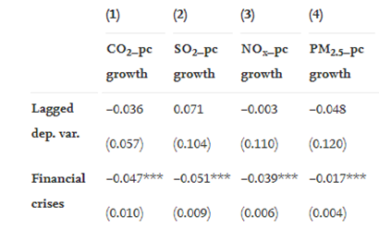
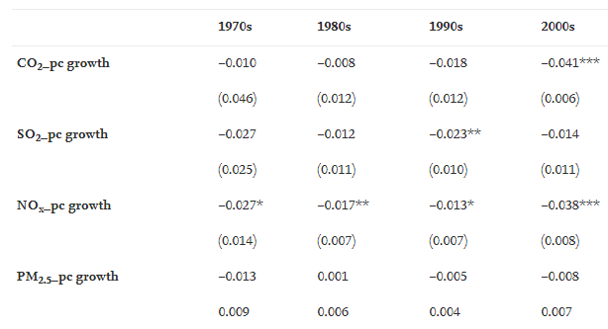
Project Phase A: Financial Crises and Environmental Sustainability (air pollution)
State of the art: case-studies, ‘punctuated degrowth thesis’, ‘darkening skies paradox’
Strategy: Short vs. Medium term effects
Findings on the Short-term impact:
Impact across income groups
Positive impact
Crisis with output loss
Impact across decades

Slide 9
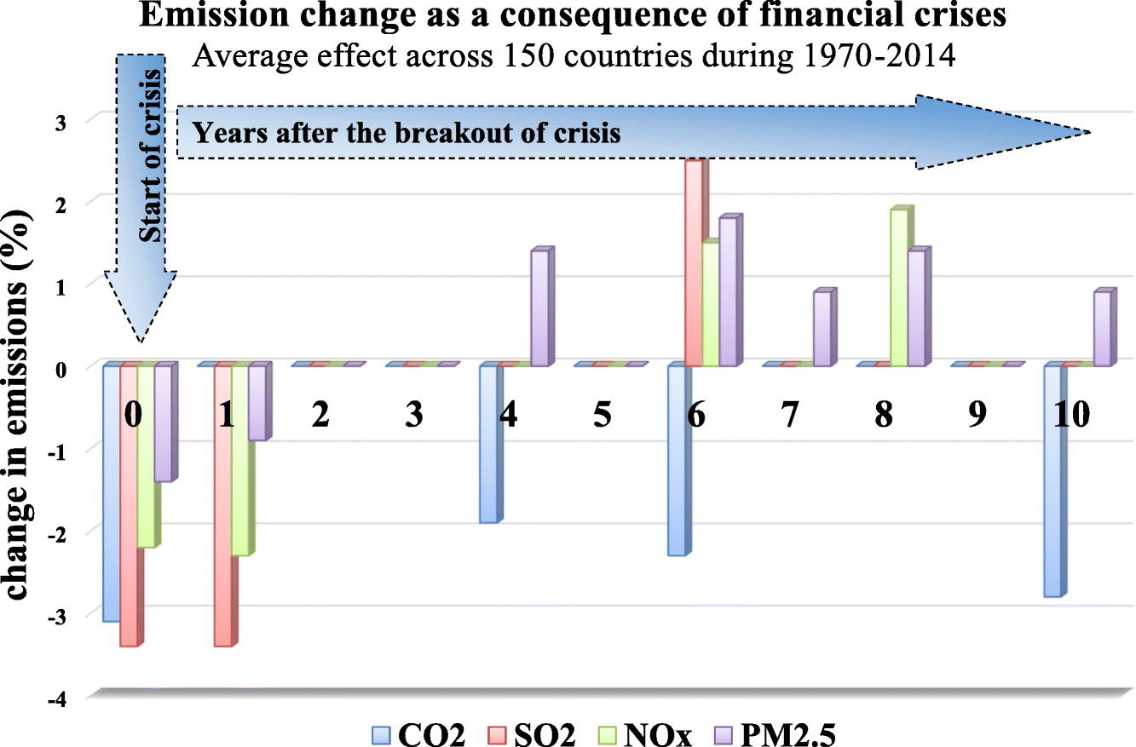
Project Phase A: Financial Crises and Environmental Sustainability(air pollution)
Findings on Medium-term impact
Conclusion
Link to open assess (until Oct.30):
https://authors.elsevier.com/a/1ZiZpB8cckSdd

Slide 10
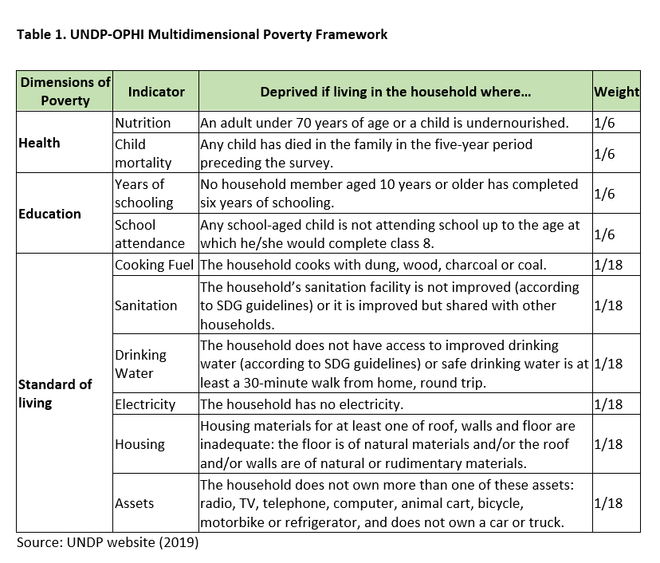
Project Phase B: Financial Crises and the attainment of the SDGs
Aim and challenge
Prioritising poverty - Adopting an adjusted Multidimentional Poverty Framework as a solution

Slide 11
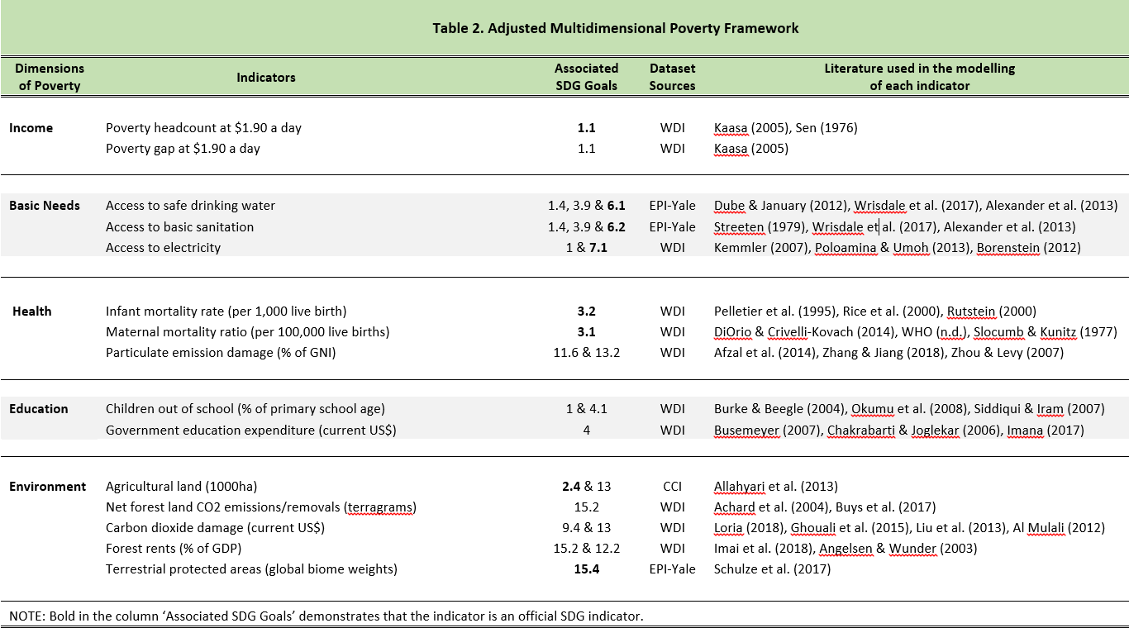
Project Phase B: Financial Crises and the attainment of the SDGs

Slide 12
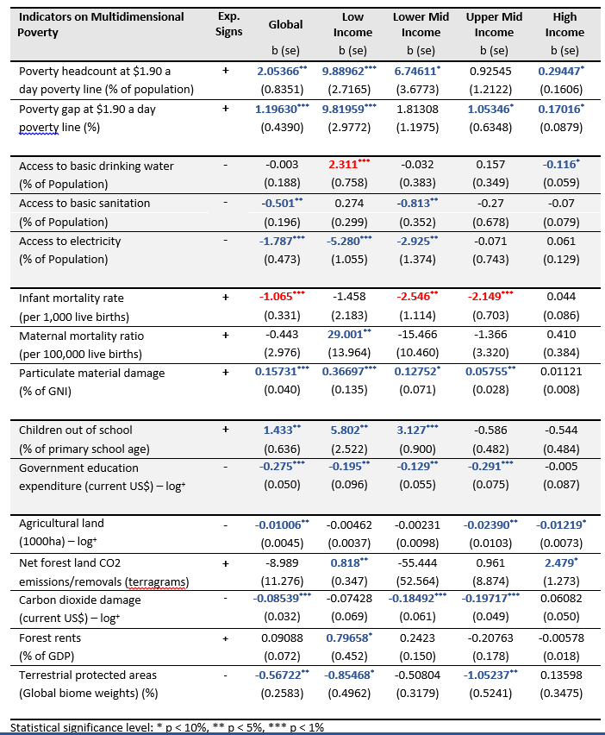
Project Phase B: Financial Crises and the attainment of the SDGs: findings 1
Selected impact on LICs:
  poverty headcount and poverty gap (est. 9.8%)
  government expenditure on education (est. 17.7%)
  children out of school (est. 5.8%)
  access to electricity (est.5.3%)
  reduction in biodiversity (est. 0.85%)
  forest rents (est. 0.8%)
  particulate material damage (est. 0.4%)
  maternal mortality (est. 0.03%)

Slide 13
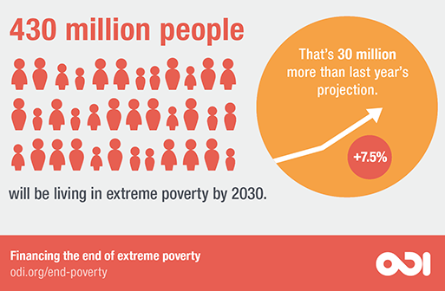
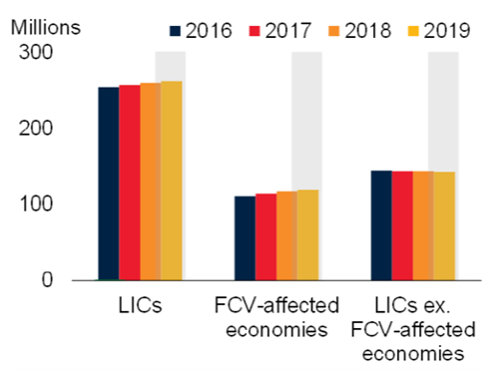
Project Phase B: Financial Crises and the attainment of the SDGs: findings 1
Main findings
poverty headcount and poverty gap in LICs will get significantly worse (est. 9.8%) if no immediate action is taken
Poverty headcount
-People in extreme poverty: 731m
-Estimate for LIC: 318m (43.4% population)
-If impact materialises: 31.2m
-Caveat
WB,2019

Slide 14
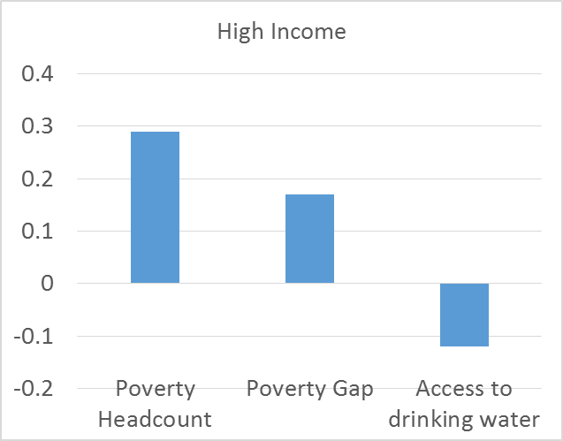
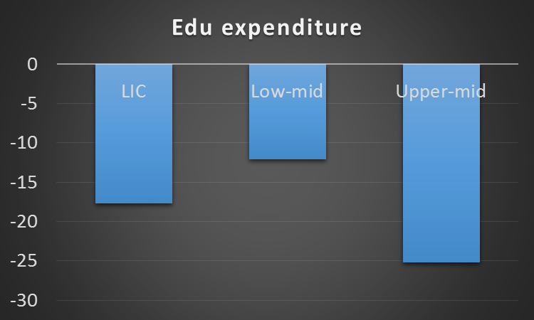
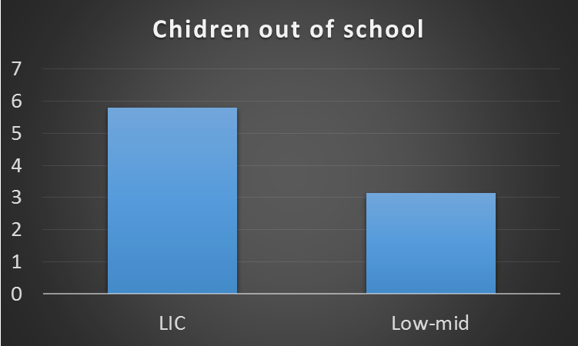
Project Phase B: Financial Crises and the attainment of the SDGs: findings 2
Not only developing countries
Destructive impact on education
Not all results are negative: Access to water and child mortality
Work in progress…

Slide 15
Conclusions
The big picture: what do estimates tell us
Changes in the ‘vulnerability/resilience nexus’ in LIC
SDG interaction: ‘need for integrated frameworks’, ‘the blind spot of monetary poverty’, ‘surviving vs. escaping poverty; ‘multidimentional poverty’
Can it be done?

Slide 16
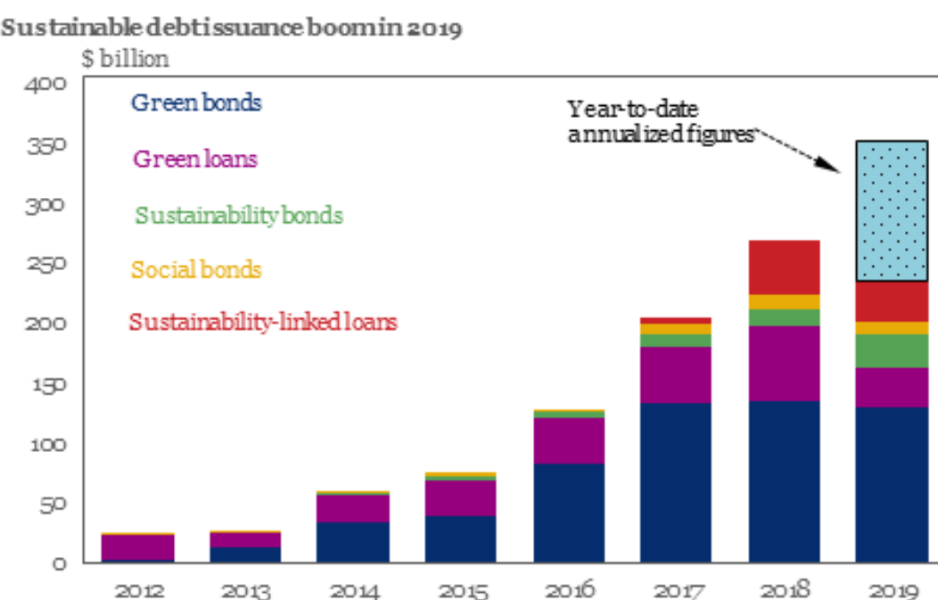
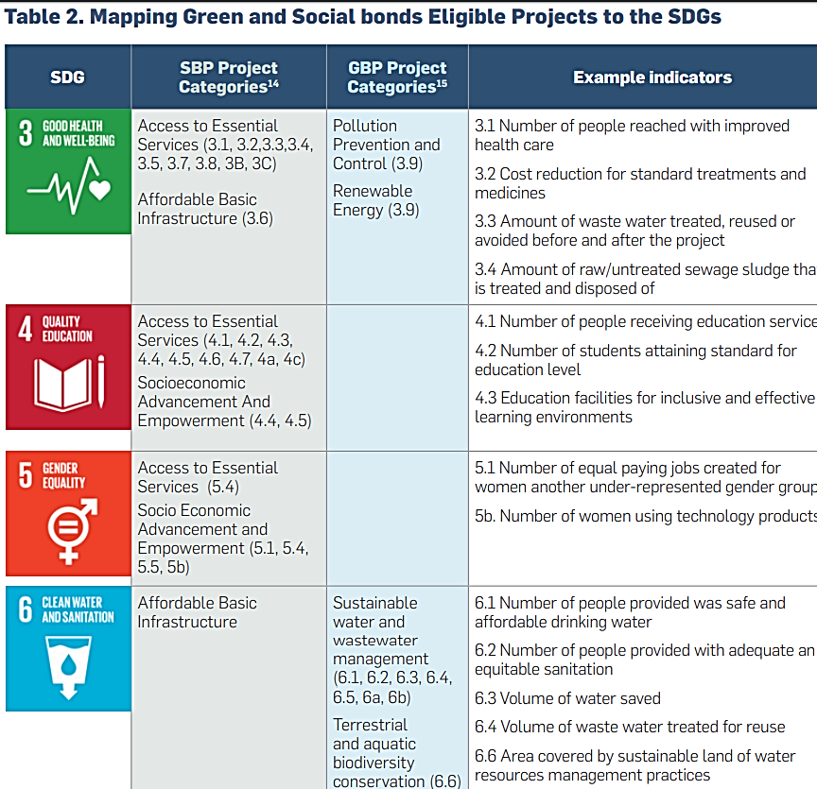
Recommendations 1
IIF, 2019
Bridge the SDG funding gap (shortfall of about US$2.5 trillion) by tapping into private capital markets (green, blue, disaster, pandemic, SDG bonds)
UN Global Compact white paper: SDG Bonds & Corporate Finance (2018)
Limits

Slide 17
Recommendations 2
New institutional Framework: Mobilising the SDG 17, Target 17.4: ‘Assist developing countries in attaining long-term debt sustainability through coordinated policies aimed at fostering debt financing, debt relief and debt restructuring, as appropriate, and address the external debt of highly indebted poor countries to reduce debt distress’
  Debt Sustainability Framework for LIC
  Further integration of current ‘attainment to SDGs metrics’ with criteria for ‘assessing vulnerability’ and ‘assessing concessional funding’ => to create fiscal fiscal pre-emptively
Higher risk instruments (e.g. WB guarantees program)
More radical, ‘out-of-the-box’ ideas
  Issuing safe assets (bonds) (currently with negative rates)
Very radical, ‘out-of-the-box’ ideas
  QE for LIC+ (keeping interest rates low)
  Issuing an SDG blockchain asset (SDG)

Slide 18
Thank you

Slide 19
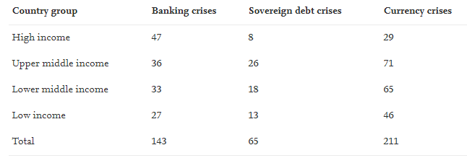
Financial crises
Laeven and Valencia (2018). 1970-2017.
Banking crises are included when two conditions are met: there are significant signs of financial distress in the banking system (e.g. bank runs, bank liquidations, significant losses in the banking system in terms of non-performing loans or total assets), and significant banking policy interventions in response to banking losses (e.g. deposit freezes, bank nationalizations, substantial public liquidity support or guarantees).
Currency crises are defined as a nominal depreciation of the country’s currency vis-à-vis the U.S. dollar of at least 30 percent, that is also at least 10 percentage points higher than the rate of depreciation in the year before.
Sovereign debt crises, these include episodes of sovereign default or debt restructuring.
58 percent of the crises in the dataset have a duration of three or more years, whilst the most frequent duration in the dataset is that of five or more years (approximately 37 percent of the total). The database includes 151 banking crises, 236 currency crises and 75 sovereign debt crises; of these 41 are twin crises (banking and currency) and 11 triple crises (banking, currency, sovereign debt). The most frequent type of crisis in high-income countries is that of banking crises, whereas for middle- and low- income countries is currency crises.

