Slide 1
Governing climate smart agriculture
Joanes Atela, Hussein Mahmoud, Lars Otto Naess, Patrick Ndaki, Peter Newell, Hannington Odame, Raphael Rurangwa, Olivia Taylor, Amdissa Teshome, John Thompson and Charles Tonui

Slide 2
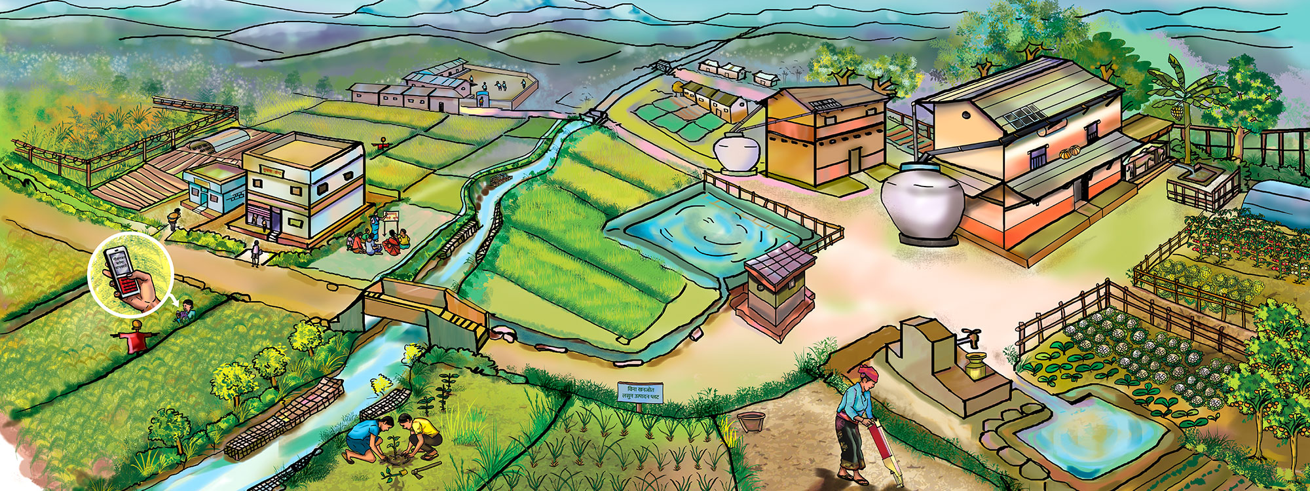
Starting point
The Sustainable Development Goals draw attention to the interdependence between food, agriculture and the climate system, reflected also in increasingly powerful global discourses such as 'Climate Smart Agriculture‘ (CSA).
Despite CSA’s promise of ‘triple-wins’ around food security, climate mitigation and adaptation, conflicts and trade-offs arise around:
i) Attempts to govern the nexus around water, energy and food;
ii) Doing so in ways which align with other SDGs and regional priorities.
We therefore need to enrich our understanding of the diverse contexts and ways in which states will have to navigate and address the inevitable choices and conflicts, synergies and trade-offs that will characterise efforts to simultaneously implement SDGs.

Slide 3
Core Research Question:
What are the incentives for some of the poorest regions of the world to develop climate resilient agricultural systems?
The project seeks to analyse the incentives (and disincentives) that lead state and market actors in Africa to commit to implementing more climate resilient agricultural approaches and practices.
It explores comparatively how countries with different governance systems are handling the complex interface between food, energy, water and climate in pursuit of the SDGs.
It examines the governance of the interface between agriculture and climate change in four African countries – Ethiopia, Kenya, Rwanda and Tanzania.

Slide 4




Comparative framework
We account for differences in the ways in which Kenya, Tanzania, Ethiopia and Rwanda have sought to address these challenges through reference to a comparative framework which illuminates the crucial importance of
governance and the role of the state, including degrees of de-centralisation and democratization and the nature of bureaucratic politics
economics in terms of aid dependence and trading relationships as well as the organization of the agricultural sector in the country
socio-cultural factors, focusing in particular on the role of knowledge politics: whose expertise frames the options on the table, whose framings dominate and whose metrics and indicators are preferred to measure performance against agreed targets.

Slide 5
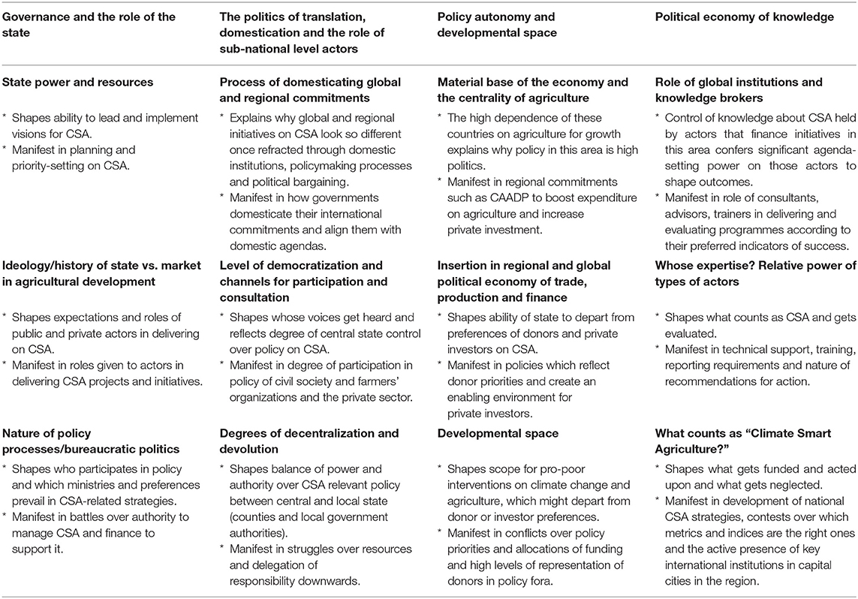

Slide 6
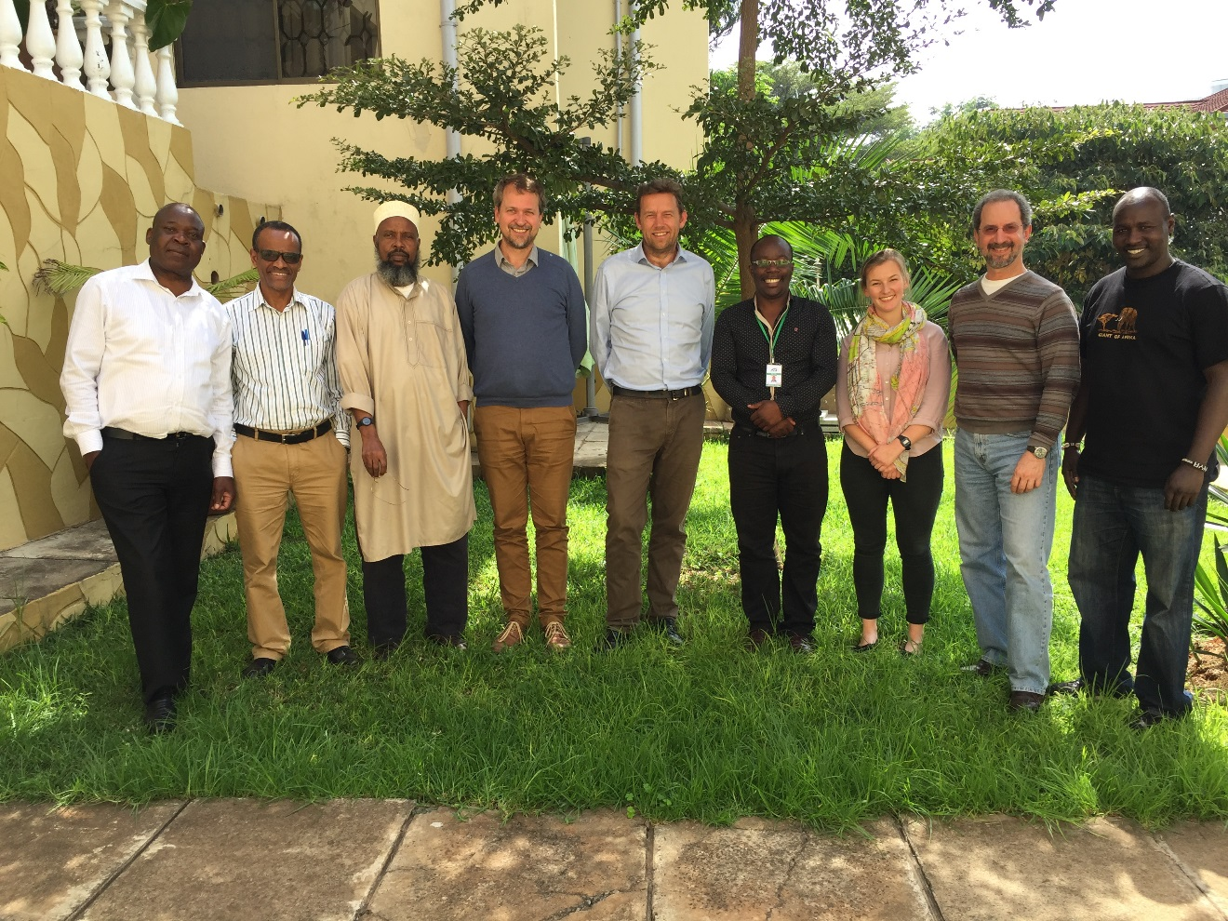
Project approach based on:
Collaboration with 4 in country partners to carry out
i) Interviews and review of secondary literature and country data.
ii)‘Power-mapping’ with key stakeholders to facilitate a participatory and triangulated discussion of key actors, processes and institutions.
iii) National mapping papers four each case study country drawing out dynamics to allow for comparative analysis.

Slide 7
Emerging findings I
There is a ‘triple disconnect’ between the global, national, and local scales as the trade-offs inherent in dealing with the political and ecological connections between SDGs are negotiated across levels of authority
The language of ‘synergy’ and ‘integration’ around the SDG objectives masks the reality of institutional jockeying for position between:
  (i) global governance institutions at the international level
  (ii) among governmental departments at the national level
  (ii) between national and local government actors who seek to position themselves to benefit from new resource flows associated with climate finance and the SDGs.
This competition tends to reproduce siloed policy practices within government and development agencies.

Slide 8
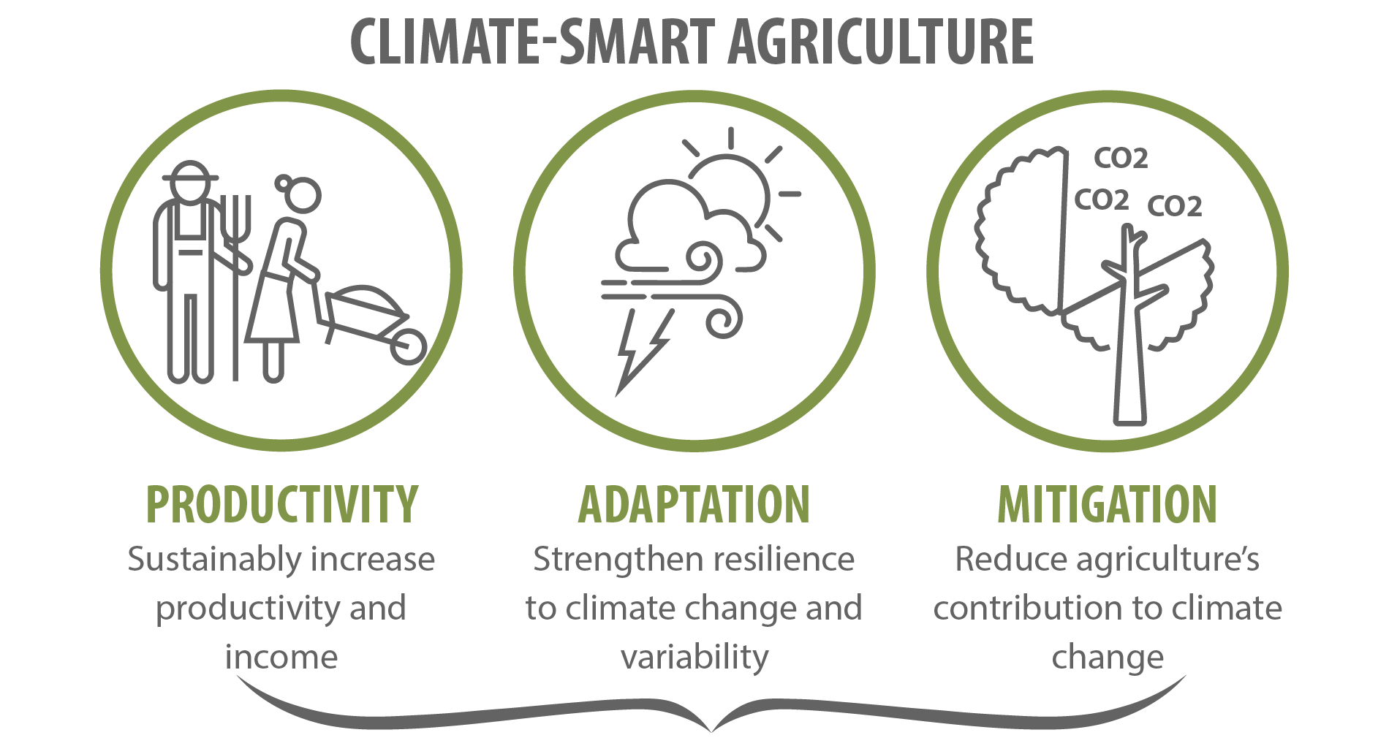
Emerging findings II
The process is not a one-way, top-down imposition of a particular approach to CSA.
Global interventions look different once translated into diverse domestic political and economic settings and refracted through local institutional processes
Competition between agencies, differing interests, and the very ambiguity of CSA, can create opportunities, as well as challenges, for national and local government officials to acquire authority and resources by invoking the label “climate smart.”
The reality of how different regions and social groups deal with these challenges on the ground is often very different from the way projects are imagined by donors and multilateral development banks (MDBs), as well as regional initiatives such as CAADP.

Slide 9
Examples from national case studies
Siloes and sector-based approaches: Tanzania: “The challenge we have had as a country at both national and local levels, we always plan sector-wise and not integrative.
Trade offs & turf wars: Kenya: Due to devolution, the national government government ministries only set the agenda as agricultural policy is devolved to county level. They therefore do not have to navigate trade offs. As one ministry official put it; ‘We cannot direct how counties respond (to our policies)’.
Domestication of international policy paradigms: Kenya: The original CSA paradigm of CSA as ‘triple win’ defined by the FAO (2013) has very little traction beyond narrative framings. For example, researchers at a national agricultural research organization acknowledged that they have been ‘doing resilience work for many years…. If you get the narrative right then you’re speaking the same language’.
Examples from Newell, Taylor & Tonui, 2018.

Slide 10
Key lessons from this project
To understand the prospects of effective implementation of the SDGs, we need to engage with the ‘messy’ politics of governing the relationship between SDGs which address food, agriculture and climate change.
Such processes manifest themselves in institutional competition and battles over authority, struggles over resources and a contested knowledge politics.
To recognise importance of diverse contexts in shaping what is possible > generic blueprints and toolkits.
Political economy approaches can help to understand & engage with the power relations which privilege some ways of advancing the SDGs while marginalising others & combined with political ecology help to make sense of the impacts of implications of this on different social groups.
Opening up policy-making processes to greater citizen engagement, for example, will be vital to realising the potential of the SDGs to benefit the lives of the poor and to build a more sustainable economy.

Slide 11
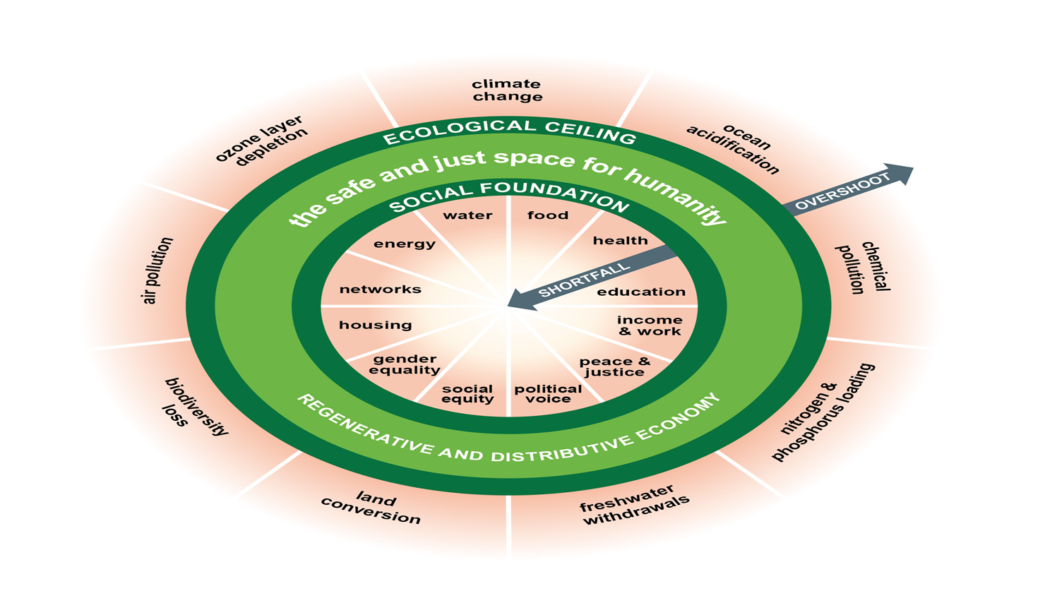

Slide 12
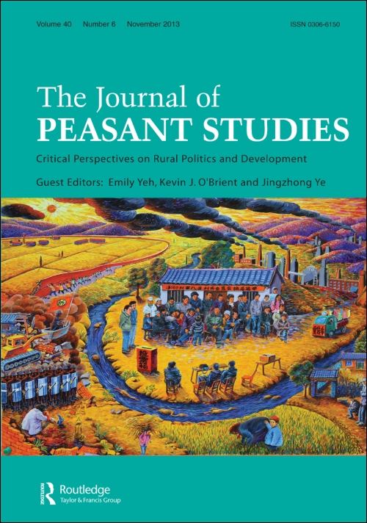
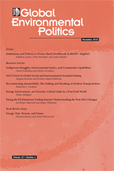

Further reading
Frontiers special issue (papers by Newell, Taylor, Naess, Thompson plus partners (published) + by each of our country partners (in process)
Newell, Peter, Taylor, Olivia, Naess, Lars Otto, Thompson, John, Mahmoud, Hussein, Ndaki, Patrick, Rurangwa, Raphael and Teshome, Amdissa (2019) Climate smart agriculture? Governing the sustainable development goals in Sub-Saharan Africa. Frontiers in Sustainable Food Systems, 3 (56).
Peter Newell, Olivia Taylor & Charles Tonui (2018) ‘Governing Food and Agriculture in a Warming World’, Global Environmental Politics 18 (12): 53-71.
Peter Newell & Olivia Taylor (2017) 'Contested landscapes: The Global Political Economy of Climate Smart Agriculture', The Journal of Peasant Studies 45(1): 80-88
Jennifer Clapp, Peter Newell & Zoe W. Brent (2017) ‘The global political economy of climate change, agriculture and food systems’, The Journal of Peasant Studies 45(1).
Linus Karlsson, Lars Otto Naess, Andrea Nightingale & John Thompson (2018) ‘Triple wins’ or ‘triple faults’? Analysing the equity implications of policy discourses on climate-smart agriculture (CSA), The Journal of Peasant Studies, 45:1, 150-174

