Slide 1
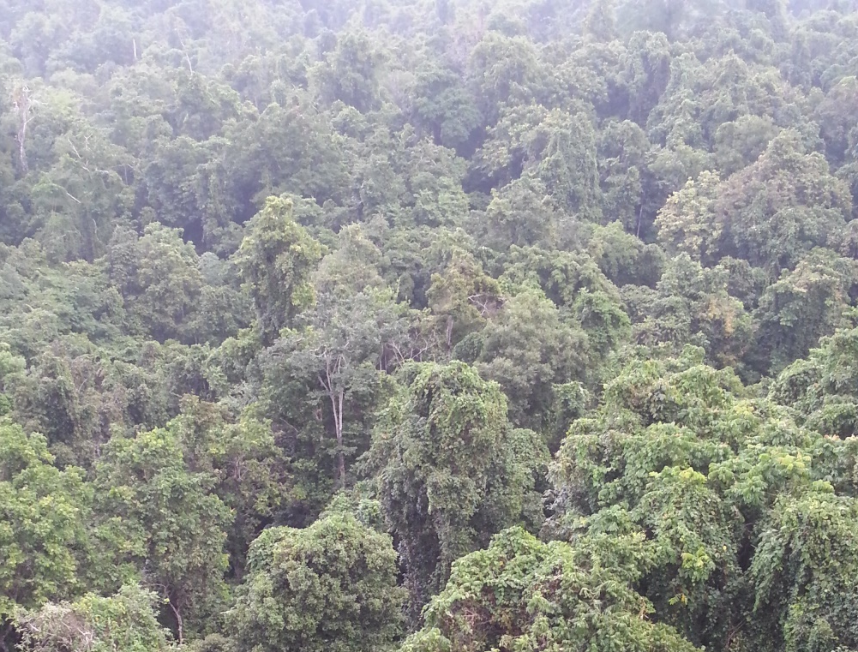
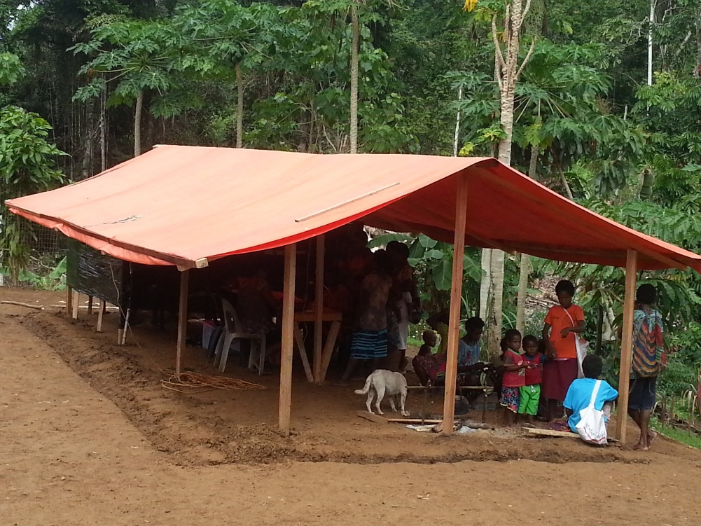
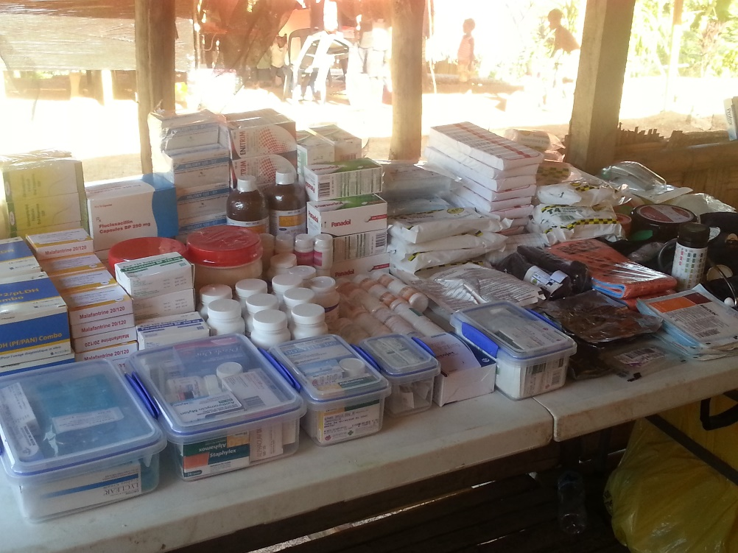
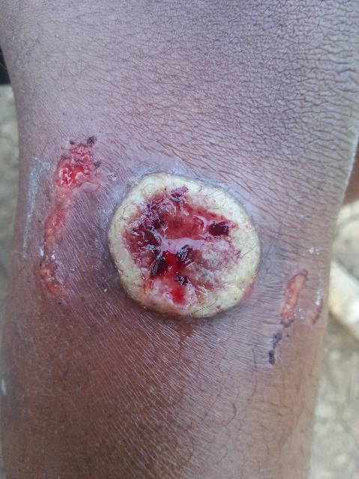
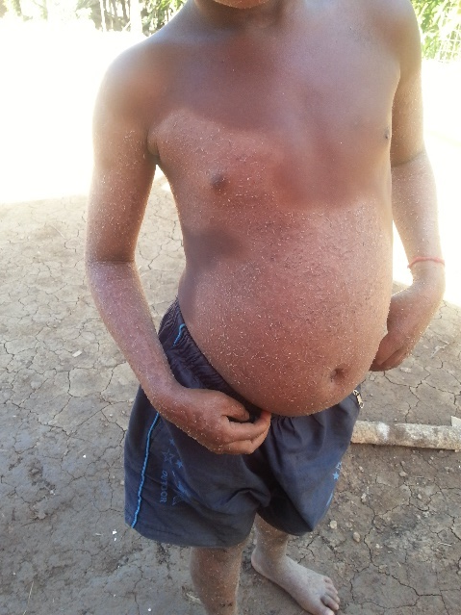



Planetary Health and the SDGs:
Combining health and conservation programmes in
Papua New Guinea and other conservation areas
Jo Middleton, Research Fellow
Department of Primary Care and Public Health, Brighton and Sussex Medical School
SSRP SURFACES Project and Darwin Initiative, School of Life Sciences, University of Sussex
Notes:
Attached is the all-but-final version of the programme. You will have 20 minutes maximum to speak, followed by around 5 minutes for discussion. That will be followed by 10 minutes of comments from the Discussant, James Fairhead.
It would be very much appreciated if you could send me your final or draft slides as soon as possible so that we could forward them to the Discussant and Session Chair.
With regards to the contents of your talk – The aim of the Symposium is to present results not only from SSRP but also associated projects, so you don’t have to limit your remarks to an SSRP-funded project. But we would like to have a certain coherence among the talks. So please keep in mind the motto of the Symposium, “Science for SDG implementation”, and please try and say something about the following points:
- Scientific results pertaining to SDG interactions and single SDGs
- Lessons/evidence from this research for policymakers and civil society to help them achieve the SDGs. We’re looking for big messages, backed up by evidence!

Slide 2
What we will cover today
  Context
  Planetary Health as scientific field and medical movement
  Relationship of Planetary Health to the SDGs
Sussex implementation research in PNG and beyond
  SSRP Surfaces: understanding and enhancing health in the vulnerable rainforests of Papua New Guinea
  Examples from our ongoing SSRP global evidence mapping of projects integrating action on health and conservation SDGs
  Planetary Health work at University of Sussex
Questions and discussion

Slide 3
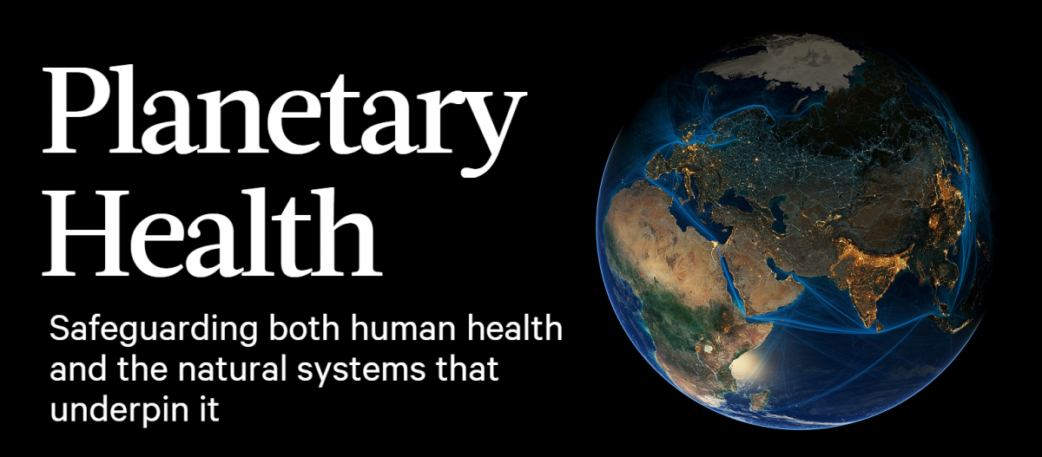
Planetary Health lens
The Lancet 386: 10007, 1973–2028, 14 Nov 2015
  ‘Planetary Health as scientific field
  is focused on ‘linkages between human-caused disruptions of earth's natural systems & the resulting impacts on public health.’ [planetaryhealthalliance.org]
  ‘the priority medicine gives to being human is also its great conceit—and flaw … Human well-being depends strongly on the interacting web of living species… It’s time to make protecting the biodiversity of our planet the next great cause of planetary health.’ [Horton, The Lancet, 11 Nov 2017]:

Slide 4
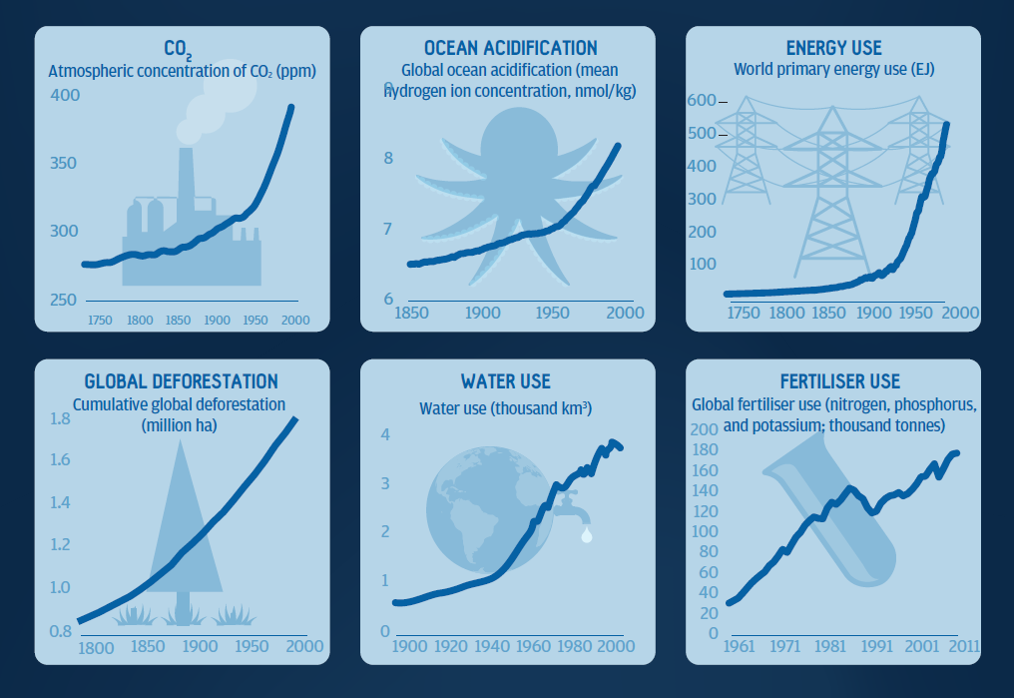
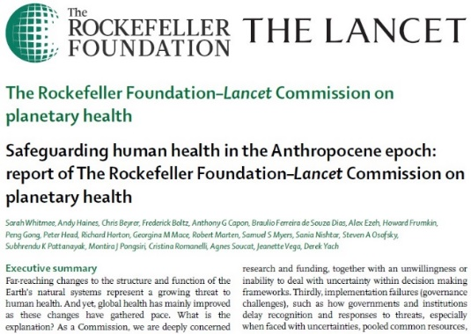
The Lancet 386: 10007, 1973–2028, 14 Nov 2015
‘A planetary health lens
Many global challenges come into sharper focus when they are viewed with the idea of planetary health in mind. Equipping students with what we have called a planetary health lens will enable them to have an understanding and appreciation of the crucial linkages, cause–effect relationships, and feedback loops between environmental change and human health.’
  Planetary Health as scientific field
  is focused on ‘linkages between human-caused disruptions of earth's natural systems & the resulting impacts on public health.’ [planetaryhealthalliance.org]
‘we conclude that the continuing degradation of natural systems threatens to reverse the health gains seen over the last century. In short, we have mortgaged the health of future generations to realise economic and development gains in the present.’ [thelancet.com/commissions/planetary-health]
Stone et al. (2018) Cross-cutting principles for planetary health education. Lancet Planetary Health 2:5.

Slide 5
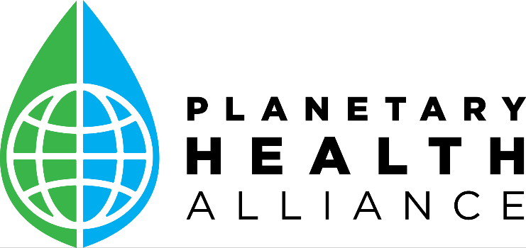
  Funded by Rockefeller Foundation and Wellcome, hosted by Harvard
  Consortium of over 200 universities, NGOs, and government entities.
  44 countries at Sept 2019 members meeting at Stanford University
  Facilitates collaboration between member institutions and health bodies.

Slide 6
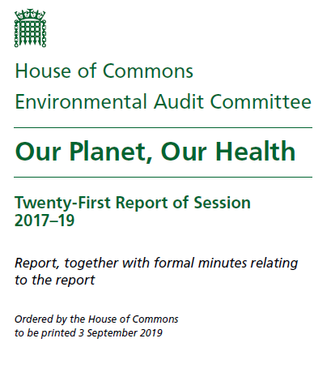
UK
‘There should be a single point of accountability for planetary health at both ministerial and senior civil service levels. The Government should also establish a joint unit to manage planetary health across Government.’ – HoC AEC
International level
Planetary Health not only aiming to integrate action across SDGs now, but also contribute to a coherent vision which will replace SDGs at the end of their implementation period.

Slide 7
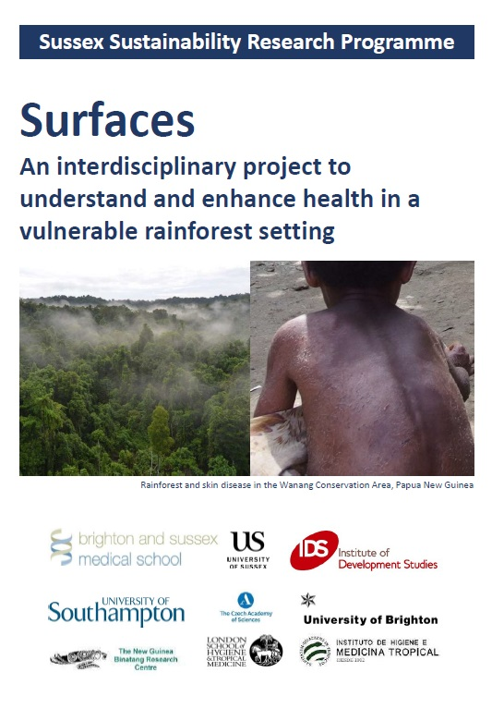
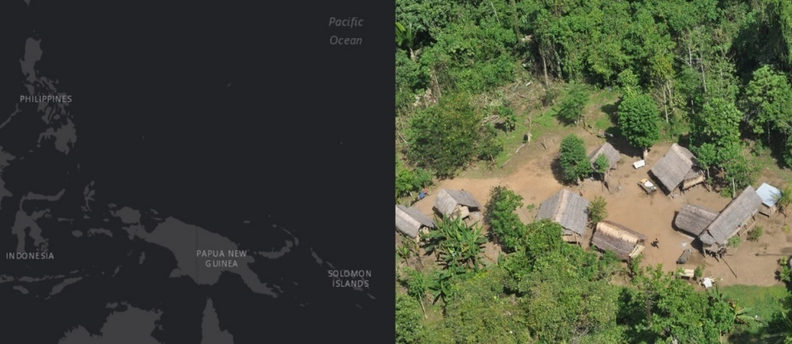
New Guinea = third largest tropical rainforest on Earth. [Sherman and Bryan 2011]
One quarter of the forests of PNG (New Guinea’s eastern half) cleared or degraded, nearly half by commercial loggers servicing global commodity demands. [Sherman et al 2009; Laurance et al 2012]
PNG’s health-related SDG indicators worse than all but two countries outside sub-Saharan Africa. [Lim et al 2015]
[Lim et al (2015) Measuring the health-related Sustainable Development Goals in 188 countries: a baseline analysis from the Global Burden of Disease Study 2015. Lancet 388:10053; Shearman and Bryan (2011) A bioregional analysis of the distribution of rainforest cover, deforestation and degradation in Papua New Guinea. Austral Ecol 36:1.; Shearman et al (2009) Forest Conversion and Degradation in Papua New Guinea 1972–2002. Biotropica 41:3.; Laurance et al (2012) Defeating the ‘resource curse’: Key priorities for conserving Papua New Guinea’s native forests. Biol Conser 151:1.]

Slide 8
SSSRP Surfaces: understanding & enhancing health in the vulnerable rainforests of PNG
Sussex (PI: Alan Stewart) has a nearly two decade collaboration with the Wanang community.
Building on this, SURFACES is mapping evidence on integrated health & conservation projects worldwide, and aims to provide a practical example in PNG’s rainforests, with a particular focus on neglected tropical skin diseases.
[Background on project: Middleton et al. (2017) Surfaces: An interdisciplinary project to understand and enhance health in the vulnerable rainforests of PNG. Inaugural Planetary Health / GeoHealth Annual Meeting; 28-30 April 2017; Harvard Medical School, Boston, USA]

Slide 9
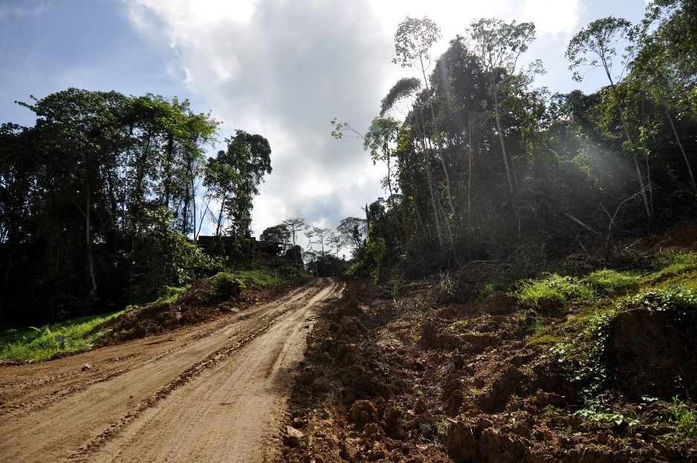
Desire for health services (SDG 3) can drive engagement in destruction OR conservation of forests (SDG 15)
For example: logging companies’ offer of roads and income to forest communities can partly extinguish the remoteness that bars access to health services.
[Middleton et al 2017; Ali and Jacobs 2007]
However, health services provision and an understanding of health-related ecosystem services can incentivise conservation. [Ali 2013]
[Wikimedia Commons: Shankar Raman TR]
[Middleton et al. (2017) Surfaces: An interdisciplinary project to understand and enhance health in the vulnerable rainforests of PNG. Inaugural Planetary Health / GeoHealth Annual Meeting; 28-30 April 2017; Harvard Medical School, Boston, USA.; Ali R. (2013) Approaching conservation through health. In: Colfer CJ, ed. Human health and forests. Abingdon/New York: Earthscan Ali & Jacobs (2007) Saving the rainforest through health care: Medicine as conservation in Borneo. Int J Occu Environ Health; 13(3):295-311.]
Remote communities in developing countries ned for health
Provioson of health services by conservationisys cann build support for conservation.
Nature provides ecosystem services…
Histoty of urvan green areas and UK national parks linked to need for urban poor to access outddor recreation… this continues with the 2017 National Parks England-Public Health England collaboration.

Slide 10
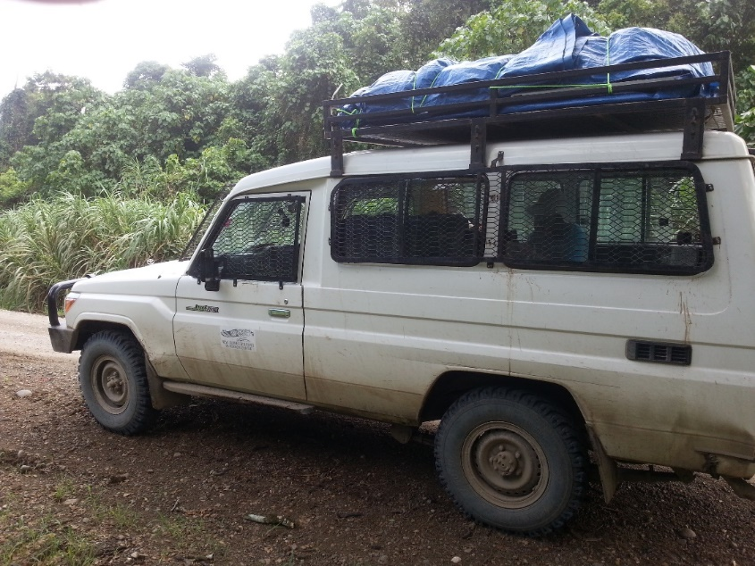

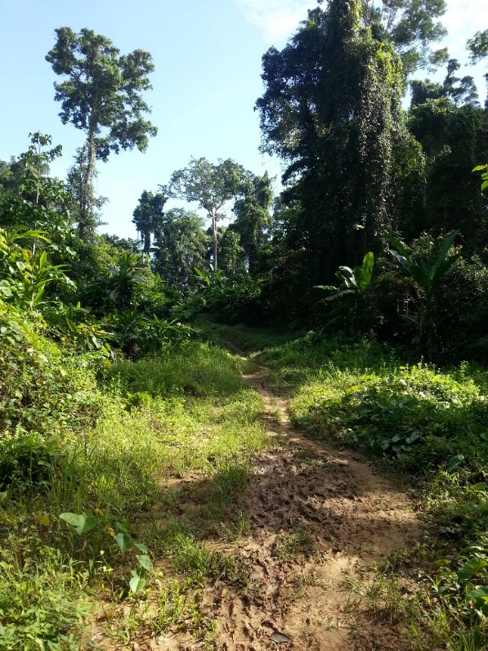

Slide 11
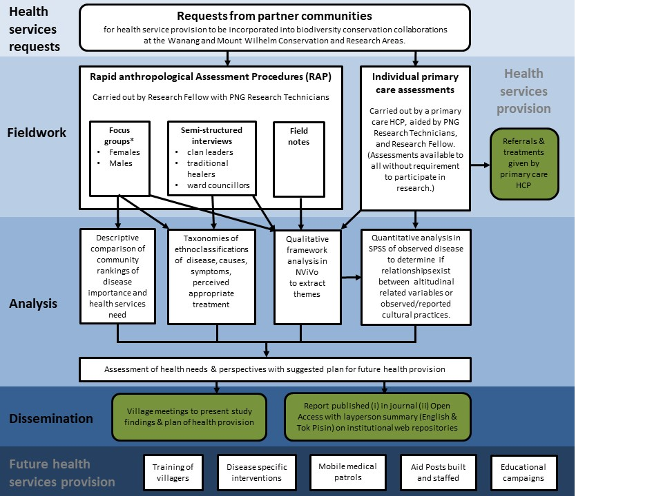
SSRP funded health needs assessment at Wanang
April 2019 successful application for £355,000

Slide 12
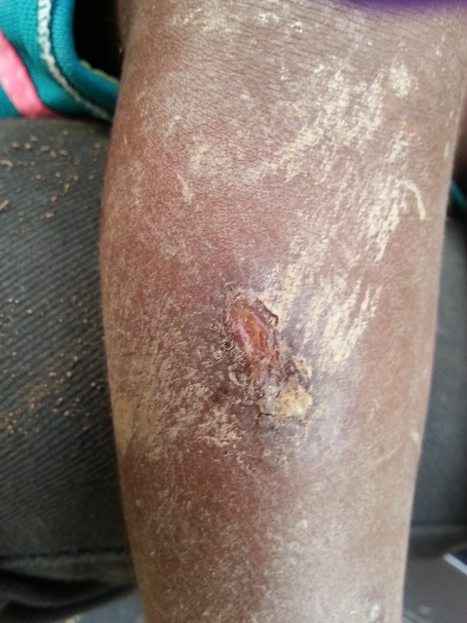
 | M | F | T
History | 75 | 55 | 130
Examined | 60 | 51 | 111
Treated | 34 | 29 | 63
Referred | 16 | 15 | 31
  Planning with 4 focus groups & 6 interviews.
  ethnobotany

Slide 13
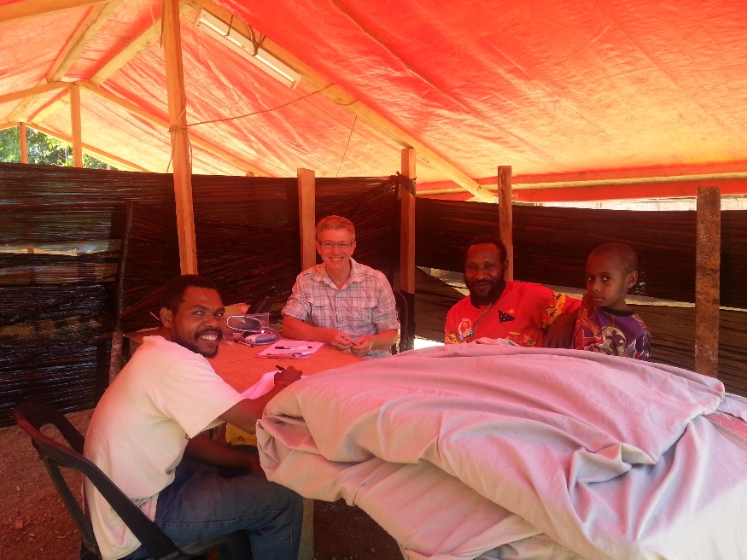
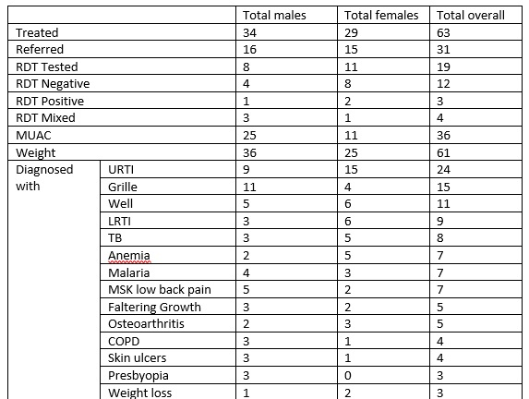
Value of multidisciplinary fieldwork team…inc. ethnobotany
Triangulation of qual & quant data very useful
Translation of community priorities to SDG health indicators and Darwin project targets
[Increased health worker density (from baseline of 0:2000 to 1:2000) (SDG3.D.1); improved proportion of children 1-year old covered by all national programme vaccines (from <10% at baseline to 60%) (SDG 3.B.1); improved proportion of births attended by skilled health personnel (0% at baseline to 60% in Wanang, at least 20% in buffer zone communities) (SDG 3.1.2); increased proportion of women of reproductive age (aged 15-49) who have their need for family planning satisfied with modern methods (from 0% at baseline to 50% in Wanang, and at least 20% in buffer zone communities) (SDG 3.8.1); reduction in number of people requiring interventions against neglected tropical diseases [specifically in this setting mycoses, scabies, yaws] (decreased 50% against baseline) (SDG 3.3.5); improved in-community availability of malaria Rapid Diagnostic Tests and treatment (from 0% baseline availability to 70% availability to all who seek aid) (SDG 3.3.3.) ].
Same SDG target approach for biodiversity.

Slide 14
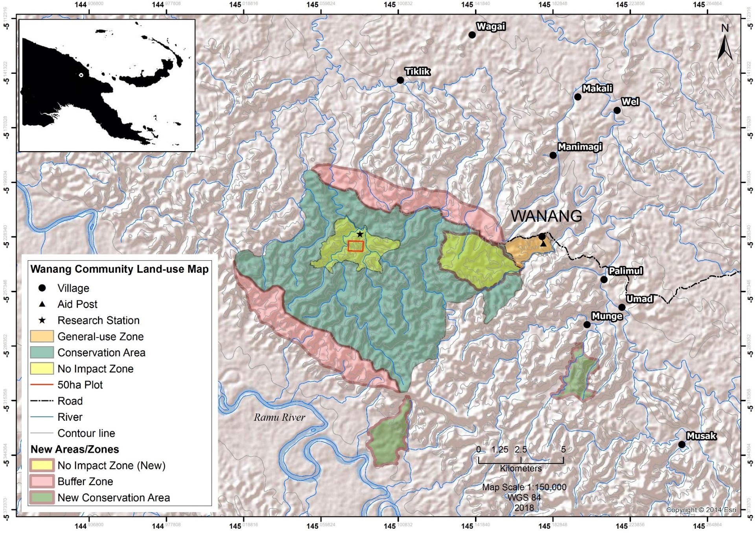
Wanang 2019-2022

Slide 15
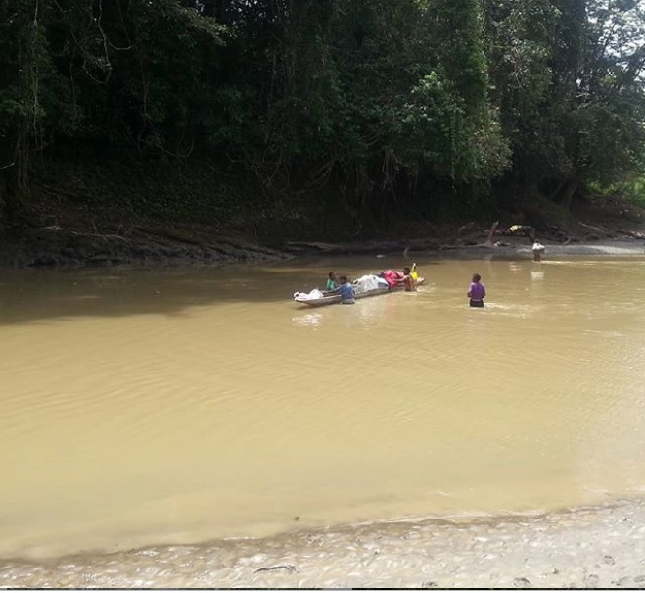
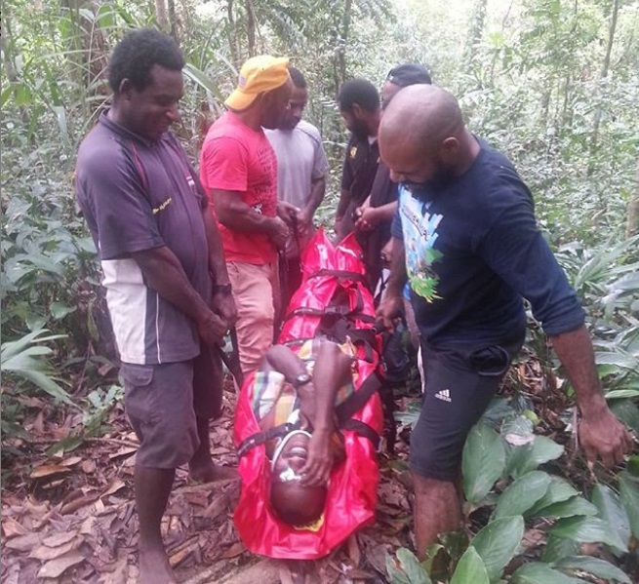
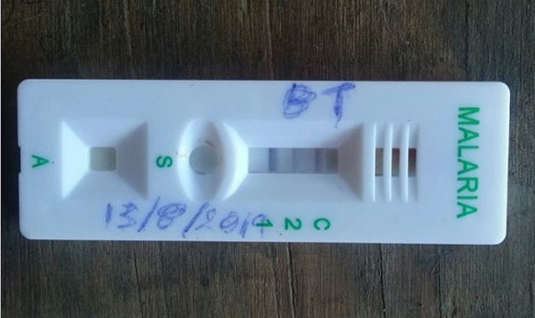
Pictures from 2019
Clinic construction and expansion of conservation area underway
Baseline surveys underway (biodiversity; health; attitudes to conservation)
2-year project evaluation to DFID-DEFRA
National school education programme
10-site survey to establish link between health and forest status

Slide 16
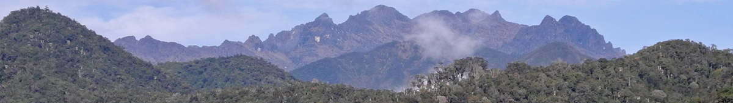
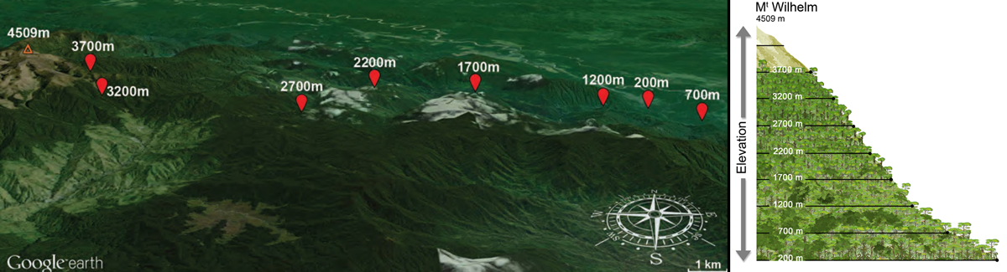
Next Steps: July 2020 health needs assessment up Mount Wilhelm (4509m)
41km transect from near sea-level (200m.)
to tree line (3700m.)
3000 people, in 7 communities
We will examine c.300 people over 3 weeks on-site.
Urgent treatment alongside research
Parallel focus on ecological determinants of skin diseases

Slide 17
Integrated conservation and health approaches
KEY POINT
Projects
      (i) conceptually link health to conservation (e.g. education in effective watershed management to reduce diarrhoeal disease).
and/or
(ii) do so operationally (e.g. vaccination rounds to generate goodwill for conservation programmes).
[Ali (2013) Approaching Conservation through Health. Human Health and Forests: A Global Overview of Issues, Practice, and Policy. New York: Earthscan.; Oglethorpe et al (2008) Healthy People, Healthy Ecosystems: A Manual on Integrating Health and Family Planning into Conservation Projects. Washington: WWF.]

Slide 18
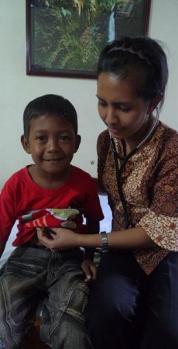
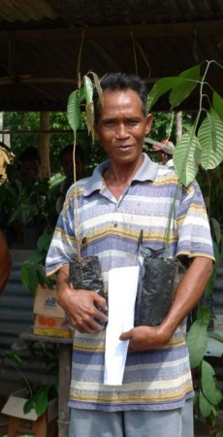
Borneo: Operational link
Setting
Gunung Palung National Park, 90,000h rainforest with c.2,500 orangutans.
Threat
60,000 people around park border ,mostly very poor. ‘Government health care is hard to be reach, medical emergencies put local people into debt, and illegal logging is one of the ways to earn cash.’ [alamsehatlestari.org]
Intervention
Following ‘radical listening’: ASRI mobile health patrols; health clinic linked directly to conservation via village level pricing indexed to <illegal logging, & individual ‘payment’ inc. non-monetary options (i.e. growing and/or planting saplings for reforestation). Different temporal and spatial factors than PNG.
Notes:
â€“ this is southwestern Borneo, Gunung Palung National Park.
What we provide
Health care â€“ high quality, affordable, accessible medical service â€“ is the cornerstone of our program. We believe that by making health care available to all local villagers around the park, and by weaving health care initiatives together with conservation ones, local people will be empowered to act as forest guardians, rather than illegal loggers.
ASRIâ€™s health clinic is located in Sukadana, a large town on the border of Gunung Palung. The clinic is open four days a week and is staffed by 5 doctors, 1 pharmacist, 5 nurses, and 6 administrative and other staff. Services offered at the clinic include, but are not limited to, the following:
Free birth control for village women
Free immunizations for children
General medicine
A comprehensive pharmacy
Dental care
The clinic also coordinates a DOTS program (Direct Observed Therapy Short-course) in which village health care workers help to oversee the treatment of tuberculosis patients in their communities (see video below).
ASRIâ€™s mobile clinic visits remote communities around Gunung Palung National ParkÂ each month, bringing pharmaceuticals, immunizations, a mobile dental chair, and other services to villages without easy access to the clinic in Sukadana.
What we ask in return
Villagers can trade conservation of the national park for health care services at the ASRI clinic or mobile clinic. They can do this in two ways: first, treatment at the clinic can be paid for by bartering items used in conservation projects, including seedlingsÂ for reforestation work and manure used to create organic compost for farming, and by helping on reforestation work. Â Second, park-border communities that cease illegal logging within the park receive extra discounts on ASRIâ€™s health care services. No one is ever refused treatment at the clinic — the discounts are simply additional rewards for conservation communities.
https://healthinharmony.org/2017/06/28/impact-measuring-results/#more-10563
Your Impact: Measuring the Results
Part 3 of 3 – Our Progress. Read Part 1 here and Part 2 here.
The first two parts of this series outlined the conservation challenges in Borneo and our efforts to combat deforestation by engaging communities. The question now is whether our solutions work. But when dealing with issues that combine economics, health care, social justice, and conservation biology, how do you measure progress? Planetary health is an emerging discipline and we are using methods that have not been tried before. So there aren’t many clear benchmarks for comparison.
We can start by asking what success would look like. For Health In Harmony’s Indonesian partner, Alam Sehat Lestari (ASRI), complete success would mean 1) zero deforestation in Gunung Palung National Park, 2) a return of the park to 100% natural vegetation cover, and 3) net forest growth throughout the region. And we would have achieved those goals by creating healthy communities that are invested in the long-term integrity of the natural landscape. So how do we stack up against those goals?
Goal 1. Zero deforestation: Just three years before we began our work, the national park was losing as much as 1,800 hectares of forest every year to illegal logging and farming^{1,2}. But after ten years of working in the area, deforestation had declined to its lowest levels since measurements began, to around 200 hectares per year. That corresponds to an annual deforestation rate of 0.23%, which is over 95% less than peak deforestation in 2002, over 60% less than the lowest pre-ASRI rates, and 67% lower than average rates across Borneo³. At the same time, our surveys of local communities recorded a 70% drop in the number of illegal loggers, from 3% of households in 2007 to less than 1% in 2012.

Slide 19
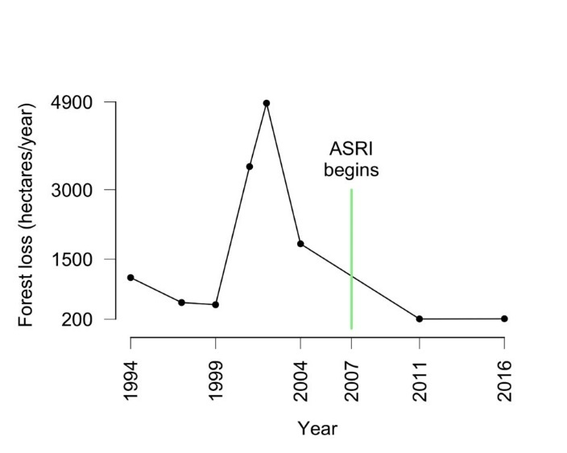
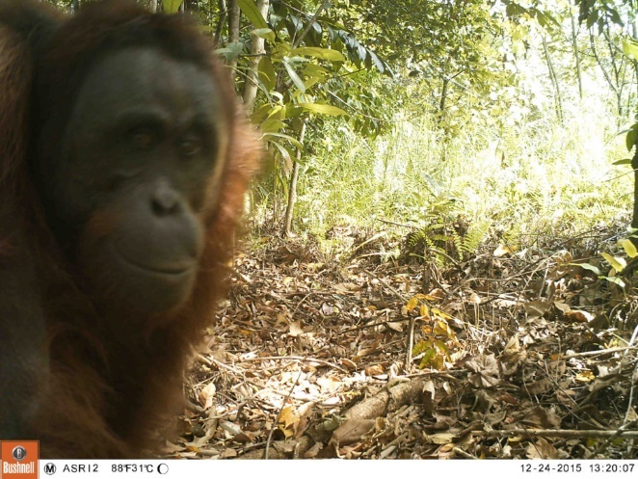
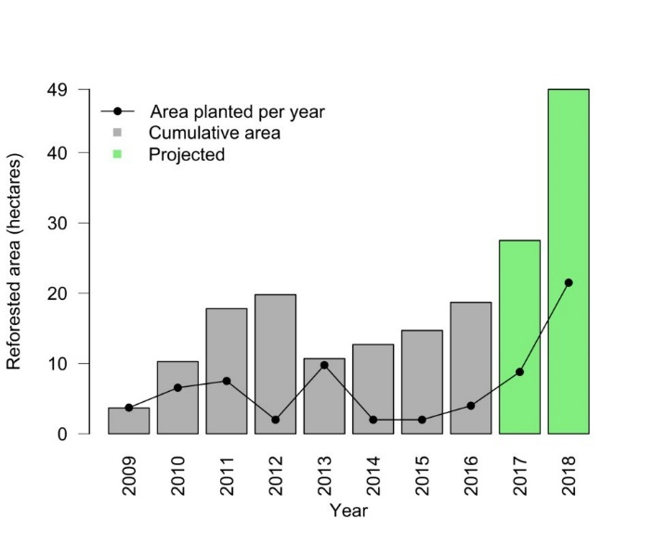
Borneo: ASRI (2/2)
Results are encouraging…
[healthinharmony.org/2017/06/28/impact-measuring-results/#more-10563]
…but ?

Slide 20


Uganda: Operational link + reducing anthroponotic disease hazard
  Scabies, and gastrointestinal parasites spread from humans to endangered gorillas
  Clinic services communities around park to make ‘healthy people, health animals’ & incentivise conservation (esp. <poaching).
  Different temporal and spatial factors than PNG project
Evidence… under assessment. [ctph.org]

Slide 21
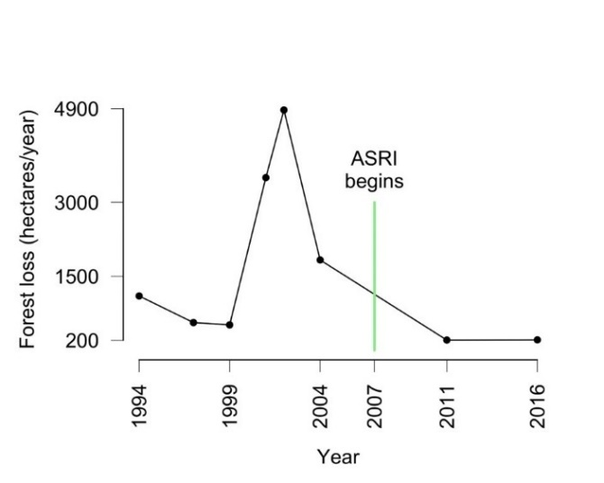
Evidence Mapping
Well underway… >60 projects identified.
Mapping output to Lancet Planetary Health by year end
Operational linkages
Mostly localised bolt-ons to existing NGO conservation programmes. As such critical evaluations are often not carried out, and are even more rarely published. Collecting NGO data.
Established integrated conservation and health projects carrying out evaluation research, but even these can lack comparator sites or accurate baseline data.
Conceptual linkages
Report changes in behaviour or environmental management, with a presumption such changes will have produced the desired environmental objectives. However, the programmes rarely collected the ecological data needed to demonstrate the presumed effect.
Whilst evidence is building on the links between biodiversity and human health, less evidence education on this conceptual link results in biodiversity conservation actually happening.
Need for scientific support for SDG integration in this area, often carried out by small NGOs
Results are encouraging…
Notes:
Weak evidence base justifying projects
One of the earliest (but maybe unsurprising [Sutherland and Wordsley 2017]) findings of our ongoing systematic mapping of evidence on integrated conservation and health programmes was the paucity of the published evidence base demonstrating their efficacy. Concerning projects with operational linkages, the majority we are aware of are localised bolt-ons to existing NGO conservation programmes. As such critical evaluations are often not carried out, and are even more rarely published. We are however keen to bring together such NGO data that exists, and welcome any additions to our mapping. Some of the more established integrated conservation and health projects have been carrying out evaluation research, but even these can lack comparator sites or accurate baseline data. Our observations of the field overall mirror those of an evidence synthesis that examined just the subset of such projects which could be characterised as adopting the Population, Health and Environment approach. It concluded projects often report changes in behaviour or environmental management (at a household or community level), with a presumption such changes will have produced the desired environmental objectives. However, the programmes rarely collected the ecological data needed to demonstrate the presumed effects (Yavinsky et al. 2015). Similarly, whilst evidence is building on the links between biodiversity and human health (Pienkowski et al. 2017; Sandifer et al. 2015; Keesing et al. 2010; Sala et al. 2009), we have seen less evidence that education on this conceptual link results in biodiversity conservation actually happening. We would thus encourage thorough, open monitoring and evaluation of all new projects. Given the present absence of a substantive, open and reliable evidence base some constructive scepticism towards NGO claims is warranted when planning interventions in this area. We are however aware of some high quality evaluations in progress (for example, one [IIED 2019] on ‘Conservation Through Public Health’ in Uganda), and we will be publishing evaluations of our PNG project in addition to our evidence synthesis of published and grey literature on projects worldwide.

Slide 22
  Planetary Health at University of Sussex
  Planetary Health Alliance
  BSMS PHA member institution since first annual meeting (spring 2017)
  Lead for PHA medical & nursing educational working group
  Sussex science for the SDGs
  SSRP SURFACES in Papua New Guinea
  SSRP HIV resistance & climate change in South Africa
  SSRP air pollution, health, and poverty in India and China
  Tulsi work with rangers in India
  BSMS work on sustainable healthcare and climate change and health
  UK work such as win-win interventions to reduce Lyme Disease in UK National Parks
  Future Planetary Health theme in next SSRP grant call, and today.

