Slide 1

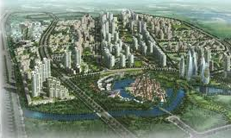
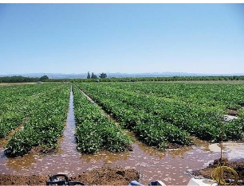
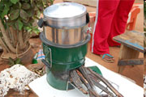
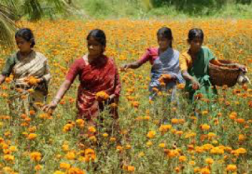
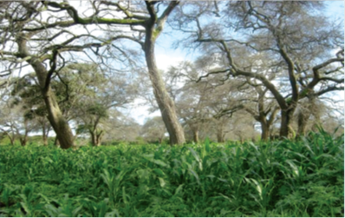
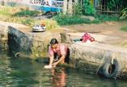


SDGs and Trade Policy: Finding the synergies
Emily Lydgate
Senior Lecturer
Sussex Law School
SSRP Sussex Sustainability Research Programme

Slide 2

Interconnections between trade policy and other SDG goals
Notes:
So what are the particular goals of SSRP? What are its key ideas?
Return to SDGs. An important fact is that the SDGs obviously won’t be cheap.

Slide 3
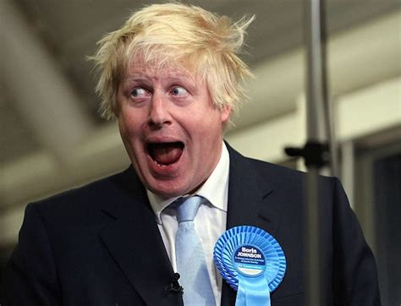
Case study: UK
Notes:
So what are the particular goals of SSRP? What are its key ideas?
Return to SDGs. An important fact is that the SDGs obviously won’t be cheap.

Slide 4
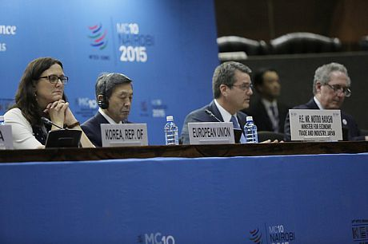
UK Trade Policy to-do list
'Roll-over’ (re-negotiate) 37 existing EU Free Trade Agreements involving over 60 countries
Negotiate new trade deals (US? China? India?)
Develop procedures for negotiating/ratifying Free Trade Agreements
Expand and train UK civil service in trade policy and negotiation roles
Re-establish UK’s position in the WTO (what tariffs does it apply to all other countries?)
Notes:
So what are the particular goals of SSRP? What are its key ideas?
Return to SDGs. An important fact is that the SDGs obviously won’t be cheap.

Slide 5
Achieving sustainable trade post-Brexit: the UK and beyond (SSRP project 2018)
Dr Rob Amos (PDR), Dr Emily Lydgate (PI), Professor Jim Rollo, (co-I), Dr Peter Holmes (co-I); Dr Chiara Armeni (co-I); Dr Dirk Willenbockel (co-I); Dr Max Mendez-Parra (external partner, ODI).
How will the UK integrate sustainable development objectives into UK trade policy?
Procedural and substantive dimensions
SSRP
Sussex Sustainability Research Programme
Notes:
17 goals and 169 targets to be achieved by 2030
Everyone wants SDGs
Going to be expensive
Max synergies, min trade-offs an opportunity for efficiency
But not so easy, need to learn more, and fast
Many interconnections
David Le Blanc 2015 Towards integration at last? The sustainable development goals as a network of targets
Department of Economic & Social Affairs DESA Working Paper No. 141 ST/ESA/2015/DWP/141
Figure 5 Links between SDG targets and other goals made by scientists in a review of SDGs: The whole SDG system
Source: Author’s elaboration, from data in ICSU-ISSC (2015).
Note: In the ICSU-ISSC paper, the chapter on goal 11 (cities) does not record links with targets under other goals. This explain the lower number of links starting from that goal compared to many other goals.

Slide 6
Example: Sustainability Impact Assessment
Key findings I:
Sustainability Impact Assessment (SIA) of Trade Agreements increases understanding of clashes between SDGs, and can also directly support synergistic approaches to addressing multiple SDGs.
SIA supports greater compliance with Decent Work and Economic Growth aspects of SDG 8 and environmental SDGs (6, Clean Water; 13, Climate Action; 14, Life below water; 15, Life on Land).
Notes:
So what are the particular goals of SSRP? What are its key ideas?
Return to SDGs. An important fact is that the SDGs obviously won’t be cheap.

Slide 7
Sustainability Impact Assessment
Key findings II:
SIA can also aid high-consuming countries (eg UK) in understanding of the impacts of their domestic consumption on trade partners. This helps to fill a key gap in the implementation of SDG 12 on Responsible Production and Consumption.
However there is room for improvement in current approaches: timing, scope, influence.
Notes:
So what are the particular goals of SSRP? What are its key ideas?
Return to SDGs. An important fact is that the SDGs obviously won’t be cheap.

Slide 8


Trade, Transboundary Impacts and the Implementation of SDG 12 (2019)
- SDG 12 least well-resourced SDG
One of the poorest implementation records
- Gap: OECD countries failing to account for transboundary impacts of domestic consumption
Notes:
So what are the particular goals of SSRP? What are its key ideas?
Return to SDGs. An important fact is that the SDGs obviously won’t be cheap.

Slide 9
Trade, Transboundary Impacts and the Implementation of SDG 12 (2019)
Key findings:
There are considerable gaps in existing EU/international law mechanisms to account for transboundary environmental harm
SDG 12 offers an opportunity to address gaps and account for harms more systematically
Accounting for transboundary harm would facilitate understanding and cooperation for transformative implementation of SDG 12.
Notes:
So what are the particular goals of SSRP? What are its key ideas?
Return to SDGs. An important fact is that the SDGs obviously won’t be cheap.

Slide 10
Thank you
Emily Lydgate
e.lydgate@sussex.ac.uk
SSRP Sussex Sustainability Research Programme

