Slide 1
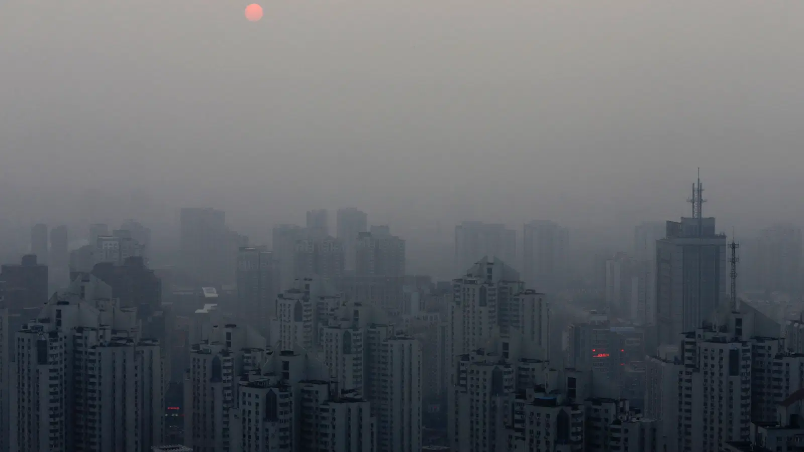
Outdoor Air pollution, health and social inequality in fast industrialising countries
By Wei Shen
16/09/2020

Slide 2
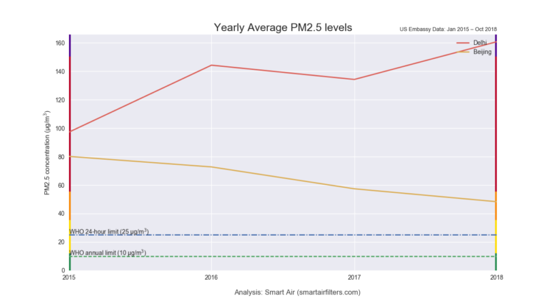
The (unequal) impact of air pollution and health
Ambient air pollution (pm2.5) caused various disease, disabilities and immature deaths across life span, from low-birth weight to dementia.
In many low income countries, it is the single largest cause for non-communicable disease mortality.
Multiple pollution sources: stationary and mobile, natural and man caused, households and organisational.

Slide 3
How pollution induced health problems affect poverty?
Protective constraints: knowledge and capacity
Occupation, housing conditions, travelling and daily commuting
Health care access, nutrition, mental health, daily habits, underlying disease
Exposure
Susceptibility
Health risk
O’Neill et al, 2003

Slide 4
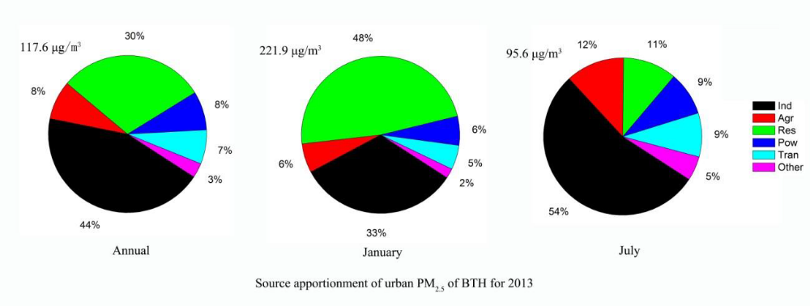
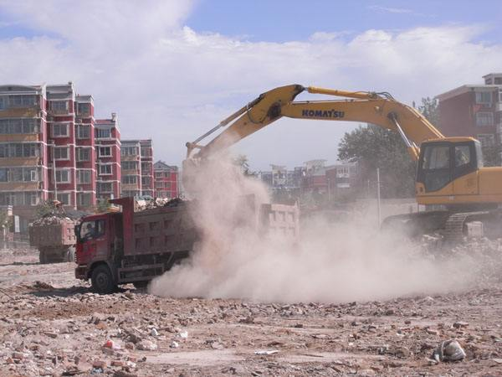
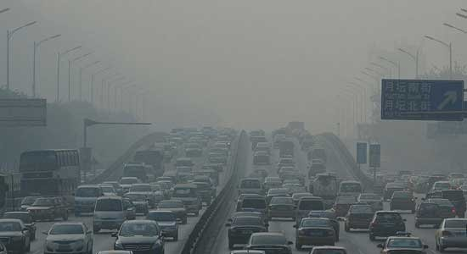
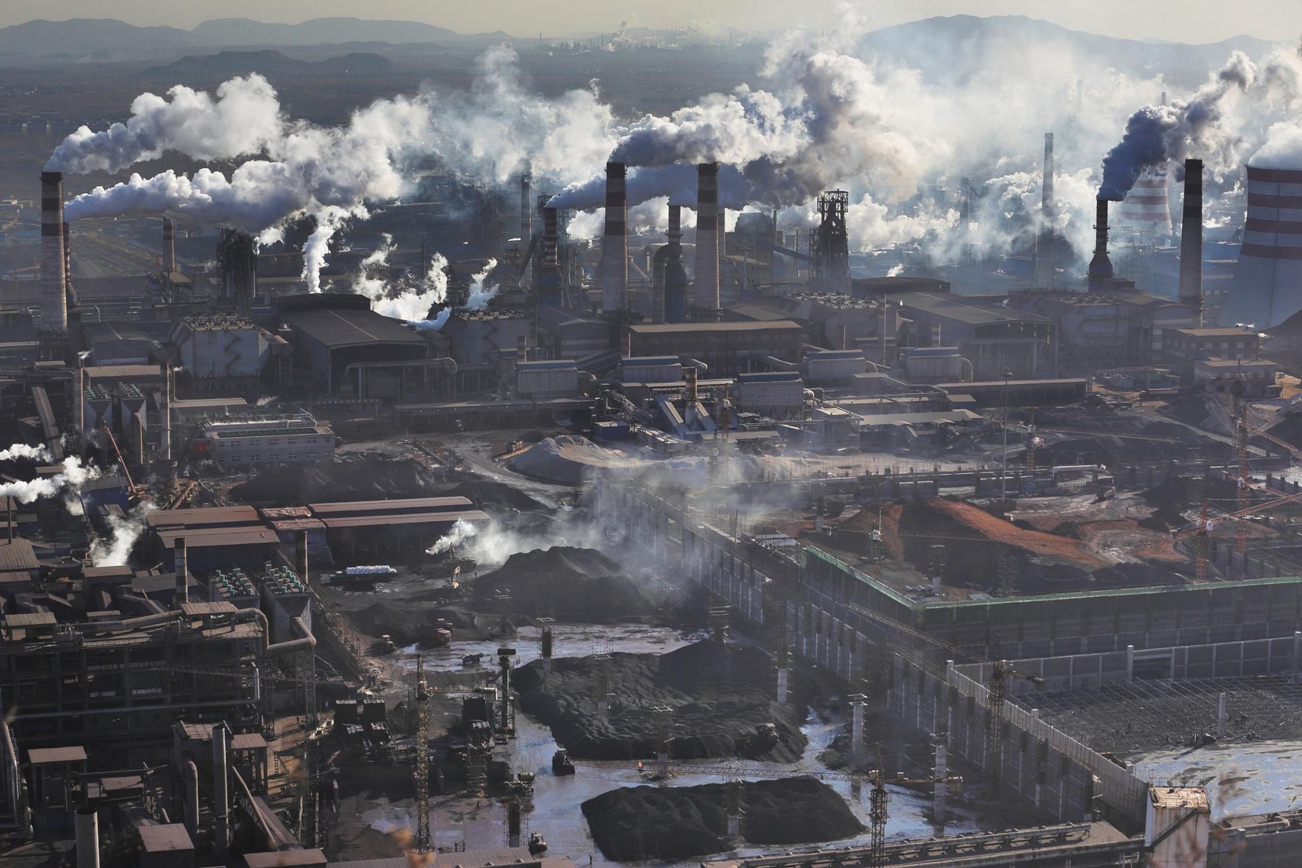
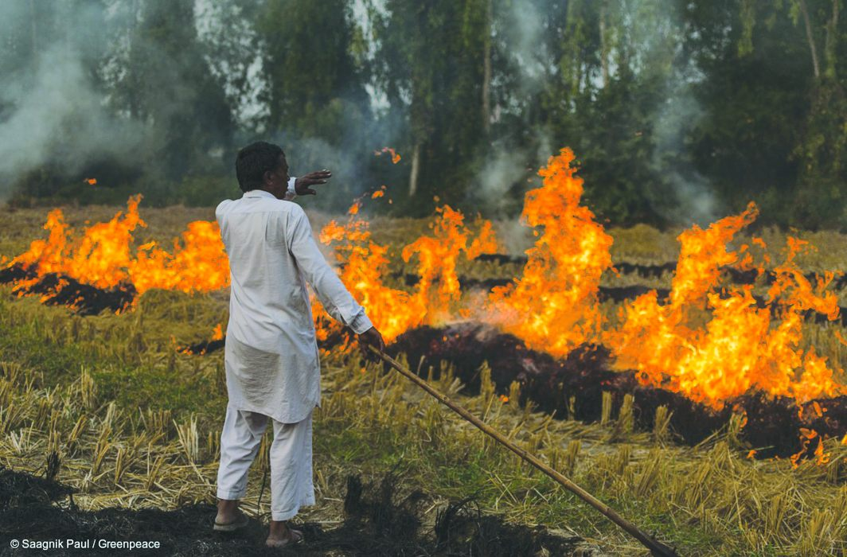
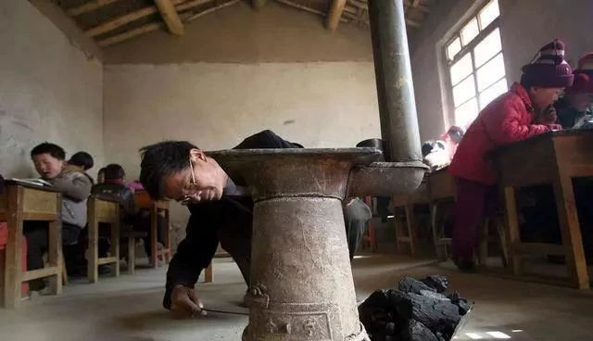
Political constraints: silence of the ‘polluters’
Source: FORHEAD, 2018

Slide 5
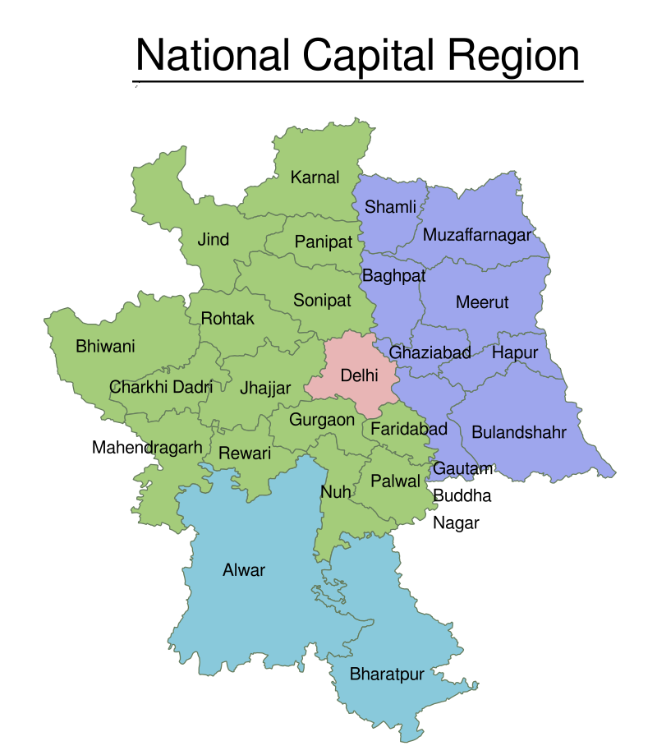
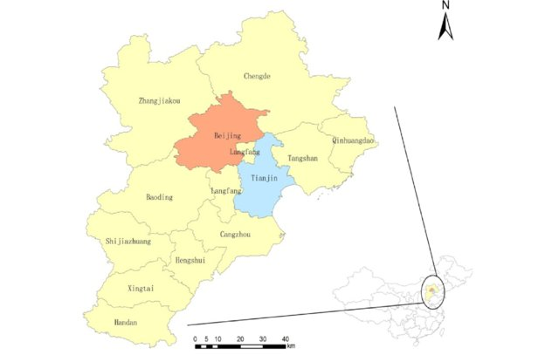
Structural constraints: social/spatial determinants
Jingjinji: Beijing, Tianjin and Hebei

Slide 6
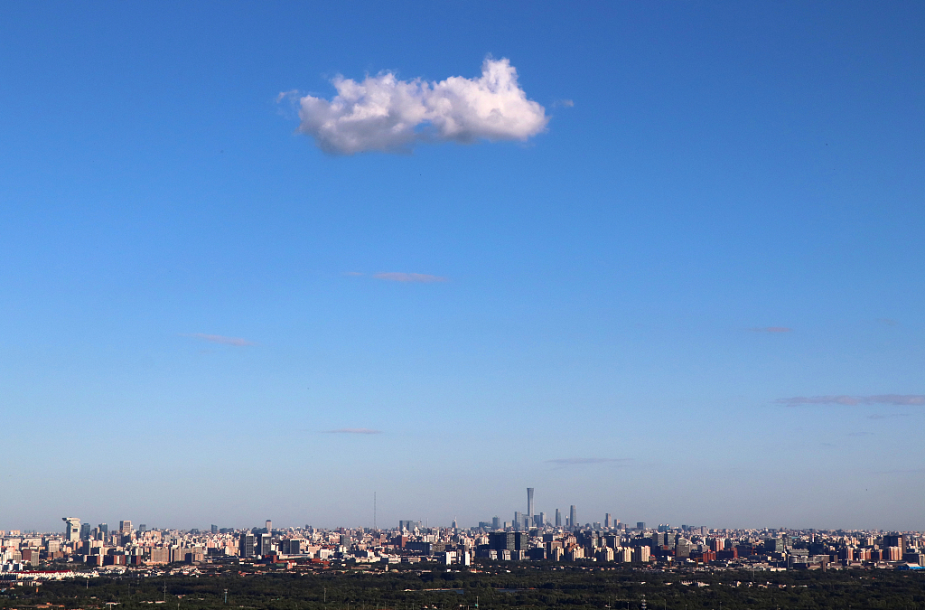
The price of a blue sky in Beijing:
Stone Township in Hebei:
Cement and cement-related industries contributed to 95% of the local revenue and provided 90% of local employment before 2013
Only two state-owned cement industries survived by 2017
90% of local workforce were laid off known as “Green unemployment”.
‘It is my honour to make some sacrifice for the blue sky and people’s health in Beijing. But I would appreciate if local government can do something to help us out of this difficulty.’
--- interview with a local laid off worker
GDP Per capita (in USD) for Beijing, Tianjin and Hebei (2012 -2018)

Slide 7
Towards a political economy of just transition
Structural Constraints
Urban-rural divide
Sectoral adjustment
Political Constraints
Participation
Networking
Protective
Constraints
Affordability
Mobility
Knowledge
Responsiveness
Inter-locality imbalances
State-business relations
Health inequalities
Exposure
Susceptibility
Illness
Mortality
Social inequalities
Jobs
Education
Poverty
Segregation
Shen et al, 2020
Thank you!

