Slide 1
Treatment choices in Psychosis
SPRiG 2019
Professor Kathy Greenwood

Slide 2
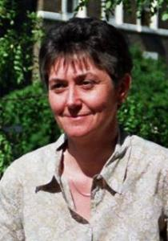



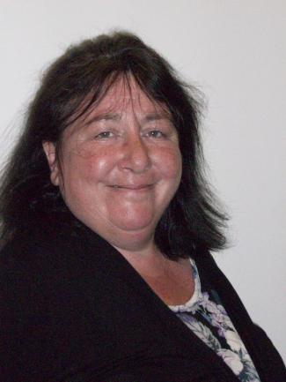
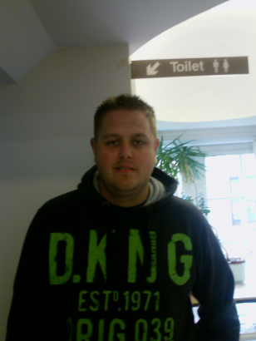



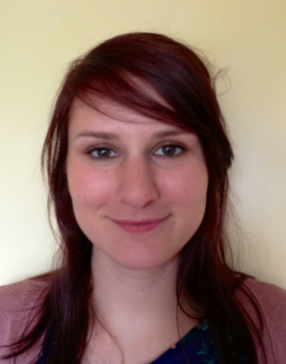
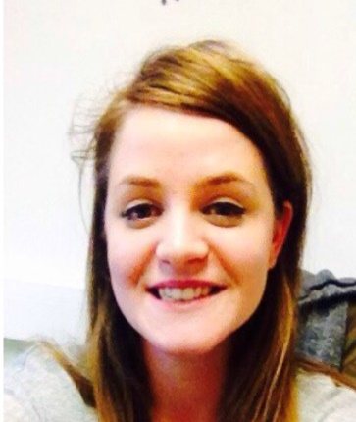
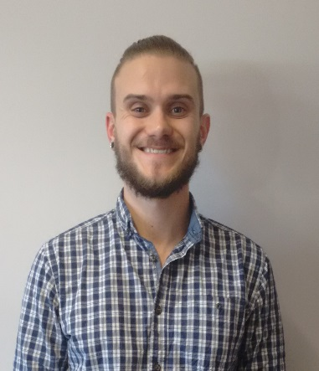
Collaborators
Institute of Psychiatry
Sussex Partnership NHS Foundation Trust
University of Sussex, Psychology
Notes:
2
The other thing I typically do at the start of the conference is remind us why we bother about research – because it’s associated with higher standards of care.

Slide 3

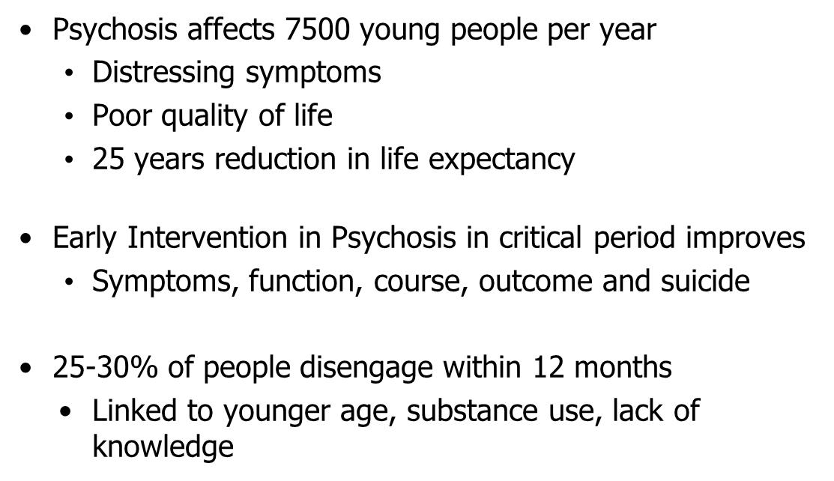

Slide 4
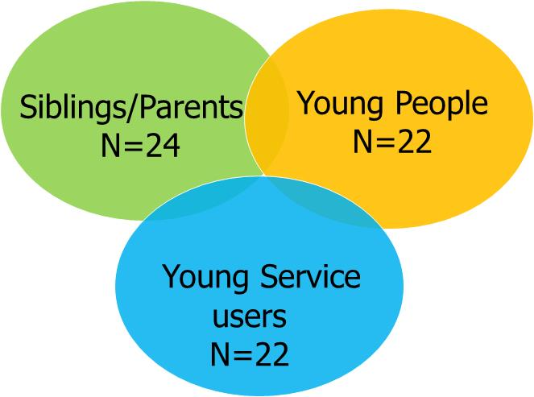
Engagement study –phase 1 interviews
N= 68 people, n=40 qualitative data sets, thematic analysis

Slide 5

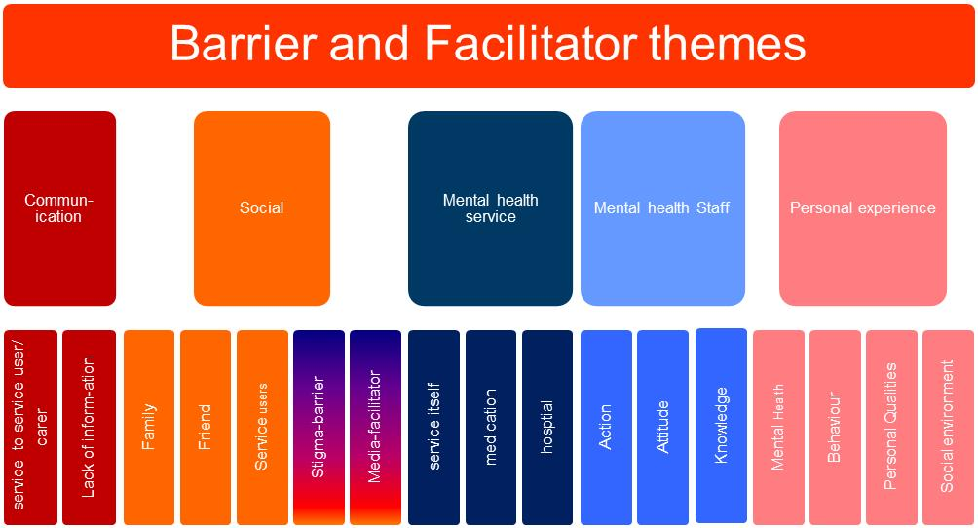

Slide 6


Engagement study – phase 2 – delphi consultation
National EIP leads,
Clinical directors, Service managers
Team leaders, Care co-ordinators
Psychiatrists, Psychologists, Pharmacists N=27

Slide 7
Engagement study – phase 3 EYE model
Communications
Transparent hopeful communication
Myth busting booklets
Website
Social
Socially inclusive practice
Social support group
Family and friends protocol
Peer workers
Family and FriendsBooklets
Mental Health Service
Open accesible service
EIP/Treatment Choice Booklets
Training
Mental Health staff
Transparent, honest, flexible
Goal-focussed, hope inspiring engagement
Training
Personal qualities
Engagement oriented personal characteristics
Booklets, Website, forum
Notes:
Information, social integration, service choice and flexible goal focussed relationships, leading to hope (agency and pathways to meet goals) and recovery)
Therapeutic engagement with EIP services at its best includes (i) transparent, hopeful communication; (ii) socially inclusive practice; (iii) open, accessible services (iv) positive experiences with staff, and (v) engagement-oriented personal characteristics.

Slide 8
The Early Youth Engagement (EYE) project: The Results
  Phase 3 pre-post service adaptation pilot (n= 298)
    Drop out at 12 months
    Relationship between engagement and access to materials

Slide 9
Drop Out at 12 months
Cohort | Engaged | Not Engaged
Pre | 143 | 45
Post | 94 | 16
Reduction in drop out from 24% to 14.5%

Slide 10
The Early Youth Engagement (EYE) project: Relationship between engagement and access to materials
The more EYE communication approaches used (booklets and website) to engage participants (n = 75), the more likely they were to be engaged 12 months later (p = .014).
Notes:
BUT BF calculates the likelihood of the data seen if the intervention works, compared to the likelihood of the data if the intervention doesn’t work – the higher above 1 the better and 3 means fairly confident that the intervention works – BF was 1.12 so suggest limited confidence that the intervention works

Slide 11
The Early Youth Engagement (EYE) project: The qualitative part
Service users
carers
clinicians
Communication
Social
Involvement
Hope
Goals/ practical focus
Trust
Reduced isolation/
stigma
Pride/
professionalism
Content
Style
Choice
Reassurance

Slide 12

The EYE-2 Project

Slide 13
Who are the research team?
  National EIP and clinical psychosis leads from around the country
    London
    Manchester
    South of England
  Researchers
    Health economics
    Implementation
    Statistics
    PPI – Mc Pin
    Qualitative experts

Slide 14
EYE-2 project
The Early Youth Engagement in first episode psychosis (EYE-2) study.
Cluster randomized controlled trial of implementation, effectiveness & cost effectiveness of the team-based motivational engagement intervention to improve engagement
Funded - NIHR Health Services and Delivery Research (£1.72million)
6 sites – Hampshire, Sussex, Thames Valley, London, Manchester, Cambridge-Norfolk

Slide 15
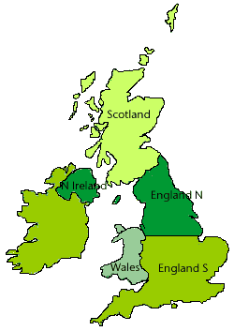
EYE-2 aims
(i) evaluate the effectiveness of the intervention with respect to disengagement & routinely collected outcomes (HoNOS, QPR, DIALOG, service use) at 0, 6, 12, 18 & 24 months in 950 service users
(ii) Complete a large-scale evaluation with all clinicians of EYE-2 delivery, assessed through questionnaire at start, mid & end of trial, & qualitatively in interviews.
(iii) determine societal & NHS costs, savings, and overall cost effectiveness & produce a commissioning guide

Slide 16
What did service users and their families say?
Well...I mean...there was times when, I got worse and I needed information to kind of, help me, to feel like yeah I wasn’t alone. So, from here [booklet], I went on the internet. And then, I read a few stories or something...it stopped me feeling like I was.... alone.
I’ve gotta admit I think if I, hadn’t have been so stubborn, and used some of these. Sort of like websites where you can, like a forum and all that sort of, I think I probably could’ve got over...it quicker but...I just, ate Ben and Jerry’s and watched Netflix.
The good thing I like about that [treatment choice] booklet, it’s not all about medication. There’s only a bit at the back and I’m like ooh, that looks interesting.
If I had this booklet or found information like this when I was (first in) early intervention it would have probably helped me, it would have probably stopped me going to the hospital, cause I would have known what to do much better and id be like okay, okay I’m really ill. I should allow them to treat me rather than being forced treatment

Slide 17
What do clinicians say?
…The EYE project is a perfect fit for our style of working, our ethos, our approach, our values… the goals are the same. You know, remove barriers to engagement, encourage more positive meaningful engagement, ncourage collaboration, bust stigma and myths around…mental health problems
My initial contacts with clients are now much different since the introduction of the EYE materials. They very much form, the basis of initial discussions with clients and their friends and carers and relatives. So in that regard I guess it is quite a positive development in terms of that initial engagement with clients.

Slide 18
Treatment choices and hope for the future
“they say it’s a reuptake inhibitor, it does this, and its scientifically proven, but there are, you know, it’s also proven by experiments that you know human touch releases Oxytocin exercise releases endorphins”
When I meet with the [clinician], what I do like is that he doesn’t just look at my medication, he looks at the whole bigger picture. So he’ll discuss what else is going on in my life, um, talks about education and stuff like that, you know, anything that could be happening in my life at the moment, or in the near future and, I think that’s, I think that’s a good thing, because obviously I do need the medication but, my diagnosis can get in the way of sort of my personal life and, you know my social life, that sort of thing’

Slide 19
Value of treatment choices
Facilitators
‘Think what my sort of, short term and medium term goals are .., ‘
yeah she was understanding about, about my wishes to do with medication and helped me to kind of do things that I-I felt would help like say yoga and /meditation and, hot baths [laughter] thi… you know things like that which I can do myself.’

Slide 20
Hope leads to better social outcomes
Therapeutic relationship (P)
Therapeutic relationship (SU)
Social activity
Hopefulness
Community belonging
Professional hopefulness

Slide 21
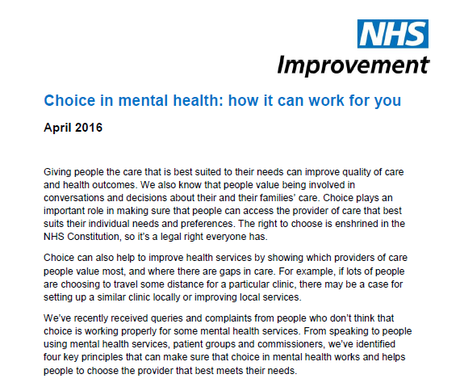
NHS England Guidance
Importance of
explaining appropriate treatments and interventions
offering interventions supported by NICE guidelines

Slide 22
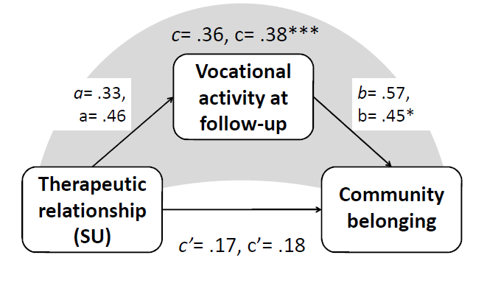
Our roles are critical to outcomes

Slide 23
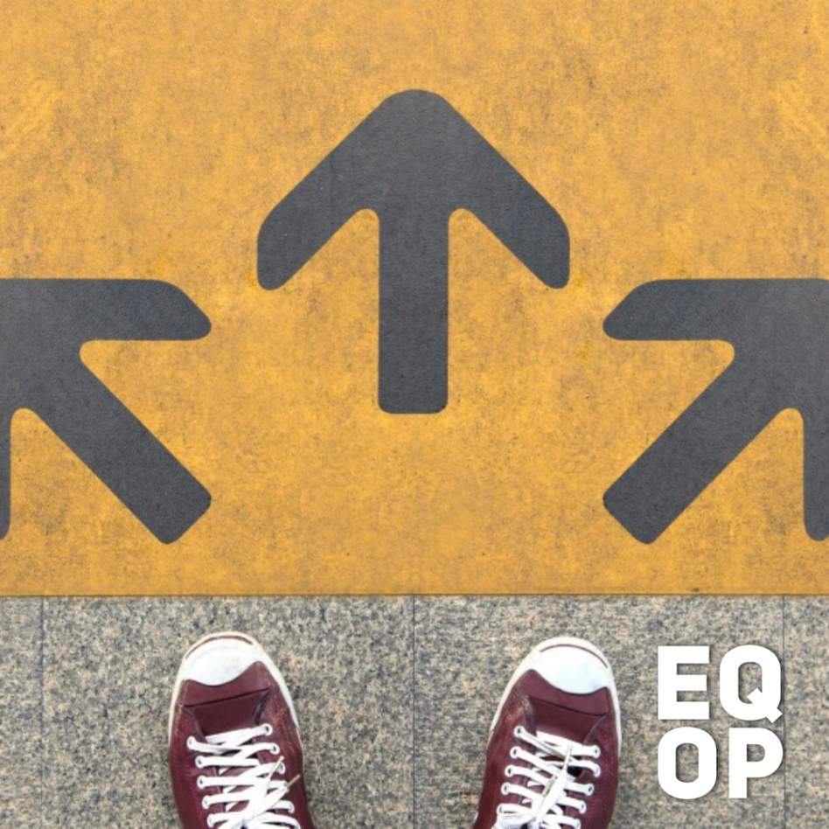
Collaboration and Choice in the Context of Risk
Importance of choice and collaboration in context of difficult treatment choices/risk
Service users more likely engaged if have choices about treatments/admissions
Don’t want to feel that they only have one option, or forced to accept something against their will.

Slide 24
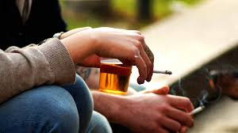

Collaboration and Choice in the Context of Risk
But there are lots of challenges to providing autonomy and choice
  Risk of suicide/harm to self or others
  When service user unable to take on board and weigh up decisions
  when you can see that the service user is making unwise decision
  when a service user influenced by current unusual beliefs or experiences
  when family members have conflicting views about treatment
  when there are real or perceived time constraints

Slide 25
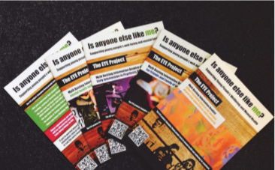
The EYE-2 Booklets – A psychoeducational approach

Slide 26
The Treatment Choices booklet
When to use
Discussing treatment options
What its for
Supporting discussion and providing choices about treatment
A barrier to use?
Potentially too long for some service users
After distress has settled
Discussing new treatment option
Things are feeling “stuck”/reviewing options/what’s been offered
Evidence for treatments
Written with help of service users
Photocopy or download chapters

Slide 27
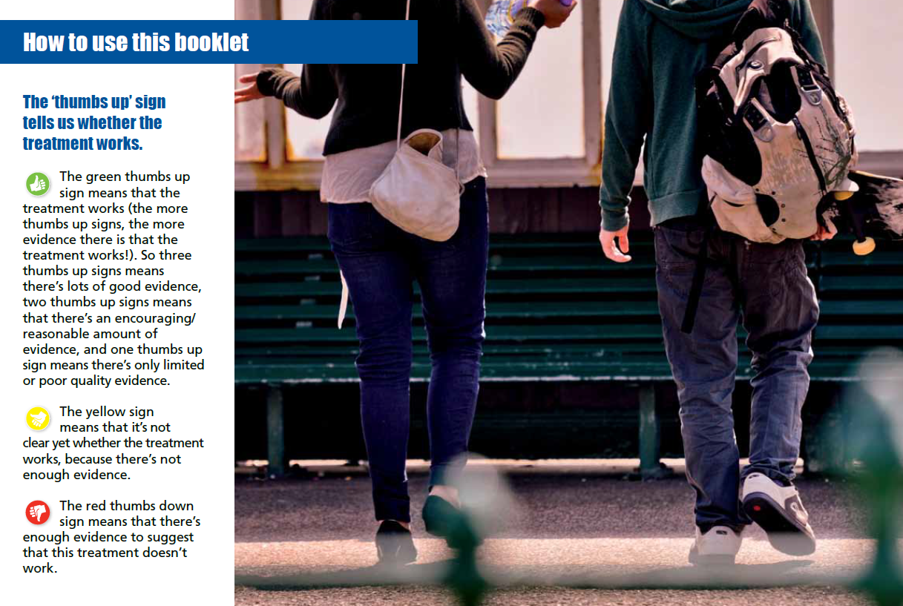

Slide 28
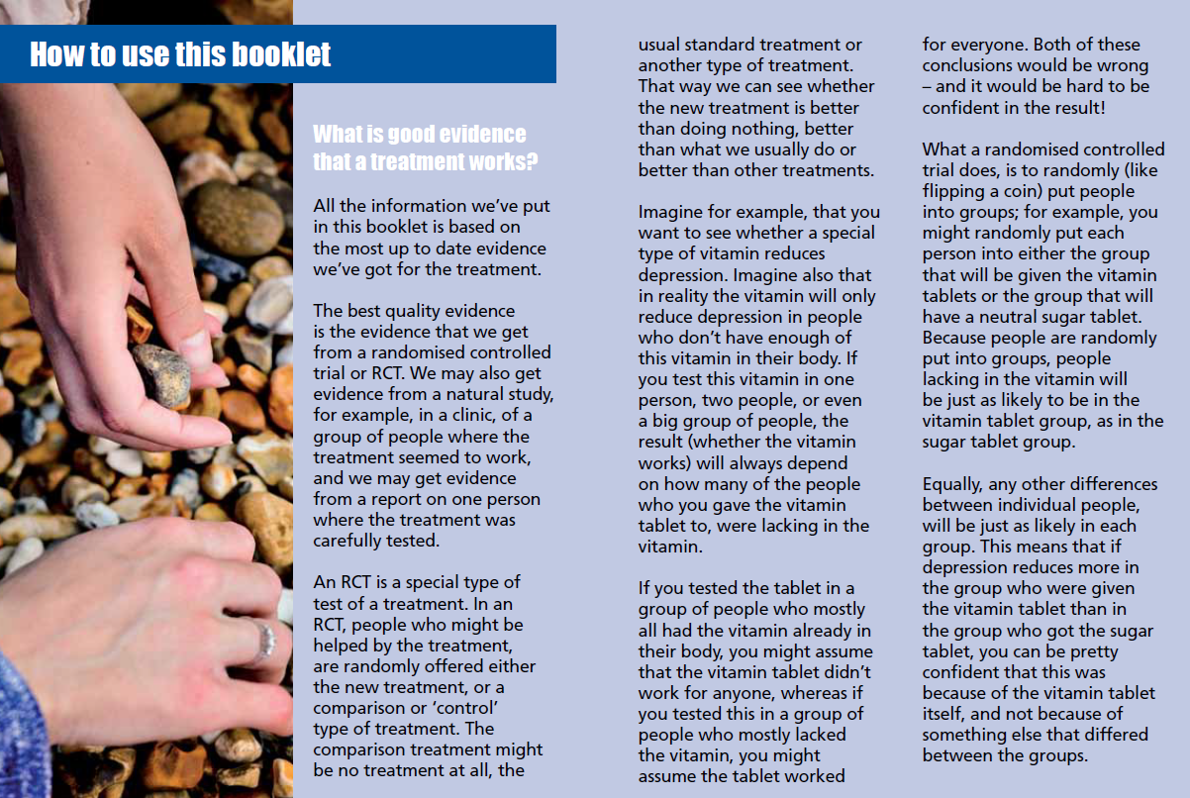

Slide 29
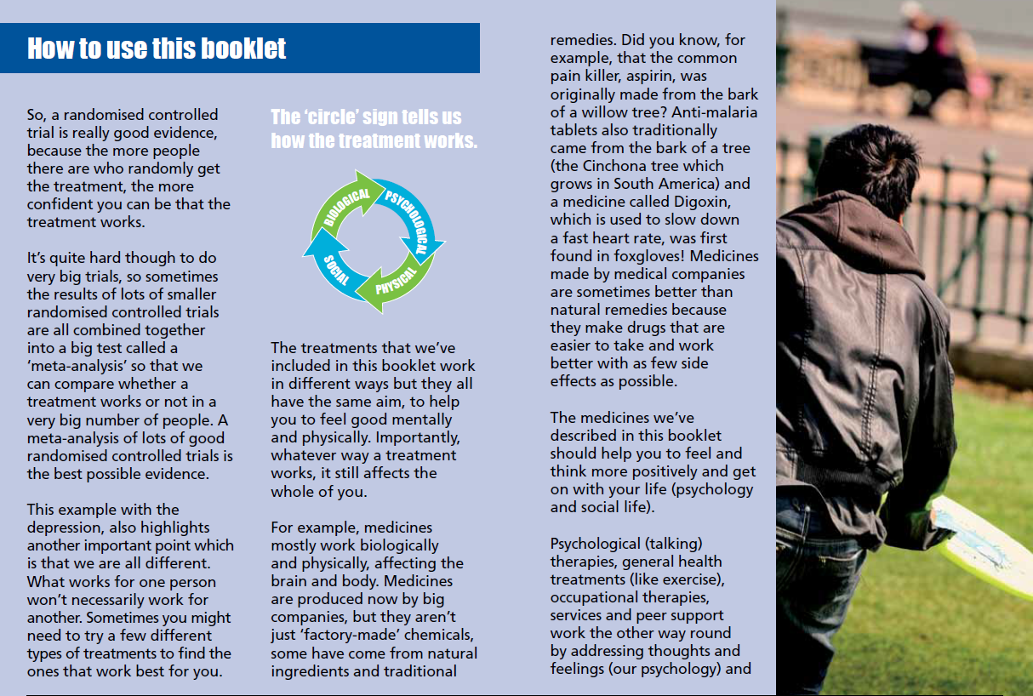

Slide 30
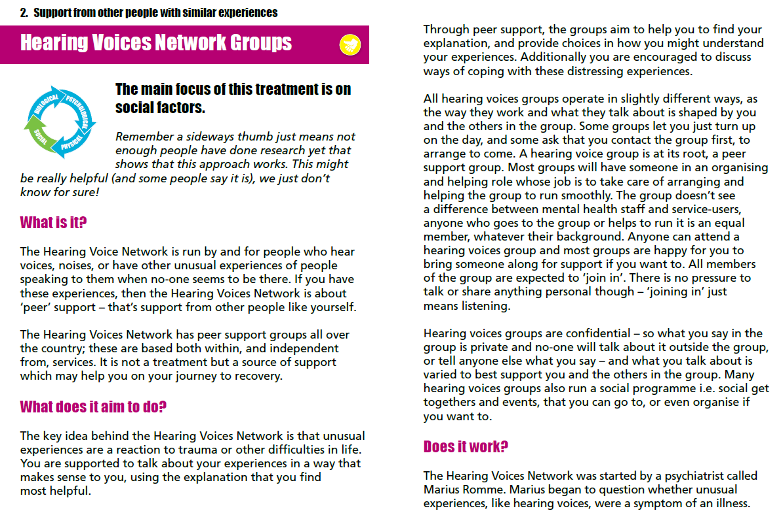

Slide 31
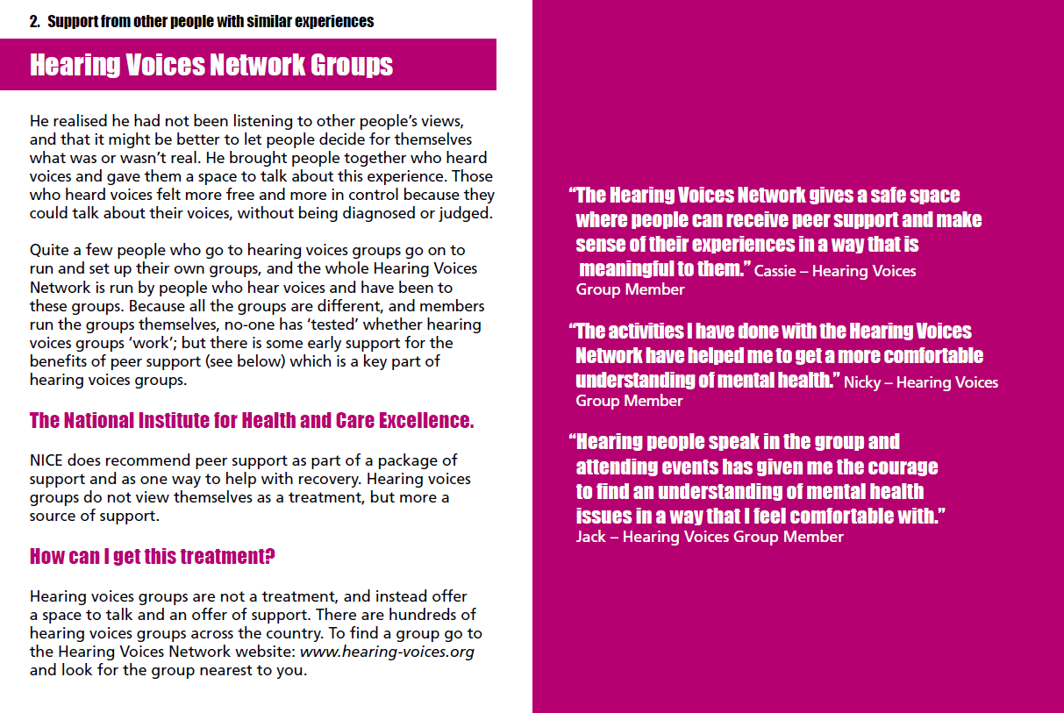

Slide 32


Slide 33
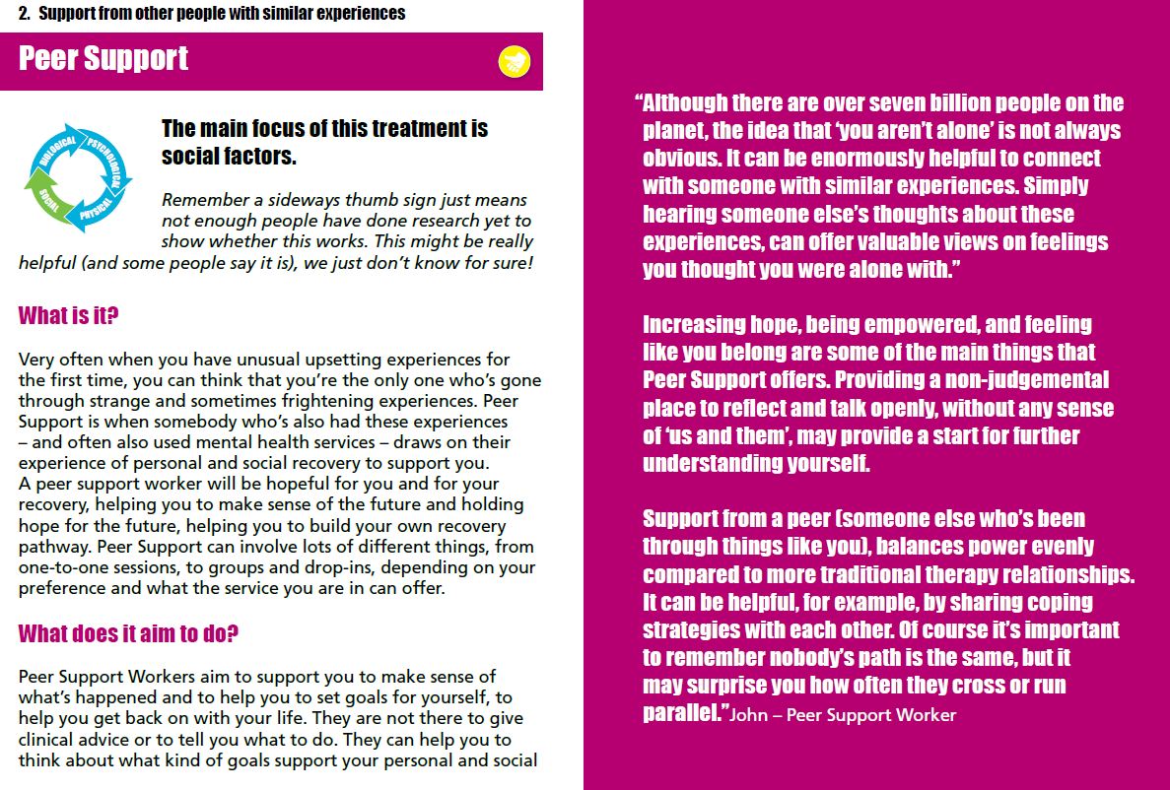

Slide 34
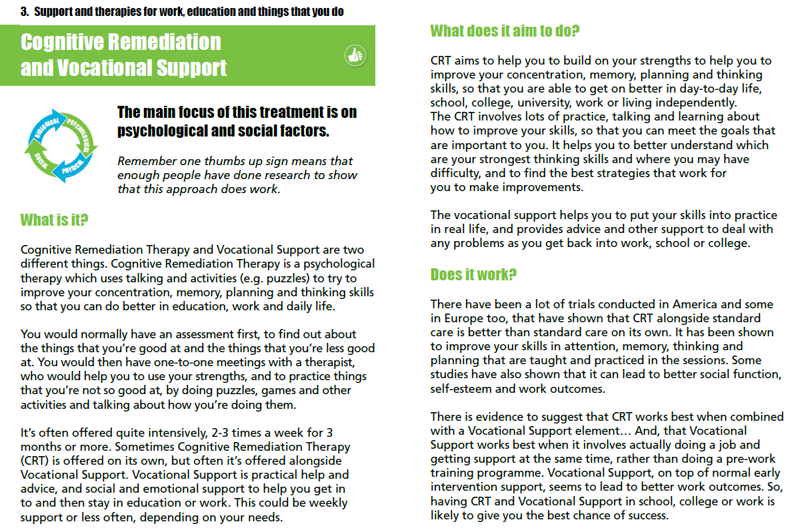

Slide 35
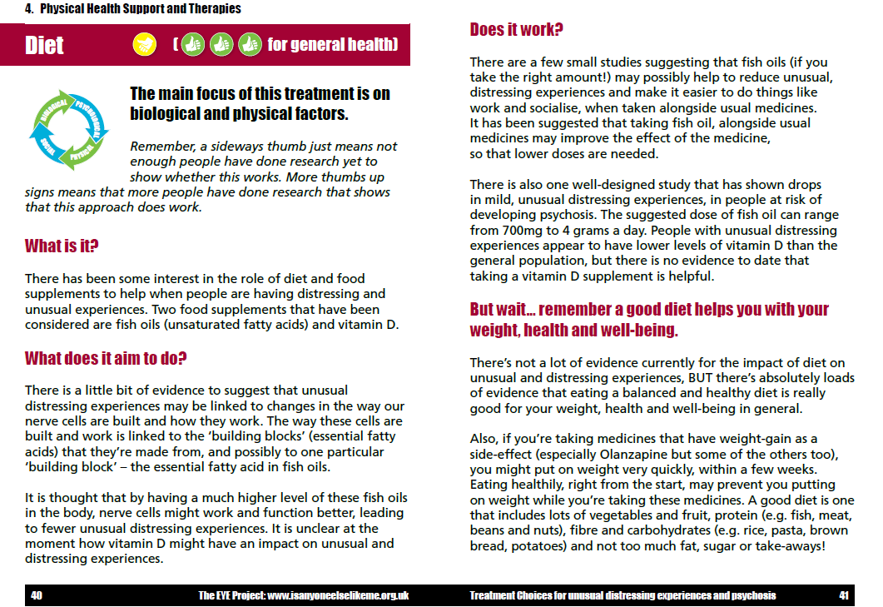

Slide 36
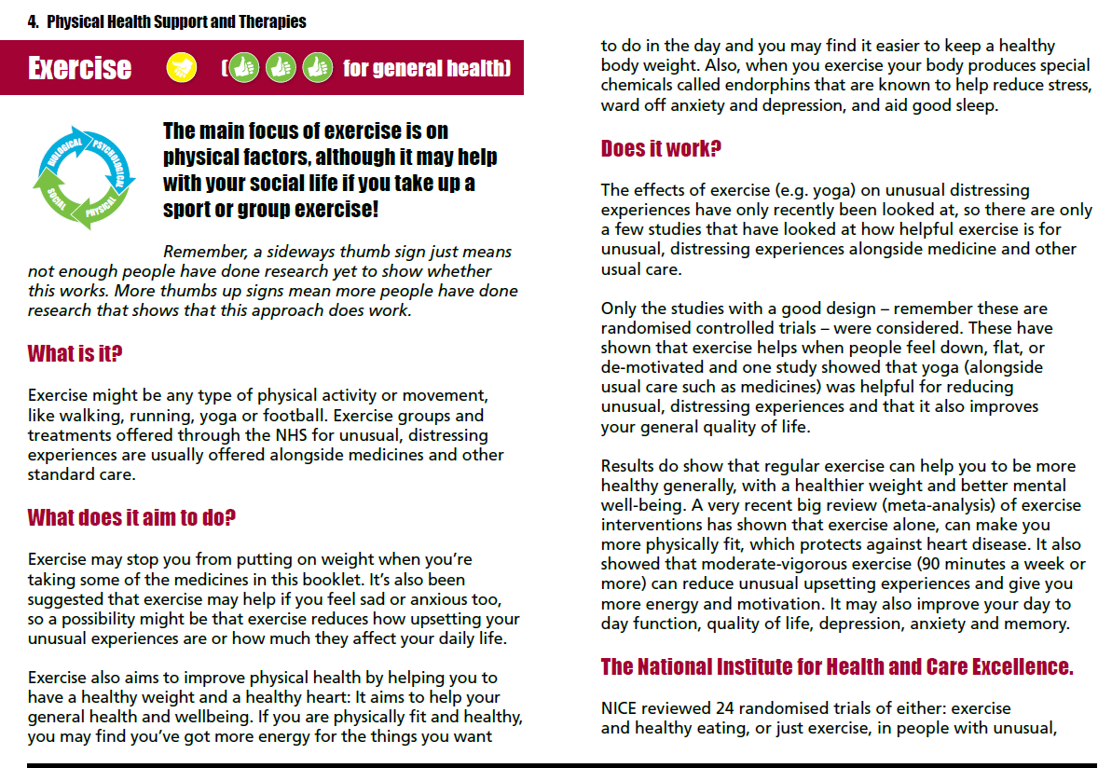

Slide 37
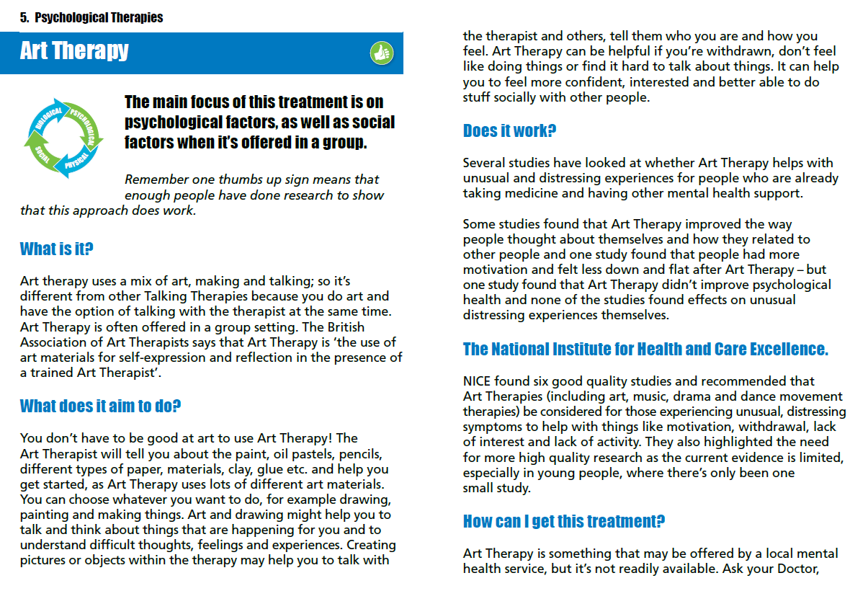

Slide 38
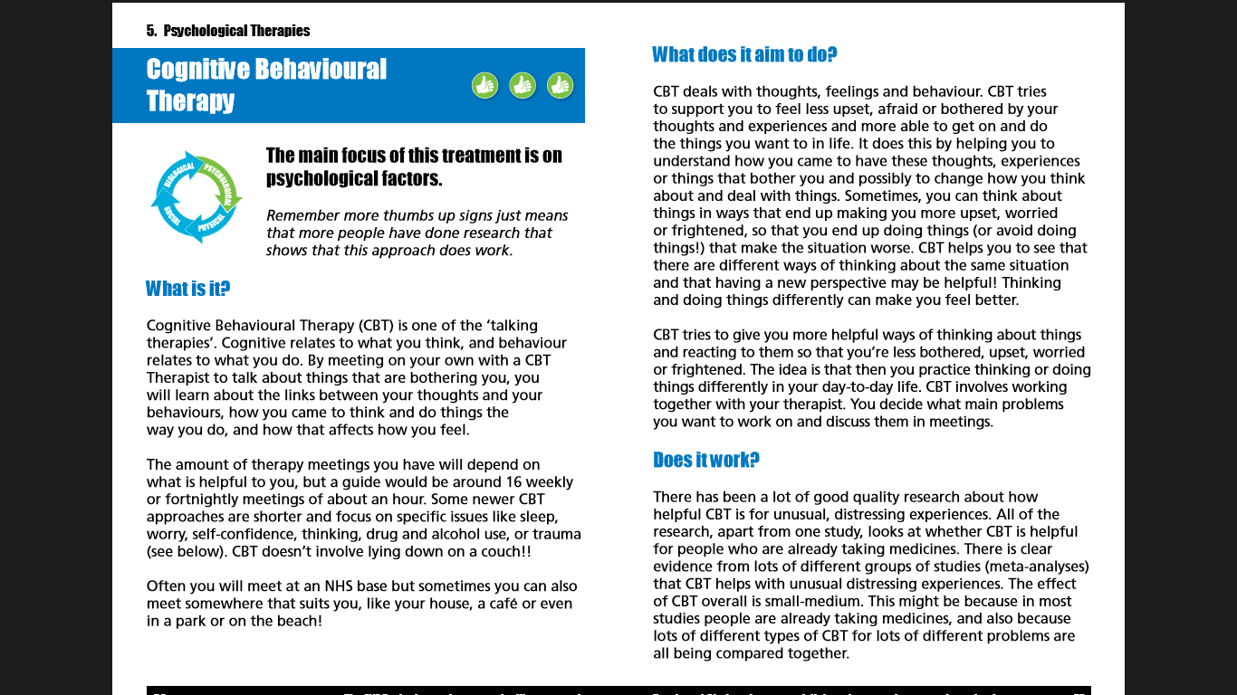

Slide 39
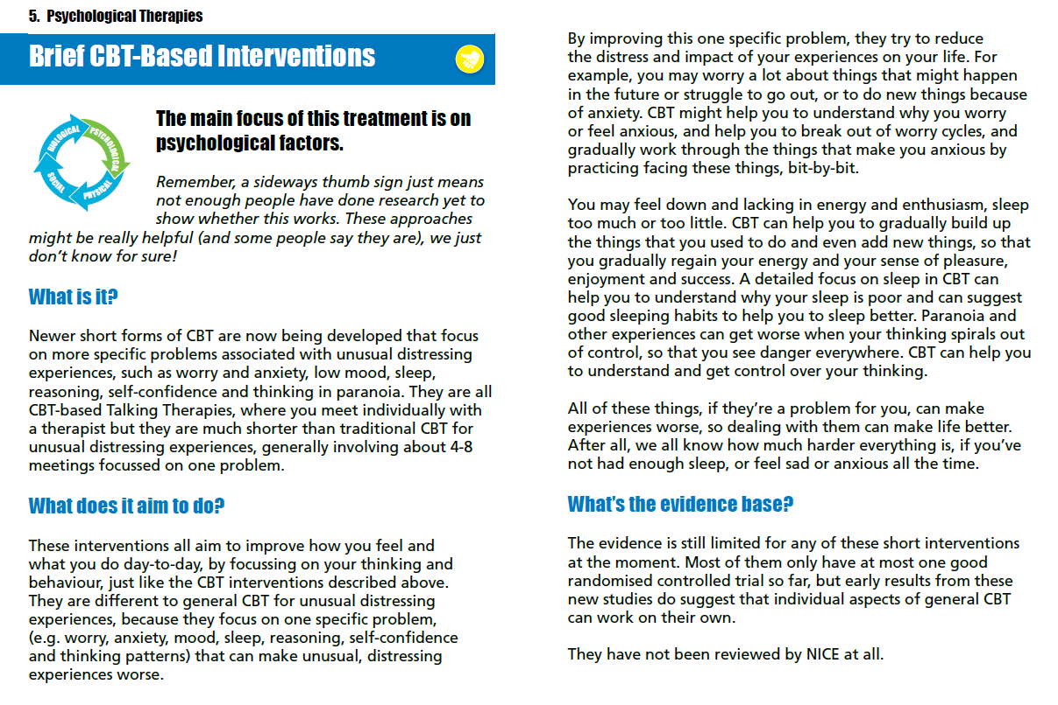

Slide 40
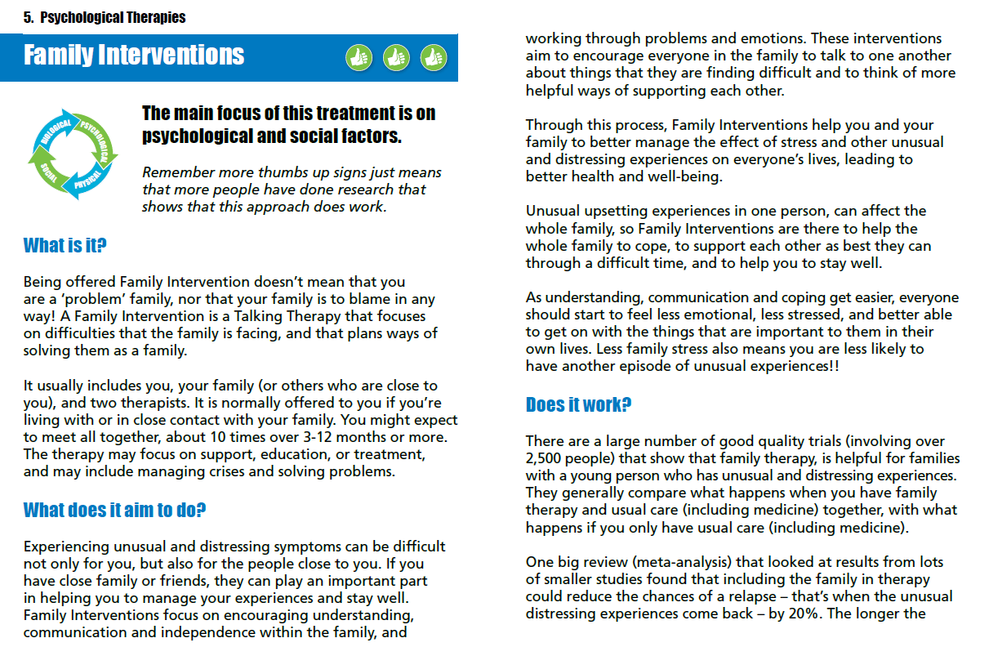

Slide 41
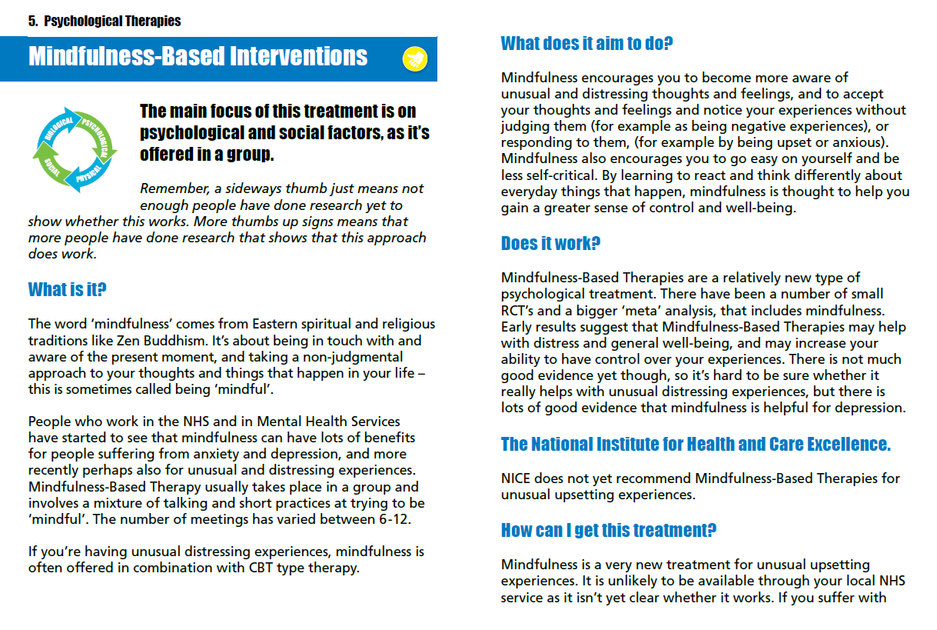

Slide 42
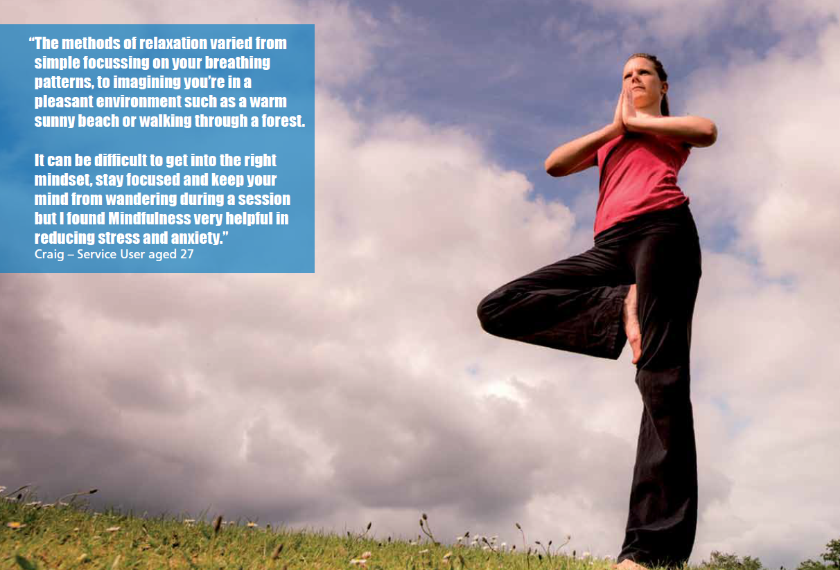

Slide 43
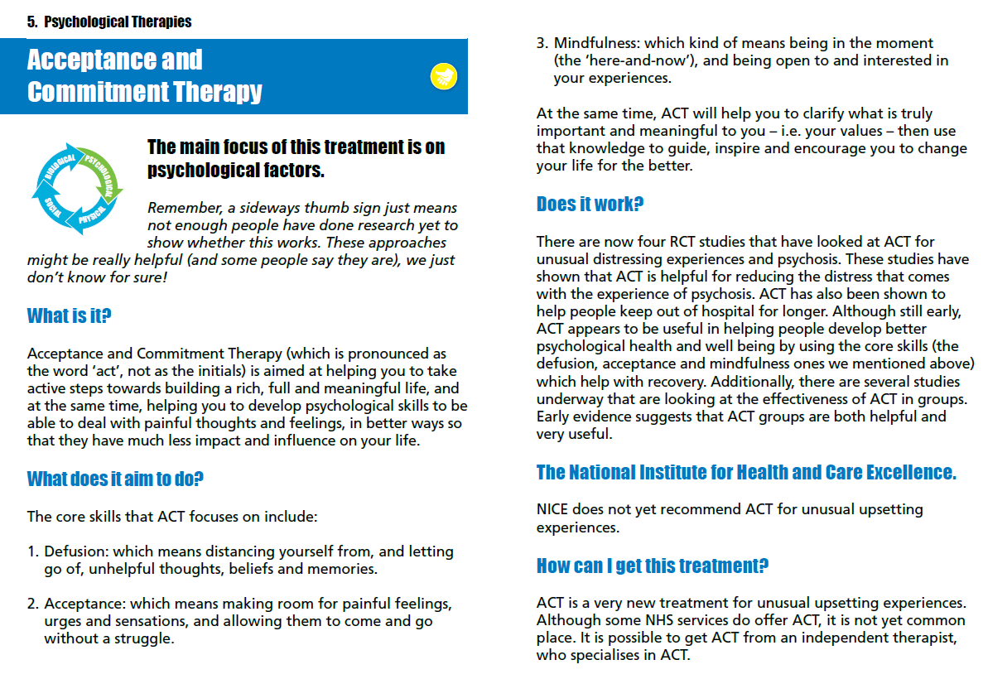

Slide 44
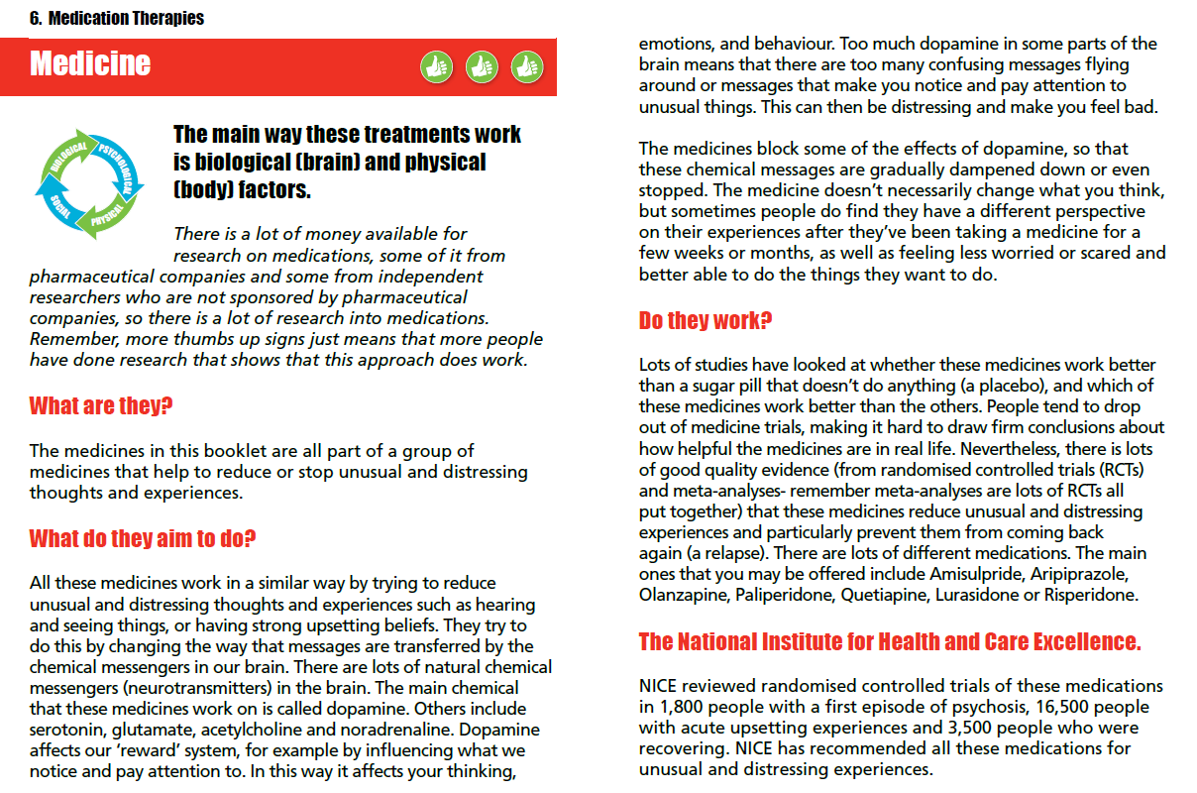

Slide 45
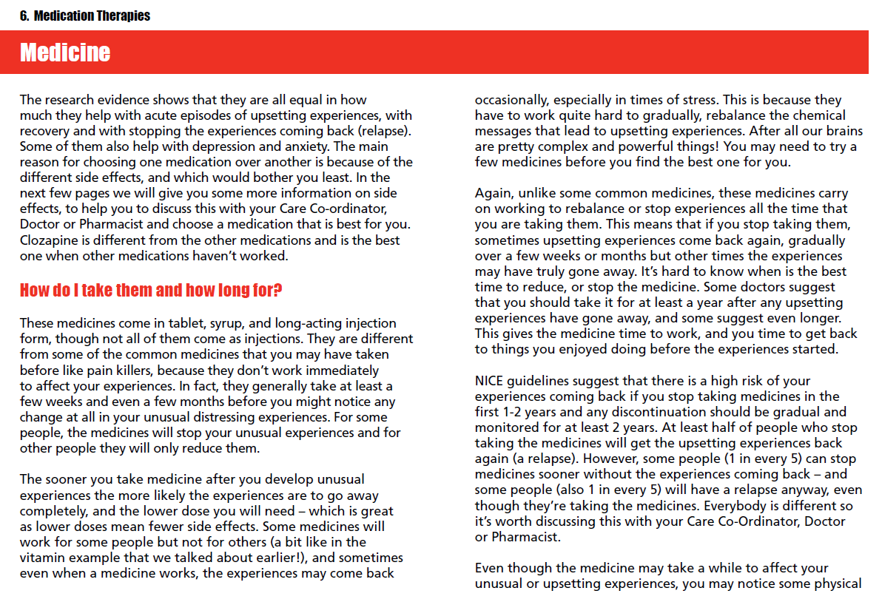

Slide 46
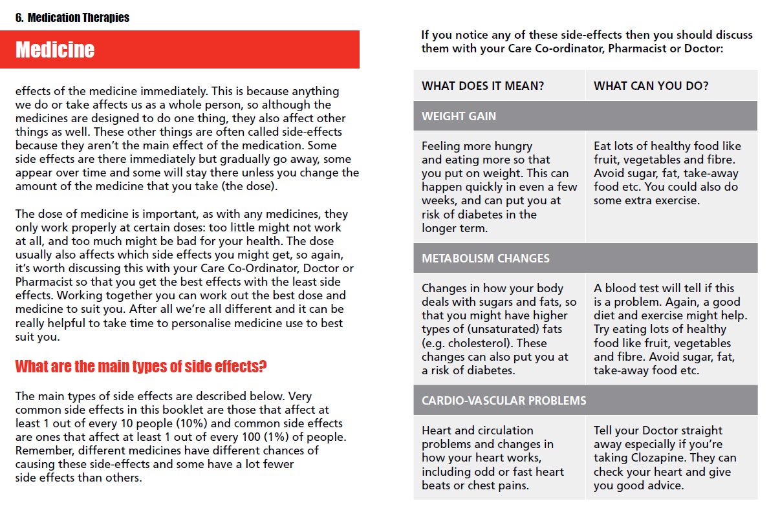

Slide 47
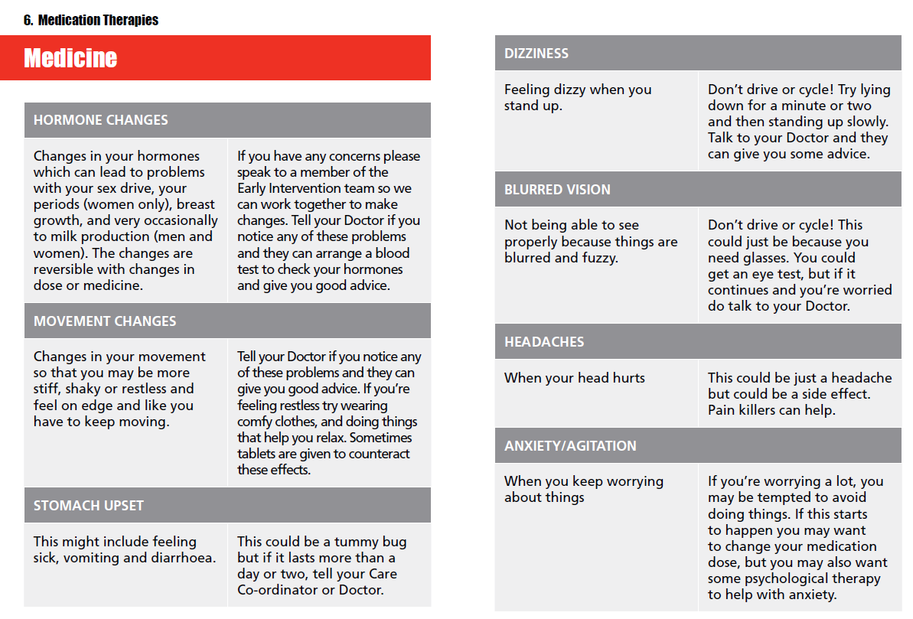

Slide 48
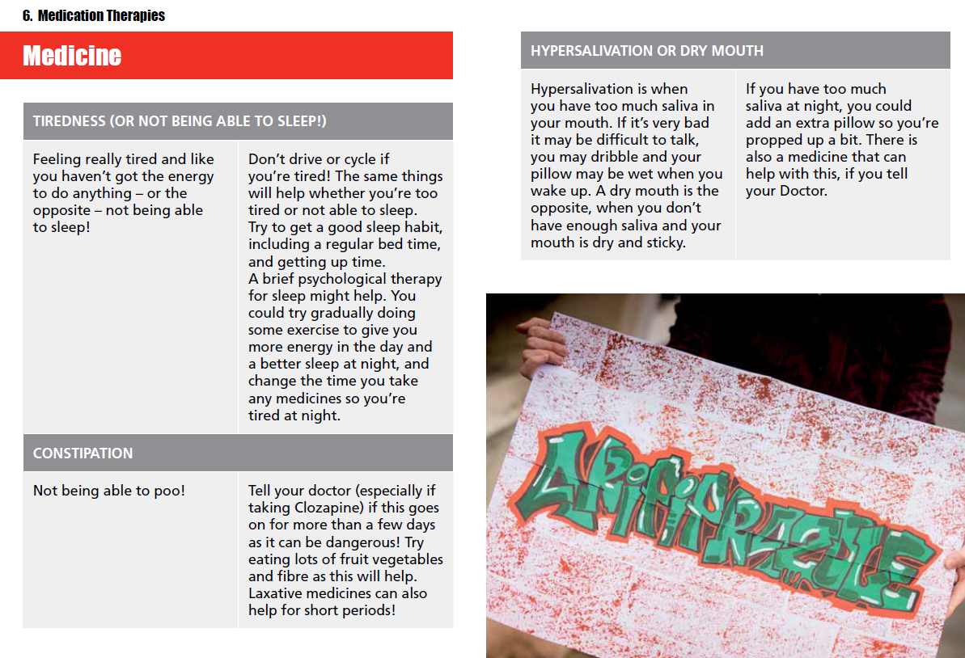

Slide 49
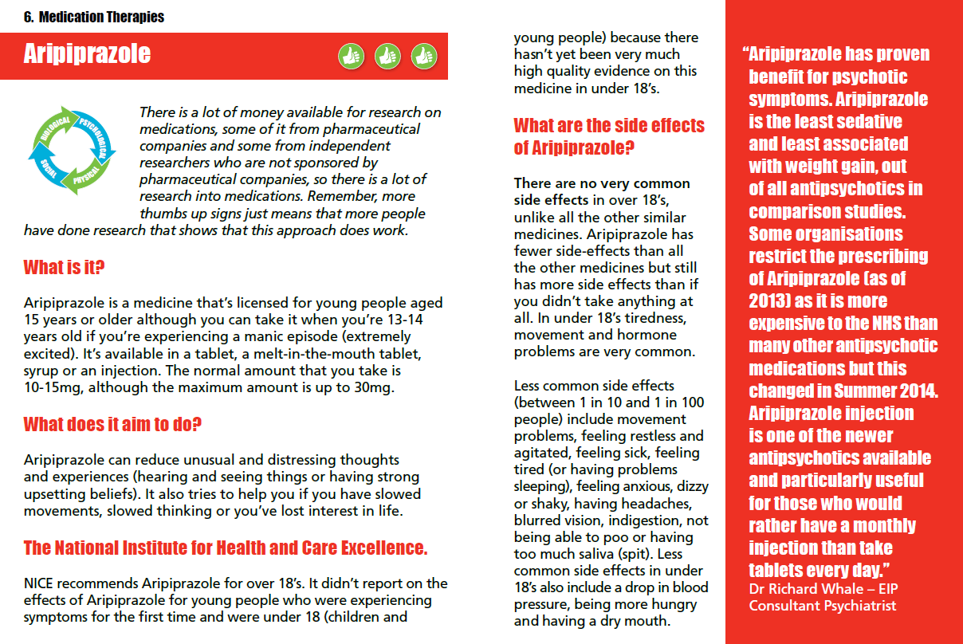

Slide 50
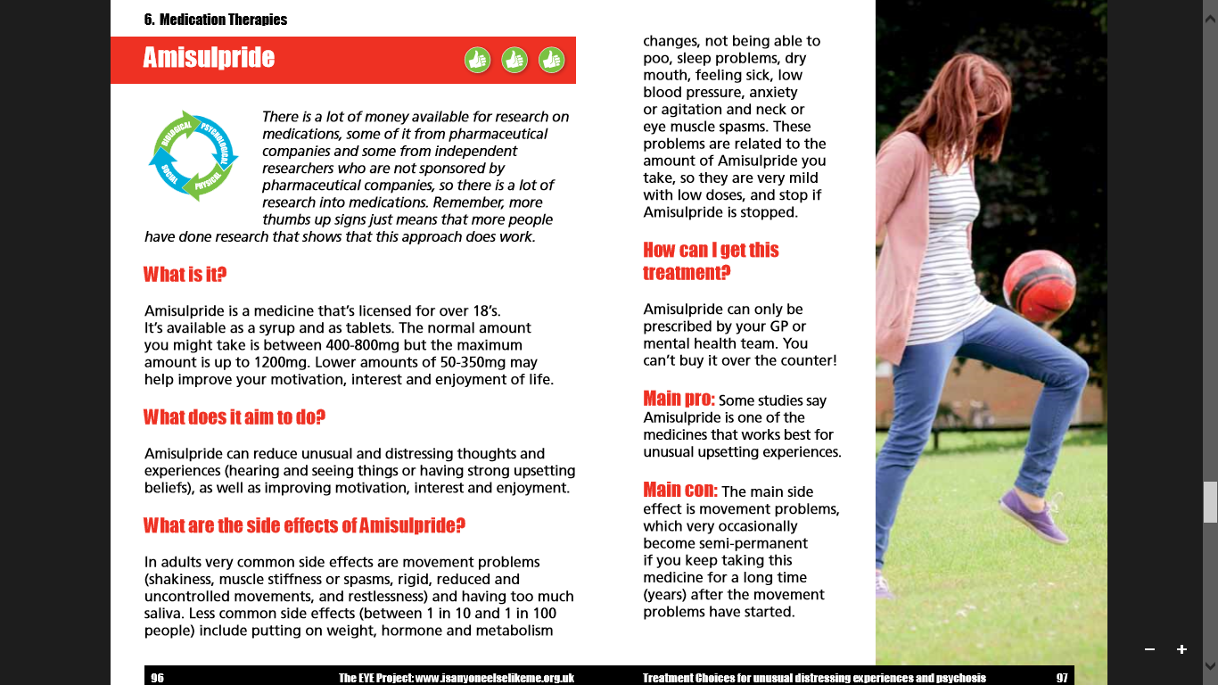

Slide 51
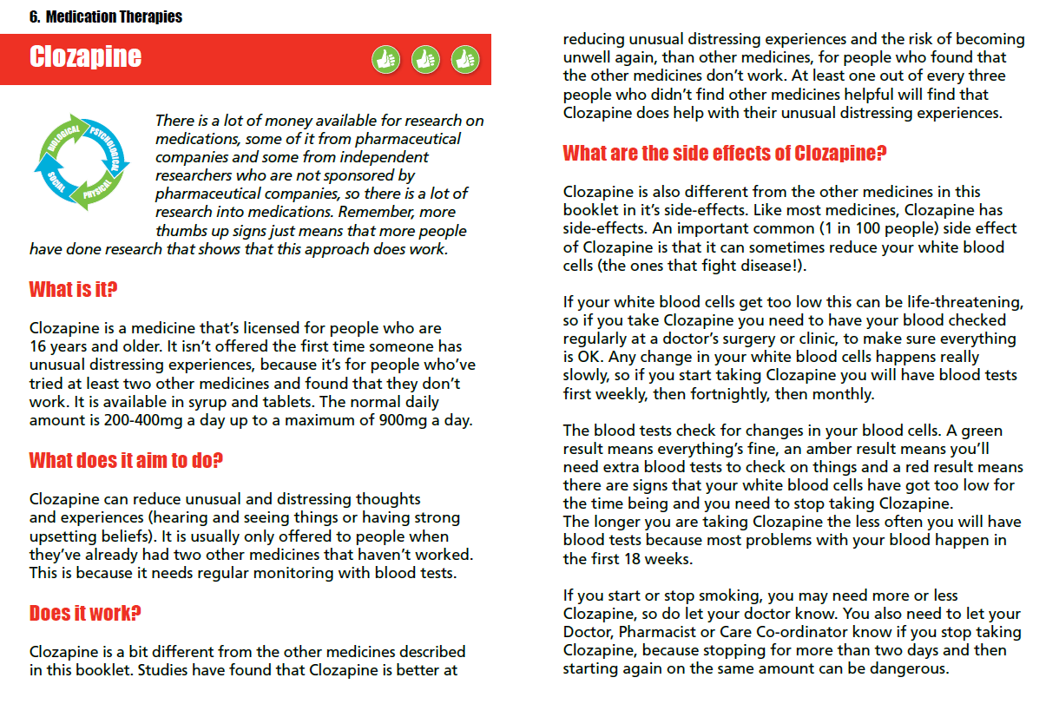

Slide 52
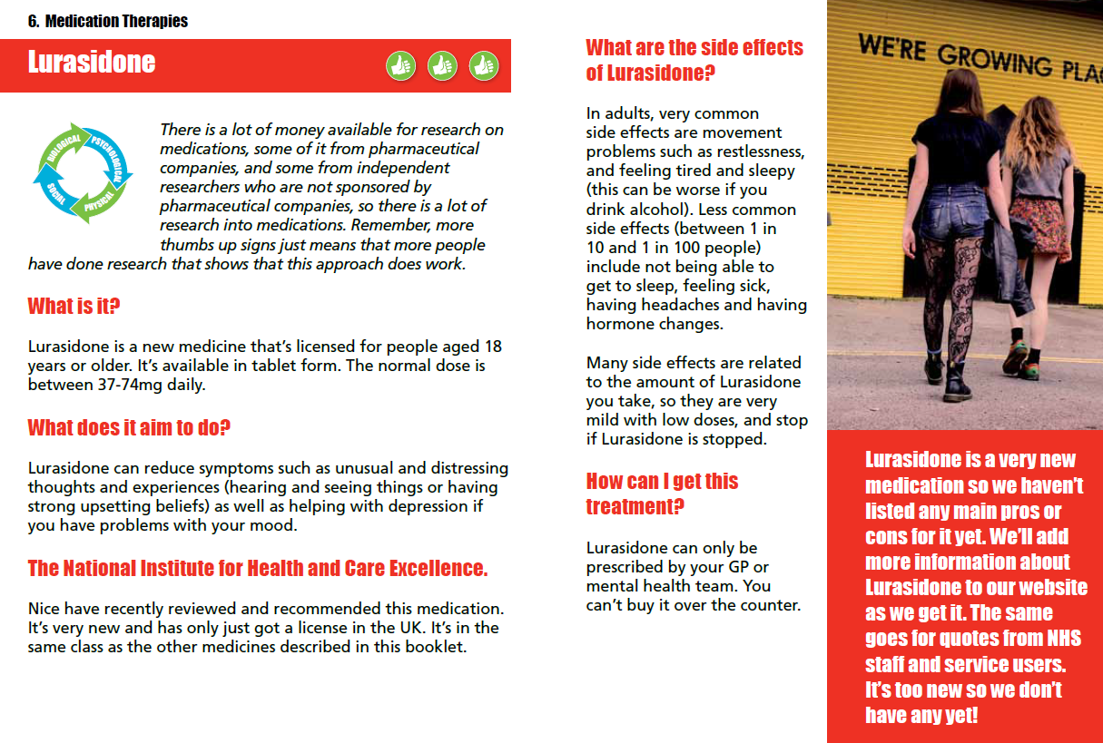

Slide 53
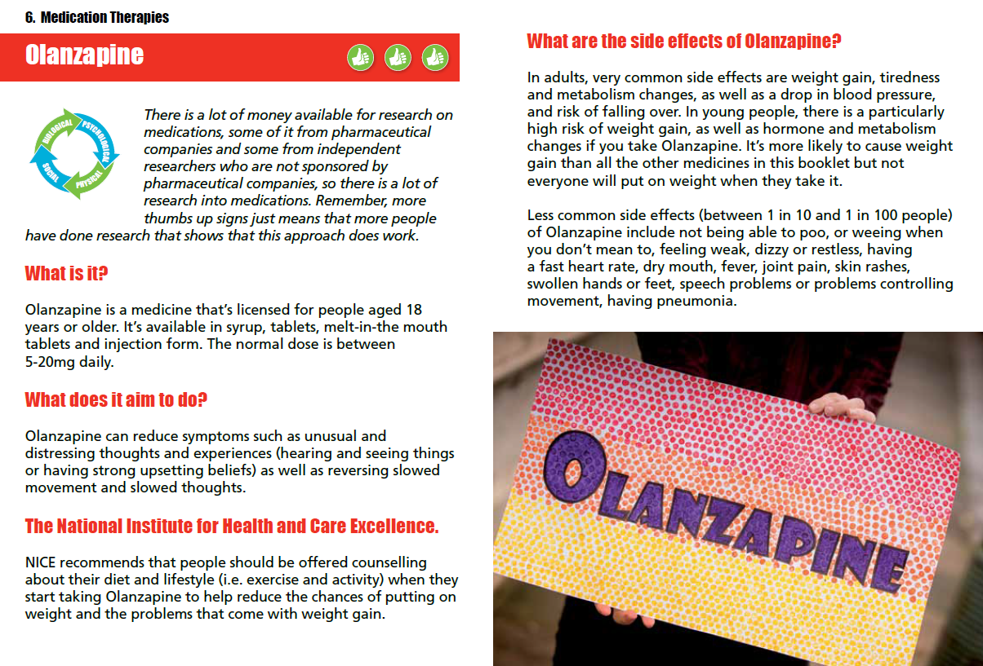

Slide 54
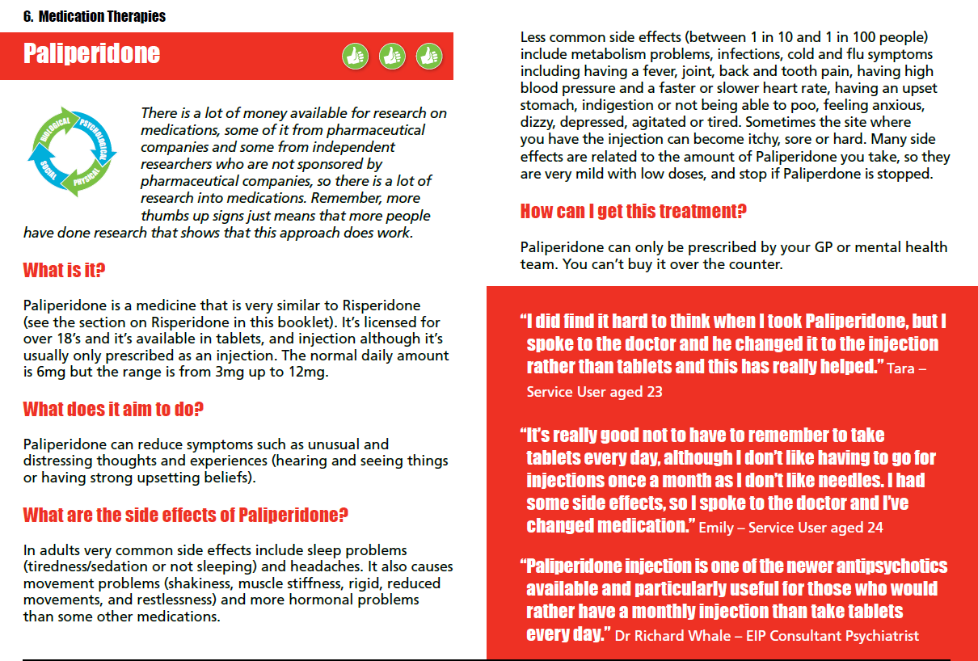

Slide 55
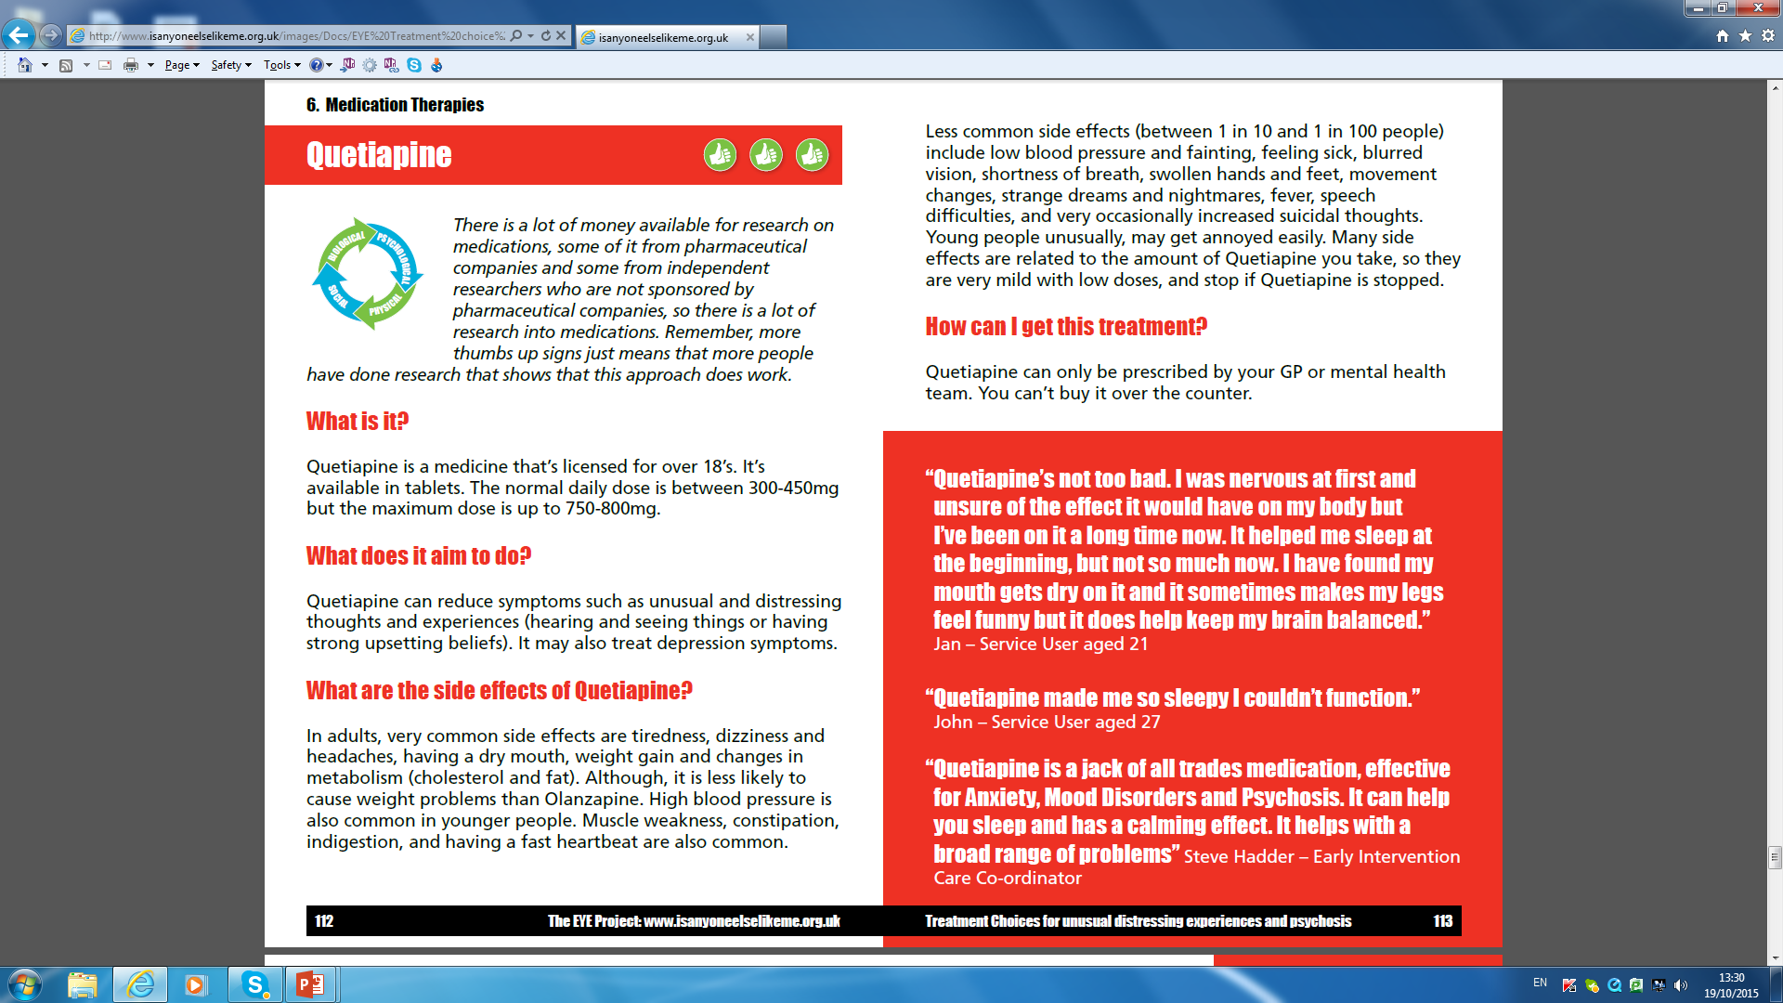

Slide 56


Slide 58
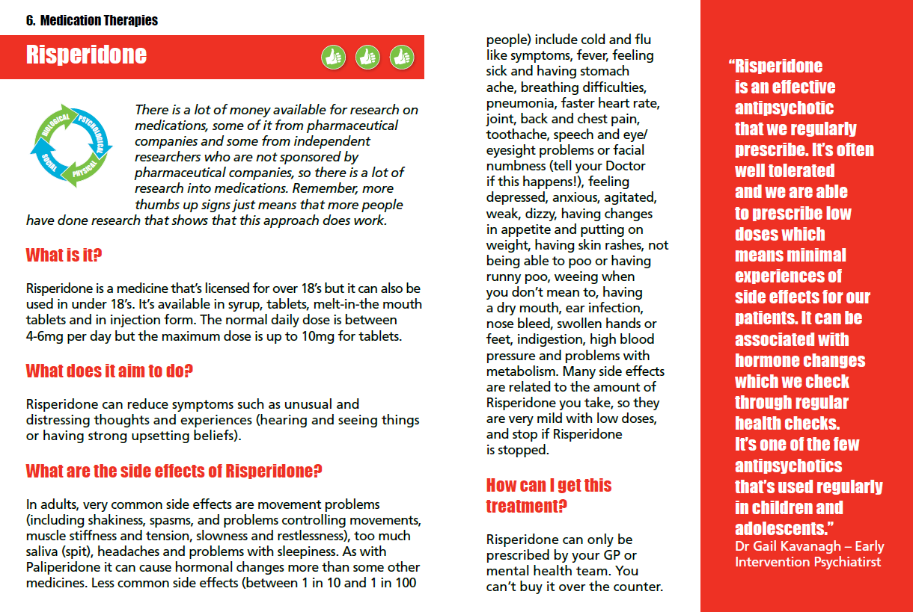

Slide 59
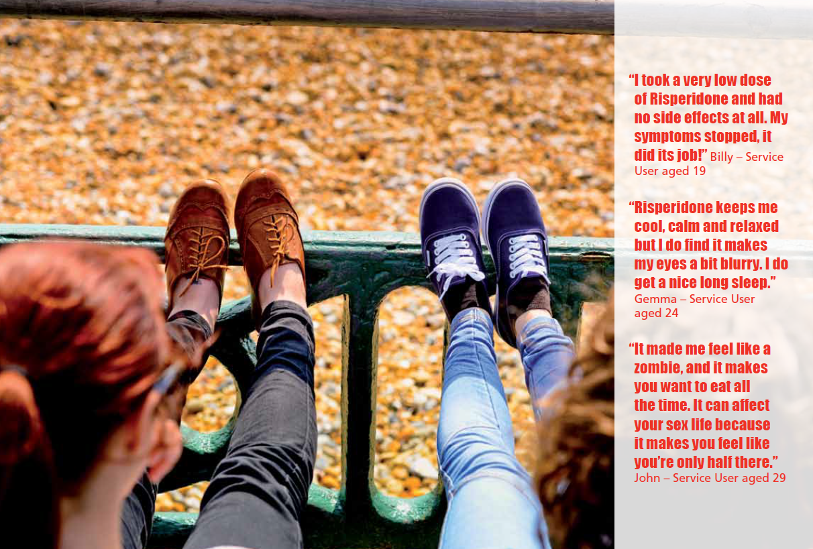

Slide 60
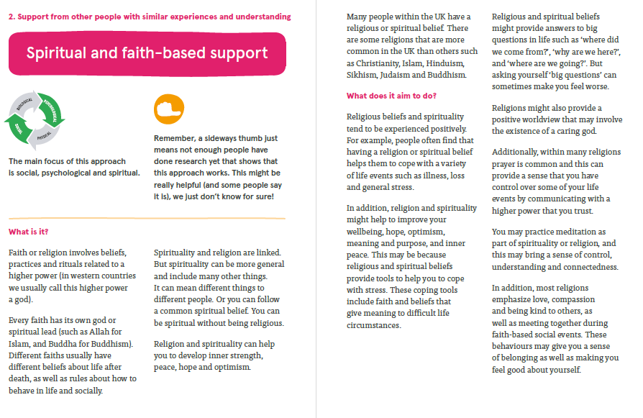

Slide 61
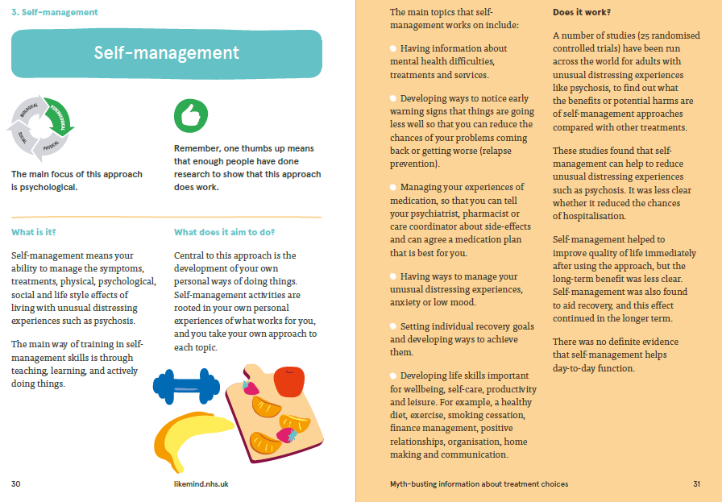

Slide 62
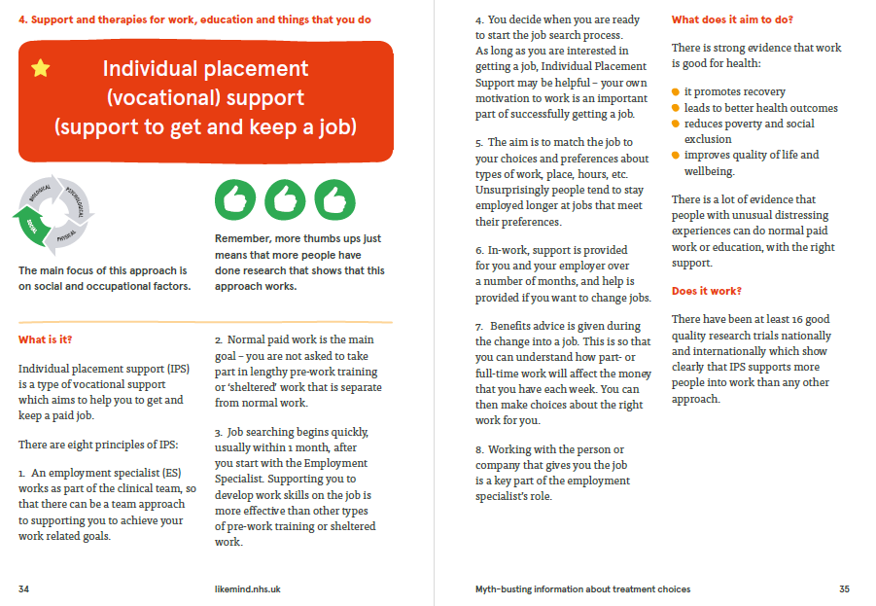

Slide 63
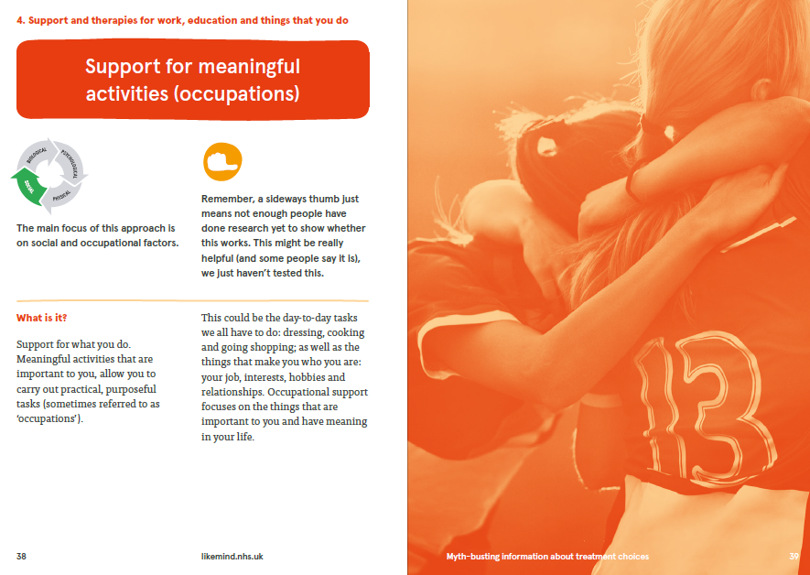

Slide 64
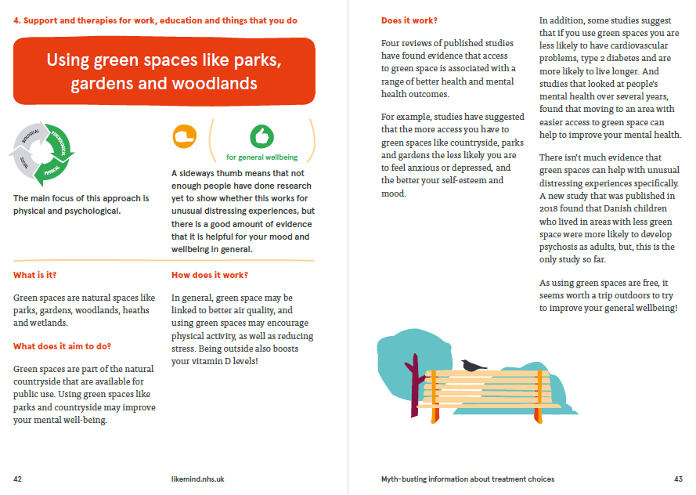

Slide 65


Slide 66
Research Team
Chief Investigator Prof Kathryn Greenwood Co-applicants Prof Philiipa Garety Dr Emmanuelle Peters Dr Sunil Nandha Prof Paul French Dr Heather Law Dr Shanaya Rathod/ Dr Peter Phiri Prof Belinda Lennox Dr Louise Johns Dr Jo Hodgekins Dr Michelle Painter Dr Richard Hooper Dr Stephen Bremner Dr Richard de Visser Prof Andy Healey | Prof David Fowler Dr Rose Thompson Prof Carl May Dan Charlton Dr Stuart Clarke Anastacia O’Donnell Dr Rebecca Jarvis Dr Francis Irwin CTU Debbie Lambert Chris Jones Chloe Bruce PPI team Chris, Gary, Rachel, Gill, Carolyn, Dolly, Emily, | Trial Co-ordinators Dr Jenny Gu Dr Iga Abraowicz Dr Rebecca Webb Research Assistants Vicci Smallman Karmen Au-Yeung Olivia Collier Sophie Moore Danielle Wilson Sibella Riccio Laura Blackett Megan Williams Michelle Griffin-Doyle Millie Scarlet
 | ,

Slide 67

















Notes:
67

