Slide 1

Trading places
Understanding psychosis risk among migrants & their descendants
James B. Kirkbride
Reader in Epidemiology
Division of Psychiatry, UCL
Notes:
Thanks very much for inviting me to come and speak to you at the Centre for Academic Mental Health. I know there is a lot of fantastic research conducted here, and I hope you will find this talk of interest. The topic of my talk today is on migration and psychosis risk. I’m going to show you how this is one of the pre-eminent public health tragedies of our time.
In this talk I’ll present an overview of existing and new data – from epidemiology and beyond – which begins to put a handle on the drivers of increased psychosis risk for people who decide to trade places. I’ll show that this risk is related not only to the process of migration, but the places we leave behind and the places that we move to.

Slide 2
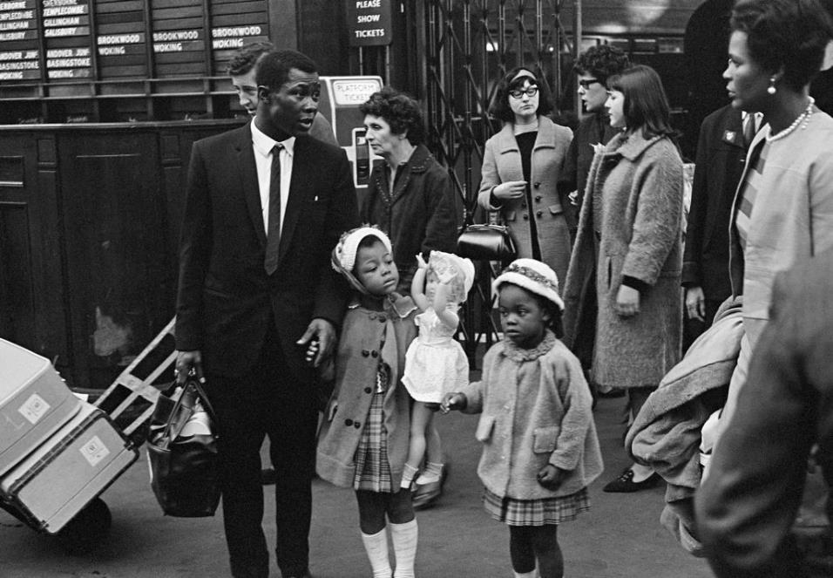
George Rodger / Magnum
Notes:
Arguably, migrants present one of the most vulnerable groups in society. Migration – and the process of beginning a new life in a new country - is one of the largest psychological challenges that humans can undertake. This migrant journey can be made willingly, or by force; alone or with family or friends. In either case, it can produce stresses and strains which may themselves have – for some – long-lasting effects on mental health. How modern, developed countries respond to immigrant populations, in providing supportive environments – which enrich both migrant and host populations alike – should be seen as both a public mental health priority and a source of national pride.
At the outset of this talk there are probably four things you know about the role of migration in psychotic disorders
Afro-Caribbean immigrants arrive at Waterloo station

Slide 3

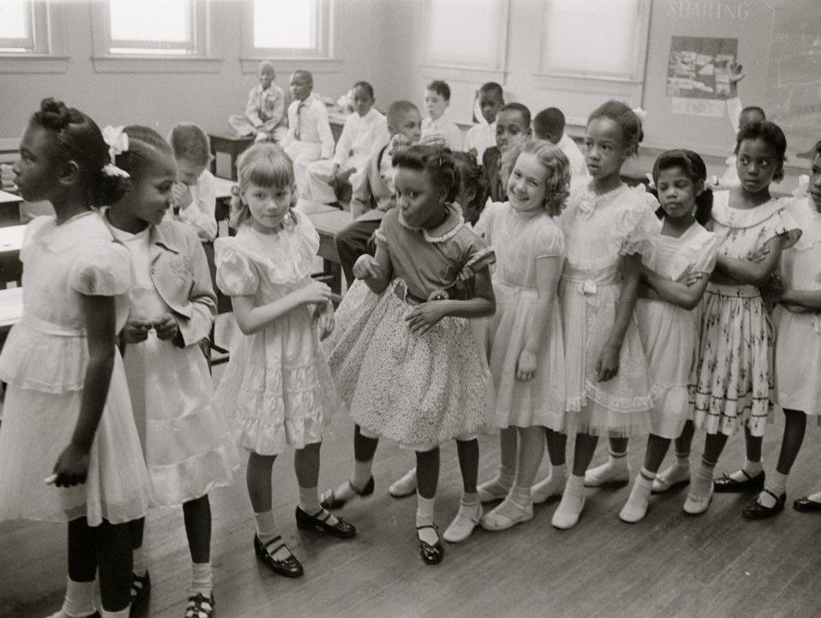

Higher risk of psychotic disorders amongst migrants
Higher extends to descendants of migrants
Causes remain largely unknown
Public mental health tragedy of our times

Slide 4
Proposed hypotheses
Background
Current research
Beyond psychiatric epidemiology
Prevention

Slide 5
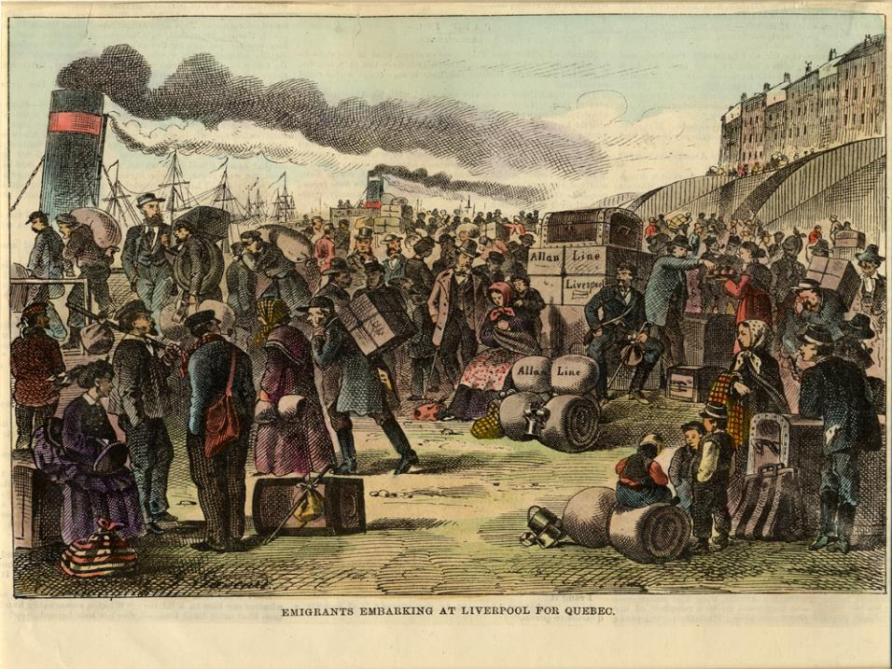
Notes:
Start of our journey into the role migration plays in psychosis risk really begins with the industrial revolution, and in particular the advent of the steam engine. For the first time, this really permitted quick, mass migration. And although not cheap, migration offered the promise of escape from unemployment, famine or war to new lands with opportunities for great prosperity.
Emigrant leaving Liverpool for Québec City aboard an Allan Line vessel, Circa 1873

Slide 6

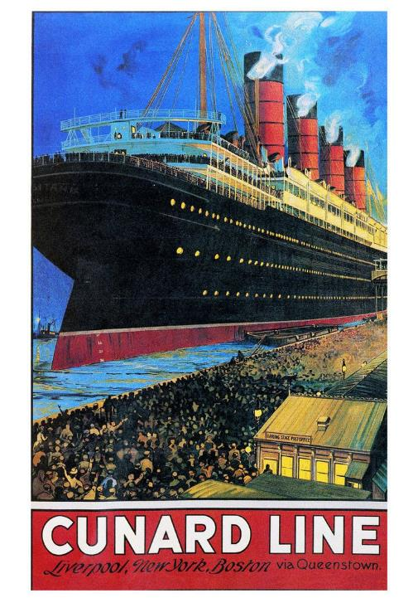

Slide 7
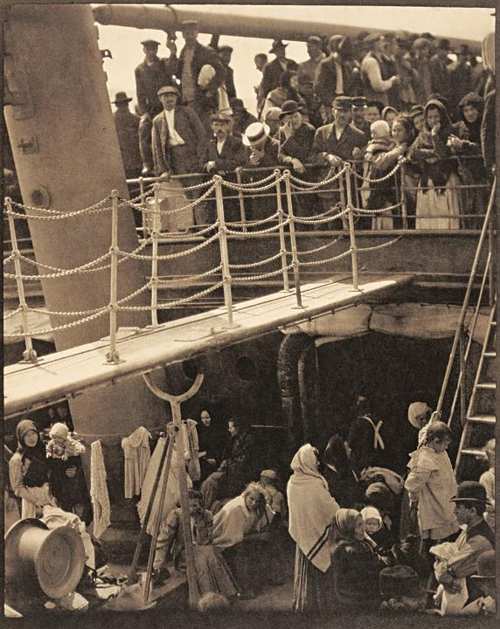
Alfred Stieglitz

Slide 8
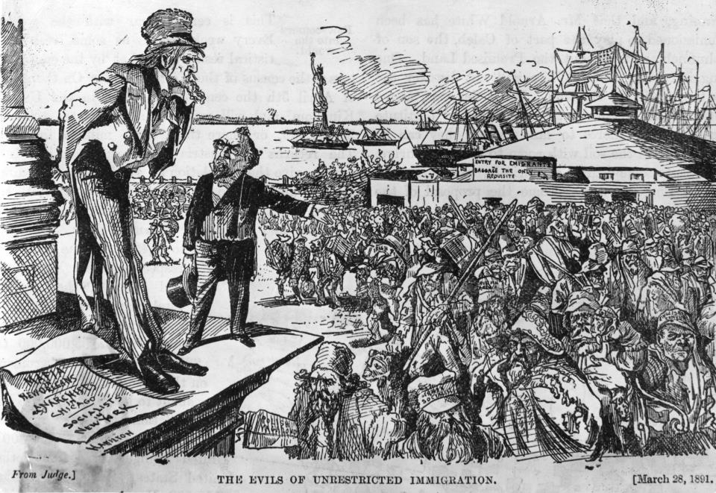

Slide 9
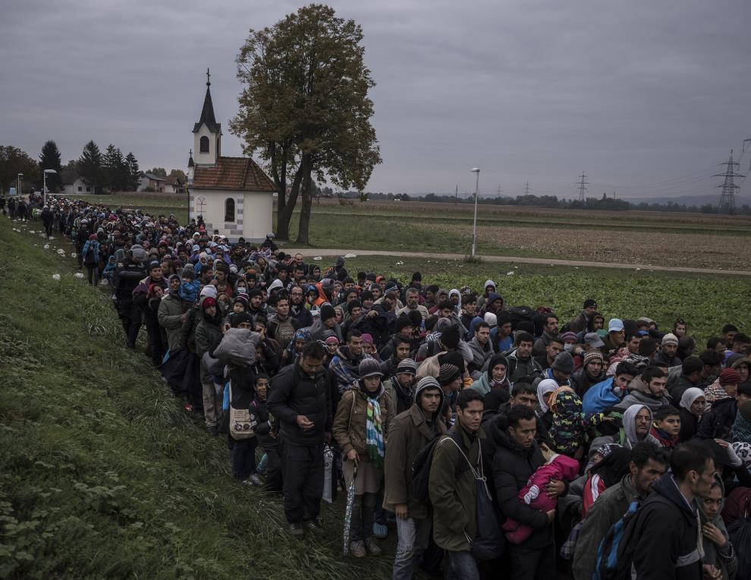
Sergey Ponomarev for The New York Times
Notes:
Oct. 22, 2015. Migrants walking past a church, escorted by Slovenian riot police to a registration camp outside Dobova, Slovenia. The small Balkan nations along the path of the human migration through Europe have seen record numbers of refugees cross their borders, and have been overwhelmed in their ability to manage the human flow.
https://www.nytimes.com/slideshow/2016/04/18/blogs/photography-pulitzer-for-coverage-of-refugee-crisis/s/18-lens-refugees-slide-LQTA.html

Slide 10

Sergey Ponomarev for The New York Times
Notes:
Nov. 16, 2015. Migrants arrive by a Turkish boat near the village of Skala, on the Greek island of Lesbos. The Turkish boat owner delivered about 150 people to the Greek coast and tried to escape back to Turkey; he was arrested in Turkish waters.
https://www.nytimes.com/slideshow/2016/04/18/blogs/photography-pulitzer-for-coverage-of-refugee-crisis/s/18-lens-refugees-slide-8AS8.html

Slide 11
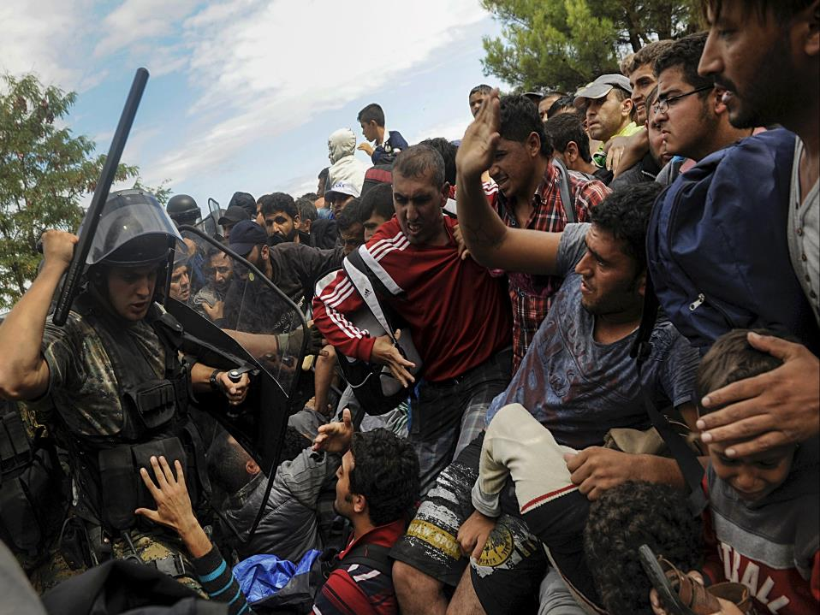
Alexandros Avramidis/Reuters
Notes:
A Macedonian police officer raised his baton toward migrants to stop them from entering into Macedonia near Idomeni, Greece. Aug. 22, 2015.
https://www.nytimes.com/slideshow/2016/04/18/blogs/photography-pulitzer-coverage-of-the-migrant-crisis/s/18-lens-reuters-pulitz-slide-99H7.html

Slide 12
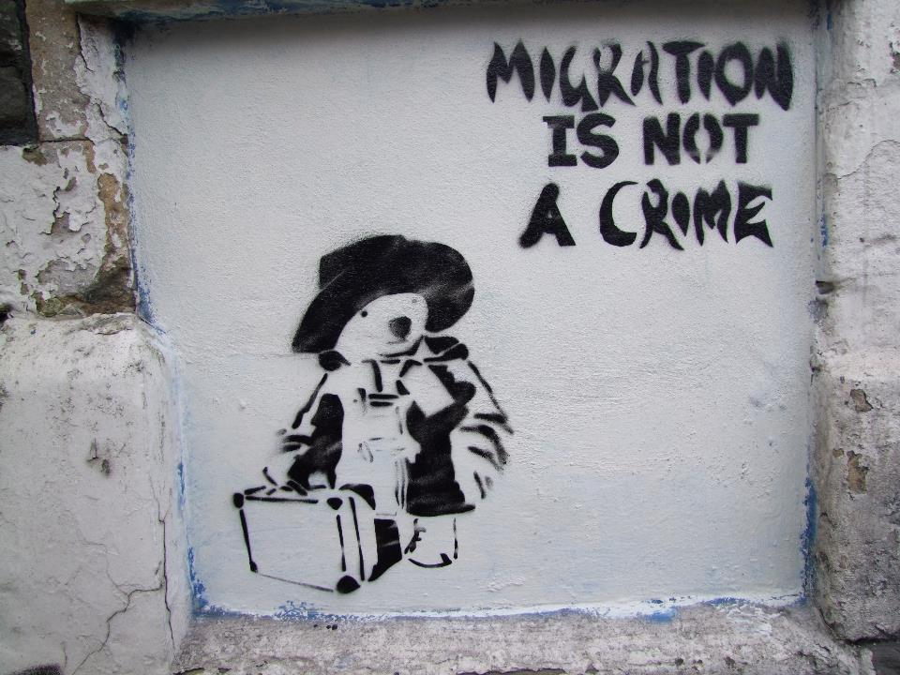

Slide 13





Slide 14

Background
Hypotheses
Research
Beyond Epi
Prevention
Bryan Charnley
Notes:
Bryan Charnley, 1949-1991

Slide 15
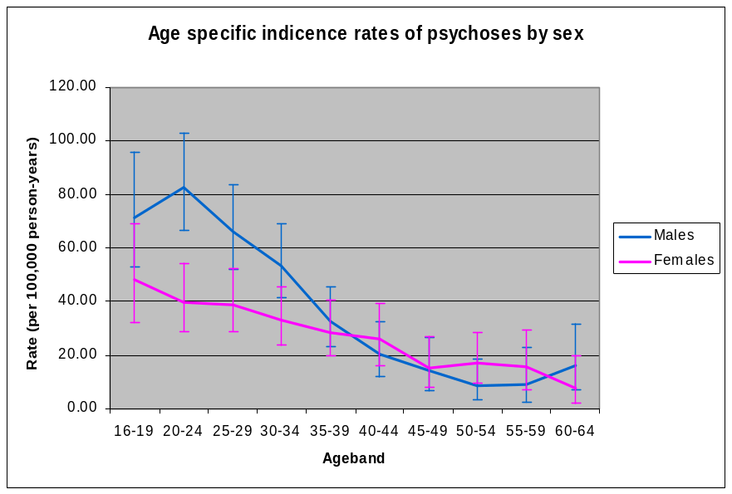
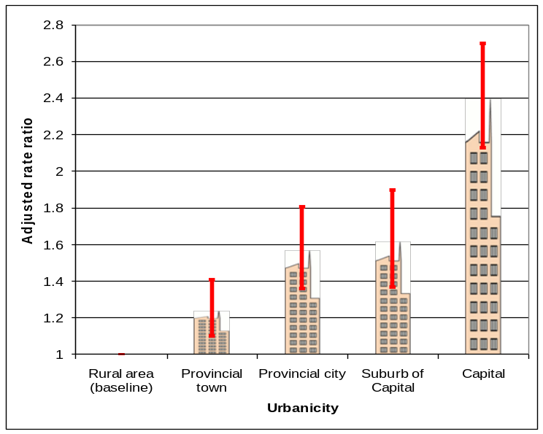
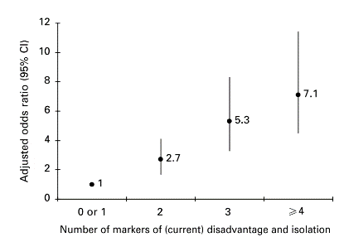
Background
Hypotheses
Research
Beyond Epi
Prevention
Kirkbride et al, Arch Gen Psych, 2006
Mortensen et al, NEJM, 1999
Morgan et al, Psychol Med, 2008
Notes:
I now want to introduce you to an important feature of the epidemiology of psychotic disorders, heterogeneity
Lifetime prevalence of schizophrenia quoted at 1%
Challenge you to find an empirical reference to the 1%
In Saha et al 10-90th percentile 0.18-1.6%
Settling on a median of 0.4% (29 studies)
Prevalence of all psychotic disorders even higher

Slide 16

Background
Hypotheses
Research
Beyond Epi
Prevention
Alex Colville / National Gallery of Canada

Slide 17


Background
Hypotheses
Research
Beyond Epi
Prevention
Cantor-Graae & Selten, Am J Psych, 2005
Bourque et al., Psychol Med, 2011
Notes:
Rate in migrants overall cf general population

Slide 18
Background
Hypotheses
Research
Beyond Epi
Prevention
Kirkbride et al., PLoS One, 2012
Notes:
Rate in black Caribbean and African groups compared with the general population.

Slide 19

Background
Hypotheses
Research
Beyond Epi
Prevention
Notes:
So, where did it all begin? Well, this stamp tells a clue.
Norwegian migration to the USA in the 1850s-1920s was high. Particularly due to economic problems, crop failure.
1/3 of the Norwegian population migrated to the USA during this time.
In 2009, 16.5% of the Minnesotan population claimed Norwegian heritage

Slide 20
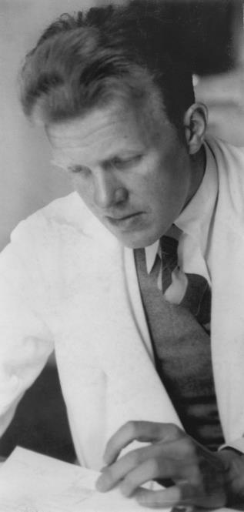
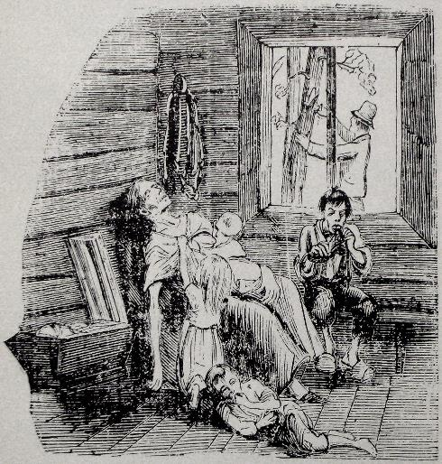
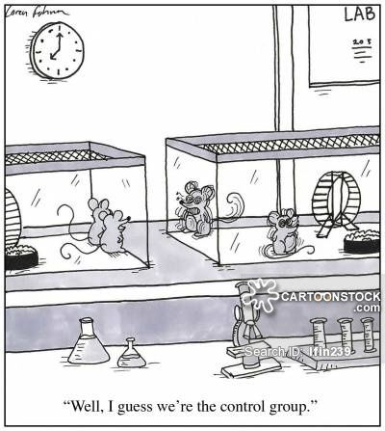
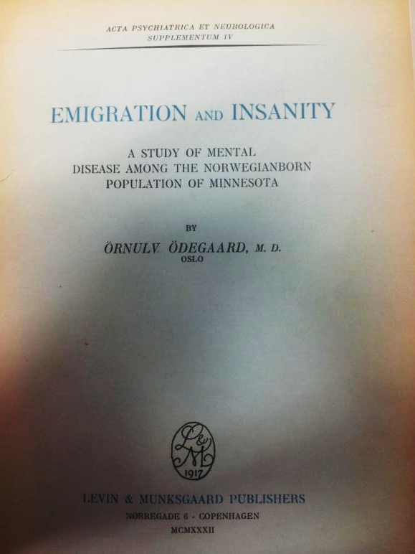
Background
Hypotheses
Research
Beyond Epi
Prevention
Ørnulv Ødegaard, Norwegian psychiatrist, 1901-1983
Published doctoral thesis
Ground-breaking psychiatric epidemiology at the time for use of control groups
Higher rates in Norwegian migrants than US or Norwegian controls
Social disadvantage prior to migration – or selection – explained excess
Notes:
Wrote doctoral thesis while in Minnesota
Despite groundbreaking epidemiology he has been criticised for other areas of clinical practice, including conducting the first lobotomy in Norway in 1941, and continuing the practice although his trials showed poor results.

Slide 21
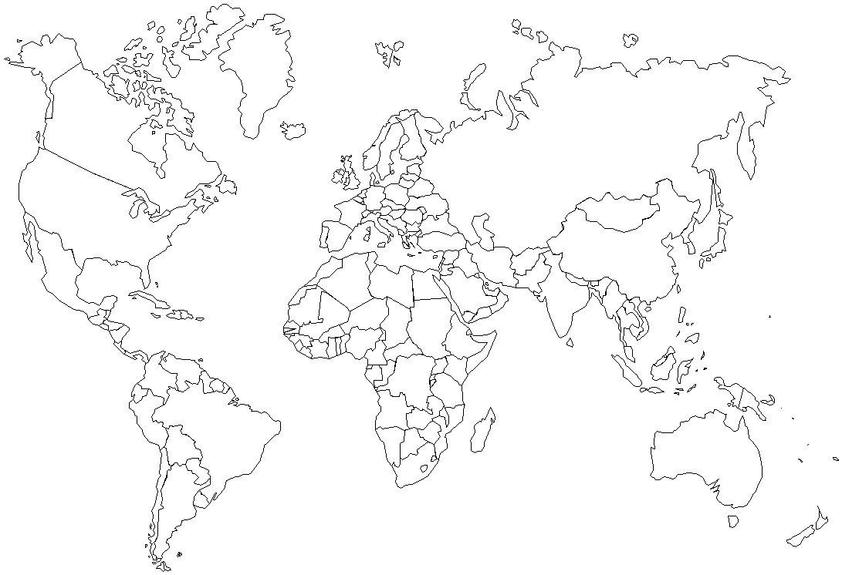
Norwegians to the USA (Odegaard, 1932)

Slide 22
Foreign-born groups to New York (Malzberg, 1964)

Slide 23
African-Americans in USA (Bresnahan et al, 2007)

Slide 24
British & Continental Europeans to Canada (Smith et al, 2006)

Slide 25
Caribbean migrants & offspring to UK (Hemsi, 1967; Harrison et al, 1988; van Os et al, 1996; Fearon et al, 2006, Kirkbride et al, 2008b, 2017)

Slide 26
Black African migrants & offspring to UK (King et al, 1994; van Os et al, 1996; Fearon et al, 2006, Kirkbride et al, 2008b, 2017)

Slide 27
Pakistani & Bangladeshi migrants & offspring to UK (King et al, 1994; Kirkbride et al, 2008b, 2017 Coid et al, 2008)

Slide 28
Surinamese, Dutch Antillean, Moroccan & Turkish migrants to the Netherlands (Selten et al, 1994, 1999, 2001; Veling et al, 2006)

Slide 29
Migrants and their offspring to Israel, Italy, France, Denmark and Sweden (Weiser et al, 2008; Zolkowska et al, 2001, Cantor-Graae et al, 2003, Tarricone et al, 2012, Tortelli et al, 2014, Mule et al, 2017)

Slide 31
McGrath et al. 2001

Slide 32
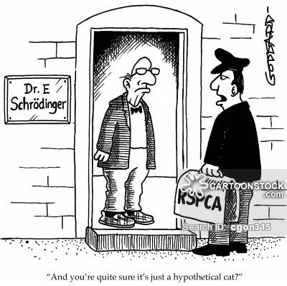
Background
Hypotheses
Research
Beyond Epi
Prevention

Slide 33


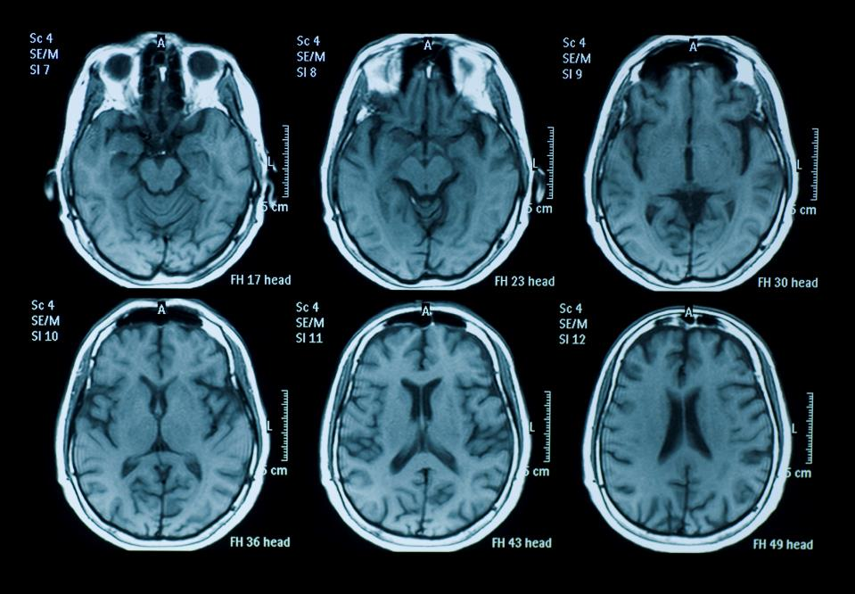


Background
Hypotheses
Research
Beyond Epi
Prevention
1. Selective migration
2. Demographic differences
3. Higher rates in countries of origin
4. Misdiagnosis
5. Social stressors

Slide 34
Background
Hypotheses
Research
Beyond Epi
Prevention
1. Selective migration

Slide 35
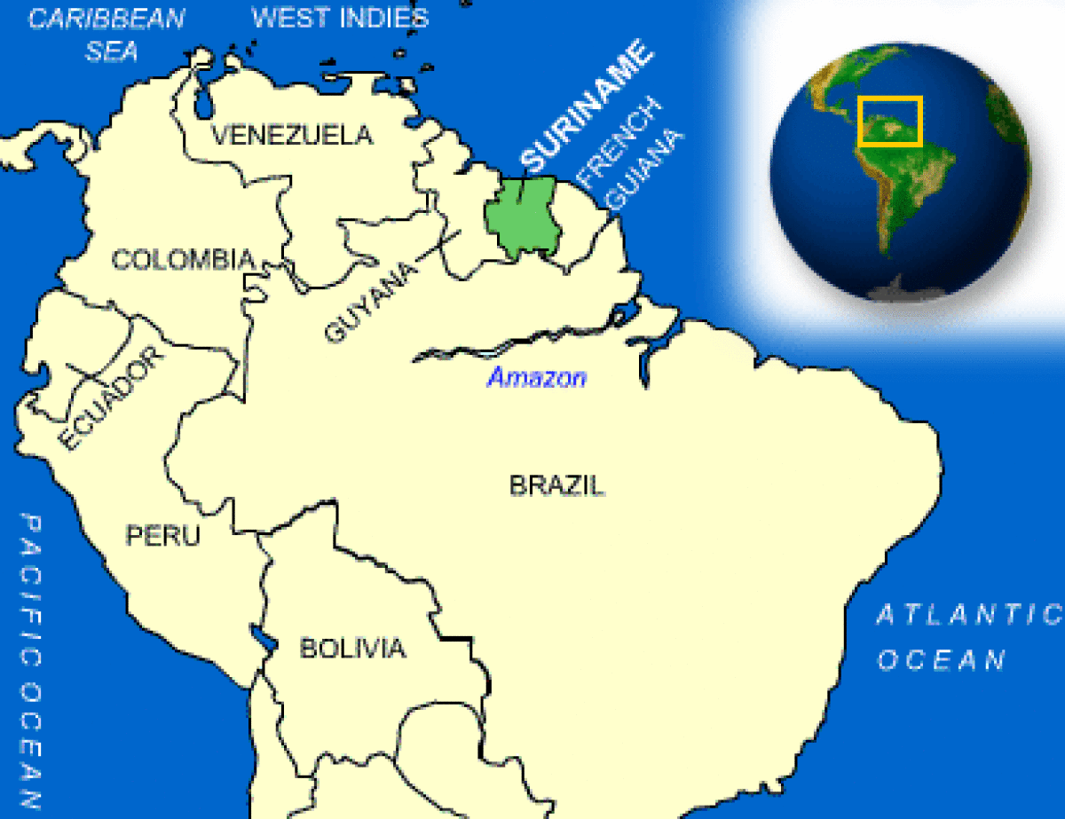

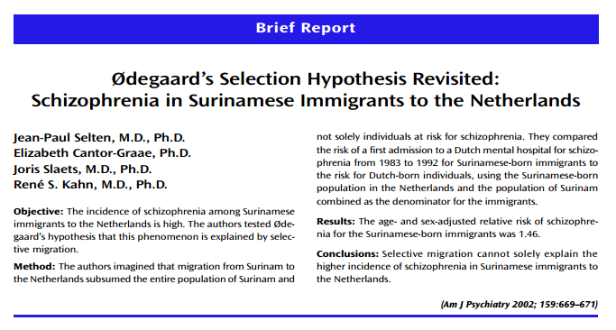
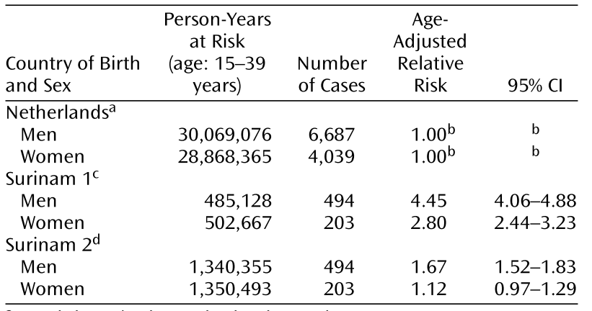
Background
Hypotheses
Research
Beyond Epi
Prevention
1. Selective migration
Selten et al, Am J Psych, 2002
Notes:
Returning to psychosis, perhaps strongest evidence against selection comes from clever thought experiments

Slide 36
Background
Hypotheses
Research
Beyond Epi
Prevention
1. Selective migration
2. Demographic differences

Slide 37

Background
Hypotheses
Research
Beyond Epi
Prevention
2. Demographic differences
Richardson et al, Under review
Solmi et al, Under review
Kirkbride et al, Am J Psych, 2017
Kirkbride et al, Schiz Bull, 2017
Kirkbride et al, Soc Psych Psych Epi, 2017
Kirkbride et al, Act Psych Scand, 2015
Notes:
We have recently replicated this finding in a different population, using data from more rural East Anglia.
FEP data from a defined catchment over 3 years

Slide 38
Background
Hypotheses
Research
Beyond Epi
Prevention
2. Demographic differences
*
*
*
*
*
*
*
*
*
*
*
*
*
*
*p<0.05
Kirkbride et al, Schiz Bull, 2017
Notes:
We have recently replicated this finding in a different population, using data from more rural East Anglia.
FEP data from a defined catchment over 3 years

Slide 39
Background
Hypotheses
Research
Beyond Epi
Prevention
1. Selective migration
2. Demographic differences
3. Higher rates in countries of origin

Slide 40
Background
Hypotheses
Research
Beyond Epi
Prevention
3. Higher rates in countries of origin
Crude rate comparisons only
Only one study (Mahy et al) directly tested rates in Caribbean vs white & Caribbean rates in England
No comparative studies outside of Caribbean
New studies being established i.e. INTREPID
Morgan et al, Psych Med, 2016
Kirkbride et al, PLoS One, 2012
Mahy et al, Br J Psych, 1999
Hickling & Rodgers-Johnson, Br J Psych, 1995
Bhugra et al, Br J Psych, 1996
Notes:
Intrepid was set up in India, Nigeria and Trinidad.
Only pilot data currently available (Morgan et al 2016)
Tenatively suggests rates are 25-30 in Nigeria and Trinidad, but only 15 in India
Rates in Indian population in UK also appear to be lower (Kirkbride et al 2017 – SEPEA)

Slide 41
Background
Hypotheses
Research
Beyond Epi
Prevention
1. Selective migration
2. Demographic differences
3. Higher rates in countries of origin
4. Misdiagnosis

Slide 42

Background
Hypotheses
Research
Beyond Epi
Prevention
4. Misdiagnosis
Racist psychiatric practice
Culturally insensitive diagnostic tools
Conflated with structural injustices which generate inequalities in care & outcomes
  Coercive pathways to care
  Longer inpatient stays
  Over-representation on secure wards
  Less likely to receive 2nd generation antipsychotics
  Conducive to distrust of MH services
  “The topic has the potential to align mental disorder with ethnic/racial identity”
Morgan et al, Br J Psych, 2005a&b
Takei et al, Br J Psych,1998
Koffman et al, Br J Psych,1997
Mallinger et al, Psych Serv,2005
Kuno & Rothbard, Am J Psych, 2002
Nazroo & Iley, In “Migration & Mental Health”, 2008
Notes:
Higher rates of disorder may be explained by racist psychiatric practice, with psychiatrists more likely to diagnoses someone from a BME background with a FEP, due to stereotypes about behaviours, appearance etc…
Or due to culturally insensitive diagnostic tools – including ICD-10 & DSM-IV – which mean culturally appropriate behaviours in some ethnic groups may be more likely to be regarded as psychotic
Conducive – fear of dying in hospital or being over-medicalised in particular. These views of psychiatry, and research in psychiatry certainly do not help create mentally healthy environments.
But what is the evidence for them?

Slide 43
Background
Hypotheses
Research
Beyond Epi
Prevention
4. Misdiagnosis
*p<0.05
Mahy et al, Br J Psych, 1999
Notes:
Mahy – rates higher in the black Caribbean sample in London, despite using the same diagnostic instruments & psychiatrists
Blindin

Slide 44
Background
Hypotheses
Research
Beyond Epi
Prevention
1. Selective migration
2. Demographic differences
3. Higher rates in countries of origin
4. Misdiagnosis
5. Social stressors
Notes:
We can think of social stressors which take place before, during and after the migration event.
One way to study the potential impact of pre-migratory stressors on psychosis risk is via risk in refugee populations
Here I want to begin to move on from hypotheses to the state of current research in this area of psychiatric epidemiology, and show some recent findings from Canada, and from my group

Slide 45
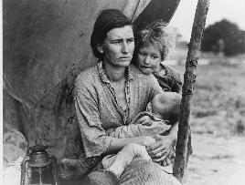
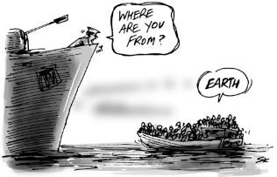

Background
Hypotheses
Research
Beyond Epi
Prevention
Lange
Kneebone
Pre
During
Post
Notes:
Pre, during & post

Slide 46
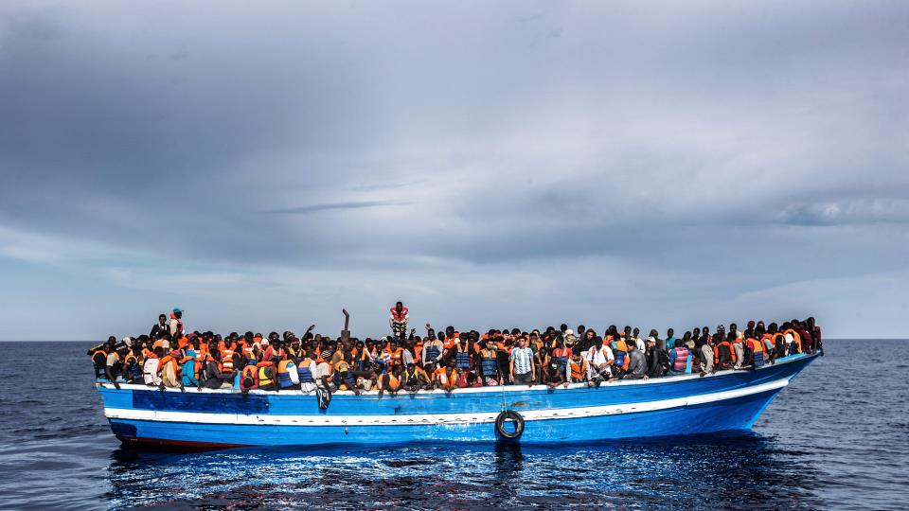
Background
Hypotheses
Research
Beyond Epi
Prevention

Slide 47
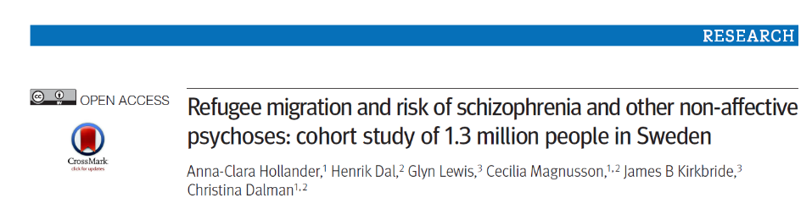

Background
Hypotheses
Research
Beyond Epi
Prevention
Were refugees at higher risk of psychotic disorders than
Native-born Swedes?
Other migrants from the same region?
Hollander et al, BMJ, 2016
Notes:
Born after 1984, alive on 14th birthday in Sweden, followed to DoX or 31 Dec 2011
1.3 million people
3,704 people diagnosed with a non-affective psychotic disorder

Slide 48
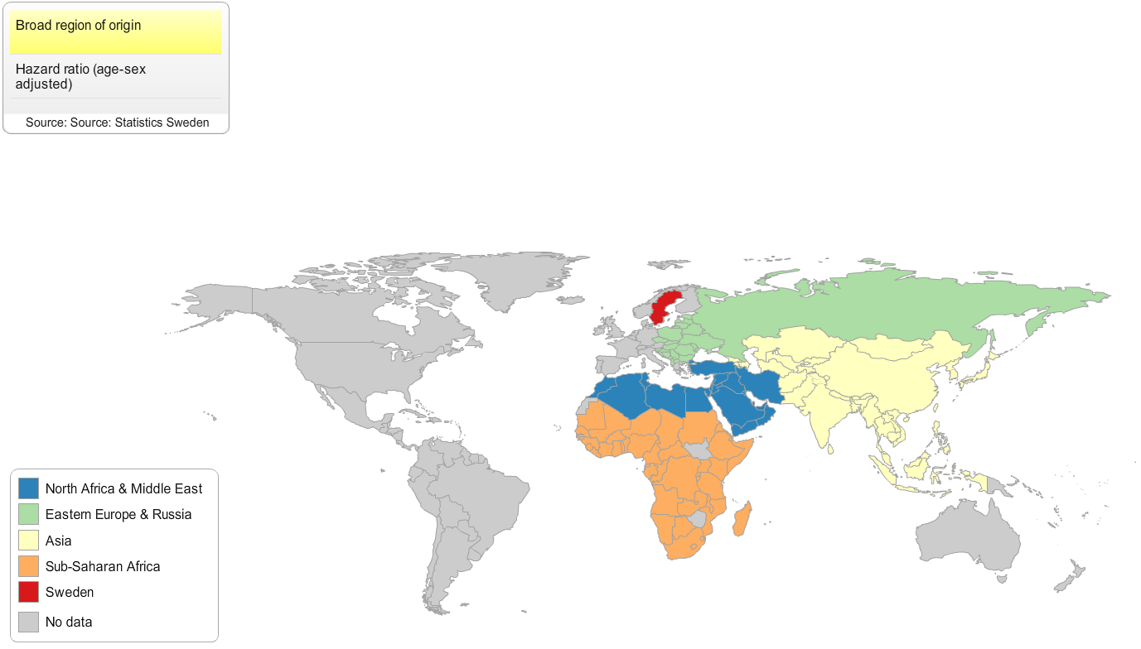
Background
Hypotheses
Research
Beyond Epi
Prevention
Hollander et al, BMJ, 2016
Notes:
24,123 refugees + 132,663 other migrants
At least 1000 migrants

Slide 49
Background
Hypotheses
Research
Beyond Epi
Prevention
66% increase
Adjusted for age, sex, income & urban residency
Hollander et al, BMJ, 2016
Notes:
Possible that refugees face an increased level of stressors prior to migration
Unfortunately, little epi data available on these experiences to date
We do know from other research that traumas, particularly in childhood increase risk

Slide 50
Background
Hypotheses
Research
Beyond Epi
Prevention
Lange
Kneebone
Pre
During
Post
Notes:
Pre, during & post

Slide 51


Background
Hypotheses
Research
Beyond Epi
Prevention
Does social support during migration affect psychosis risk?
Hypothesis: Those with more social isolation would have higher risk of ICD-10 non-affective psychosis
Linked register on 838,717 immigrants to Sweden
Born 1968-1997, followed from 14 years until 2011
Whether you moved with adult family members
Whether you had adult family members in Sweden at time of immigration
First & second degree relatives
Dykxhoorn et al, Schizophrenia Research
Notes:
We looked at levels of social support available during the migration window and whether this affected psychosis risk
Work done by my PhD student Jen Dykxhoorn, formally at OttawaU
Moving with a family member within a 12 month window.

Slide 52
Background
Hypotheses
Research
Beyond Epi
Prevention
Does not support hypothesis that social support during migration is protective
Higher risk in “joiners” compatible with selection effect
Or “joiners” have mismatch in expected vs actual social support
Effect limited to men from Europe, North & South America
No differences in risk for migrants from other regions by social support type
Adjusted for age, sex, time period & other exposure (with or join)
Dykxhoorn et al, Schizophrenia Research
Notes:
Effect of joining ltd to N&S America men (smallest group) & European men (2nd largest group)
No differences in groups who convey the highest risk i.e. African groups etc…

Slide 53
Background
Hypotheses
Research
Beyond Epi
Prevention
Lange
Kneebone
Pre
During
Post
Notes:
Pre, during & post

Slide 54


Background
Hypotheses
Research
Beyond Epi
Prevention
Does the social experience following migration affect psychosis risk?
Social defeat hypothesis posits that repeated exposure to social adversity may increase risk
What if it was not “defeat”, but social distance & disempowerment that increased risk?
Translocation & loss of social & cultural values, beliefs, customs & laws
Hypothesis: Greater sociocultural distance & disempowerment explain elevated psychosis risk in ethnic minority groups
Selten & Cantor-Graae, Br J Psych, 2005
Selten et al, Schiz Bull, 2013
Jongsma et al, In preparation

Slide 55
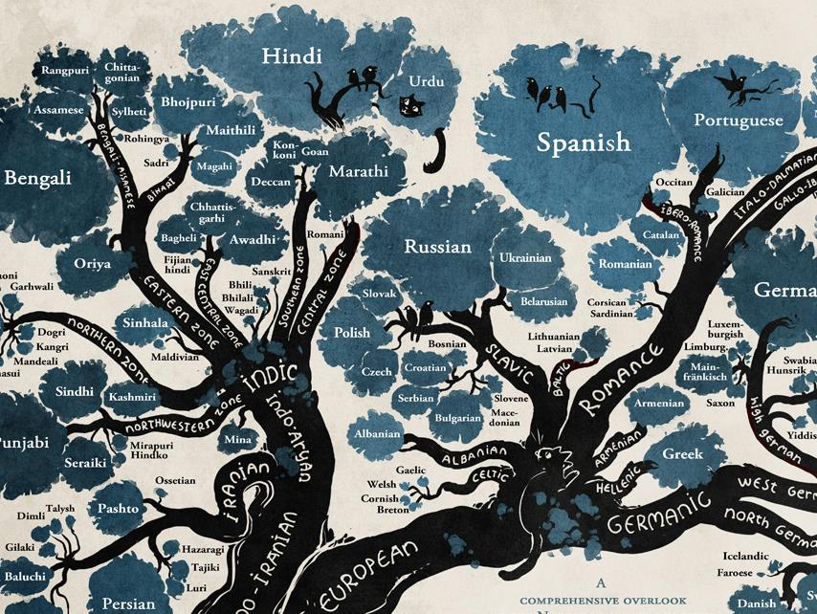
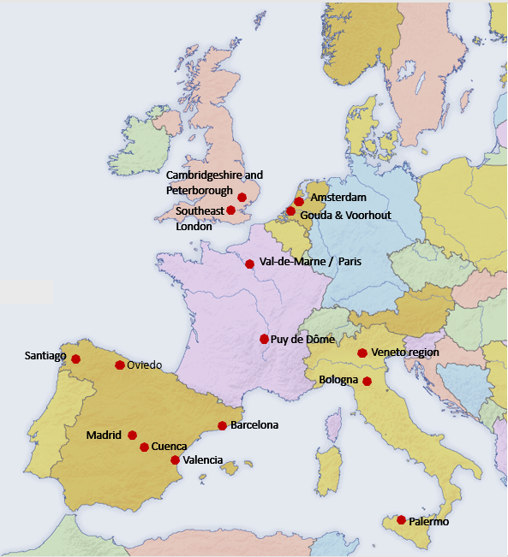
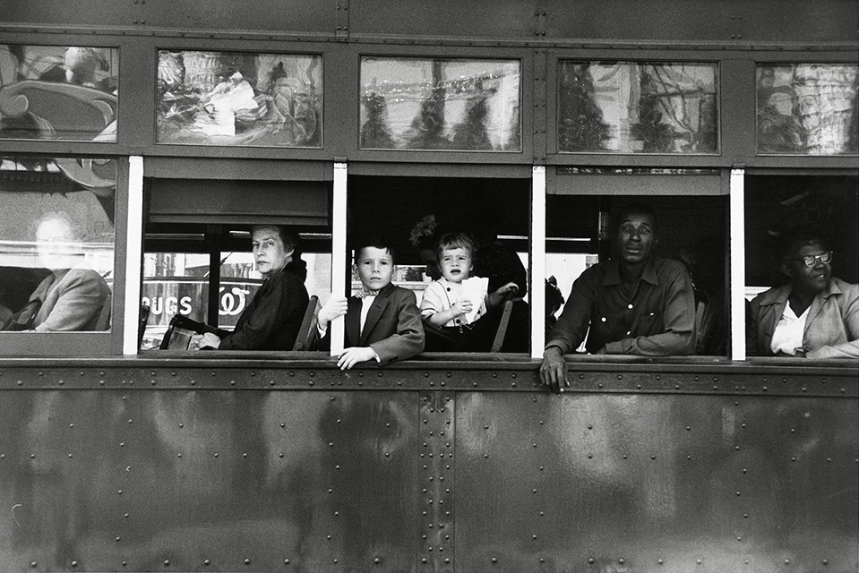


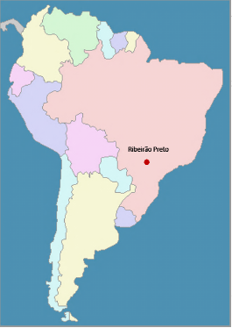
Background
Hypotheses
Research
Beyond Epi
Prevention
Data from EU-GEI case-control study
1100 cases of FEP & 1143 controls from 17 centres in 6 countries
UK, Netherlands, France, Spain, Italy & Brasil
Ethnic majority versus ethnic minority
Sociocultural distance: Can be accurately measured by language trees
Social disempowerment: experiences of discrimination
Logistic regression, multiple imputation
Jongsma et al, In preparation

Slide 56
Background
Hypotheses
Research
Beyond Epi
Prevention
RESULTS REMOVED FROM POST-PRESENTATION SLIDE SET DUE TO ONGOING PEER REVIEW
Notes:
Further work suggests it is cultural distance, not discrimination which predicts the raised rates in migrant groups
While discrimination might represent acute, perceived experiences, social and cultural distance may reflect more chronic, structural effects of discrimination deeply embedded in society

Slide 57
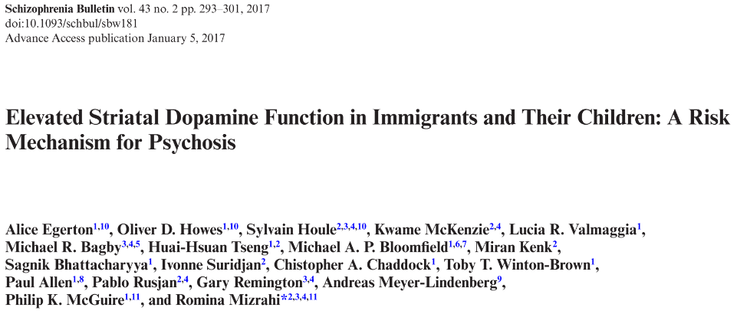
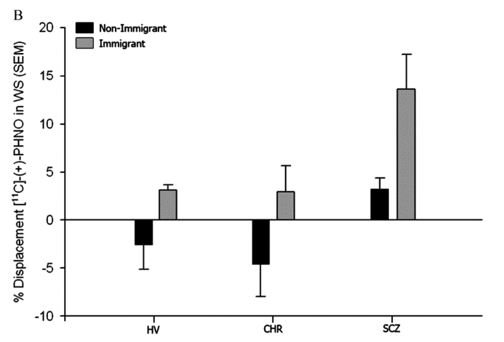
Background
Hypotheses
Research
Beyond Epi
Prevention
40 German controls, 40 ethnic minority subjects
Egerton et al, Schiz Bull, 2017
Notes:
Further more recent work from a Canadian-UK consortium shows that striatal dopamine is elevated in migrants compared with non migrant groups
Sample based on a total of 57 immigrant & 76 non-immigrant groups, of which 73 participants were CHR
PET study

Slide 58
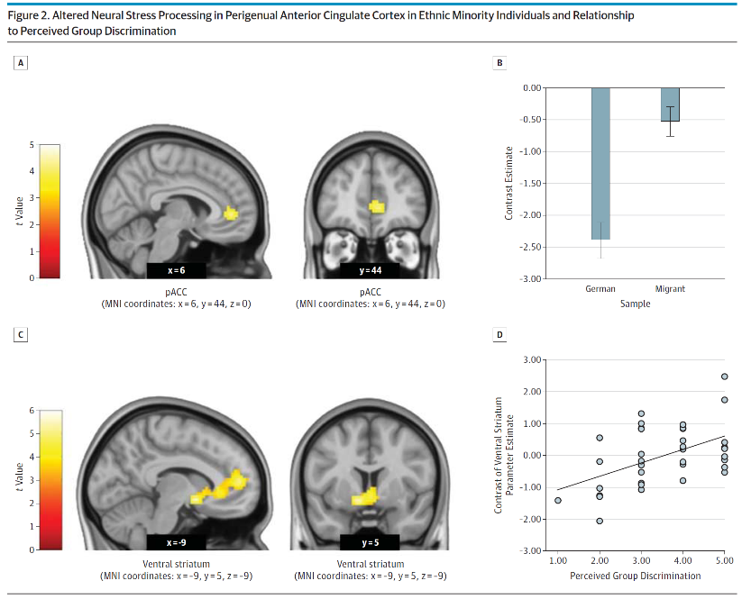
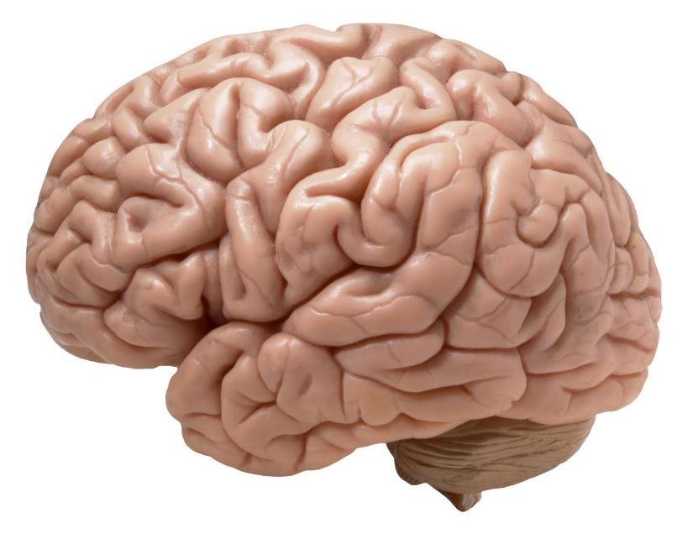

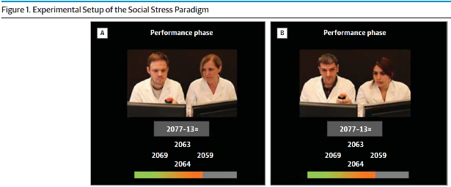
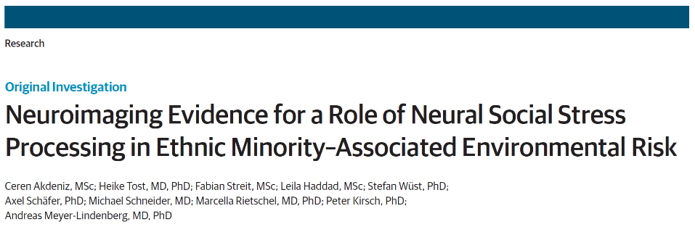
Background
Hypotheses
Research
Beyond Epi
Prevention
40 German controls, 40 ethnic minority subjects
Notes:
This is how I feel when I start talking off epidemiology
Here, we can look at social neuroscience for clues
40 ethnic minority participants, mostly Turkish/Italian/Polish backgrounds, 40 German controls
Subjected to cognitive (arithmetic) task, with disapproving feedback
A & B: Greater activation of the perigenual anterior cingulate cortext (pACC) in migrants, responsible for stress regulation
C& D: Also greater ventral striatum activation associated with greater perceived ethnic discrimination

Slide 59

Background
Hypotheses
Research
Beyond Epi
Prevention
Consistently raised rates of psychotic disorder in migrants & their descendants
Act specifically on psychotic disorders
Not explained by selective migration, demographic differences
Unlikely to be explained by raised rates in country of origin, or misdiagnosis
Social stressors occurring before and after index migration appear relevant to risk
Notes:
Epidemiological evidence points to…
More work needed for country of origin rates & misdiagnosis
But this is not enough. One of the Bradford-Hill criteria for causation is experimentation….
Here we need to look beyond epidemiology for clues…

Slide 60
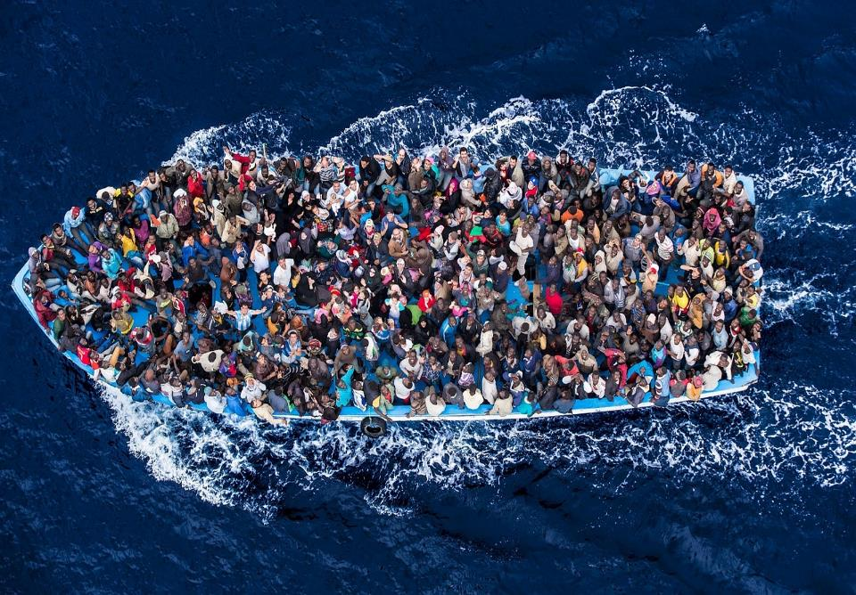
Background
Hypotheses
Research
Beyond Epi
Prevention
Prevention depends on identification of causal factors
Migration neither sufficient, nor necessary to cause psychosis
New research suggests sociocultural distance may account for excess risk in minority groups
Interventions which combatted post-migratory structural conditions may be effective
Or targeting BME groups at high-risk of psychosis
Kirkbride et al, Acta Psych Scand, 2015
Kirkbride et al, J Pub Ment Health, 2010
Kirkbride et al, Acta Psych Scand, 2015
Notes:
If we could prevent the causes of FEP in BME groups we estimated up to 21.6% of all cases in the English population could be prevented, rising to 66.9% of cases in BME groups,
But prevention depends on identification of causal factors
McKenzie – someway from a consensus before prevention possible
Kirkbride – BME groups underpresented in ARMS samples, needs addressing

Slide 61






PsyLife group
Hannah Jongsma
Jen Dykxhoorn
Francesca Solmi
Thanks
Peter Jones
Jeremy Coid
Craig Morgan
Jean Stafford
Ka-Young Ban
Keltie McDonald
Anna-Clara Hollander
Christina Dalman
Lawren Harris, 1930
Notes:
Lawren Harris
Mt Lefroy, 1930.

Slide 62
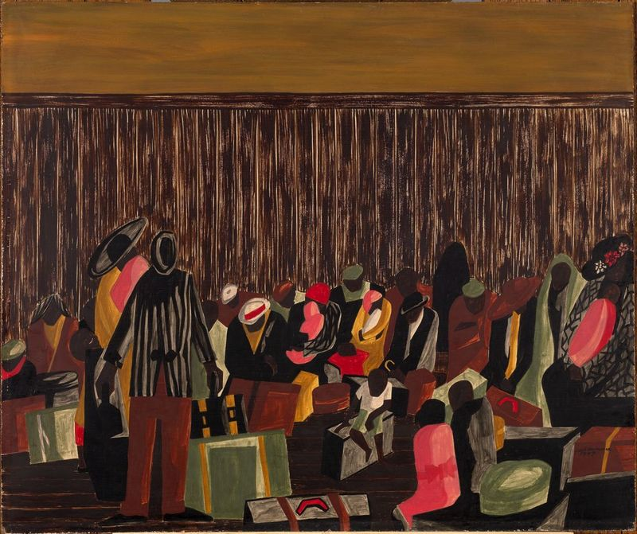
Background
Hypotheses
Research
Beyond Epi
Prevention
Excess psychosis risk in migrants and their descendants is the public mental health tragedy of our times
Morgan & Hutchinson, Psych Med, 2010
Kirkbride, World Psychiatry, 2017
Jacob Lawrence, 1947
Notes:
Need to address both the structural & cultural factors that not only increase risk but perpetuate inequalities in care outcomes
This excess risk should be seen as genuine, and not conflated with the separate, but real injustices faced by some BME groups in access to and treatment from services for psychosis.
Denial of this excess burden, exacerbates, not alleviates the burden faced in these groups, and marks this out as the greatest public mental health tragedy of our times.

Slide 63
Dr James Kirkbride
j.kirkbride@ucl.ac.uk
@dr_jb_kirkbride
www.psylife.eu
Lawren Harris, 1930
Notes:
Lawren Harris
Mt Lefroy, 1930.

