Slide 1


CBT for psychosis –
Integrating attachment principles
Sussex 2022
Dr Katherine Newman Taylor
Associate Professor, University of Southampton
Consultant Clinical Psychologist (Hon)
Southern Health NHSF Trust

Slide 2




CBT for psychosis – Integrating attachment principles
Tess Maguire
Clinical Psychologist
University of Southampton
Kathy Carnelley
Associate Professor
University of Southampton
Sean Harper
Consultant Clinical Psychologist
NHS Lothian
Monica Sood
PhD Candidate
University of Southampton

Slide 3

Where are we with CBT for psychosis?
In the UK, NICE (2014) recommends CBT and FI for all with a diagnosis of schizophrenia
RCTs indicate benefits but clinical and quality of life outcomes remain modest (Jones et al, 2018; Laws et al., 2018)
Formulation based CBT for psychosis (cf. Turner et al., 2014; 2020) and problem specific approaches may be more effective (Freeman et al, 2021)
Continuum model (Johns & van Os, 2001) – targeting key processes in analogue groups to draw implications for clinical groups

Slide 4
What about engagement?
“In our clinical practice, we find engaging to be perhaps the biggest challenge facing a therapist” (Chadwick, Birchwood & Trower, 1996)
“Consideration of the concept of ‘insight’ is crucial to any discussion of the management of psychosis” (Kingdon & Turkington, 1994)
“Individuals with psychosis … develop causal beliefs that may be associated with engagement with services and treatment … This may have important implications for clinical practice” (Carter, Read, Pyle & Morrison, 2016)
“[In our recent review, we] found that greater difficulties in forming relationships were associated with poorer engagement with services, more problematic relationships with staff, and more frequent and longer hospital admissions” (Gumley et al., 2020)

Slide 5
Engagement and outcomes in CBT for psychosis
Many with psychosis do not access CBT promptly (Birchwood et al., 2013)
DUP is typically 1-2 years and predicts poorer clinical and social outcomes (Boonstra et al., 2012; Marshall et al., 2004; Perkins et al., 2005; Sullivan et al., 2019)
In 2001, the WHO identified reduction in DUP an international priority
In the UK – delays within secondary care make the largest contribution to DUP, followed by delays in help-seeking (Birchwood et al., 2013)
Once in contact with services, ~1/3 disengage before receiving ‘full dose’ interventions (Doyle et al., 2014; Kreyenbuhl et al., 2009)
High dropout rates for CBT for psychosis in routine settings (Fanning et al., 2012; Richardson et al., 2019); better in trials (cf. Jolley et al., 2015)

Slide 6

What is attachment and why is this relevant?
We attach to early care givers in infancy – to feel safe to explore the world, and know where to come back to at times of threat
The bonds we form in early life shape our beliefs about ourselves and others, our ability to manage our feelings, and our relationships
(Bowlby, 1969/1988)

Slide 7



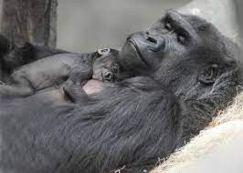


Slide 8
What is attachment and why is this relevant?
We attach to early care givers in infancy – to feel safe to explore the world, and know where to come back to at times of threat
The bonds we form in early life shape our beliefs about ourselves and others, our ability to manage our feelings, and our relationships
(Bowlby, 1969/1988)

Slide 9
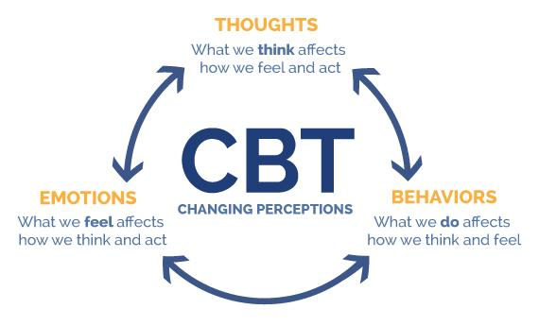
What is attachment and why is this relevant?
Early experiences shape our beliefs about ourselves and others
These in turn affect the thoughts, feelings and behaviours that maintain mental health conditions
(Beck 1967; 1975)

Slide 10
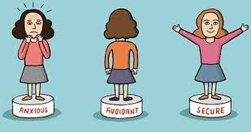
Attachment styles
(Ainsworth et al., 1978; Bowlby, 1969; 1988)

Slide 11


What is attachment and why is this relevant?
Attachment style | Attachment figure availability and responsiveness in times of need | Working model beliefs about self, others, and relationships | Emotion regulation strategy
Secure | Available, responsive, caring | “I am worthy of love; others are available and supportive” | Security-based (self-soothing, help-seeking)
Anxious | Inconsistently available and responsive | “I am unworthy of love” | Hyperactivation (exaggerating distress to seek attention and reassurance needed)
Avoidant | Unavailable, unresponsive, rejecting | “Others will reject me and cannot be depended on in times of need” | Deactivation (suppressing distress and self-reliance)
Secure
Anxious
Avoidant

Slide 12
Psychosis, paranoia and attachment
People with psychosis more likely to report early adversity (Varese et al, 2012)
Framework to conceptualise cognitive, affective, and behavioural processes in psychosis (Gumley, et al., 2014)
Many with psychosis insecurely attached (Berry et al., 20o7; Murphy et al., 2020)
Paranoia is associated with anxious and avoidant attachment (Berry et al., 2006; Lavin et al., 2020; Murphy et al., 2020; Pickering et al., 2008)

Slide 13
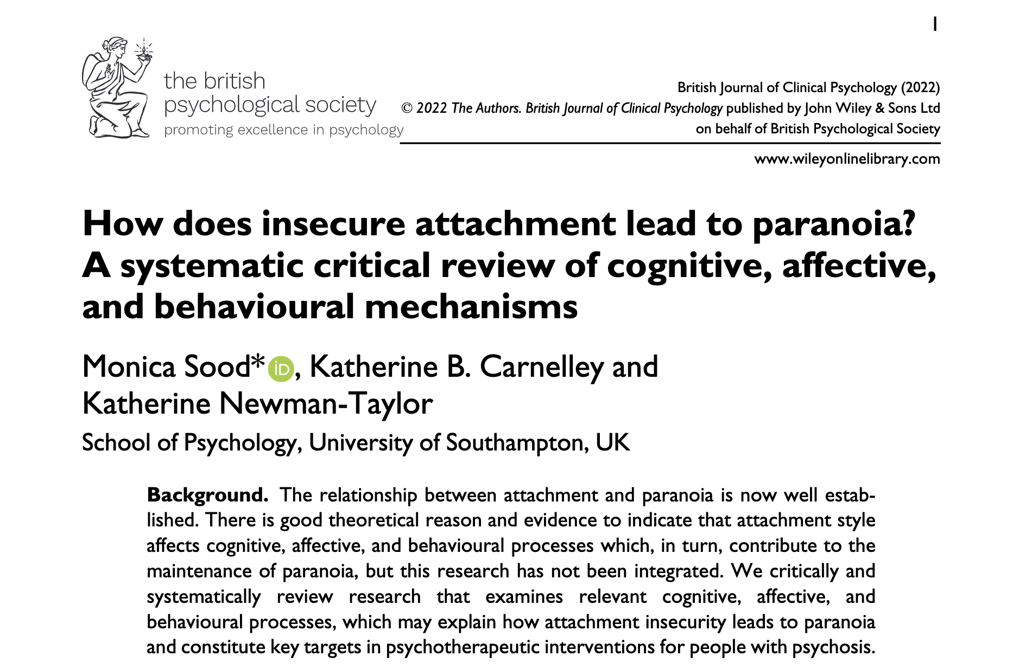
Attachment in psychosis
Monica’s lit review / prestn
Experimental studies

Slide 14

Attachment and psychosis – cognition
1. Negative self-beliefs mediate reln btn attachment anxiety / avoidance and paranoia
3. People with avoidant attachment may be poor at mentalizing (but not linked to paranoia in early psychosis)
2. Fusion mediates association btn primed attachment and paranoia (non-clinical)
4. Dissociation mediates association btn disorganised attachment and voice hearing
    Possible pathways (cf. Berry et al., 2020):
    Disorganized attachment → dissociation → voices
    Anxious / avoidant attachment → negative beliefs and fusion → paranoia

Slide 15
Attachment and psychosis – emotion regulation and behaviour
1. People with psychosis and attachment anxiety / avoidance use more maladaptive and less adaptive ER strategies
Engagement
Securely attached – well engaged
Avoidantly attached – struggle to engage
Anxiously attached – inconsistent results
2. Strong
therapeutic alliance promotes use of adaptive ER in psychosis
    Key points:
    Insecure attachment → maladaptive emotion regulation strategies
    Avoidant attachment → poor engagement

Slide 16
The story so far
CBT for psychosis is good but not good enough
Poor engagement and DUP are a problem
Targeting specific psychological processes may be a more fruitful approach
Attachment theory allows us to make sense of (people’s responses to) psychosis in developmental context – a model of intra and interpersonal processes maintaining distress
Identifies cognitive, affective and behavioural processes that may be targeted in CBT to improve clinical and recovery outcomes

Slide 17
Attachment and psychosis – experimental studies
Can we help people with paranoia to feel interpersonally secure?
Attachment imagery priming studies – compare secure and insecure attachment imagery priming

Slide 18
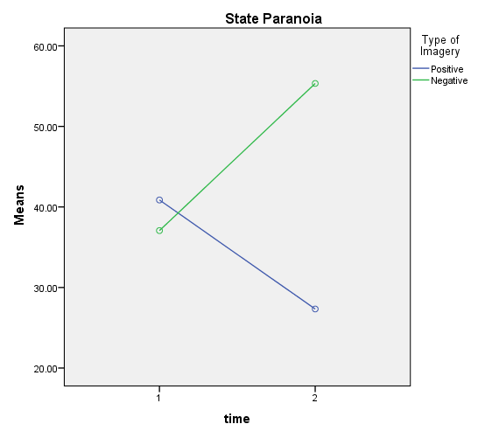
Does attachment imagery reduce paranoia?
Non-clinical studies (Bullock et al., 2016)
Initial assessment
Measures of paranoia and anxiety
Secure
Insecure
Measures of paranoia and anxiety
(Bennetts et al., 2020; Bullock et al., 2016; Newman-Taylor et al, 2017; 2021; Sood & Newman-Taylor, 2020; Sood et al., 2021)

Slide 19
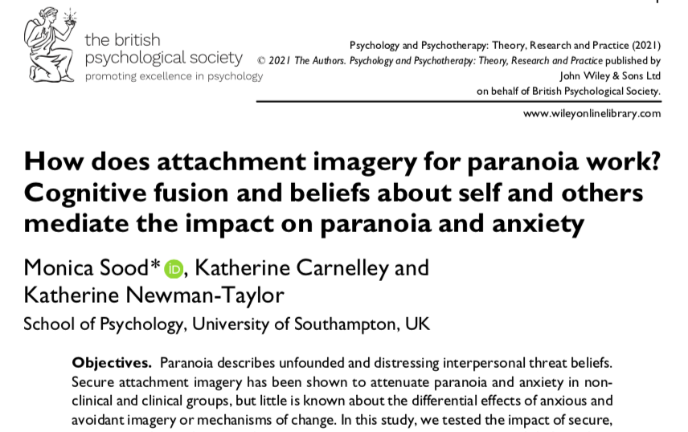

Slide 20
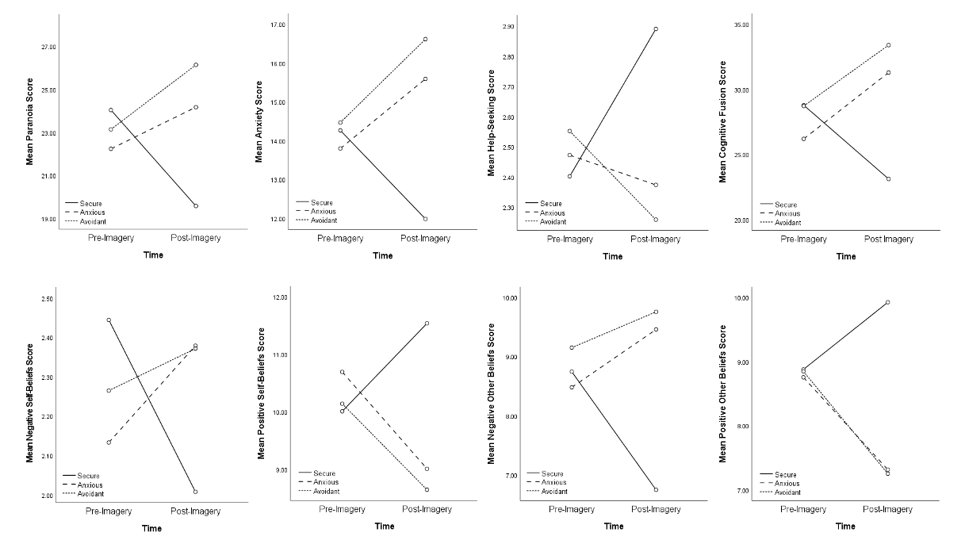
Impact of attachment imagery and candidate mechanisms –cognition and cognitive fusion (Sood et al., 2021)
IV: secure, anxious, avoidant imagery
DV: paranoia, anxiety, help-seeking
Meds: negative self- and other-beliefs and cognitive fusion
n=303 (182 men, 18-65 years, M=26.24, SD=8.30)

Slide 21
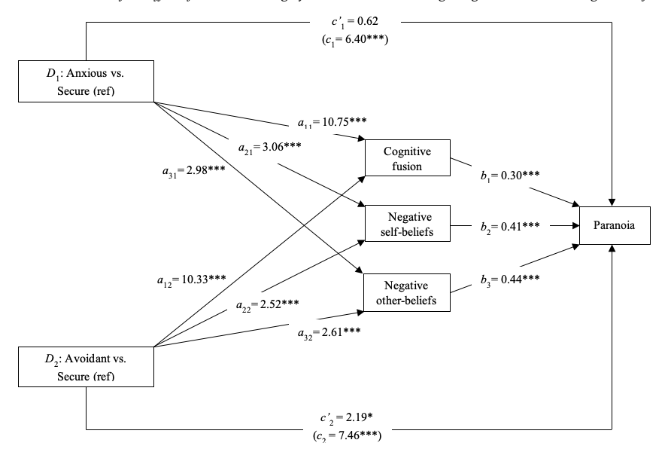
Impact of attachment imagery on cognition and cognitive fusion (Sood et al., 2021)

Slide 22
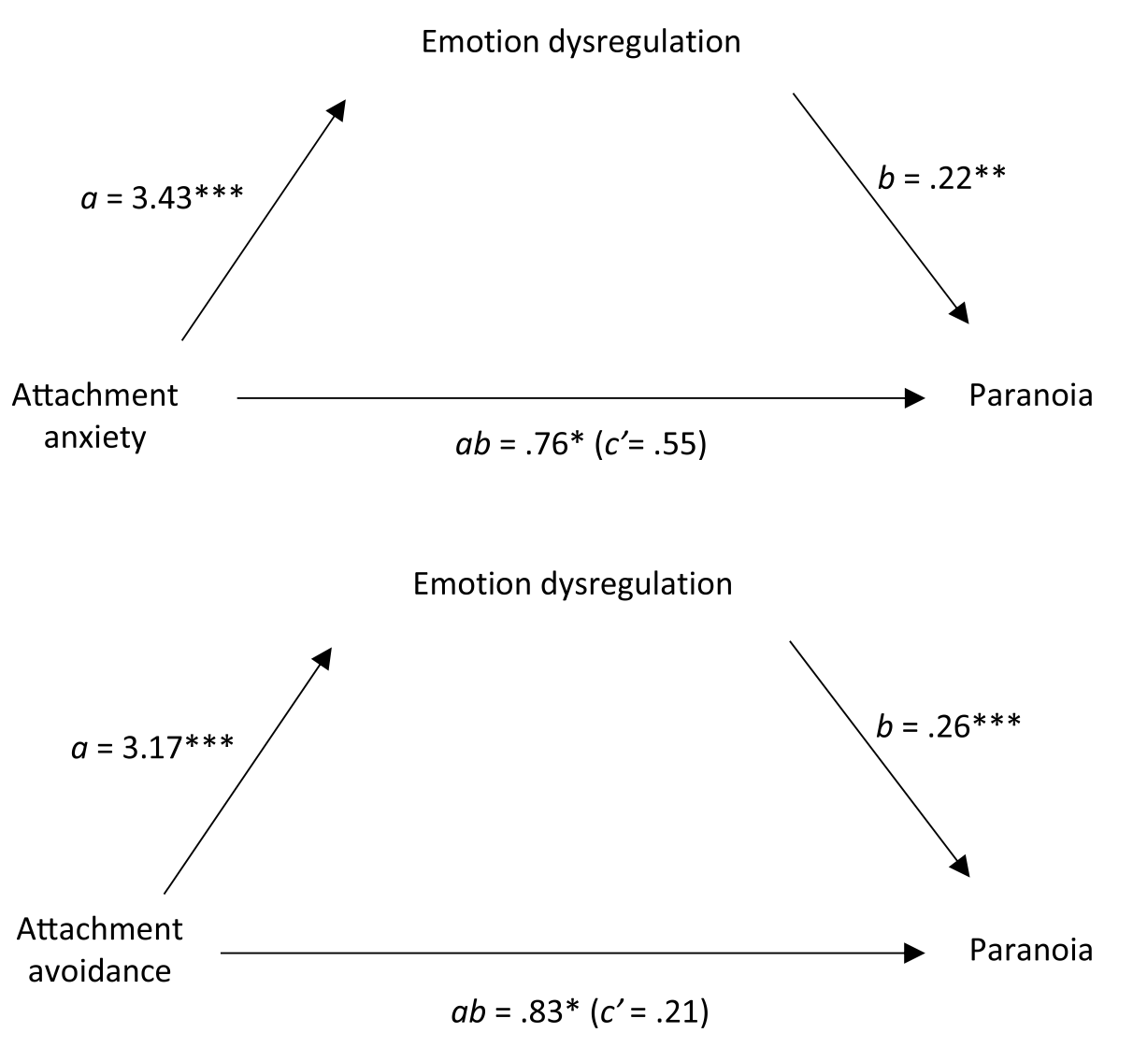
Does ER mediate the attachment-paranoia association?
(Partridge et al., 2022)
ER (DERS) mediated attachment anxiety- paranoia association
ER (DERS) mediated attachment avoidance-paranoia association
Suppression (ERQ) did not mediate attachment avoidance-paranoia association (under-powered)
Attachment anxiety associated with hyperactivating ER
Attachment avoidance associated with deactivating ER
cf Sood et al. (2022)

Slide 23
Clinical implications – assess attachment and adapt CBT for paranoia (Sood et al., 2022)
Attachment style | Relationship and engagement | Cognition | Emotion regulation
Anxious | Expect ambivalence, fear of judgement Raise awareness of impact of excessive help-seeking | Target negative self-beliefs – build trust in self and self-efficacy | Practice mindfulness / worry management as alternative to rumination and catastrophisation
Avoidant | Expect excessive self-reliance Increase help-seeking and accepting | Target negative other-beliefs – build trust in others | Practice emotional expression as alternative to suppression
Anxious
Avoidant

Slide 24
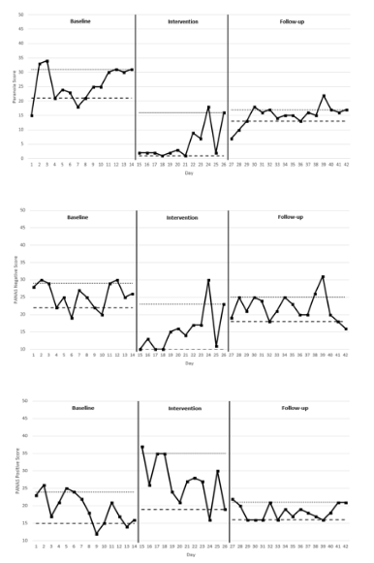
Does attachment imagery reduce paranoia?
Preliminary clinical studies (Pitfield et al., 2020)
Paranoia – reduced
‘Negative’ feelings – reduced
‘Positive’ feelings – increased
(Newman-Taylor, 2020; Pitfield et al., 2020; Sood et al., underway)

Slide 25
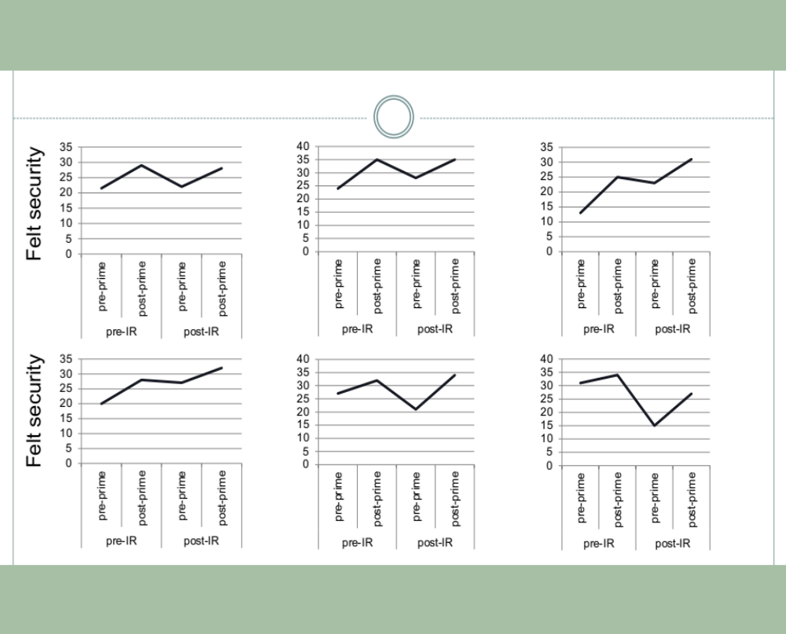
Felt security to facilitate imagery rescripting
(Newman-Taylor, 2020)

Slide 26
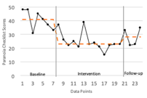
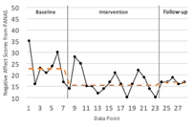
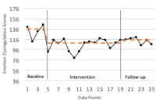
Affect regulation case series in EIP (Silva et al., 2020)
Preliminary study of DBT skills in people with psychosis with paranoia (GPTS clinical range)
ABA design; intervention phase – eight sessions over four weeks
Assessment and simple formulation followed by DBT distress tolerance and emotion regulation skills with no adaption
State paranoia
↓ 5/7 ppts
Negative affect
↓ in 6/7 ppts
Emotion regulation
↑ 6/7 ppts

Slide 27
Clinical implications
May – understanding my voices and fears about others
Triggers: Intrusive voices (cruel, commanding), memories of past harm
Thinking: I’m no good, unwanted, can’t cope
They’ll get me
Coping: Don’t go out, listen to voices, sometimes follow commands, give up on what’s important
Feelings: Terror, sadness, tension in body (particularly stomach)
Notes:
27

Slide 28

May – typical interventions
Triggers: Intrusive voices (cruel, commanding), memories of past harm
Alternative appraisals
Thinking: I’m no good, unwanted, can’t cope
They’ll get me
Graded exposure, BA, responding to commanding voices
Relaxation?
Coping: Don’t go out, listen to voices, sometimes follow commands, give up on what’s important
Feelings: Terror, sadness, tension in body (particularly stomach)
Notes:
28

Slide 29
Targeting attachment congruent processes
Interpersonal assumptions / rules
If I ask for help I’ll be rejected
If in trouble I must cope alone
Triggers: Intrusive voices (cruel, commanding), memories of past harm
Thinking: I’m no good, unwanted, can’t cope
They’ll get me
Alternative assumptions?
BEs to explore acting as if?
Learn to sit with these? Practise asking for help?
Felt security / imagery
Other ER strategies
Coping: Don’t go out, do less, listen to voices, push difficult thoughts and feelings away, avoid asking for help
Feelings: Terror, sadness, tension in body (particularly stomach)
Notes:
29

Slide 30
Mapping staff-patient interactions in acute settings
(Newman-Taylor et al., in press)
Self – safe, worthy of care
Others – responsive, caring
Others offer help as best they can
Can cope with difficult feelings
Seek help when needed
At times of threat eg psychosis

Slide 31
Insecure anxious attachment
Self – unsafe, unloved, can't cope
(Others – unreliable, can't be trusted)
Others give help or pull away (unable to meet my needs)
Feelings seem overwhelming
Seek care (fearing abandonment) and reassurance excessively
At times of threat eg psychosis

Slide 32
Insecure avoidant attachment
(Self – alone)
Others – can’t be trusted, rejecting / smothering / harmful
Others unaware of my needs so don't offer to help or rush in when I reach crisis (feels too much)
Feelings seem overwhelming
Must cope by myself (even when I need help)
At times of threat eg psychosis

Slide 33
Insecure avoidant attachment – helpful responses
Self – alone
Others – can’t be trusted, rejecting / smothering / harmful
Others unaware of my needs so don't offer to help or rush in when I reach crisis (feels too much)
Feelings seem overwhelming
Must cope by myself (even when I need help)
Psychological needs: Immediate – to be allowed to withdraw
Subsequently – to learn to trust others
Ward staff: Teach – expression of emotions
Focus on – shared activities, giving and accepting help

Slide 34
Summary
People with psychosis are often insecurely attached
This affects ability to access services, engage in CBT, remain engaged – high risk of not receiving the interventions likely to be useful
If we know someone’s attachment style, we can anticipate key beliefs, emotion regulation strategies, and help-seeking behaviours, when distressed (e.g., when hearing voices, paranoid, confused, in threatening environments)
We can then weave this information into our routine clinical practice
  Therapy – initial engagement, assessment, formulation, treatment
  Consulting with teams – CMHTs, EIPs, wards
  Embed in service governance systems – e.g., routine assessments, reflective practice

Slide 35
Next steps
“I think you need to identify these [attachment patterns] with the patients themselves ... put the control in the hands of the patient”
(Lived experience participant, Newman-Taylor et al., in press)

Slide 36
Thank you
Any questions?
knt@soton.ac.uk

Slide 37
References
Arriaga, X. B., Kumashiro, M., Simpson, J. A., & Overall, N. C. (2017). Revising working models across time: Relationship situations that enhance attachment security. Personality and Social Psychology Review, 22(1), 71-96. https://doi.org/10.1177/1088868317705257
Beck, A.T. (1967). The diagnosis and management of depression. University of Pennsylvania Press.
Beck, A.T. (1975). Cognitive therapy and the emotional disorders. International Universities Press.
Bennetts, A., Stopa, L., & Newman-Taylor, K. (2020). Does mental imagery affect paranoia, anxiety and core beliefs? A pilot experimental study in an analogue sample. Psychosis, 12(2), 182-187.
Berry, K., Barrowclough, C., & Wearden, A. (2007). A review of the role of adult attachment style in psychosis: unexplored issues and questions for further research. Clinical Psychology Review, 27(4), 458-475. https://doi.org/10.1016/j.cpr.2006.09.006
Birchwood, M., Connor, C., Lester, H., Patterson, P., Freemantle, N., Marshall, M., ... & Singh, S. P. (2013). Reducing duration of untreated psychosis: care pathways to early intervention in psychosis services. British Journal of Psychiatry, 203(1), 58-64.
Boonstra, N., Klaassen, R., Sytema, S., Marshall, M., De Haan, L., Wunderink, L., & Wiersma, D. (2012). Duration of untreated psychosis and negative symptoms — a systematic review and meta-analysis of individual patient data. Schizophrenia Research, 142(1-3), 12-19.
Bowlby, J. (1969). Attachment and loss (Vol. 1): Attachment. Basic Books.
Bowlby, J. (1988). A secure base. Basic Books.

Slide 38
References
Bucci, S., Roberts, N. H., Danquah, A. N., & Berry, K. (2014). Using attachment theory to inform the design and delivery of mental health services: A systematic review of the literature. Psychology and Psychotherapy: Theory, Research and Practice, 88(1), 1-20.
Bullock, G., Newman-Taylor, K., & Stopa, L. (2016). The role of mental imagery in non-clinical paranoia. Journal of Behavior Therapy and Experimental Psychiatry, 50, 264–268. doi:10.1016/j.jbtep.2015.10.002
Doyle, R., Turner, N., Fanning. F., Brennan, D., Renwick, L., Lawlor, E., & Clarke, M. (2014). First-episode psychosis and disengagement from treatment: A systematic review. Psychiatric Services 65(5), 603-611. https://doi.org/10.1176/appi.ps.201200570
Fanning, F., Foley, S., Lawlor, E., McWilliams, S., Jackson, D., Renwick, L., … Trimble, T. (2012). Group cognitive behavioural therapy for first episode psychosis: Who's referred, who attends and who completes it? Early Intervention in Psychiatry, 6, 432–441.
Gumley, A. I., Taylor, H. E. F., Schwannauer, M., & MacBeth, A. (2014). A systematic review of attachment and psychosis: measurement, construct validity and outcomes. Acta Psychiatrica Scandinavica, 129(4), 257-274.
Jolley, S., Garety, P., Peters, E., Fornells-Ambrojo, M., Onwumere, J., Harris, V., … Johns, L. (2015). Opportunities and challenges in Improving Access to Psychological Therapies for people with Severe Mental Illness (IAPT-SMI): Evaluating the first operational year of the South London and Maudsley (SLaM) demonstration site for psychosis. Behaviour Research and Therapy, 64, 24– 30. https://doi.org/10.1016/j.brat.2014.11.006

Slide 39
References
Johns, L. C., & Van Os, J. (2001). The continuity of psychotic experiences in the general population. Clinical psychology review, 21(8), 1125-1141.
Jones, C., Hacker, D., Meaden, A., Cormac, I., Irving, C. B., Xia, J, Zhao, S., Shi, C., & Chen, J. (2018). Is cognitive behavioural therapy as effective as other psychosocial treatments for people with schizophrenia. Cochrane Database of Systematic Reviews. https://doi.org/10.1002/14651858.CD008712.pub3
Kreyenbuhl, J., Nossel, I. R., & Dixon, L. B. (2009). Disengagement from mental health treatment among individuals with schizophrenia and strategies for facilitating connections to care: A review of the literature. Schizophrenia Bulletin, 35(4), 696– 703. https://doi.org/10.1093/schbul/sbp046
Lafontaine, M. F., Brassard, A., Lussier, Y., Valois, P., Shaver, P. R., & Johnson, S. M. (2015). Selecting the best items for a short-form of the Experiences in Close Relationships questionnaire. European Journal of Psychological Assessment. https://doi.org/10.1027/1015-5759/a000243
Laws, K. R., Darlington, N., Kondel, T. K., McKenna, P. J., & Jauhar, S. (2018). Cognitive Behavioural Therapy for schizophrenia-outcomes for functioning, distress and quality of life: a meta-analysis. BMC Psychology, 6(1), 1-10.
Luke, M. A., Sedikides, C., & Carnelley, K. B. (2012). Your love lifts me higher! The energizing quality of secure relationships. Personality and Social Psychology Bulletin, 38, 721-733. doi: 10.1177/0146167211436117
Marshall, M., Lewis, S., Lockwood, A., Drake, R., Jones, P., & Croudace, T. (2005). Association between duration of untreated psychosis and outcome in cohorts of first-episode patients: a systematic review. Archives of General Psychiatry, 62(9), 975-983.
Murphy, R., Goodall, K., & Woodrow, A. (2020). The relationship between attachment insecurity and experiences on the paranoia continuum: A meta‐analysis. British Journal of Clinical Psychology, 59(3), 290-318.

Slide 40
References
Newman-Taylor, K., & Stopa, L. (2013). The fear of others: A pilot study of social anxiety processes in paranoia. Behavioural and Cognitive Psychotherapy, 41(1), 66-88. https://doi.org/10.1017/S1352465812000690
Newman-Taylor, K. (2020). ‘Felt security’as a means of facilitating imagery rescripting in psychosis: a clinical protocol and illustrative case study. The Cognitive Behaviour Therapist, 13.
Newman-Taylor, K., Sood, M., Rowe, A. C., & Carnelley, K. B. (2021). Attachment imagery as a means of effecting change in paranoia, mood, and behavioural intentions in an analogue sample. Brain Sciences, 11(10), 1257. https://doi.org/10.3390/brainsci11101257
NICE. (2014). Psychosis and schizophrenia in adults: Prevention and management. London, UK: NICE.
Sood, M., Carnelley, K. B., & Newman-Taylor, K. (2022). Do emotion regulation strategies mediate the attachment–paranoia association? An experimental study of repeated attachment-imagery priming and stress buffering. Psychology and Psychotherapy: Theory Research and Practice. https://doi.org/ 10.1111/PAPT.12398
Sood, M., Carnelley, K. B., & Newman-Taylor, K. (2021). How does attachment imagery for paranoia work? Cognitive fusion and beliefs about self and others mediate the impact on paranoia and anxiety. Psychology and Psychotherapy: Theory Research and Practice, 94(4), 973-993. https://doi.org/ 10.1111/papt.12354
Sood, M., Carnelley, K. B., & Newman-Taylor, K. (2022). How does insecure attachment lead to paranoia? A systematic critical review of cognitive, affective, and behavioral mechanisms. British Journal of Clinical Psychology. https://doi.org/10.1111/bjc.12361

Slide 41
References
Sood, M., & Newman-Taylor, K. (2020). Cognitive fusion mediates the impact of attachment imagery on paranoia and anxiety. Cognitive Therapy and Research, 44, 1150–1161. https://doi.org/10.1007%2Fs10608-020-10127-y
Perkins, D. O., Gu, H., Boteva, K., & Lieberman, J. A. (2005). Relationship between duration of untreated psychosis and outcome in first-episode schizophrenia: a critical review and meta-analysis. American Journal of Psychiatry, 162(10), 1785-1804.
Pitfield, C., Maguire, T., & Newman-Taylor, K. (2020). Impact of attachment imagery on paranoia and mood: Evidence from two single case studies. Behavioural and Cognitive Psychotherapy, 48(5), 572-583.
Pollard, C., Bucci, S., MacBeth, A., & Berry, K. (2020). The revised Psychosis Attachment Measure: Measuring disorganized attachment. British Journal of Clinical Psychology, 59(3), 335-353.
Richardson, T., Dasyam, B., Courtney, H., White, L., Tedbury, J., Butt, J., & Newman‐Taylor, K. (2019). Predictors of disengagement from cognitive behavioural therapy for psychosis in a National Health Service setting: A retrospective evaluation. British Journal of Clinical Psychology, 58(4), 440-451.
Safran, J. D. (1990). Towards a refinement of cognitive therapy in light of interpersonal theory: I. Theory. Clinical psychology review, 10(1), 87-105.
Safran, J. D. (1990). Towards a refinement of cognitive therapy in light of interpersonal theory: II. Practice. Clinical Psychology Review, 10(1), 107-121.
Safran, J., & Segal, Z. V. (1996). Interpersonal process in cognitive therapy. Jason Aronson, Incorporated.
.

Slide 42
References
Silva, D., Maguire, T., McSherry, P., & Newman-Taylor, K. (2021). Targeting affect leads to reduced paranoia in people with psychosis: A single case series. Behavioural and Cognitive Psychotherapy, 49(3), 302-313.
Sullivan, S. A., Carroll, R., Peters, T. J., Amos, T., Jones, P. B., Marshall, M., ... & Tilling, K. (2019). Duration of untreated psychosis and clinical outcomes of first episode psychosis: an observational and an instrumental variables analysis. Early Intervention in Psychiatry, 13(4), 841-847.
Turner, D. T., Burger, S., Smit, F., Valmaggia, L. R., & van der Gaag, M. (2020). What constitutes sufficient evidence for case formulation–driven CBT for psychosis? Cumulative meta-analysis of the effect on hallucinations and delusions. Schizophrenia Bulletin, 46(5), 1072-1085.
Turner DT, van der Gaag M, Karyotaki E, & Cuijpers P. (2014). Psychological interventions for psychosis: a meta-analysis of comparative outcome studies. American Journal of Psychiatry, 171(5), 523–538
Varese, F., Smeets, F., Drukker, M., Lieverse, R., Lataster, T., Viechtbauer, W., ... & Bentall, R. P. (2012). Childhood adversities increase the risk of psychosis: a meta-analysis of patient-control, prospective-and cross-sectional cohort studies. Schizophrenia Bulletin, 38(4), 661-671.

