Slide 1
Recreating Unusual Bodily Sensations
Jamie Moffatt, PhD Student, University of Sussex
Supervisors: Prof. Kathryn Greenwood & Prof. Sarah Garfinkel

Slide 2
What are unusual bodily sensations?

Slide 3
Černis, Freeman & Ehlers (2020)
“It’s as if what appears to be the reality around me is crumbling”
“..and suddenly I feel a bit outside of myself, dizzy, and kind of disoriented”
“And it didn’t feel like it was my body, it just felt like – I was sort of reflecting. Like I was a mirror or a camera or something like that. I wasn’t aware that I actually had a body”

Slide 4
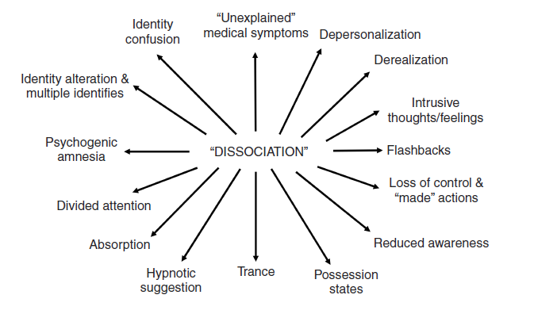
Dissociation / Anomalous Self-Experiences
Detachment
Depersonalisation
Derealisation
Out-of-body experiences
Emotional Numbing
Range from benign to more severe experiences
Brown (2006)

Slide 5
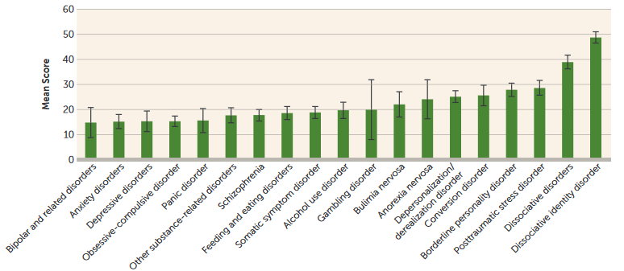
Dissociation Prevalence
Up to 50% of people with psychosis (Renard et al., 2016)
3.4% of the general population (Maaranen et al., 2004)
  Lyssenko et al (2018)
Notes:
Add in Lyssenko graph
You’ll note however, that dissociation is quite far down the list in terms of prevalence in this graph
But, it’s important because… lead into discussion on precursors

Slide 6
Dissociation and Psychosis
Symptom | Number of Effects | Correlation with Dissociation (r)
Global positive symptoms | 98 | .437
Longden et al (2020)
Notes:
Appears to be important for the development of these other types of experiences
Longden et al (2020) – meta analysis of 98 studies and 20,436 participants
Significant positive association between dissociation and positive symptoms in both clinical and non-clinical groups
Interestingly, the association is stronger in non-clinical groups
Specific associations found between dissociation and hallucinations, dissociation and delusions, dissociation and paranoia, (between medium-to-large)
Much smaller association between negative symptoms and dissociation (small)

Slide 7
Dissociation and Psychosis
Symptom | Number of Effects | Correlation with Dissociation (r)
Global positive symptoms | 98 | .437
Hallucinations | 50 | .461
Longden et al (2020)
Notes:
Appears to be important for the development of these other types of experiences
Longden et al (2020) – meta analysis of 98 studies and 20,436 participants
Significant positive association between dissociation and positive symptoms in both clinical and non-clinical groups
Interestingly, the association is stronger in non-clinical groups
Specific associations found between dissociation and hallucinations, dissociation and delusions, dissociation and paranoia, (between medium-to-large)
Much smaller association between negative symptoms and dissociation (small)

Slide 8
Dissociation and Psychosis
Symptom | Number of Effects | Correlation with Dissociation (r)
Global positive symptoms | 98 | .437
Hallucinations | 50 | .461
Delusions | 30 | .418
Longden et al (2020)
Notes:
Appears to be important for the development of these other types of experiences
Longden et al (2020) – meta analysis of 98 studies and 20,436 participants
Significant positive association between dissociation and positive symptoms in both clinical and non-clinical groups
Interestingly, the association is stronger in non-clinical groups
Specific associations found between dissociation and hallucinations, dissociation and delusions, dissociation and paranoia, (between medium-to-large)
Much smaller association between negative symptoms and dissociation (small)

Slide 9
Dissociation and Psychosis
Symptom | Number of Effects | Correlation with Dissociation (r)
Global positive symptoms | 98 | .437
Hallucinations | 50 | .461
Delusions | 30 | .418
Paranoia | 22 | .447
Longden et al (2020)
Notes:
Appears to be important for the development of these other types of experiences
Longden et al (2020) – meta analysis of 98 studies and 20,436 participants
Significant positive association between dissociation and positive symptoms in both clinical and non-clinical groups
Interestingly, the association is stronger in non-clinical groups
Specific associations found between dissociation and hallucinations, dissociation and delusions, dissociation and paranoia, (between medium-to-large)
Much smaller association between negative symptoms and dissociation (small)

Slide 10
Dissociation and Psychosis
Symptom | Number of Effects | Correlation with Dissociation (r)
Global positive symptoms | 98 | .437
Hallucinations | 50 | .461
Delusions | 30 | .418
Paranoia | 22 | .447
Global Negative Symptoms | 27 | .138
Longden et al (2020)
Notes:
Appears to be important for the development of these other types of experiences
Longden et al (2020) – meta analysis of 98 studies and 20,436 participants
Significant positive association between dissociation and positive symptoms in both clinical and non-clinical groups
Interestingly, the association is stronger in non-clinical groups
Specific associations found between dissociation and hallucinations, dissociation and delusions, dissociation and paranoia, (between medium-to-large)
Much smaller association between negative symptoms and dissociation (small)

Slide 11
Dissociation and Psychosis
Symptom | Number of Effects | Correlation with Dissociation (r)
Global positive symptoms | 98 | .437
Hallucinations | 50 | .461
Delusions | 30 | .418
Paranoia | 22 | .447
Global Negative Symptoms | 27 | .138
Dissociation by another name?
Does dissociation cause other anomalous experiences?
Do they share a common cause?
Evidence that dissociation acts as a “prodromal” symptom (Nelson, Thompson & Yung, 2012)
Longden et al (2020)
Notes:
Appears to be important for the development of these other types of experiences
Longden et al (2020) – meta analysis of 98 studies and 20,436 participants
Significant positive association between dissociation and positive symptoms in both clinical and non-clinical groups
Interestingly, the association is stronger in non-clinical groups
Specific associations found between dissociation and hallucinations, dissociation and delusions, dissociation and paranoia, (between medium-to-large)
Much smaller association between negative symptoms and dissociation (small)

Slide 12

Tactile Hallucinations
“I’ve had somebody … throw water at me legs before, when I’ve had a pair of shorts on, but there’s no water there, and it’s just that … water sensation”
Experience of touch in the absence of any actual touch
Up to 13% of people with psychosis report tactile hallucinations in their lifetime (McCarthy-Jones et al., 2017)
The third most common hallucination type (Mitchell et al., 2017)
Multi-modal hallucinations being recognized as more common (Montagnese et al., 2021)

Slide 13
Recreating Unusual Experiences

Slide 14
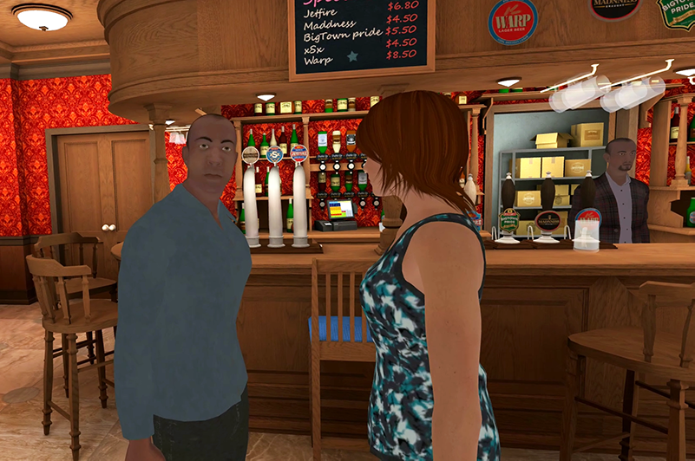
At the (virtual) pub
Riches et al (2020)
Notes:
VR designed to create this kind of “paranoia experience” – you wander around the bar, passing a few groups. Sometimes they’ll laugh as you walk by or say something about you as you move around. Afterwards participants were interviewed about their experience, to identify the kinds of thought processes, the kinds of interpretations that can lead to more paranoid-type thoughts.
Maybe removing the Powers study here? Complicated and less clear proof of concept than the Paranoia one

Slide 15
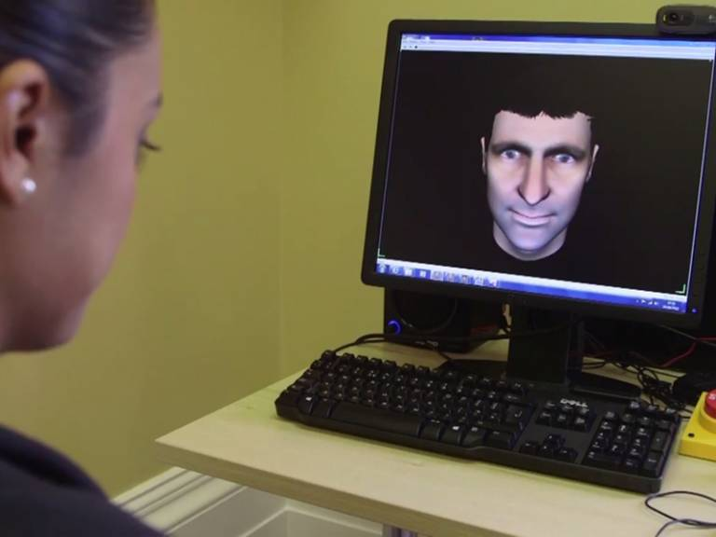
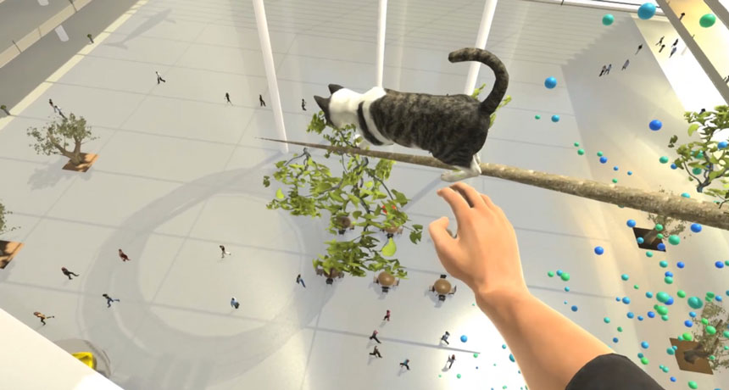
Therapeutic Value?
VR treatments for height phobia (Freeman et al., 2018)
AVATAR Therapy (Craig et al., 2018)

Slide 16
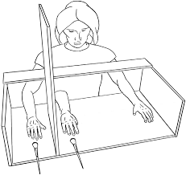
Recreating Unusual Bodily Sensations
Sense of body ownership is flexible
Depends on multisensory synchrony
Not quite the same as dissociation
Rubber Hand Illusion (Botvinick & Cohen, 1998)

Slide 17
Mixed-Reality and Body Disownership

Slide 18
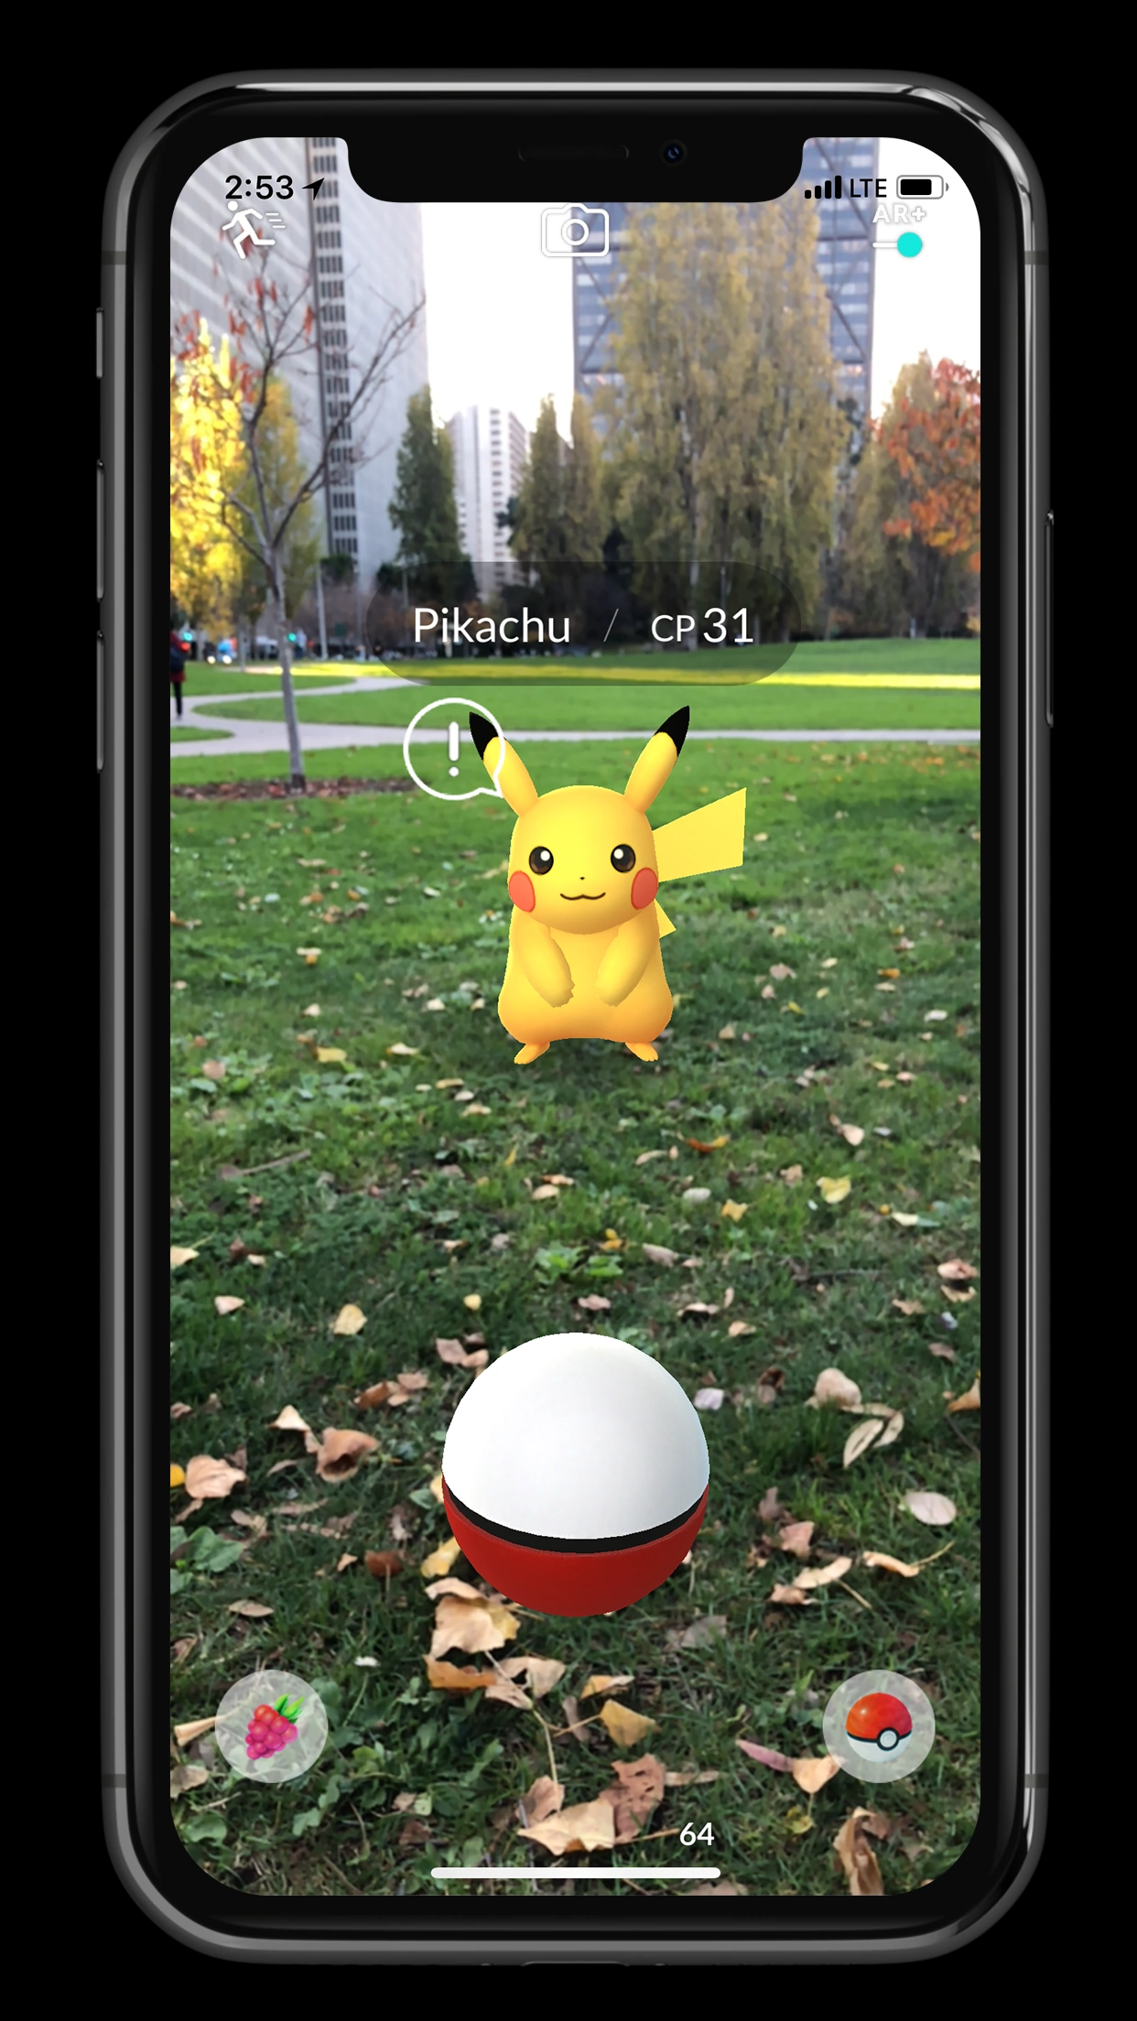
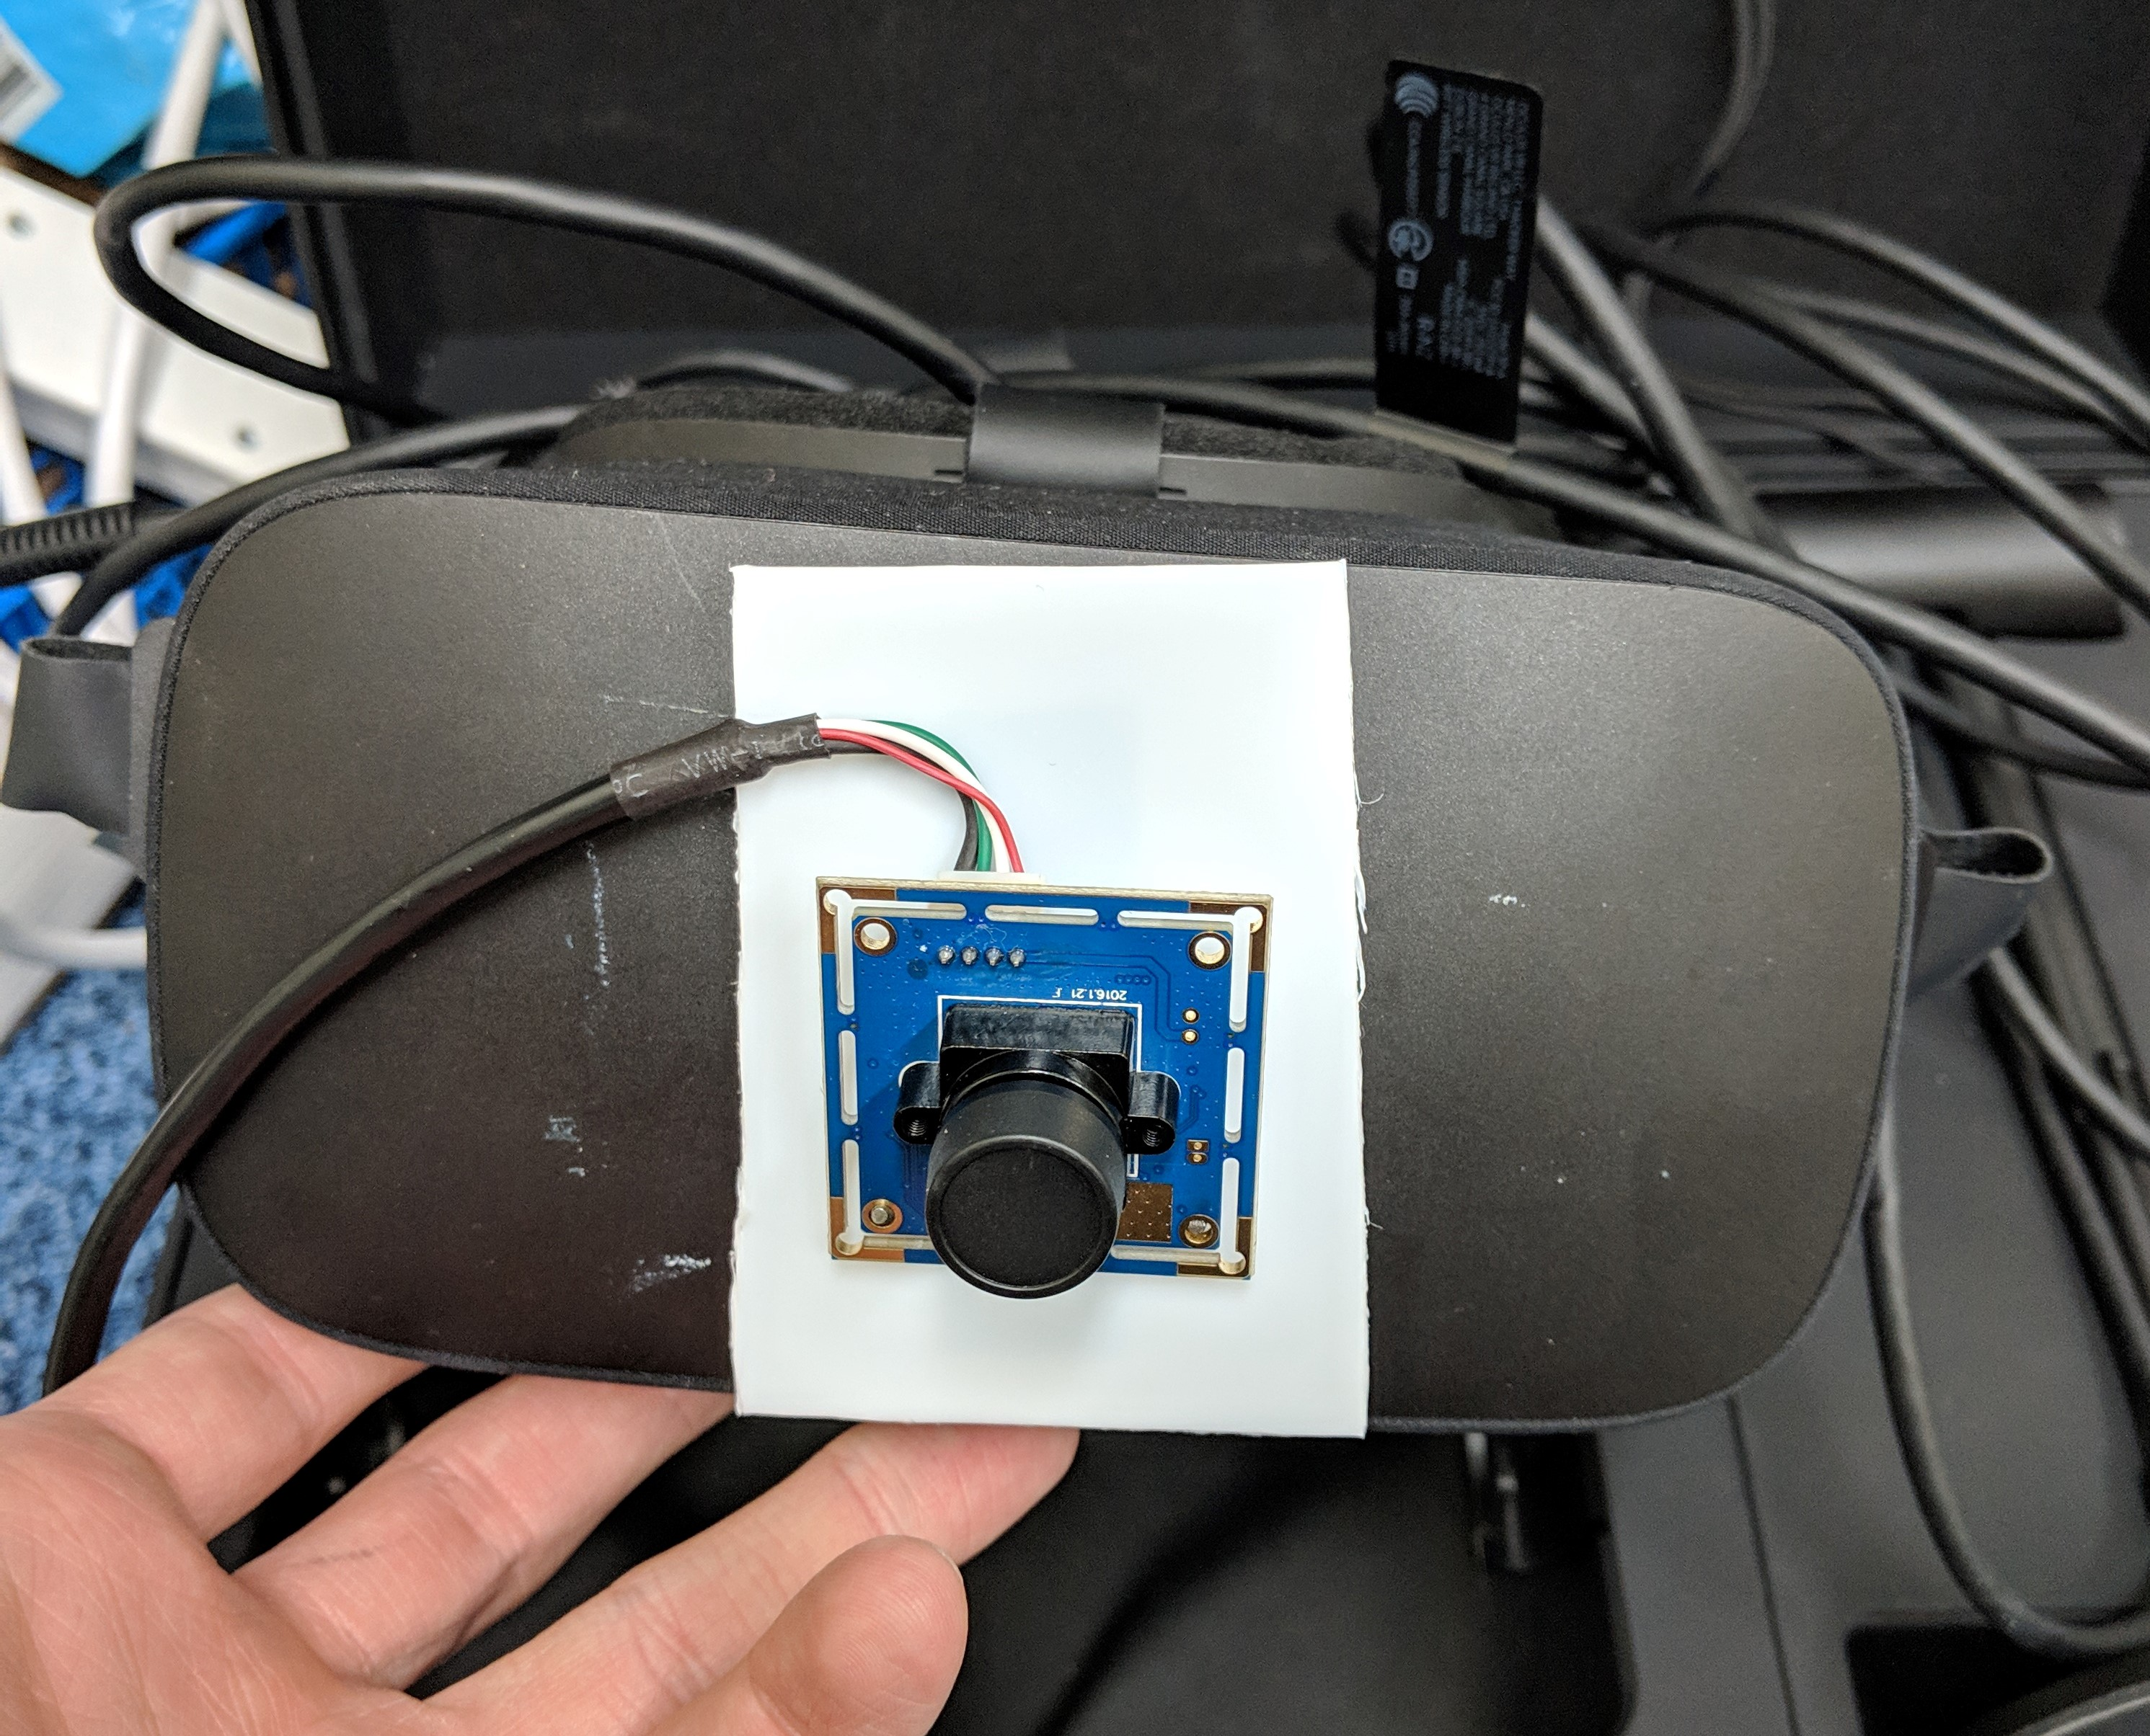


Mixed-Reality Task*
*Roel Lesur et al (2020)

Slide 19




Mixed-Reality Task*
*Roel Lesur et al (2020)
No Delay
Delay
Touch Sensation
Visual Sensation
Time
Time

Slide 20
Self vs Other
No Delay
Delay
Only for other-generated touch?
Do other- and self-generated touch differently associate with anomalous experiences?
Time
Time

Slide 21


Interoception
Sensing of bodily sensations and changes to bodily states (Khalsa et al., 2018)
Interoceptive accuracy lower in people with dissociation (Schaflein et al., 2018)
Lower interoceptive accuracy associated with enhanced susceptibility to RHI (Tsakiris et al., 2011)
Notes:
Interoception is a good candidate for a source of sensory data that may influence body ownership

Slide 22
Questionnaires
Dissociation
Cambridge Depersonalisation Scale (Sierra & Berrios, 2000)
Somatoform Dissociation Questionnaire (Nijenhuis et al., 1996)
Anomalous Perceptions
Cardiff Anomalous Perceptions Scale (Bell et al., 2006)

Slide 23
Mixed-Reality Task – “Long” Version
Item | Sometimes I felt… | Factor
1. | Alienation from my body | Disownership
2. | As if my body does not belong to me anymore | Disownership
3. | As if my body was numb | Deafference
4. | As though the experience of my hand was less vivid than normal | Deafference
5. | As if the body I saw was my own | Embodiment
6. | As if I could move the seen body | Embodiment
7. | As if I were not real or as if I were cut-off from the world | Derealisation
8. | As if my surroundings felt detached or unreal | Derealisation
9. | That the experience was pleasant | Pleasantness
4 trials
60 seconds each
Delay
No delay Self-stroking | 1s Delay Self-stroking
No delay Other-stroking | 1s Delay Other-stroking
Source

Slide 24
Sensitivity to Delay
What amount of delay is noticeable? What amount causes dissociation?
Are there individual differences?
Time Delay

Slide 25
Mixed-Reality Task – “Threshold” Version
Item | Question
1. | It felt as if the touch/movement I saw and felt was synchronous (in time)
2. | It felt as if the hand that I saw was my own
3. | The experience felt pleasant
80 trials
9 seconds each
Time Delay
Self | 0ms | 66ms | 132ms | 198ms | 264ms | 330ms | 396ms | 462ms | 528ms | 594ms
Other | 0ms | 66ms | 132ms | 198ms | 264ms | 330ms | 396ms | 462ms | 528ms | 594ms
Source

Slide 26
Mixed-Reality Summary
Time delay between seen and felt sensations of touch leads to feelings of dissociation
These feelings related to dissociative feelings experienced in daily life, and with interoceptive ability
Participants more sensitive to self-stroking than other-stroking
Sensitivity to delay of self-generated sensations correlated with dissociative feelings in daily life

Slide 27
Recreating Tactile Hallucinations

Slide 28


Slide 29
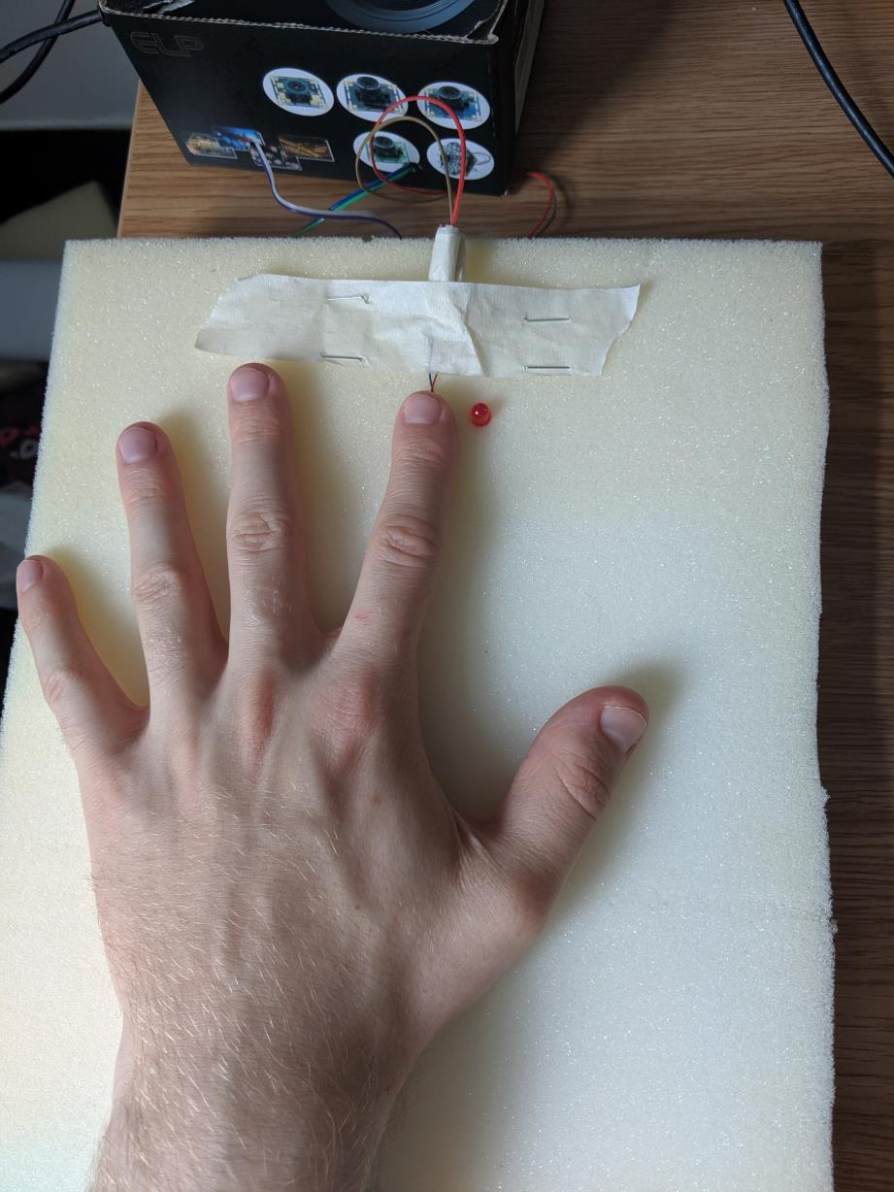
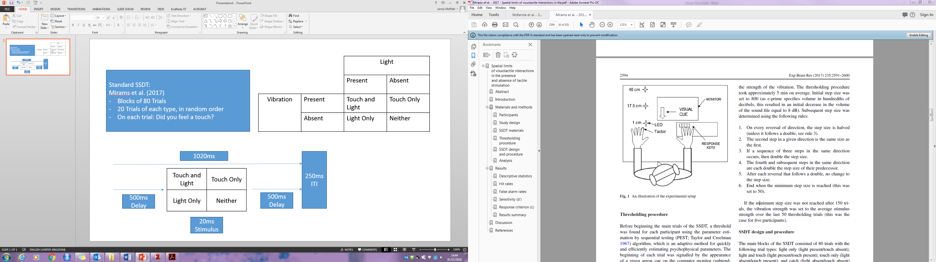
Somatic Signal Detection Task*
*Lloyd et al (2008)
Mirams et al (2017)
Notes:
I’m going to describe the method we used for this task in detail, please let me know if anything doesn’t make sense.
Participant also wears headphones which plays white noise during task, to mask sounds from vibrations. Light dimmed in the room.
4 blocks thresholding, 4 blocks of SSDT main

Slide 30

Somatic Signal Detection Task*
*Lloyd et al (2008)
1. Touch and Light
2. Touch only
3. Light only
4. No Touch, no Light

Slide 31
Somatic Signal Detection Task*
*Lloyd et al (2008)
1. Touch and Light
2. Touch only
3. Light only
4. No Touch, no Light
Did you feel a touch?
Yes/No
Hits
False Alarm

Slide 32
Overall Summary

Slide 33
Bringing the Tasks Together
Mixed-reality: higher dissociation associated with enhanced sensitivity to a delay between sight and feeling of self-generated tactile sensations
SSDT: higher dissociation associated with reduced ability to use a visual cue to enhance tactile perception
Dissociation may involve greater attention being paid to self-generated tactile sensations (1), which may reduce ability to use multisensory cues to enhance tactile perception (2)

Slide 34
Summary
Mixed-reality can be used to create feelings of dissociation that are associated with real life experiences of dissociation
We were unable to replicate a task for recreating tactile hallucinations
Together, the data from these tasks points towards a role for multisensory integration and self perception in dissociation
As always – more research needed!

Slide 35
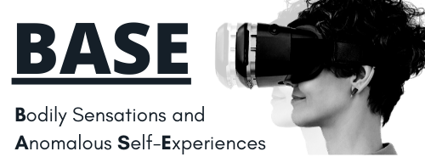

Future Research

Slide 36



Resources
https://www.unrealuk.org/
Dodie

Slide 37

Acknowledgements
Kathryn Greenwood
Sarah Garfinkel
Marte Roel Lesur
Bigna Lenggenhager
Jamie Ward
Hugo Critchley
Maxine Sherman
Keisuke Suzuki
Jolyon Miles-Wilson
Magdalena Del Rio Forster
Simon Saryazdi
Dennis Larsson
And many more!
100

Slide 38
Thank you for listening!

