Slide 1
The Emilia-Romagna guidance for promoting health and well-being in people experiencing a first episode of psychosis or at high risk of psychosis
27th May 2026
Dr. Giorgia Chiappalone
University of Bologna
AUSL Romagna
Notes:
Good afternoon. I’m here to talk about the regional programme for early interventions in psychosis.

Slide 2

Early psychosis: a disruptive event in a critical phase of development
Psychotic disorders affect around 2-3% of adolescents and young adults
Schizophrenia: its lifetime prevalence is estimated to be approximately between 0.3% and 0.7%, although this varies according to ethnicity, geographical background, and migration-related
Median incidence rate is around 15.2 cases per 100.000 people
M > F
Onset between adolescence and early adulthood -> not only psychiatric symptoms, but an existential rupture
Notes:
Let’s start with some numbers. Psychotic disorders affect around 2-3% of adolescents and young adults. Among them, schizophrenia remains the condition with the greatest clinical and social impact. Its lifetime prevalence is estimated between 0.3% and 0.7%, with differences due to ethnicity, geographical background, and migration-related factors. In young people, the median incidence rate is around 15.2 cases per 100,000 people, with a higher frequency in males than in females.
These epidemiological data show that psychotic disorders usually emerge during a crucial developmental period, in which people are gaining autonomy and shaping their identity.
For this reason, psychotic onset can have consequences that go far beyond symptoms. It may affect the way a person sees themselves, relates to others, and projects themselves into the future. In some cases, it can substantially alter the individual’s developmental and biographical trajectory.
For this reason, models of care have moved towards early, preventive and integrated intervention. The focus has shifted from managing an already established disorder to recognising, as early as possible, situations in which psychological distress may evolve into a full-blown psychotic disorder.

Slide 3

Emilia-Romagna programme
2016 >> 2024
Notes:
So the Emilia-Romagna regional programme for early psychosis follows this approach: it aims to identify people at high risk, or at first presentation of psychosis, to offer them an integrated and personalised care pathway, and to promote recovery in clinical, personal, relational and social sense.
These are regional recommentations for organising care for people at high risk of psychosis or at first presentation of psychosis. The 2024 version updates the previous 2016 recommendations, incorporating recent evidence and the experience developed through the programme over the last decade.

Slide 4
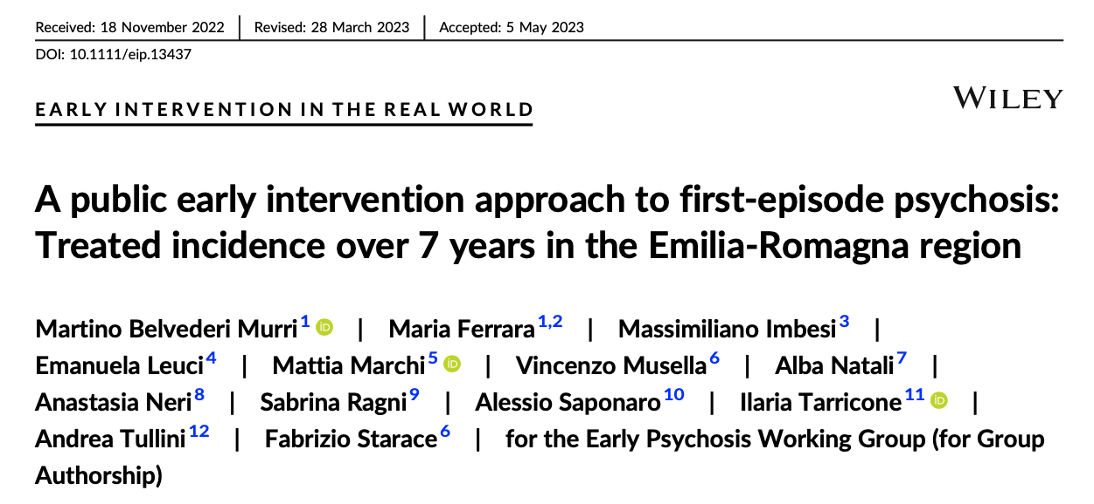
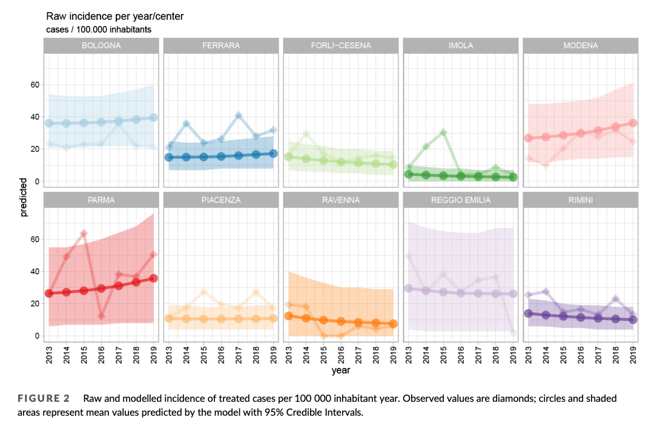
25.3 / 100,000 person-years
Regional treated incidence, 2013-2019
Age 18-35 | N = 1,318
No clear temporal trend: variability appears mainly related to area, rather than year or population density.
Notes:
These are some regional data on first-episode psychosis. They come from a study published in 2023 by professor Belvederi Murri, aiming to estimate the treated incidence (meaning the incidence of treated cases) among individuals aged 18 to 35 with first-episode psychosis who came into contact with the public mental healthcare system in Emilia-Romagna. The study used data collected between 2013 and 2019 considering 10 catchment areas such as Bologna, Ferrara, Forlì-Cesena, Modena, Parma, Piacenza, Ravenna, Reggio Emilia, Rimini, and Imola.
Overall, they found 25.3 new treated cases of first-episode psychosis per 100,000 people per year. This finding is interesting because it shows a quite high regional incidence, but above all a territorial variability. If we take a look at the individual areas, we can see that incidence does not appear to follow a clear linear trend over time, nor does it seem to be explained by population density; rather, the variability appears to be mainly associated with the specific area or centre of reference.

Slide 5
The Duration of Untreated Psychosis (DUP)
- The regional programme was introduced in September 2012, with DUP reduction as one of its core objectives
- Psychosis-related consequences can be considered time-dependent
- A shorter DUP is associated with:
  less severe symptoms at first contact
  fewer negative symptoms
  better response to antipsychotic treatment
  better global, social and occupational functioning
  better quality of life
Notes:
Taking into consideration that the regional programme was introduced in September 2012, the current model is based on almost fourteen years of regional experience in early intervention.
In the regional programme, DUP refers to the Duration of Untreated Psychosis. Reducing DUP is one of the main target of the early psychosis programme: this means shortening the time between the onset of psychotic symptoms and access to integrated care. This is clinically important because the consequences of psychosis are, to some extent, time-dependent. The longer psychotic symptoms remain unrecognised and untreated, the greater the risk that clinical and functional and social consequences will become more established and harder to reverse.
The recommendations underline that a shorter DUP is associated with less severe symptoms at first contact with services, fewer negative symptoms, a better response to antipsychotic treatment, better functioning, and a better quality of life.
For this reason, the programme also has a strong organisational dimension. Services need to identify possible cases earlier, facilitate access, communicate with each other, and ensure that assessment and care planning take place without unnecessary delay.

Slide 6

Target population: from high-risk states
to first-episode psychosis
Main age range:
15-35 years
Median age of onset: 22-23 years
Target population:
First-episode psychosis
High risk mental states
APS
BLIPS
Familial vulnerability + functional decline
Inclusion criteria:
DUP < 2 years
DUP > years if they have not yet received intervention
Notes:
The programme is addressed to two main groups: individuals at the first manifestation of psychosis, and high-risk mental states. It applies to young people between 15 and 35 years, with a DUP of less than two years (or even more if they have not previously received the intervention described in the regional programme).
The programme aims to reduce distress, monitor clinical evolution, support functioning, and, where possible, reduce the risk of transition to psychosis. High-risk mental states are usually grouped into three main categories.
The first is attenuated psychotic symptoms: these are experiences similar to psychotic symptoms (such as suspiciousness, unusual ideas, perceptual abnormalities or mild disorganisation), but they are less intense, more transient, and associated with at least partially preserved reality testing.
The second category is represented by BLIPS: brief and intermittent episodes of full-blown psychotic symptoms, which remit spontaneously and last less than one week.
The third category concerns familial vulnerability associated with recent functional decline: this may include individuals with a first-degree relative with a psychotic disorder, or people with schizotypal disorder with a significant deterioration in functioning.

Slide 7
Service organisation: a community-based network
Italian psychiatric reform, 1978 (Franco Basaglia, Law 180)
From asylum-based psychiatry
to a public, community-based mental health system
The DSMDP coordinates:
CSM: adult community mental health centres
NPIA: child and adolescent neuropsychiatry
SerDP: addiction services
SPDC: psychiatric inpatient units
Rehabilitation and social inclusion pathways
Other actors involved:
general practitioners and paediatricians
social services
schools
Community Health Centres
voluntary organisations and private social sector
early psychosis care requires a network, not a single service!!
Notes:
In order to better understand the Emilia-Romagna programme, it’s useful to recall that Italian mental health care is mainly public and community-based. Since the psychiatric reform of 1978, associated with Franco Basaglia and Law 180, mental health care has moved away from large psychiatric hospitals towards territorial services.
In Emilia-Romagna, the central structure is the Department of Mental Health and Pathological Addictions, or DSMDP, which is responsible for implementing the early psychosis pathway. It coordinates adult community mental health centres, child and adolescent neuropsychiatry, addiction services, psychiatric inpatient units, and rehabilitation or social inclusion programmes.
However, early psychosis care also involves general practitioners, schools, social services and community organisations, because early signs often appear first in everyday contexts. The regional model is therefore based on a coordinated network, ensuring continuity and shared responsibilities.

Slide 8

Early identification and screening
Warning signs:
progressive social withdrawal
decline in school/work functioning
reduced self-care
behavioural changes
suspiciousness or unusual ideas
perceptual disturbances
mild thought or speech disorganisation
Recommendend screening tools:
CVEP (checklist for the assessment of psychotic onset)
PQ brief version (prodromal questionnaire)
specialist assessment
Notes:
The first signs of a possible psychotic onset are not always immediately recognisable as psychotic symptoms. They may emerge gradually and be interpreted as an adolescent crisis, depressive withdrawal, anxiety, substance abuse, or difficulties in school or family life.
For this reason, early identification is a crucial part of the programme. Clinicians are encouraged to pay attention to early signs such as progressive social withdrawal, suspiciousness, unusual ideas, and so on.
We recommend the use of specific screening tools, particularly the Checklist for the Assessment of Psychotic Onset, or CVEP, and the brief version of the Prodromal Questionnaire, or PQ. Anyway, these tools are not intended to provide a definitive diagnosis: their role is to help professionals collect warning signs in a more systematic way and decide whether a more in-depth specialist assessment is needed.

Slide 9
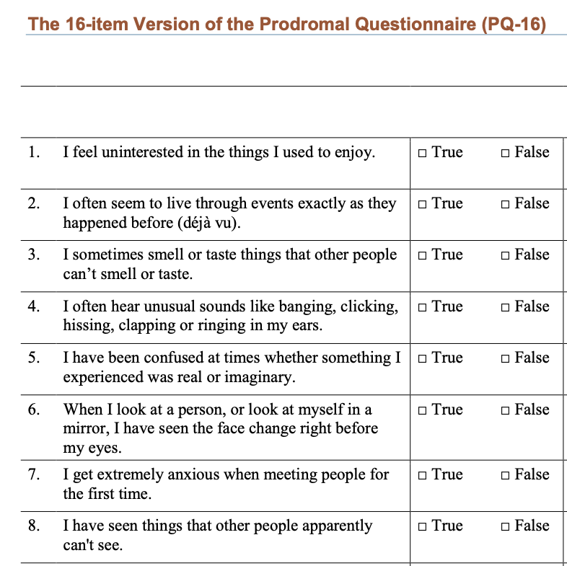
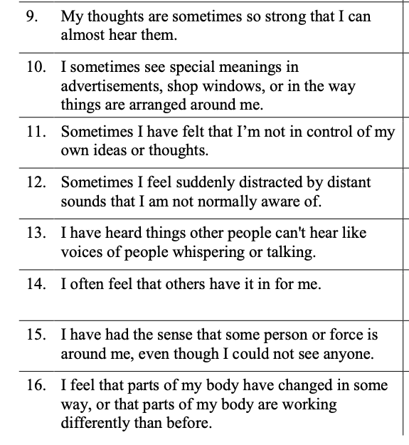
PQ-16 (self-report)
PQ-16 / iPQ-16: Ising et al., 2012; Pelizza et al., 2018; Azzali et al., 2018; Pelizza et al., 2019.
Notes:
The first screening tool is the PQ-16, the 16-item version of the Prodromal Questionnaire. It is a brief self-report questionnaire, designed to detect psychotic-like experiences in young help-seeking individuals.
Each item is answered as true or false, and if the experience is present, the person is also asked to rate the associated distress.

Slide 10
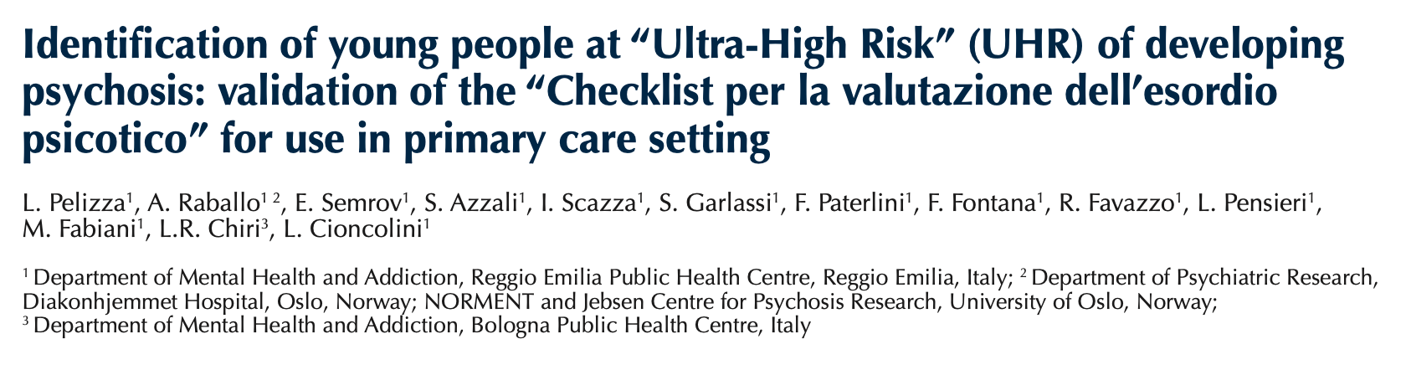
CVEP
Affective and cognitive changes
- Sleep difficulties
- Depressed mood
- Poor concentration
- Tension or nervousness
- Restlessness or agitation
Vulnerability item:
First-degree family history of psychosis plus increased stress or functional deterioration
Clinician-rated checklist
20 items
Adapted from the Primary Care Checklist (French et al., 2012.)
Psychotic-like experiences
- Feeling that people are watching you
- Hearing or perceiving things that other people cannot
- Ideas of reference
- Odd or unusual beliefs
- Odd manner of thinking or speech
- Inappropriate or incongruent affect
- Odd behaviour or appearance
Social and functional changes
- Spending more time alone
- Arguing more often with friends or family
- Family members are concerned
- Reduced interest or involvement in work, study, daily activities, or social relationships
Notes:
The second tool is the CVEP, the Italian Checklist for the Assessment of Psychotic Onset. It’s the Italian adaptation of the Primary Care Checklist, and it’s intended mainly as a clinician-rated checklist.
Compared with the PQ-16, it’s less focused on self-reported anomalous experiences and more on the general clinical picture with attention to psychotic-like experiences.
Anyway, screening should not be limited to specialist mental health services. It should also involve trained professionals working in primary care, paediatrics, social services, schools and family counselling services. It should also involve professionals working in Community Health Houses, which in the Italian healthcare system are local facilities where people can access different types of healthcare and social assistance.
If the initial interview or screening tools suggest a possible high-risk state or psychotic onset, the person should be referred for specialist assessment.

Slide 11
Specialist assessment and case formulation
Case formulation including:
psychopathology
personal and social functioning
suicide and aggression risk
substance use
physical health
family context
school/work functioning
stressful life events
cultural factors and available resources
Recommended tools:
CAARMS (assessment of high-risk mental states)
MINI (categorical differential diagnosis)
Within one month!
What is happening in this person’s life?
Which resources can we activate?
Notes:
After screening, the next step is specialist assessment. The regional programme recommend developing a case formulation, meaning a comprehensive understanding of the person, their functioning, their life context, and the factors that may have contributed to the onset or worsening of symptoms.
This assessment includes categorical diagnosis, but it also brings together several other dimensions, such as psychopathology, personal and social functioning, risk to self or others, substance use, physical health, family relationships, school or work, stressful life events, cultural factors, and available resources. According to the regional recommendations, this phase should usually be completed within one month of referral.
Also during this stage, psychometric tools can help make the assessment more structured and consistent. The programme mention, among others, the Comprehensive Assessment of At-Risk Mental States (CAARMS), which is used to assess high-risk mental states, and the Mini International Neuropsychiatric Interview (MINI), which supports categorical differential diagnosis.
The involvement of the patient, and whenever possible the family, is also essential. The reasons for the assessment and for any proposed intervention should be explained clearly, encouraging active participation from the beginning. In this sense, case formulation is also a collaborative process because it helps the team and the patient build a personalised care pathway, based on clinical needs, strengths, preferences, and taking into consideration the person’s life context.
So the question “what disorder does this person have?” becomes more like “what is happening in this person’s life, what has contributed to the crisis, what risks need to be addressed, and what resources can be activated?”

Slide 12

Management of high-risk mental states
Guiding principle: intervene without overtreating
Recommended interventions:
Main target:
Current symptoms
Stress factors
Coping strategies
Global functioning
CBT-oriented psychological support
Family interventions
Skills training
Educational, occupational or vocational support
Antipsychotics are not recommended
for subthreshold symptoms or to prevent transition to psychosis!
Notes:
Once specialist assessment has been completed, the care pathway depends on whether the person presents with full-blown psychosis or a high-risk mental state. In high-risk mental states, symptoms are subthreshold, but distress and functional impairment can still be significant, with anxiety, depressive symptoms, social withdrawal, and difficulties at school, work, or in relationships.
For this reason, the intervention should be active but proportionate, avoiding unnecessary stigma or overtreatment. The regional recommendations mainly recommend psychological and psychosocial interventions, including CBT, family work, skills training, and educational or vocational support when needed. The aim is to reduce distress, improve coping, protect functioning, and monitor possible clinical progression. Family involvement is especially important in young people, because relatives can help clinicians understand the situation, notice early warning signs, and support the person in a more balanced way.
Pharmacological treatment requires caution. Antipsychotics should not be prescribed for subthreshold symptoms or simply to prevent transition to psychosis. They may be considered only in selected cases, such as severe distress, rapid functional deterioration, risk, or poor response to first-line psychosocial interventions.

Slide 13


Acute psychotic crisis: integrated care
Therapeutic
alliance
Involve
the family
Convey
hope
Goals are not only pharmacological
define both
short- and
long-term
care plans
Acute care should be integrated with community-based services from the outset!
Notes:
If the patient develops an acute psychotic crisis, the programme focuses on a more critical clinical phase. The immediate priorities are to reduce psychotic symptoms, subjective distress, disorganised or risky behaviour, and the risk of harm to self or others.
However, acute care is not only about medication or symptom control. From the beginning, clinicians should work on therapeutic alliance, involve the family when possible, convey realistic hope, and start defining both short-term and longer-term care priorities.
Whenever it is clinically safe, the acute phase should be managed in the least restrictive setting, preferably in the community. If hospital admission is necessary, it should be closely connected with the community pathway. The community services should be involved as soon as possible, with communication to the early psychosis team within 48 hours.
So, even during acute crisis, the model remains integrated: symptom reduction, risk management, family support, and continuity of care.

Slide 14
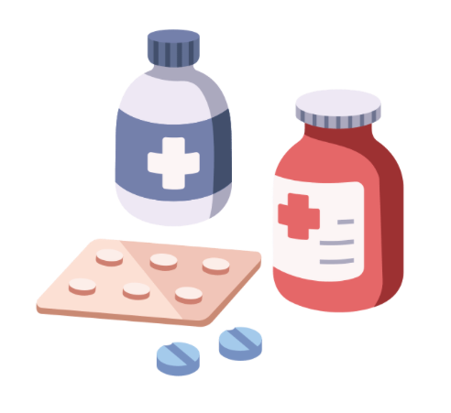
Pharmacological treatment
Main recommendations:
Start treatment as early as possible, if indicated
Consider 24-48 h observation without antipsychotics in
selected first-episode cases
Prefer second-generation antipsychotics
Individualise treatment choice
Provide clear information to patient and family
Use the minimum effective dose
Monitor physical health and side effects
Maintain treatment for 12-24 months after response,
with gradual reduction only after complete remission
Notes:
According to the regional recommendations, pharmacological treatment should be started when a first episode of psychosis is confirmed or strongly suspected.
At the same time, in a first episode a short period of observation without medication may be appropriate, usually for 24 to 48 hours. This is particularly true when there is a diagnostic uncertainty and the clinical condition allows it. During this period, benzodiazepines may be used to manage anxiety, insomnia or agitation.
Second-generation antipsychotics are recommended as first-line treatment, mainly because of their lower risk of extrapyramidal side effects compared with first-generation antipsychotics. However, the choice of medication should always be individualised. Clinicians should consider the clinical presentation, side-effect profile, patient preference and physical comorbidities.
The patient and their family should be informed about the medication: expected benefits, possible side effects, alternative options, and the choice of medication. This is important in early psychosis, because the first experience of medication can strongly influence the patient’s future relationship with both services and pharmacological treatment.
The general principle is to use the minimum effective dose, balancing symptom reduction with tolerability. If relevant side effects occur we should consider dose adjustment or switching medication. After clinical response, treatment is generally maintained for 12 to 24 months, with gradual dose reduction only in complete remission and with close follow-up.

Slide 15

Psychological, psychoeducational and psychosocial interventions
CBT-oriented approaches
Psychoeducation
Family interventions
To work on symptoms, insight, social anxiety and adherence
To help patient and family understand the disorder, treatment and early warning signs
To improve communication, problem-solving, mutual understanding and relapse prevention
Pharmacological treatment should be integrated with psychological, psychoeducational and family interventions to support recovery and prevent relapse
Notes:
As I said before, the regional programme includes psychological, psychoeducational and psychosocial interventions as essential parts of the care pathway.
CBT is recommended both in the acute phase and in the following stages. It can help address positive and negative symptoms, social anxiety, illness awareness and adherence to treatment. It also helps the patient make sense of the psychotic experience in a less frightening way, by linking thoughts, emotions, symptoms and behaviour.
Psychoeducation is addressed to both the patient and the family. It provides information about the disorder and treatment, but also helps develop a shared language around what is happening. This includes recognising early warning signs, improving adherence, reducing stigma, and preparing a relapse prevention plan.
Family work is also central. It focuses on communication, problem-solving, reducing expressed emotion and improving mutual support. Together, these interventions make the programme genuinely multicomponent, rather than centred on medication alone.

Slide 16

Recovery
the first 2-5 years are
a critical window for intervention!
Symptom remission
Relationships
Daily functioning
Rebuilding
a life project
Study
Work
Autonomy
Notes:
In the regional programme, recovery means more than symptomatic remission. Reducing delusions, hallucinations, disorganisation and distress is essential, especially in the acute phase, but the pathway must also support functioning, autonomy and the person’s ability to invest in their future.
This is particularly important in early psychosis, because as we said the disorder often emerges while identity is still being shaped. After a first episode, the patient may need support to make sense of the experience.
The recommendations emphasise that functional recovery is often more complex than symptomatic recovery. For this reason, interventions should target functioning from the first episode, especially during the first years after onset. Recovery goals should be realistic, meaningful and agreed with the patient, avoiding excessive pressure.
This may involve rehabilitation professionals, educators, social skills training, social inclusion programmes and work-oriented interventions such as Individual Placement and Support.

Slide 17

Physical health monitoring as part of the care pathway
Protecting physical health improves prognosis, prevents complications and supports treatment adherence
Baseline and follow-up monitoring
ECG when indicated, blood tests, weight, waist circumference, blood pressure, movement disorders
Metabolic and cardiovascular risk
Glucose, lipid profile, cardiovascular risk factors, antipsychotic-related side effects
Lifestyle assessment
Smoking, alcohol/substance use, diet, physical activity and sleep.
Healthy lifestyle promotion
Psychoeducation on diet, exercise, smoking reduction/cessation and sleep hygiene
Integrated care
GP, SerDP, dietitians or other specialists when needed
Notes:
In the regional programme, preserving physical health is part of psychosis care. Risk factors in these population include smoking, sedentary behaviour, alcohol or substance use. Also the exposure to side effects of antipsychotic contributes to the risk.
Monitoring should start from the beginning of the pathway, including weight, waist circumference, blood pressure, and so on. An ECG should be considered when clinically indicated, depending on the medication and cardiovascular risk profile.
The programme also promotes healthier lifestyles, through psychoeducation.

Slide 18
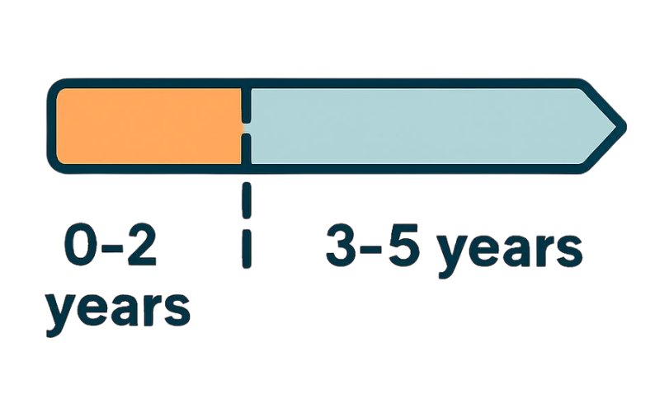
The first years after the onset: relapse prevention and recovery
High vulnerability to relapse
Risk of functional decline
Functioning at 2 years predicts later outcomes
Ongoing vulnerability:
Periodic care plan reviews
Redefinition of goals and interventions when needed
Close follow-up:
  monitor symptoms, relapse risk, adherence and side effects
Continue multicomponent interventions:
  psychological interventions, psychoeducation, family work, relapse prevention
Monitor physical health:
  weight, metabolic risk, cardiovascular risk, lifestyle and substance use
Support functional recovery:
  return to study/work, daily routine, social skills and meaningful activities
Schedule periodic reviews:
  reassess goals, treatment plan and level of functioning
Adjust treatment gradually, monitor symptoms and clinical signs
Consolidate social inclusion:
  autonomy, community adjustment, work, leisure time and quality of life
Annual physical health check:
  physical examination, weight, blood pressure, waist circumference, lipids, ECG and fasting glucose
Notes:
After the acute phase, the care pathway needs to continue over time. In the first years after the onset, patients remain vulnerable, both to relapse and to possible deterioration in global functioning. During the first 2 years after the onset, specific interventions can have a significant impact on the person’s later trajectory. The level of functioning achieved around two years after diagnosis is also considered an important predictor of future functioning. During this phase, the interventions already started should be maintained. Moreover, the patient and family should be helped to recognise early warning signs and to know when and how to contact services.
After the first two years, and up to five years after the onset, vulnerability usually decreases, but it doesn’t disappear. Some patients may be in complete remission, while others may still present residual symptoms. Periodic reviews of the care plan are therefore needed, with possible redefinition of goals and interventions.

Slide 19
Specific populations
Dual diagnosis
- Coordinate psychosis care with SerDP
- Integrate substance-use treatment, toxicological screening and relapse prevention
Migrant patients
- Assess migration history, trauma, social vulnerability and access barriers
- Involve linguistic/cultural mediation when needed
Sex and gender
- Recognise atypical presentations in women
- Consider reproductive health, pregnancy, postpartum period and pharmacological implications
Severe personality disorders
- Therapeutic contract, crisis planning and clear collaboration with the patient
Notes:
The Emilia-Romagna programme also includes recommendations for specific populations.
When substance abuse is present, the pathway should involve the addiction service. The recommendations also stress the importance of toxicological screening, which should be included within a shared therapeutic framework, rather than experienced by the patient as a controlling or punitive measure.
A second area concerns people from migrant backgrounds. When needed, linguistic and cultural mediation should be activated.
The recommendations also pay attention to sex and gender. In women, psychosis may present with less evident behavioural disturbance and a greater prominence of affective symptoms, anxiety or depression. We also need to take into account reproductive health, which can be impaired by pharmacological treatment.
Finally the programme mention severe personality disorders. We must pay attention to the possible overlap of psychotic-like symptoms such as affective instability and interpersonal dysregulation.

Slide 20
From regional recommendations to local care pathways
The regional model becomes effective when translated into a structured local pathway
Local guidelines
- Each DSMDP develops its own care pathway for early psychosis
Access and assessment
- The local guidelines defines how patients enter the pathway and who carries out the assessment
Reference professional
- A designated professional coordinates the care project across services
Periodic reviews
- The care plan is reviewed every 6-12 months and adjusted when needed
CURE electronic record
- Inclusion, assessments, interventions and outcome indicators are documented in CURE
Notes:
To make the programme applicable in everyday clinical practice, the regional recommendations state that each Department of Mental Health and Pathological Addictions should develop its own local guidelines, in italian called PDTA. This can be understood as a local care pathway: it defines how people enter the programme, who carries out the assessment, which interventions should be activated, and how the person is monitored over time.
Within the pathway, a reference professional is identified. Their role is to maintain an overall view of the care project and facilitate coordination between services involved. They help ensure that the pathway remains coherent and that responsibilities are clearly defined.
The programme also recommend periodic reviews of the care project, usually every 6 to 12 months. These reviews are used to assess whether the goals are still appropriate, whether the interventions remain effective, and whether the care plan needs to be adjusted. This flexibility is essential, especially in the first years after onset, when the clinical picture, functioning and personal needs may change significantly.
Finally, an important role is played by CURE, which is the regional electronic clinical record available since 2022.

Slide 21
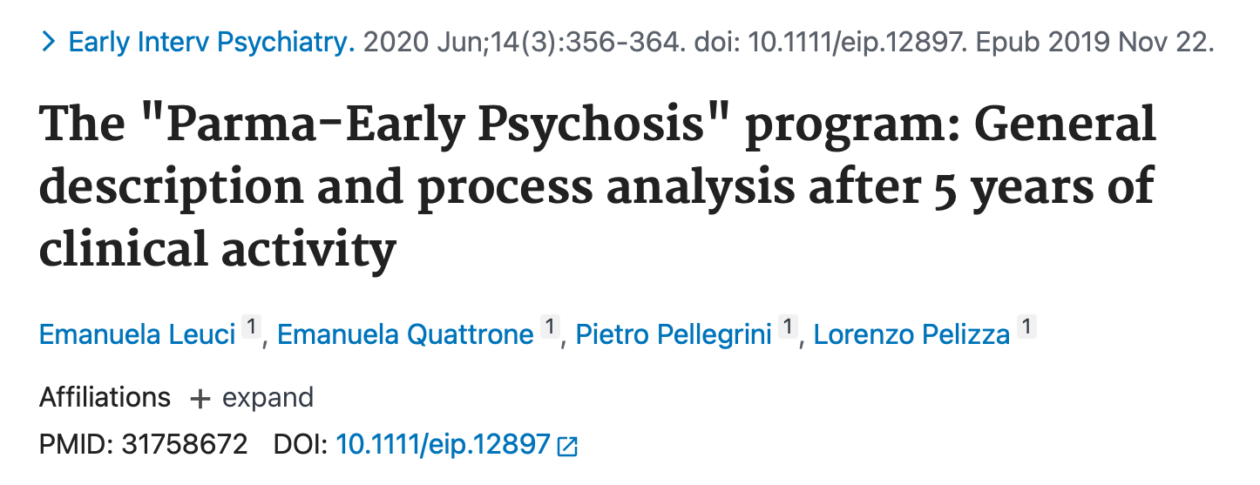
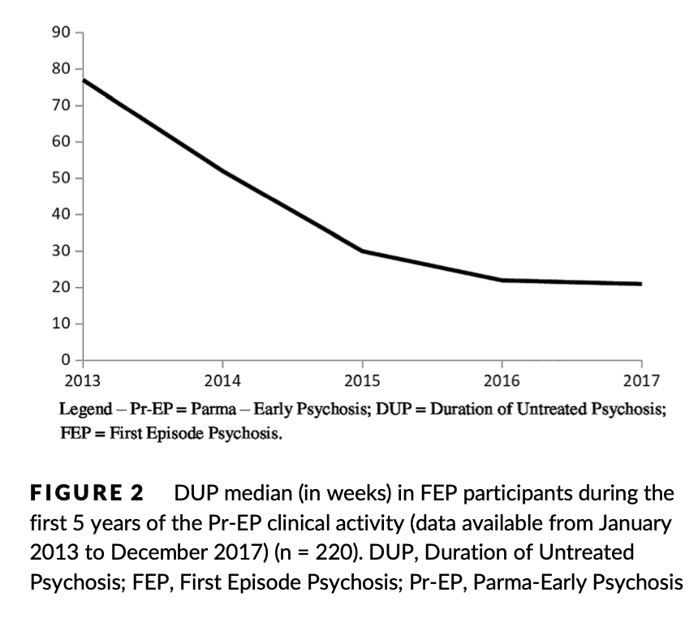
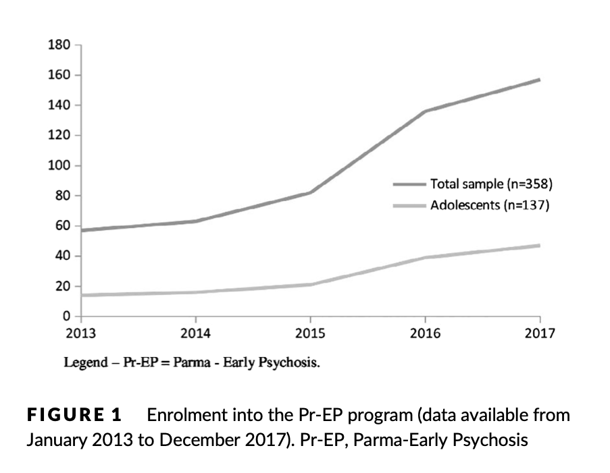
From clinical practice to real world evidence: the Pr-EP programme
DUP decreased (2013>17)
77 weeks -> 21 weeks
358 help-seeking individuals entered the programme
220 FEP + 138 UHR
40 drop-outs at 1 year (11.8%)
Notes:
A useful example of the application of this programme comes from the Parma-Early Psychosis programme. During the first five years of clinical activity, from 2013 to 2017, 358 people entered the programme. Of these, 220 had a first episode of psychosis and 138 met ultra-high-risk criteria.
Most referrals came from general practitioners and emergency or general hospital services. The first-year drop-out rate was relatively low, around 12%, suggesting good acceptability of the care pathway. Most importantly, the median duration of untreated psychosis decreased over time, from 77 weeks in 2013 to 21 weeks in 2017.

Slide 22
Early psychosis: protecting life trajectories
Final take-home messages
- The Emilia-Romagna model for early psychosis is based on prevention and early intervention
- The aim is to reduce DUP, recognise high-risk states and build timely, integrated and personalised pathways
- The final goal is to prevent psychosis from becoming a definitive rupture and to preserve the person’s biographical continuity
Notes:
In conclusion, the Emilia-Romagna model for early psychosis is grounded in a preventive approach by reducing the duration of untreated psychosis, identifying high-risk mental states, and offering a personalised care pathway.
Psychotic onset often occurs at a stage when identity, social functioning, family relationships, education, work and future plans are still being built. For this reason, early intervention has a protective function: it aims to reduce the clinical impact of psychosis, but also to preserve as much as possible the person’s biographical continuity. In this sense, the programme is a clinical pathway, but also a cultural model.

Slide 23
Thanks for the attention ☺

