Slide 1



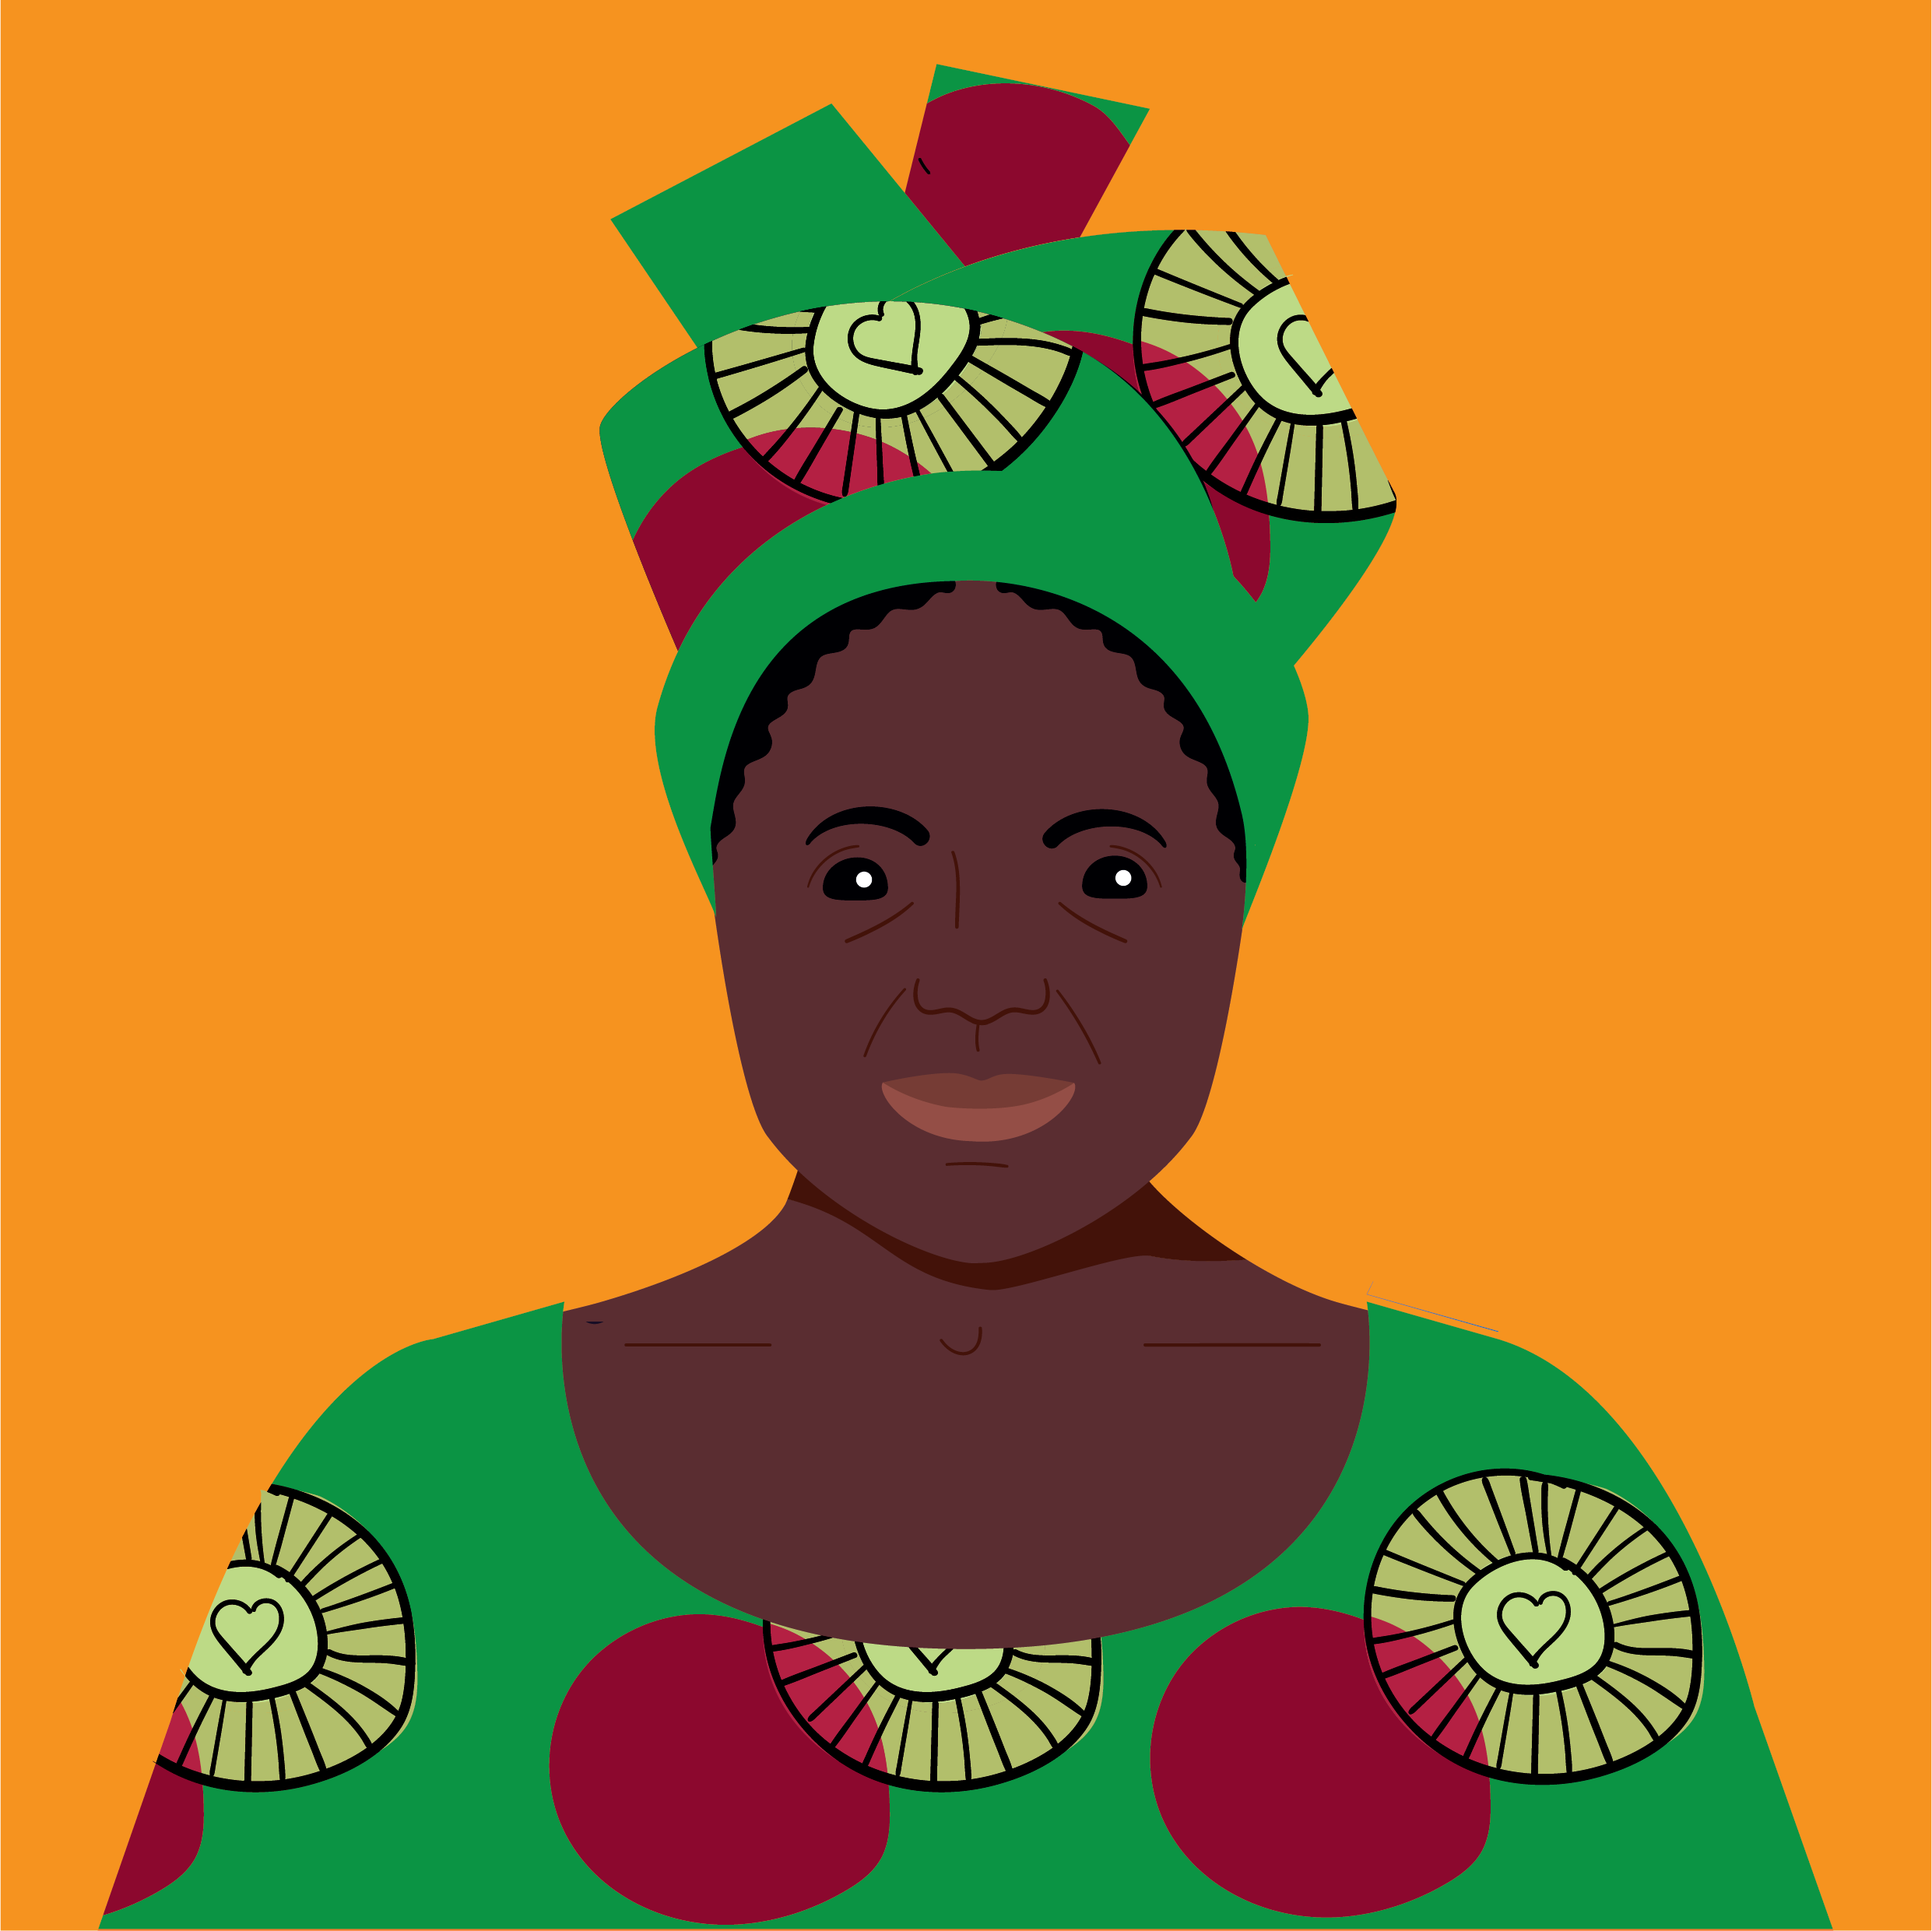
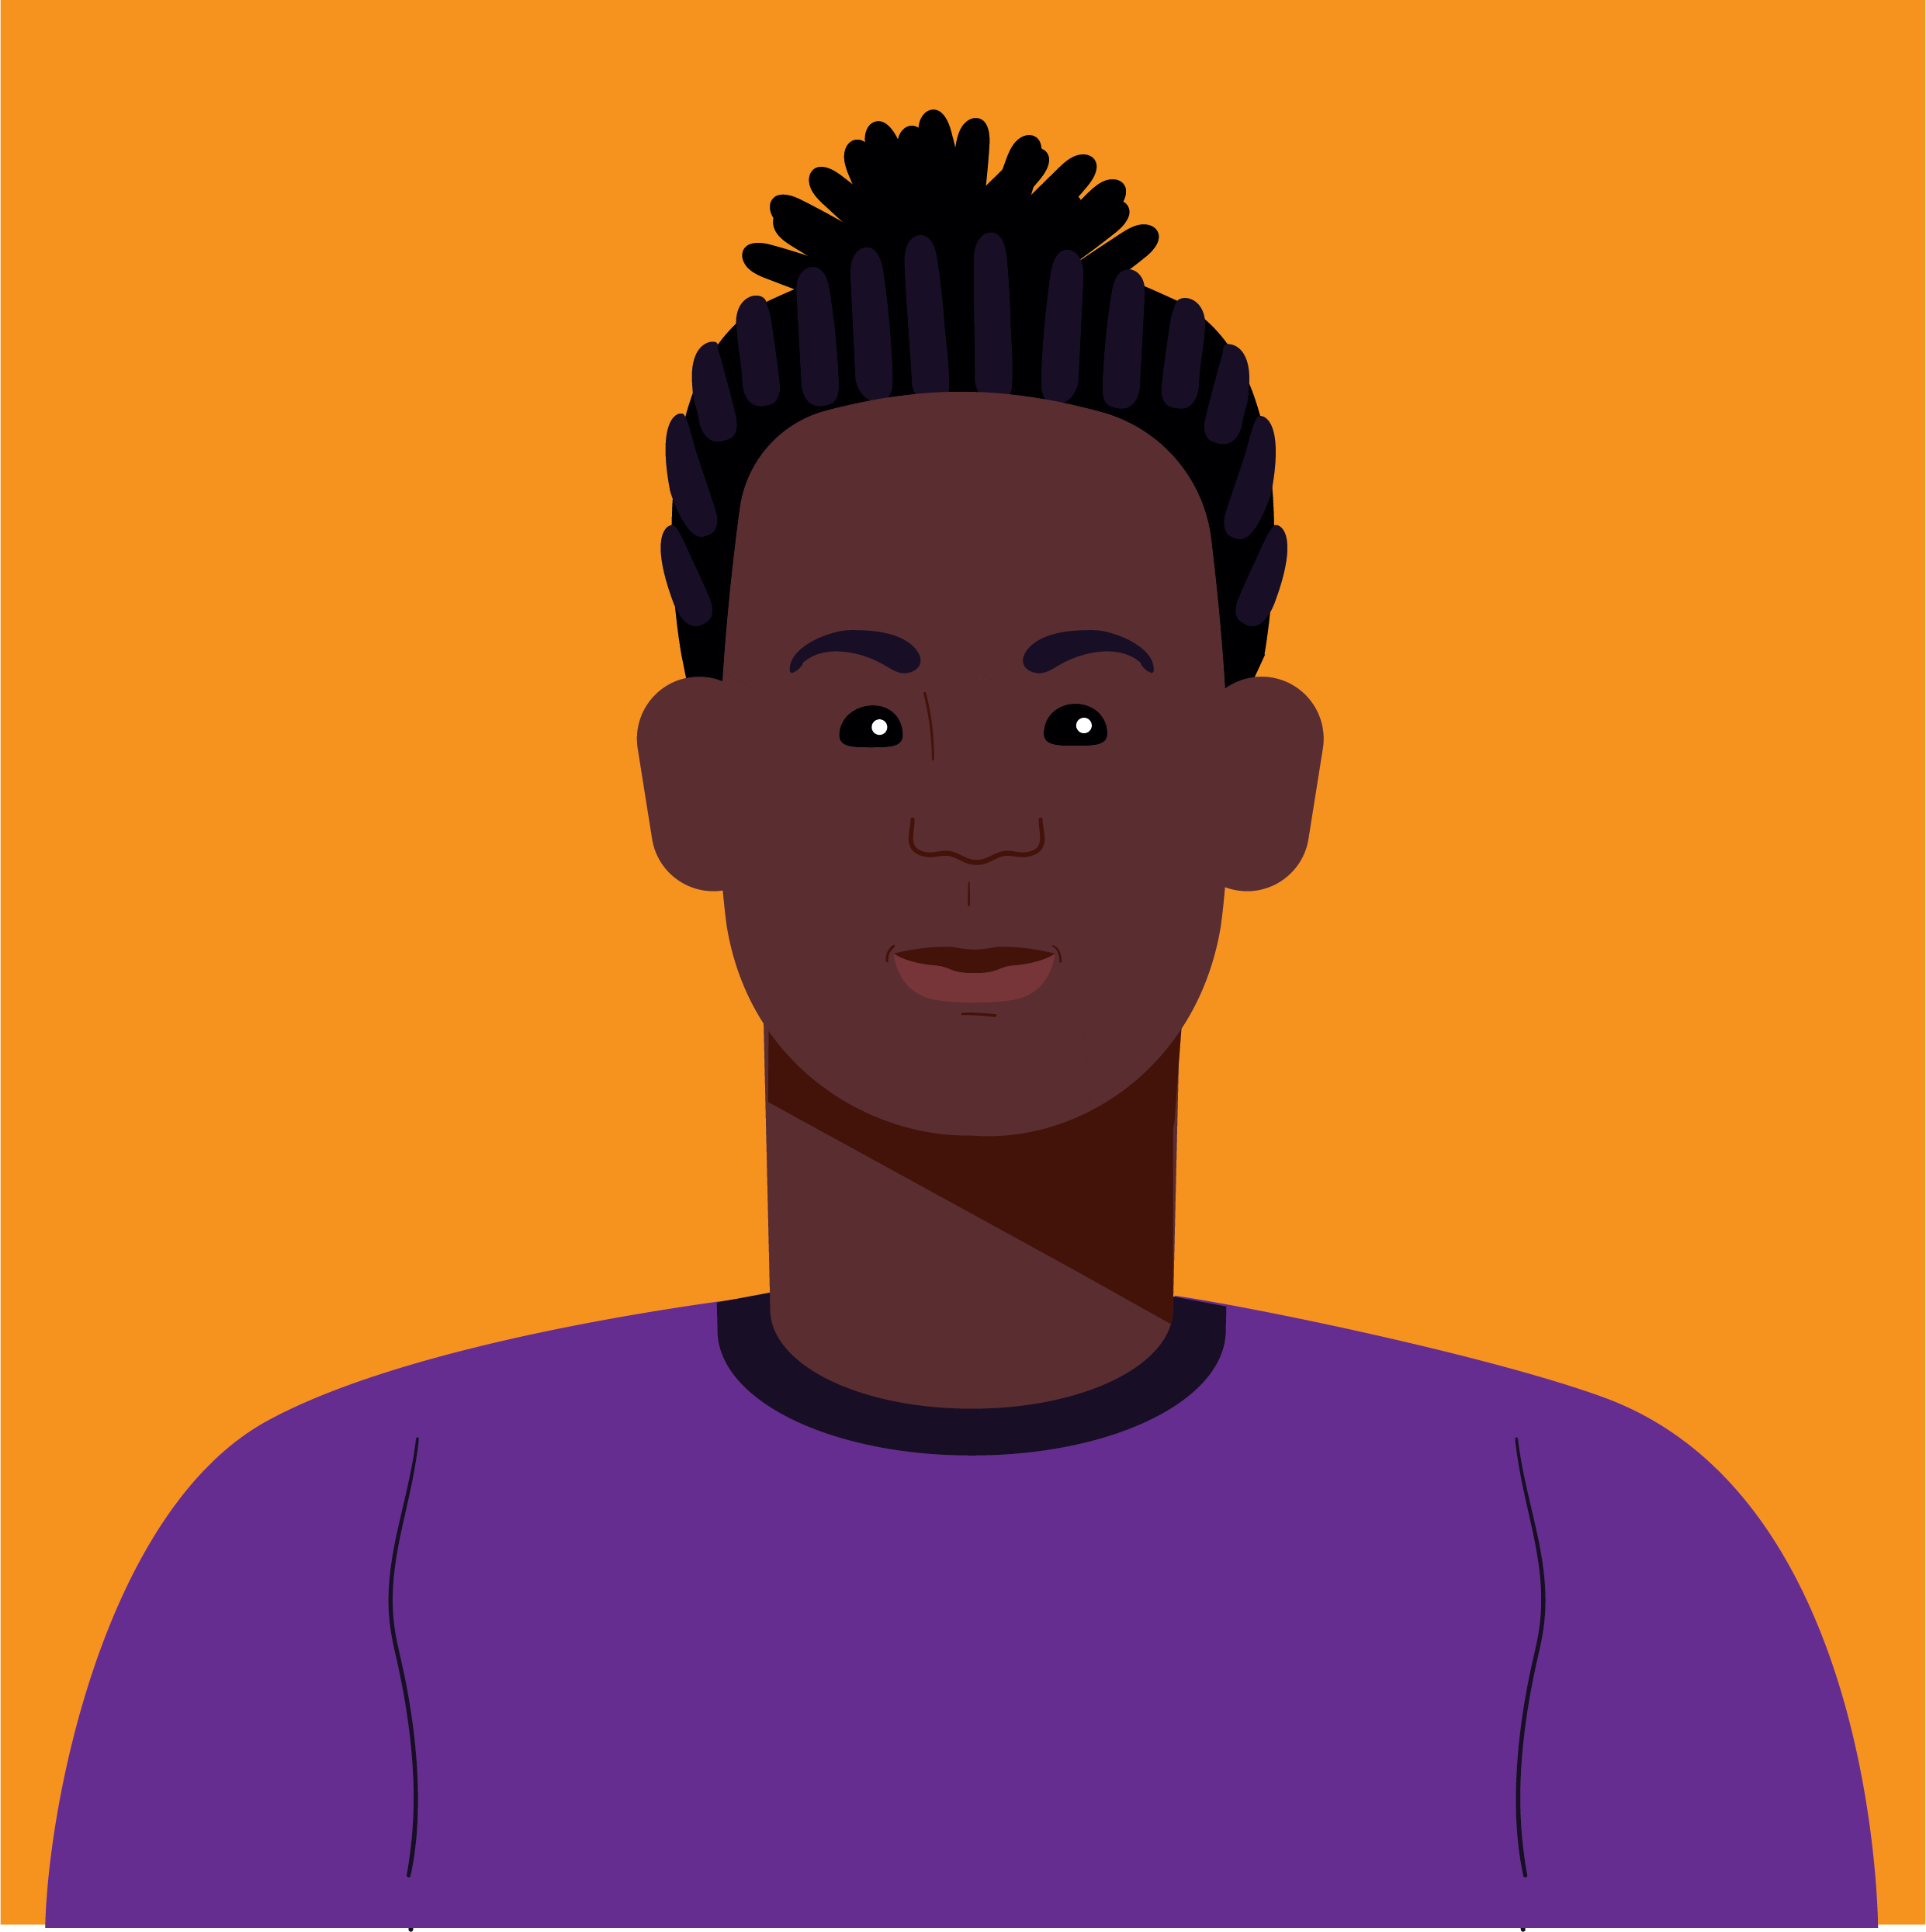



Principal Investigator – Prof. Dawn Edge
Clinical Supervisor – Prof. Katherine Berry

Slide 2
Why is CaFI needed?
High rates of schizophrenia among migrant and UK’s minority ethnic communities
Most striking, African & Caribbean backgrounds, including Mixed heritage compared with White British
African-Caribbean: 9 times greater risk (IRR 9.1 (6.6-12.6); 95% confidence interval)
Black African: 6 times greater risk (IRR 5.8 (3.9-8.4) ; 95% confidence interval)
(Morgan et al., 2006; Kirkbride et al., 2012)

Slide 3
Why is CaFI needed?
Negative care pathways: police & compulsory admission vs Family Physician (GP) (Morgan et al., 2005)
More coercive care (Bhui et al., 2003; Morgan et al., 2004; Morgan et al., 2005)
Worse clinical and non-clinical outcomes (Fearon et al., 2006; Fearon et al., 2007; Sharpley, Hutchinson, McKenzie & Murray, 2001)
Lack of access to psychological therapy (Care Quality Commission, 2011; Das-Munshi, Bhugra & Crawford, 2018)
Labelled ‘hard-to-reach’

Slide 4
Fear & mistrust
Family burden & breakdown
Delayed access
Inferior access, experience & outcomes
Longer lengths of stay
More severe symptoms on admission
More coercive care

Slide 5


Why is CaFI needed?
Family Intervention for psychosis
  Strong evidence base (Claxton, Onwumere & Fornells-Ambrojo, 2017)
  Recommended by NICE for ‘service users in regular contact with families’ (NICE, 2014)
  Poorly implemented in the NHS
  Uptake especially low in African, Caribbean and other minoritised groups (Berry and Haddock, 2008)

Slide 6
Why is CaFI needed?
Ethos of services incompatible with different cultures as psychological interventions are mainly developed in Western countries
Culture influences coping mechanisms and willingness to accept help (e.g. Bernal & Saez-Santiago, 2006)
People engage more with psychological therapy when their cultural beliefs are considered (Rathod et al., 2010).
NICE recommends need to consider culture and ethnicity in interventions for individuals diagnosed with schizophrenia

Slide 7
What is CaFI?
Culturally-adapted Family Intervention
10 x 1-hour sessions delivered by Lead & Co-therapist dyads
Co-produced with African & Caribbean origin people, advocates & health professionals
Hybrid model: CBT-based with BFT
Family Support Members (FSM’s)
CaFI:Digital: online therapy

Slide 8

The CaFI Journey

Slide 9
Public & Patient Involvement & Engagement (PPIE)
Community Engagement Conferences Gain insight into the ‘problem’ from key stakeholder perspectives
  Service users
  Families
  Health and care practitioners, commissioners and providers
Identify research priorities → studies
Study 1: Culturally-adapted Family Intervention (CaFI) for African-Caribbeans diagnosed with schizophrenia and their families (HS&DR; 2013-7)
Study 2: Co-production of e-learning resource to improve African-Caribbean families' knowledge about schizophrenia and engagement with services: a feasibility pilot study (RfPB; 2015-8) (“CaSPER study”)
Notes:
9

Slide 10

Coproduction with Stakeholders
Literature review to generate typical components of culturally adapted psychosocial interventions to serve as initial framework
  Key points: “more than translation”, need to incorporate important concepts [e.g., spirituality]
Community engagement conferences and focus groups with service users, carers, and professionals
  Structure and core components
  Address stereotypes & misconceptions of African and Caribbean cultures
  Racism “elephant in the room”
  Incorporate African and Caribbean specific elements and meaningful phrases e.g., “dealing with the system”
Consensus conference to refine content, outcome, and delivery
  Experts by experience and profession

Slide 11
Models of family intervention for psychosis
Developed from the idea of stress-vulnerability model and high Expressed Emotion triggering relapse in vulnerable people.
Differs from family therapy, which prioritises family functioning outcomes, framing the condition as a manifestation of familial problems (e.g. Millar, 2022; Stratton et al., 2010).
Problematic interactions framed in terms of family members’ coping strategies and communication styles that relate to beliefs and appraisals about psychosis.
Cognitive approaches which focus on beliefs and appraisals versus behavioural approaches which focus on learning communication skills, problem solving and supporting service users in managing condition (e.g. Kuipers et al., 2002; Barrowclough & Tarrier, 1992 and Falloon et al 1984).
Common ingredients: alliance building with families, psychoeducation, familial communication, problem solving and relapse prevention.

Slide 12
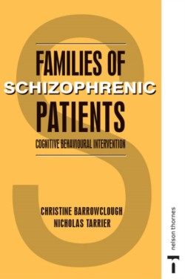
Barrowclough and Tarrier model (1992)
1. Engagement and Assessment
2. Psychoeducation
3. Communication
4. Stress management, coping and problem solving
5. Relapse prevention

Slide 13
CaFI Therapy
1. Engagement and Assessment
Asking about discrimination and racism, beliefs and models of mental health problems [spiritual explanations], cultural markers of social functioning [nurturing others], family dynamics, confidentiality and risks of disclosure
2. ‘Shared Learning’
Structure of statutory services; models of mental health (SVM); awareness of resources; stigma cards; videos of famous people with psychosis; role of medication/illicit drugs; challenging common misconceptions [mental health problems as “weakness”],
3. Communication
Assertiveness, communication of positive and negative feelings; working with culturally specific forms of communication; language
4. Stress management, coping and problem solving
Managing conflict; holistic approaches to wellness and wellbeing
5. Staying well & maintaining gains
Explicit recovery focus; assets vs deficits approach

Slide 14
Family Support Members
Family support members (FSMs)
    Work alongside those with no contact with families.
FSMs identified in two ways:
    Nominated: nominate people they consider important or influential in their lives, people who they trust or anyone who provides emotional support (e.g. friends, local pastors or other ‘trusted individuals’ such as support, youth or community workers)
    Recruited: People specifically recruited to work with those patients who are unable to nominate anyone – may include Peer Support workers

Slide 15


Training Programme for Therapists
Cultural Competency and Family Work
CaFI Manual
Core competence to work with service users experiencing psychosis and families
Impact of culture on family work
Relationship between racism, discrimination, adversity, and psychological distress
Power and prejudice in building trusting therapeutic relationships
Context of CaFI: Historical, cultural, and social context of African and Caribbean mental health in the UK
Development of CaFI
Delivering therapy in research
CaFI’s “Ethos of Delivery”
Components and bespoke resources

Slide 16
What did CaFI pilot study reveal?
(2013 – 2018)
24 of 26 Family Units tried CaFI completed all 10 sessions (92%)
Family Units comprised service users, family members or Family Support Members (FSMs)
High rates of recruitment, retention, and data completion
CaFI acceptable. All service users, family members, FSMs and health professionals would recommend it

Slide 17
Benefits for service users
Improved understanding of psychosis
Improved symptoms (feeling less paranoid)
Better function (going back to university, volunteering, getting paid work)
Better communication with healthcare professionals and their families

Slide 18
Benefits for family members
Increased understanding of the condition
Better engagement and support with the service users

Slide 19
Benefits for healthcare professionals
Improved cultural awareness & understanding of Caribbean people’s needs
Using CaFI skills and materials in everyday practise

Slide 20
Case study one: Samuel and Michelle
Background
18 year old Samuel was mixed heritage and mum Michelle was WB
Samuel was under EIP team but did not take prescribed medication
Frequent arguments with Michelle resorting to calling the police
‘Aggressive and bullying’
‘Nagging and critical’
Sibling Kate, biological dad Michael and step-dad Stuart

Slide 21
Case study one: Samuel and Michelle
Engagement
Michelle’s frustration of having been through it before
Medication seen as fix for all problems
Michelle’s voice prominent in sessions
Sessions dominated by shouting about house rules and medication
Positive shared time together during evenings
Goals to spend more time enjoying each other’s company and reduce the number of arguments

Slide 22
Case study one: Samuel and Michelle
Shared learning
Samuel: other people don’t understand psychosis
Sharing his experiences as part of sessions e.g. people at college talking about him including comments about his skin colour and threatening voices
Michelle’s own history of abuse and impact on how she received Samuel’s behaviour

Slide 23
Case study one: Samuel and Michelle
Communication
Mini formulations of conflict episodes with a focus on misunderstanding of view points
Practising expressing active listening and positive and negative feelings in and outside of sessions

Slide 24
Case study one: Samuel and Michelle
Coping and problem solving
Samuel perceived services and institutions as being racist and unsupportive e.g. EIP team, college staff
Encouraging positive risk taking in terms of opening up communication with CC and tutors
Michelle recognised need for time out
Problem solving in relation to disagreements at home

Slide 25
Case study one: Samuel and Michelle
Reflections and outcome
Therapists’ concerns about not being able to emphasise with Samuel as withdrawn and no personal experience of being Black
Therapist fears of racism and siding with Michelle
Improvements in Samuel’s confidence reported by CC
Improved relationship between Samuel and Michelle
Role of wider family

Slide 26
Case study two: Sharon and Jackie
Background
Sharon 45 year old single lady living of African-Caribbean decent in supported accommodation
Paranoid schizophrenia and depression with long history of inpatient admissions
Ambivalent about therapy as no previous experience
Family discouraged her from talking to strangers about problems
Brother who did not want to participate due to his own mental health difficulties
Sharon did not want father to be approached as he had other commitments and didn’t like talking
Jackie CC who was WB and had not previously spoke to Sharon about her culturally background and race due to fears of appearing racist

Slide 27
Case study two: Sharon and Jackie
Engagement
Sharon’s earlier history of sexual abuse and parental invalidation
Difficult adolescence and early involvement in services following loss of grandmother (positive attachment figure)
Mistreatment within mental health services
Diagnosis brought shame to the family
Mistrust of others and negative self-beliefs > social isolation
Impact on relationships with staff within supported accommodation and CMHT

Slide 28
Case study two: Sharon and Jackie
Shared learning
Sharon’s medicalised view of mental illness versus psychologically informed understanding
Jackie learning about Sharon’s history
Stress vulnerability model
Role of stigma

Slide 29
Case study two: Sharon and Jackie
Communication
Arguments with supported accommodation staff and Jackie
Mini-formulations and pros and cons of each response style
Practising skills in assertiveness with Jackie within sessions and staff outside of sessions
Developing assertiveness skills in her relationship with her father

Slide 30
Case study two: Sharon and Jackie
Coping skills
Identifying helpful and unhelpful coping strategies in relation to symptoms
Formulating thinking style in the context of history and reappraising thinking
Importance of self compassion and compassion focused imagery
Behavioural relaxation techniques to mange stress and anxiety

Slide 31
Case study two: Sharon and Jackie
Reflections and outcome
Lack of trust in therapists and Jackie leading to frequent ruptures in alliance
Discussed in supervision and learning to reflect on these with Sharon
Better relationships with staff in supported accommodation
Felt more confident in managing mood and understanding mental health
Jackie’s increased understanding of Sharon
Ongoing struggles in relationship with her father

Slide 32
Case study three: John and April
Background
34 year old man whose parents had originated from Caribbean
In PICU due to aggressive behaviour on acute ward
7 year history of admissions under Mental Health Act typically brought into hospital by police
Period of absconding during therapy and medication needed to be re-started
John did not have contact with any family members and did not want to involve them in the therapy
6 sessions added by FSMn (April) African Caribbean female with previous experience as a social worker

Slide 33
Case study three: John and April
Engagement
Trauma history with distant family relationships
Shooting of close friend in teenage years
Racial discrimination (treated unfairly by police and apathy from health professionals)
Drug use, avoidance of close relationships and aggression towards others
John’s goals were to reduce anxiety and improve mood
April’s goals were to learn more about psychosis from a first hand perspective and support John through therapy

Slide 34
Case study three: John and April
Shared learning
John believed that his father was controlling him and causes symptoms of psychosis through voodoo
April shared knowledge of this explanatory framework with therapists
Reported no previous explanation of psychosis
Experiences framed in terms of trauma and drug use
Videos and stories of other successful Black people with experiences of psychosis with input from April

Slide 35
Case study three: John and April
Coping skills and communication
Activity scheduling to help regulate mood
Monitoring mood and behavioural exercises to cope with anxiety
Practising communicating needs to staff with support from April

Slide 36
Case study three: John and April
Reflections and outcome
Challenges of working within inpatient environments
John’s improved self-efficacy in relation to mood
Improved communication with staff: reassurances information wasn’t being disclosed to father
Lack of focus on building bridges with family
Advantages of having FSMn – sharing experiences
Barriers to working with FSMn – anxiety about inpatient environment/risk, blurring of individualised therapy versus FI.

Slide 37
CaFI RCT

Slide 38
National, multi-site RCT: The effect on relapse of Culturally-adapted Family Intervention (CaFI) compared to usual care among Sub-Saharan African & Caribbean people diagnosed with psychosis in the UK: a Randomised Controlled Trial (NIHR HTA; 2019-23)
CaFI compared with ‘Usual Care’
404 ‘Family Units’ service users and family members/FSMs (202 in each arm)
Sites: Northwest, Midlands, London, Southwest

Slide 39
Study Aims
Evaluate CaFI’s effectiveness for service users of Sub-Saharan and Caribbean origin diagnosed with psychoses (ICD-10 F20-F29) (21) and their families compared to usual care.
Primary outcome measures = relapse
Examine cost effectiveness
Determine how to maximise facilitators and overcome barriers to successful implementation.
Assess the acceptability of the intervention to key stakeholders – including patients, their families and mental health professionals.

Slide 40

Strengths and challenges to the trial
What has gone well
Initial rate of service user
recruitment very promising
High quality resources and CaFI digital
offer of online or in person therapy
Trained high number of staff in family interventions and cultural competency
Service users joining without family feeling able to invite family to intervention sessions once therapy begins

Slide 41
Strengths and challenges to the trial
Challenges within the RCT
Therapist recruitment and retention (existing staff versus trial therapists, NHS workforce crisis, staff payment and integration into NHS systems).
Participant recruitment challenges (pockets of recruitment, recruiting between 2-3 people per therapy case, co-ordinating diaries and working with volunteers).
High staff turn-over of research staff and having to re-embed people within services and community groups.
Service users hard to contact for therapy following recruitment complicated by delayed starts to therapy.

Slide 42

Overall summary and reflections
Overlap with traditional FI
Importance of raising issues of racism and discrimination
Acknowledging differences and power issues
Differences between Western and non Western models of mental health and respecting these
How life experiences impact on beliefs and therapy
Special note to experiences of services
Role of FSMs but blurred boundaries
Benefits of working towards engaging estranged family members
Therapist training in cultural competency and use of supervision
Note on ethnic matching > workforce training in culturally-sensitive interventions

Slide 43








Slide 44
Acknowledgments
CaFI Research Team & collaborators
Funder: National Institute for Health Research (NIHR)
  CaFI Pilot: HD&FR (12/5001/62)
  CaSPER: RfPB (PB-PG-0212-27109)
  CaFI: HTA( 16/167/76)

Slide 45
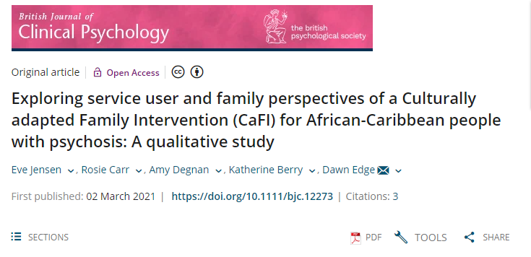

Slide 46
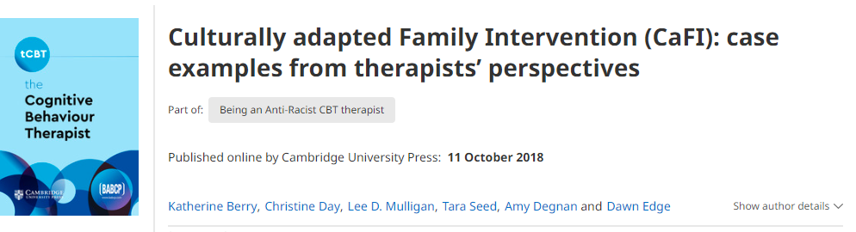

Slide 47


Get in touch
Professor Dawn Edge
Project lead
dawn.edge@manchester.ac.uk
Professor Katherine Berry
Clinical Supervisor
katherine.berry@Manchester.ac.uk
https://sites.manchester.ac.uk/cafi/
Email: cafi@gmmh.nhs.uk @cafistudy

Slide 48
How you can help
Now Recruiting
Therapists
  Lead therapists: Clinical Psychologists or HCPC registered candidates with expertise in delivering family work, CBT trained
  Co-therapists: Assistant Psychologists, Support Workers, Healthcare Assistants, Trainee Psychiatrists and Clinical Psychologists

