Slide 1

Cognitive models of voice-hearing, from the psychopathological to the everyday
Peter Moseley
Dept. of Psychology
email: peter.moseley@northumbria.ac.uk
Twitter: @pmoseley89

Slide 2
Cognitive models of voice-hearing, from the psychopathological to the everyday
Clinical and non-clinical voice-hearing
Three studies – cognition in clinical and non-clinical voice-hearing
  Early Intervention in Psychosis service users
  ‘Non-clinical voice-hearers’
  General population
How do we make sense of the massive variation in voice-hearing when trying to understand cognitive mechanisms?

Slide 3
Auditory verbal hallucinations (AVH)
The experience of hearing a voice in the absence of any speaker. Also referred to as ‘voice-hearing’.
Sample | Lifetime prevalence
Schizophrenia/psychosis | 80%
Bipolar disorder | 34%
General population | 2-38%
General population (persistent) | ?
Aleman and Laroi (2008); Toh et al. (2015); Maijer et al. (2018)

Slide 4
I’ve had bad voices and good voices, like nice ones and bad. One was called Michael, and one was called Margaret. Michael was the bad one, he used to tell us to kill myself and self-harm, like tell us that I don’t, like, no one wants us here and stuff like that. And then on the other hand, I’ve got Margaret telling us that, that I’m a good lass, like a nice lass and stuff. They start whispering and … and I just get stressed out and I don’t know what to do. And that’s when everything like goes downhill and I end up self-harming myself…
“Violet” – female, age 18
(Diagnosis: PTSD)

Slide 5
It could just be like…an actual bark or like…a shout or a noise, you know like someone that is more just ehm like a bang on the table or something like that
“Bill”, male, age 24 (diagnosis: psychotic disorder)
I hear as well like regular like screaming and … kind of maybe like you’d say evil laughing, so they’re not even always saying anything, or like someone crying, screaming and wailing.
“Olivia”, female, age 22 (diagnosis: bipolar disorder)

Slide 6
Across three studies, we used similar tasks to test four different cognitive models of hallucinations:
  Biased reality monitoring
  Atypical language processing (lateralization)
  Over-weighted top-down processing
  Poor intentional inhibition of memory

Slide 7

Three studies: cognitive correlates of voice-hearing
What are the cognitive mechanisms underlying voices in different clinical and non-clinical populations?
Study 1: Psychosis patients vs. matched controls
  N = 40 (33 completed cognitive testing), mean age = 29.7, N female = 13
  recruited through Early Intervention in Psychosis services
  hearing voices at least once a week for a month (but typically much longer).
  No diagnosed neurological disorder
Study 2: Non-clinical (spiritual) voice hearers vs. matched controls
  N = 27 (26 completed cognitive testing)
  mean age = 58.3, N female = 18
  recruited through spiritualist communities, newsletters, SNU
  hearing voices at least once a month (‘clairaudience’) for three months
  No psychiatric or neurological diagnosis
Phenomenology interview and cognitive testing.

Slide 8
Clinical and non-clinical voice-hearing
 | Non-clinical % (N = 27) | Clinical % (N = 40) | Log odds [95% CI]
Abusive/violent | 11.5 | 87.5 | -3.98 [-5.5, -2.5]
Commanding | 26.9 | 67.5 | -1.72 [-2.8, -0.6]
Elicit negative emotions | 38.5 | 100 | -4.85 [-7.7, -1.9]
Ability to influence | 84.6 | 27.5 | 2.67 [1.4, 3.9]
Volitional | 92.3 | 2.5 | 6.15 [3.69, 8.6]
Helpful/positive | 92.3 | 42.5 | 2.79 [1.2, 4.4]
Recognisable | 76.9 | 47.5 | 1.30 [0.2, 2.4]
“Boundary” | 11.5 | 35.0 | -1.42 [-2.8, -0.05]
Moseley et al. (in prep)

Slide 9
Proneness to hallucinations as a continuous trait (Study 3)
Brookwell et al. (2013)
Meta-analysis: evidence for association between hallucinations in the general population and:
criterion in signal detection
source memory errors
But – publication bias.

Slide 10
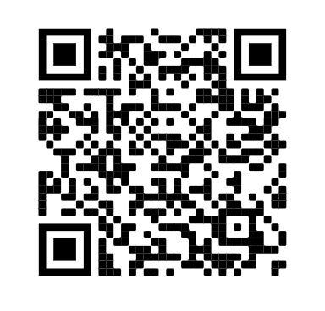

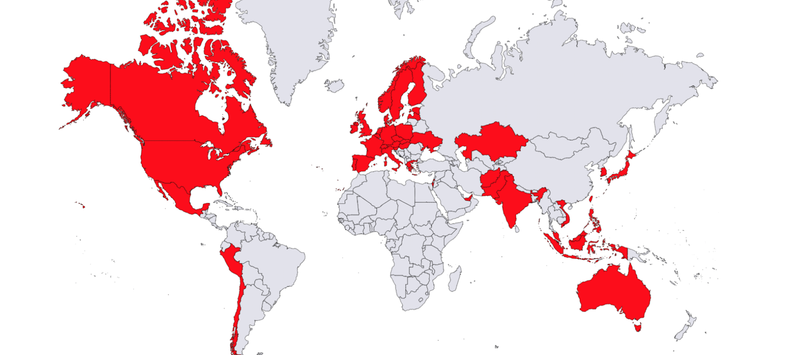
Study 3: multisite replication
N = 1394 participants from the general population
11 data collection sites, in 7 countries, in 4 languages
Additional online data collection (Prolific.ac)
All participants assessed using CAPS and LSHS
Pre-registered hypotheses and exclusion criteria
Moseley et al. (2021, Psych Sci)

Slide 11
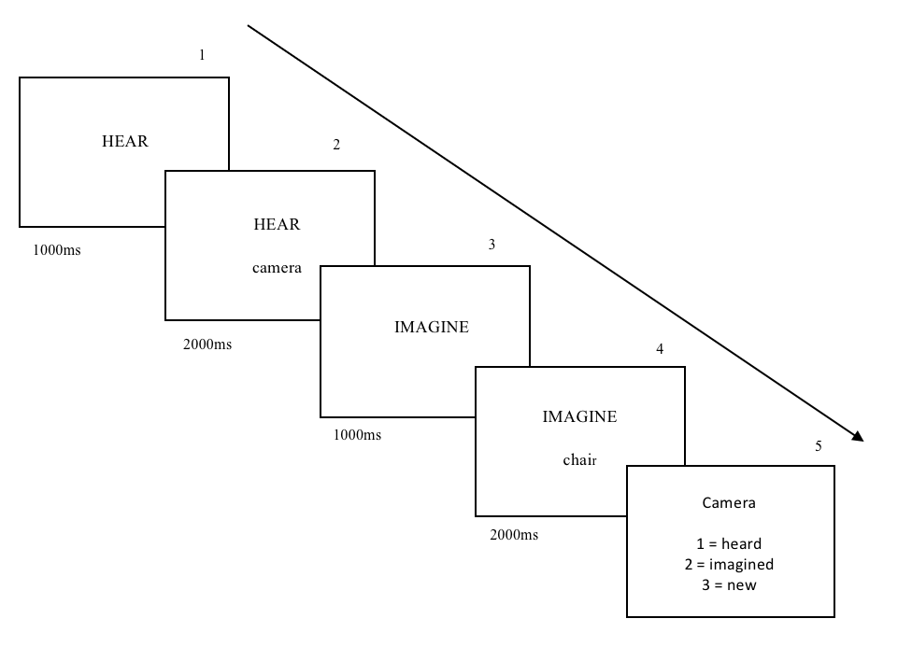

Hallucinations as biased reality monitoring
Problems with monitoring the source of information
Source Memory
Outcome variable:
self-other errors
Garrison*, Moseley* et al. (2017, Cortex)

Slide 12
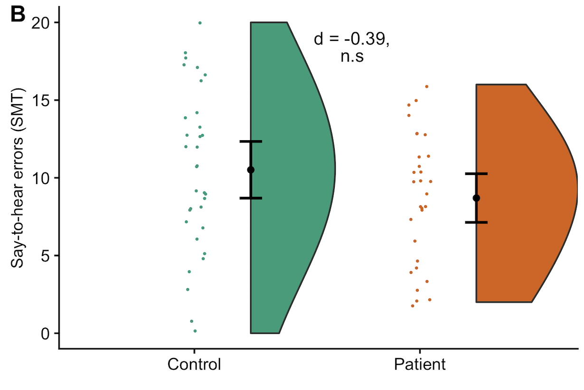
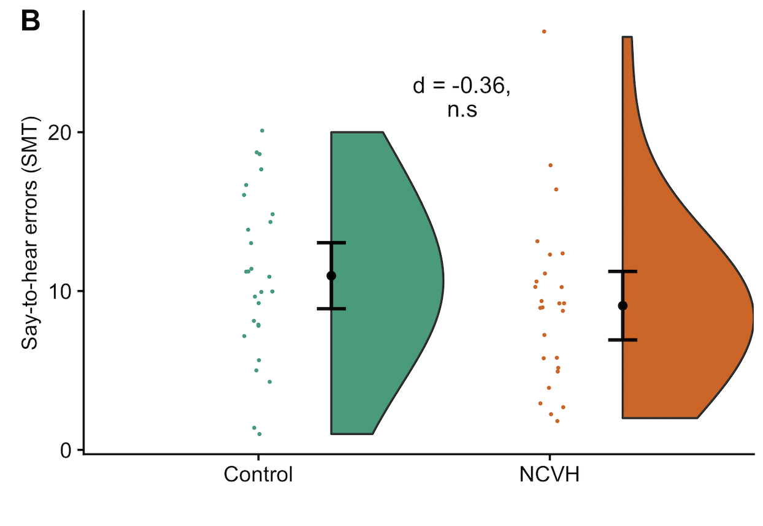
Study 1 – psychosis patients
Reality monitoring
No difference between voice-hearing patients and healthy controls in source memory errors (d = -0.39, p = .132)
Study 2 – non-clinical voice-hearers
No difference between non-clinical voice-hearers and healthy controls in source memory errors (d = -0.36, p = .24).
Moseley et al. (accepted, Clin. Psych. Sci.)

Slide 13
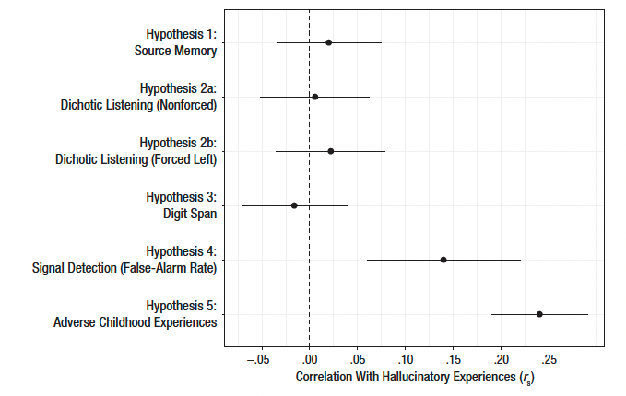
Study 3: reality monitoring (source memory) performance was not associated with hallucinatory experiences in the general population (n = 1375)
Moseley et al. (2021, Psych Sci)

Slide 14
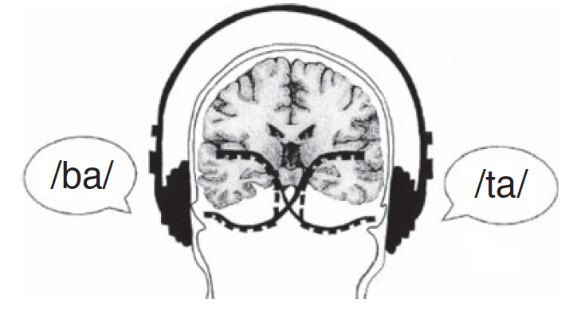
Hallucinations as atypical language processing
Atypical language lateralization and attentional control leads to impaired processing of language stimuli
C-V dichotic listening
Outcome variable: right ear advantage (laterality index)
Figure taken from Hugdahl et al. (2012)

Slide 15
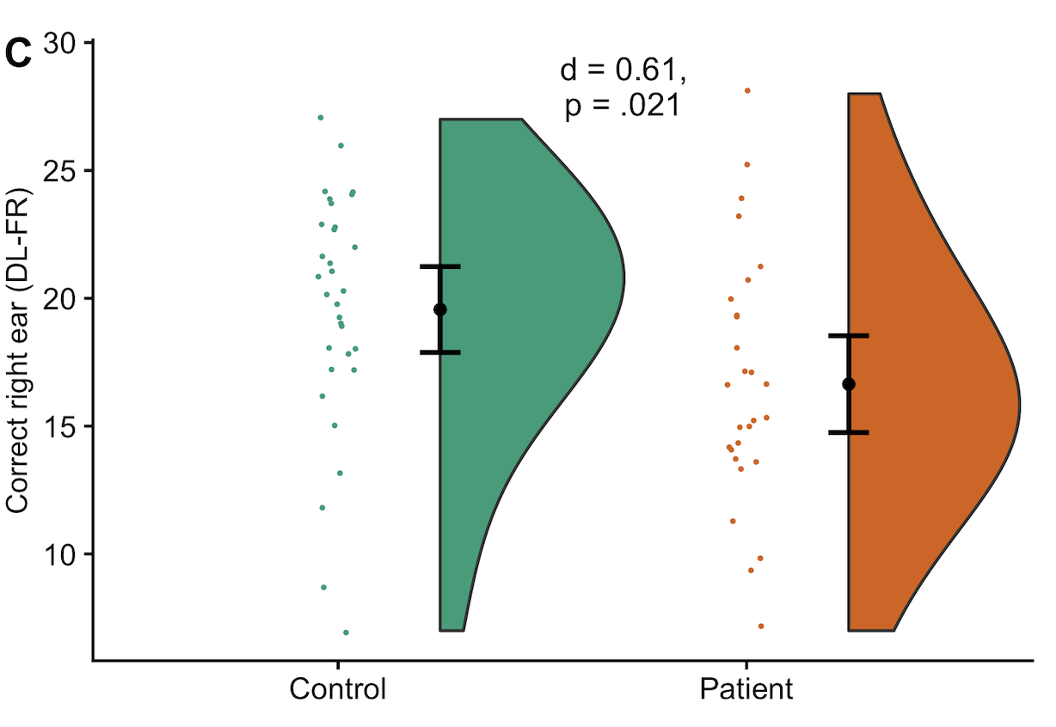
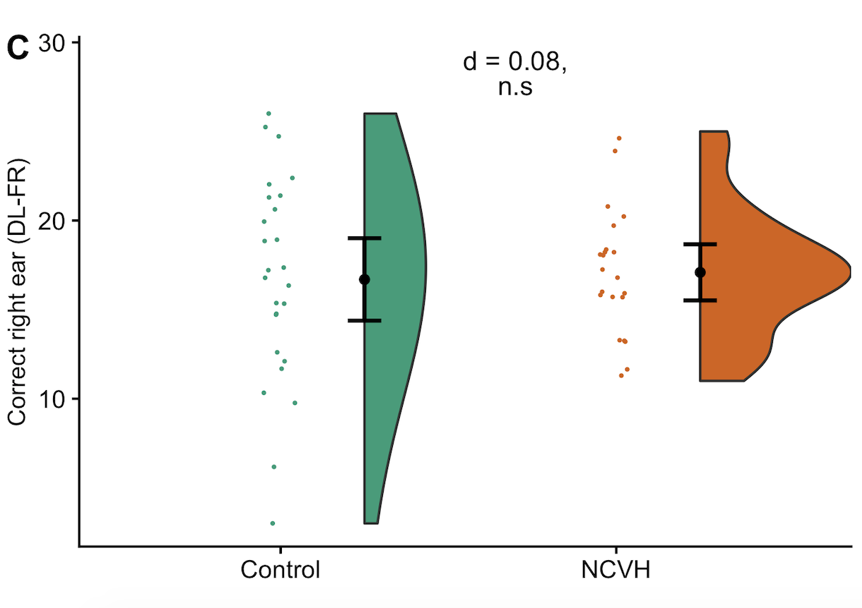
Study 1 – psychosis patients
Dichotic listening
Voice-hearing psychosis patients showed atypical right-ear performance compared to controls (d = 0.61, p = .02)
Study 2 – non-clinical voice-hearers
Non-clinical voice-hearers showed no difference compared to controls (d = 0.08, p = .77).
Moseley et al. (accepted, Clin. Psych. Sci.)

Slide 16
Study 3: dichotic listening performance was not associated with hallucinatory experiences in the general population, in any task condition (n = 1262)
Moseley et al. (2021, Psych Sci)

Slide 17
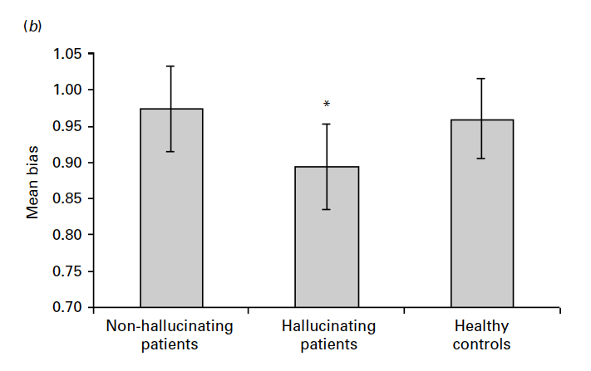
Hallucinations as over-weighted top-down processing – previous evidence
AVH explained as an imbalance between top-down and bottom-up processes, where top-down processes (e.g., expectation, prior knowledge) relating to speech are weighted more strongly in individuals experiencing AVH.
Signal detection task (SDT) (speech in white noise).
Key variable: false alarm responses (and SDT parameters)
Vercammen et al. (2008)

Slide 18
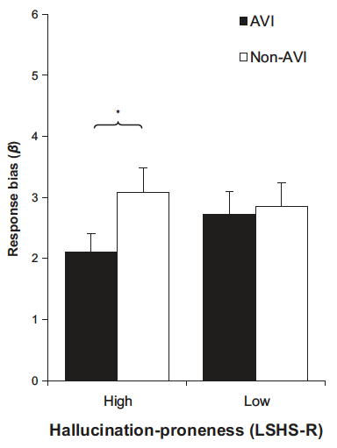
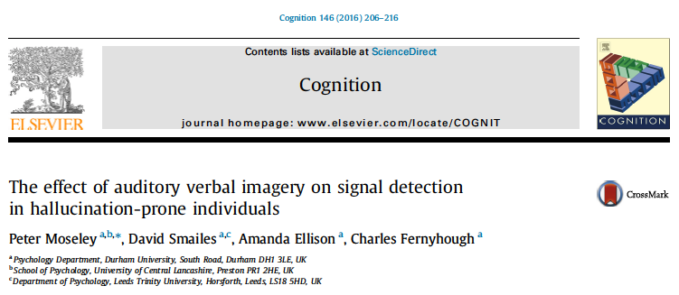
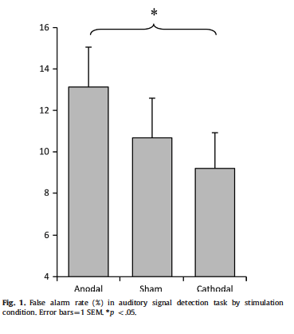
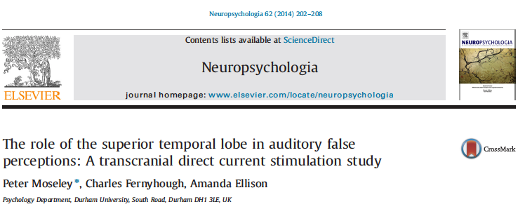
Hallucinations as over-weighted top-down processing – previous evidence
Assessing task performance in the general population:
Additional use of auditory verbal imagery further lowers criterion
(N = 120).
Noninvasive brain stimulation of left STG modulates FA rate on a signal detection task.
(N = 30)
Moseley et al. (2016, Cognition; 2014, Neuropsychologia)

Slide 19
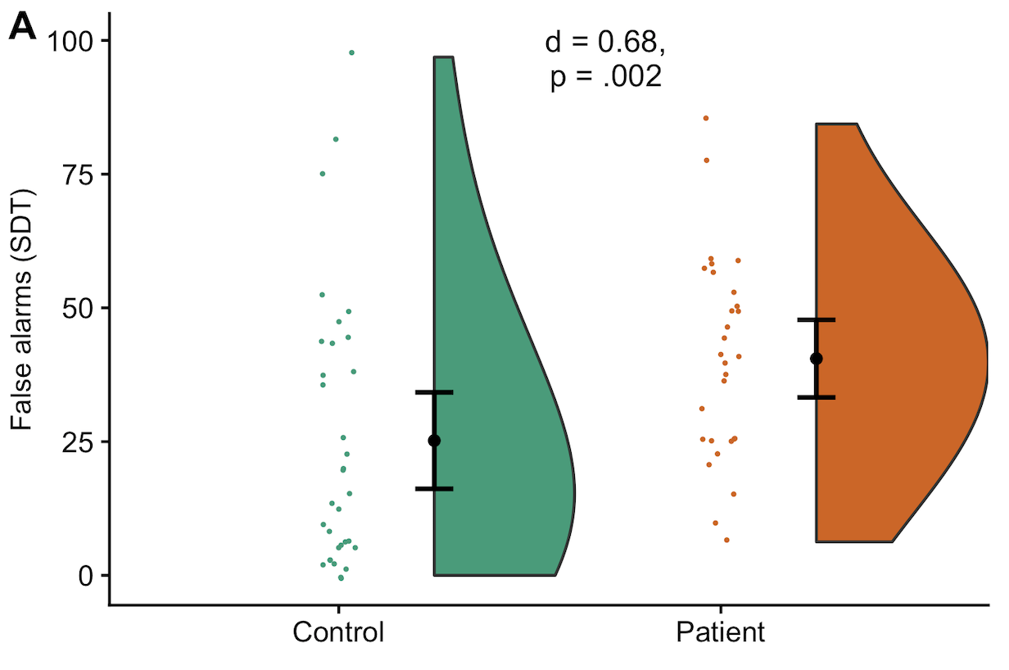
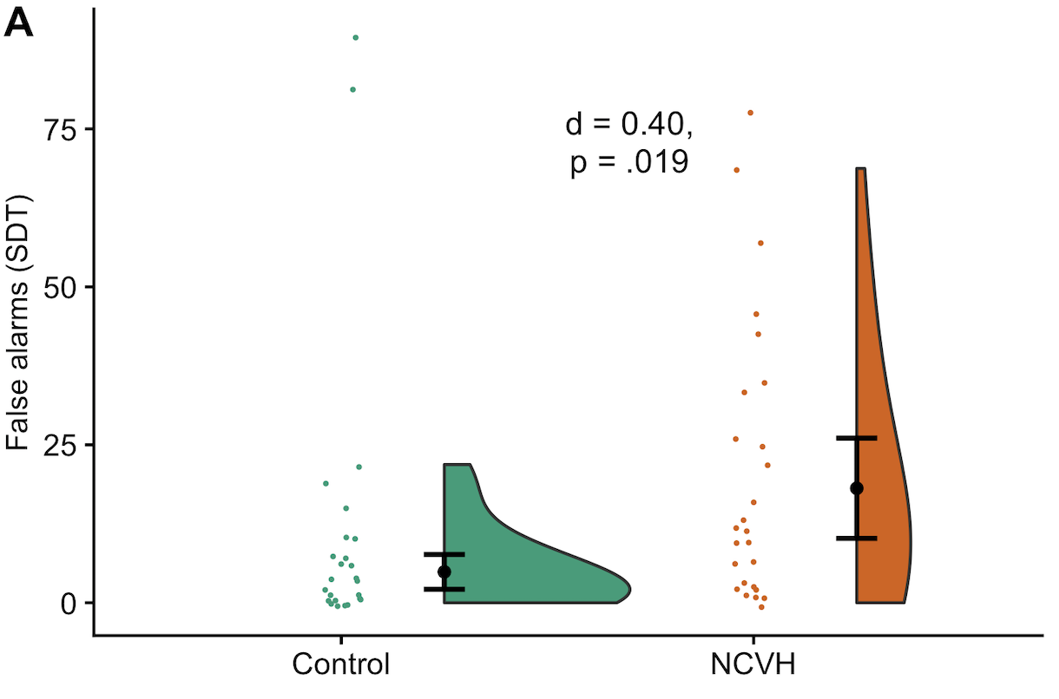
Study 1 – psychosis patients
Auditory signal detection
Voice-hearing psychosis patients made more false alarms than matched healthy controls (d = 0.68, p = .002).
Study 2 – non-clinical voice-hearers
Non-clinical voice-hearers made more false alarms than matched controls (d = 0.40, p = .02).
Moseley et al. (accepted, Clin. Psych. Sci.)

Slide 20
Study 3: number of false alarms on the signal detection task correlated with number of reported hallucinatory experiences in the general population (r = .14, n = 594 – lab only)
Moseley et al. (2021, Psych Sci)

Slide 21
Reality monitoring (source memory): neither group showed impairment or bias, no association in the general population
Language lateralization (dichotic listening): voice-hearers with psychosis show a reduced right ear advantage, but NCVH do not. No association in the general population.
Top-down processing (signal detection): psychosis patients and NCVHs make more false alarms, which are also associated with hallucinatory experiences in the general population

Slide 22
Hallucinations as failures of cognitive inhibition
Intentional inhibition of currently irrelevant memories
Requires participants to inhibit previously seen images as part of a continuous recognition task.
Outcome variable: number of images participant incorrectly labels as repeated in second block

Slide 23
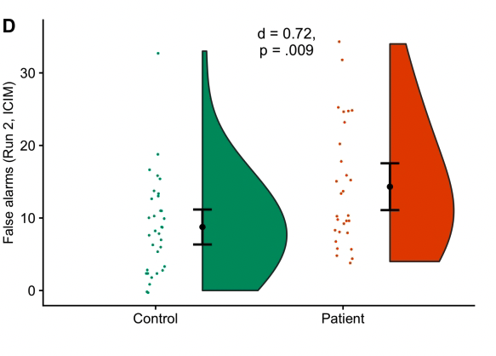
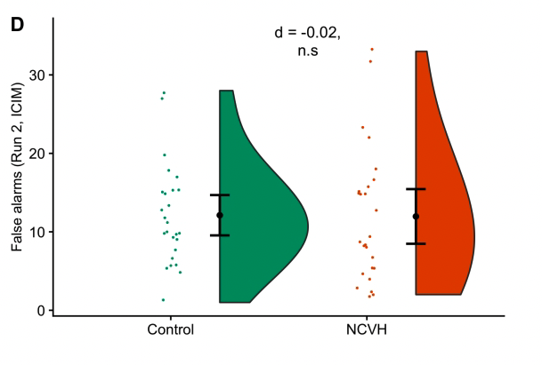
Study 1 – psychosis patients
Intentional inhibition
Voice-hearing psychosis patients failed to inhibit more previous images than controls (d = 0.72, p = .009)
Study 2 – non-clinical voice-hearers
Non-clinical voice-hearers showed no difference compared to controls (d = -0.02, p = .94).

Slide 24
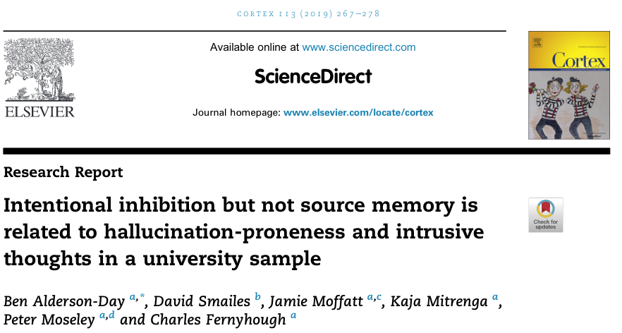
Some evidence that intentional inhibition may be linked to hallucinatory experiences and intrusive thoughts in the general population – but more evidence needed (Alderson-Day et al., 2019).

Slide 25
Limitations
No control group of EIP service users without voices!
EIP isn’t necessarily reflective of psychosis/clinical voice-hearing more broadly.
Relatively small sample sizes in Study 1 and Study 2.
NCVHs were older than psychosis patients (though, all had matched controls).

Slide 26
How do we explain the huge variation in voice-hearing experiences?
Notes:
So, as I said earlier, one thing that interests me is thinking about how to explain the huge variation in voice-hearing, and if or how we can link that to underlying mechanisms. This is something I’ve been thinking about in collaboration with Wei Lin Toh at Swinburne University in Melbourne, and Charles Fernyhough at Durham Uni. Recently, we’ve been working on a paper trying to lay out ways of thinking about this…

Slide 27
Neural
Atypical lateralisation
Gyrification
Peripheral sensory deficits
Fronto-temporal dysconnectivity
Default mode network alterations
Auditory cortex hyperactivity
Explaining variation between individuals
Cognitive
Mental imagery
Inner speech misattribution
Reality monitoring
Top-down/prior weighting
Cognitive control/ inhibition
Each shape represents a ‘mechanism’ for which there is at least some evidence in association with hallucinations
Mechanisms might not be exclusive (e.g., top-down processing will be linked to mental imagery vividness).
Neuro-transmitter dysfunction
Personal-sociocultural
Dissociation
Religious/ spiritual practices
Personality traits
Cultural beliefs
Social agent represent-ation
Trauma
Context
Sensory deprivation
Stimulation
Sleep deprivation
Life stressors
Notes:
…and in the process we ended up putting together a diagram like this trying to lay out all the different potential mechanisms underlying voice-hearing. I know this looks a bit over-whelming, and ultimately it didn’t make it into the final paper we submitted, but all hexagon just represents a single factor for which evidence suggests a link with voice-hearing. We’ve separated them by colour into neural, cognitive, and socio-cultural mechanisms, as well as contextual factors in yellow circles.

Slide 28
Neural
Atypical lateralisation
Gyrification
Peripheral sensory deficits
Fronto-temporal dysconnectivity
Default mode network alterations
Auditory cortex hyperactivity
Explaining variation between individuals
Cognitive
Mental imagery
Inner speech misattribution
Reality monitoring
Top-down/prior weighting
Cognitive control/ inhibition
Each shape represents a ‘mechanism’ for which there is at least some evidence in association with hallucinations
Mechanisms might not be exclusive (e.g., top-down processing will be linked to mental imagery vividness).
Neuro-transmitter dysfunction
Personal-sociocultural
Dissociation
Religious/ spiritual practices
Personality traits
Cultural beliefs
Social agent represent-ation
Trauma
Context
Sensory deprivation
Stimulation
Sleep deprivation
Life stressors
Notes:
You’ll notice of course that there are a lot of different factors, and I’ve only discussed a few of them today – the one’s I’ve highlighted here. And of course not all of these factors will be completely exclusive of one another – as an example, mental imagery, top-down or prior weighting, and auditory cortical activity are likely to be highly associated.
The point here isn’t necessarily to present a model of voice-hearing. Actually, in talking with Wei Lin and Charles when writing this paper, we started from the point of trying to summarise all the evidence to present an up-to-date model of voice-hearing, but ended up coming to the conclusion that trying to take into account the variety of voice-hearing experiences in one model would be too speculative – we just don’t have enough evidence across different groups to say anything that concrete.

Slide 29
Hypothetical cases of voice-hearing
Notes:
But, what we can do, is discuss how we should think about this problem in the first place. That is, how can we explain the underlying mechanisms of voices that present with wildly varying phenomenologies? Here I want to present a couple of hypothetical cases of how voice-hearing can have both common underlying factors, but also follow different pathways, and then discuss how we should go about researching this going forward.

Slide 30
Hypothetical cases of voice-hearing
Top-down/prior weighting
Top-down/prior weighting
A case of ‘non-clinical’ voice-hearing
A case of ‘clinical’ voice-hearing
Notes:
So, here I’m describing two individuals, one who broadly might fit into our ‘non-clinical voice-hearer’ category, and one who might typically present to psychosis services and have a need for care. Consistent with the evidence I presented today, we might expect both of these individuals to show over-weighting of top-down processes, specifically those relating to speech.

Slide 31
Hypothetical cases of voice-hearing
Atypical lateralisation
Cognitive control/ inhibition
Top-down/prior weighting
Top-down/prior weighting
A case of ‘non-clinical’ voice-hearing
A case of ‘clinical’ voice-hearing
Notes:
… but, also consistent with the findings I presented, the individual in the clinical group might also show atypical patterns of lateralization, and reduced cognitive inhibition, explaining the intrusive and uncontrollable nature of their voice experiences, in contrast to the individual in the non-clinical group.

Slide 32
Hypothetical cases of voice-hearing
Religious/ spiritual practices
Atypical lateralisation
Cognitive control/ inhibition
Top-down/prior weighting
Top-down/prior weighting
A case of ‘non-clinical’ voice-hearing
A case of ‘clinical’ voice-hearing
Notes:
As I mentioned, many non-clinical voice-hearers report religious or spiritual practices associated with their voice-hearing, and our interviews raised the possibility that these practices can at least sometimes shape, or even play a causal role in, voice-hearing.

Slide 33
Hypothetical cases of voice-hearing
Religious/ spiritual practices
Atypical lateralisation
Cognitive control/ inhibition
Top-down/prior weighting
Top-down/prior weighting
Personality traits
Mental imagery
Personality traits
Mental imagery
A case of ‘non-clinical’ voice-hearing
A case of ‘clinical’ voice-hearing
Notes:
Meanwhile, we can add other common factors – for example, a very common finding across clinical and non-clinical groups is highly vivid mental imagery being associated with voice-hearing, as well as personality traits such as schizotypy and absorptive tendencies. So, already here we have the building blocks of different experiences – one intrusive and uncontrollable, in the clinical case, and one more controlled and spiritual in interpretation, in the non-clinical case.

Slide 34
Hypothetical cases of voice-hearing
Trauma
Religious/ spiritual practices
Atypical lateralisation
Cognitive control/ inhibition
Top-down/prior weighting
Top-down/prior weighting
Personality traits
Mental imagery
Personality traits
Mental imagery
A case of ‘non-clinical’ voice-hearing
A case of ‘clinical’ voice-hearing
Notes:
Of course, one well-replicated finding is the large role of trauma in clinical cases of voice-hearing, which may increase voice severity, or shape the experience itself.

Slide 35
Hypothetical cases of voice-hearing
Sleep deprivation
Trauma
Neuro-transmitter dysfunction
Religious/ spiritual practices
Atypical lateralisation
Cognitive control/ inhibition
Top-down/prior weighting
Top-down/prior weighting
Personality traits
Mental imagery
Personality traits
Mental imagery
A case of ‘non-clinical’ voice-hearing
A case of ‘clinical’ voice-hearing
Notes:
…and to that we could also add neurotransmitter dysfunction – in particular in levels of dopamine or glutamate – which might affect the salience given to these kind of experiences. And of course, we also know that psychosis patients frequently report poor quality sleep – and some excellent work in the O-CAP lab at Oxford is increasingly looking at the kind of causal role this may play in experiences such as voice-hearing.

Slide 36
Hypothetical cases of voice-hearing
Neuro-transmitter dysfunction
Stimulation
Sleep deprivation
Trauma
Peripheral sensory deficits
Fronto-temporal dysconnectivity
Religious/ spiritual practices
Atypical lateralisation
Cognitive control/ inhibition
Top-down/prior weighting
Top-down/prior weighting
Personality traits
Mental imagery
Personality traits
Mental imagery
A case of ‘non-clinical’ voice-hearing
A case of ‘clinical’ voice-hearing
Notes:
Meanwhile, we might add factors such as hearing loss to factors underlying a non-clinical case of voice-hearing, as well as deliberate exogenous stimulation (for example, use of psychoactive drugs, or even specific sensory stimulation techniques). So, you can see how by building these diagrams from a common base, we end up with two individuals reporting voice-hearing but with understandably different phenomenologies in attributes such as intrusiveness, control, and emotional valence.

Slide 37
These are supposed to be hypothetical cases – not statements that all clinical/non-clinical voices will follow this pattern. In fact, the point is that different individuals might have different biases/impairments, which are associated – possibly causally – with different kinds of voice-hearing.
Notes:
To emphasize, this isn’t supposed to be a new model of voice-hearing in clinical and non-clinical groups – these could apply only to individual cases, or individual phenomenological attributes. The point is that by trying to lump all kinds of voice-hearing in different groups and in different individuals into one explanation, we are missing important nuance.

Slide 38
“Clinical” and “non-clinical” aren’t likely to be ‘natural kinds’ anyway, and so probably not the most accurate way (scientifically speaking) to understand mechanism.
Research needs to do more to link cognitive mechanisms to different kinds of voices. And we probably need to be more nuanced than just “clinical” vs “non-clinical”!
How to do this going forward?
Notes:
Indeed, today I’ve focused on grouping participants into clinical and non-clinical categories, but this isn’t likely to be optimal. While it might explain a literal category in terms of whether participants have come into contact with psychosis services, the clinical non-clinical split isn’t likely to be a ‘natural kind’, and so probably isn’t the best way to try to understanding mechanism either.
I would say that going forward we should focus on trying to understand underlying factors of different kinds of voices – and that probably means that cognitive neuroscientists need to pay more attention to phenomenology, and try to compare phenomenological different kinds of voices at the level of mechanism, rather than just trying to compare voice-hearing to non-voice-hearing individuals.
Of course, the problem is how to do this. I think solving this problem is going to require large scale collaborations – that is, multisite data collection projects a bit like the one I presented today, with standardized detailed assessments of phenomenology and cognitive testing, to obtain adequate statistical power to ensure good reproducibility.
So I hope that made some sense and is at least soe food for thought going forward. Thank you very much for listening, and I’m happy to take any questions you might have,

Slide 39
Acknowledgements
Charles Fernyhough
Susan Rossell
Ben Alderson-Day
And also…Vaughan Bell (UCL), Andre Aleman (Groningen), Branislava Curcic-Blake (Groningen), Jon Simons (Cambridge), Jane Garrison (Cambridge), Matteo Cella (Kings), Ken Hugdahl (Bergen), Josef Bless (Bergen), Frank Laroi (Bergen), Angela Woods (Durham), David Smailes (Northumbria)
Kaja Mitrenga
Jamie Moffatt

Slide 40
Study 3: multisite replication
All participants (N = 1394) assessed for hallucinations using the CAPS and LSHS scales, plus:
Data collection site | N
Bergen, Norway | 56
Cambridge, UK | 44
Durham, UK | 81
Groningen, Netherlands | 67
Kings, UK | 54
Montpellier, France | 57
Prague, Czech Rep | 53
Roehampton, UK | 39
Swinburne, Australia | 77
UCL, UK | 45
Vancouver, Canada | 44
Lab total | 594
Prolific.ac (online) | 800
Total | 1394
Auditory signal detection (lab-only)
Reality monitoring
Consonant-vowel dichotic listening
Verbal working memory
Matrix reasoning
Adverse childhood events, depression, anxiety, cannabis, nicotine, alcohol.
Moseley et al. (accepted)
Notes:
Incidentally has been a great way of getting students involved in research

Slide 41
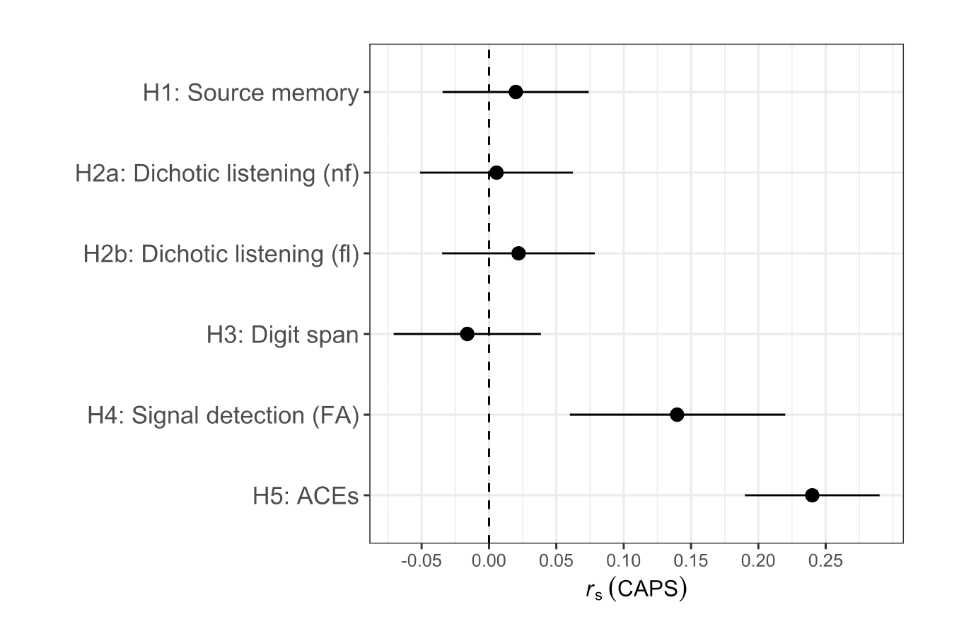
A multisite replication study
Hallucinatory experiences in the general population (CAPS) is associated with auditory signal detection performance.
 | r_{s} | 95% CI
Signal detection | 0.14 | [.06, .22]
Dichotic listening (non-forced) | 0.01 | [-.05, .06]
Dichotic listening (forced-left) | 0.02 | [-.03, .08]
Reality monitoring | 0.02 | [-.03, .07]
…But not performance on dichotic listening, reality monitoring, or digit span tasks (equivalence testing, all p < .05)
Comparable data quality for lab-based vs. online data
Moseley et al. (accepted)

