Slide 1
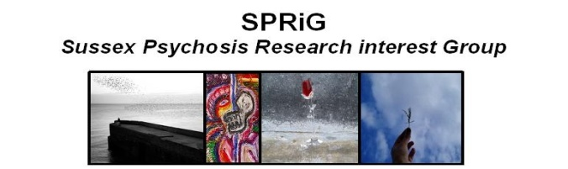


Social inclusion for young people with and without psychosis
Clio Berry (c.berry@sussex.ac.uk)
Dr. Kathryn Greenwood
Sussex Partnership NHS Foundation Trust and
University of Sussex, England, UK

Slide 2
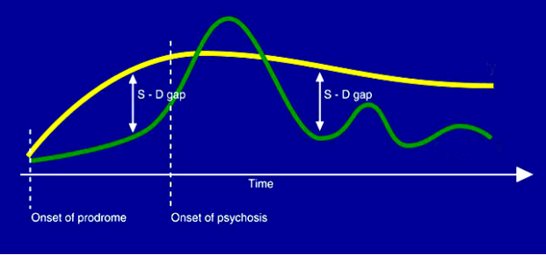
Why social inclusion?

Slide 3
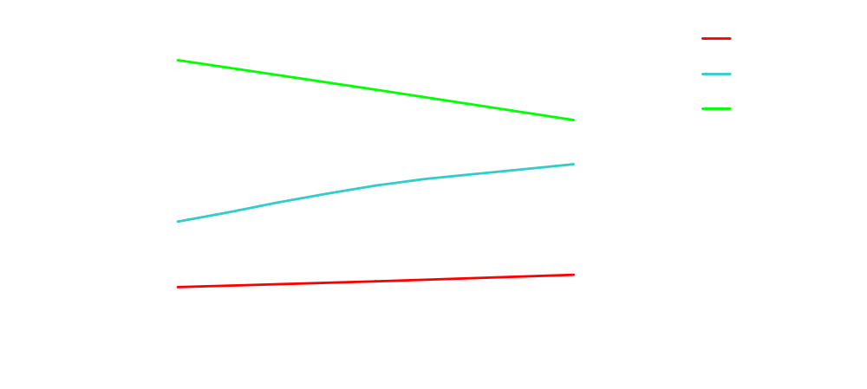
Why social inclusion?
EIP service users across 5 sites between 2006-2010 (N = 1027)
  Structured activity assessed at baseline, 6 months and 12 months
7%
Hours per week in Structured Activity
27%
66%
Hodgekins et al. (in prep)

Slide 4
Personal recovery and social inclusion
Hope-inspiring, supportive relational environment
Inclusive communities
External
HOPEFULNESS
SOCIAL INCLUSION
PERSONAL ADAPTATION
Mental health services
Satisfaction of basic needs
NEGATIVE SELF-BELIEFS
Individual
    (Beck et al., 2009;Brennaman & Lobo, 2011; Jacobson & Greenley, 2001; Romano et al., 2010; Windell & Norman, 2012)
    (Beck et al., 1009; Rector et al., 2005)
Notes:
-Two types of external influences most important in a mental health service context
-Social inclusion particularly important for young people with psychosis
-in addition to hopefulness, cognitive models of psychosis suggest that negative self-beliefs are also relevant to social and occupational outcomes

Slide 5
What is social inclusion?
Traditional measures focus on deficit or on work and education only
What else matters?
  Activities
  Social relationships
  Subjective experience
  Belonging
  Broad occupation
Young people with psychosis tend to have:
→
→ Less reciprocal relationships
(MacDonald et al., 2000; Shimitras et al., 2003)
Notes:
-social inclusion as key part of personal recovery and important to young people with psychosis
-social inclusion as comprehensive and multi-dimensional
-social/occupational/community indicators
-social inclusion particularly important as studies show negative social and occupational outcomes for young people with psychosis- although studies do not look at social inclusion explicitly
-interest in the influence of age on social inclusion within young people
-some suggestion that developmental agendas would influence social inclusion, e.g. adolescent focus on peer relationships moving to young adult focus on occupational activity and community involvement
-possible reduction of objective social activity over time
-suggestion that negative self-beliefs have more influence in young adulthood compared to adolescence due to cognitive maturity
-but very limited consideration as to developmental theory of hope and its effects
5

Slide 6
Influences on social inclusion in psychosis
Individual
  Negative self-beliefs
  Hopefulness
Age
  Developmental agendas (Carstensen, 1991; Iarocci et al., 2008)
  Negative self-beliefs influence behaviour upon cognitive maturity (D’Alessandro & Burton, 2006)
  Limited developmental theory for hope (Esteves et al., 2013)

Slide 7
External influences on social inclusion in psychosis
Therapeutic relationships may influence social and occupational outcomes (Lester et al., 2011; Harris et al., 2012; O’Toole et al., 2004)
  Small to moderate effects on quality of life and objective social functioning
Professionals’ optimistic expectations are key (Perry et al., 2007; Windell & Norman, 2012)
  Effect of professional hopefulness on days spent in employment over 2 years (O’Connell & Stein, 2011)

Slide 8
Research questions
How do individual factors influence social inclusion for young people with and without psychosis?
  What influence does age have on social inclusion and the influence of individual factors?
How do external factors influence social inclusion for young people with psychosis?
  What is the interplay between individual and external influences on social inclusion for young people with psychosis?

Slide 9
Study 1: Healthy young people
Online, cross-sectional questionnaire
Large sample of ‘healthy’ young people
Measures of social inclusion, negative self-beliefs and hopefulness
N=387 | M(SD) / %
Age (Range= 14-36 years) | 20.83 (4.49)
Female | 61.5%
White British | 77%
In employment and/or education | 95.9%

Slide 10
Study 1: Measures
Social inclusion
  1) Social network size and 2) reciprocity
  (Social Relationship Scale (SRS; MacFarlane et al., 1981)
  3) Social contact, 4) cultural inclusion, 5) political
  inclusion, and 6) belonging and meaningful occupation
  (Social Inclusion Measure (SIM; Secker et al., 2009)
  I have felt that what I do is valued by others [in the last month]’
Negative self-beliefs
  Dysfunctional Attitudes Questionnaire (Weissman, 1978)
    Defeatist performance beliefs: ‘If I fail at my work then I am a failure as a person’
    Need for approval: ‘I can’t be happy unless most people I know admire me’
Hope
  Domain Specific Hope Scale (Sympson, 1999)
    Work hope: ‘I can always find a job if I set my mind to it’
    Social hope: ‘Even if someone seems unapproachable, I know I can find a way to break the ice’
Notes:
-So the first study was a cross-sectional online questionnaire with 387 health young people, the demographic information is there
-The young people completed measures of negative self-beliefs and positive self-beliefs (hope) in domains relevant to social inclusion
-Two measures were used to assess social inclusion, capturing both objective activity and subjective social inclusion
10

Slide 11
Study 1: Findings
How do individual factors (negative self-beliefs and hope) influence social inclusion for young people without psychosis?
    Both negative self-beliefs and hopefulness seem important
What influence does age have on social inclusion and the influence of individual factors?
    Negative self-beliefs seem to have a greater impact as people age
      Negative self-beliefs influence behaviour upon cognitive maturity (D’Alessandro & Burton, 2006)

Slide 12
Negative self-beliefs and hope are associated with social inclusion for healthy young people (n= 387)
Need for approval beliefs
Social contact
.26**
Social activity
.73
negative self- beliefs
.55***
Social network size
.12*
-.52***
.59***
Defeatist performance beliefs
Social network reciprocity
.52***
.40**
social inclusion
-.25***
Political inclusion
Social hope
.56***
.43**
Community Belonging
Cultural inclusion
hope
.51***
.87
Occupational hope
.29***
Belonging and meaningful occupation
*p<.05, **p<.01, ***p<.001 Note: standardised path coefficients are shown
χ²: 50.65(25), p=.001 χ² /df: 2.03 CFI: .95 RMSEA: .05 SRMR: .04
Notes:
-Structural equation modelling was used to assess the relationship between these variables and all the nodes in this model are supported by individual factor analyses
-Final model suggests that both negative and positive self-beliefs are related to social inclusion at one timepoint, although this pathway here was not significant
-Social inclusion can be represented by a two factor structure where one factor represents more objective social activity and one more subjective community belonging
12

Slide 13
Hope is more important for adolescents (14 to 18 years; n= 152)
Need for approval beliefs
Predictor | Adolescents β | Young adults β | p
Social activity
Need App | .13 | .33** | .18
Def Per | -.20 | -.39*** | .39
Soc Hope | .53*** | .52*** | .77
Community belonging
Need App | -.04 | .19* | .05
Def Per | .07 | -.39*** | .001
Soc Hope | .41*** | .47*** | .51
Occ Hope | .44*** | .22** | .13
Social activity
Defeatist performance beliefs
.53***
.42**
Social hope
.41***
Community Belonging
Occupational hope
.44***
*p<.05, **p<.01, ***p<.001 Note: standardised path coefficients are shown
χ²: 88.65(63), p=.02 χ² /df: 1.41 CFI: .95 RMSEA: .05 SRMR: .06
Notes:
-Split the sample into two developmental groups; adolescents and young adults
-Social inclusion itself, structure and factor loadings, are equivalent but the effects of self-beliefs is different
-in adolescence, only hope is relevant
13

Slide 14
Negative self-beliefs are more influential for young adults (19 to 36 years; n= 235)
Need for approval beliefs
Predictor | Adolescents β | Young adults β | p
Social activity
Need App | .13 | .33** | .18
Def Per | -.20 | -.39*** | .39
Soc Hope | .53*** | .52*** | .77
Community belonging
Need App | -.04 | .19* | .05
Def Per | .07 | -.39*** | .001
Soc Hope | .41*** | .47*** | .51
Occ Hope | .44*** | .22** | .13
.33**
Social activity
-.39***
Defeatist performance beliefs
-.39***
.19*
.88***
.52***
Social hope
.47***
Community Belonging
Occupational hope
.22**
*p<.05, **p<.01, ***p<.001 Note: standardised path coefficients are shown
χ²: 88.65(63), p=.02 χ² /df: 1.41 CFI: .95 RMSEA: .05 SRMR: .06
Notes:
In young adulthood, negative self-beliefs are relevant
-hope is still relevant, but with a trend towards it being less influential (occupational hope and community belonging)
14

Slide 15
Research questions
How do individual factors influence social inclusion for young people with and without psychosis?
  What influence does age have on social inclusion and the influence of individual factors?
How do external factors influence social inclusion for young people with psychosis?
  What is the interplay between individual and external influences on social inclusion for young people with psychosis?

Slide 16
Study 2: Young people with psychosis
Sussex mental health services
Young people with psychosis
Main mental health professional (3 months plus relationship)
Mainly Early Intervention in Psychosis clients
C. 5 month follow-up (3-7 months)
N= 51 | M (SD) / %
Service users
Age (18 – 37 years) | 26.12 (5.59)
Male | 58.8%
Illness duration (6 – 204 months) | Median=24
First Episode Psychosis | 52.9%
Professionals
Age (28 – 61 years) | 43.59 (7.76)
Female | 76.5%
Employment duration (24 – 384 months) | 150.35 (104.18)
Nurse | 72.5%

Slide 17
Study 2: Measures
  Individual factors:
    Negative self-beliefs (baseline):
      Dysfunctional attitudes (defeatist performance and need for approval)
      Self-stigma; e.g. ‘I am embarrassed or ashamed that I have a mental illness’
    Hope (total across domains) (5 month follow-up)
  External/Therapeutic factors (baseline):
    Service user and professional rated therapeutic relationship
      Working alliance and emotional climate
    (General) Professional hopefulness regarding social/functional outcomes:
      e.g. ‘I expect that clients with psychosis have the ability to…have intimate relationships’
  Social inclusion (5 month follow-up):
    Social activity and community belonging

Slide 18
Study 2: Individual influences
 | Defeatist performance | Need for approval | Self-stigma | Hope | Social activity | Community belonging
NEGATIVE SELF-BELIEFS
Defeatist performance | 1
Need for approval | .64*** | 1
Service user self-stigma | .71*** | .61*** | 1
HOPE | -.21 | -.15 | -.43** | 1
SOCIAL INCLUSION
Social activity | -.08 | .05 | -.31* | .43** | 1
Community belonging | -.27 | -.17 | -.41** | .66*** | .32* | 1
*p<.05, **p<.01, ***p<.001
Notes:
-Self-stigma is associated with social inclusion but other negative beliefs are not
-Hope (total) is associated with social inclusion
18

Slide 19
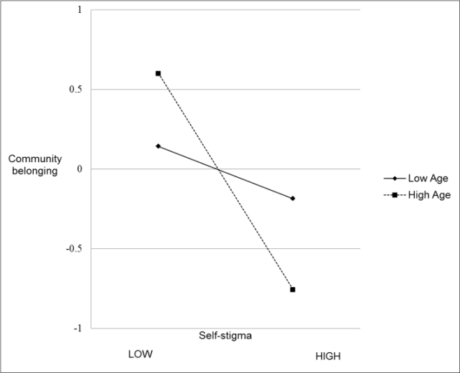
Study 2: Age differences
COMMUNITY BELONGING
No age differences for:
  Defeatist performance beliefs
  Need for approval
  Hope
Younger
Older
Self-stigma has a greater effect for older people
  Age*Self-stigma; β= -.24*
Notes:
Age differences in psychosis were examined differently to the healthy young people due to the smaller sample size
-no differences were found for hope or dysfunctional attitudes
-but, self-stigma did seem to have a more negative impact on both social activity and community belonging with age
-so in line with healthy young people in that negative self-beliefs have more effect for older people
19

Slide 20
Study 2: External and individual influences
Hopefulness
External influence
Social activity
Hope-inspiring relationships
  Moderate effects on hopefulness (Hicks et al., 2012) and self-efficacy (Melau, 2012)
  What about professional optimism?

Slide 21
Study 2: Professional-rated therapeutic relationship
Therapeutic relationship (P)
Indirect effect: ab= .14, ab= .07, 95% [.03, .14]
.37*
.38***
Social activity
Hopefulness
.62***
Community belonging
Indirect effect: ab= .23, ab= .25, 95% [.08, .49]
*p<.05, **p<.01, ***p<.001 Note: standardised path coefficients are shown
Notes:
In addition to the internal self-beliefs, therapeutic relationship and professional hopefulness were associated with service users’ hopefulness and/or social inclusion
Tested a series of path models to see whether these therapeutic factors seemed to predict social inclusion outcomes, and whether this was through the extent to which they were hope-inspring
-Professional therapeutic relationship influences social inclusion through increasing service user hope
21

Slide 22
Study 2: Service user-rated therapeutic relationship
Therapeutic relationship (P)
Indirect effect: ab= .22, ab= .11, 95% [.06, .18]
Therapeutic relationship (SU)
.54***
Social activity
Hopefulness
.42***
.63***
Community belonging
Indirect effect: ab= .26, ab= .28, 95% [.16, .44]
*p<.05, **p<.01, ***p<.001 Note: standardised path coefficients are shown
Notes:
-Therapeutic relationship rated by service users …
22

Slide 23
Study 2: Professional optimistic expectations
Indirect effect: ab= .15, ab= .12, 95% [.05, .12]
Therapeutic relationship (SU)
.51***
Social activity
Hopefulness
.70***
Community belonging
.30***
Professional expectations
Indirect effect: ab= .21, ab= .35, 95% [.15, .63]
*p<.05, **p<.01, ***p<.001 Note: standardised path coefficients are shown
Notes:
And professional hopefulness….
BUT associations between the service user therapeutic relationship and hopefulness and social inclusion are most robust when controlling for clinical symptoms- so something especially important about service users perceptions of care
Direct effects tend to not be significant, suggesting most of influence of TR and professional hopefulness is through service users’ hope
23

Slide 24
Study 2: Findings so far…
How do individual factors influence social inclusion for young people with psychosis?
    Hopefulness seems more important than negative self-beliefs
What influence does age have?
    Self-stigma has a greater impact with age
How do external factors influence social inclusion for young people with psychosis?
    Therapeutic relationships and optimistic professionals seem influential
What is the interplay between individual and external influences?
    External influences seem to influence social inclusion by being hope-inspiring

Slide 25
Study 2: Vocational activity
Employment and education
More distal outcome of personal recovery, e.g.
  hopefulness → social inclusion → vocational activity
  Influence of external factors
  Therapeutic relationships
  Professional optimistic expectations
 | Frequency (%)
Baseline | 26 (51.0)
Employment | 20 (39.2)
Education | 13 (25.5)
Follow-up | 33 (64.7)
Employment | 27 (52.9)
Education | 11 (25)
Change
Started vocational activity | 11 (21.6)
Stopped vocational activity | 4 (7.8)
No change | 36 (70.6)

Slide 26
Study 2: External influences and vocational activity
 | SUTR | PTR | OE | TO | H | SA | CB | VAB | VAF
Therapeutic relationships
Service user-rated (SUTR) | 1
Professional-rated (PTR) | .33* | 1
Professional optimistic expectations (OE) | .40** | .20 | .25 | 1
Service user hopefulness (H) | .42** | .36** | .08 | .30* | 1
Service users’ social inclusion
Social activity (SA) | -.02 | .30* | .00 | -.07 | .43** | 1
Community belonging (CB) | .34* | .33* | .14 | .11 | .66*** | .32* | 1
Vocational activity
Baseline | -.12 | .13 | .08 | .11 | .24 | .14 | .12 | 1
Follow-up | .10 | .44** | .17 | .07 | .44** | .31* | .47** | .43** | 1

Slide 27
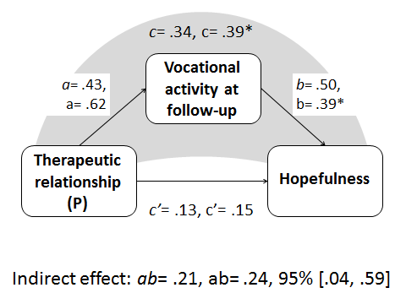
Study 2: External and individual influences on vocational activity
Associations between external and individual influences, social inclusion and vocational activity
Direct influence of professional-rated therapeutic relationship?
Vocational activity then influencing hopefulness and social inclusion

Slide 28
Overall findings
Social inclusion for healthy young people
Negative self-beliefs
Hope
Social inclusion for young people with psychosis
External factors (therapeutic relationship and professional hopefulness)
Self-stigma
Hope
    Individual factors:
      Negative self-beliefs and hope important for healthy young people
      Hope (and self-stigma) more relevant in psychosis
    Age
      Negative self-beliefs are more influential with age but hope more important for adolescents
    External factors in psychosis:
      Hope-inspiring
    Vocational activity:
  Associated with internal and external factors
  Part of the journey, not an outcome
Notes:
28

Slide 29

Implications
Unique role of hope in social inclusion compared to presence or absence of negative self-beliefs
Greater emphasis on hopefulness and positive self-beliefs in treatment for young people with psychosis
  E.g. Social Recovery focused Cognitive Behavioural Therapy (SRCBT; Fowler et al., 2009)
  E.g. Hope therapy? (Snyder, 2000)
Developmental theory of hopefulness?
Brief online intervention for hopefulness?
  Young people au fait with technology ()
  Cost-effective and suitable for young people who do not use services

Slide 30
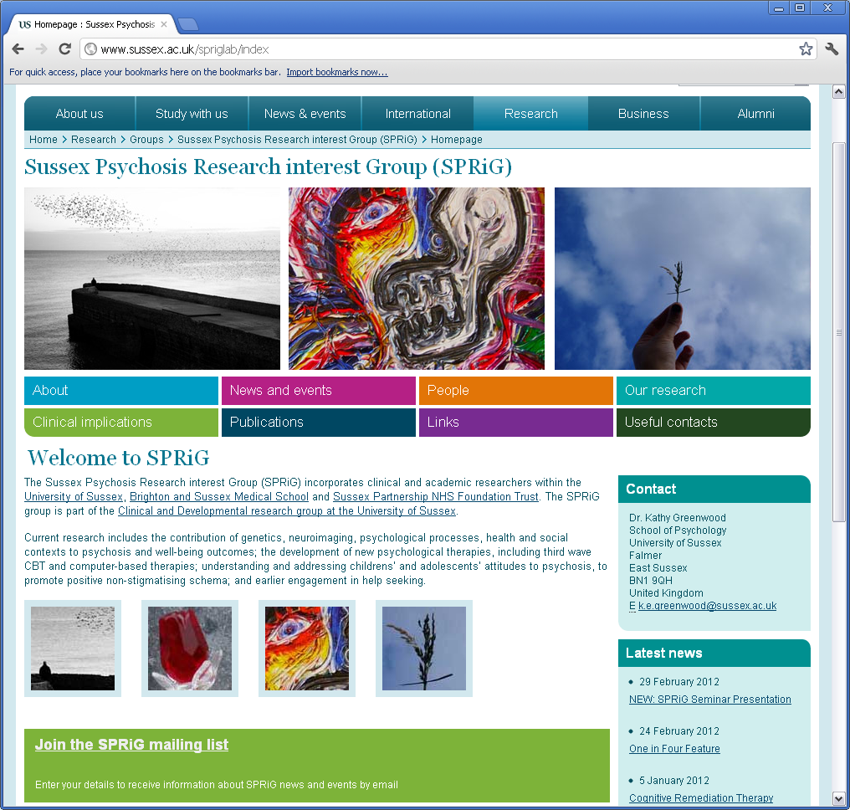
Thank you
www.sussex.ac.uk/spriglab
Clio Berry (c.berry@sussex.ac.uk)

