Slide 1

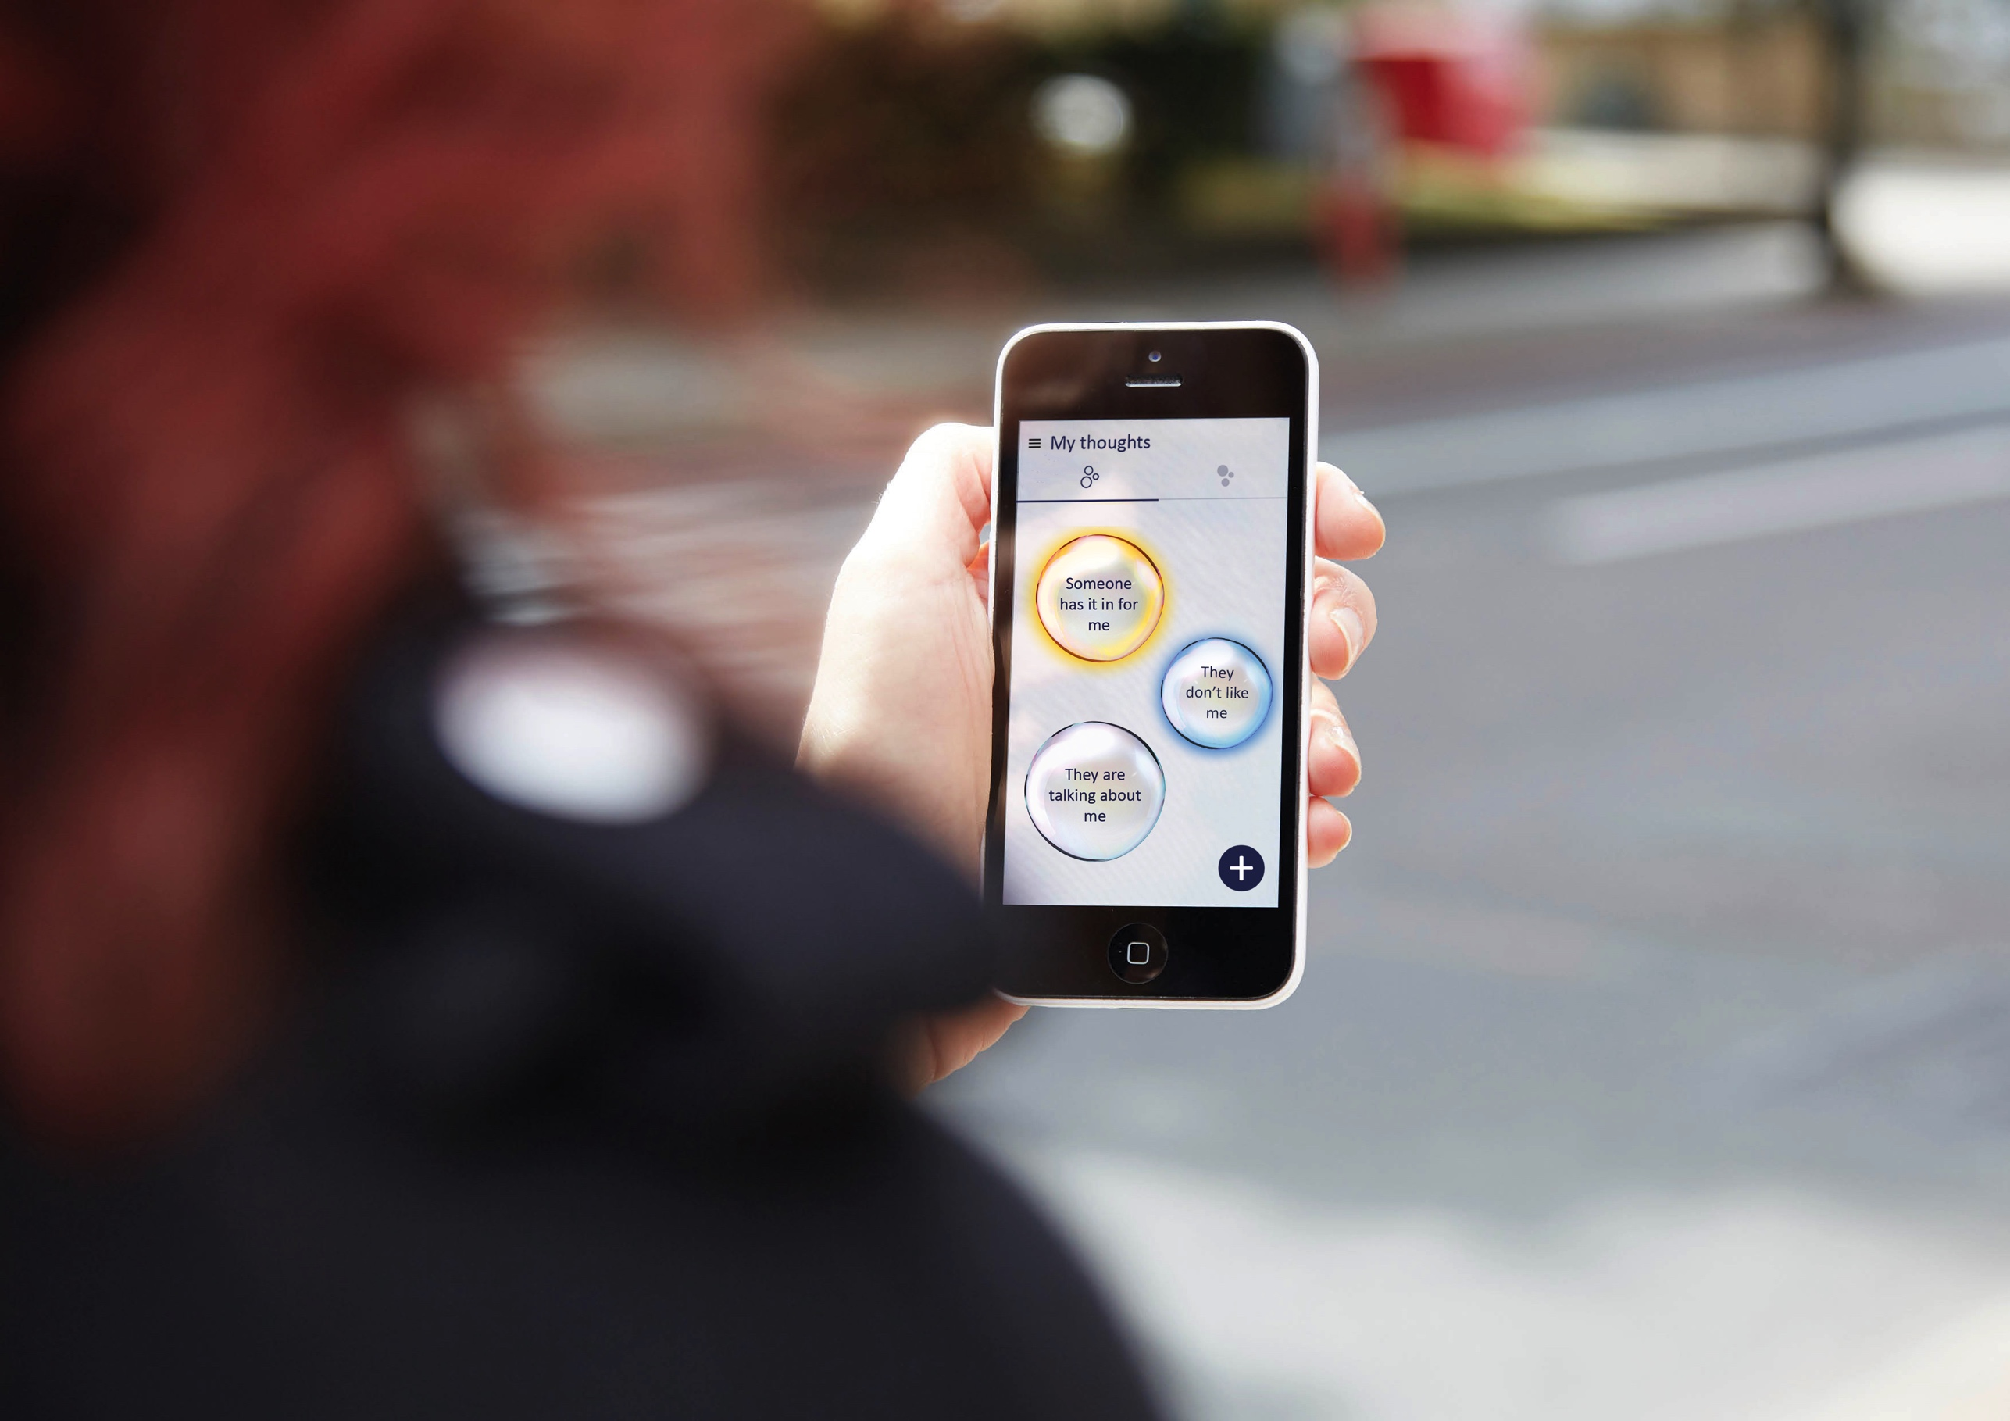

The effects on paranoia of SlowMo a blended digital therapy in a randomised controlled trial
Notes:
I

Slide 2

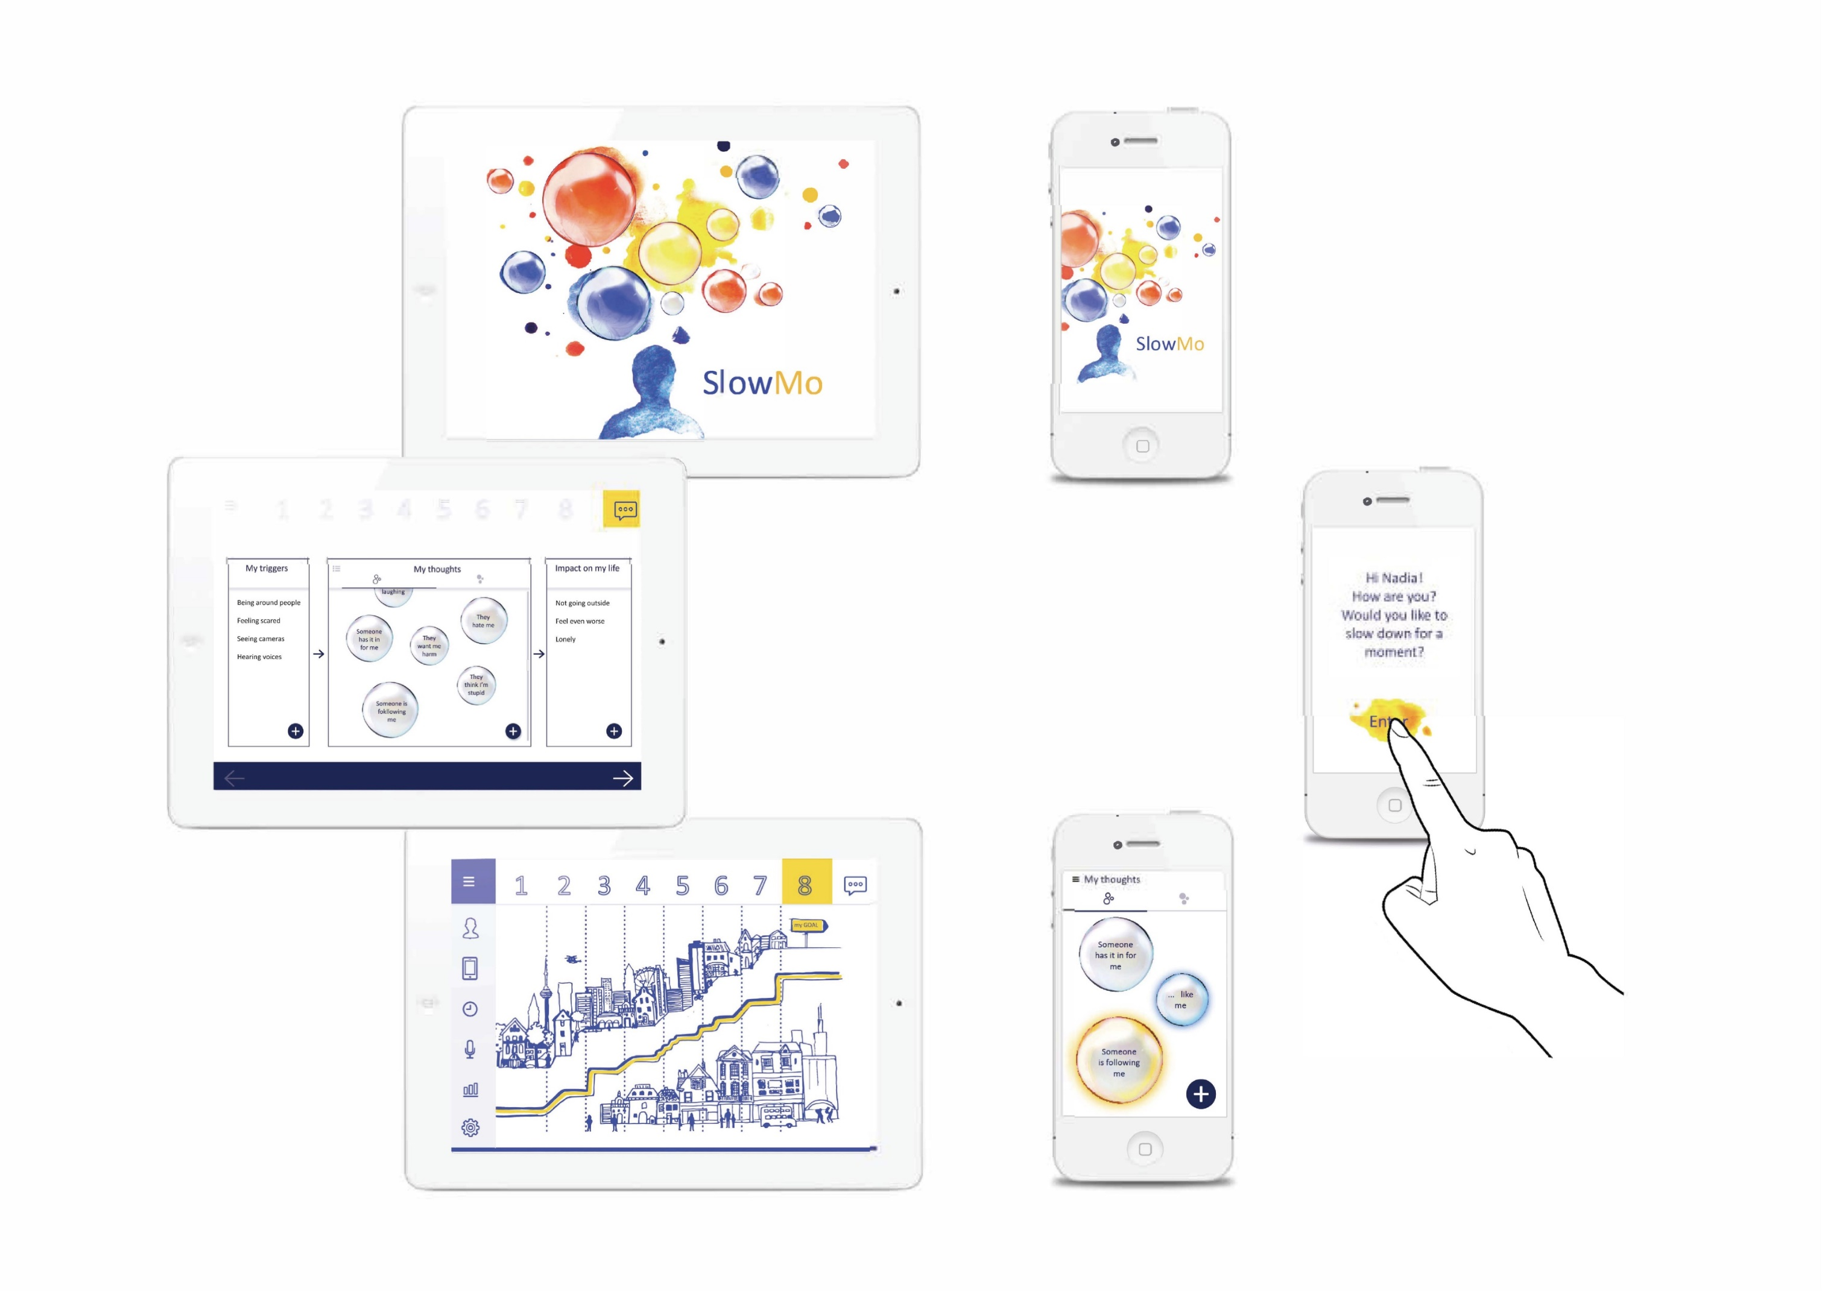

SlowMo therapy

Slide 3
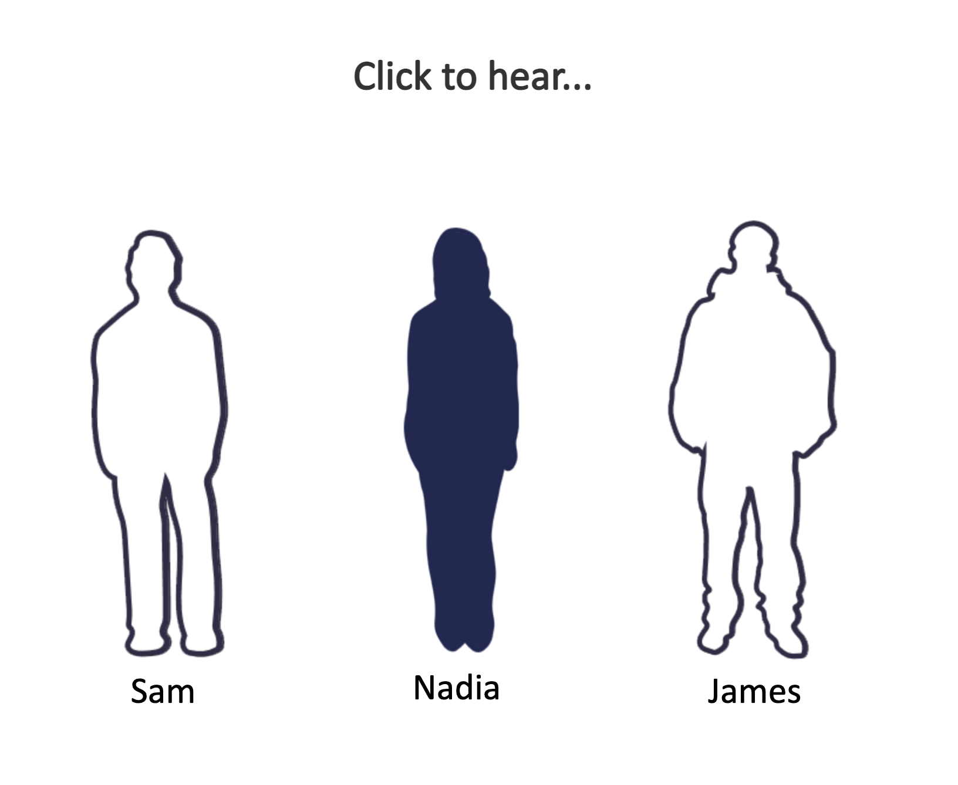
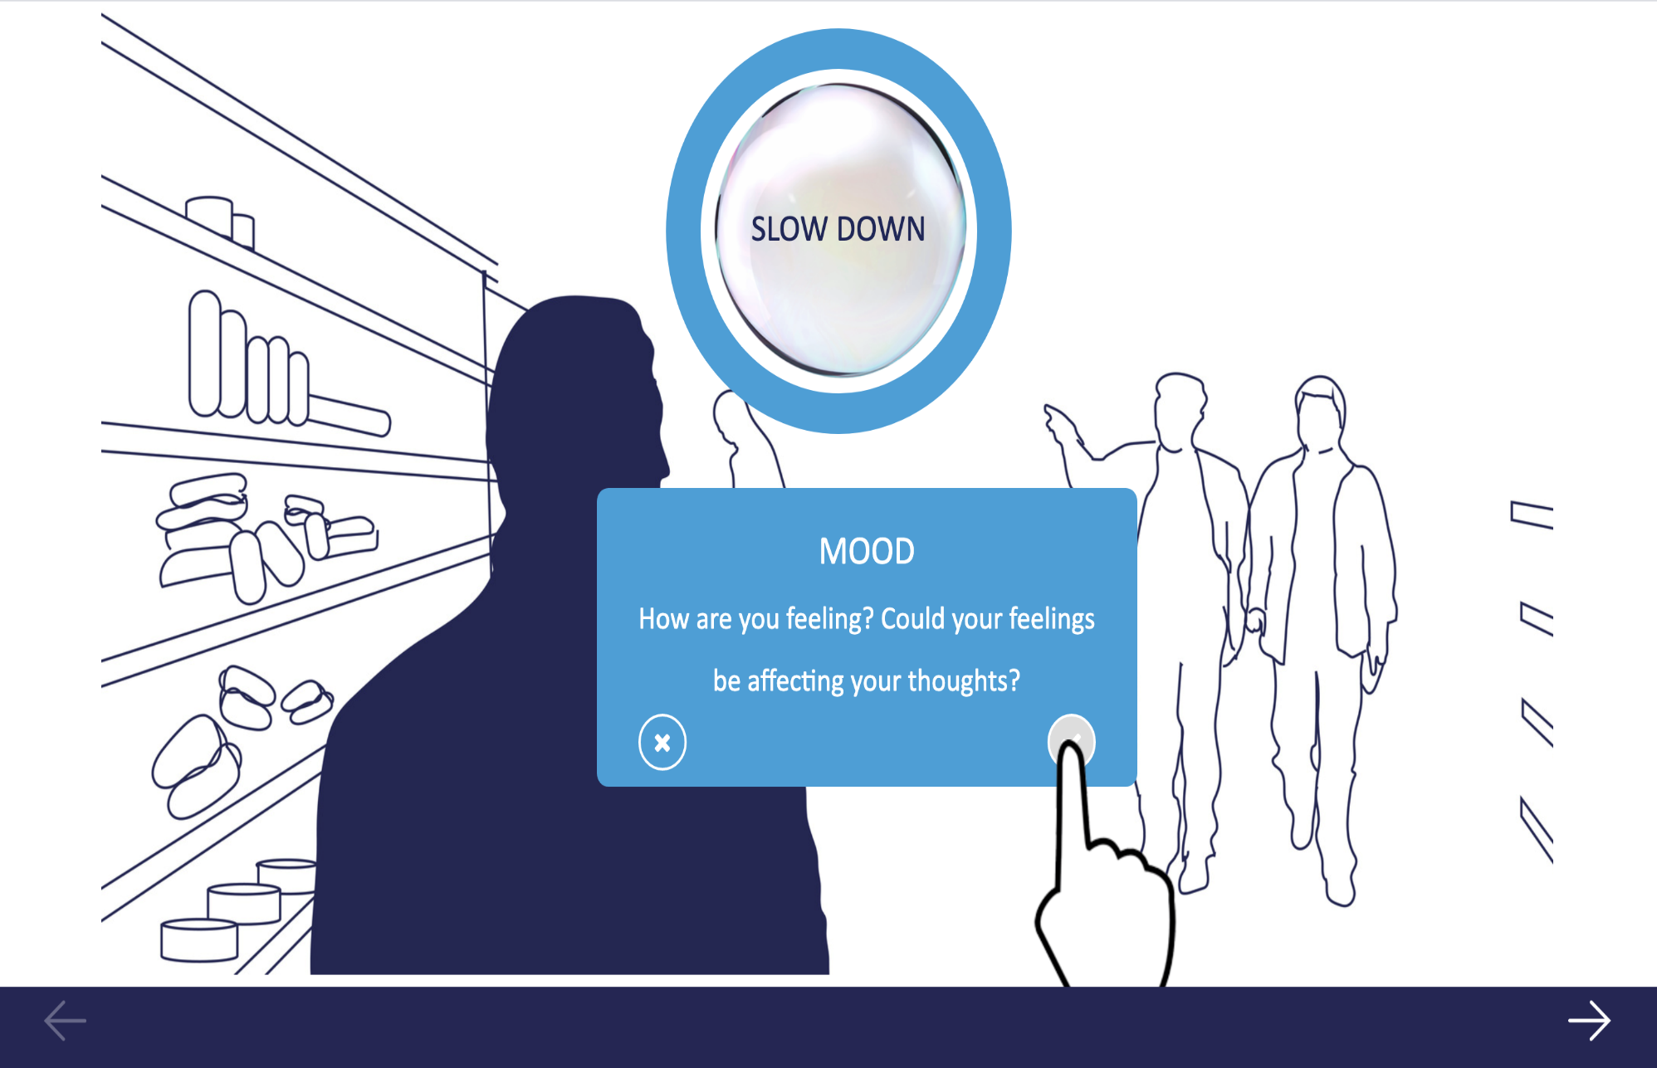
People of SlowMo: Stories –learning from social connections

Slide 4


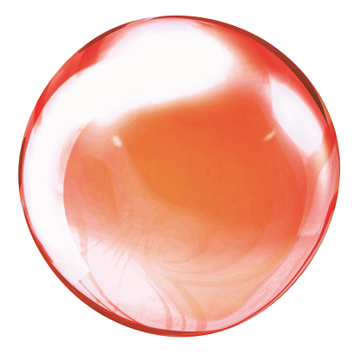



SlowMo: feeling safer
Don’t stress
Could be coincidence
Don’t
jump to conclusions
Slow
down when thinking fast
Slow
down for a moment
Relax -
think it over
Don’t
overthink
It’s never too late to change
Don’t over-react to thoughts
Pay
attention
to what
I’m doing
Calm down play some music

Slide 5
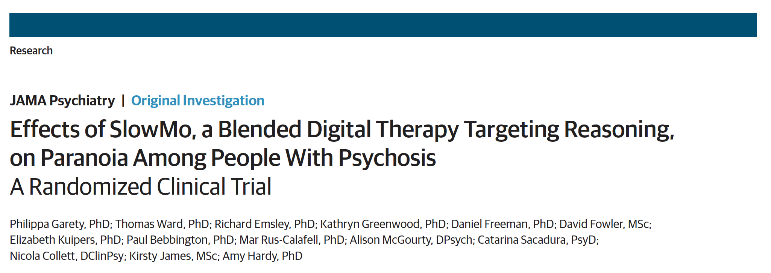
Highlight: 10 /11 paranoia measures at 12 weeks, and 8/11 at 24 weeks significant small-moderate effects
JAMA Psychiatry. 2021. doi:10.1001/jamapsychiatry.2021.0326
Published online April 7, 2021
Notes:
Does it work? How does it work?

Slide 6

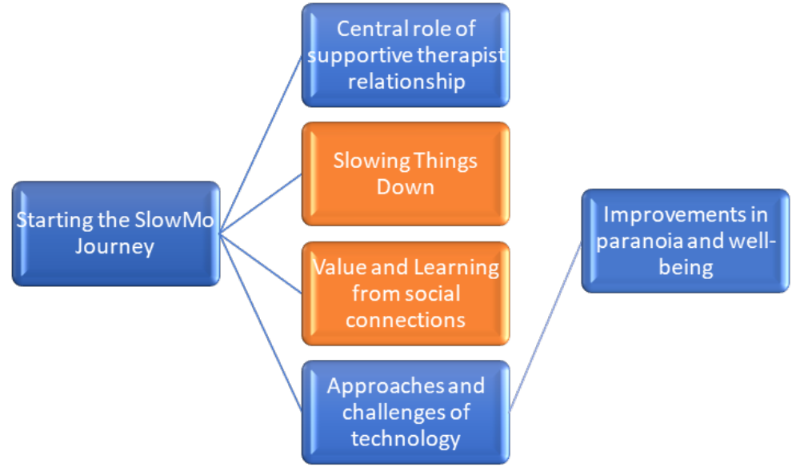
Highlight: Qualitative co-produced therapy themes identified
Notes:
Does it work? How does it work?

Slide 7
Highlight: The Sussex Psychological Therapies Clinic for Paranoia Slowmo – a multi-perspective collaboration
Community Transformation
Recovery College
Patient and Public Involvement
Digital Approaches
To data collection
Psychological therapies
for paranoia
Testing implementation

Slide 8
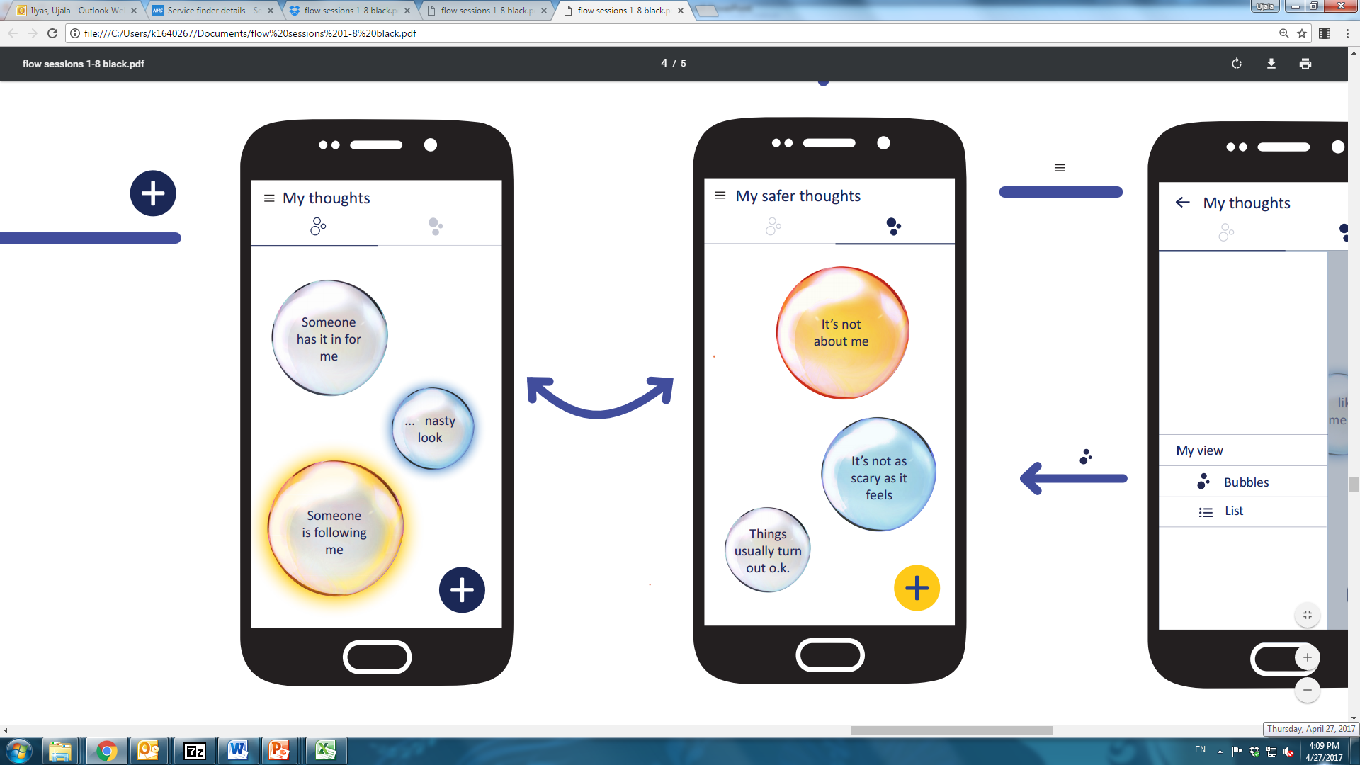
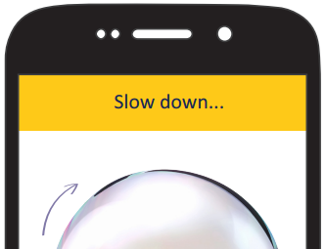
SlowMo trial team
Chief Investigator Prof Philippa Garety | Trial Co-ordinator Dr Tom Ward Site Co-ordinators Dr Nicola Collett Dr Mar Rus-Calafell Dr Alison McGourty Dr Cat Sacadura Therapists Dr Simone Farrelly Dr Kat Pugh Dr Sam Fraser Dr Emma Černis Dr Katherine Law Dr Annabel Ivins Software Evolyst Ltd | Research Workers Ujala Ilyas Elâ Örücü Eva Tolmeijer Michaela Rea Rikesh Halkoree Evelin Vogel Vicci Smallman Claire Vella Valerija Lvova Phoebe Maple-Horvat Catherine Belton Anna East | Healthcare Designers Helen Hamlyn Centre for Design, Royal College of Art: Ed Matthews Jonathan West Anna Wojdecka
Prof Philippa Garety | Dr Tom Ward | Healthcare Designers – Helen Hamlyn Centre for Design, Royal College of Art Ed Matthews Jonathan West Anna Wojdecka
Co-applicants Prof Paul Bebbington Prof Graham Dunn Prof Richard Emsley (Lead Statistician) Prof David Fowler Prof Daniel Freeman Prof Kathy Greenwood (PPI Lead) Dr Amy Hardy (Digital Lead) Dr Helen Harding Prof Elizabeth Kuipers Statistician Kirsty James PPI Consultants/ SU Researchers Alice Hicks, Angie, Dan, Amy, Helen, Natalie, Anthony, Alex and others | Site Co-ordinators
Prof Paul Bebbington Prof Graham Dunn Prof Richard Emsley (Lead Statistician) Prof David Fowler Prof Daniel Freeman Prof Kathy Greenwood (PPI Lead) Dr Amy Hardy (Digital Lead) Dr Helen Harding Prof Elizabeth Kuipers Statistician Kirsty James Software Evolyst Ltd: Dr Christopher Golby Evan Harris Josh Perry Prince Mannix Rahul Mahajan Ben Skirth | Dr Nicola Collett Dr Mar Rus-Calafell Dr Alison McGourty Dr Cat Sacadura Therapists Dr Simone Farrelly Drs Kat Pugh Dr Sam Fraser Dr Emma Černis Dr Katherine Law Dr Annabel Ivins | Helen Hamlyn Centre for Design, Royal College of Art: Ed Matthews Jonathan West Anna Wojdecka Software Evolyst Ltd: Dr Christopher Golby Evan Harris Josh Perry Prince Mannix Rahul Mahajan Ben Skirth
Research Workers Ujala Ilyas, Elâ Örücü, Eva Tolmeijer, Michaela Rea, Rikesh Halkoree, Evelin Vogel, Vicci Smallman, Claire Vella, Valerija Lvova, Phoebe Maple-Horvat, Catherine Belton, Anna East | PPI Consultants/ SU Researchers Alice Hicks, Angie, Dan, Amy, Helen and Natalie, Anthony, Alex and others | Dr Christopher Golby Evan Harris Josh Perry Prince Mannix Rahul Mahajan Ben Skirth

Slide 9













Notes:
Needs updates one without MINDWAVE.

