Slide 1
Soteria
Being with, not doing to.
Combining compassion and evidence in approaches to psychosis

Slide 2
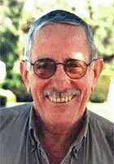
Dr Loren Mosher, psychiatrist
Research training at Tavistock Clinic
Inspired by Kinglsey Hall (RD Laing) and alternative treatments for ‘schizophrenia’
1970s - Head of Center for Studies of Schizophrenia, National Institute of Mental Health
1970-92 investigator and later Research Director of Soteria Project, San Jose, California

Slide 3
Mosher’s questions
Could people newly labelled as 'schizophrenic' and deemed so dysfunctional as to require hospitalization be successfully treated in a small, home-like, non-hospital setting without anti-psychotic drugs?
How would their clinical outcomes compare at six weeks, six months and one and two years, to those of a group of similarly selected and studied persons who received the usual in-patient and out-patient follow up care?
Outcomes meant whether factors such as hospitalization , medications and psychotic symptoms continued and whether levels of psychological functioning improved or deteriorated

Slide 4
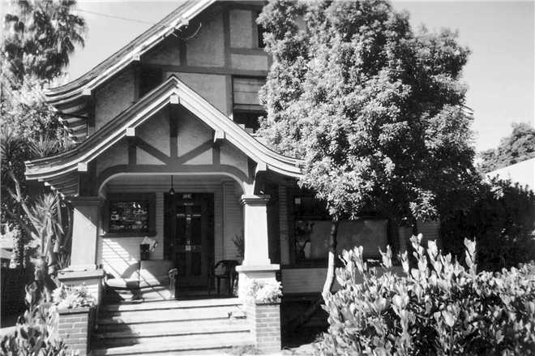
Soteria House, San Jose, 1971-1983

Slide 5
Features of Soteria House
research project ran from 1971 to 1983, comparing Soteria with in-patient TAU
primarily 1st or 2nd break psychosis
ordinary home-like environment
typically 6 residents
primarily non-medical and untrained staff

Slide 6
Features of Soteria House
preserving resident's personal power, social networks, and communal responsibilities
finding meaning in the subjective experience of psychosis by "being with" clients (The Vigil)
no or minimal use of antipsychotic medication (with any medication taken from a position of choice and without coercion). As much as possible, service users did not receive neuroleptic drugs during the first 6 weeks, in order to give them the best chance of responding to the house

Slide 7
in Mosher’s words
"the 24 hour a day application
of interpersonal phenomenological
interventions by a nonprofessional staff, usually without neuroleptic drug treatment, in the context of a small, homelike, quiet, supportive, protective, and tolerant social environment”

Slide 8
being with
interpersonal phenomenology focuses on the development of a non-intrusive, non-controlling but actively empathetic relationship with the person experiencing ‘psychosis’ without having to do anything explicitly therapeutic or controlling. In shorthand, it can be characterised as ‘being with’

Slide 9
responses to psychosis
Aliens from Venus had selected him for a special mission and would be arriving at a local park to pick him up at 7 o’clock. Test the hypothesis..
The Vigil. Hours, sometimes days being with a resident who was going through psychosis. Sometimes talking, sometimes not. Benignly being with.

Slide 10
Outcomes
Two random assignment studies of the Soteria model and its modification for long-term system clients reveal that 85% to 90% of acute and long-term clients deemed in need of acute hospitalization can be returned to the community without use of conventional hospital treatment.
Soteria, designed as a drug free treatment environment, was as successful as antipsychotic drug treatment in reducing psychotic symptoms in 6 weeks.
THE JOURNAL OF NERVOUS AND MENTAL DISEASE,1999 Mosher, L,M.
http://www.ncbi.nlm.nih.gov/pubmed/10086470

Slide 11
Outcomes
A systematic review of research studies on Soteria found that residents at Soteria did at least as well as patients who were treated with standard hospital treatment on measurements of psychotic symptoms and global functioning.
Calton, Spandler. Schizophrenia Bulletin 2008
Notes:
http://www.ncbi.nlm.nih.gov/pubmed/10086470

Slide 12
The word spreads
Soteria projects in Sweden, Holland, Finland, Germany, Switzerland and Hungary
Soteria Network UK, Bradford
and Brighton!

Slide 13
Why do we need Soteria?
Current TAU paradigm is broken
  Pharma and the biomedical view has corrupted psychiatry. Prescribed medication is the third biggest killer after cancer and heart disease. (‘Deadly Medicines and Organized Crime’ Peter Gotzsche 2013)
  Psychiatric disability rates and prescribing habits have risen in parallel with prescribing habits over the past 20 years, showing that medicines are at best ineffective (Anatomy of an Epidemic, Robert Whitaker, 2010)
  Long term studies are now revealing the disabling and life-threatening harms of long term use of psychiatric medication, and the positive outcomes associated with avoiding them
Notes:
Peter Gotzsche – Danish physician, medical researcher Leader of the Nordic Cochrane Center, cofounder of the Cochrane colllaboration – sytematic review of RCT’s.
Their Moto –Trusted evidence, informed decisions- lead to better health!
TAU – treatment as usual. Brain shrinkage not due to schizophrenia but to long term use of antipsychotics – monkey research

Slide 14
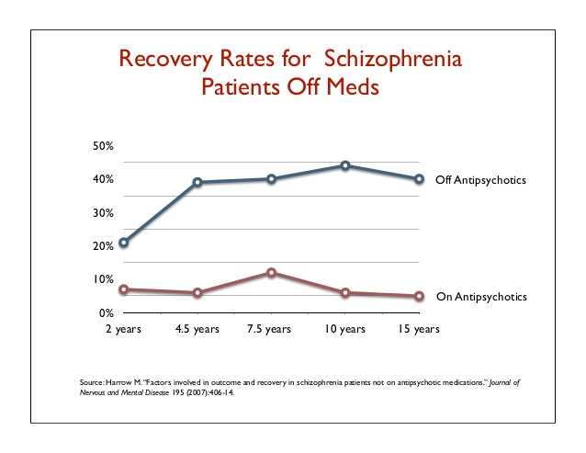
Why do we need Soteria?
  How would Soteria residents be faring after 5, 10, 15 and 20 years with a minimal or no medication regime?
  The Harrow study shows us:
  Latest 20 year results confirm the pattern. Harrow, Jobe. Does treatment of schizophrenia with antipsychotic medications eliminate or reduce psychosis? A 20-year multi-follow-up study. University of Illinois, 2014
Notes:
Professor Martin Harrow Psychologist special interest in Schizophrenia and mood disorders and a chess champion! Question – do patients with ‘Schizophrenia’ need antipsychotics for life?

Slide 15
Why do we need Soteria?
Cheaper and more effective than TAU
Service users like it and are not battling with a service they feel does not understand their experiences
Mounting evidence from other non-Soteria approaches that psychological and relationship-based services, eg Open Dialogue, are more effective than disease-based TAU
Notes:
Example from psychological therapy – aliens visiting

Slide 16
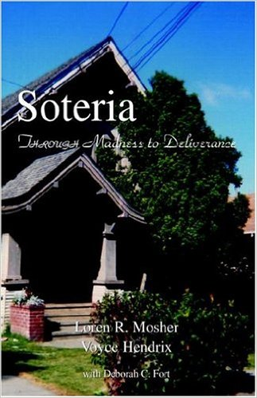

Soteria. Through Madness to Deliverance. by Loren R. Mosher & Voyce Hendrix
Hendrix? Any relation? Yes!
Notes:
Voyce Hendrix – Clinical director of Soteria House – worked with Mosher.

Slide 17
Soteria Brighton Aims
Set up a Soteria House eventually!!!
Raise awareness via SIP events, of alternative perspectives to mainstream approaches, emerging from current research.
Set up a group focusing on managing medication
Set up a Soteria Café
Campaign for a choice of treatment and guidelines for guided reduction of psychiatric medication.
Notes:
Any chance of a ward in Mill view?

Slide 18
Recommended Resources
BPS Division of Clinical Psychology – Understanding Psychosis and Schizophrenia
Mad in America Website www.madinamerica.com
Council for Evidence Based Psychiatry website www.cepuk.org
Madness Explained: Psychosis and Human Nature by Richard Bentall
Notes:
Free to download from BPS website
Richard Bentall won the BPS book prize

Slide 19
Future Events
Look out for the Maudsley Debates
Next one 11th May 2016 This house believes that Nice Guidelines ‘CG 178 Psychosis and Schizophrenia in Adults is unbiased and evidence based’.
Last year and now online ‘This house believes that the use of long term use of psychiatric medication is doing more harm than good.’

Slide 20
Future Soteria Brighton Events
9th June 2016 Alchemy project.
Sept 2016 Soteria Bradford present their work at the Soteria house they have set up!
Nov 2016 Suman Fernando – Psychiatrist presenting cultural perspectives in mental health.

Slide 21
Thank You
Questions for Soteria Brighton Members which include carers, individuals with lived experience and a variety of mental health professionals…………..

