Slide 2


Metacognition and psychosis-spectrum experiences in clinical and non-clinical populations
Dr Emma Palmer-Cooper
School of Psychology, Centre for Innovation in Mental Health, University of Southampton
@dr_emmaclaire
e.c.palmer-cooper@soton.ac.uk

Slide 3
Today’s Talk
Metacognition
  General Population
  Clinical Population
Non-clinical Research
Hierarchical Model of Metacognition

Slide 4
Metacognition

Slide 5
What is Metacognition?
‘Thinking about thinking’ (Flavell, 1979)
  (Nelson & Narens, 1990)
Very broad term for a complex set of processes
Knowledge about Cognition
Cognition
Monitoring
Control

Slide 6
So instead of the simple Nelson and Narens Model…
  (Palmer-Cooper, Wright, Greenwood, Wykes, In Prep)
General beliefs about one’s thoughts and abilities
Self-reflection (about thoughts and cognitive performance)
Confidence about in-the-moment cognitive performance
Monitoring
Control

Slide 7
What is Metacognition?
Umbrella/General Term
Awareness
Ability
Confidence
Efficiency
Insight
Knowledge
Control
Theory of Mind
Mind Reading
Metacognition
Notes:
Many words used to describe it across psychological literature

Slide 8
So instead of the simple Nelson and Narens Model…
  (Palmer-Cooper, Wright, Greenwood, Wykes, In Prep)
Metacognitive ability: higher-order perspective
Metacognitive experience/reflection: appraisal of experience
Metacognitive efficiency/accuracy: “feeling of knowing”
Monitoring
Control

Slide 9

What is Metacognition?
Control and utilise knowledge about the self
Reflect on current and past experiences
  update knowledge
Knowledge forms beliefs about the self and abilities
Help make judgements about the world around us
  in the moment
  about current and past abilities

Slide 10
Metacognition in
General Populations

Slide 11

General Population
Beliefs
Beliefs about thoughts are significantly associated with the “psychotic-like experiences” in healthy adults (Reeder, Rexhepi-Johansson & Wykes, 2009)
Metacognitive beliefs better in a community sample of compared to ARMS population (Welsh et al, 2013)
  Not maladaptive, e.g. ‘worry is dangerous for me’.
When considering non-clinical voice hearers, healthy adults and clinical voice-hearers:
  Two non‐clinical had less maladaptive metacognitive beliefs than clinical group.

Slide 12
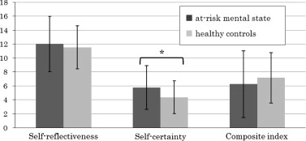
General Population
Self-Reflection
Self-reflection (Beck Cognitive Insight Scale, BCIS) is negatively associated with ageing (Buchy, Brodeur, & Lepage, 2012).
No significant differences in self-reflection (BCIS) between ARMS
  But Overconfidence Bias (self-certainty, BCIS) is lower in healthy adults
  Uchida et al., 2014

Slide 13

General Population
In-the-moment
In-the-moment perceptual metacognitive accuracy increases throughout adolescence, (Weil et al, 2013).
  Implications for education and attainment (not for this talk!).
Notes:
Developmental and cognitive psychology has demonstrated that throughout adolescence, in-the-moment perceptual metacognition improves (Weil et al, 2013).

Slide 14
Investigated relationship between age and objective, in-the-moment metacognition in healthy adults.
Palmer, David & Fleming, 2014
PhD Research

Slide 15

60 participants, 18 - 84 years, mean age 40.3 years
  recruited in South London
  Opportunity sampling
  Cross sectional design
55% female
Not currently depressed.
Participants & Design

Slide 16
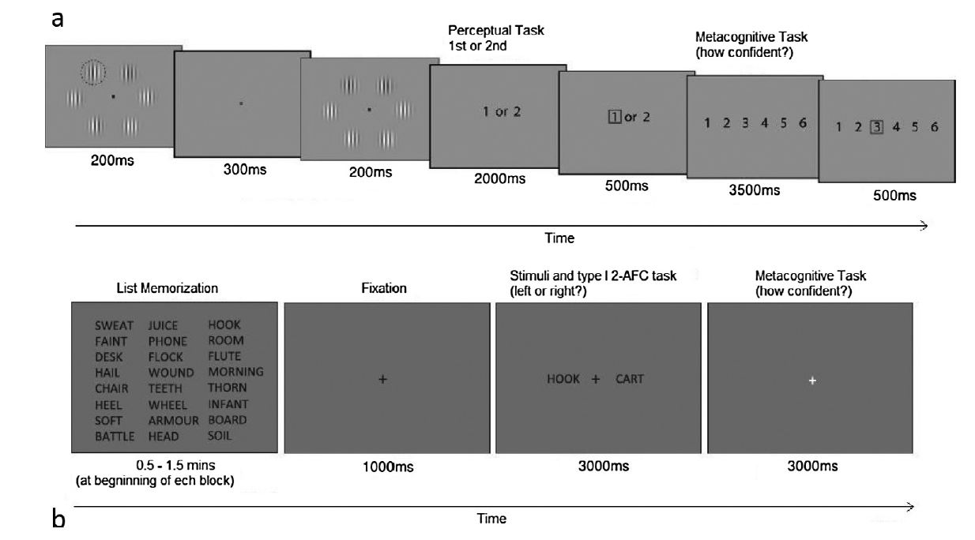
Perceptual metacognitive accuracy
Memory memory metacognitive accuracy
Methods

Slide 17
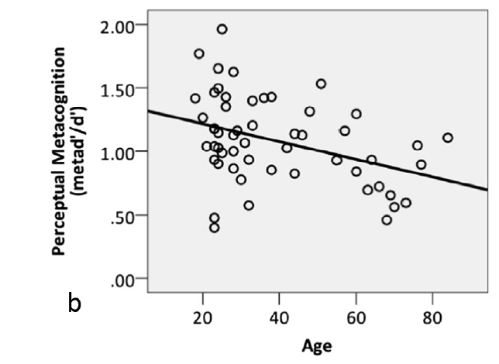
In-the-moment perceptual metacognitive accuracy negatively associated with age.
  r = - 0.38, p = 0.005
In-the-moment memory metacognitive accuracy decline with age not significant.
  r= - 0.064, p = 0.70
Results
Correlation
Notes:
Small but significant assocciation
Sub-Scale analyses demonstrated that ..

Slide 18
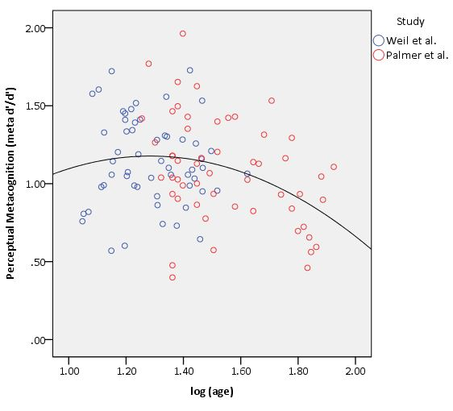
Measurable lifetime inverted U-shaped profile of in-the-moment perceptual metacognitive accuracy,
Quadratic trend line (r=0.14, p = 0.02)
Results
Correlation
Notes:
When combined with research in adults, there is a measurable lifetime inverted U-shaped profile of these metacognitive abilities, clearly demonstrating a decline in metacognitive accuracy throughout middle- to late-adulthood (Palmer, David & Fleming, 2014).
This age-related reduction in metacognition can lead to a reduced ability to assess and address the risks of carrying out in daily activities, such as driving (Ross et al, 2012).

Slide 19
General Population
In-the-moment
This age-related reduction in perceptual metacognition can lead to a reduced ability to assess and address the risks of carrying out in daily activities, such as driving (Ross et al, 2012).
Notes:
Developmental and cognitive psychology has demonstrated that throughout adolescence, in-the-moment perceptual metacognition improves (Weil et al, 2013).
When combined with research in adults, there is a measurable lifetime inverted U-shaped profile of these metacognitive abilities, clearly demonstrating a decline in metacognitive accuracy throughout middle- to late-adulthood (Palmer, David & Fleming, 2014).
This age-related reduction in metacognition can lead to a reduced ability to assess and address the risks of carrying out in daily activities, such as driving (Ross et al, 2012).

Slide 20
Metacognition in
Psychosis Populations

Slide 21
Psychosis Populations
General consensus that poor metacognition is associated with psychosis and related disorders, however it is measured/conceptualised.
Commonly associated with clinical insight (David, Bedford, Wiffen, Gilleen, 2012).
  Sub-section of metacognition, cannot compare to healthy adults
  Recent research focuses on more general metacognition

Slide 22
Psychosis Population
Self-reported Beliefs & Ability
Better metacognitive ability significantly predicts improvement in functioning in FEP across a 3-year period (Wright, Davies, Fowler & Greenwood, 2019).
Meta-analysis showed people with psychosis had more maladaptive metacognitive beliefs compared to healthy adults (Sellers, Varesea, Wellsa, Morrison, 2017).
Maladaptive metacognitive beliefs were a better predictor of course of illness than anxiety and depression (Austin et al, 2015)
Notes:
So now to the highest order of metacognition,
Again beliefs and general metacognitive ability predicts improvement in function over 3 years,

Slide 23

Psychosis Population
Self-Reflection
Individuals with psychosis and cognitive insight
  Mixed evidence in the literature
  Patients with psychosis tend to have impaired cognitive insight (Beck et al., 2004; Kao et al., 2011)
  Worse than healthy controls (Warman, Lysaker, & Martin, 2007)
  No difference to healthy controls (Engh et al., 2007)
Notes:
More evidence for the self-reported measures of metacognitive function turning to self-reflection…

Slide 24
Found better self-reflection in depressed, functioning psychosis population compared to non-depressed controls.
Results
ANOVA
Notes:
Alternatively, it is suggested that FEP patients appear more self-reflective than healthy adults because they do indeed reflect more on their personal experiences and thoughts, as they are having unusual illness-relted experiences (Bedford, 2010)
However this is not to say that healthy adults have “worse” cognitive insight than FEP patients, perhaps instead they answer the BCIS differently to patient groups as they 1) do not have as much to reflect on, or 2) interpret questions differently.

Slide 25
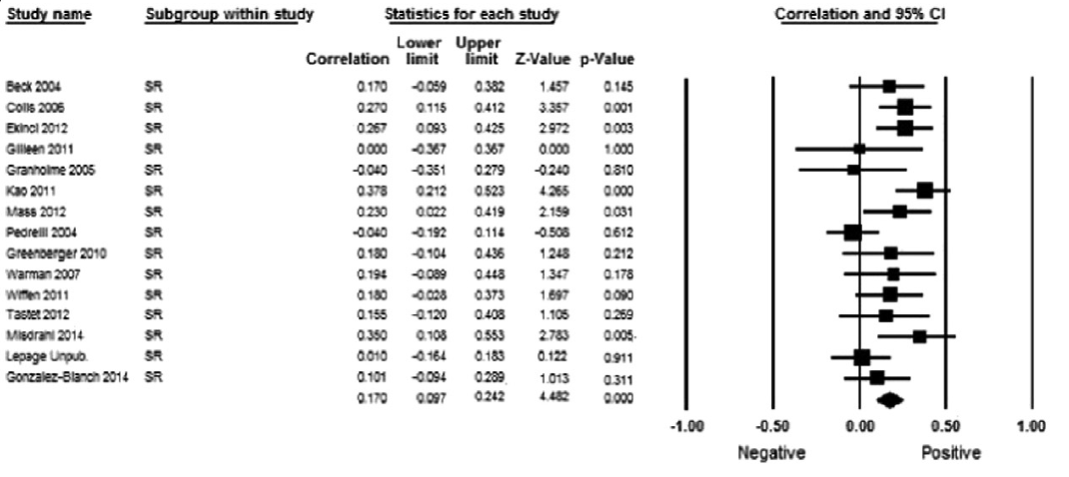
15 studies, 1379 patients with a psychotic disorder
BCIS self-reflection was associated with low mood
r = .170, p< .01; z = 4.48
Palmer, Gilleen & David, 2015
Results
Meta-analysis
Notes:
Similar to clinical insight…
Where lower mood is associated with better self-reflection. Perhaps depressive realism created more accurate self-understanding

Slide 26
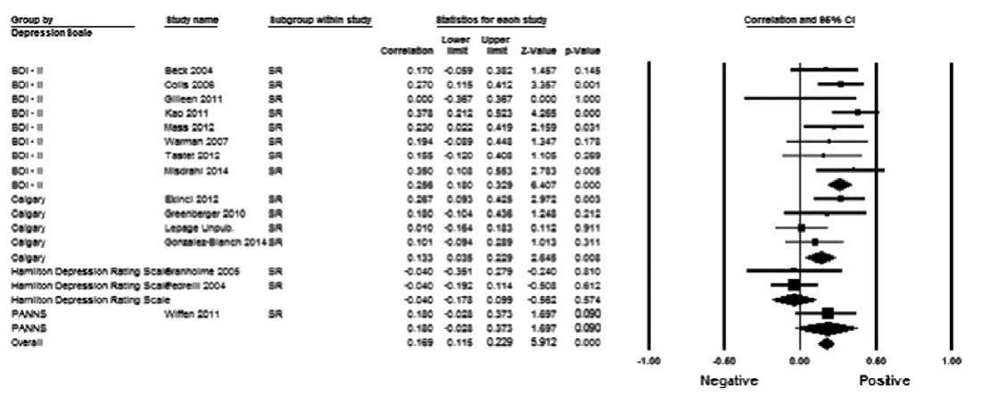
15 studies1379 patients with a psychotic disorder
BCIS self-reflection was associated with low mood
  Not affected by depression measure, but scales with explicit responses were more highly correlated
Palmer, Gilleen & David, 2015
Results
Meta-analysis
Notes:
The BDI-II questionnaire was the most commonly
used measure: 9 of the 16 studies included in the SR analysis.
The CDS was used in 3 of the studies; the Hamilton scale was used in
2 studies, and the PANSS depression measure was only used once. The
highest overall correlation andmost significant effectwas seen between
SR and the Beck Depression Inventory-II (BDI-II; r = .256, p b .001),
followed by the he Calgary Depression Scale (CDS; r = .135, p b .03).
Neither the Hamilton Depression Rating Scale (HDRS) (r = −.040,
p = .574) nor the PANSS depression item (r= .18, p = .09) had a significant
relationship with SR.

Slide 27
7 studies, 466 patients with a psychotic disorder
BCIS self-reflection was not associated with neurocognition
  Composite index was associated with neurocognition, driven by self-certainty
  Self-reflection not associated
Nair, Palmer, Aleman & David, 2014
Results
Meta-analysis
Notes:
So there was no direct relationship between cognition and metacognition, as measured bt the self-reflectiveness subscale of the BCIS, but the cognitive bias of self-certainty was

Slide 28
Psychosis Population
Self-Reflection
Metacognition (BCIS self-reflection) partially mediates the relationship between neurocognition and functional capacity
  Fully mediates the relationship between functional capacity and social and occupational function. (Davies, Fowler & Greenwood, 2017).
  No direct correlation between self-reflection and neurocognition.
Self-awareness and cognitive biases in psychosis predict function and outcomes
  Generally, worse self-reflection is related to worse positive symptoms and worse recovery (O’Connor et al., 2017; Lysaker et al., 2005; Lysaker et al., 2010).
Negative association with delusions (Bora, Erkan, Kayahan, & Veznedaroglu, 2007; Engh et al., 2009).
Notes:
More recent research has delved into this relationship a bit more and Geoff Davies showed that metacognition partially mediates the relationship between neurocognition and functional capacity…
And fully mediates the relationship between functional capacity and social and occupational function.
So here it seems your ability to reflect on behaviour and function is key to further applying skills into occupational and social situations.
And a number of studies have also shown self-reflection predicts functional outcomes in psychosis, where O’connor showed self-reflection at baseline can predict outcomes at 3 years.
Also more delusional thinkers are less self reflective.
There are really important implications for treatment here as with cognitive remediation therapy or metacognitive therapy people can learn to reflect and integrate knowledge into their everyday behaviour and so improve their social and occupational function and recovery from anomalous experiences more generally.

Slide 29
Psychosis Population
In-the-moment
Less objective investigations in psychosis.
Mixed evidence with Feeling of Knowing Memory tasks
  Some evidence FOK difference between psychosis and healthy adult groups (Bacon, Danion, Kauffmann-Muller, & Bruant, 2001)
  Others found no difference (Souchay, Bacon, & Danion, 2006)
Similar for Judgements of Learning (JOL)
1 or 2?

Slide 30
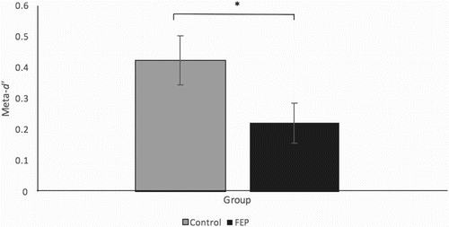
Psychosis Population
In-the-moment
In-the-moment perceptual metacognitive accuracy:
  FEP group worse than healthy adults (Davies et al, 2018)
But
  No significant associations directly between visual or auditory metacognitive efficiency and anomalous experiences.
  Wright et al (in prep)
Notes:
So we know people with psychosis are less metacognitively accurate, but this does not directly explain their experiences of anomalous sensory eprceptions like hallucinations.

Slide 31
Investigated in-the-moment memory metacognitive accuracy in FEP vs Depressed young adults and Healthy young adults.
PhD Research

Slide 32
50 healthy participants, 18 - 59 years, mean age 32.0 years
  54% female
20 depressed participants, 18 - 59 years, mean age 26.8 years
  66% female
15 current FEP participants, 18 - 59 years, mean age 29.7 years
  35% female
Participants & Design

Slide 33
In-the-moment memory metacognitive accuracy:
  FEP group worse than other adults F=7.53, p<.01,
  FEP<HC=Dep
Results
ANOVA

Slide 34
Results
Not enough FEP participants completed the Perceptual task to run comparison.
Notes:
Small but significant assocciation
Sub-Scale analyses demonstrated that ..

Slide 35
Psychosis Population
In-the-moment
Now need to consider how this might impact real-world functioning and investigate further.
1 or 2?

Slide 36
Psychosis Population
Where does metacognition sit?
Treatment improves function but not necessarily metacognition.
  Moritz et al.
Models very simple
  Don’t all account for different influences of mood and neurocognition.

Slide 37
Recent work: Metacognition and Schizotypal Personality Traits in non-clinical populations

Slide 38
Schizotypal Personality Traits
Similar to the positive and negative symptoms experienced by individuals with psychosis (Davidson, Hoffman, & Spaulding, 2016).
  Positive association with traits and symptoms in psychosis populations.
In non-clinical populations, moderate levels of these traits are associated with vulnerability for developing psychosis (Horan, Reise, Subotnik, Ventura, & Nuechterlein, 2008).
Traits present and measurable in general population
Schizotypal Personality Traits
Notes:
What we expect, as seen in clinical populations too. So we expected to see similar results across populations.

Slide 39
Schizotypal Personality Traits
Only one study has assessed the relationship between cognitive insight and SPTs in healthy individuals (Sacks, de Mamani, & Garcia, 2012)
  More cognitive bias (self-certainty) is associated with a greater number of SPTs
  Rather than metacognitive processes.
Schizotypal Personality Traits

Slide 40
What is the relationship between cognitive insight and schizotypal personality traits in a non-clinical population?
Research Question
Notes:
As we can measure schizotypal personality traits and cognitive insight in the healthy population we sought to see whether there was a similar association between traits and thinking styles in non-clinical population, so our research question was…
First study to assess this using all dimensions of cognitive insight.

Slide 41
Results
Summary (not published)
Overall cognitive insight was positively associated with total SPQ-BR traits
Driven by the association between self-reflection and SPQ-BR total
Self-certainty (cognitive bias) was not associated with total SPQ-BR total score
Notes:
Average BCIS scores were comparable to other large healthy adult samples (Buchy, Brodeur, Lepage, 2012)
Self-reflectiveness M= 12.9 (3.7)
Self-certainty M= 7.2 (2.7)
Composite index M= 5.6 (4.4)
Average SPQ-BR scores are within an expected range for undergraduate students (Callaway, Cohen, Matthews & Dinzeo, 2014)
SPQ-BR total M= 63.7 (17.4)
Small but significant assocciation
Sub-Scale analyses demonstrated that ..

Slide 42
Results
Summary (not published)
SPQ-BR predicted overall cognitive insight
Interpersonal and Disorganised traits predicted self-reflection
Cognitive-perceptual and Disorganised traits predicted self-certainty
Notes:
Small but significant predictor
With one standard unit increase in the SPQ-BR, the predicted value of the BCIS overall will increase by .32 units.

Slide 43


Interpretations
Previous Research
Previous research showed higher self-certainty associated with more SPTs in healthy adult students
  This research did not completely support this finding
Interpretation
≠
Notes:
We suggest that people who have a higher number of sub-clinical SPTs will be aware and certain of trait-related experiences.
However, when experiences reach clinical levels they negatively impact self-reflection. What we mean here is that the cognitive biases that are associated with psychotic illnesses, reflection and overconfidence, lead appraisal style resulting in lower overall cognitive insight.
Further, people who have fewer trait-related experiences have less to be aware and certain of, in relation to the BCIS questions. Some questions relate to anomalous experiences ‘My unusual experiences may be due to my being extremely upset or stressed.’ which will result in ’less aware or certain answers’ if people do not have those experiences.
When experiences reach clinical levels they negatively impact thinking styles, such as self-reflection, and cognitive biases lead to increased certainty in poorly apprised experiences.
People who have fewer trait-related experiences have less to be aware and certain of so harder to measure on BCIS

Slide 44
Interpretations
Clinical Comparisons
Higher SPQ-BR score associated with higher overall cognitive insight
  Opposite to clinical samples
SPTs in healthy adults predict thinking styles and bias
  Disorganised traits predict both self-reflectiveness and self-certainty
  Interpersonal traits predict self-reflectiveness
  Cognitive-Perceptual predict self-certainty
Interpretation
Notes:
We suggest that people who have a higher number of sub-clinical SPTs will be aware and certain of trait-related experiences.
However, when experiences reach clinical levels they negatively impact self-reflection. What we mean here is that the cognitive biases that are associated with psychotic illnesses, reflection and overconfidence, lead appraisal style resulting in lower overall cognitive insight.
Further, people who have fewer trait-related experiences have less to be aware and certain of, in relation to the BCIS questions. Some questions relate to anomalous experiences ‘My unusual experiences may be due to my being extremely upset or stressed.’ which will result in ’less aware or certain answers’ if people do not have those experiences.
When experiences reach clinical levels they negatively impact thinking styles, such as self-reflection, and cognitive biases lead to increased certainty in poorly apprised experiences.
People who have fewer trait-related experiences have less to be aware and certain of so harder to measure on BCIS

Slide 45
Interpretations
Higher number of sub-clinical SPTs results in more awareness and certainty in trait-related experiences.
  At clinical levels, traits negatively impact metacognition
  Cognitive biases lead to increased certainty in poorly apprised experiences.
People who have fewer trait-related experiences have less to be aware and certain of.
Interpretation
Notes:
We suggest that people who have a higher number of sub-clinical SPTs will be aware and certain of trait-related experiences.
However, when experiences reach clinical levels they negatively impact self-reflection. What we mean here is that the cognitive biases that are associated with psychotic illnesses, reflection and overconfidence, lead appraisal style resulting in lower overall cognitive insight.
Further, people who have fewer trait-related experiences have less to be aware and certain of, in relation to the BCIS questions. Some questions relate to anomalous experiences ‘My unusual experiences may be due to my being extremely upset or stressed.’ which will result in ’less aware or certain answers’ if people do not have those experiences.
When experiences reach clinical levels they negatively impact thinking styles, such as self-reflection, and cognitive biases lead to increased certainty in poorly apprised experiences.
People who have fewer trait-related experiences have less to be aware and certain of so harder to measure on BCIS

Slide 46
Recent work: Metacognition and Anomalous Experiences in non-clinical populations

Slide 47
What is the relationship between cognitive insight and hallucination and delusion proneness in a non-clinical population?
Research Question
Notes:
As we can measure schizotypal personality traits and cognitive insight in the healthy population we sought to see whether there was a similar association between traits and thinking styles in non-clinical population, so our research question was…
First study to assess this using all dimensions of cognitive insight.

Slide 48
Self-reflection was positively associated with total Hallucination Proneness
Self-reflection was positively associated with total Delusion Proneness
Metacognitive beliefs were positively associated with total Hallucination Proneness
Metacognitive beliefs were positively associated with total Delusion Proneness
Results
Summary (not published)
Notes:
These BCIS scores were slightly higher but we haven’t finished collecting the data yet so cautious conclusions.
Small but significant assocciation
Opposite to clinical populations

Slide 49
Interpretations
Clinical Comparisons
Previous research showed negative association between Delusion Proneness and symptom severity in clinical population
In this study, higher self-reflection and metacognitive beliefs associated with higher overall self-reflection
  Opposite to clinical samples
Anomalous Experiences in healthy adults associated with better awareness
Interpretation
Notes:
We suggest that people who have a higher number of sub-clinical anomalous experiences will be aware and certain of trait-related experiences.
However, when experiences reach clinical levels they negatively impact self-reflection and beliefs. What we mean here is that the cognitive biases that are associated with psychotic illnesses, reflection and overconfidence, lead appraisal style resulting in lower overall cognitive insight.
Further, people who have fewer trait-related experiences have less to be aware and certain of, in relation to the BCIS questions. Some questions relate to anomalous experiences ‘My unusual experiences may be due to my being extremely upset or stressed.’ which will result in ’less aware or certain answers’ if people do not have those experiences.
When experiences reach clinical levels they negatively impact thinking styles, such as self-reflection, and cognitive biases lead to increased certainty in poorly apprised experiences.
People who have fewer trait-related experiences have less to be aware and certain of so harder to measure on BCIS

Slide 50
Recent work: Measures of metacognition and model building in non-clinical populations

Slide 51
Hierarchical Model of Metacognition
More than just two levels or processes interacting with each other.
Schizotypal Personality Traits

Slide 52
So instead of the simple Nelson and Narens Model…
  (Nelson and Narens 1990)
General beliefs about one’s thoughts and abilities
Self-reflection (about thoughts and cognitive performance)
Confidence about in-the-moment cognitive performance
Monitoring
Control

Slide 53
So instead of the simple Nelson and Narens Model…
  (Nelson and Narens 1990)
Metacognitive ability: higher-order perspective
Metacognitive experience: appraisal and reflection on experience
Metacognitive efficiency: “feeling of knowing”
Monitoring
Control

Slide 54
Metacognitive Beliefs (MCQ-30) correlated with self-reflection (BCIS)
Cognitive insight (BCIS) correlated with Efficiency
Results
Summary (not published)

Slide 55
Results
Correlation
Metacognitive Accuracy not correlated with
  Self-reflection
  Metacognitive Beliefs

Slide 56
Model Testing
Initial Results
Different aspects of metacognition via different assessments are not associated
  suggests a hierarchy of measures that are conceptually similar but not always strongly associated
  More work to do!
Model Testing
Initial Results

Slide 57
Future work

Slide 58
Measurement Protocol
ICHR Working Group
In-the-moment assessments – more ecologically valid than dots or word recognition
Self-report assessments
True in-the-moment assessments
Using online mobile technology and EMA to ensure true representation

Slide 59
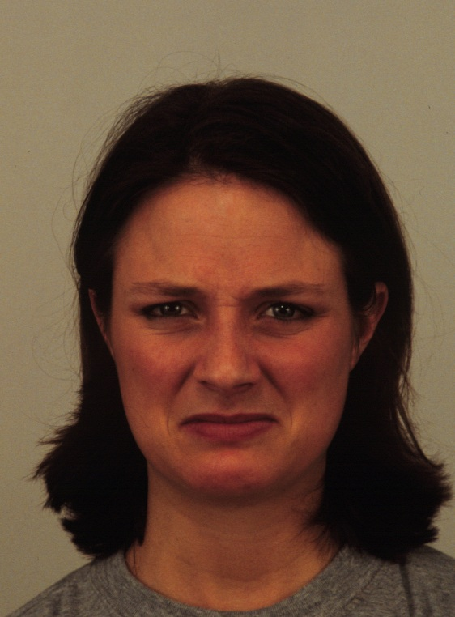
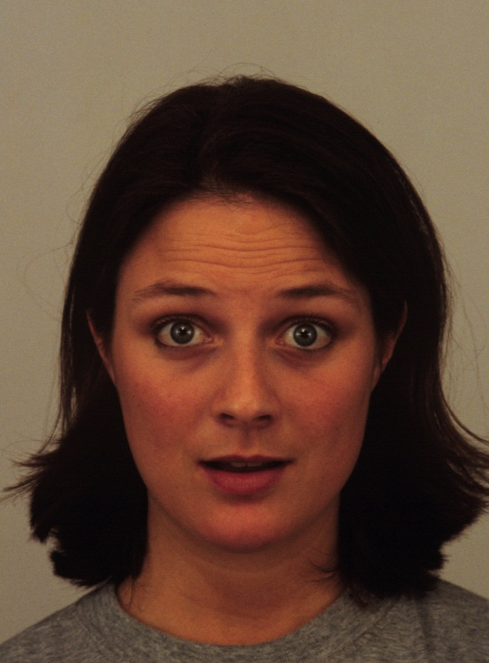
Which face is showing disgust?
+
1 2
Notes:
Or always compare to neutral?

Slide 60
How confident are you that this judgement was correct?
Not at all confident Very Confident
1 2 3 4 5 6

Slide 61
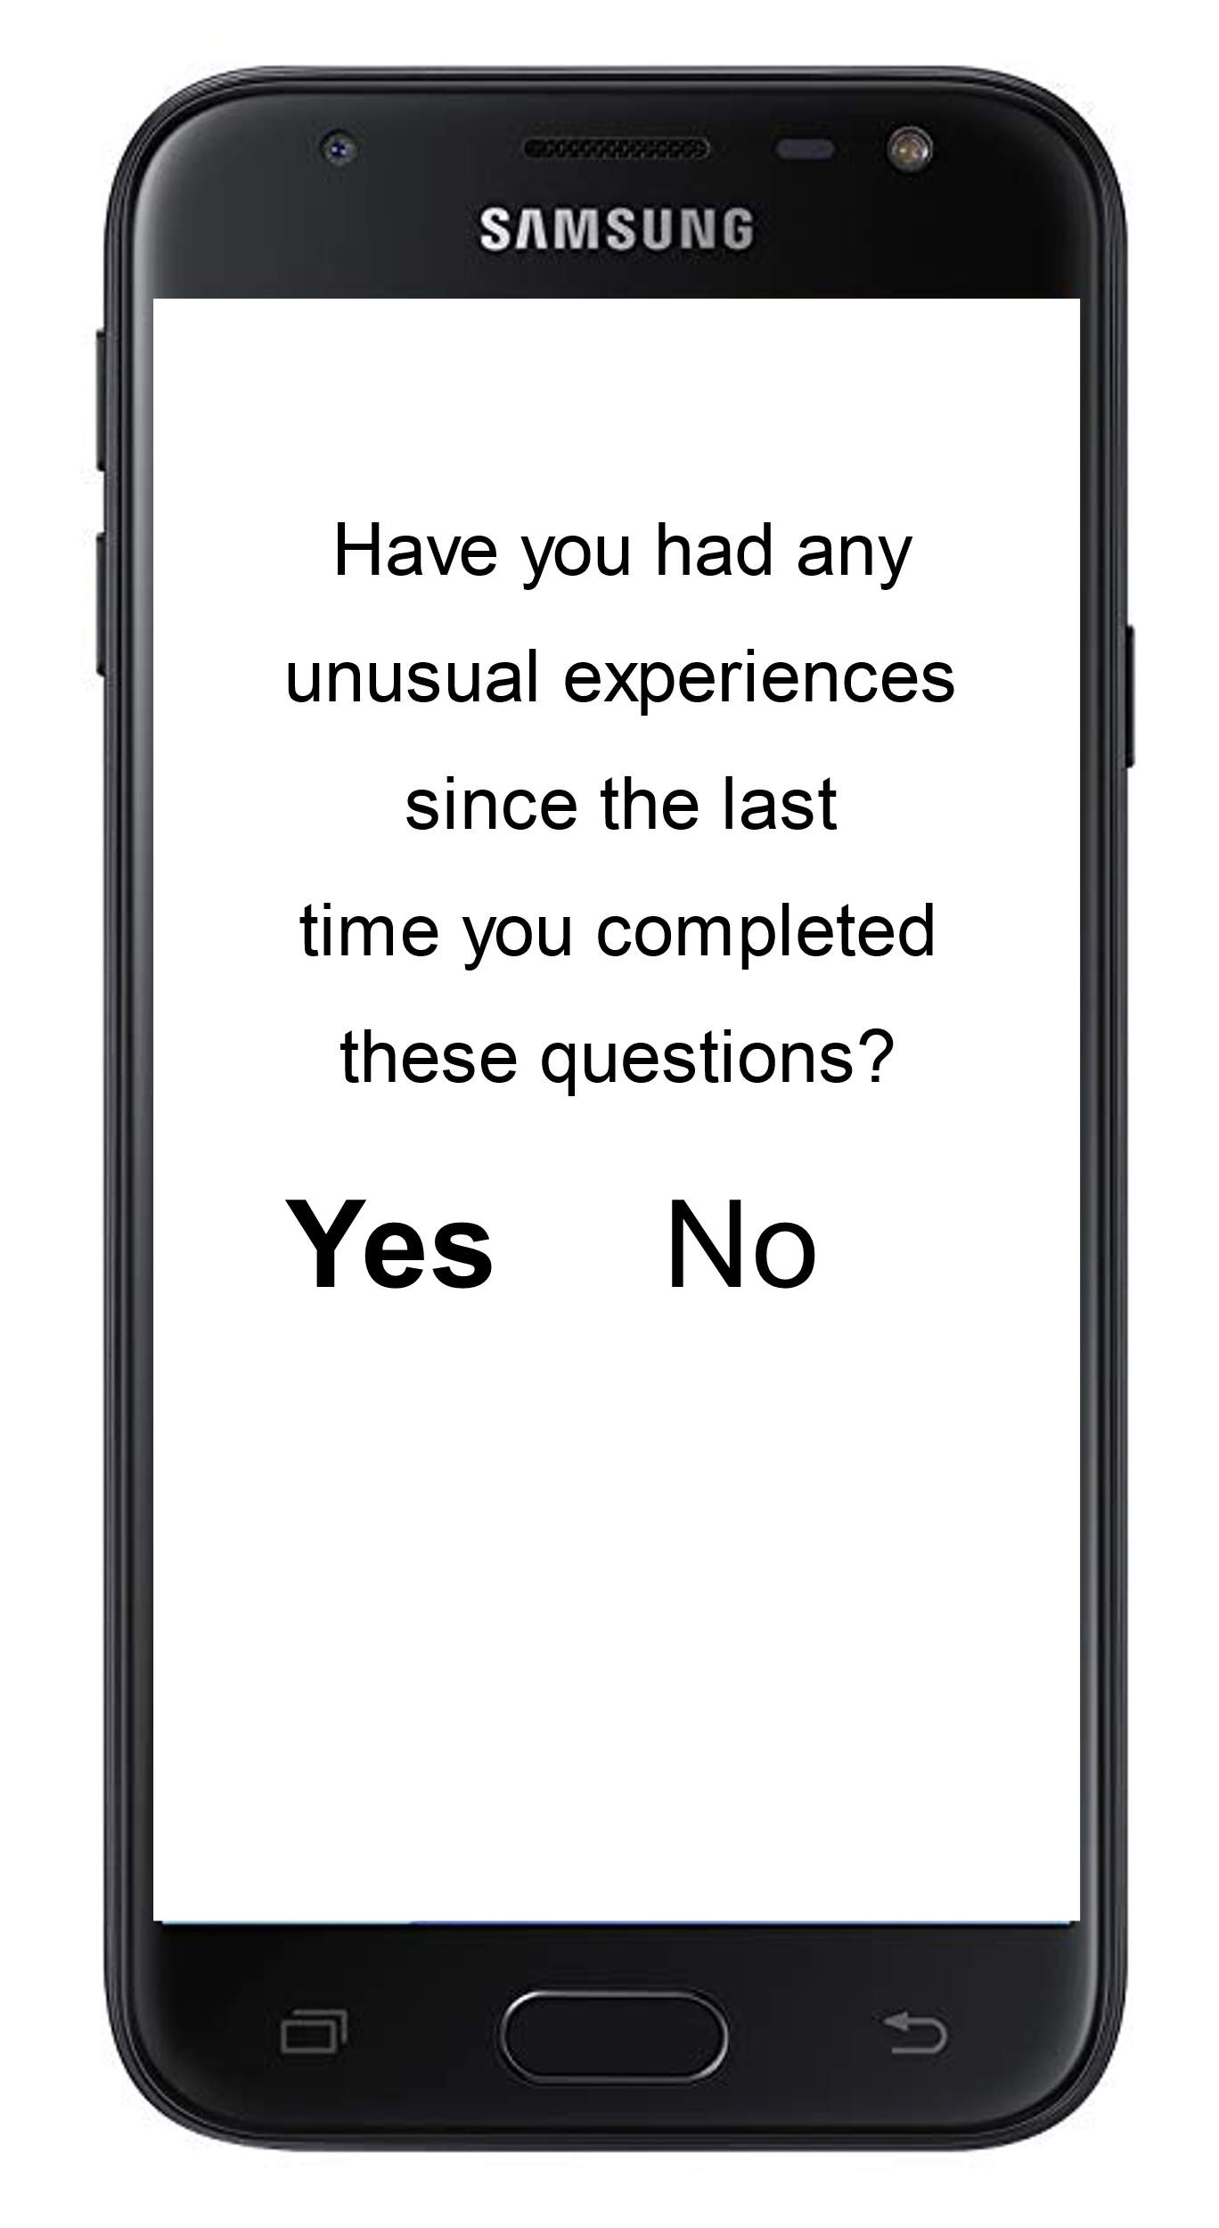
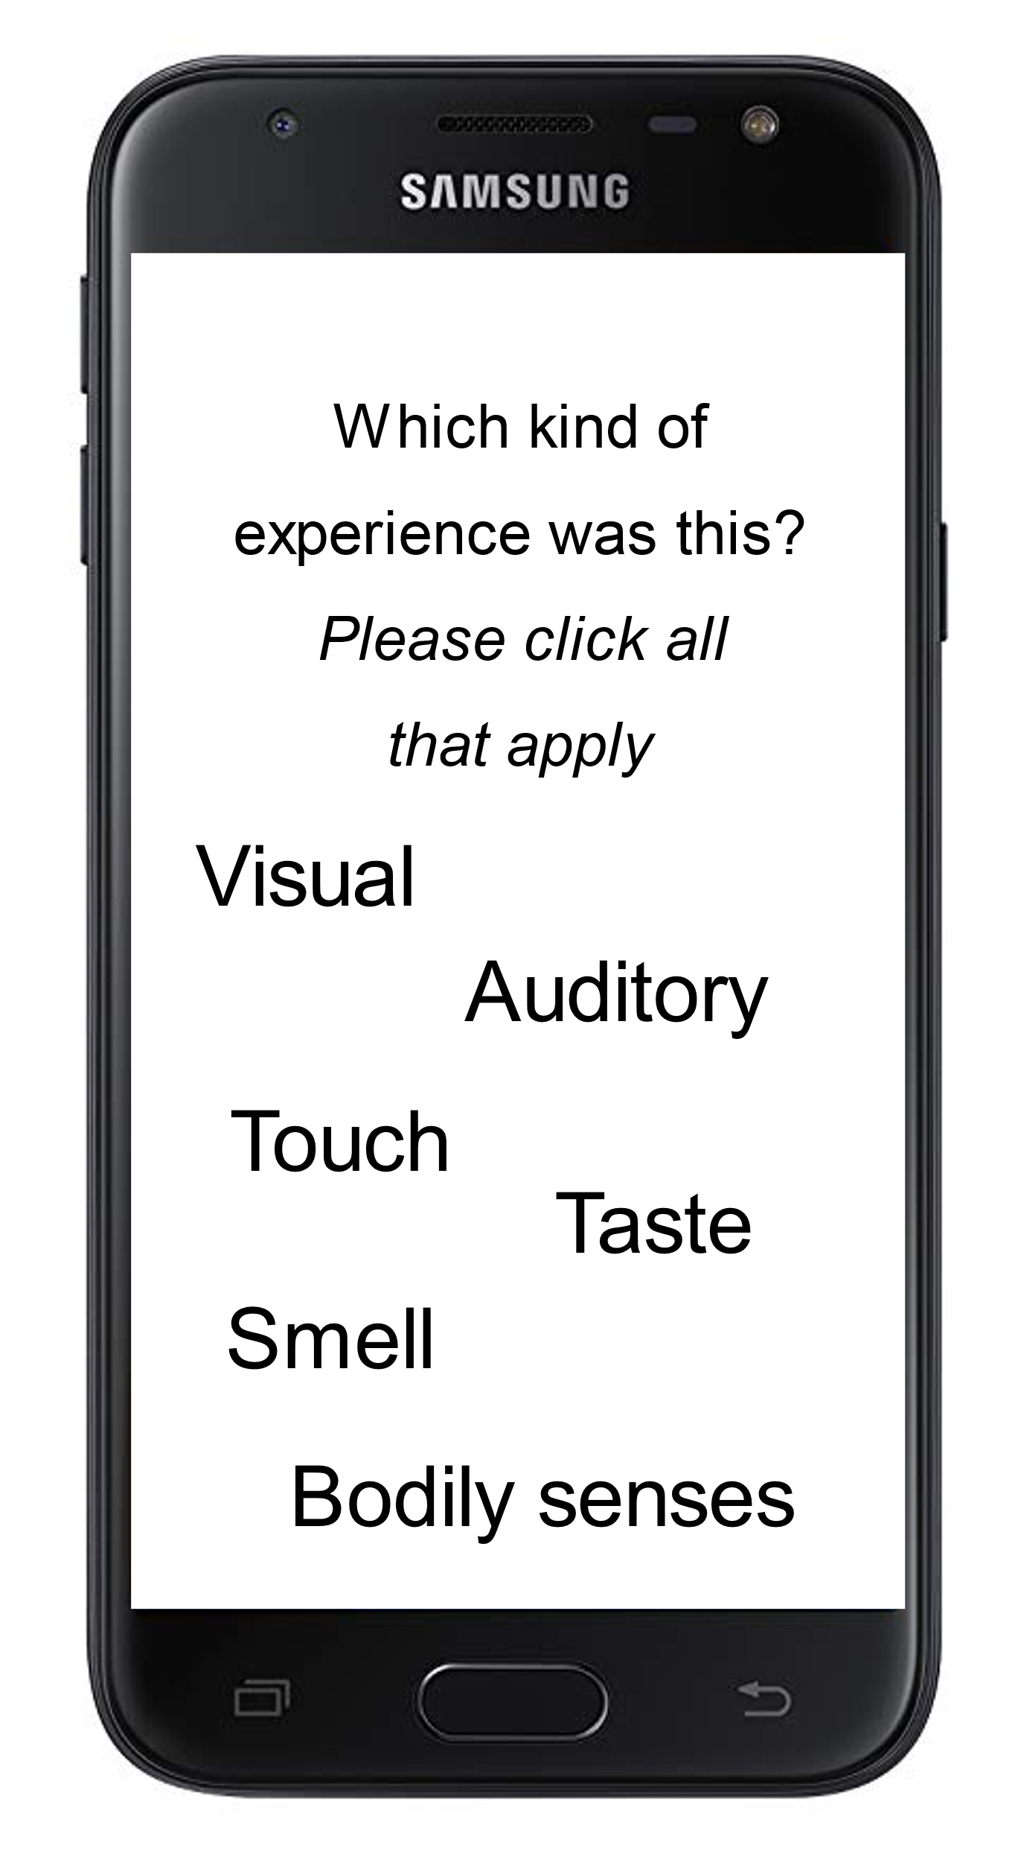
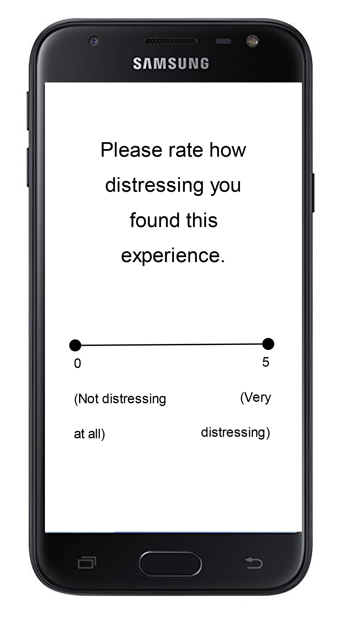

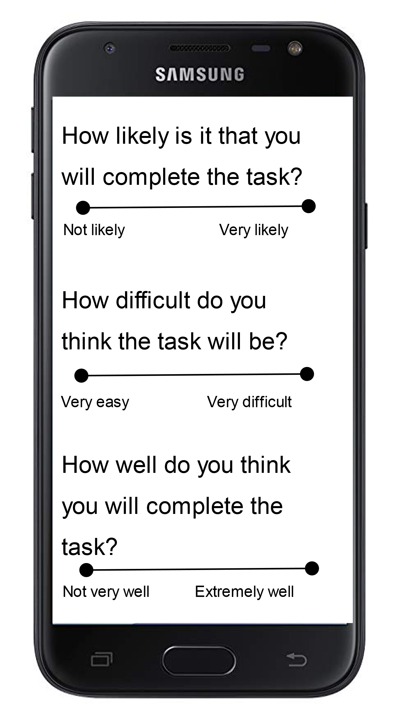
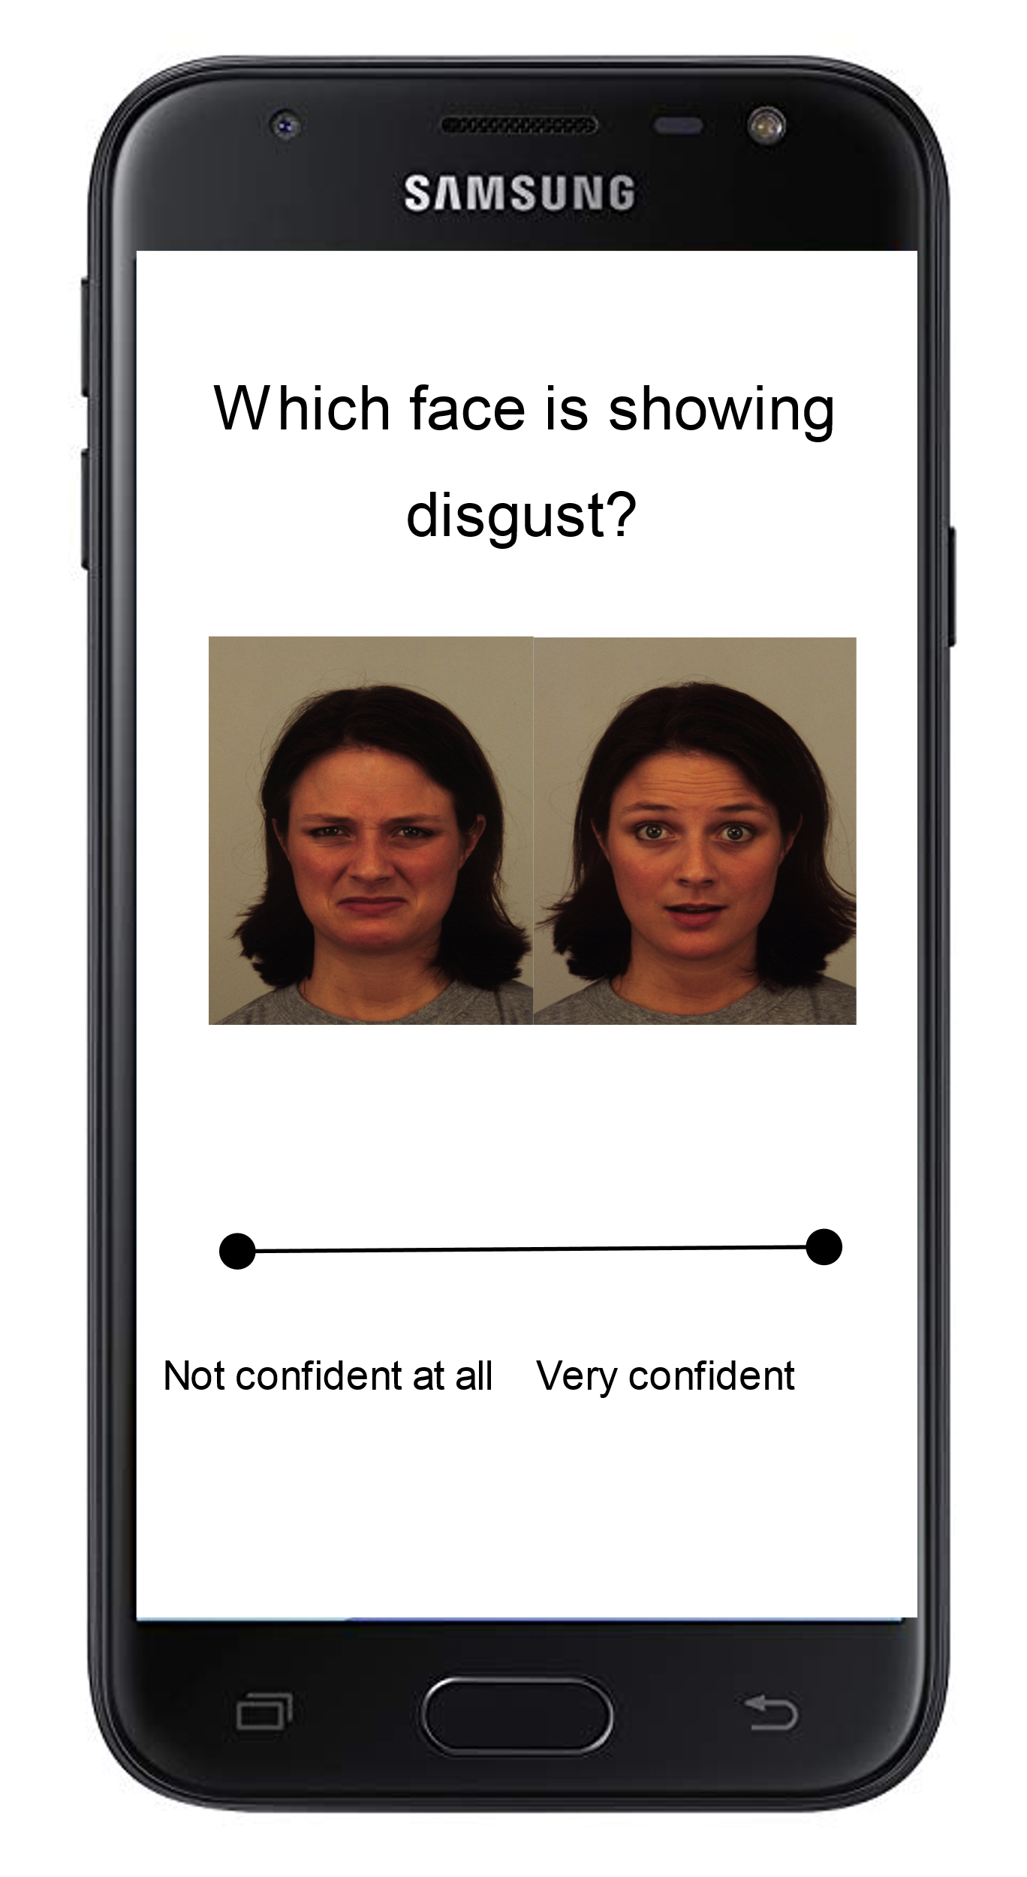
Example of EMA items

Slide 62
Unusual Sensory Experiences
Group Comparisons
Compare metacognition in individuals who have unusual sensory experiences
  Non-clinical hallucination prone/Schizotypal personality traits
  ASMR
  Tulpamancers
  Clinical psychosis

Slide 63
Thank you!
Questions?
dr_emmaclaire
e.c.palmer-cooper@soton.ac.uk

