Slide 1

Building a therapeutic alliance remotely
Dr Nick Grey
Associate Director Psychology and Psychological Therapies

Slide 2
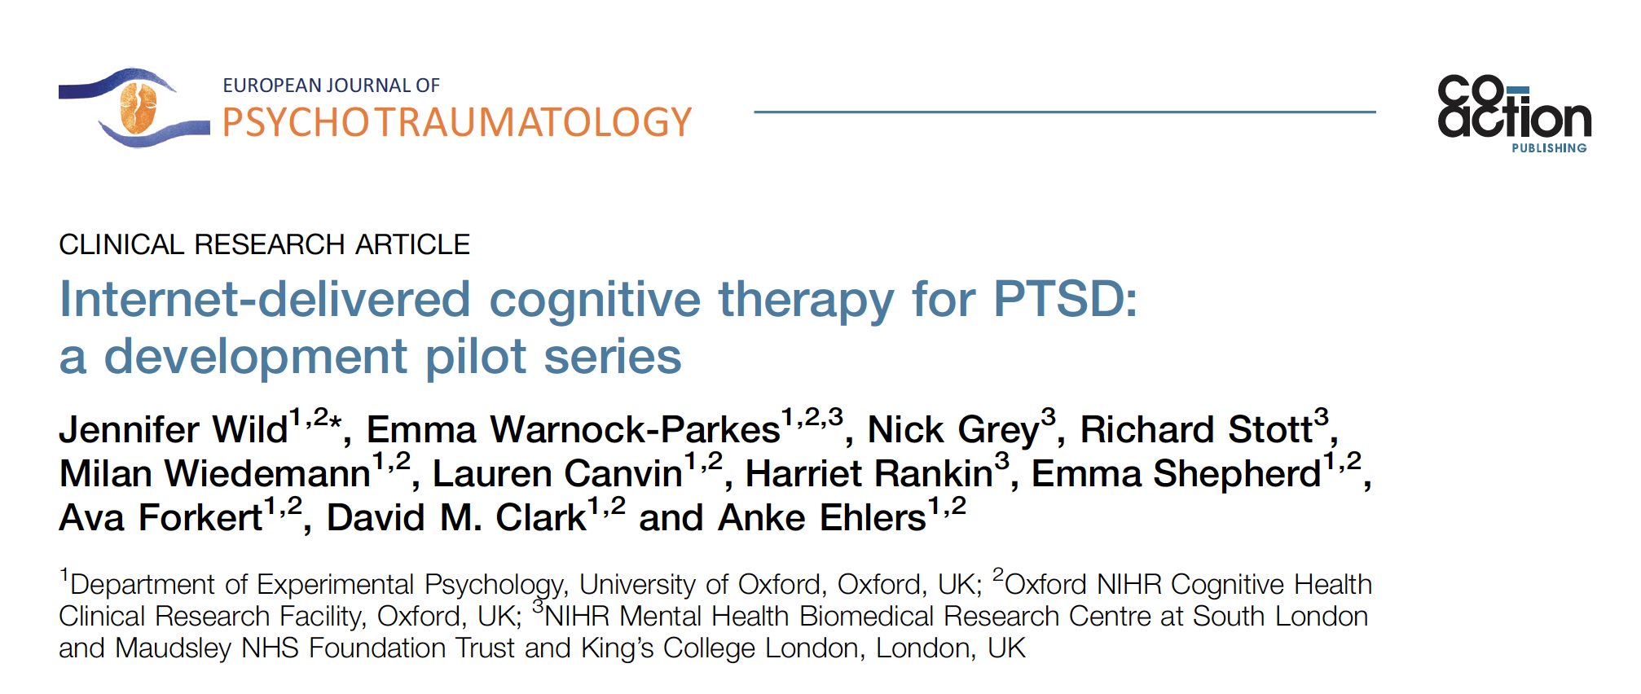
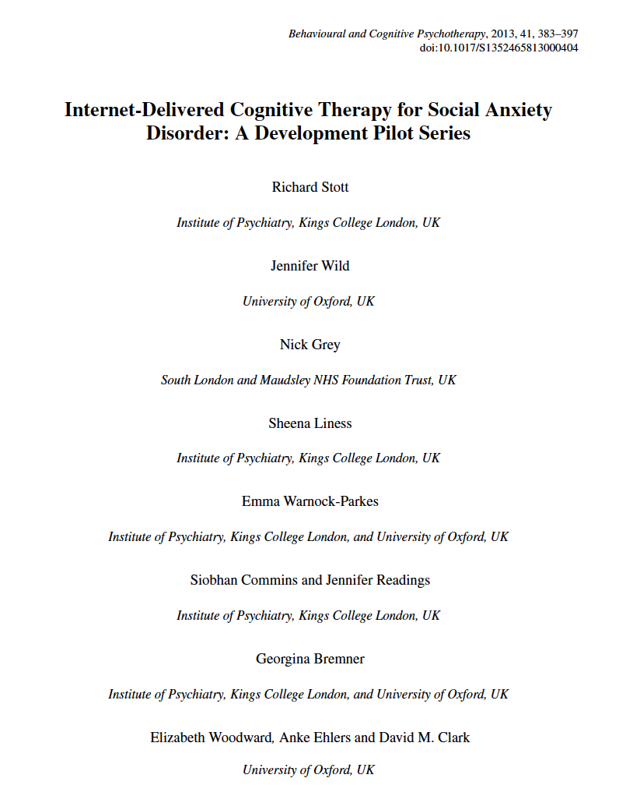
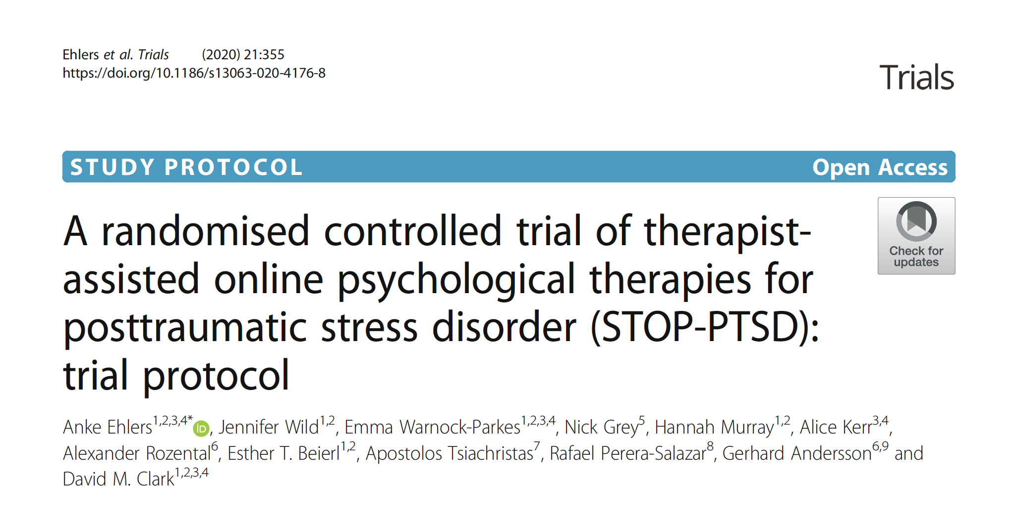
Patient-rated working alliance equivalent remote vs face-to-face
Therapist-rated working alliance lower in remote
Clinical outcomes equivalent

Slide 3

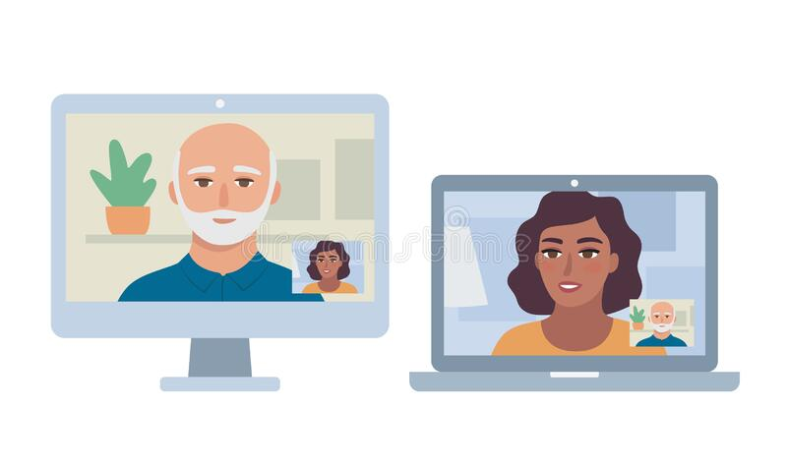
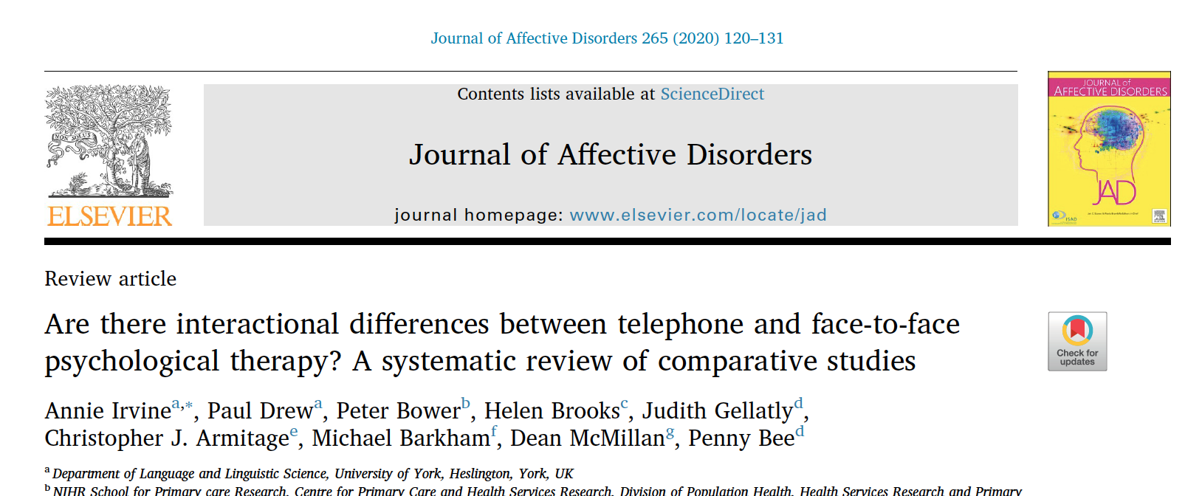
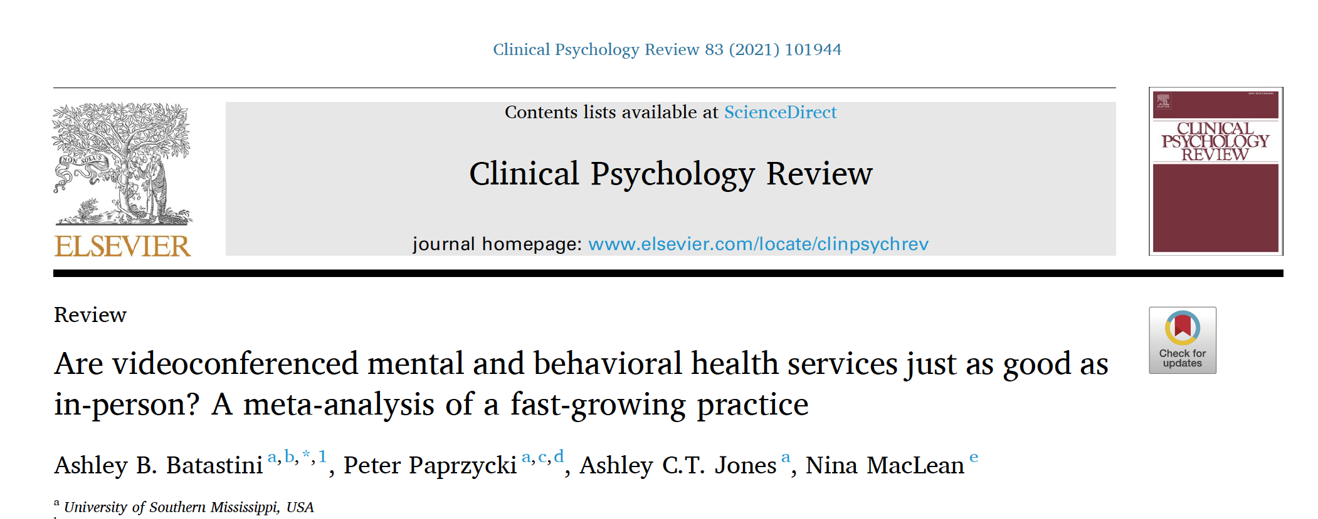
Therapeutic alliance
Disclosure
Empathy
Attentiveness
Participation
Can work well
Evidence growing but more needed!

Slide 4
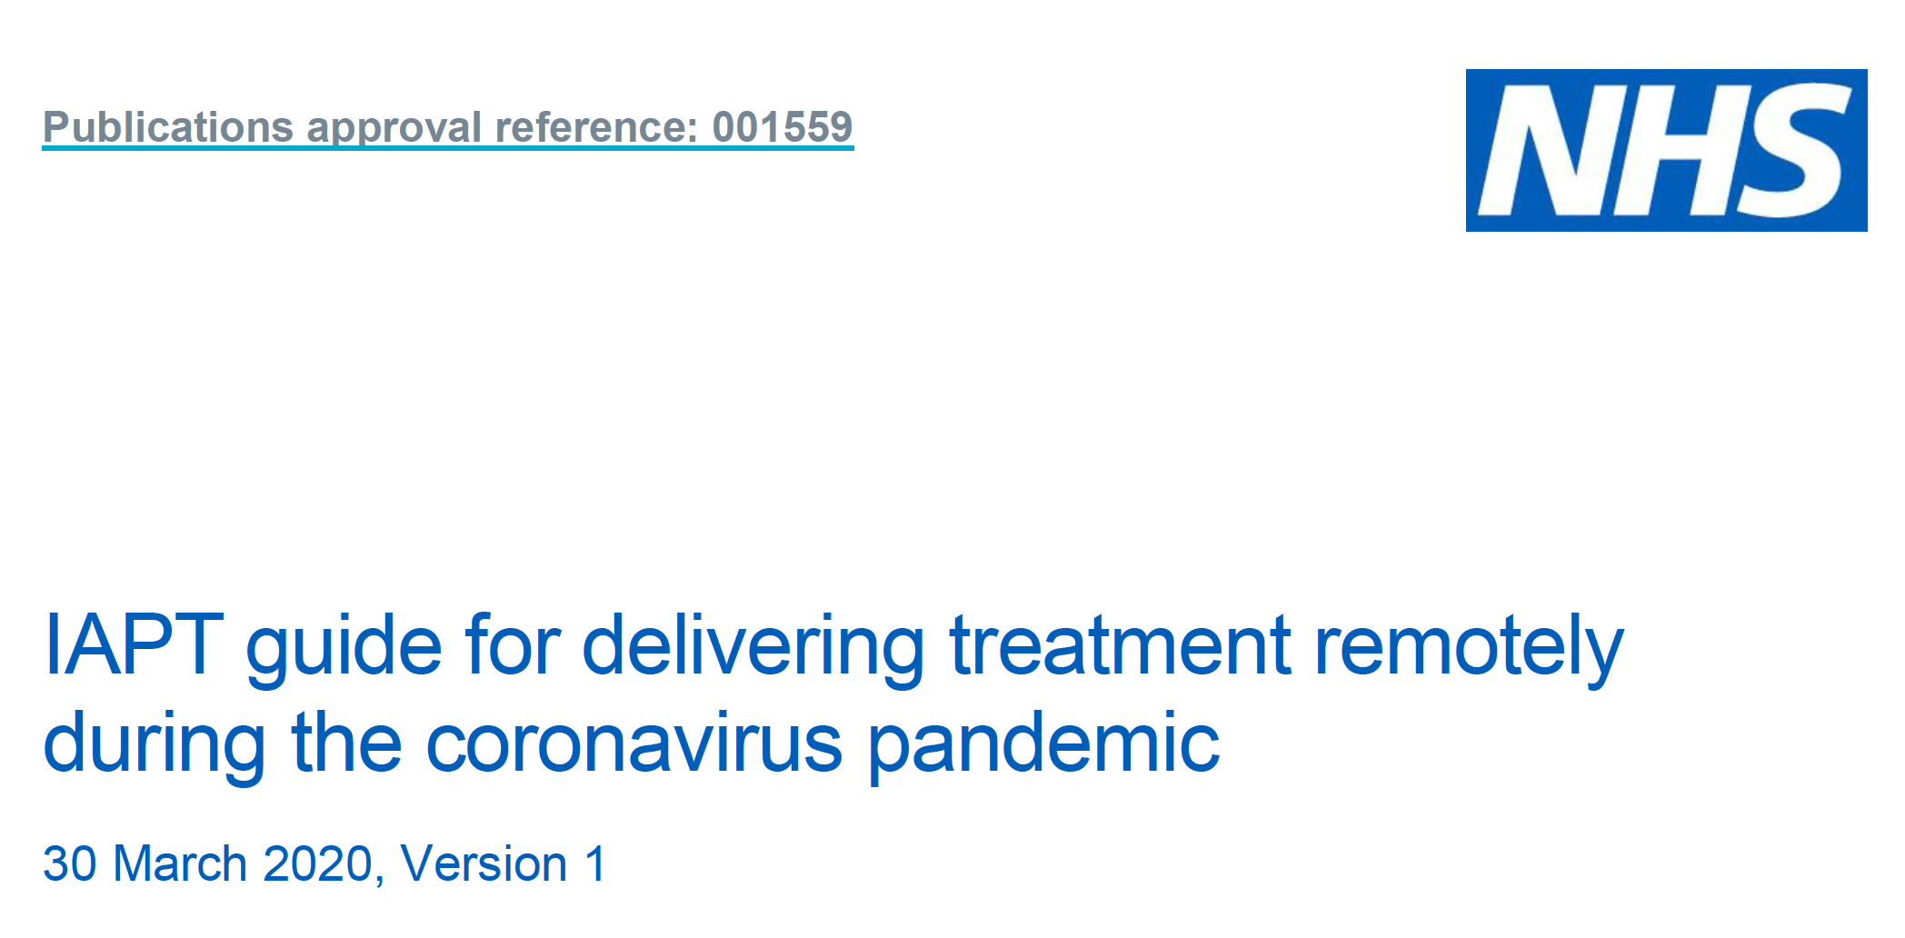

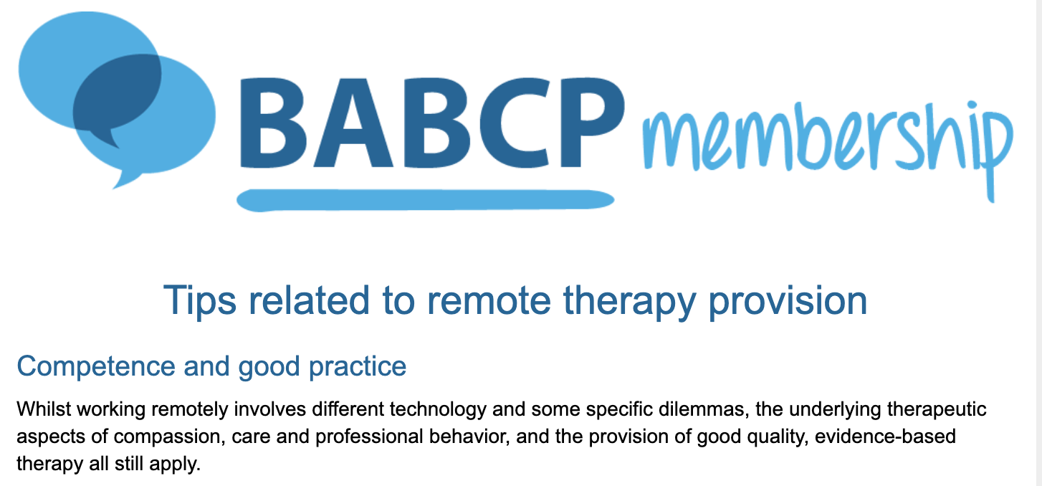
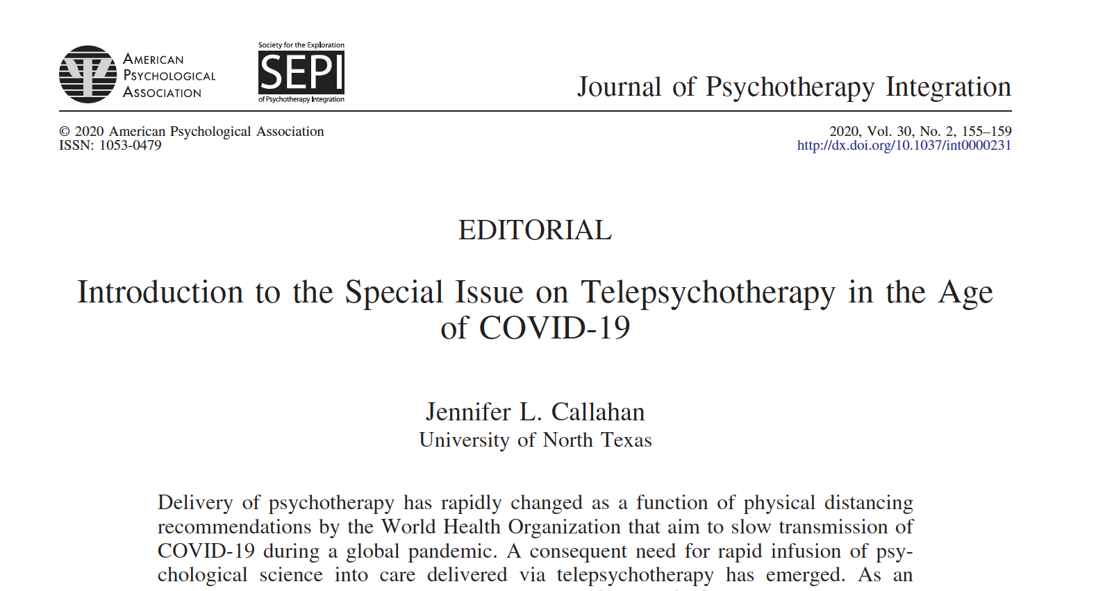
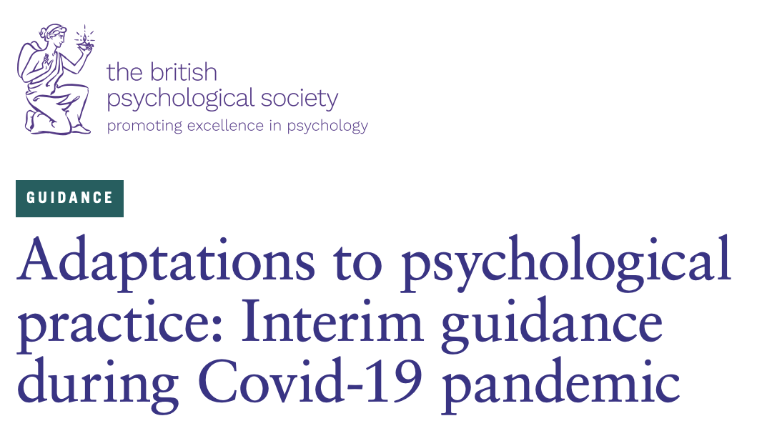
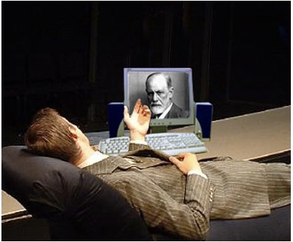
Notes:
IAPT have been offering remote treatments for years!

Slide 5
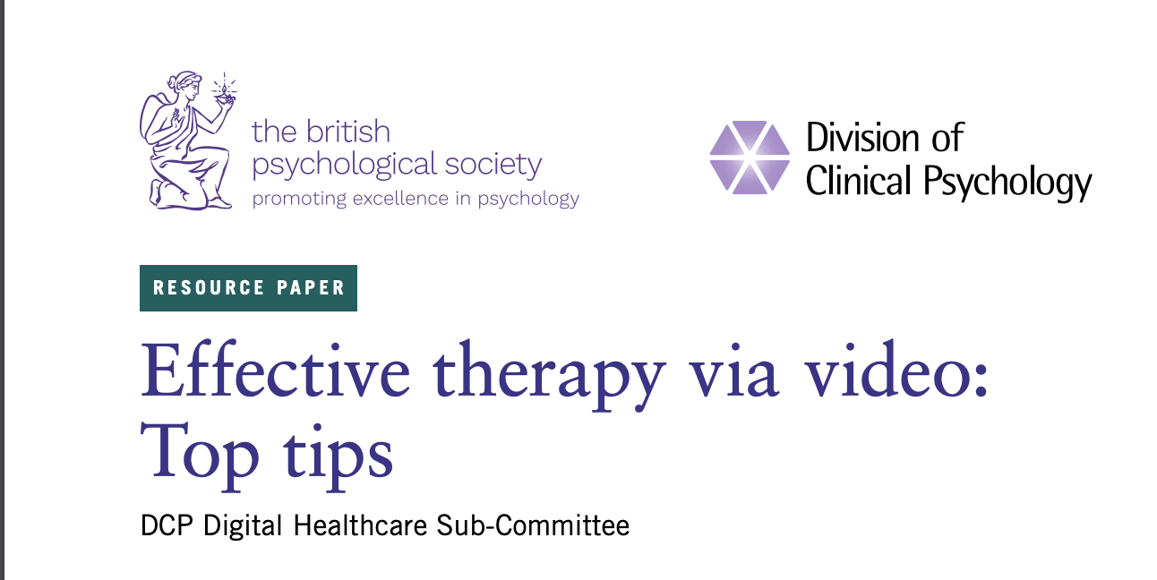
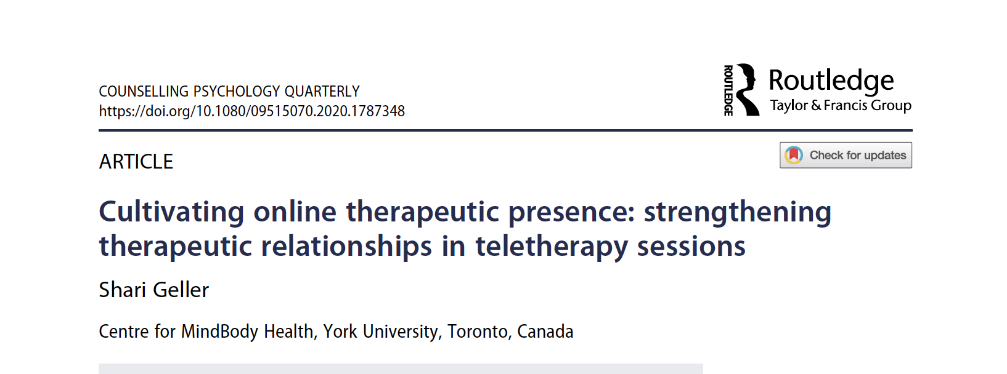
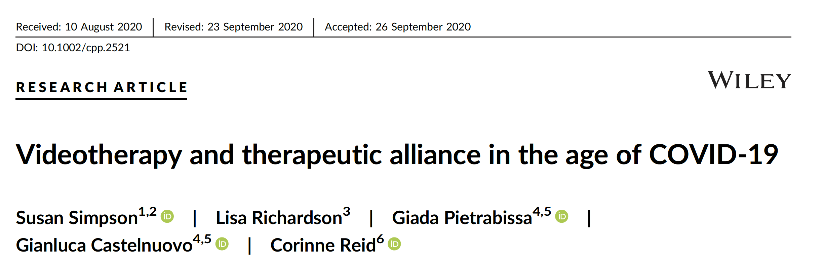
BPS free webinar
https://www.bps.org.uk/coronavirus-resources/professional/webinar-top-tips-providing-effective-therapy-video

Slide 6


Building alliance remotely
Safety
Consistency
Feel understood
Shared goals/purpose

Slide 7
Building alliance remotely
Telepresence

Slide 8

Building alliance remotely
Notes:
Maximise presence of voice
Ask for feedback

Slide 9


Building alliance remotely
Notes:
Lighting – face can be seen – esp facial expression
Background - plain
Framing
Distance from camera
Get feedback from client
Ensure facial expression, eye gaze and gestures can be seen
Eye-contact
Look at camera
Keep their face and notes near camera

Slide 10

Building alliance remotely
Safety
Consistency
Notes:
Rehearsal of tech and what to do

Slide 11
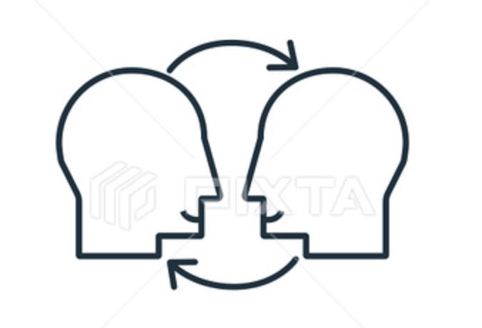


Building alliance remotely
Notes:
Empathy
Ask for feedback
Warmth
USUAL stuff
If you cant build a therapeutic relationship in person – you’re going to have trouble remotely!

Slide 12


Building alliance remotely
Feel understood
Shared goals/purpose
Notes:
Use of screen sharing
creative media – pictures etc
Whiteboards
Shared writing
Greater self disclosure to increase therapist presence

Slide 13

Building alliance remotely
Children and young people
People with a learning disability
Autistic people
Older people
Groups
Notes:
Yes, buts

Slide 14

Building alliance remotely
Notes:
Our own assumptions get in the way

Slide 15






nick.grey@spft.nhs.uk
www.researchgate.net/profile/Nick_Grey
@nickdgrey

