Slide 1




Early signs Monitoring to Prevent relapse in psychosis and prOmote Wellbeing, Engagement and Recovery (EMPOWER):
A pilot Cluster Randomised Controlled Trial
ISRCTN: 9959262
Andrew Gumley
on behalf of EMPOWER Research Collaboration

Slide 2


Funder’s statement
This research was funded by the NIHR Health Technology Assessment programme (project number 13/154/04) and by NHMRC (APP1095879).
This study was supported by NHS Research Scotland, through the Chief Scientist Office and the Scottish Mental Health Research Network.
The views expressed are those of the author(s) and not necessarily those of the NHS, the NIHR or the Department of Health.

Slide 3















Slide 4
The team
EMPOWER Research Collaboration
John Ainsworth
Mario Alvarez
Max Birchwood
Andy Briggs
Sandra Bucci
Sue Cotton
Paul French
Reeva Lederman
Shon Lewis
Graeme MacLennan
Cathy Mihilopoulos
John Norrie
Frank Reilly
Swaran Singh
Lesley Smith
Suresh Sundrum
Andrew Thompson
Matthias Schwannauer
Chris Williams
Alison Yung
Glasgow
Professor Andrew Gumley
Dr Simon Bradstreet
Helen Whitehill
Alison Wilson Kay
David Thomson
Jayne Artis
Stephanie Allan
Claire Matrunola
Andrea Clark
Professor Hamish McLeod
Melbourne
Professor John Gleeson
Professor John Farhall
Dr Emma Morton
Imogen Bell
Emily Castagnini
Maria Lambrou

Slide 5
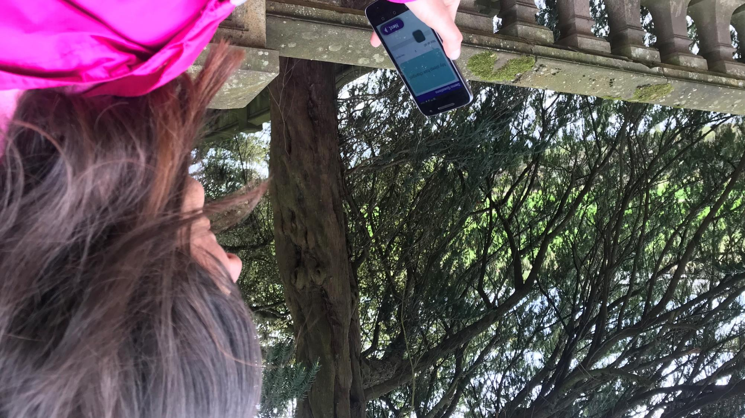

Our aim
To build and test a digital intervention which:
Enhances recognition of early warning signs;
Is peer and clinician supported;
Supports self management;
Provides a stepped care pathway.

Slide 6
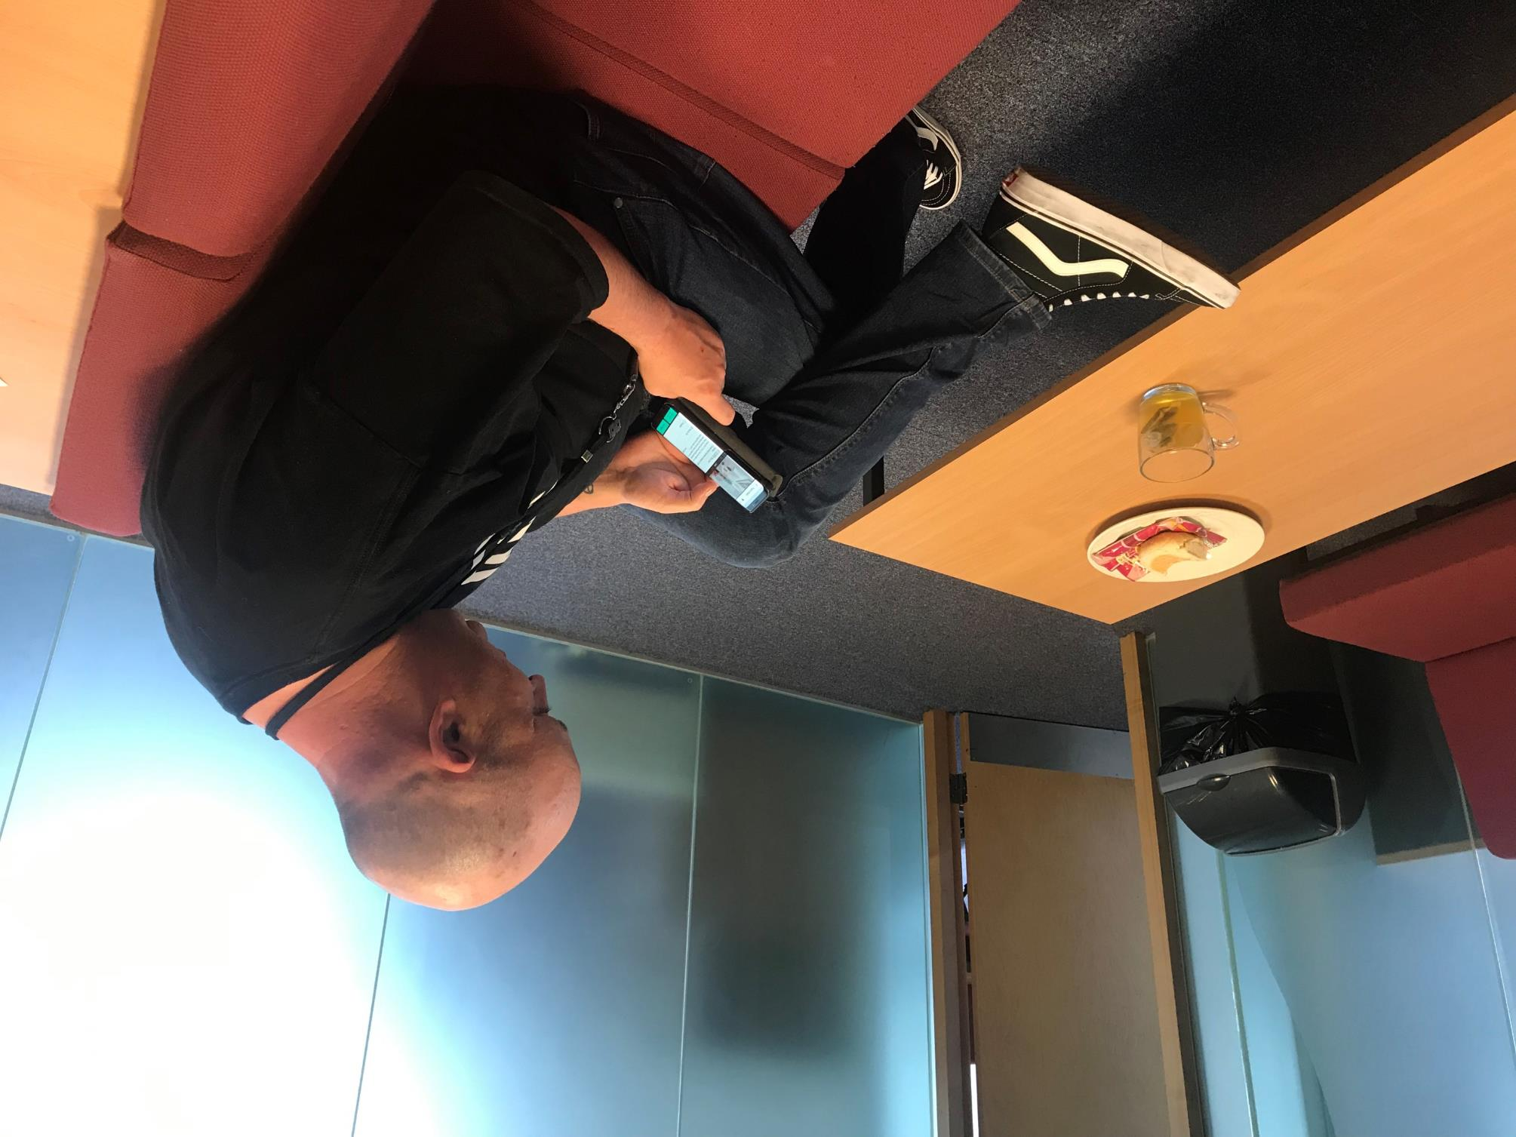
Our approach
Relationships at centre of relapse and recovery
Fear of relapse strains relationships and decision making
Digital technology may empower:
  Track changes in wellbeing,
  Develop awareness of the “ebb and flow” of feelings,
  Access wellbeing resources, and
  Share data to access support.

Slide 7
Service provider
Service recipient
I could end up back in hospital
Behaviours: Increased monitoring, risk oriented
Feelings: Concern, suspiciousness
I’ll let everyone down
Something’s not quite right
Feelings of fear, anxiety, shame leads to avoidance, hypervigilance, over positive
What might happen?
Relationships

Slide 8
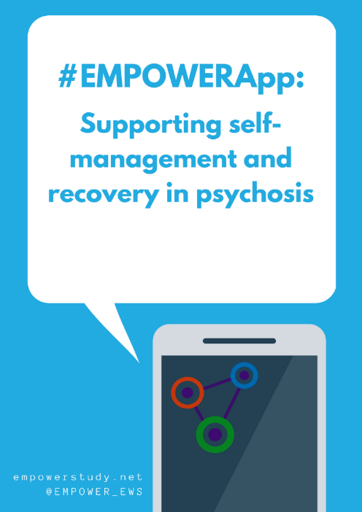
The research
Phase 1: stakeholder engagement on early signs and potential for digital
Phase 2: pilot Cluster Randomised Controlled Trial
  Can we conduct a definitive multicentre trial?
  Feasibility, acceptability, usability, safety and outcome signals
  12-month follow-up
  Process evaluation

Slide 9
EMPOWER Phase I
Our qualitative study aimed to explore
  current practice in relation to early warning signs;
  the acceptability and usability of mobile phone monitoring of early signs (hypothetical acceptability); and
  identify incentives and barriers to implementation (hypothetical implementation) by Mental Health teams, service users and carers.
Participants comprised of 88 mental health staff, NHSGG&C (n=54, 9 focus groups) and NorthWestern Mental Health (n=34, 4 focus groups).
Twenty-one service users were recruited from the UK (n=5, 3 focus groups) and Australia (n=16, 4 focus groups)
Forty carers from UK (n=20, 2 focus groups) and Australia (n=20, 3 focus groups).

Slide 10
Group | Expected Barriers | Expected Facilitators
Staff | Service Users "Chaotic Lives." | Service User Youth
 | Service User Paranoia | Clinical usefulness of data
 | Uncertainty about whether EWS data are useful in EI
 | App providing "decontextualized data”
 | Lack of Staff time
Carers | Service User having previous negative service experience | More Attuned Responses from mental health Staff
 | Service Users inputting inaccurate data | Carer support for trying something new
Service Users | Data privacy concerns | Having access to own data
 | Concern the App will replace service access | Wanting own data to be accurate
 |  | Importance of good user experience (UX)

Slide 11

TO HERE
The intervention
Peer Support Working integrated
Clinician supported
  Check in prompt monitoring
  Integrated with community teams
Algorithm regulated as a Class 1 medical device by MHRA
BACK END AND INTERVENTION HERE

Slide 12
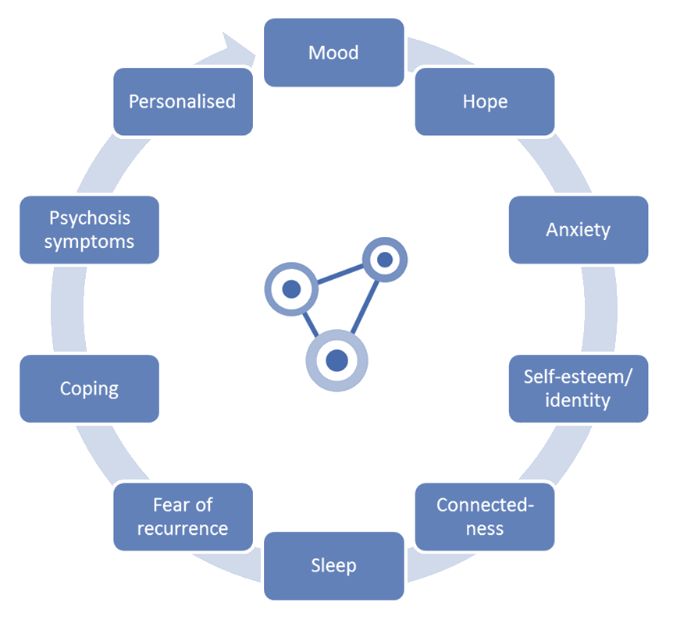
Notes:
Between 19 and 56 depending on selection of personal questions and branching (probes)

Slide 13

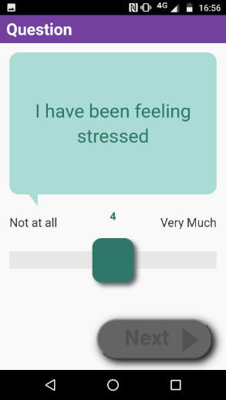
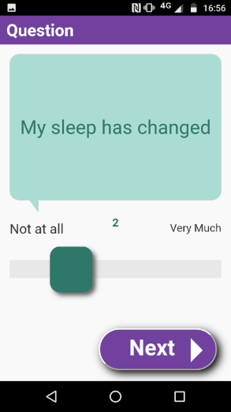
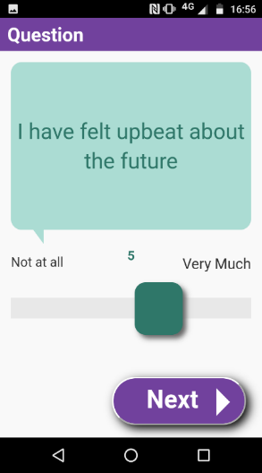
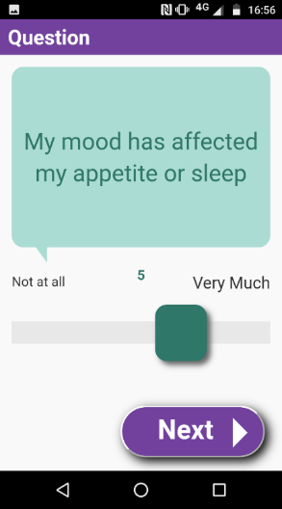

Slide 14
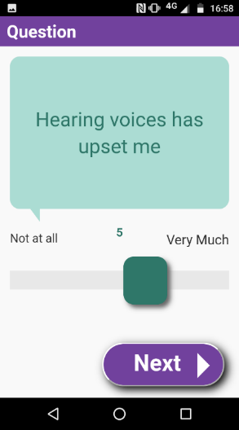
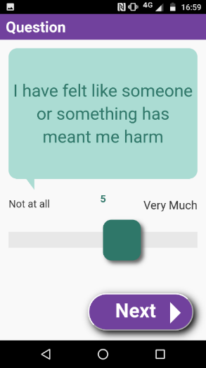
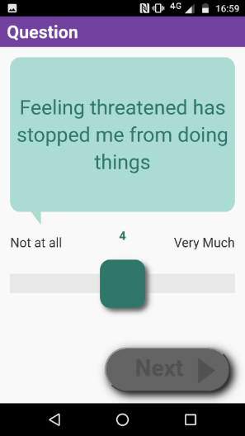
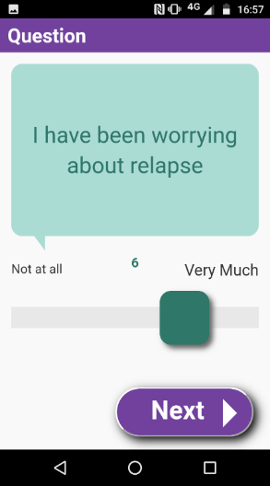
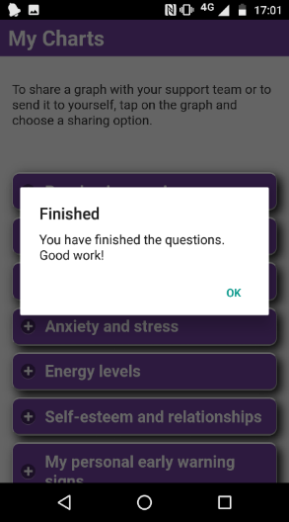

Slide 15

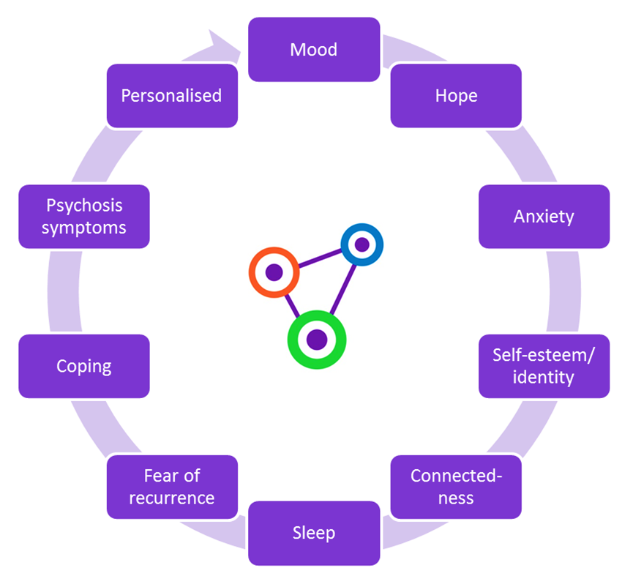
Adherence in EMPOWER was predetermined as people using the App on more than 33% of possible occasions. What proportion of participants do you think met this target?
  18%
  38%
  58%
  78%

Slide 16

Responses compared to baseline
No change
Message generated
Small change
Targeted message generated
Larger change
Message generated
ChIP

Slide 17
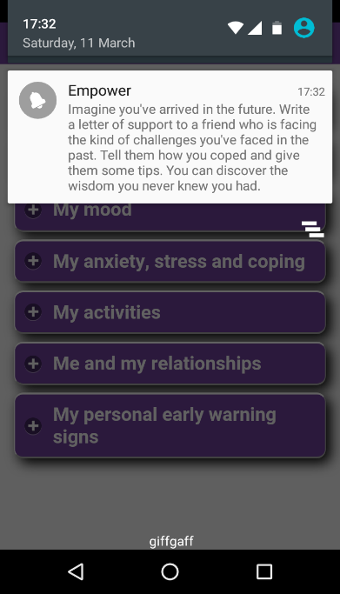


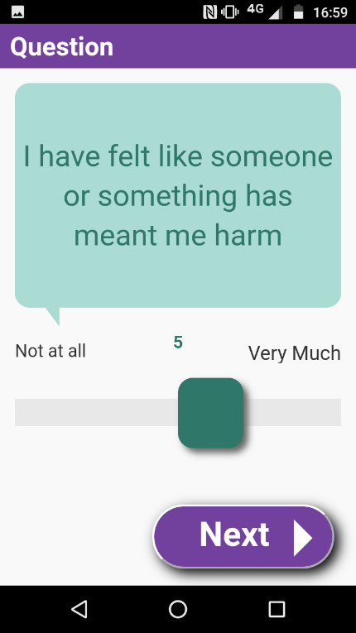

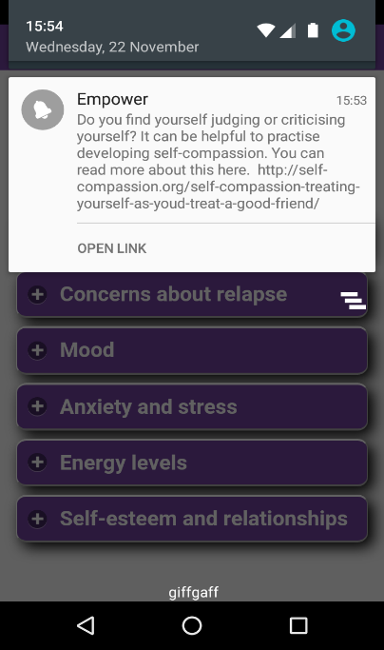
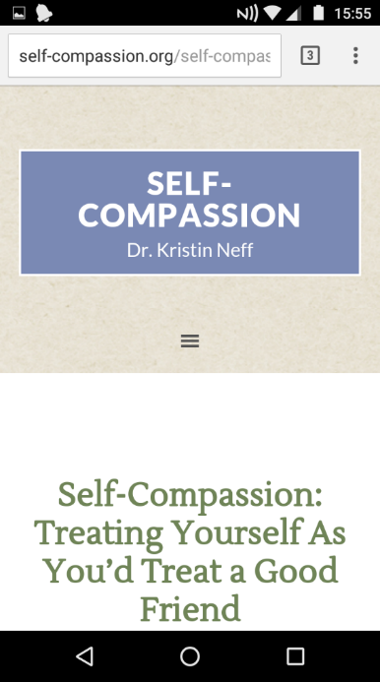

Slide 18
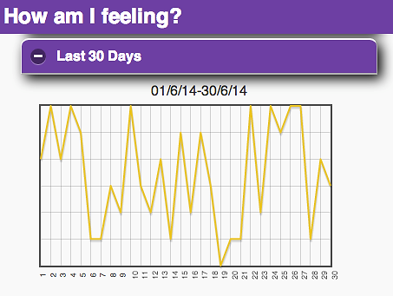
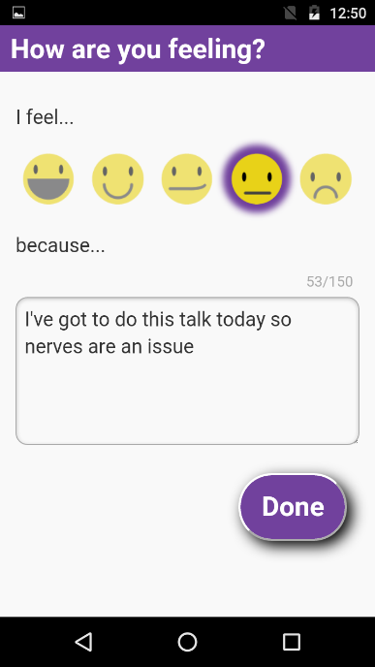

Slide 19
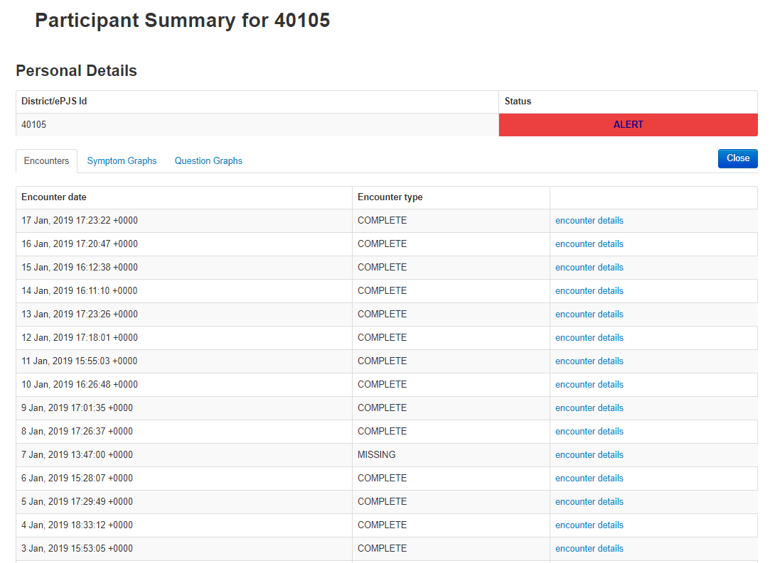

Slide 20
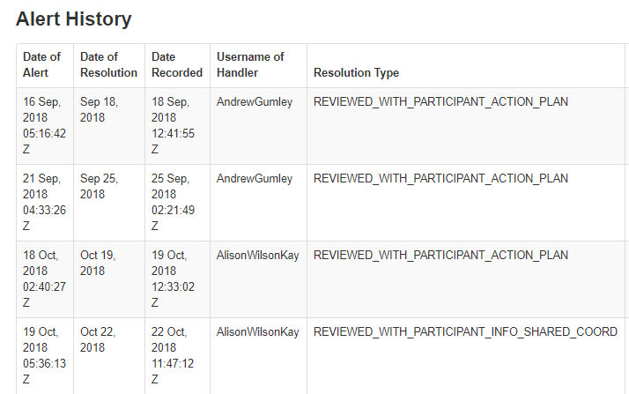
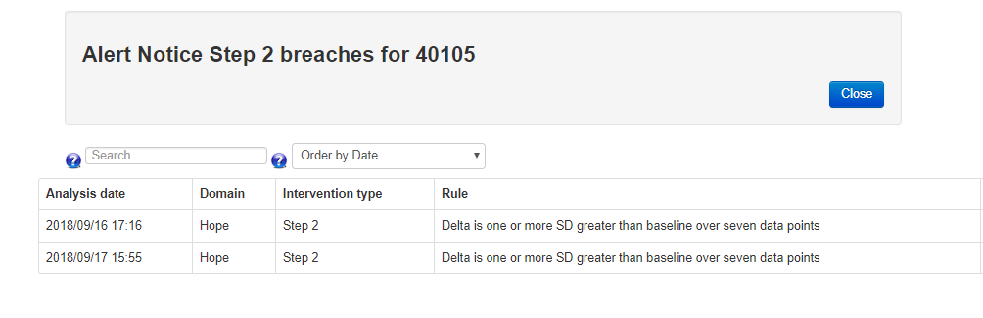

Slide 21
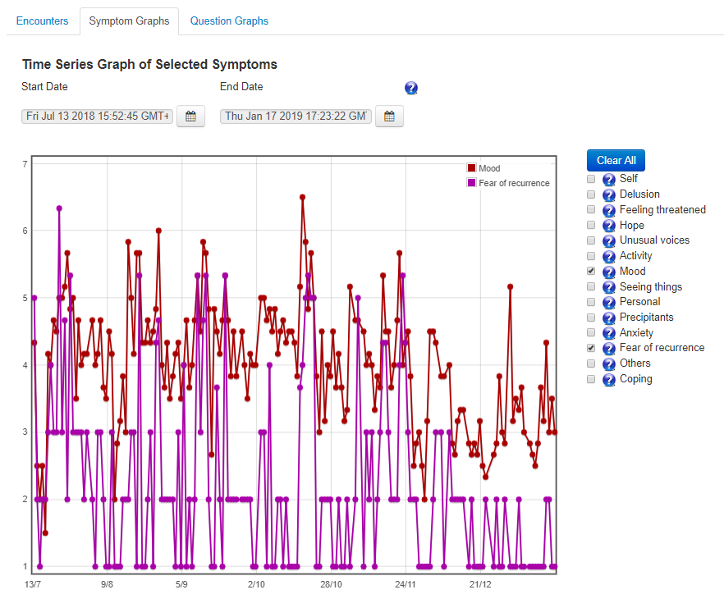

Slide 22

Phase II: Can we recruit?
Enrolment
Consent
Teams = 8
Keyworkers = 106
Caseload = 1140
Randomisation
Approached for Consent = 129
Consented n = 86
Teams:
EMPOWER (n=4)
TAU (n=4)
Participants:
EMPOWER (n=42, median=12.0)
TAU (n=31, median = 10.5)
Notes:
Check if anyone here from any of the participating teams?

Slide 23
Could we recruit to EMPOWER?
Notes:
Data extracted on 14th February 2019
Observations (5234) - the number of times all participants had the opportunity to complete a dataset
Days (134) - mean number of days people completed question sets
Engagements (3716) – the number of times people completed a dataset
Overall engagement (71%) – this is the proportion of 3716 from 5234
Adherence (78%) - number completing >33% question sets

Slide 24
Can we deliver EMPOWER?
Of the 41 (n=42 randomised) participants who had the app set up, 33 (80.5%) completed the 4 week baseline.
These participants used the app for a mean of 31.5 weeks (sd = 14.5; range = 44).
During that period participants used the app for a mean of 64.1% (sd = 22.5; range 76.3) of days. Therefore, according to our a priori criterion of acceptable engagement of 33% daily usage, 30 (91%) participants met our criterion for adherence.
Of those randomised to EMPOWER this represents 71% meeting the criterion. This range of 71% to 91% provides a broader estimate of overall engagement.
Fourteen participants (42.4%) were still using the app at their final follow up assessment.
Notes:
Data extracted on 14th February 2019
Observations (5234) - the number of times all participants had the opportunity to complete a dataset
Days (134) - mean number of days people completed question sets
Engagements (3716) – the number of times people completed a dataset
Overall engagement (71%) – this is the proportion of 3716 from 5234
Adherence (78%) - number completing >33% question sets

Slide 25
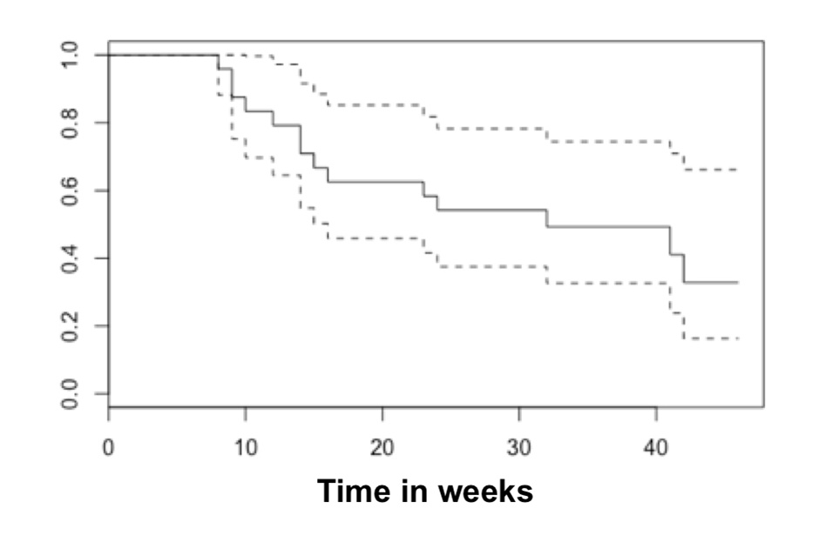
Can we deliver EMPOWER?
Overall, the median survival for not missing four sequential weeks of 33% usage was 32 weeks (bootstrapped 95% CI = 14, ꝏ).
In other words, for 50% of participants who had completed a baseline it took 33 weeks before missing four sequential weeks of intended intervention usage.
Notes:
Data extracted on 14th February 2019
Observations (5234) - the number of times all participants had the opportunity to complete a dataset
Days (134) - mean number of days people completed question sets
Engagements (3716) – the number of times people completed a dataset
Overall engagement (71%) – this is the proportion of 3716 from 5234
Adherence (78%) - number completing >33% question sets

Slide 26
Can we deliver EMPOWER?
A total of 522 Peer Support Worker sessions were offered to 42 participants in the EMPOWER group (mean=12.4, sd=6.8; median=11.0, IQR=10.0).
We also explored the number of Check-In Prompts (ChIPs) triggered by the algorithm during the study.
There were 558 ChIPs during the study across 37 participants (mean=15.1, sd=10.5); median=13.0, IQR=15).
A total of 28 mobile phones were provided to and used by participants, 22 in Glasgow and six in Melbourne.
In total six provided phones were either lost or stolen, four in Glasgow and two in Melbourne, with handsets replaced on three of those occasions.
Notes:
Data extracted on 14th February 2019
Observations (5234) - the number of times all participants had the opportunity to complete a dataset
Days (134) - mean number of days people completed question sets
Engagements (3716) – the number of times people completed a dataset
Overall engagement (71%) – this is the proportion of 3716 from 5234
Adherence (78%) - number completing >33% question sets

Slide 27


Slide 28

Safety and adverse effects
54 adverse events recorded
29 events for people allocated to EMPOWER (affecting 19 people)
13 were intervention related (affecting 11 people).
Most of these occurred within one month of App installation
Of these one was a Serious Adverse Event
Notes:
Data from March
Adverse event: Any untoward medical occurrence, unintended disease or injury, or untoward clinical signs in service user/patient participants, whether or not related to the investigational medical device (i.e. the EMPOWER algorithm). This includes adverse events related to the EMPOWER intervention group and to the treatment as usual (TAU) group and also to all research procedures involved. Adverse events may be classified as follows.
An adverse event is defined by the ISO14155:2011 guidelines for medical device trials as serious if it:
Results in death or,
Is a life-threatening illness or injury or,
Requires [voluntary or involuntary] hospitalisation or prolongation of existing hospitalisation or,
Results in persistent or significant disability or incapacity or,
Medical or surgical intervention required to prevent any of the above,
Leads to foetal distress, foetal death or consists of a congenital anomaly or birth defect or,
Is otherwise considered medically significant by the investigator.

Slide 29

Process evaluation
The how and why EMPOWER works or does not in the context of the trial
How are end users experiencing EMPOWER?
Not just building theory to understand intervention use but also to improve it
Place – where participants are when they answer the questionnaire.
Appraisals – self-monitoring is not neutral
Motivations – varied and diverse
Notes:
12 interviews to date in Glasgow
Not just building theory - People have fed back on technical issues and design ideas
Place – getting people in their daily life. Intervening in people’s lives. EMA sold as ecological validity but may be a potential intrusion.
Appraisals – this feels very different and new to many people. People have very varied experiences of self monitoring. People like seeing that they are doing well.
Motivations – improving English. Giving access to a person and services. Sense of security. Route in to services.

Slide 30
The developing intervention
Expectations and assumptions | Experience in practice
Early warning signs | Check in Prompts
Relapse prevention | Ebb and flow – wellness
Symptom monitoring | Cultivating relationship with experiences
–ve change focus | +ve changes important
Routine KW contact | Strategic KW contact
Peer Work detached from data | Peer work informed by data
 | Digital inclusion and skills development
 | Adverse events
Next steps
Increased blending
Time limited
Digitally informed peer support
Longer lead in to digital
Retain service connection
Enhanced outputs

Slide 31
Progress and next steps
Phase 1 complete and being written up for publication
Phase 2 ends in June
Process evaluation ongoing
Longest duration to date in field
Optimising the intervention for scalability

Slide 32


empowerstudy.net

