Slide 1
Virtual consultations and digital approaches with people with unusual distressing experiences (psychosis)
Prof Kathy Greenwood
University of Sussex and Sussex Partnership Foundation Trust

Slide 2
Santesteban-Echari et al 2021 – review of virtual conference interventions in psychosis
14 eligible studies (N = 439 individuals).
All reported that videoconferencing implementation was feasible,
Most of them described high acceptance by individuals with a
Schizophrenia-spectrum disorder.
Selection bias of studies was high, and methodological quality was poor.
Notes:
Does it work? How does it work?

Slide 3
CBTp approaches are highly adaptable to remote/virtual approaches (Kopelovich and Turkington 2021)
Cognitive behavioral interventions are highly adaptable to our current state of remote care. CBT is frequently delivered through or enhanced by remote applications, including:
telepsychiatry (Hartley et al. 2014),
smartphone applications (Ben-Zeev et al. 2014a, b),
Wearable devices (Naslund et al. 2016),
texting (Ben-Zeev et al. 2014a, b),
web-based platforms (Gottlieb et al. 2013), and
virtual reality (Freeman et al. 2016)
Notes:
Does it work? How does it work?

Slide 4
CBTp approaches are highly adaptable to remote/virtual approaches (Kopelovich and Turkington 2021)
Digital approaches can help with
who we reach
improved management for long term health conditions (e.g. CONNECT)
sustained clinical contact during emergencies (e.g. Crisis team)
Digital approaches are acceptable to people with psychosis (Daker-White and Rogers 2013; Santesteban- Echarri et al. 2020),
May be preferable for some service delivery (Bee et al. 2010).
Notes:
Does it work? How does it work?

Slide 5
Challenges to TA in virtual consultations
(Kopelovich and Turkington 2021)
Practical challenges include:
poor connections
delays in the exchange of written therapeutic materials.
Client not confident with technology, not having safe private location.
Psychological challenges
worry thoughts related to technology surveillance, or
feeling of unreality associated with virtual encounters
Consider shorter more frequent sessions, tip sheets with graphics for clients, engaging on enjoyable, non-emotional topics first,
Notes:
Does it work? How does it work?

Slide 6
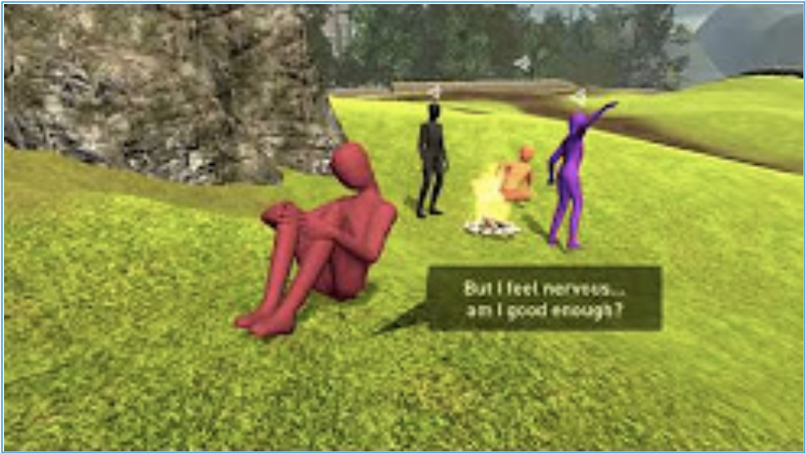
ProReal for social groups in psychosis
Notes:
Does it work? How does it work?

Slide 7
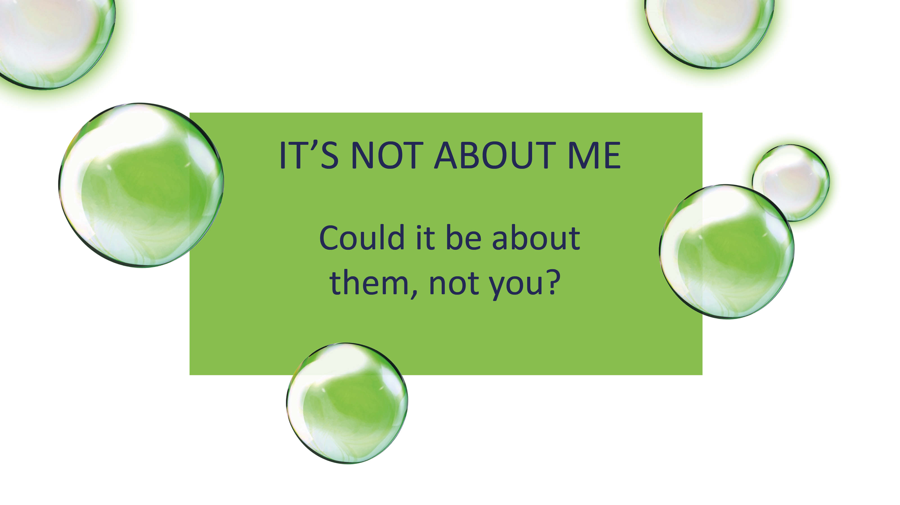


A co-produced thematic analysis of service users’ subjective experience of SlowMo
Prof Kathy Greenwood
University of Sussex and Sussex Partnership Foundation Trust

Slide 8


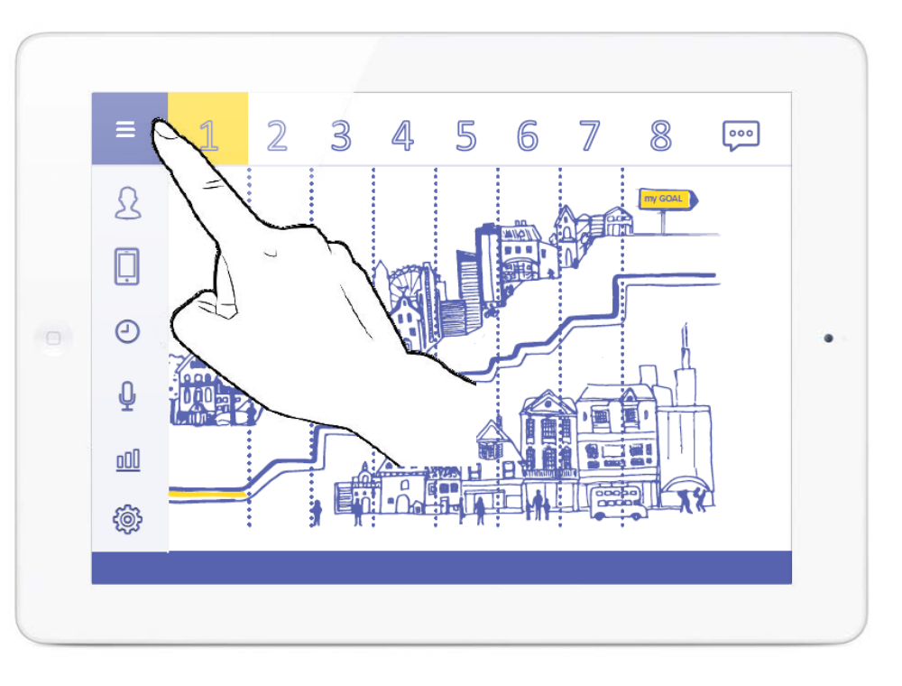
User experience – TA critical to engagement and outcome
Triangle
of Alliance
Clarke et al. 2016; Goldsmith et al. 2015; Cavanagh 2010; Vernmark et al. 2019: Cavanagh et al. 2018

Slide 9
User experience – TA critical to engagement and outcome
Triangle
of Alliance
Clarke et al. 2016; Goldsmith et al. 2015; Cavanagh 2010; Vernmark et al. 2019: Cavanagh et al. 2018

Slide 10
User experience – TA critical to engagement and outcome
Triangle
of Alliance
Clarke et al. 2016; Goldsmith et al. 2015; Cavanagh 2010; Vernmark et al. 2019: Cavanagh et al. 2018

Slide 11

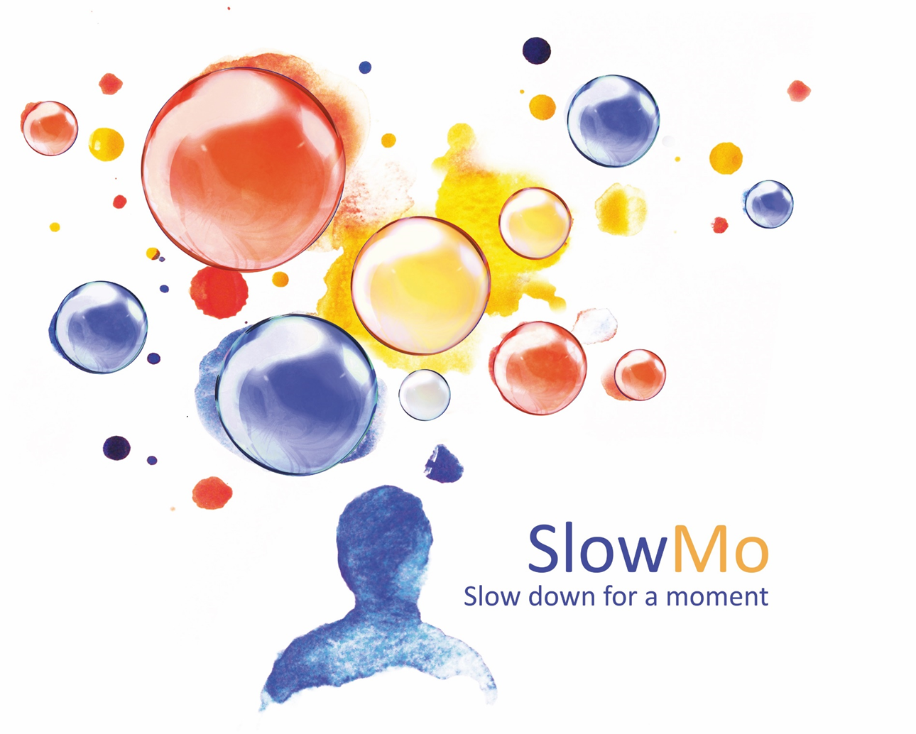


Co-produced Qualitative Evaluation of user experience
Key Aims:
To explore the subjective service user experience of:
  (i) the SlowMo therapy content and concepts
  (ii) the experience of the blended therapy approach (the triangle of alliance)
  (iii) the digital aspects of the intervention
The SlowMo trial is supported by the Efficacy and Mechanism Evaluation (EME) Programme, an MRC and NIHR partnership.
Notes:
Does it work? How does it work?

Slide 12
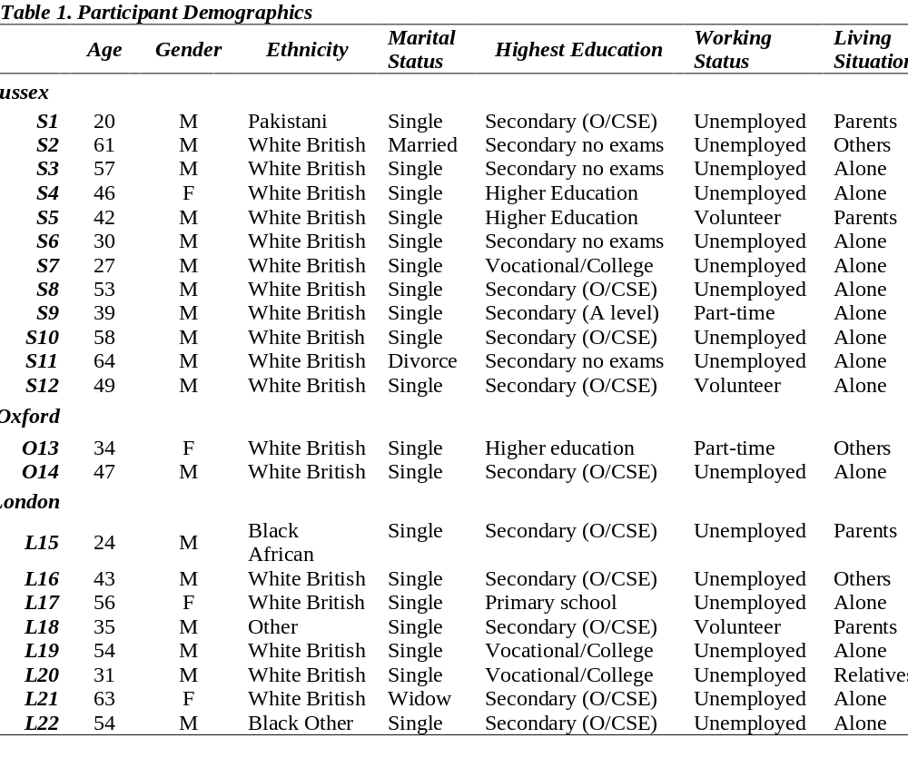
Participants
Notes:
Does it work? How does it work?

Slide 13
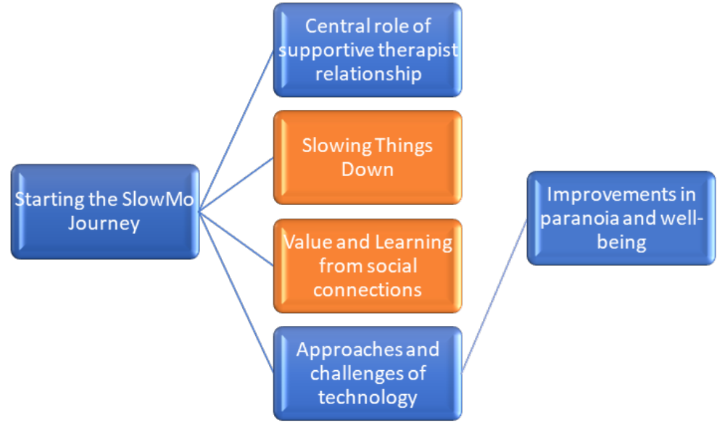
Results
Notes:
Does it work? How does it work?

Slide 14

Digital experiences and outcomes
Approaches and Challenges of Technology
Use of technology to support positive outcomes
Cognitive demands of blended therapy as therapeutic or overwhelming
Personal relationship with the app
Challenges to using technology
Notes:
Does it work? How does it work?

Slide 15
Example quotes
Use of technology to support positive outcomes
L15: ‘Before I go out, I check the phone, then leave, pop the bubbles, slow down. I used it every day, but I’m not using it so much now. The tips and personal message come up and are helpful when I have worries and work as a reminder’
Notes:
Does it work? How does it work?

Slide 16
Conclusion
The role of the supportive therapist remained central.
The triangle of alliance between service user, therapist and digital platform can be highly effective with good outcomes in psychosis.
We are starting a Psychological therapies (SlowMo) clinic in Sussex
Notes:
Does it work? How does it work?

