Slide 1



Pilot randomised control trial of Positive Written Disclosure for carers of people with psychosis
C4C
Caring for Caregivers
PI: Dr Chrissie Jones c.j.jones@surrey.ac.uk

Slide 2
Overview of talk
Who do we mean by carers and why are we interested?
Why older adults and carers of people with psychosis specifically?
Why might positive writing help?
How did the Lived Experience Advisory Panel shape the C4C study?
What were our aims and did we meet them?
What next?

Slide 3
Who is a carer?
Any person who provides unpaid support to a partner, child, relative or friend who couldn’t manage to live independently or whose health or wellbeing would deteriorate without this help

Slide 4

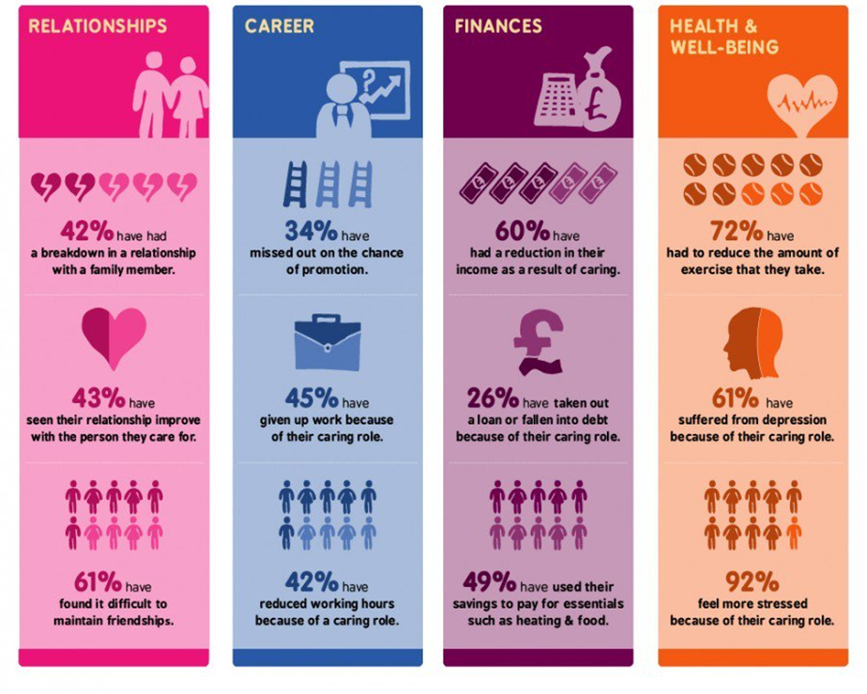
Why carers?

Slide 5
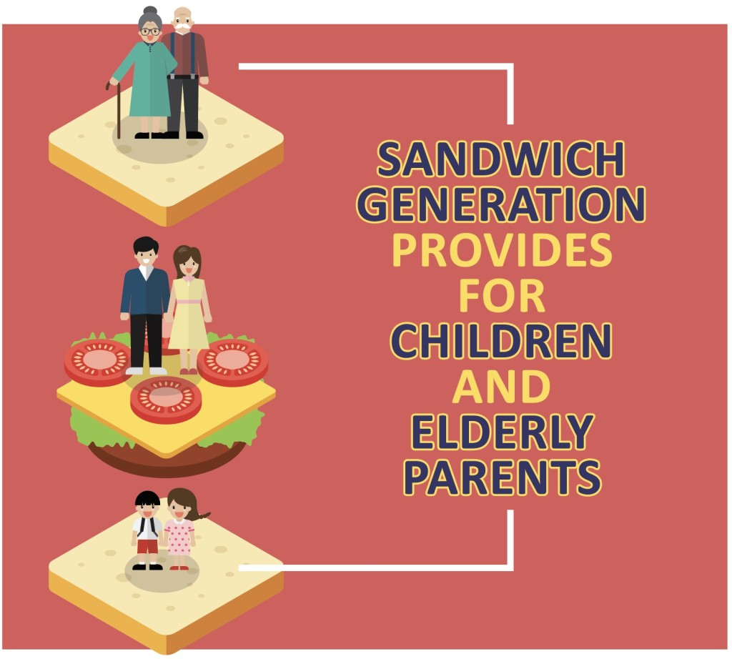
Why older adult carers?
Often refers to those looking after children at the same time as caring for older parents
Term can be used more broadly to describe a variety of multiple caring responsibilities for people in different generations
Studies show that this is becoming one of the hardest pressed generations

Slide 6



Why psychosis carers?
Many carers are faced with confusing and distressing illness symptoms
  delusions, poor self-care, risky health behaviours, and isolation
  difficult behaviours that may, at times, include acts of aggression and self-harm that can be stigmatising
Care recipient outcomes are closely related to the quality of carer relationship which can place a burden on the carer, and feelings of guilt at times of relapse
Approximately 40% report poor psychological functioning that includes depression and other stress-related disorders
Notes:
he World Health Organization estimated that the burden to individual families from psychotic disorders such as schizophrenia is only exceeded by dementia and quadriplegia.

Slide 7

Why positive writing?
Few studies have explored ways to alleviate stress and improve carer wellbeing
  Psychosocial/psychoeducational therapies improve knowledge of the care recipients condition, but have only a small effect on carers wellbeing
  NICE recommend that family therapy should be offered to all families of people with schizophrenia for at least 6 months
Therapies can be difficult to implement and prolonged engagement impractical
Need for an accessible and effective therapy for carer of people with psychosis
  Two studies found that carers writing about positive experiences reported greater improvements in psychological wellbeing
  However studies included a wide range of carers
Notes:
(e.g. those of any age with physical or mental illness, addiction or disability)

Slide 8
LEAP
How did the Lived Experience Advisory Panel (LEAP) shape the C4C study?

Slide 9
LEAP on study design
Writing in itself, irrespective of the topic could be helpful

Slide 10
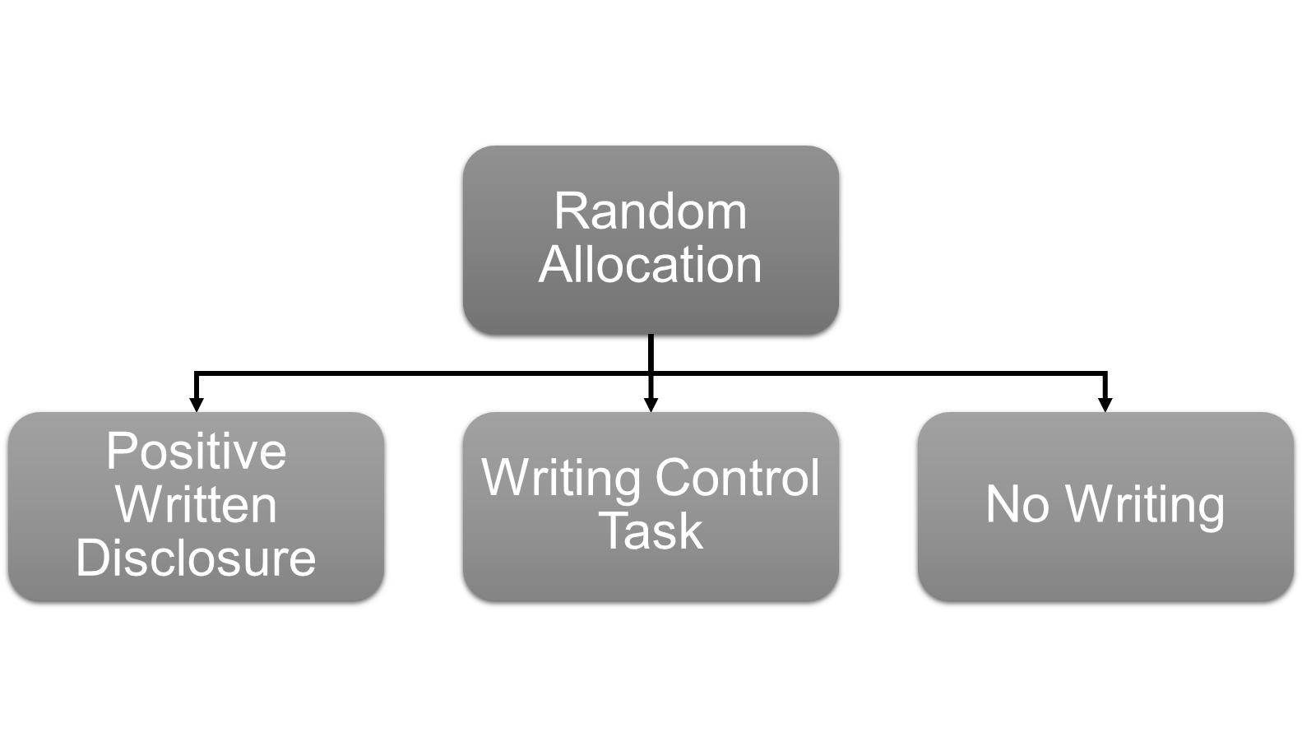
LEAP on study design
Writing in itself, irrespective of the topic could be helpful

Slide 11

LEAP on images
Those images are not neutral – they could trigger positive or negative emotions

Slide 12

LEAP on images
Those images are not neutral – they could trigger positive or negative emotions

Slide 13
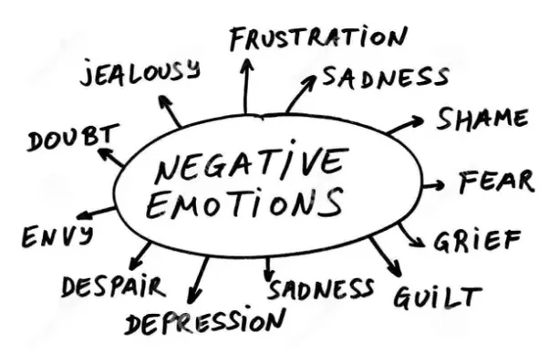
LEAP on questionnaires
All of these measures have a negative focus

Slide 14
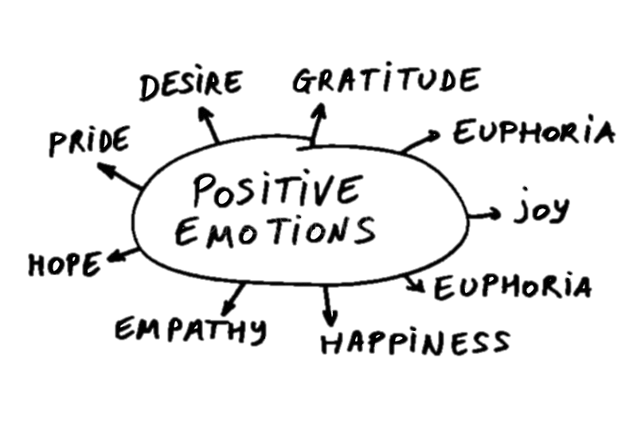
LEAP on questionnaires
All of these measures have a negative focus

Slide 15
Aims
Feasibility study to determine if a full trial of positive writing in older adult carers of people experiencing psychosis is justified in terms of:
  Recruitment (N=60)
  Retention (≥60% participation and primary outcome ≥80% complete)
  Reasons for dropout
  Adherence to writing task (analysis of writing)
Do older adults carers of people with psychosis find positive writing and the study design:
  Acceptable
  Accessible Qualitative interviews
  Feasible

Slide 16


Participants
To be eligible to take part, carers had to be:
Aged 50 or over*
Currently a carer
Care recipient must have a psychosis diagnosis
Able to read and write in English
*Originally the inclusion criteria was carers aged 60+
Oxleas
Notes:
(including schizophrenia, schizo-affective disorders, psychotic depression and bipolar illnesses)

Slide 17
Intervention
Positive Written Disclosure (PWD)
Aim: To improve mood and wellbeing
Duration: 20 minutes, for 3 consecutive days
Write about your deepest thoughts and emotions towards a positive experience or memory

Slide 18



Controls
Writing Control (WC) OR 2. No writing

Slide 19
Procedure
Initial Meeting | → | Intervention | → | Follow Up | → | Debrief
Discussed the study, took consent, and completed baseline questionnaires Mood (+ and -) Depression, anxiety, stress Wellbeing Self-efficacy Leisure time |  | Randomly allocated to receive either: PWD Writing Control No writing Control |  | Completed questionnaires 1, 3 and 6 months later |  | Some carers completed an interview on their experiences of the study

Slide 20
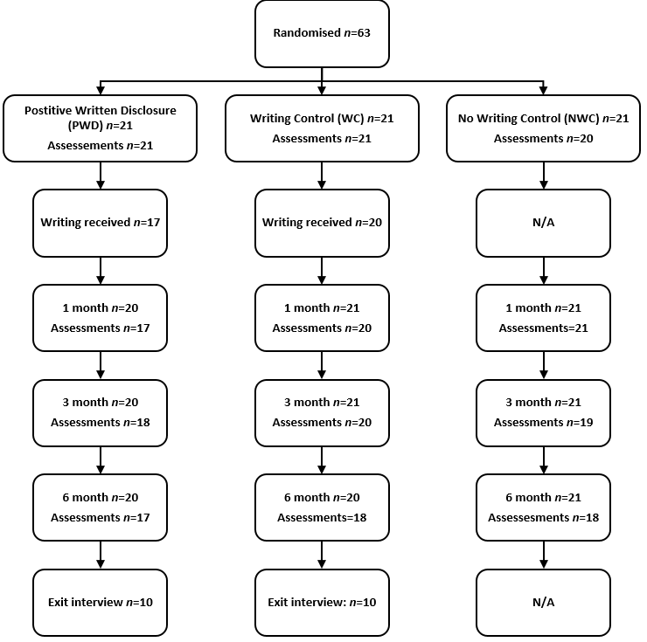

Results – consort

Slide 21

Could we recruit and retain?
63 (105%) target population recruited
  36 from Sussex, 17 Kent, 8 Surrey and 2 from Oxleas
61 (96.8%) retention at 6-months
53 (84.1%) primary outcome completion at 6-months
2 (3.2%) withdrawals
  Both due to care recipient relapse

Slide 22
Who took part?
 | PWD (N=21) | WC (N=21) | NWC (N=20)*
Mean age (SD) | 64.48 (7.96) | 64.10 (7.60) | 63.85 (8.64)
Gender n (%) Male Female | 7 (33.3) 14 (66.6) | 5 (23.8) 16 (76.2) | 4 (20.0) 16 (80.0)
Mean number of years spent care giving (SD) | 13.50 (11.32) | 12.58 (14.04) | 15.13 (11.37)
Mean hours per week spent care giving (SD) | 57.05 (52.63) | 63.57 (63.71) | 62.30 (64.72)
Relationship to main care recipient Parent Spouse Sibling Uncle Friend | 15 (71.4) 4 (19.0) 1 (4.8) 1 (4.8) - | 17 (81.0) 3 (14.3) 1 (4.8) - - | 12 (60) 5 (25) 2 (10.0) - 1 (5.0)
Care recipient diagnoses Schizophrenia Schizoaffective disorder Psychosis not otherwise specified Bipolar Depression with psychotic features Psychosis Delusional disorder | 6 (28.6) 3 (14.3 2 (9.5) 7 (33.3) 2 (9.5) 1 (4.8) - | 7 (33.3) 5 (23.8) 1 (4.8) 2 (9.5) 2 (9.5) 4 (19) - | 11 (55.0) 2 (10.0) 1 (5.0) 4 (20.0) - 1 (5.0) 1 (5.0)
Regularly keeps a diary/writes about emotions | 4 (19.0) | 3 (14.3) | -
Notes:
Mean number of people carer is providing for (SD)
1.82 (0.60)
2.13 (0.99)
2.38 (2.13)

Slide 23
Did carers stick to task?
38 (90.5%) returned writing
  38 (100%) completed all 3 days
Writing category | PWD n=17 | NW n=21
Total words | 1247.12 (454.16) | 1066.95 (268.88)
Positive words | 12.48 (3.54) | 1.93 (0.95)
Negative words | 2.36 (1.33) | 0.55 (0.43)
Causation words | 1.57 (0.82) | 0.22 (0.33)
Insight | 6.38 (1.90) | 1.00 (0.56)

Slide 24
Was PWD acceptable?
Perceived changes in thoughts, feelings and behaviour:
More positive attitude
Focus on doing things for myself
Providing a distraction/escapism
Intervention difficulties:
Narrow focus
Personality factors
Finding space and time
Broaden accessibility of intervention:
Provision of choices
Provision of prompts
Notes:
Bubble 1 - the interventions’ benefits was that it supported them to maintain a positive attitude and fostered a sense of gratitude. And the intervention supported them to realise the importance of spending some time doing things they enjoy. the intervention as a distraction and escapism from daily routine and caring and other type of responsibilities
Bubble 2 –
Bubble 3 –
Bubble 4 – Some in the PWD found the intervention stressful and unhelpful as an experience citing an increase in self-awareness and recognition that they were not coping well but asked for help as a result. reported that they did not enjoy the intervention due to its narrow focus i.e. writing only about positive emotions. It seemed that the focus on the positives only, fostered a sense of loss for those participants. A common denominator among participants’ accounts was the difficulty of remembering positive experiences which by its own terms created a sense of sadness. Others also reported that their lives have taken another turn and they did not want to remember past positive experiences

Slide 25
Was PWD acceptable?
Perceived changes in thoughts, feelings and behaviour:
More positive attitude
Focus on doing things for myself
Providing a distraction/escapism
“It was rewarding cause it was limited only to positive things in one’s past life and it made one go back through one’s life searching for these positive things”
“I do feel I am getting down or if things getting on top of me this is a way of escaping and you know, um getting my mind on other things”
“I am thinking because of this therapeutic value of this study of maybe trying to join a writers' group or something, creative writing because I quite like writing… The moment you put it out and get down to it, I found that I really did enjoy it. And it was like my time rather than being a carer”
Notes:
Bubble 1 - the interventions’ benefits was that it supported them to maintain a positive attitude and fostered a sense of gratitude. And the intervention supported them to realise the importance of spending some time doing things they enjoy. the intervention as a distraction and escapism from daily routine and caring and other type of responsibilities
Bubble 2 –
Bubble 3 –
Bubble 4 – Some in the PWD found the intervention stressful and unhelpful as an experience citing an increase in self-awareness and recognition that they were not coping well but asked for help as a result. reported that they did not enjoy the intervention due to its narrow focus i.e. writing only about positive emotions. It seemed that the focus on the positives only, fostered a sense of loss for those participants. A common denominator among participants’ accounts was the difficulty of remembering positive experiences which by its own terms created a sense of sadness. Others also reported that their lives have taken another turn and they did not want to remember past positive experiences

Slide 26
Was PWD acceptable?
Perceived changes in thoughts, feelings and behaviour:
More positive attitude
Focus on doing things for myself
Providing a distraction/escapism
Intervention difficulties:
Narrow focus
Personality factors
Finding space and time
Broaden accessibility of intervention:
Provision of choices
Provision of prompts
Notes:
Bubble 1 - the interventions’ benefits was that it supported them to maintain a positive attitude and fostered a sense of gratitude. And the intervention supported them to realise the importance of spending some time doing things they enjoy. the intervention as a distraction and escapism from daily routine and caring and other type of responsibilities
Bubble 2 –
Bubble 3 –
Bubble 4 – Some in the PWD found the intervention stressful and unhelpful as an experience citing an increase in self-awareness and recognition that they were not coping well but asked for help as a result. reported that they did not enjoy the intervention due to its narrow focus i.e. writing only about positive emotions. It seemed that the focus on the positives only, fostered a sense of loss for those participants. A common denominator among participants’ accounts was the difficulty of remembering positive experiences which by its own terms created a sense of sadness. Others also reported that their lives have taken another turn and they did not want to remember past positive experiences

Slide 27
Was PWD acceptable?
Intervention difficulties:
Narrow focus
Personality factors
Finding space and time
“Well, it [positive writing] wasn’t helpful as and when I write but it helped to bring out that I wasn’t coping very well. So, it made me do something about it”
“Having to draw on emotions, was very difficult because I am a very private person and I don’t generally express myself in that way”
“I think definitely a degree of frustration “oh there’s got to be something happy that you can think about that happened after you were 16 years old”, and that was frustrating because there wasn’t”
Notes:
Bubble 1 - the interventions’ benefits was that it supported them to maintain a positive attitude and fostered a sense of gratitude. And the intervention supported them to realise the importance of spending some time doing things they enjoy. the intervention as a distraction and escapism from daily routine and caring and other type of responsibilities
Bubble 2 –
Bubble 3 –
Bubble 4 – Some in the PWD found the intervention stressful and unhelpful as an experience citing an increase in self-awareness and recognition that they were not coping well but asked for help as a result. reported that they did not enjoy the intervention due to its narrow focus i.e. writing only about positive emotions. It seemed that the focus on the positives only, fostered a sense of loss for those participants. A common denominator among participants’ accounts was the difficulty of remembering positive experiences which by its own terms created a sense of sadness. Others also reported that their lives have taken another turn and they did not want to remember past positive experiences

Slide 28
Was PWD acceptable?
Perceived changes in thoughts, feelings and behaviour:
More positive attitude
Focus on doing things for myself
Providing a distraction/escapism
Intervention difficulties:
Narrow focus
Personality factors
Finding space and time
Broaden accessibility of intervention:
Provision of choices
Provision of prompts
Notes:
Bubble 1 - the interventions’ benefits was that it supported them to maintain a positive attitude and fostered a sense of gratitude. And the intervention supported them to realise the importance of spending some time doing things they enjoy. the intervention as a distraction and escapism from daily routine and caring and other type of responsibilities
Bubble 2 –
Bubble 3 –
Bubble 4 – Some in the PWD found the intervention stressful and unhelpful as an experience citing an increase in self-awareness and recognition that they were not coping well but asked for help as a result. reported that they did not enjoy the intervention due to its narrow focus i.e. writing only about positive emotions. It seemed that the focus on the positives only, fostered a sense of loss for those participants. A common denominator among participants’ accounts was the difficulty of remembering positive experiences which by its own terms created a sense of sadness. Others also reported that their lives have taken another turn and they did not want to remember past positive experiences

Slide 29
Was PWD acceptable?
Broaden accessibility of intervention:
Provision of choices
Provision of prompts
“if you can give people more prompts um you know, like, something like think about, you know, think about what experience you’re going to write about, remember how you felt before or how you felt during or how you felt after, what was the weather like”
“I mean for some people this might be writing poetry, it might be writing ... umm ...you know, much shorter initiative words or statement, it doesn’t have to be essay like and I think by providing people more choice”
“maybe just suggesting any emotion, really, not just happy; not just sad but any emotion that people feel and ..and write that down”
Notes:
Bubble 1 - the interventions’ benefits was that it supported them to maintain a positive attitude and fostered a sense of gratitude. And the intervention supported them to realise the importance of spending some time doing things they enjoy. the intervention as a distraction and escapism from daily routine and caring and other type of responsibilities
Bubble 2 –
Bubble 3 –
Bubble 4 – Some in the PWD found the intervention stressful and unhelpful as an experience citing an increase in self-awareness and recognition that they were not coping well but asked for help as a result. reported that they did not enjoy the intervention due to its narrow focus i.e. writing only about positive emotions. It seemed that the focus on the positives only, fostered a sense of loss for those participants. A common denominator among participants’ accounts was the difficulty of remembering positive experiences which by its own terms created a sense of sadness. Others also reported that their lives have taken another turn and they did not want to remember past positive experiences

Slide 30
Was WC acceptable?
Perceptions of the writing task:
An escapism
Time for myself
Preference to express emotion
Writing difficulties:
Fit everything in within timescale
Being busy
Confusion around the pictures and their relevance
Participating in research:
Transparency
Being noticed
Lack of space to comment on change

Slide 31
Was WC acceptable?
Perceptions of the writing task:
An escapism
Time for myself
Preference to express emotion
“was something completely different, a complete break from you know, the routine, from day to day staff it was like escapism in a way and it also made me concentrate you know, very much on the task I was doing”
it helps to get things down, gets out of your head and onto the paper, I think, yes, that would have been more beneficial than describing picture
“it helps to get things down, gets out of your head and onto the paper, I think, yes, that would have been more beneficial than describing picture”
“I don’t get much time for myself and I suppose it was a bit of time for me to sit down and think about whatever writing I was doing”

Slide 32
Was WC acceptable?
Perceptions of the writing task:
An escapism
Time for myself
Preference to express emotion
Writing difficulties:
Fit everything in within timescale
Being busy
Confusion around the pictures and their relevance
Participating in research:
Transparency
Being noticed
Lack of space to comment on change

Slide 33
Was WC acceptable?
“I think my first reaction was ooh this is interesting. I wondered what you wanted descriptions of pictures for”
Writing difficulties:
Fit everything in within timescale
Being busy
Confusion around the pictures and their relevance
“I was...maybe a little bit worried about making mistakes and then taking time to sort of rectify them in my own mind while, when I would run out of time and not be able to put everything on there”
“I found it difficult to find the time to actually do the writing…I had to be reminded a number of times that I hadn’t still submitted my pieces”

Slide 34
Results – acceptability (WC)
Perceptions of the writing task:
An escapism
Time for myself
Preference to express emotion
Writing difficulties:
Fit everything in within timescale
Being busy
Confusion around the pictures and their relevance
Participating in research:
Transparency
Being noticed
Lack of space to comment on change

Slide 35
Was WC acceptable?
“I understood that…it was research…it was very much appreciated, it was voluntary, it was going to be anonymous…everything was explained clearly…I fully understood what I was doing and the process of doing it”
Participating in research:
Transparency
Being noticed
Lack of space to comment on change
“there wasn’t anywhere that you could actually say how things had changed… things had changed but I think it needed to have more… more about my situation”
“I think being part of this project and feeling that there is some research going on into the situation of care givers has helped me greatly. It’s probably being a part of the project in some way that I found beneficial, really irrespective of which group I was put in to”

Slide 36
Acceptability – PWD and WC
Common themes in both groups
Desire for support and shared experiences
Interested to hear results of the study
Many confounding factors involved in change
“It's just nice to know to me other people that are in this sort of a similar situation, you know and when life is getting desperate”
“this is nothing like being with other people, to talk these things through and you know somebody might have...um...different experience you can compare experiences and perhaps help one another”

Slide 37

Was the study acceptable?
Largely yes but...
  Some carers found the writing only about positive experiences challenging
  Some carers found the neutral writing beneficial
  Some carers found it challenging to find the time to complete writing

Slide 38
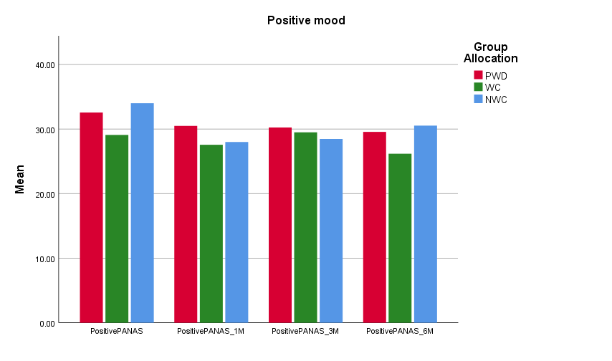
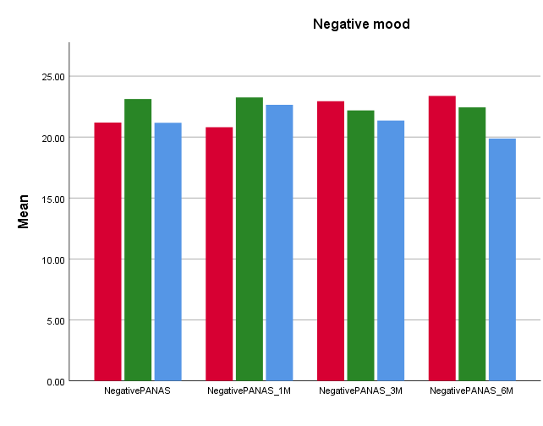
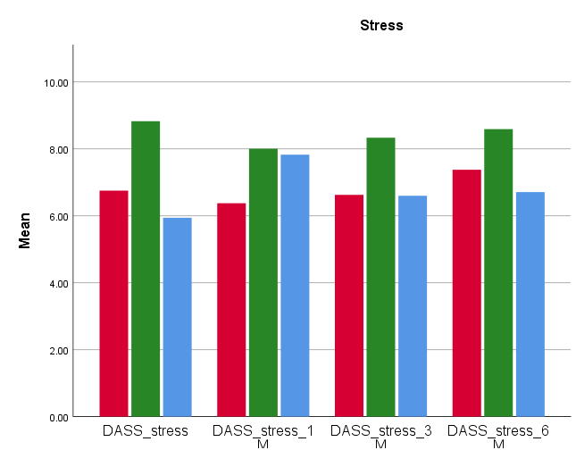
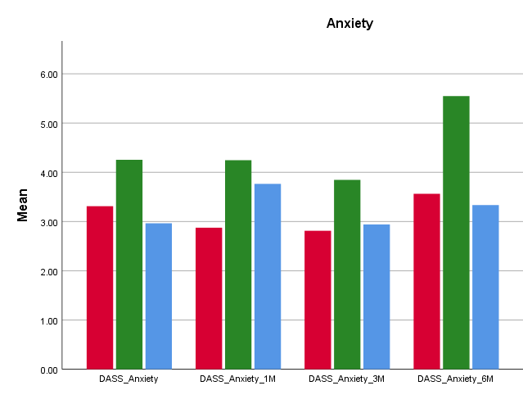
What about the questionnaires?
Average 29.7
Average 14.8
“Normal” range
(0-14)
“Normal” range
(0-7)

Slide 39
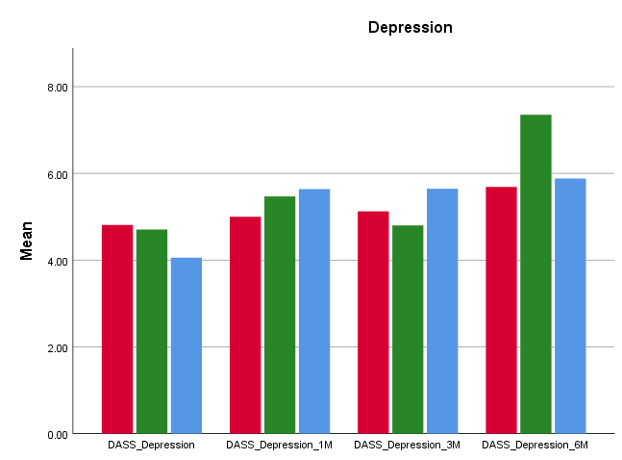
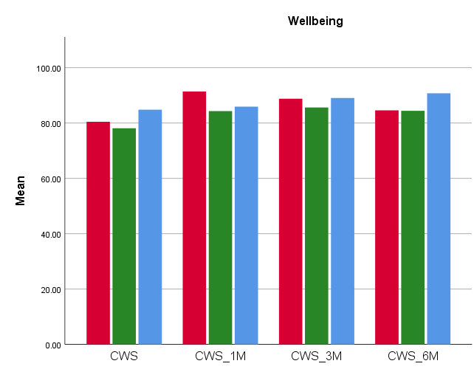
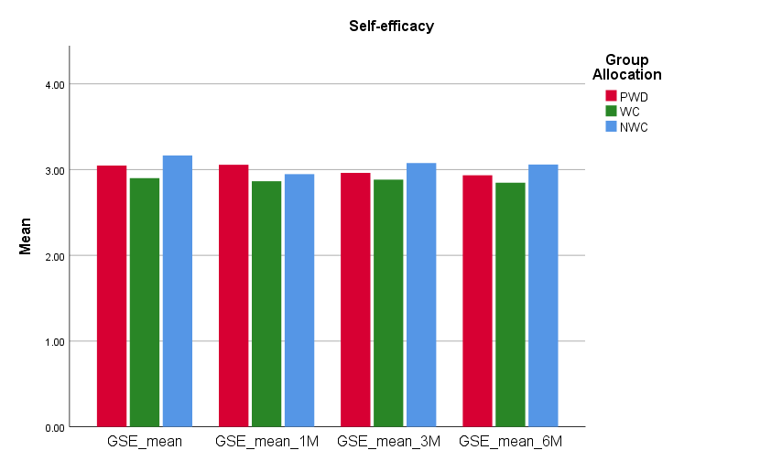
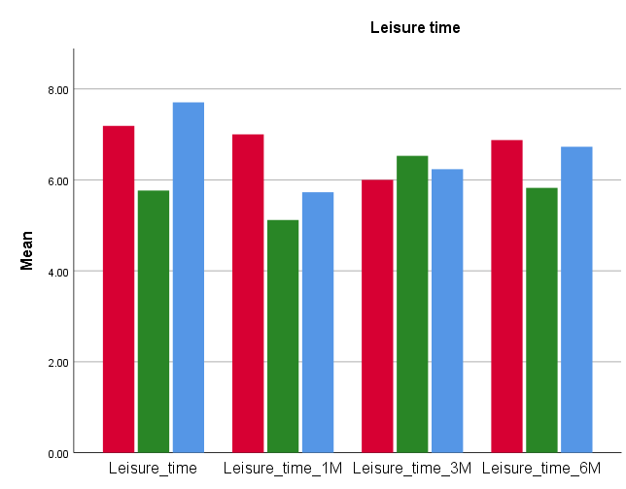
What about the questionnaires?
“Normal” range (0-9)
Average 2.9

Slide 40
Conclusions
We were able to successfully recruit to target and time*
96.8% carers retained at 6 months with 84.1% data complete at final assessment
Participants adhered to writing instructions in terms of amount and content of writing, and completion over 3 days
Majority of carers found the study acceptable although some saw the narrow focus and time to complete as barriers
Notes:
*First participants recruited in January 2017
Last participant recruited February 2018 (original gantt chart allowed for 7 months recruitment)

Slide 41

Discussion
Is a full trial of PWD justified?
Why might we not have seen any trend towards difference in outcomes?
  Carers were very experienced and coping well?
  Perhaps newer carers would benefit more?
  Perhaps writing should focus on any intense emotion?
  We used the wrong outcome measures?
  We used the wrong control?
  The intervention just doesn’t work for these carers?
What should we do next?

Slide 42

Keep in touch
I am supervising a trainee clinical psychologist who is interested in pursuing research in this area
If you are a carer and interested in being involved in more research, drop us an email to me:
  Chrissie Jones c.j.jones@surrey.ac.uk
  Becca Read r.read@surrey.ac.uk
Or come say hello to us after this meeting

Slide 43

Acknowledgements
Research team
Mark Hayward
Helen Smith
Vanessa Pinfold
Stephen Bremner
Daryl O’Connor
Cassie Hazell
Aparajita Pandey
Alexia Papamichail
Lived Experience Advisory Panel
Trial Steering Committee
Susan Ayers
Kathy Greenwood
Jill Scholl
Anna-Marie Jones
This work was supported by The Dunhill Medical Trust [grant number: R431/0715]
Notes:
*First participants recruited in January 2017
Last participant recruited February 2018 (original gantt chart allowed for 7 months recruitment)

Slide 44
Discussion
Is a full trial of PWD justified?
Why might we not have seen any trend towards difference in outcomes?
  Carers were very experienced and coping well?
  Perhaps newer carers would benefit more?
  Perhaps writing should focus on any intense emotion?
  We used the wrong outcome measures?
  We used the wrong control?
  The intervention just doesn’t work for these carers?
What should we do next?

