Slide 1




Trial:
Trauma-focused CBT for psychosis
Dr Amy Hardy
Lecturer, Institute of Psychiatry, Psychology & Neuroscience, King’s College London
Consultant Clinical Psychologist & Trauma-informed Care Lead, Psychological Interventions Clinic for Outpatients with Psychosis, South London & Maudsley NHS Foundation Trust
amy.hardy@kcl.ac.uk : @AmybHardy

Slide 2


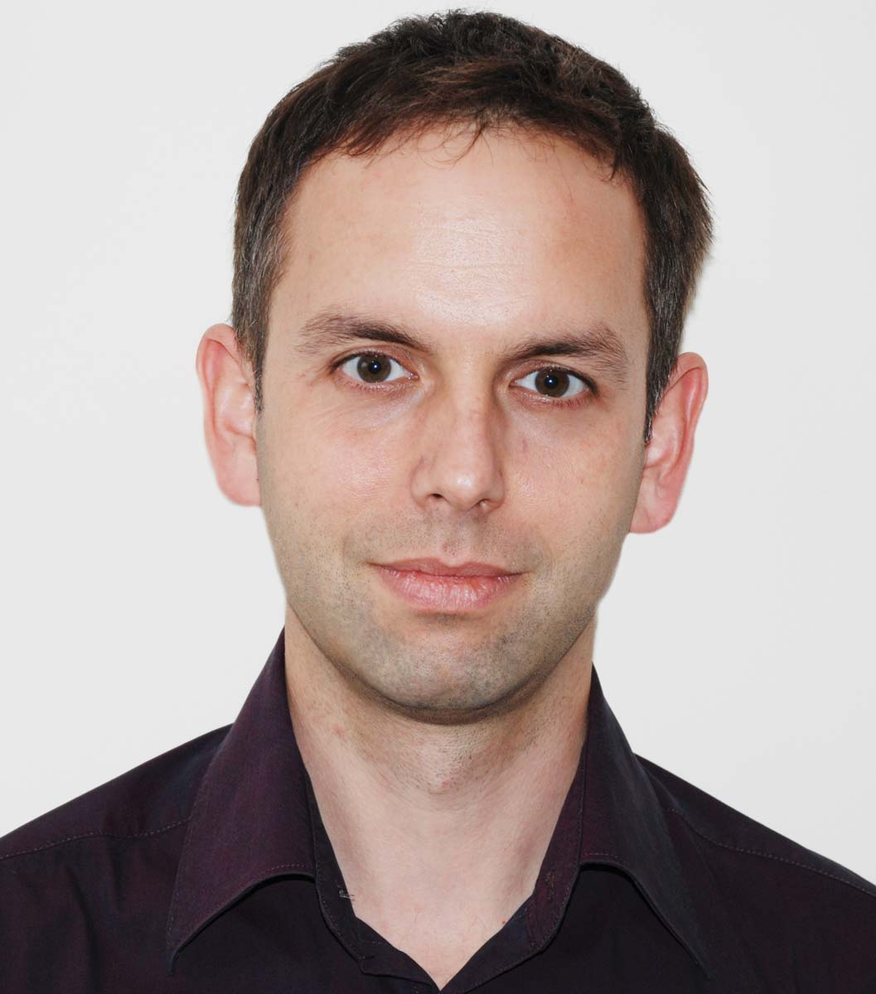
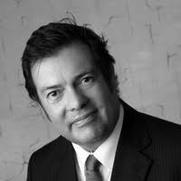
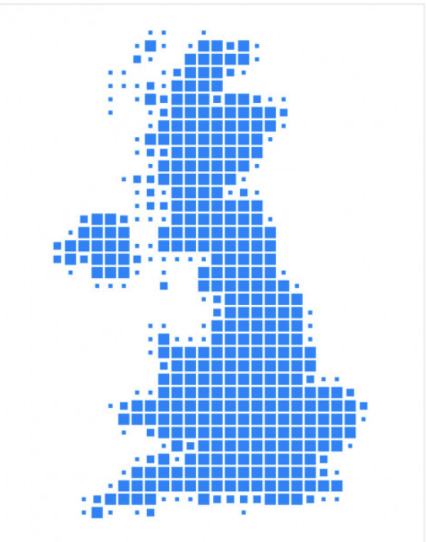
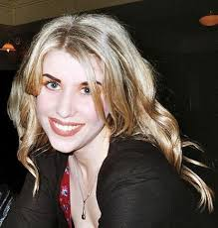
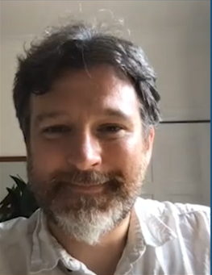



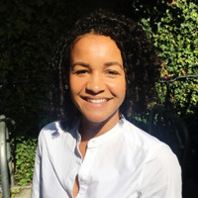
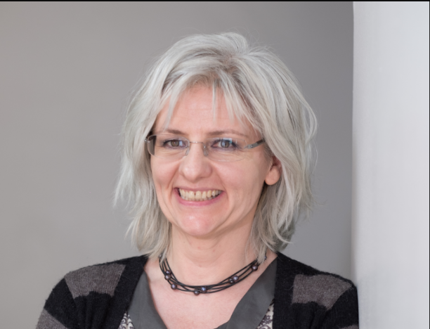
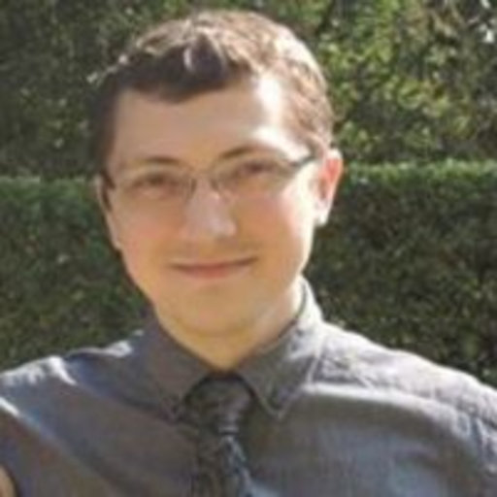
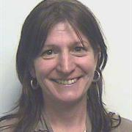
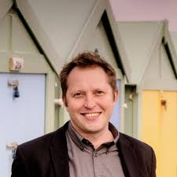
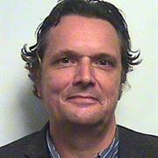
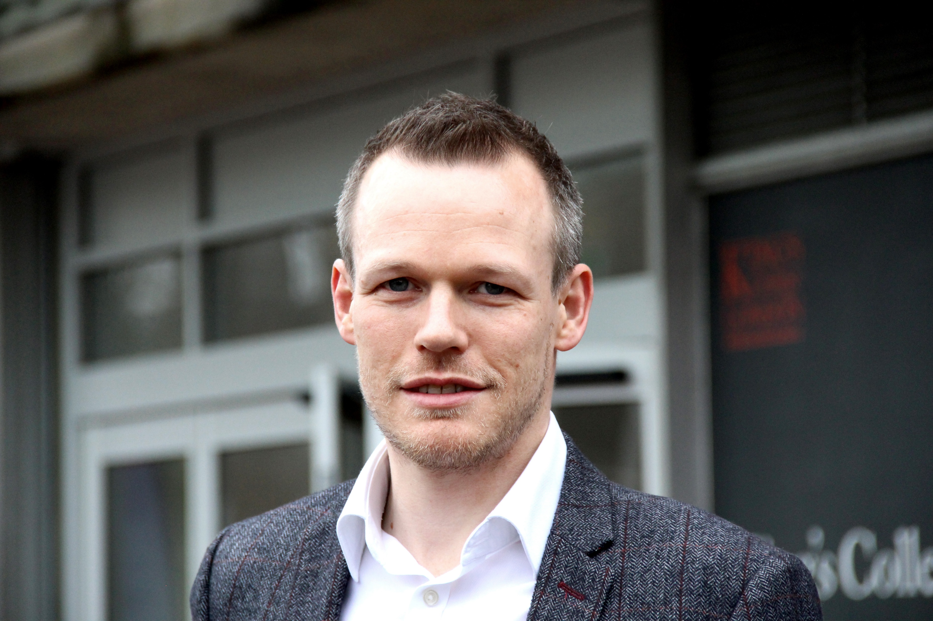
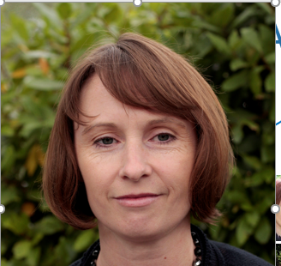

Prof Tony Morrison
Team
Dr Samantha Bowe
Dr Rob Dudley
Prof Doug Turkington
Dr Eleanor Longden
Dr Filippo Varese
Dr Amy Hardy
Dr Nadine Keen
Prof Craig Steel
Dr Sarah Swan
Prof Emmanuelle Peters
Dr Raphael Underwood
Prof Kathy Greenwood
Dr Nick Grey
Prof David Fowler
Prof Richard Emsley
Prof Sarah Byford
Prof Elizabeth Kuipers

Slide 3
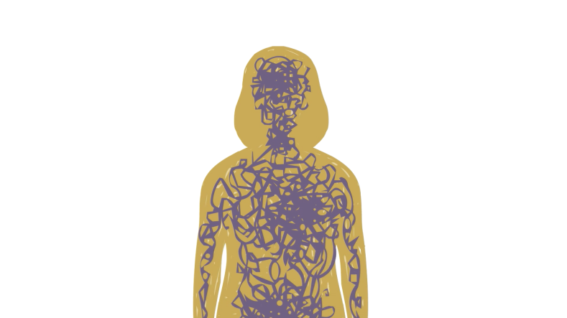
Trauma, PTSD & psychosis
Past (4 – 6x) and current (10x) victimization common in psychosis compared to general population, rates comparable to PD, PTSD and depression (de Vries et al, 2018; Khalifeh et al, 2014; Mattheson et al, 2013).
Psychosis and related experiences can be traumatic and have impact on mental health, intersects with structural adversities (Brewin et al, 2019; Fornells-Ambrojo et al, 2016).
Current and lifetime prevalence of PTSD 12-16% and 14-53%, compared to 3.5% and 7-12% in the general population (Grubaugh et al, 2011; Kessler et al, 2017; Steel et al, 2017; de Bont et al, 2015).
Childhood trauma related to increased psychosis, with a dose-response relationship, and indications of associations between specific types of traumatic events and psychosis symptoms, and phenomenological links (Bailey et al, 2018; Varese et al, 2012).

Slide 4
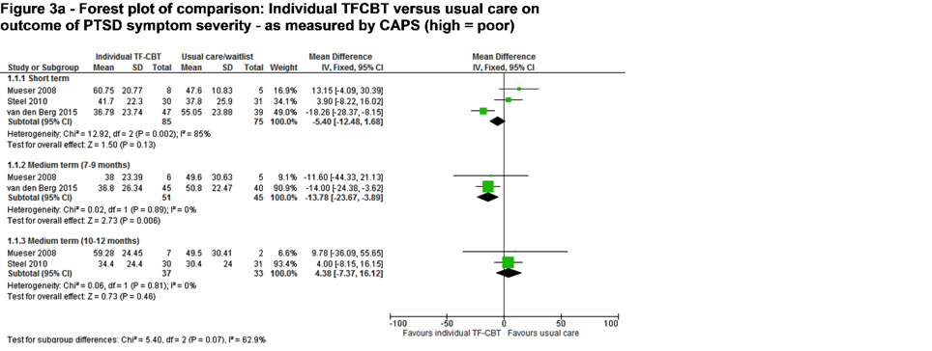
Are trauma-focused therapies safe, acceptable and effective for PTSD in psychosis?
Meta-analysis of RCTs for PTSD in psychosis
(Sin & Spain, 2017; also see Swan, Keen et al, 2017)

Slide 5
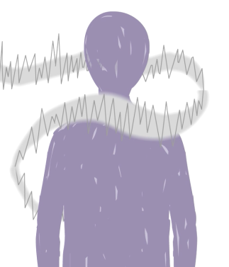
Are trauma-focused therapies effective for psychosis?
Metaanalysis of 12 studies (Brand et al, 2018):
Small effect on delusions at both post-treatment and follow-up, but this only reached significance at follow-up.
Effects on hallucinations and negative symptoms were small and non-significant.
Emerging evidence suggests trauma memory techniques targeting psychosis may have beneficial impact:
Prolonged exposure for memories related to voices (Brand et al, 2020a, 2020b).
Imagery rescripting memories related to voices (Paulnik, Steel & Artnz, 2019, Paulnik et al, 2020).

Slide 6
Therapeutics targets in trauma therapy for psychosis?
See Alameda et al, 2020; Bloomfield et al, 2021; Hardy, 2017; Hardy, van die Giessen & van den Berg, 2020
§
Emotion regulation
Episodic memory
Schematic beliefs
Fear, shame, anger, sadness
Hypervigilance
Rumination
Suppression
Dissociative detachment
Substance use
Interpersonal sensitivity
Dependent relating
Avoidant relating
Social support
Intrusive memories
Flashbacks
Nightmares
Decontextualised intrusions
Negative beliefs about self
Negative beliefs about others
Meta-cognitive beliefs

Slide 7
Trauma-focused CBT for psychosis
(Consistent with NICE, 2014; 2018)
Trauma-focused CBT
for psychosis
Targets memories, anomalous experiences, emotions, emotion regulation,
and beliefs

Slide 8



This study is funded by the National Institute for Health Research (NIHR) Health Technology Assessment (HTA) programme (Reference NIHR128623).
The views expressed are those of the author(s) and not necessarily those of the NIHR or the Department of Health and Social Care.
Trial
PI: Emmanuelle Peters
N = 300 participants with PTSD and distressing psychosis
9 months of trauma-focused CBT for psychosis vs TAU
Assessments at baseline, 4, 9 and 24 month follow-up
Evaluate effectiveness and cost-effectiveness
ESM and fMRI for subgroup of participants at baseline and 9-months
Results expected 2025

Slide 9
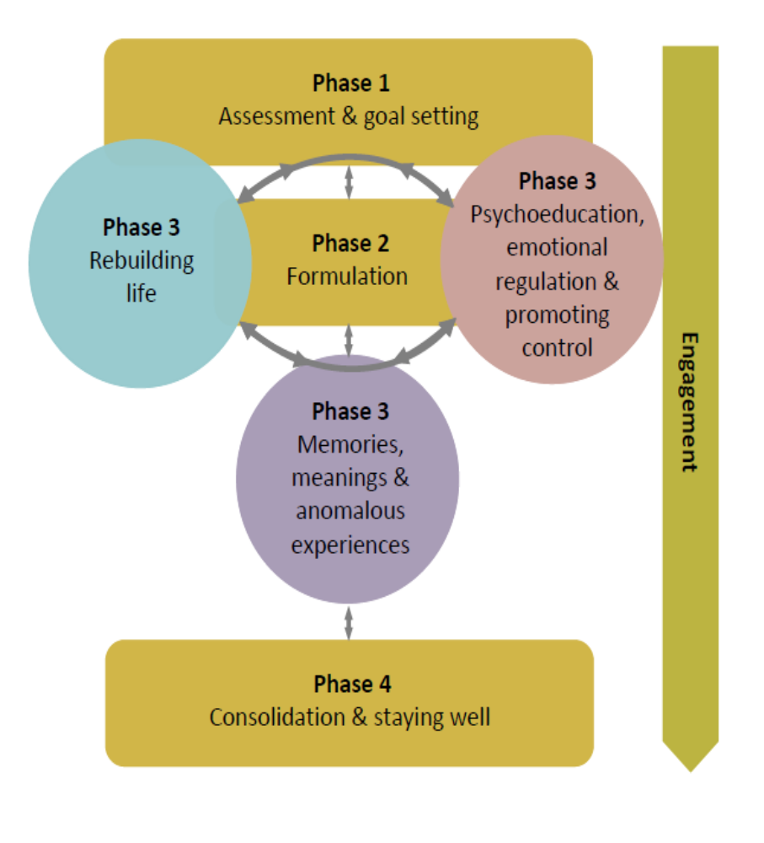
therapy
Integration of tf-CBT & CBTp.
Flexible use of phases, iteratively move between.
Engagement consistent theme (safety and trust).
Focus on rebuilding life throughout and staying well planning as in CBTp.
Therapeutic techniques often useful for both psychosis and PTSD, given overlapping mechanisms.

Slide 10
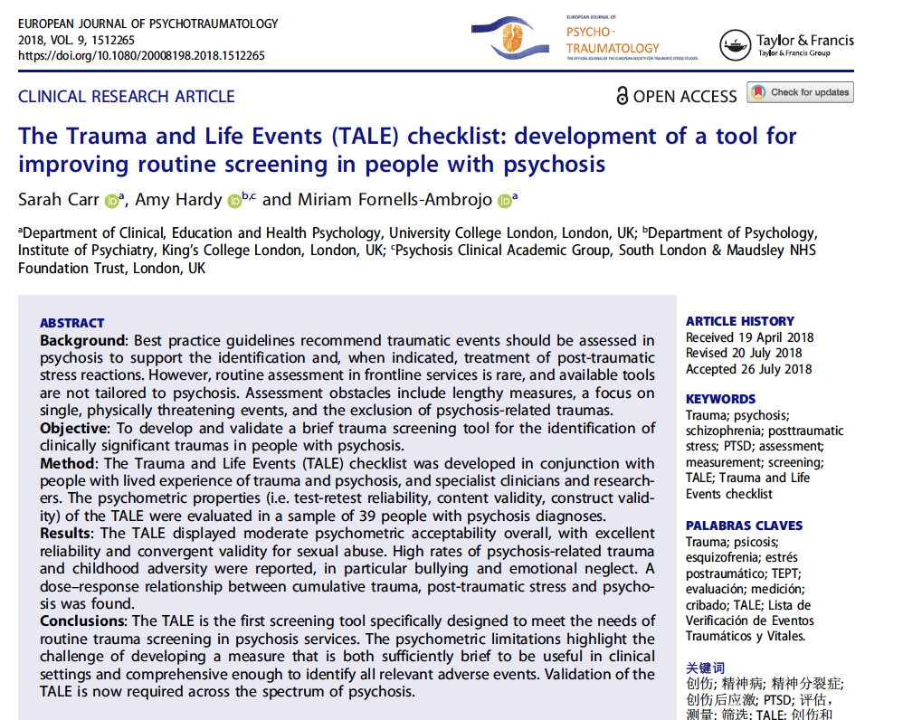
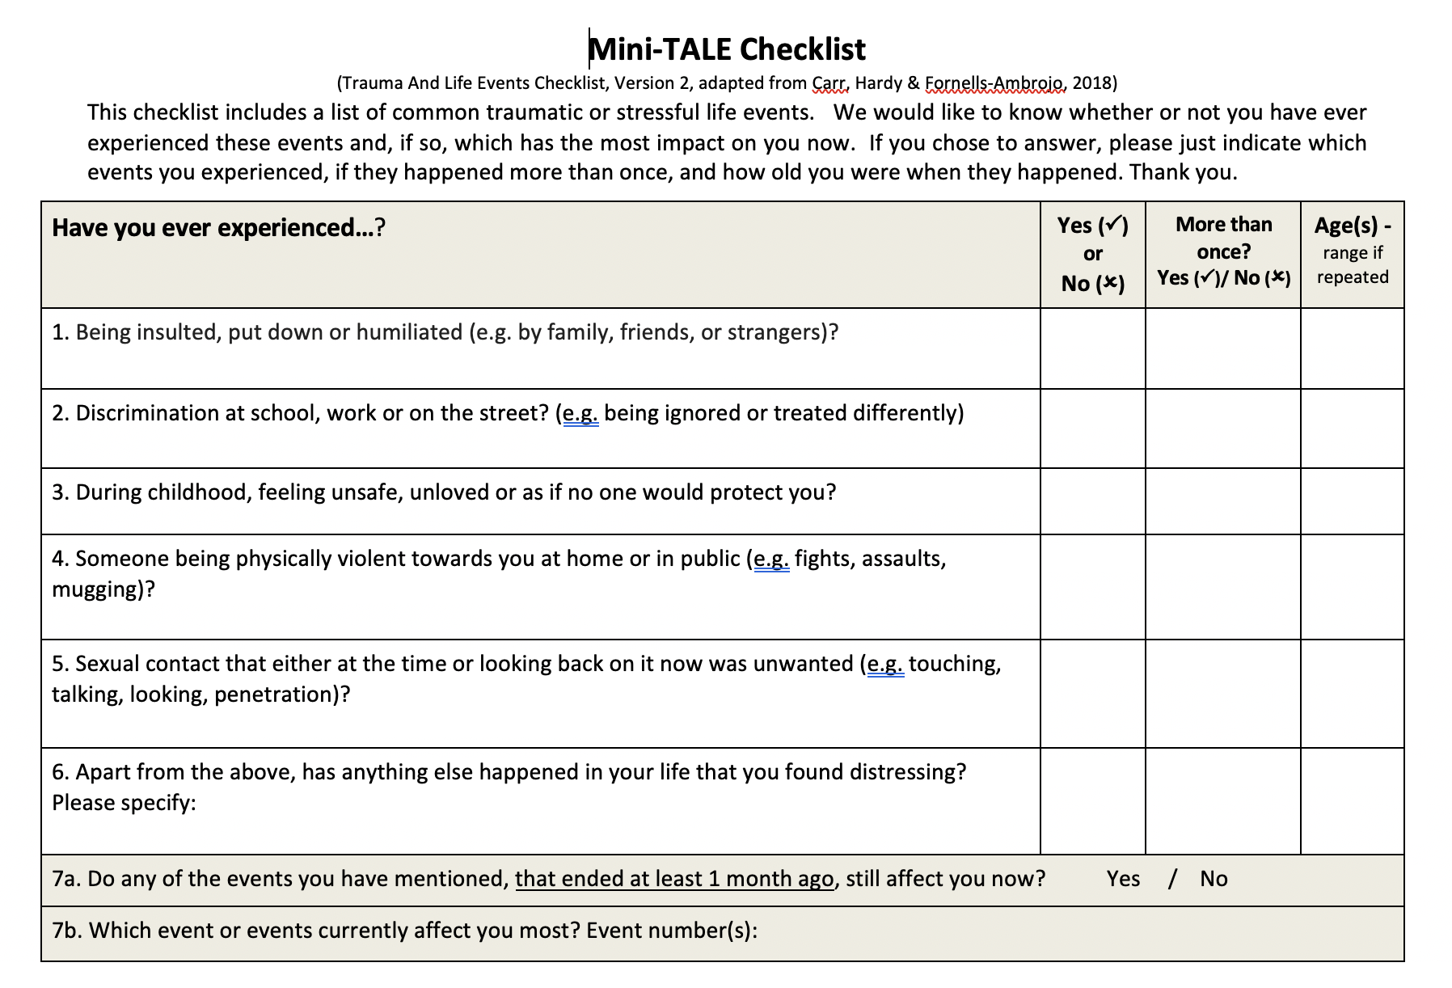
Traumatic event assessment

Slide 11
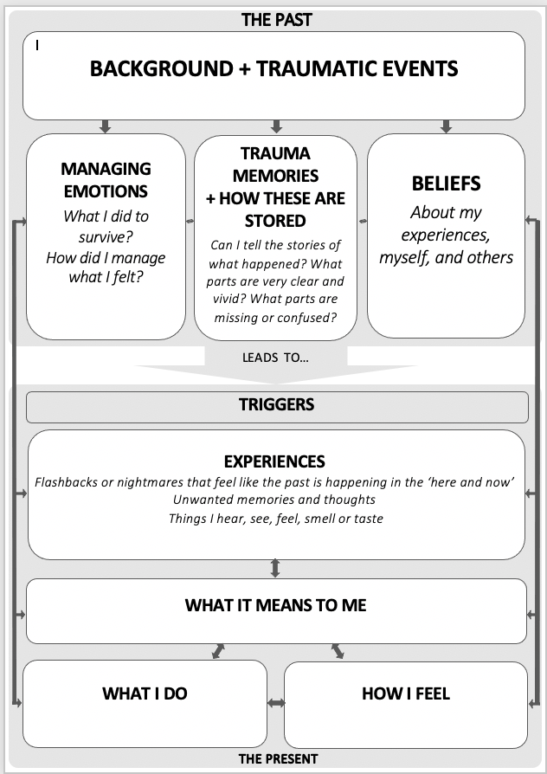
Formulation model:
Post-traumatic stress in psychosis
Hardy, 2017; Hardy, van die Giessen & van den Berg, 2020; Hardy, Keen, Bowe & STAR therapy team, in prep

Slide 12
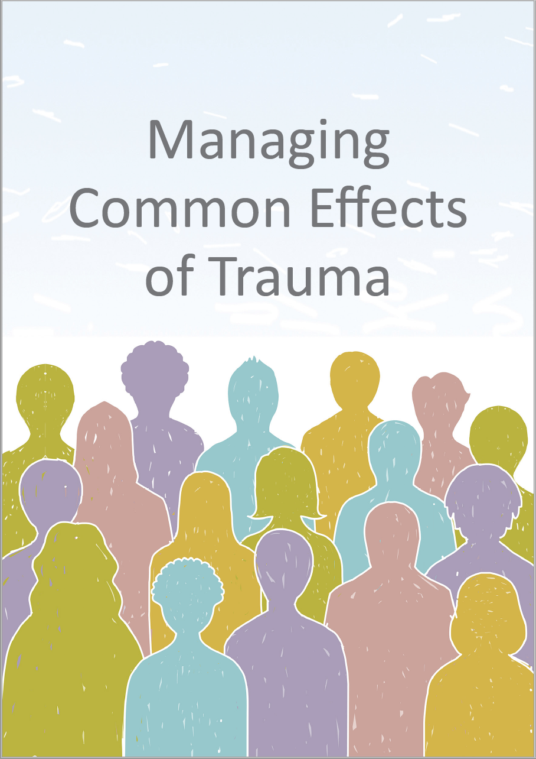
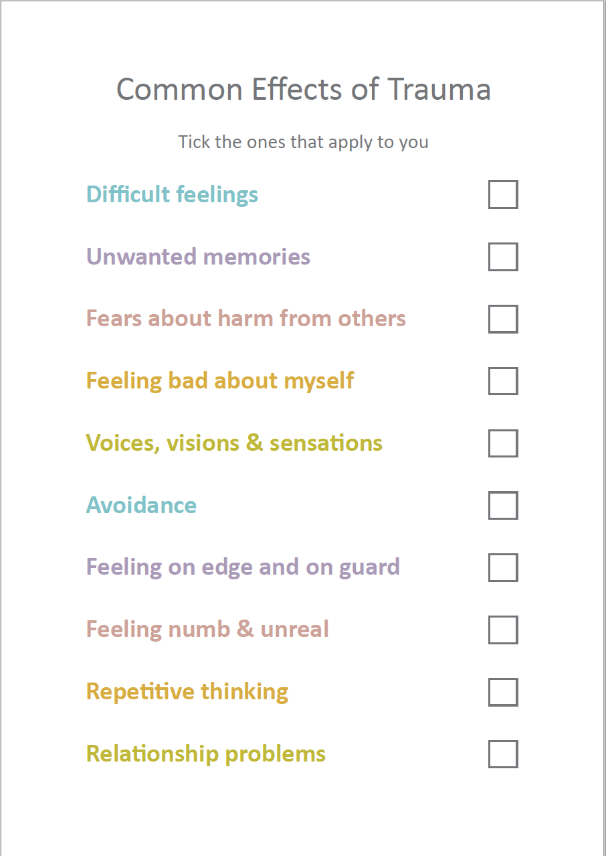
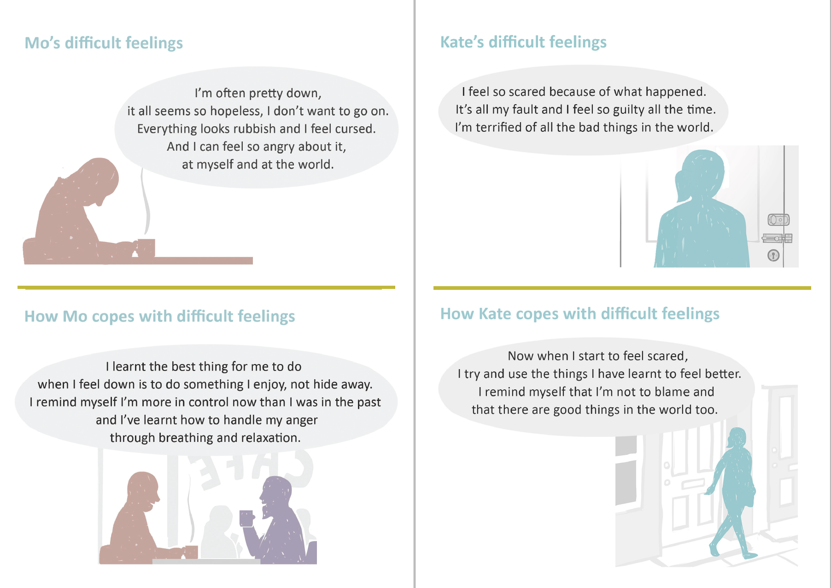
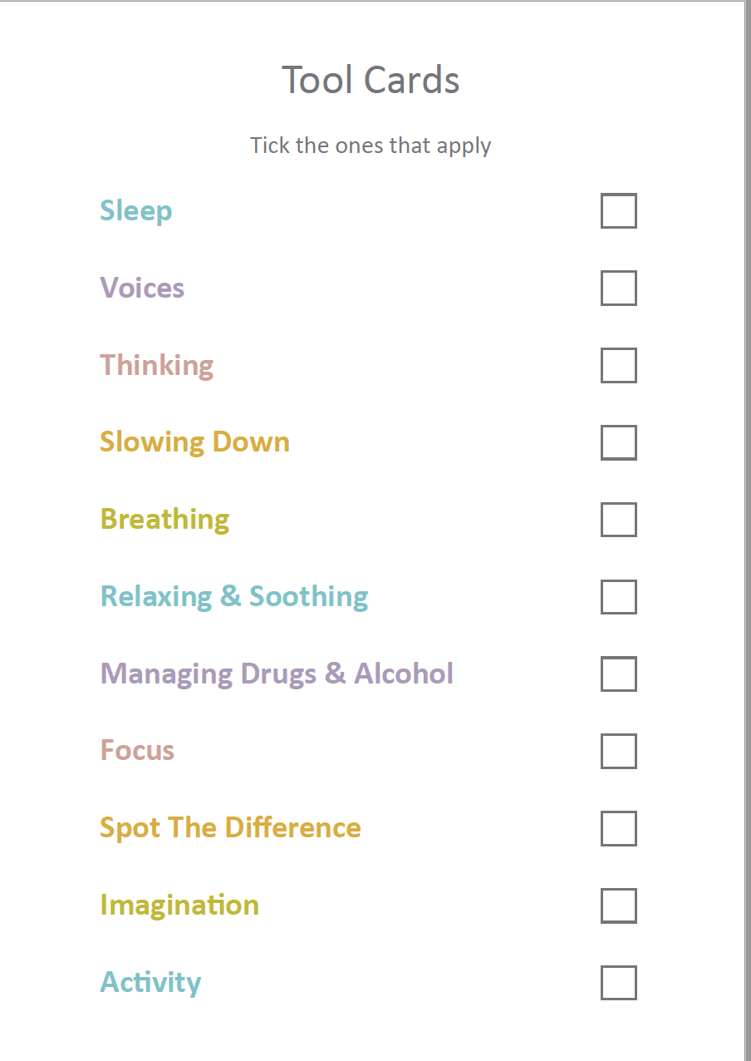
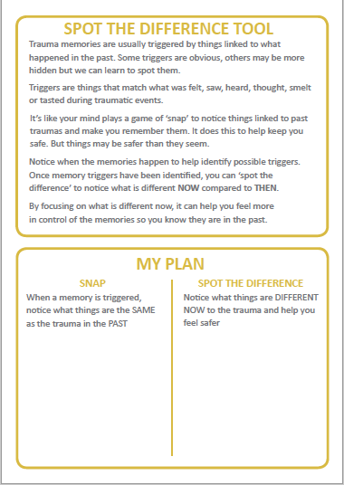
Promoting control: stories and tool cards

Slide 13
therapy
Integration of tf-CBT & CBTp.
Flexible use of phases, iteratively move between.
Engagement consistent theme (safety and trust).
Focus on rebuilding life throughout and staying well planning as in CBTp.
Therapeutic techniques often useful for both psychosis and PTSD, given overlapping mechanisms.

Slide 14

Thank you for listening!

