Slide 1

“I don’t think interventions can be delivered remotely to this client group”….what do I know!

Slide 2

Brief & targeted CBT
LIMITED
RESOURCES
Briefly trained
therapists
Notes:
For those of you who are not familiar with SVC, we seek to address the gap that exists between what’s recommended nationally and locally for patients distressed by hearing voices – and the reality of only 26% of patients being offered CBT.
This gap is partly attributable to limited resources as CBT can be quite long and is typically delivered by highly trained therapists.
Consequently, we have developed brief CBT interventions that can be delivered by briefly trained therapists.

Slide 3

Collaboration: clinical services and R&D!
Sussex
Voices Clinic
Clinicians deliver therapy
Expert training & supervision
Clinic Assistants administrate
Notes:
To deliver these interventions we work in collaboration with clinical services:
They provide the clinicians who we train and supervise in the delivery of the interventions – and jointly-funded Assistants provide all the necessary support.

Slide 4
Where is the Sussex Voices Clinic?
Currently available to patients in:
  Eastbourne ATS
  AAW ATS
  Western ATS
  HWH&L ATS
  Hailsham EIP
  East Sussex CAMHS
Notes:
We currently work with these clinical services to offer interventions across the age-span and across diagnoses

Slide 5



Notes:
Back in March when the Pandemic arrived we, like most services, started meeting with patients by phone and videocall.
I was skeptical about how successful this would be – hence the title of my talk

Slide 6




Monthly Breakdown of Referrals 2020
Notes:
…and we noticed an initial downturn in referrals (which are usually 14-15 per month).
These rates have recently recovered

Slide 7
Number of Referrals from March to November
Notes:
…and a comparison with the same time period from last year suggests that referrals during the pandemic have been similar to 2019.

Slide 8
Percentage of Referrals Who Attended an Initial Meeting
Notes:
Of greater interest has been the levels of engagement.
Yes, clinicians have been referring their patients, but did they engage with assessments offered remotely?
The answer seems to be yes – as attendance at baseline assessments seems to have been higher when compared to the same time period last year when all assessments were face-to-face

Slide 9
Clinic Assistant experience of remote assessments
+ve
-ve
Booking appointments is easier – not room booking
Clients pleased about not having to travel
Assessments can over-run without being ejected from the room
During phone assessments, notes can be read and taken
Technical issues can cause stress for clients (but sorting these issues takes far less time than travelling)
Completing measures can be difficult for clients when the measure is not visible
Notes:
In terms of the experience of our assistants when offering assessments remotely – it’s been mixed.
Remote assessments can be logistically simpler and more flexible…
….but there have been the usual technical problems and some issues with completing measures

Slide 10
Remote Therapy Waiting List/In Progress (75%) vs F2F Waiting List (25%)
Notes:
In terms of willingness of patients to receive the intervention remotely, the majority seem to be willing to work on phone or videocall – but some want to wait for F2F meetings in the new normal

Slide 11
Therapist experience of remote delivery
Positives
Negatives
No missed sessions
Appointments start on time
Easier for clients to open-up
Lots of pausing, summarizing and checking understanding
Feels less personal
Need to be vigilant for subtle changes variations in verbal communication which might be meaningful
Notes:
….and therapist experience has offered some positive experiences….but remote working is not the same!

Slide 12
What about group therapy?
Notes:
Prior to the pandemic we also offered therapy in groups – and have recently compared our learning from our trail of this intervention with the experience in clinical practice
Pre-pandemic, we stopped offering the groups as it was proving difficult to get a group of patients to a mental health centre at the same time. The opportunity to offer a group remotely negated these difficulties, so we piloted a group on Zoom.

Slide 13
…mixed feedback
Positives
Negatives
Good, as don’t do F2F very well – virtual was a blessing
It was a little bit less intimidating…because I don’t need to meet new people in person
It was nice not having to sit next to someone with their annoying habits
It was nice to do the group from the comfort of own home
Zoom was complicated to use
My laptop ran out of battery
Makes it a lot harder to get to know people – not the same as a real-life group
Notes:
The virtual group generated mixed feedback as it seemed to be accessible to patients who may otherwise have struggled to attend.
But again, there were technical issues and a sense of it not being the same.
When asked how they would have preferred the group to have been offered,
Virtual = 2
F2F – 1
Unsure = 2

Slide 14

What to do in the new normal?
Notes:
What does all this mean for our practice in the new normal?
Wherever possible, we will be trying to offer and respect the choices of our patients – do they want to be seen F2F, on videocall or phone?

Slide 15
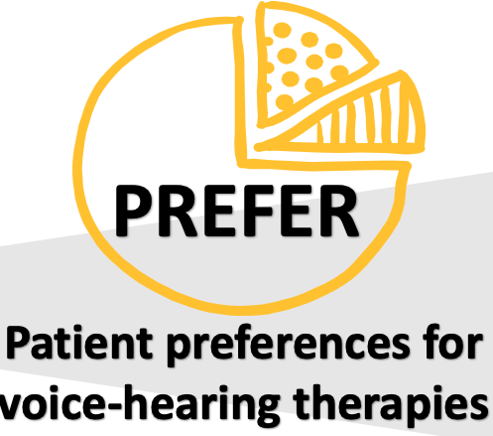
Inclusion criteria
  16 years and over
  Hearing voices for at least six months, irrespective of diagnosis
  Receiving secondary care mental health services from SPFT
For more information and to make a referral – contact Hazel.Frost@sussexpartnership.nhs.uk
Notes:
In this respect, I’d like to draw your attention to a currently recruiting study of patient preferences for how interventions are offered.
We are keen to meet with any adults who hear voices and are currently receiving a service from SPFT. If you would like to know more about the study or wish to make a referral, please contact Hazel.

Slide 16
Thanks to the SVC (core) team
Hazel Frost
Evelin Vogel
Sophie Green
Edward Harvey
Anna-Marie Jones
Edward Harvey
George Needell
Joseph Sherborne
… and to our numerous therapists…who are too many to mention
Notes:
I’d like to conclude by thanking all the colleagues who help SVC to make a difference each day

