Slide 1


Principal Investigator (PI): Emmanuelle Peters
Local PI: Kathy Greenwood
Therapist: Chris Scane
Therapy Supervisor: Cat Sacadura
Research worker: Molly Heeger

Slide 2

Interpersonal victimization is 4-6 times higher in people with psychosis (de Vries et al, 2019)
Notes:
Bertine de Vries, Jooske T van Busschbach, Elisabeth C D van der Stouwe, André Aleman, Jan J M van Dijk, Paul H Lysaker, Johan Arends, Saskia A Nijman, Gerdina H M Pijnenborg (2019) Prevalence Rate and Risk Factors of Victimization in Adult Patients With a Psychotic Disorder: A Systematic Review and Meta-analysis, Schizophrenia Bulletin, Volume 45, Issue 1, January 2019, Pages 114–126,

Slide 3
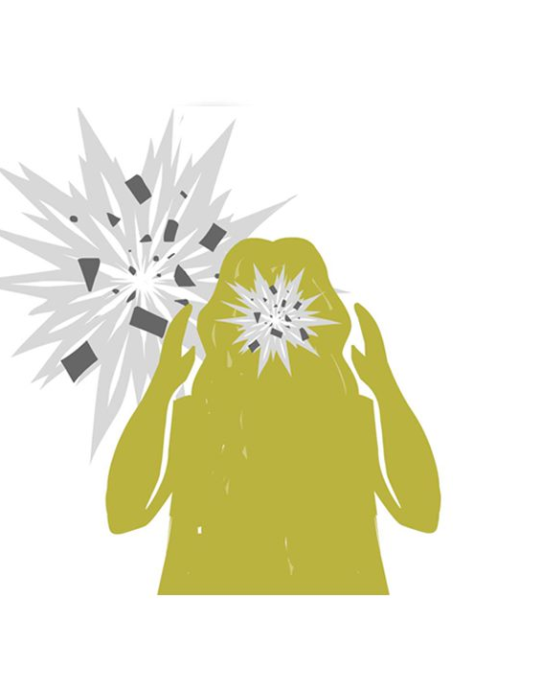
15% of the psychosis population have Post-Traumatic Stress Disorder (PTSD)
(de Bont et al, 2015)
However, in clinical practice PTSD is often not identified in people with psychosis
Notes:
de Bont PA, van den Berg DP, van der Vleugel BM, de Roos C, de Jongh A, van der Gaag M, et al. Predictive validity of the Trauma Screening Questionnaire in detecting post-traumatic stress disorder in patients with psychotic disorders. Br J Psychiatry. 2015;206(5):408-16.

Slide 4

What do we want to find out in the STAR trial?
Primary research question:
Does trauma-focused CBTp reduce PTSD symptoms in participants with distressing psychosis and PTSD symptoms, at the end of therapy?
Secondary research question:
Does trauma-focused CBTp reduce psychosis symptoms, distress and functioning problems?
Do the effects last?
Is it cost effective?
Is it acceptable to participants and to therapists?

Slide 5

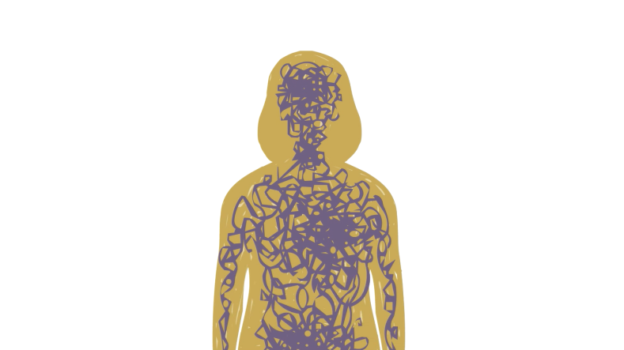
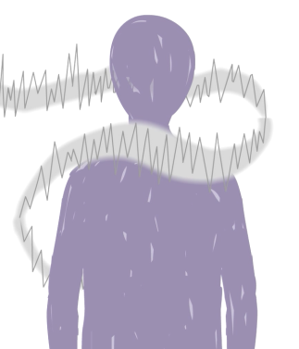

Who is the STAR trial for?
The STAR trial is for adults in secondary/tertiary care:
Who have been through a stressful or traumatic event(s) that still affects them now
And
Experience distressing psychotic symptoms, such as voices and/or delusions

Slide 6
What will we do in the STAR Trial?
We will evaluate the effectiveness of an integrated trauma-focused CBT for psychosis (TF-CBTp) in largest RCT to date
Our published case-studies (Keen, Hunter & Peters, 17; Ward-Brown, Varese et al, 18; Varese et al, 20, Paulik, Steel & Arntz, 19; Brand, Hardy et al, 20) & 3 systematic reviews (Sin et al, 17 (Cochrane); Swan, Keen et al, 17; Brand et al, 18) show this therapy is acceptable and feasible for clients with psychosis
Trauma-focused work already happening in routine psychosis services
STAR is taking place in 5 sites across England: London, Manchester, Oxford, Newcastle and Sussex
Notes:
References:
(1) Keen N, Hunter ECM, Peters E. Integrated Trauma-Focused Cognitive-Behavioural Therapy for Post-traumatic Stress and Psychotic Symptoms: A Case-Series Study Using Imaginal Reprocessing Strategies. Front Psychiatry. 2017;8:92.
(2) Ward-Brown J, Keane D, Bhutani G, Malkin D, Sellwood B, Varese F. TF-CBT and EMDR for young people with trauma and first episode psychosis (using a phasic treatment approach): two early intervention service case studies. Cogn Beh Ther. 2018;11.
(3) Varese F., D. M., Dudley R., Bowe S., Christodoulides T., Common S., Grace T., Lumley V., McCartney L., Pace S., Reeves R., Morrison A.P., Turkington D. (In press). Targeting dissociation using cognitive behavioural therapy in voice-hearers with psychosis and a history of interpersonal trauma: A case series. Psychology and Psychotherapy: Theory, Research and Practice.
(4) Georgie Paulik, Craig Steel and Arnoud Arntz (2019) Imagery rescripting for the treatment of trauma in voice hearers: a case series. Behavioural and Cognitive Psychotherapy, 1–17
(5) Rachel M. Brand, Sarah Bendall, Amy Hardy, Susan L. Rossell and Neil Thomas (2020) Trauma-focused imaginal exposure for auditory hallucinations: A case series. Psychology and Psychotherapy: Theory, Research and Practice. DOI:10.1111/papt.12284
(6) Sin J, Spain D, Furuta M, Murrells T, Norman I. Psychological interventions for post-traumatic stress disorder (PTSD) in people with severe mental illness. Cochrane Database Syst Rev. 2017;1:CD011464.
(7) Swan S, Keen N, Reynolds N, Onwumere J. Psychological Interventions for Post-traumatic Stress Symptoms in Psychosis: A Systematic Review of Outcomes. Frontiers in Psychology. 2017;8.
(8) Brand RM, McEnery C, Rossell S, Bendall S, Thomas N. Do trauma-focussed psychological interventions have an effect on psychotic symptoms? A systematic review and meta-analysis. Schizophr Res. 2018.

Slide 7
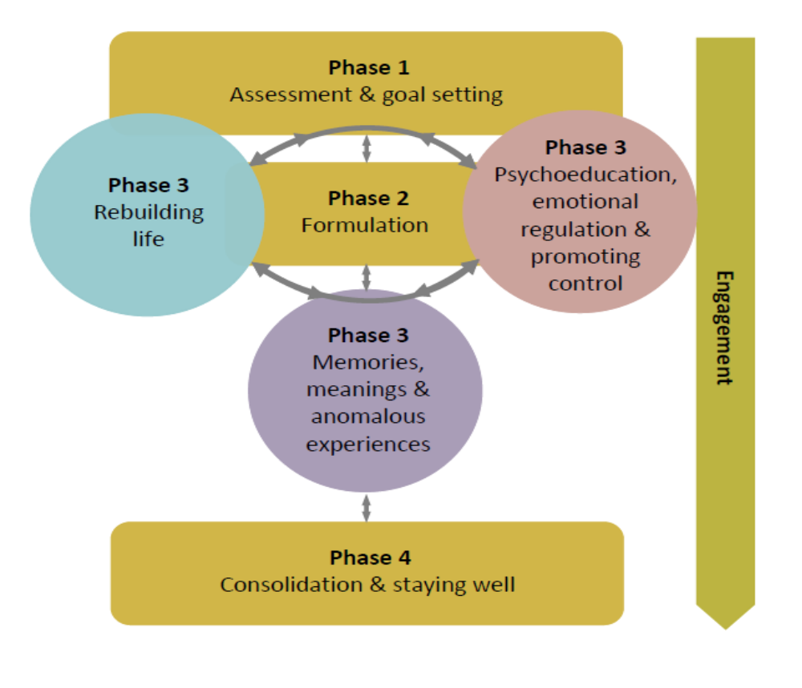
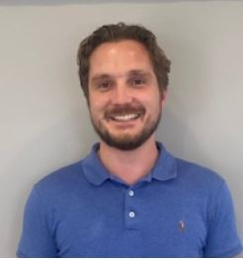
Overview of TF-CBTp (9m duration)
STAR trial therapy
Dr Chris Scane
(Sussex therapist)
Notes:
TF-CBTp is an individualised, formulation-based therapy that will last 9m, with up to 3 joint sessions with care-coordinator and/or carer, as appropriate, in the last 3m.

Slide 8
Integrating standard therapy for PTSD and psychosis
Aim to adhere to model-based interventions for PTSD
Psychosis interventions embedded throughout
Often possible to target psychosis with interventions for PTSD (meanings and behaviours to be addressed are often common across both)

Slide 9
Four broad phases
Pragmatic and flexible
Formulation-based and individualised
Generally there will be much interweaving of the phases within and across sessions.

Slide 10
Engagement is key throughout the therapy
All work needs to be done in the context of a good therapeutic relationship
Importance of trust & safety

Slide 11
Is TF-CBTp safe to do remotely?
YES!
10+ year evidence of safety, acceptability & efficacy of PTSD therapies being delivered remotely (see Wells et al, 20, for review)
Lots of guidance available (Wild, Grey et al, 20; https://oxcadatresources.com/covid-19-resources/)
We have carried out practice cases successfully on all sites
We will adhere to participant choice between face-to-face, video or phone delivery of sessions (whenever possible within local guidelines)
Notes:
Wells, S.Y., Morland, L.A., Wilhite, E.R., Grubbs, K.M., Rauch, S.A.M., Acierno, R. & McLean, C.P. (2020) Delivering prolonged exposure therapy via videoconferencing during the COVID-19 pandemic; An overview of the research and special considerations for providers. Journal of Traumatic Stress, 1-11. DOI: 10.1002/jts.22573
Wild, J., Warnock-Parkes, E., Murray,H., Kerr, A., Thew, G., Grey,N., Clark, D.M. & Ehlers, A. (2020). Treating posttraumatic Stress Disorder Remotely with Cognitive Therapy for PTSD. European Journal of Psychotraumatology, 11:1, 1785818 doi: 10.1080/20008198.2020.1785818

Slide 12
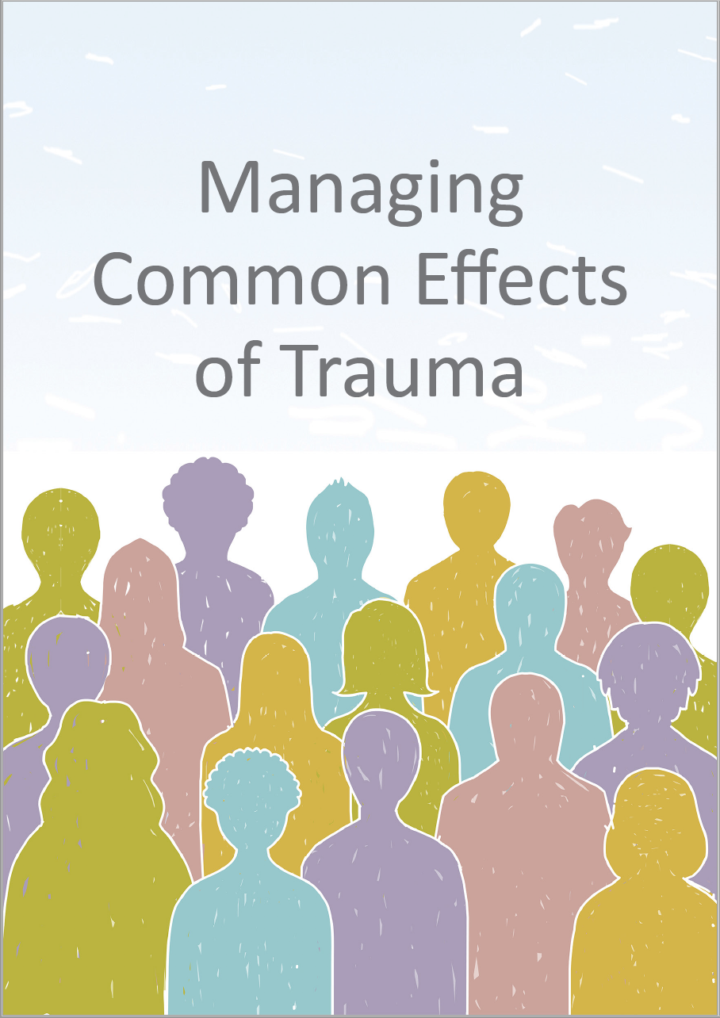
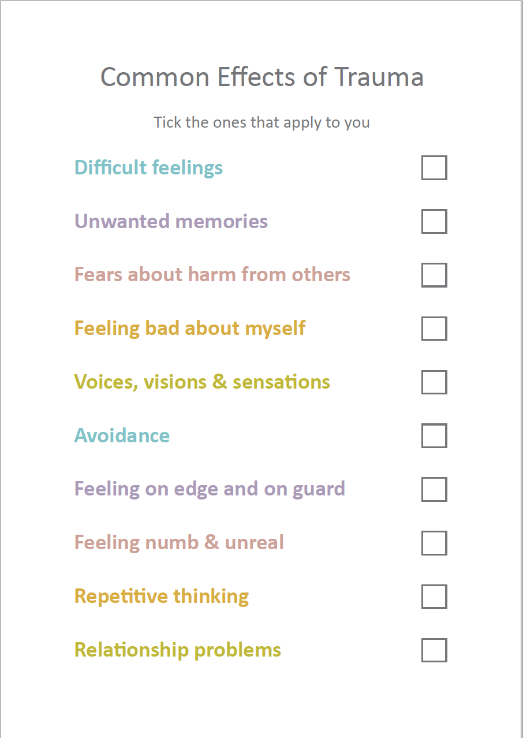
Notes:
Therapy will include psychoeducation and promoting control materials developed by the STAR team, which can be provided in leaflet or powerpoint format, to make it accessible for our population

Slide 13
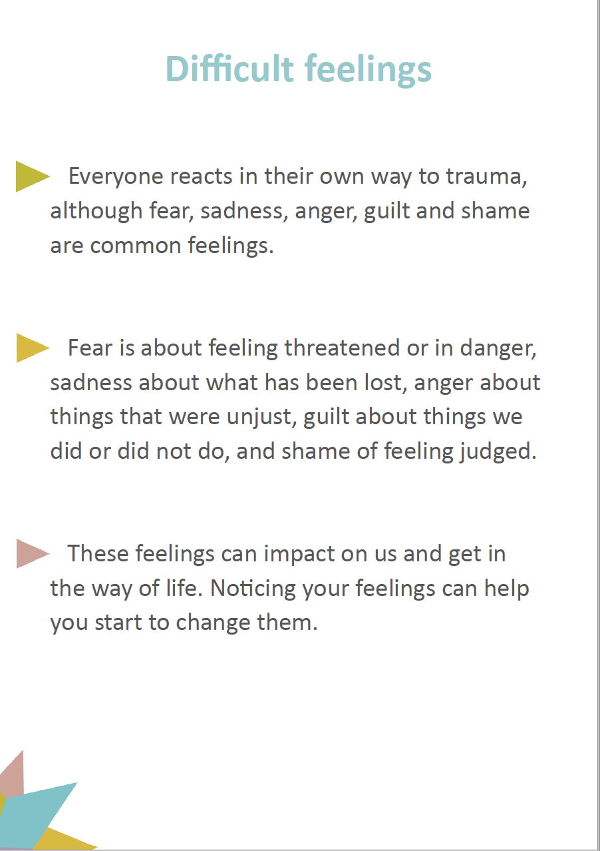
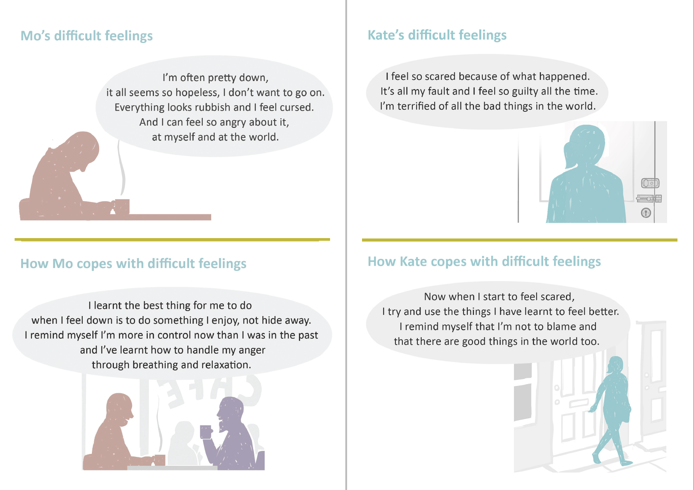
Notes:
This slide and next: Eg of materials – there will also be audio vignettes available of the characters talking about their experiences and how they have coped

Slide 14
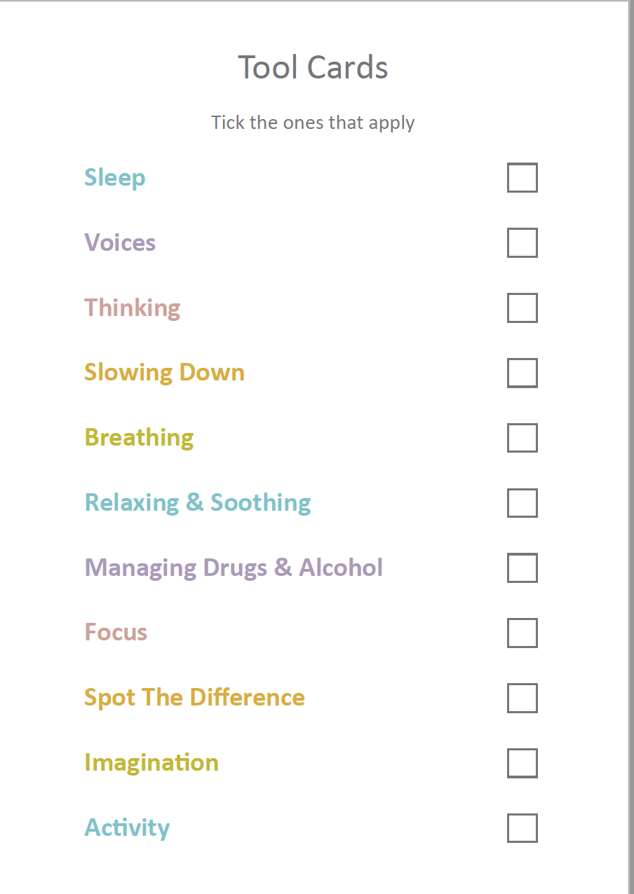

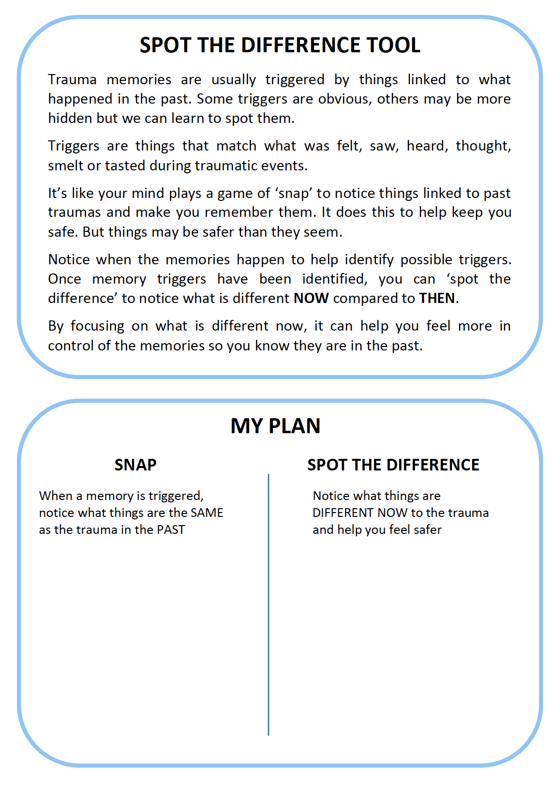

Slide 15



Participant's Journey Through the STAR
Trial
Baseline Ax
Follow up 1
(4m)
Follow up 2
(9m)
Final follow up
(24m)
(12m) (15m) (18m) (21m)
Participants will receive £20 reimbursement for their time at each follow-up plus travel expenses*
*This does not include the ‘keeping in touch’ telephone calls
Notes:
Participants will be in the study for 2 years. Assessments with RAs will take place prior to randomisation, 4m (around ½ way through therapy for those in the therapy group), 9m (end of therapy) and 24m (15m after start of therapy) from the start of the trial. There will be phone calls every 3m between the end of therapy and final follow-up, to keep in touch and ask about use of services.

Slide 16
Implications for clinical practice
The proposed therapy, if acceptable, will provide a new, integrated psychological therapy for people with complex mental health problems whose needs are often not met by mental health services
The proposed intervention has the potential to:
  Provide significant patient benefit in terms of reducing distressing symptoms of post-traumatic stress, psychosis and emotional problems
  Enable clinicians to implement trauma-focused therapy confidently in this population
  Be cost-effective to service providers through reduced service use

Slide 17

Thanks for listening!

