Slide 1
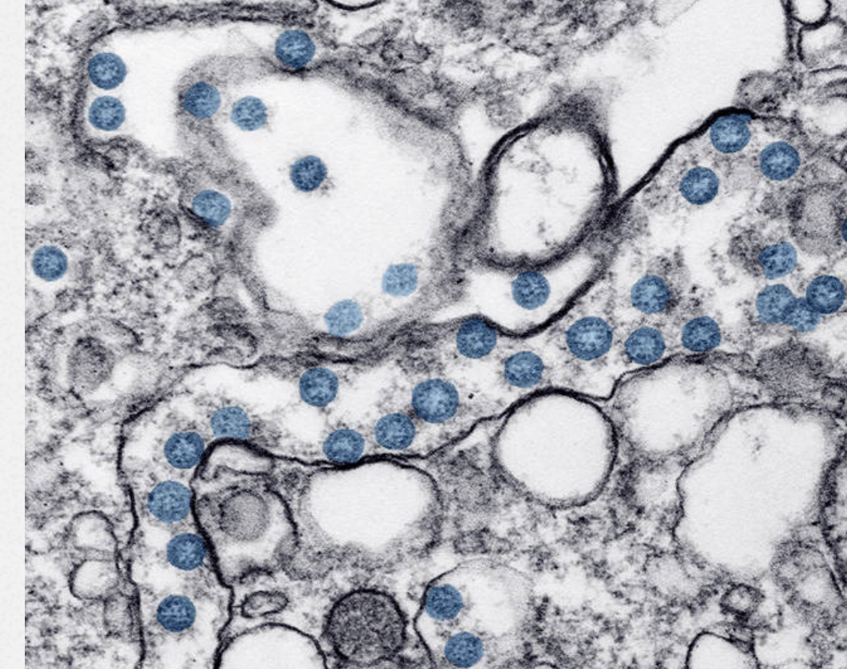
Psychosis Studies
2020
Dr Richard Whale
Sussex Partnership NHS Foundation Trust
Brighton and Sussex Medical School

Slide 2
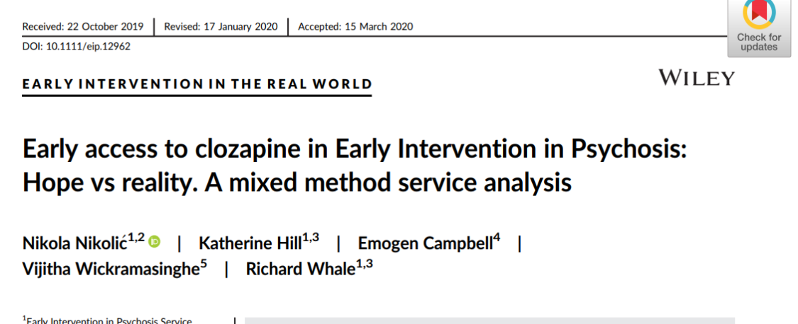
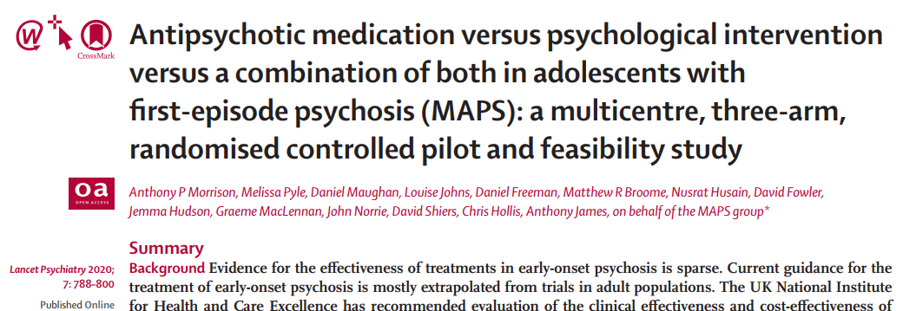
S1P cohort study Olutayo Ajayi, Marissa Wilson, Michael Harris, Marco Pereira, Jessica Buckle, Emily Forshall, Titus Murphy, Aries Connoly, William Hayhurst, Nick Palfrey, Sophie Aurora, Andrew Thompson Gail Kavanagh Rick Fraser
Negative symptom assessment in FEP. Jessica Austin
Other EIP service outcomes. ARMS. >35 Service. Clozapine use. EIP service. Nik Nikolic.
Effectiveness of new antipsychotics. Paliperidone LAI. Sharon Cuthbert.
Aripiprazole LAI Romasia Aftab
Lurasidone orally Sunovion
Clinical outcome of market withdrawal of typical antipsychotic Rollo Sheldon. Tim Sales. Jed Hewitt. Ray Lyon
Qualitative experiences of taking antipsychotic medication Nana Tomova
Inflammatory models of psychiatric disorder aetiology Renata Fialho
Systematic reviews:
Efficacy of interventions in ‘At Risk Mental State’ re-review? Mihaela Bucur. Andy Thompson.
Ketamine clinical effects Fraser MacNicholl
Effectiveness of antipsychotics in FEP Alice Brooke. Mihaela Bucur
[MAPS Manchester group]

Slide 3
S1P cohort study
Question$ the S1P study is attempting to address
Which antipsychotic works best in FEP
Who can stop medication without problems
Who will fully recover and be off medication by 3yrs
Who will have treatment resistance and need clozapine
Who is most likely to have a new forensic event

Slide 4
S1P: 3 year naturalistic outcome cohort study
All patients in service included with information governance approval for specific data use
All FEP in EIP Sussex
Feb 2009 to Feb 2012
N=354
Treatment
resistance
Antipsychotic
Effectiveness
Antipsychotic
Discontinuation
Outcome
NEET impact on
outcome
Forensic
Outcome
‘Remission’
Outcome

Slide 5
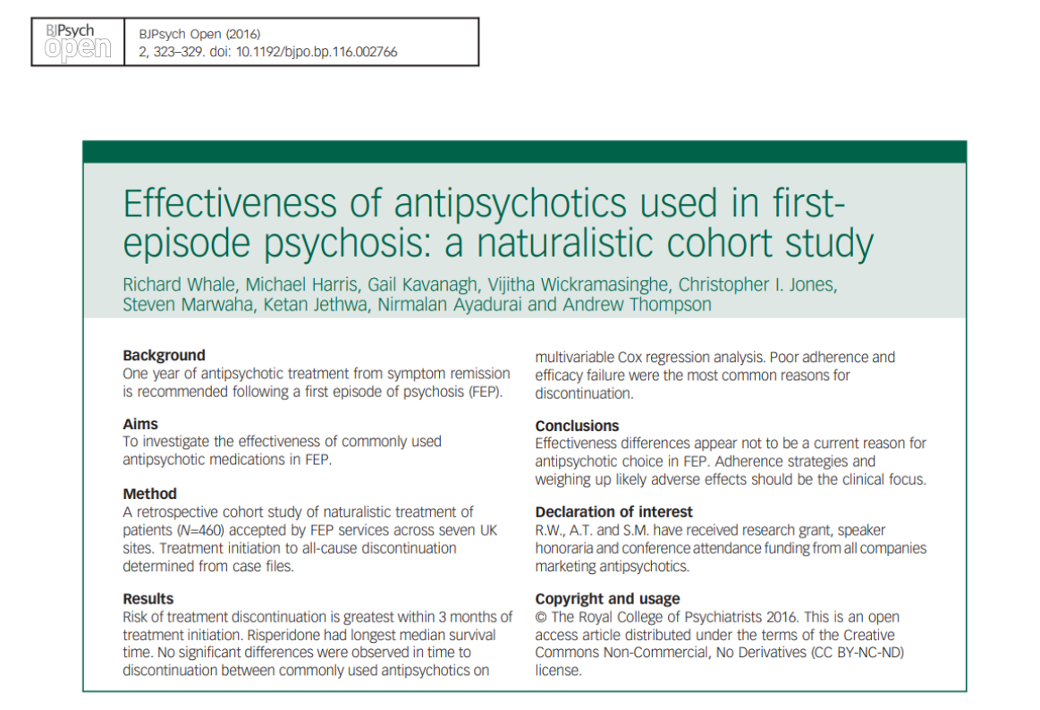

Slide 6
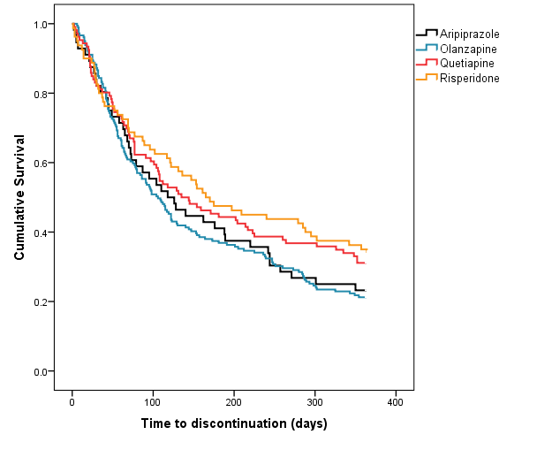
Which antipsychotic is most effective for FEP?
There is no significant difference in
‘all cause time to discontinuation’
= effectiveness between medications so the option with least adverse effects should be chosen collaboratively with the recipient

Slide 7
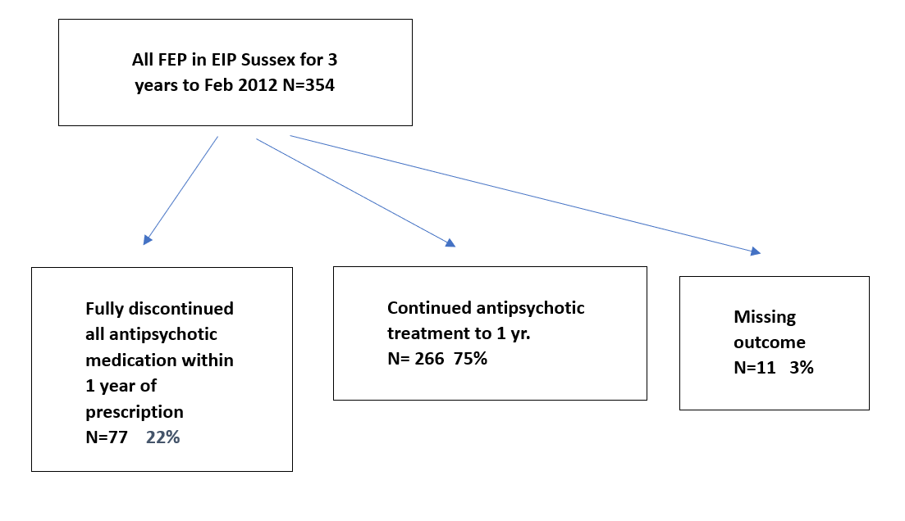
Who is most likely to discontinue medication
in the first year after an FEP?
59 cases (77%) discontinued independently,
without clinical guidance.
Olutayo Ajayi, Marissa Wilson Michael Harris Marco Pereira Jessica Buckle, Emily Forshall, Titus Murphy, Aries Connoly, William Hayhurst, Sophie Aurora, Andrew Thompson Gail Kavanagh Rick Fraser
LOGISTIC REGRESSION of baseline variables associated with full discontinuation
before 1 year (analysis sample n=343)
Variables | Univariate Analysis
 | Odds ratio [95% CI] | p
Inpatient at baseline (no vs. yes) | 0.86 [0.51-1.44] | .561
Age (years) | 0.98 [0.94-1.03] | .487
Gender (female vs. male) | 1.24 [0.72-2.15] | .441
DUP weeks | 1.00 [1.00-1.00] | .365
NEET (no vs. yes) | 0.76 [0.45-1.26] | .282
Substance abuse at baseline (no vs. yes) | 0.94 [0.57-1.56] | .804
First AP exposed to (ari vs others) |  | .044
1 vs. 2 | 0.36 [0.18-0.76] | .007
1 vs. 3 | 0.41 [0.18-0.92] | .030
1 vs. 4 | 0.37 [0.15-0.90] | .028
*

Slide 8
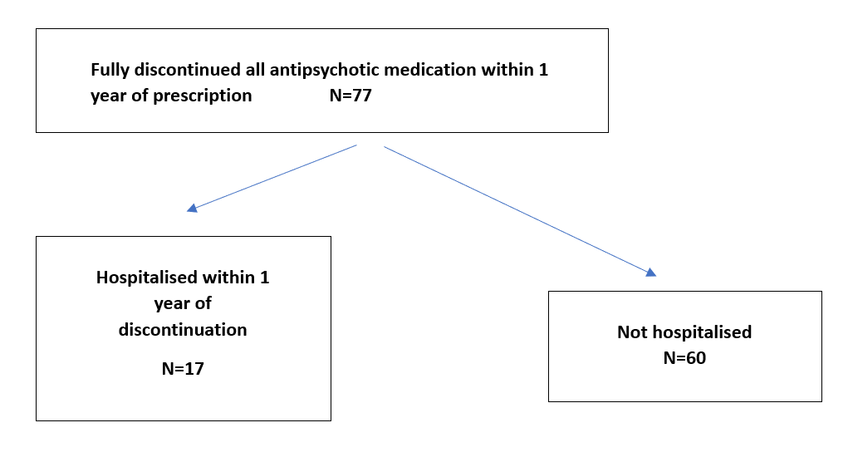
Who is most likely to be admitted after discontinuing medication?
Time to full discontinuation from initiation was mean 101.9 days
Time to admission from discontinuation was mean 118.4 days
50 of 73 patients (65%; 4 missing values) restarted antipsychotic medication within a year from full discontinuation
LOGISTIC REGRESSION – Outcome: Adm after discont < 1yr
Variables | Univariate Analysis
 | Odds ratio [95% CI] | p
Inpatient at baseline (no vs. yes) | 5.79 [1.78-18.96] | .004
Age (years) | 1.04 [0.93-1.16] | .487
Gender (female vs. male) | 1.00 [0.30-3.26] | .994
DUP weeks | 0.99 [0.96-1.02] | .394
NEET (no vs. yes) | 2.79 [0.91-8.60] | .074
Substance abuse at baseline (no vs. yes) | 1.53 [0.51-4.57] | .446
AP pre EI (no vs. yes) | 2.57 [0.80-8.23] | .112
First AP exposed to |  | .081
1 vs. 2 | 9.17 [1.06-79.39] | .044
1 vs. 3 | 3.21 [0.30-34.64] | .336
1 vs. 4 | 1.50 [0.08-26.86] | .783
Clin mx discont (no vs. yes) | 0.18 [0.02-1.47] | .109
Time to discontinuation | 1.00 ]1.00-1.01] | .686
Subst use at discont EF (no vs. yes) | 2.44 [0.77-7.77] | .130
Non engagement 1mo discount (no vs. yes) | 0.80 [0.15-4.18] | .792
FH psychosis 1st or 2nd deg (no vs. yes) | 0.24 [0.05-1.19] | .081
Neg sx baseline (no vs. yes) | 0.52 [0.06-4.66] | .559
MHA during init adm (no vs. yes) | 68.00 [6.67-68383] | < .001
*
**

Slide 9
Who is most likely to stay in symptom remission after medication
discontinuation?
24/72 (33%) who fully discontinued reported
no recurrence of psychosis symptoms
within the next year
LOGISTIC REGRESSION
Outcome: Psychosis free1yr from discont (N = 72)
Variables | Univariate Analysis
 | Odds ratio [95% CI] | p
Inpatient at baseline (no vs. yes) | 1.00 [0.36-2.35] | 1.000
Age (years) | 0.98 [0.88-1.09] | .700
Gender (female vs. male) | 0.91 [0.32-2.59] | .858
DUP weeks | 1.01 [0.99-1.02] | .310
NEET (no vs. yes) | 0.50 [0.18-1.39] | .183
Substance abuse at baseline (no vs. yes) | 0.51 [0.19-1.39] | .185
AP pre EI (no vs. yes) | 1.40 [0.52-3.77] | .505
First AP exposed to |  | .483
1 vs. 2 | 0.37 [0.10-1.41] | .143
1 vs. 3 | 0.70 [0.17-2.85] | .620
1 vs. 4 | 0.86 [0.17-4.27] | .851
Clin mx discont (no vs. yes) | 3.51 [1.11-11.11] | .032
Time discont excl continuers | 1.01 ]1.00-1.01] | .065
Subst use at discont EF (no vs. yes) | 0.39 [0.11-1.33] | .131
Non engagement 1mo discount (no vs. yes) | 1.81 [0.44-7.50] | .413
FH psychosis 1st or 2nd deg (no vs. yes) | 1.21 [0.38-3.88] | .743
Neg sx baseline (no vs. yes) | 1.61 [0.33-7.89] | .555
Restarted meds1yr from discont (no vs. yes) | 0.04 [0.01-0.15] | < .001
MHA during init adm (no vs. yes) | 0.58 [0.13-2.58] | .472
*
*
*

Slide 10
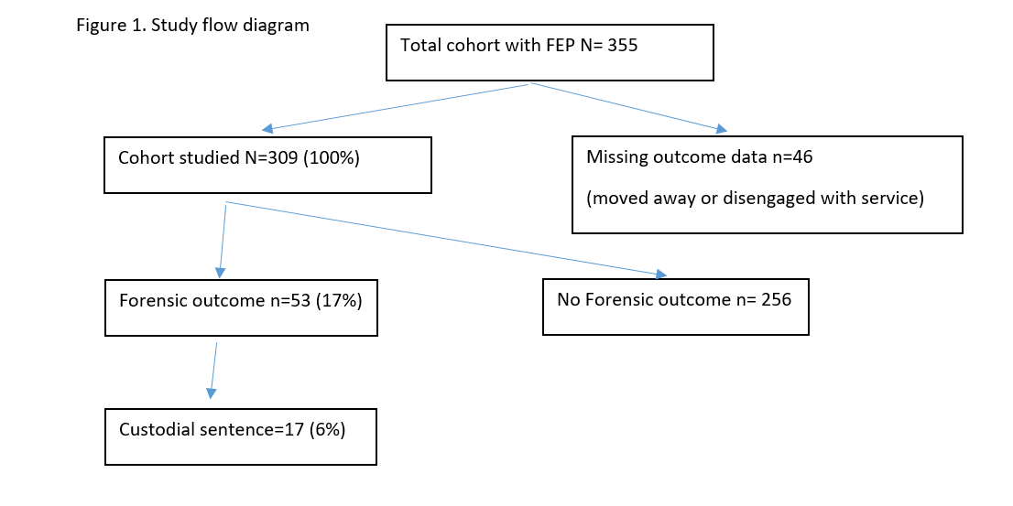
Forensic outcomes by 3 years
Primary offence charged by court
Time to first offence from FEP mean 38 weeks (range 0 - 154 weeks)

Slide 11
LOGISTIC REGRESSION –
Any forensic event within 3 years from first episode psychosis
Imprisoned within 3 years from FEP
Variables | Univariate Analysis |  |  | Multivariate Analysis
 | Odds ratio [95% CI] | p |  | Odds ratio [95% CI] | p
Inp at baseline | 0.71[0.34-1.45] | .346
Age (years) | 0.92 [0.86-0.99] | .028 |  | 0.93 [0.86-1.01] | .088
Gender (female vs. male) | 12.27 [2.90-51.96] | .001 |  | 9.12 [2.12-39.25] | .003
DUP weeks | 1.00 [1.00-1.01] | .284
Full disc < 1 years (no vs. yes) | 0.95 [0.41-2.19] | .909
Substance abuse at baseline (no vs. yes) | 4.28 [1.90-9.64] | < .001 |  | 2.95 [1.28-6.81] | .011
Multivariate model included the variables associated with discontinuation of next medication within the following year at p <.05
Variables | Univariate Analysis
 | Odds ratio [95% CI] | p
Inpt at baseline | 0.71 [0.24-2.06] | .522
Age (years) | 0.95 [0.86-1.05] | .291
Gender (female vs. male) | all male | -
DUP weeks | 1.00 [1.00-1.01] | .772
Full AP discontinuation < 1 years (no vs. yes) | 0.79 [0.22-2.82] | .712
Substance abuse at baseline (no vs. yes) | 7.40 [1.66-32.93] | .009
*
*
*
*

Slide 12
How robustly categorise clinical outcomes at 3 years in this study?
Are ICD10/DSMV diagnoses useful in FEP?
Symptom free and off medication
Persistent or relapsing remitting illness
Schizophrenia with 3 clear psychotic relapses
Bipolar disorder with 3 clear psychotic relapses
3. Resolved after stopping substances

Slide 13
S1P Conclusions (so far)
Aripiprazole Olanzapine Risperidone and Quetiapine have equal effectiveness in FEP so use those with less adverse effects.
1/3 remained symptom free <1yr after medication discontinuation
2/3 went back on it within a year from discontinuation
Those discontinuing medication are more likely to be admitted if they had a baseline admission. Clinical features of illness are consistent when relapse.
If a doctor helps you come off medication you are more likely to do better!
Serious relapse doesn’t occur immediately after medication discontinuation
Younger men who use substances most likely to be charged with an offence (17% of cohort).
Olutayo Ajayi, Marissa Wilson Michael Harris Marco Pereira Jessica Buckle, Emily Forshall, Titus Murphy, Aries Connoly, William Hayhurst, Sophie Aurora, Andrew Thompson Gail Kavanagh Rick Fraser

