Slide 1
Recreating feelings of body dis-ownership with mixed-reality
Jamie Moffatt, PhD Student, University of Sussex
Supervisors: Prof. Kathryn Greenwood & Prof. Sarah Garfinkel
Contact: jamie.moffatt@sussex.ac.uk

Slide 2
Notice
Some unpublished data has been removed from this slide – contact me at jamie.moffatt@sussex.ac.uk if you would like to be notified once the results of this study are publicly available

Slide 3
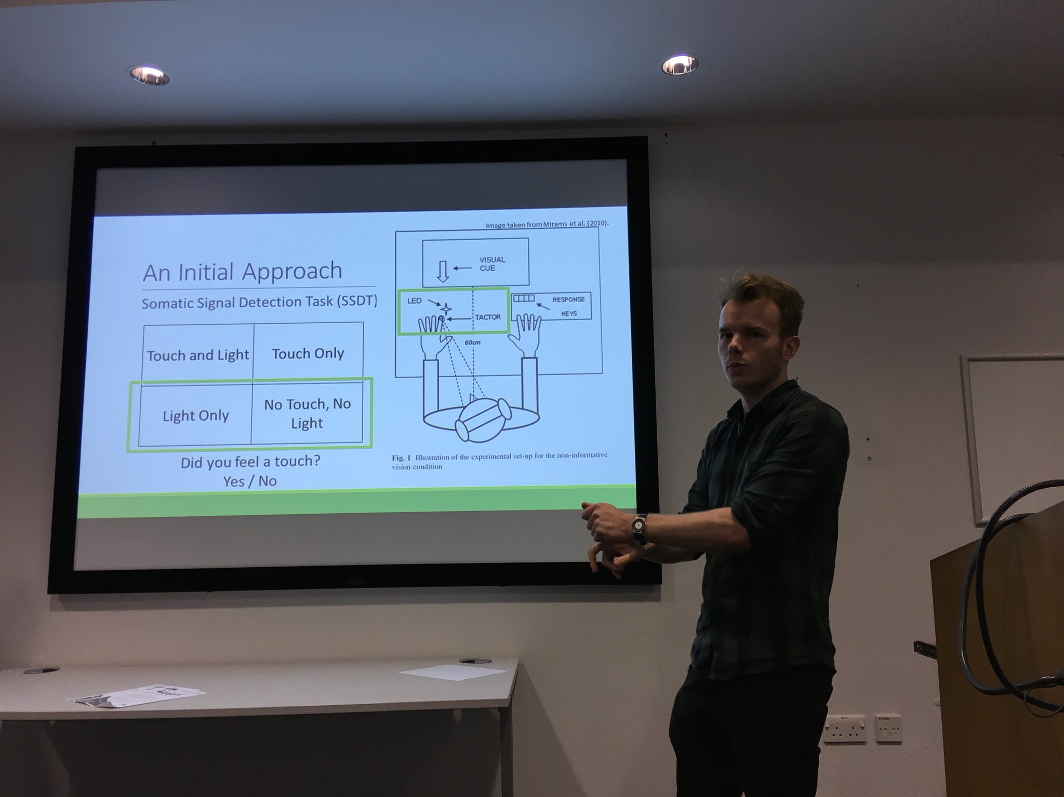

Slide 4
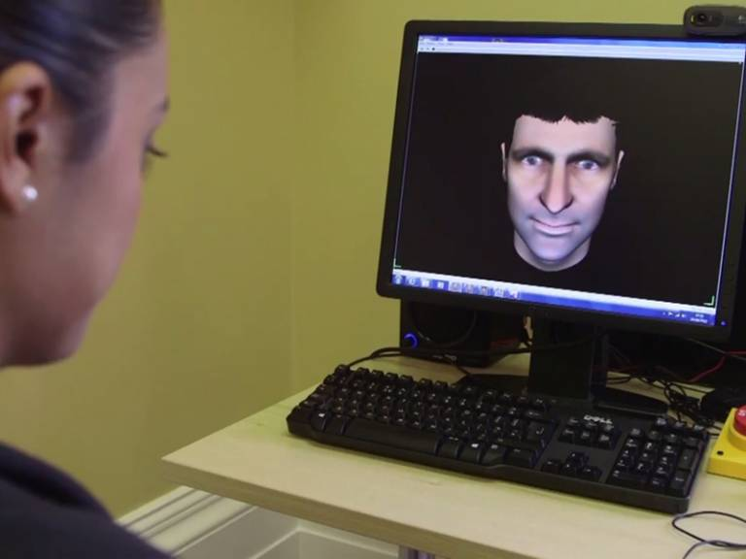
Unusual Self-Experiences & Dissociation
22-56% of people with psychosis
3.4% of the general population
“..and suddenly I feel a bit outside of myself, dizzy, and kind of disoriented”
“It’s as if what appears to be the reality around me is crumbling”
“And it didn’t feel like it was my body, it just felt like – I was sort of reflecting. Like I was a mirror or a camera or something like that. I wasn’t aware that I actually had a body”
Cernis, Freeman & Ehlers (2020)
  Haugen & Castillo (1999) Maaranen et al (2004)

Slide 5
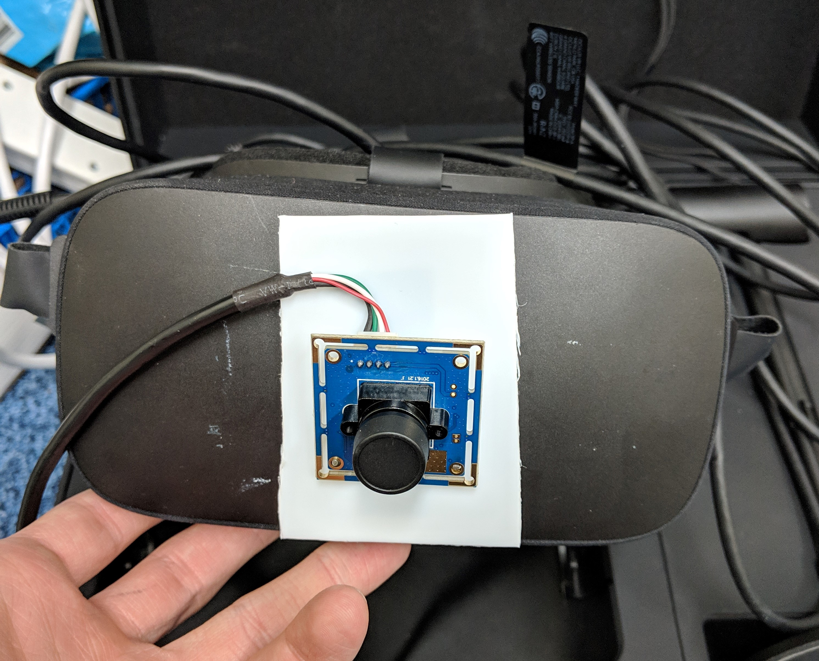


Recreating Unusual Experiences
  Roel Lesur et al (2020)
RQ1. Are induced unusual experiences related to unusual experiences that occur in daily life?

Slide 6




Potential Mechanisms?
Self-monitoring
Interoception
Phenomenological Control
RQ2. What mechanisms are related to induced unusual experiences?

Slide 7
Interoception
Sensing of bodily sensations and changes to bodily states (Khalsa et al., 2018)
Interoceptive accuracy lower in people with dissociation (Schaflein et al., 2018)
Lower interoceptive accuracy associated with enhanced susceptibility to RHI (Tsakiris et al., 2011)

Slide 8
Phenomenological Control
The ability to adapt perception according to top-down influences
Recently shown to relate to susceptibility to RHI (Lush et al., in press)
Measured with the SWASH task

Slide 9

Participants
No history of psychiatric, developmental or neurological disorder
  Cambridge Depersonalisation Scale (Sierra & Berrios, 2000)
  Cardiff Anomalous Perceptions Scale (Bell et al., 2006)
  Somatoform Dissociation Questionnaire (Nijenhuis et al., 1996)

Slide 10
Mixed-Reality Task – “Long” Version
Item | Sometimes I felt… | Factor
1. | Alienation from my body | Disownership
2. | As if my body does not belong to me anymore | Disownership
3. | As if my body was numb | Deafference
4. | As though the experience of my hand was less vivid than normal | Deafference
5. | As if the body I saw was my own | Embodiment
6. | As if I could move the seen body | Embodiment
7. | As if I were not real or as if I were cut-off from the world | Derealisation
8. | As if my surroundings felt detached or unreal | Derealisation
9. | That the experience was pleasant | Pleasantness
4 trials
60 seconds each
Delay
No delay Self-stroking | 1s Delay Self-stroking
No delay Other-stroking | 1s Delay Other-stroking
Source

Slide 11
Mixed-Reality Task – “Threshold” Version
Item | Question
1. | It felt as if the touch/movement I saw and felt was synchronous (in time)
2. | It felt as if the hand that I saw was my own
3. | The experience felt pleasant
80 trials
9 seconds each
Delay
Self | 0ms | 66ms | 132ms | 198ms | 264ms | 330ms | 396ms | 462ms | 528ms | 594ms
Other | 0ms | 66ms | 132ms | 198ms | 264ms | 330ms | 396ms | 462ms | 528ms | 594ms
Source

Slide 12
Thank you for listening!

Slide 13
References
Černis, E., Freeman, D., & Ehlers, A. (2020). Describing the indescribable: A qualitative study of dissociative experiences in psychosis. PLOS ONE, 15(2), e0229091. https://doi.org/10.1371/journal.pone.0229091
Haugen, M. C., & Castillo, R. J. (1999). Unrecognized Dissociation in Psychotic Outpatients and Implications of Ethnicity. The Journal of Nervous and Mental Disease, 187(12), 751–754.
Maaranen, P., Tanskanen, A., Honkalampi, K., Haatainen, K., Hintikka, J., & Viinamäki, H. (2005). Factors Associated with Pathological Dissociation in the General Population. Australian & New Zealand Journal of Psychiatry, 39(5), 387–394. https://doi.org/10.1080/j.1440-1614.2005.01586.x
Roel Lesur, M., Weijs, M. L., Simon, C., Kannape, O. A., & Lenggenhager, B. (2020). Psychometrics of Disembodiment and Its Differential Modulation by Visuomotor and Visuotactile Mismatches. IScience, 23(3), 100901. https://doi.org/10.1016/j.isci.2020.100901
Khalsa, S. S., Adolphs, R., Cameron, O. G., Critchley, H. D., Davenport, P. W., Feinstein, J. S., Feusner, J. D., Garfinkel, S. N., Lane, R. D., Mehling, W. E., Meuret, A. E., Nemeroff, C. B., Oppenheimer, S., Petzschner, F. H., Pollatos, O., Rhudy, J. L., Schramm, L. P., Simmons, W. K., Stein, M. B., … Zucker, N. (2018). Interoception and Mental Health: A Roadmap. Biological Psychiatry: Cognitive Neuroscience and Neuroimaging, 3(6), 501–513. https://doi.org/10.1016/j.bpsc.2017.12.004
Schäflein, E., Sattel, H. C., Pollatos, O., & Sack, M. (2018). Disconnected – Impaired Interoceptive Accuracy and Its Association With Self-Perception and Cardiac Vagal Tone in Patients With Dissociative Disorder. Frontiers in Psychology, 9. https://doi.org/10.3389/fpsyg.2018.00897
Tsakiris Manos, Jiménez Ana Tajadura-, & Costantini Marcello. (2011). Just a heartbeat away from one’s body: Interoceptive sensitivity predicts malleability of body-representations. Proceedings of the Royal Society B: Biological Sciences, 278(1717), 2470–2476. https://doi.org/10.1098/rspb.2010.2547
Lush, P., Botan, V., Scott, R. B., Seth, A., Ward, J., & Dienes, Z. (2019). Phenomenological control: Response to imaginative suggestion predicts measures of mirror touch synaesthesia, vicarious pain and the rubber hand illusion [Preprint]. PsyArXiv. https://doi.org/10.31234/osf.io/82jav
Sierra, M., & Berrios, G. E. (2000). The Cambridge Depersonalisation Scale: A new instrument for the measurement of depersonalisation. Psychiatry Research, 93(2), 153–164. https://doi.org/10.1016/S0165-1781(00)00100-1
Bell, V., Halligan, P. W., & Ellis, H. D. (2006). The Cardiff Anomalous Perceptions Scale (CAPS): A New Validated Measure of Anomalous Perceptual Experience. Schizophrenia Bulletin, 32(2), 366–377. https://doi.org/10.1093/schbul/sbj014
Nijenhuis, E. R. S., Spinhoven, P., Van Dyck, R., Van Der Hart, O., & Vanderlinden, J. (1996). The development and psychometric characteristics of the Somatoform Dissociation Questionnaire (SDQ-20),. Journal of Nervous and Mental Disease, 184(11), 688–694. https://doi.org/10.1097/00005053-199611000-00006

