Slide 1
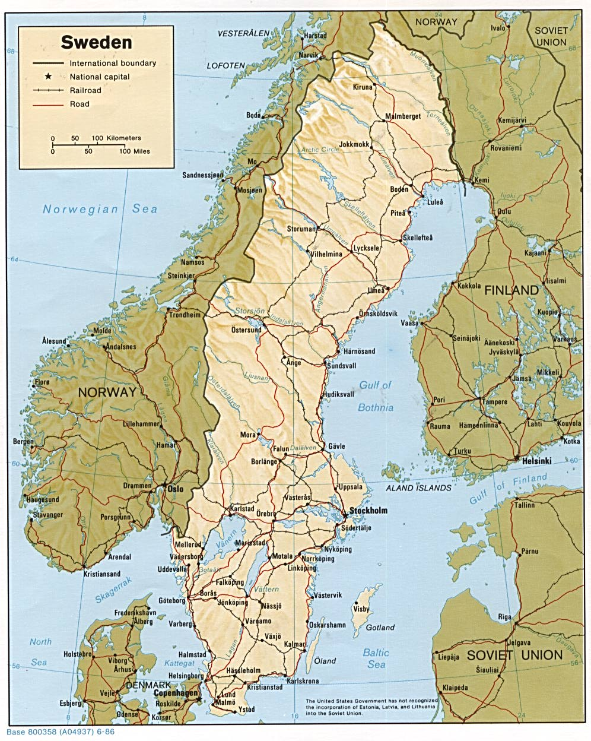
Young people’s strategies for handling economic adversity: Extending the research agenda
Sweden
Population 9 866 670 2016 (feb 2016)
About 2 miljon children between 0-17 Child benefit Free school, free school meals Free health care Free glasses Free dental care Low cost for after school care Low cost för pre school care
Notes:
Messure disponible income = 0 Children in Poverty:
In total: 12.0 % (2013)
Low income standard 5,4%, both low income standard and financial social assistance 2.4% and financial social assistance 4.2 % (Rädda barnen 2015)
12200:- 1 adult and 1 child
18544:- 2 adults and 2 children
Enough to nessesary spending, rent, food, cloths medical cost, insurance etc.
7,8% had less than =0
National social assisstance (2adults and 2 children
12060:- plus rent 6200:-=18260:-
Rädda Barnens årsrapport 2015
Messure disponible income = 0
12200:- 1 adult and 1 child
18544:- 2 adults and 2 children
Enough to nessesary spending, rent, food, cloths medical cost, insurance etc.
7,8% had less than =0
National social assisstance (2adults and 2 children
12060:- plus rent 6200:-=18260:-
Rädda Barnens årsrapport 2015
1997- 2007 reduction 22 ,3 % - 10, 7%- 2009 13%, 60% i Rosengår, 30% Malmö 12 % 2013, decreased in 127 municapilities, increased in 154, 30% Malmö, 3% i Lomma

Slide 2
Background
Numerous reports describing the long-term effects of low household income on young people’s living situations
Research from the point of children´s agency in the context of economic adversity in long term poor families demonstrates that they can experience:
Shame
Jealousy of better-off peers
Exclusion from peer-group circles
Responsibility for parents, siblings
Parents put children needs first

Slide 3
The use of different strategies to manage their economically disadvantaged situation
(Drawin on: Ridge, 2011; Attree, 2006; Harju, 2008; Van der Hoek, 2005; Fernqvist, 2013; Harju and Thorød, 2011; Redmon 2009)
Avoidance-oriented strategies
acts of purposefully avoiding situations in which they may either feel excluded or ‘different’ from peer-group members, feeling embarrassed, shameful
Accommodation-oriented strategies
matter of fact’ way in which young people accept and ‘get on with’ their situation
understanding, accepting and ‘getting by’
Active and intentionally-oriented strategies.
attempting to change the economic situation to the better, and to bring about desired outcomes
Notes:
anticipate a negative response to requests for money or things, and/or that they do not want to additionally add to their parents’ economic burden, For example, not taking part in school activities, clubs or outings – as well as truancy and dropping out of school – can all be viewed as a forms self-exclusion from social environments where economic disadvantage can be made visible
within the family, where there are risks of conflict- young people avoid money-related discussions with their parents and that they keep their wishes to themselves shielding parents from the effects of poverty on everyday life
people learn to ‘make do’ and reduce their demands on parents, want to maximize their resources, they tend nevertheless to gradually narrow their aspirations in social engagement, both in the present,

Slide 4
Research design
This study explore the strategy use of young people living in families that cannot be considered to be ‘poor’ (in the sense of long-term unemployment and/or social exclusion), but where as a consequence of the short-term unemployment of one or both of the breadwinners, the family’s financial situation has suddenly deteriorated.
Such situations are currently common in many developed countries, not least for families where parents are employed in low-skilled work in traditional manufacturing sectors
Unemployment in Sweden:
2010 at 8.9 % and levelling out at 7.7% in 2014, (7.6 feb 2016)
On average generally the net replacement for the first year is 66%, reducing over five years to an average of 37%

Slide 5
Research design
Two research questions:
How do the young people experience changes when their parent/parents became unemployed?
What strategies do they describe when adjusting to changed economic circumstances?

Slide 6
The young people
39 young people aged between 12 and 21.
22 girls and 17 boys.
37 lived in families with two parents.
At least one parent was unemployed.
For 6 of the young people both parents were unemployed.
All been unemployed more than one year (average 40-45% income loss)
41 lived in a house (which the family owned)
2 lived in flat witch the family own
2 lived in rental accommodation
20 lived in families that had a summer house/caravan/boat
All lived in families with a car

Slide 7
How to get hold of families
Drawing on data provided by
(i) the National Transition Fund for Blue-collar Workers (TSL)
(ii) the Local Transition Fund for White-collar Staff in the Private Sector (TRS)
Five municipalities in the west of Sweden with the highest numbers of unemployed workers were identified
Local trade union officials was involved
Visits to support meetings held by local trade union branches
Adult education provision
Snowball approach

Slide 8
Interviews and Analysis
Semi- structured interview guide consisting of a series of open questions focusing on the impact of the changed economic situation on
(i) family life and relationships with parents, the extended family network and with friends
(ii) the young person’s leisure and free-time activities and consumption habits.

Slide 9
Analysis
Kuczynski (2003) identifies three universal manifestations of agency; autonomy, construction and action.
Autonomy is the motivational aspect of agency and is based on self-determination and self-preservation
Construction is about the capacity to interpret coactions with the social environment
Action refers to the guidance of behavior by internal processes such as meanings, intentions and goal
Thematic analysis (Braun and Clarke, 2006)
Data was processed using NVivo 10.0

Slide 10
RQ 1: How do the children and young people experience changes when their parent/parents became unemployed?
Parents put children’s needs first
The young people in the current study notice that their parents’ own needs take second place to those of their children.
There was no great difference, other than that they economized more on other things. But there was not anything that me and my brother noticed. Nothing that involved us. Because they always put us children first. So maybe if they wanted something they would have to wait a little longer. Some months or so. If it was something for the home or tools, maybe a computer or a phone for themselves, then they had to wait longer.
Leo (21)

Slide 11
RQ 1: How do the children and young people experience changes when their parent/parents became unemployed?
The family members find ways of adapting to a new economic reality
Almost invariably they talk not of the economies that their parents have had to make, but rather how, as a family, their lifestyle has changed.
Not such a great difference more than that it was like normal. But we didn’t buy any new things, and it was not like we would change the roof. But it’s like things are standing still you could say.
Ebba (17)
Notes:
their agency in choosing not to position themselves passively (i.e. on the receiving end of parent’s economic restraint measures), but as actively involved in collective decision-making or as part of a collective effort to adapt to the new economic reality.

Slide 12
RQ 1: How do the children and young people experience changes when their parent/parents became unemployed?
Having to cut back is not necessarily negative
Many of them describe the downturn in the family’s economic situation in not exclusively negative terms
Before we bought a lot more things that were fairly unnecessary. Like now we might buy a TV and then not buy anything for another six months. We buy more necessary things. Before we bought like mixers and smoothie machines and that sort of stuff, ice-cream makers and stuff like that. Bea (14)
You eat healthier food. You can save more on money for food. And then it makes you start thinking about diet and that type of thing. It is like we buy more good food, like we buy more vegetables.
Adam (12)
Notes:
their agency in choosing not to position themselves passively (i.e. on the receiving end of parent’s economic restraint measures), but as actively involved in collective decision-making or as part of a collective effort to adapt to the new economic reality.

Slide 13
RQ 1: How do the children and young people experience changes when their parent/parents became unemployed?
Having to cut back is not necessarily negative
Many of them describe the downturn in the family’s economic situation in not exclusively negative terms
Before she worked shifts, so you only saw her every other week. So it was pretty nice to see her at home. But I feel sorry for her too. I can see it is difficult for her.
Ted (12)
You come home and she has been home all day and cleaned and made food. It’s really nice, I think, completely a good thing really. She’s more like a housewife now, that’s what I’d say.
Nils (20)
Notes:
their agency in choosing not to position themselves passively (i.e. on the receiving end of parent’s economic restraint measures), but as actively involved in collective decision-making or as part of a collective effort to adapt to the new economic reality.

Slide 14
RQ 2: What strategies do young people describe when adjusting to changed economic circumstances?
Pragmatic, accommodation-oriented strategies – choosing the best of possible alternatives and making the best of things – is the strategy type most commonly evident in the data.
As Ronja (13) explains, in the situation she finds herself in, not buying the most expensive things she might desire is self-evident:
It is of course so that you can’t buy the most expensive things when you’ve got a parent who’s unemployed.
It was actually pretty difficult, because I have been used to getting this type of jacket [expensive brand-name clothing] for quite a while now. And suddenly it stops, and I have to wear a not-so-special jacket. I was used to wearing brand-name, but that’s seldom so now. I am not used to this. But I have learnt. I have become more and more used to the situation. Felix (14)
Notes:
tAvoidance-oriented strategies, accommodation-oriented strategies and active and intentionally-oriented strategies. Only two of these strategies – accommodation-oriented strategies (accepting the situation and getting on with life in a pragmatic ‘matter of fact’ way) and active and intention-oriented strategies (attempting to change the economic situation to the better, and bringing about desired outcomes) – are to be found.
heir agency in choosing not to position themselves passively (i.e. on the receiving end of parent’s economic restraint measures), but as actively involved in collective decision-making or as part of a collective effort to adapt to the new economic reality.

Slide 15
RQ 2: What strategies do young people describe when adjusting to changed economic circumstances?
Pragmatic, accommodation-oriented strategies
Imra, (16) who played football and trained at a gym, explains that she stopped doing both because they became too expensive. Instead she prioritizes going out with friends:
I had started at a gym. But I had to quit because it was like quite expensive. I had to pay myself with my own money, and there just wasn’t enough for the whole month. It was costing me 350 [Swedish crowns] and I only had 650 left for a whole month. And I use that mostly when I am going out meeting friends.
Notes:
tAvoidance-oriented strategies, accommodation-oriented strategies and active and intentionally-oriented strategies. Only two of these strategies – accommodation-oriented strategies (accepting the situation and getting on with life in a pragmatic ‘matter of fact’ way) and active and intention-oriented strategies (attempting to change the economic situation to the better, and bringing about desired outcomes) – are to be found.
heir agency in choosing not to position themselves passively (i.e. on the receiving end of parent’s economic restraint measures), but as actively involved in collective decision-making or as part of a collective effort to adapt to the new economic reality.

Slide 16
RQ 2: What strategies do young people describe when adjusting to changed economic circumstances?
Active and intention-oriented strategies
In addition to accommodation-oriented strategies, several of the young people describe how, having to make evaluations about the nature and necessity of purchases, they have become more aware of personal finances.
Well, it gets you to think twice. That you don’t need to…No, I don’t know, but it makes you think about the things you did before, like how you used to waste money. Now it’s like, maybe you need this money later. So that you’ve got money if something should happen. Before it was more like money just grew on trees.
Sam (16)
Notes:
tAvoidance-oriented strategies, accommodation-oriented strategies and active and intentionally-oriented strategies. Only two of these strategies – accommodation-oriented strategies (accepting the situation and getting on with life in a pragmatic ‘matter of fact’ way) and active and intention-oriented strategies (attempting to change the economic situation to the better, and bringing about desired outcomes) – are to be found.
heir agency in choosing not to position themselves passively (i.e. on the receiving end of parent’s economic restraint measures), but as actively involved in collective decision-making or as part of a collective effort to adapt to the new economic reality.

Slide 17
RQ 2: What strategies do young people describe when adjusting to changed economic circumstances?
Active and intention-oriented strategies
To pay close attention to costs and expenses means that they develop skills of appraisal that will stand them in good stead for the future:
Before I’ve been liked forced to buy something as soon as I go into a shop. Well, it’s not quite like that now. My friends used to call me a shopaholic. But now I have learnt to control outgoings a little more maybe. Now it’s like I know more what I have bought and how much it costs, like. And I what the cost of everything together is. So in fact it’s better.
(Lejla 18)
Notes:
tAvoidance-oriented strategies, accommodation-oriented strategies and active and intentionally-oriented strategies. Only two of these strategies – accommodation-oriented strategies (accepting the situation and getting on with life in a pragmatic ‘matter of fact’ way) and active and intention-oriented strategies (attempting to change the economic situation to the better, and bringing about desired outcomes) – are to be found.
heir agency in choosing not to position themselves passively (i.e. on the receiving end of parent’s economic restraint measures), but as actively involved in collective decision-making or as part of a collective effort to adapt to the new economic reality.

Slide 18
RQ 2: What strategies do young people describe when adjusting to changed economic circumstances?
Active and intention-oriented strategies
Felix (14), for example, says that now when buying anything he always thinks ahead; purchases need to serviceable not only in the present but also in the future:
Our economy is pretty bad. So I have to think quite a bit, like. So when I buy something I usually buy a size bigger, or half a size, so that I don’t have to buy new every six months. And it will like last the whole year.
Notes:
tAvoidance-oriented strategies, accommodation-oriented strategies and active and intentionally-oriented strategies. Only two of these strategies – accommodation-oriented strategies (accepting the situation and getting on with life in a pragmatic ‘matter of fact’ way) and active and intention-oriented strategies (attempting to change the economic situation to the better, and bringing about desired outcomes) – are to be found.
heir agency in choosing not to position themselves passively (i.e. on the receiving end of parent’s economic restraint measures), but as actively involved in collective decision-making or as part of a collective effort to adapt to the new economic reality.

Slide 19
Conclusion
The findings show that these young people experience:
that parents generally put children’s needs first
that economic adversity is something that the family addresses collectively
cutting back on expenditure is not necessarily a negative thing.
Evidence of both accommodation-oriented strategies and active and intention-oriented strategies are found.
All of these findings are in line with those from research carried out with children and young people in families where parents are long-term unemployed and reliant on state benefits (Fernqvist 2013; Harju and Thorød, 2010; Redmond, 2009; Ridge, 2011).
Notes:
tAvoidance-oriented strategies, accommodation-oriented strategies and active and intentionally-oriented strategies. Only two of these strategies – accommodation-oriented strategies (accepting the situation and getting on with life in a pragmatic ‘matter of fact’ way) and active and intention-oriented strategies (attempting to change the economic situation to the better, and bringing about desired outcomes) – are to be found.
heir agency in choosing not to position themselves passively (i.e. on the receiving end of parent’s economic restraint measures), but as actively involved in collective decision-making or as part of a collective effort to adapt to the new economic reality.

Slide 20
Conclusion
However, there was no evidence of avoidance-oriented strategies
There were no examples in the data of strategy-use that involved either actively avoiding situations which could generate feelings of exclusion from peer-group members, or of concealing needs and desires from their parents (c.f. Harju and Thorød, 2010; Redmond, 2009; Ridge, 201; Van der Hoek, 2005).
Over and above the fact that the material resources of the families in focus here are much greater than those in the poverty studies described in the literature review (unemployment being a relatively recent occurrence), there may be an additional three reasons why evidence of self-excluding behavior characteristic of avoidance-oriented strategies is not found
In social welfare countries such as Sweden, there little stigma attaches to unemployment caused by redundancy
Sweden unemployment has in recent years tended to be unevenly distributed. It is particular groups of people, in particular locations and at particular times who are affected and young people are unlikely to feel singled out
Young people in Sweden are used to having wide-ranging scope for the exercise of personal agency.
Notes:
tAvoidance-oriented strategies, accommodation-oriented strategies and active and intentionally-oriented strategies. Only two of these strategies – accommodation-oriented strategies (accepting the situation and getting on with life in a pragmatic ‘matter of fact’ way) and active and intention-oriented strategies (attempting to change the economic situation to the better, and bringing about desired outcomes) – are to be found.
heir agency in choosing not to position themselves passively (i.e. on the receiving end of parent’s economic restraint measures), but as actively involved in collective decision-making or as part of a collective effort to adapt to the new economic reality.

Slide 21
Conclusion
By looking at the ways in which young people in middle-income families experience parental unemployment and the strategies they employ in coping with a reduction in the family’s income it is possible to say that:
While the nature and manifestations of the agency of young people in these families is, in most respects, similar to those in long-term, low-income families, the young people in the current study differ in one important respect;
they do not experience parental unemployment and financial adversity as stigmatizing. This knowledge constitutes an important contribution to the body of research exploring young people’s agency in situations of disadvantage.
Notes:
tAvoidance-oriented strategies, accommodation-oriented strategies and active and intentionally-oriented strategies. Only two of these strategies – accommodation-oriented strategies (accepting the situation and getting on with life in a pragmatic ‘matter of fact’ way) and active and intention-oriented strategies (attempting to change the economic situation to the better, and bringing about desired outcomes) – are to be found.
heir agency in choosing not to position themselves passively (i.e. on the receiving end of parent’s economic restraint measures), but as actively involved in collective decision-making or as part of a collective effort to adapt to the new economic reality.

Slide 22
Limitation
One semi-structured interview- what are the possibilities of getting descriptions of in-depth feelings óf example of shame?
Notes:
tAvoidance-oriented strategies, accommodation-oriented strategies and active and intentionally-oriented strategies. Only two of these strategies – accommodation-oriented strategies (accepting the situation and getting on with life in a pragmatic ‘matter of fact’ way) and active and intention-oriented strategies (attempting to change the economic situation to the better, and bringing about desired outcomes) – are to be found.
heir agency in choosing not to position themselves passively (i.e. on the receiving end of parent’s economic restraint measures), but as actively involved in collective decision-making or as part of a collective effort to adapt to the new economic reality.

Slide 23
Thank you for listening
contact
anette.bolin@hv.se

