Slide 1
Student Advice & Guidance
MAH Training
Autumn 2024

Slide 2
Student Advice & Guidance
Provide practical advice and guidance across a wide range of topics and concerns within a student’s experience
Ensure students can access the information and support needed to overcome any potential challenges or barriers to success.
Advisors work holistically with students to understand their needs, facilitating students to understand their choices and next steps
Intrinsically linked with PS and Academic teams across the university
Student Advice
Disability Advice
International Advice
Sexual & DV Response
Money Advice

Slide 3

Student Advice
Personal and welfare concerns
Obstacles to study
Sources of support
Progress issues
Explain university rules and processes
Identify routes to support success
Support for incidents
Awareness raising & campaigns
8 Advisors (6.5FTE)

Slide 4
Student Advice
Every School has a dedicated link Student Advisor who works closely with the Director of Student Experience.
Advisor | School Link | Working Pattern
Matt Watts | Media, Arts & Humanities Foundation (Central) | Mon-Fri
Jo Dale | Media, Arts & Humanities | Mon, Weds, Fri
Marguerite Johnson | Global Studies IDS | Tues-Fri
Laura Tolhurst | Education & Social Work Law, Politics & Sociology | Mon-Fri
Jolyon Western | Maths & Physical Sciences Engineering & Informatics | Weds-Fri
Emily Burnage | Life Sciences Psychology | Mon-Fri
Eileen Laffan | Business | Mon-Fri
Advisors also work with the School Student Experience Team on issues arising from attendance monitoring and student progress and follow up on welfare concerns arising in the School.
General questions and queries should be referred to StudentAdvice@sussex.ac.uk and will be responded to by the Duty Student Advisor

Slide 5
Student Advice
Student Referral Routes:
It is best for students to seek help independently, but sometimes you may feel that an intervention on their behalf, with their permission, is the best way forward.
Signpost student to My Sussex where they can raise an enquiry and be connected directly with the team to receive advice
Provide the team with the name and registration number of the student and ask Student Advice to reach out to them to offer advice (with consent) - avoid copying students into emails to the team please
Ask the team to provide you with the details of relevant processes or services the student requires and advise the student of these directly
NB: If there are immediate concerns for a student’s safety staff should escalate these in line with University protocols for managing risk.

Slide 6

Money Advice
1 to 1 appointments
Complex case support
Budgeting advice
Money management advice
Financial capability support
Debt advice
Alternative funding sources
Blackbullion – financial education
1 Money Advisor

Slide 7

International Advice
Visa application and extension advice
Complex visa issues support
Dependant immigration advice
Working while studying immigration advice
Graduate Route advice
Visa refusals
3 International Advisors
1 International Advice Assistant

Slide 8

Disability Advice
Practical information, advice & guidance
Specialist but non-clinical
Recommend reasonable adjustments
Coordinate NMH support
Funding advice (DSA)
SpLD/ADHD assessments
9 Disability Advisors (7FTE)
2 dedicated admin staff
4668 registered with service 23-24 (25% of all students)
4625 in 22-23
53% mental health difficulty

Slide 9
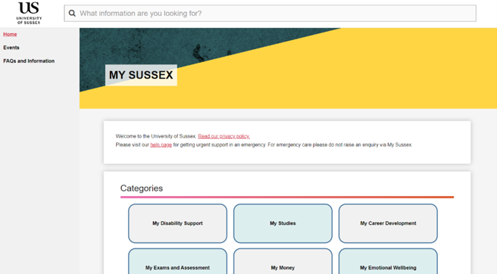
My Sussex
New online student support system
Available to students at: http://mysussex.sussex.ac.uk
Provides students with searchable FAQs to resolve easy student queries, and an enquiries hub if they require further information.
Allows staff to manage enquiries and see the student’s journey within DSE.
Opens up information on a student for DSE staff, so we can track cases from start to finish and ensure the student gets the right support throughout.

Slide 10
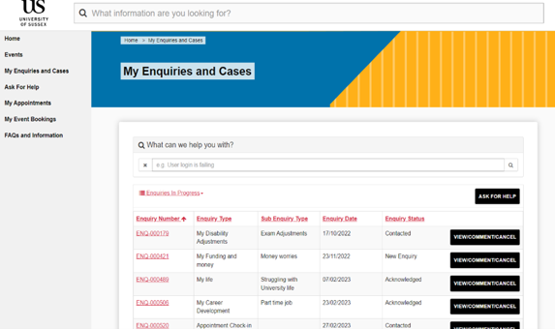
My Sussex
Students can choose the area or topic that best fits their enquiry, and the system automatically sends their enquiry to the most suitable team.
Can't book into appointments themselves via system, but an Advisor will arrange one where needed.
Drop-in sessions held Wednesday afternoons in the Student Centre with Disability Advice

Slide 11
Accessing Our Services
Key contacts for staff:
Student Advisors
StudentAdvice@sussex.ac.uk
Sexual & DV Response
svdv@sussex.ac.uk
Disability Advisors
DisabilityAdvice@sussex.ac.uk
International Advisors
Immigration@sussex.ac.uk
Money Advisor
MoneyAdvice@sussex.ac.uk
How to access and signpost to our support:
Student Hub
My Sussex - NEW
Student Centre
Support provided by email, telephone, Zoom and in-person
Appointments are booked in advance
Quick Query Advice Drop-ins

Slide 12
Disability Advice
Mike Pudan, Lead Disability Advisor

Slide 13

Did you know?
20% university students in the UK declare a disability*
Any long-term condition that has an adverse impact on one’s ability to carry out day-to-day tasks
Most common disabilities declared are mental health (56%) with a 542% rise since 2014
Disabled applicants are 38% more likely to defer entry to HE – more discerning
74% took a provider’s support offer into account when making decisions
Notes:
157% rise in applicant sharing, despite total numbers of applicants to uni decreasing. Many students still feel that they will be treated detrimentally either in terms of them being given a place or once they are at university. There is also a reported consensus that students feel they are starting a new chapter in their lives and may want to disregard any ‘labels, beliefs’, perceived or otherwise, that were previously attributed to them. Now over 128K sharing.
Definition of ‘disability’ per the equality act – and is what loosely determines our ability to support a student, however we will always look be led by the student’s description of their needs
As reported by students as part of their UCAS declaration 23/24 entry, combined with the students who registered with us after we started
Note that DSA (to be explained later) is one of the most potent forms of support for students but less than one-third of students apply for it, despite it being free and needs-based rather than household income
Evidenced by the people in the room! Clearly more than just strength of academic course to consider – will also factor in location, campus accessibility, scope of adjustments, local tertiary services etc. Disabled students’ decision making is influenced by the HE institution’s support offer: 56% attend an institution’s open day before applying, with its reputation for equality, diversity and inclusion being of particular importance.
We are more likely than other teams to support mature students, students who have taken a year out, or students who are switching unis or returning to uni following a difficult time. In 2019 disabled students were 23% more likely to defer entry than non-disabled students, rising to 28% in 2021 – this disparity varies by disability type.
Above data from UCAS Next Steps 2022:
https://www.ucas.com/file/610106/download?token=1kwt_gKE
*UCAS
**Source: Enable Magazine, accessed 16/06/19 http://enablemagazine.co.uk/universities-minister-explains-increase-in-dsa-for-postgraduate-students/

Slide 14
Pressures During University
Removal of support systems
Pressure to perform
Change of environment
Work related stress
Health concerns
Social pressure
Travel concerns
Financial difficulties
Missing family and friends
Anxiety
Isolation
Ill health
=
Academic Difficulties
Notes:
We aim to remove some of these barriers, which are often more acutely felt and inherently more challenging for disabled students.
Mental health difficulties have been the fastest-rising difficulty over the last 10 years (453% increase since 2012) and diagnosable mental health difficulties now accounts for approximately 50% of all disabled students we support. Anxiety and low-mood also commonly occur with other differences such as ADHD and Autism, as well as long-term health conditions.

Slide 15

Needs + Consent = Support
Online or in person
Reviewed by staff
Support to access evidence
Health centre on campus
Notes:
Although we will be led by you and your description of any challenges you experience, it is extremely helpful if you can provide us with evidence of your long-term condition or disability. This information can be provided online or in person, and is reviewed by advisors. We can also write to a GPs and health practitioners to encourage them to give a better description of your difficulties or the kind of adjustments you may need whilst at university. Often the more information you can provide the more accurate and effective we can make your support.
NOTE: DSA are quite strict on the evidence they will accept and so we may encourage you to get written statements that will enable you to access this additional support.
Give a reminder of the equalities act definition: Any long-term condition (that lasts or is expected to last for more than 12 months) that has a significant adverse effect on your ability to study. It can include conditions such as:
Specific learning differences (such as dyslexia, dyspraxia, dyscalculia)
Mental health conditions
Neurodiversity (such as autism, ADHD)
Physical disabilities (including mobility and sensory impairments)
Long term health conditions (such as epilepsy, cancer, HIV, etc.)
Also have a health centre on campus that can easily provide this kind of information to you and provide everything any other NHS practice would provide. We would encourage you to register when you arrive, unless: you are receiving very acute and high level care; regular check ups for your condition; or if you are receiving social care support from your home county/area.
Reiterate:
Evidence and consent form can be submitted online on the website
Attend an appointments with an advisor, or come to see us at drop-in
Disability Advisors available Monday to Friday 9am-5pm or email disabilitysupport@sussex.ac.uk
Reassure them if they are having difficulty with this get in touch
*Specific Consent to share with parents

Slide 16

What support do we provide?
Reasonable Adjustments
Practical Information, Advice and Guidance
Support workers, note takers etc.
Referral to other services e.g. PEEPs, Health Centre, Counselling
Funding advice (DSA)
Self-help
Notes:
Under the Equality Act (2010) universities (as education providers) have a duty to make reasonable adjustments (RAs) so that ‘disabled students can fully participate in the education and enjoy the other benefits, facilities and services which education providers provide for students. This goes beyond simply avoiding discrimination. It requires education providers to anticipate the needs of potential disabled students for reasonable adjustments.’
When considering adjustments for disabled students it may be useful to note that: ‘it is never unlawful under the Act to treat a disabled student more favourably than a non-disabled student for a reason connected to their disability. Therefore, education providers may provide education, benefits, facilities and services on more favourable terms to a disabled person compared to a non-disabled person.’
An anticipatory duty:
The duty to provide reasonable adjustments is anticipatory in that it ‘requires consideration of, and action in relation to, barriers that impede all disabled people’, rather than waiting for an individual disabled person to require a reasonable adjustment.
Example: ‘a university takes proactive steps to install induction hearing loops in all lecture rooms anticipating that this adjustment is likely to be required to meet the needs of hearing impaired students.’
Put in place Reasonable Adjustments such as tutor awareness information, exam arrangements and extensions to deadlines
Assess study support requirements and create a study support plan
Arrange support workers, note takers and readers and other more ‘light touch’ support persons
Liaise with academic and professional staff regarding support recommendations
If necessary, liaise with Doctor or Health Care Team
Liaise with other campus services regarding disability support needs e.g. housing, Student Advice,, money advice, Students’ Union, counselling and wider therapeutic wellbeing services
Wellbeing workshops, peer-to-peer, apps, online services, self-referral, Togetherall
The aim is that we can get your adjustments right the first time, but in practice, it is important that you continue to work with us throughout your academic journey so that we can tweak and adjust your support to better suit your ongoing needs. These needs might change during exam periods, whilst on a year abroad, during your placement, or when writing your dissertation. They may also change if you have a fluctuating condition.

Slide 17
Challenges...
Disability Advice
Inconsistent application of adjustments across School/module/academic
Clarity around alternative mode being offered
Understanding how students flag their needs at School Level
Staff reading Tutor Awareness Documents
Recording content
Adjustments for presentations
Accessibility of taught content and Canvas information
Academic Schools
Clarity around flagging of needs
Lack of detail in Tutor Awareness Documents
Presentation adjustments
Lack of appropriate teaching spaces
Late awareness raised of students' needs
Challenges accommodating exam adjustments
Expectation of School-funded support
Accessible teaching spaces
Notes:
Put in place Reasonable Adjustments such as tutor awareness information, exam arrangements and extensions to deadlines
Assess study support requirements and create a study support plan
Arrange support workers, note takers and readers and other more ‘light touch’ support persons
Liaise with academic and professional staff regarding support recommendations
If necessary, liaise with Doctor or Health Care Team
Liaise with other campus services regarding disability support needs e.g. housing, Student Advice,, money advice, Students’ Union, counselling and wider therapeutic wellbeing services
Wellbeing workshops, peer-to-peer, apps, online services, self-referral, Togetherall
The aim is that we can get your adjustments right the first time, but in practice, it is important that you continue to work with us throughout your academic journey so that we can tweak and adjust your support to better suit your ongoing needs. These needs might change during exam periods, whilst on a year abroad, during your placement, or when writing your dissertation. They may also change if you have a fluctuating condition.

Slide 18
Report + Support
Sarah Wratten, SDVR Advisor

Slide 19
Report and Support
A disclosure platform for staff and students to seek support
We look after the student side -
Student can disclose sexual or domestic abuse, incidents of hate, harassment, bullying, stalking, spiking using this simple system Report + Support - University of Sussex
Named disclosure – trained advisor is allocated the case and they reach out to the reporter and go through what they want to do next / options. Encourage this option
Anonymously – no action taken in most cases. Builds statistical picture
Notes:
Get you to start thinking about why and what we are changing. This can help you start to understand what the change will mean for you in your teams
Following these sessions we will be publishing videos/resources on Canvas, coming into team meetings to go into the functionality
To provide you with an overview of the new online student support system, My Sussex which will be launching in January
To introduce you to the key concepts of the system, providing an overview of each key piece of functionality
To provide the first steps in helping you prepare for the new system, including an insight into what is changing and why
We do not want to overwhelm you with information, today is only designed to provide an introduction
Full training will be provided to support you in using the system

Slide 20
Report and Support
If a student discloses something to you or a colleague, really encourage them to use the system as then it is recorded and we can reach out directly, already knowing a bit about what has happened
Offer to make the report on behalf of the student. SVDV advisor offers training on 3rd party reporting
Support aspect – many very useful FAQ’s and information about local support in Brighton and guidance about what someone may want to do next. Also good definitions of incidents
The system does not inform the police or instigate a disciplinary investigation of any kind, this is a disclosure tool to report and seek support
Control must be in the hands of the reporter and that is why case workers discuss options so that the reporter can choose what happens next
Notes:
Get you to start thinking about why and what we are changing. This can help you start to understand what the change will mean for you in your teams
Following these sessions we will be publishing videos/resources on Canvas, coming into team meetings to go into the functionality
To provide you with an overview of the new online student support system, My Sussex which will be launching in January
To introduce you to the key concepts of the system, providing an overview of each key piece of functionality
To provide the first steps in helping you prepare for the new system, including an insight into what is changing and why
We do not want to overwhelm you with information, today is only designed to provide an introduction
Full training will be provided to support you in using the system

Slide 21
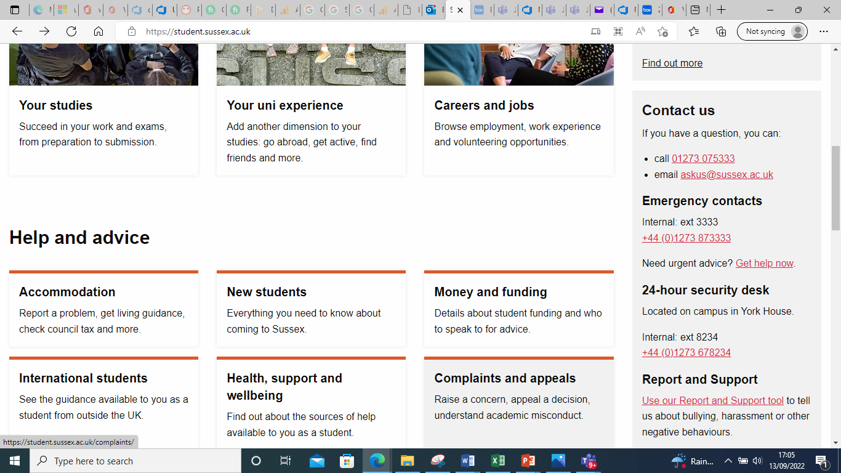
Report and Support
Notes:
Get you to start thinking about why and what we are changing. This can help you start to understand what the change will mean for you in your teams
Following these sessions we will be publishing videos/resources on Canvas, coming into team meetings to go into the functionality
To provide you with an overview of the new online student support system, My Sussex which will be launching in January
To introduce you to the key concepts of the system, providing an overview of each key piece of functionality
To provide the first steps in helping you prepare for the new system, including an insight into what is changing and why
We do not want to overwhelm you with information, today is only designed to provide an introduction
Full training will be provided to support you in using the system

