Slide 1
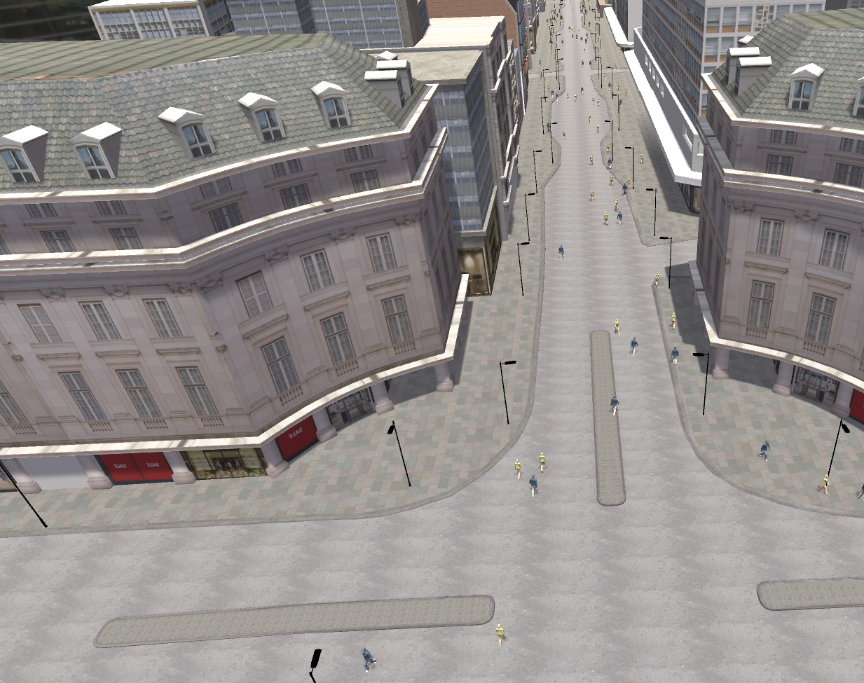







Perceived threats and ‘stampedes’:
A relational model of collective fear responses
Strand II: Virtual Reality Experiments

Slide 2
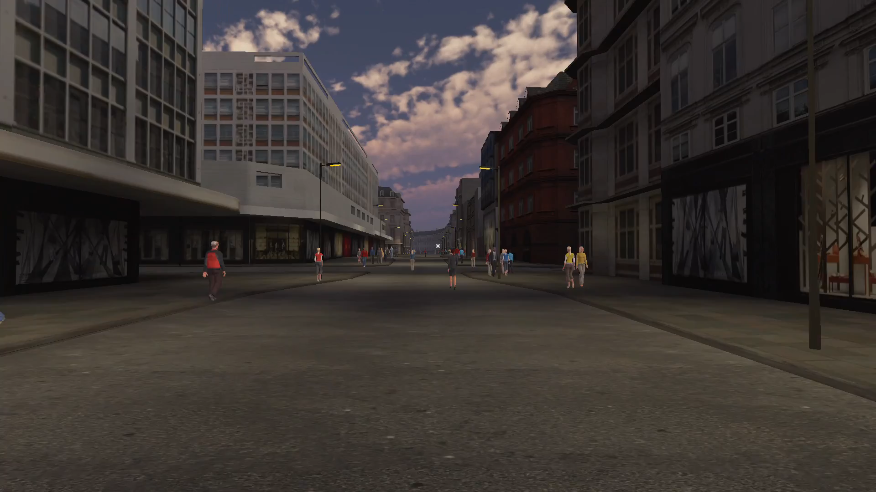
GENERAL PROCEDURE
Videos extracted from the software created by Make Real
Followed by a survey
Manipulated in the video
Ambiguity of the sound
Shared social identity
Crowd response

Slide 3
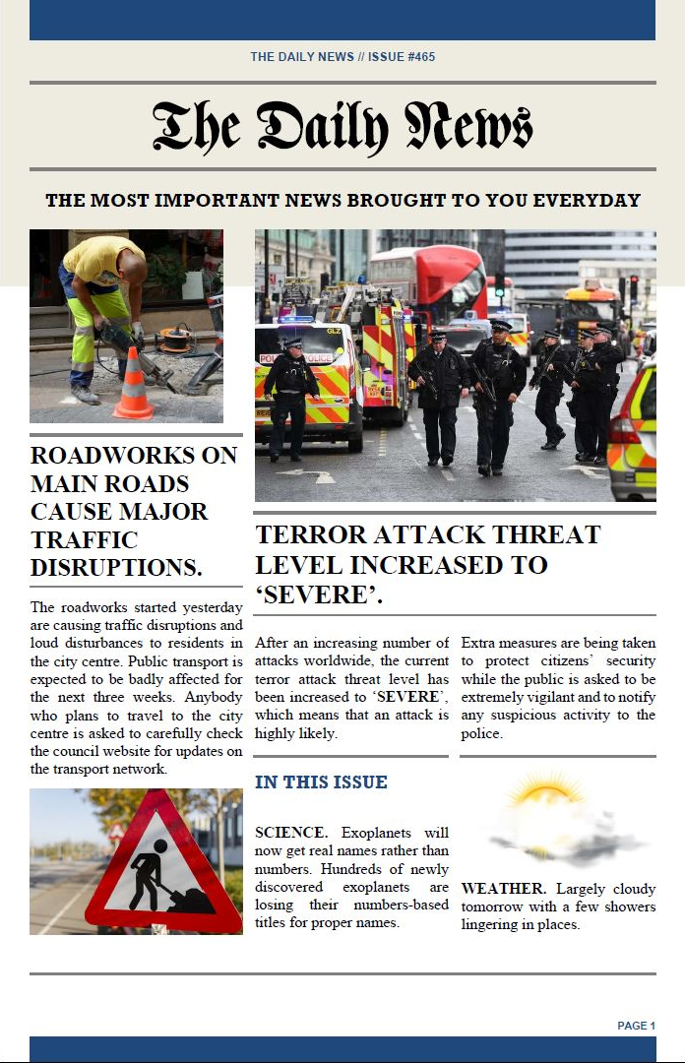

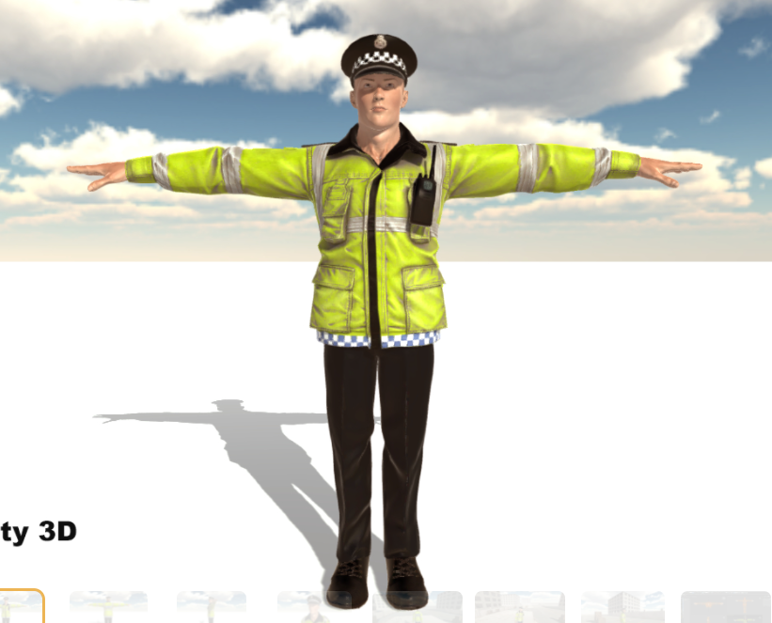
GENERAL PROCEDURE
Videos extracted from the software created by Make Real
Followed by a survey
Manipulated in the video
Ambiguity of the sound
Shared social identity
Crowd response
Group beliefs
Police intervention

Slide 4
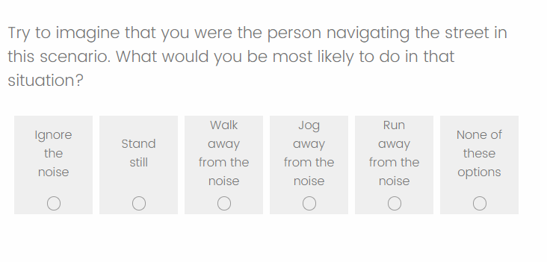
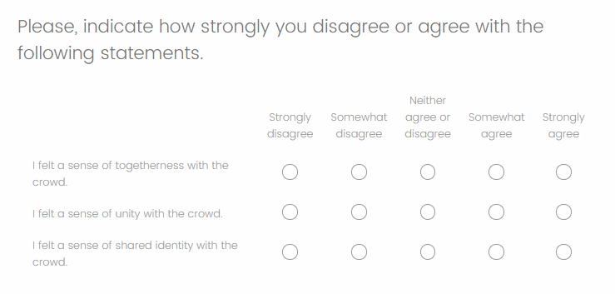
GENERAL PROCEDURE
Videos extracted from the software created by Make Real
Followed by a survey
Measured in the survey
Most likely behavioural response
Shared social identity with the crowd
Shared fate
Diagnosticity of the crowd
Anxiety, perception of danger
Etc.
Manipulated in the video
Ambiguity of the sound
Shared social identity
Crowd response
Group beliefs
Police intervention
E.g., Most likely behavioural response
E.g., Shared social identity

Slide 5

A GLIMPSE OF THE RESULTS
Pre-registered on OSF
Experiment 1
Ambiguity of the sound
  Ambiguous
  Non-ambiguous
Crowd’s response to the noise
  Control (no crowd response displayed)
  Crowd ignores the sound
  Crowd runs away from the sound

Slide 6
A GLIMPSE OF THE RESULTS
Pre-registered on OSF
Experiment 1
Ambiguity of the sound
  Ambiguous
  Non-ambiguous
Crowd’s response to the noise
  Control (no crowd response displayed)
  Crowd ignores the sound
  Crowd runs away from the sound

Slide 7
A GLIMPSE OF THE RESULTS
Pre-registered on OSF
Seeing the crowd running increases the behavioural response to run through an increase in shared social identity.
Shared ID
.995**
.219**
Crowd Response
Behav. Resp
.844** (.218)

Slide 8
A GLIMPSE OF THE RESULTS
Pre-registered on OSF
Seeing the crowd running increases the behavioural response to run through an increase in shared identity with the crowd, which in turn increases diagnosticity.
Shared ID
.350**
Diagnosticity
.995**
.180*
.927**
.156*
Crowd Response
Behav. Resp
.677** (.063)

Slide 9
A GLIMPSE OF THE RESULTS
Pre-registered on OSF
Experiment 2
Shared social identity
  Crowd perceived as ingroup members (i.e., environmentalists)
  Undefined
Crowd’s response to the noise
  Control (no crowd response displayed)
  Crowd ignores the sound
  Crowd runs away from the sound

Slide 10
A GLIMPSE OF THE RESULTS
Pre-registered on OSF
Experiment 2
Shared social identity
  Crowd perceived as ingroup members (i.e., environmentalists)
  Undefined
Crowd’s response to the noise
  Control (no crowd response displayed)
  Crowd ignores the sound
  Crowd runs away from the sound

Slide 11
FUTURE DIRECTIONS
Varying behavioural responses within the crowd
Understanding how a potential emergency is appraised
  Before seeing the crowd response
  After seeing the crowd response
Impact of the broader social context
  Threat level
Police intervention
  Social identification with the authorities and/or the crowd
  Trust in authorities
OUTPUTS
Templeton, A., Telga, M., & Arias, S. (2021). Understanding crowd responses to emergencies using virtual reality and social psychological methods. PsyArXiv. https://doi.org/10.31234/osf.io/6yz5c
Templeton, A., (2021). Enhancing Security Culture at Publicly Accessible Locations. Security and Policing. Online event.

