Slide 1
Power, Principles and Practices for Authentic Research Partnerships: Mobilizing for Change
Peter Taylor, IDS
29 Febuary 2024

Slide 2
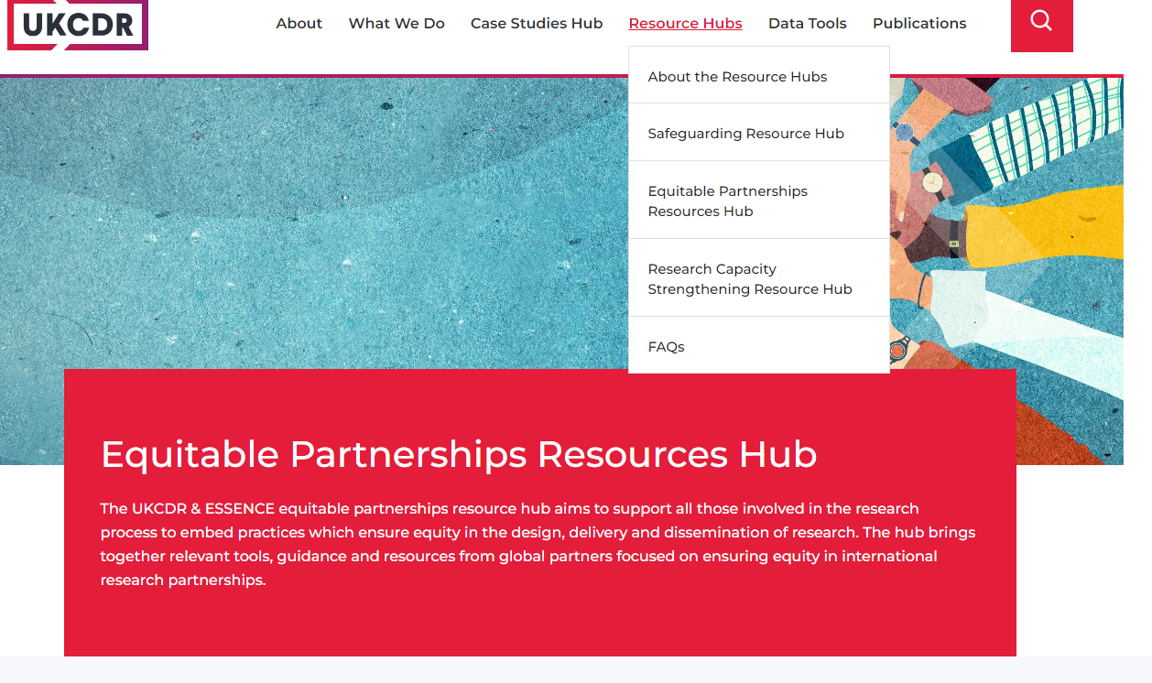
What do we mean by equitable partnerships?
“Partnerships in which there is mutual participation, mutual trust and respect, mutual benefit and equal value placed on each partners contribution at all stages of the research process” (UKCDR, 2022).

Slide 3
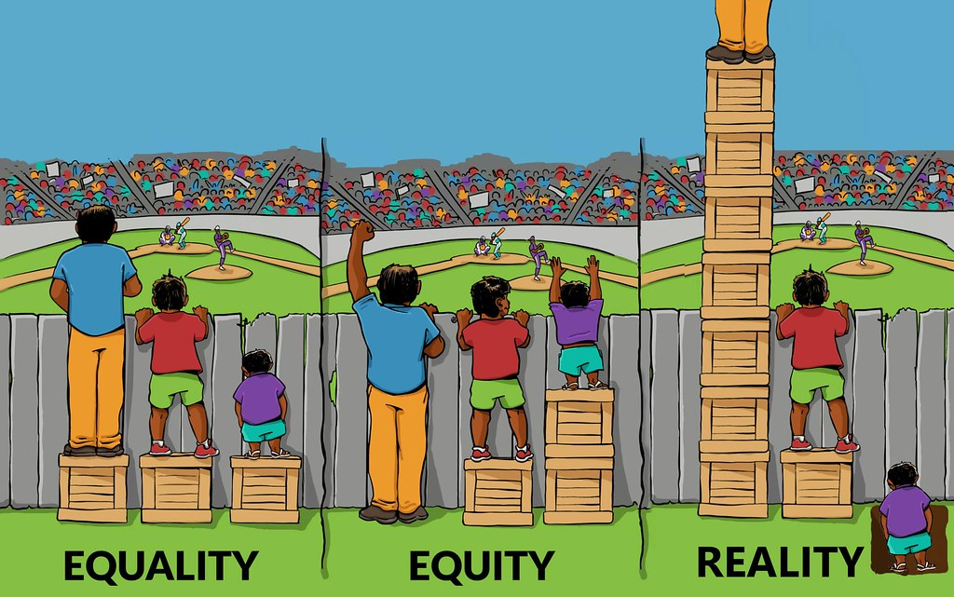
Equity, equality, reality?

Slide 4
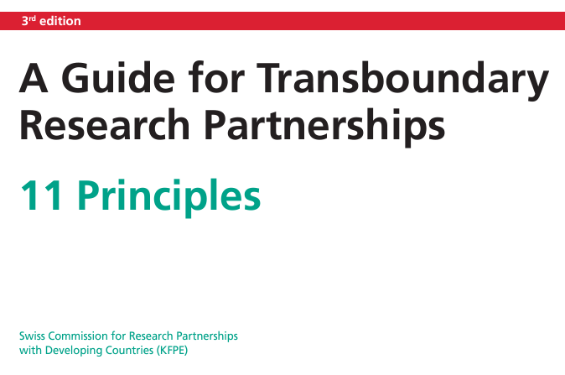
Why equitable partnerships?
“The ability of researchers to work successfully in equitable research partnerships; awareness of the benefits of such research partnerships; and suitable and sufficient support – enable research collaboration to be used more widely and effectively to contribute to sustainable development and to solving global and local challenges” (KFPE, 2018).

Slide 5
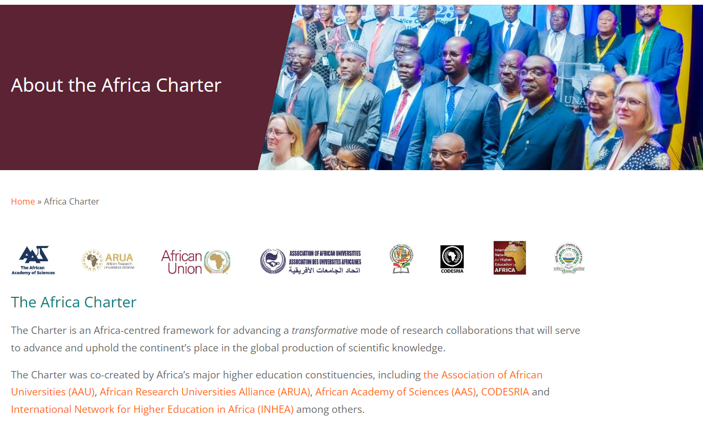
Many initiatives, including the Africa Charter

Slide 6
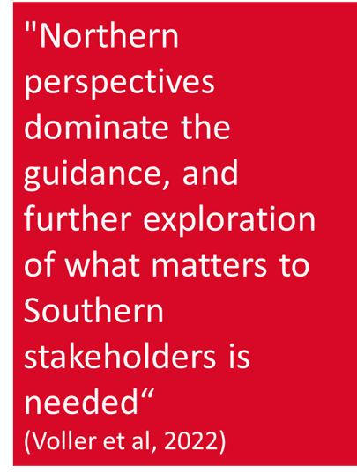
Equitable partnerships a “hot topic” – but why so difficult to achieve in practice?
Collaborations between stakeholders in global North and South expanding
Successful research partnerships strive for equity, inclusion and mutual respect
Growing debates/guidance about how research partnerships should be implemented more equitably and authentically
But is progressive change really happening?

Slide 7
“Pathways to impactful and equitable partnerships in Research for Development: a co-created, action-learning initiative”
Aim: to understand and explore how imbalances in power relations within research partnerships and collaborations involving institutions in the global North and South can be meaningfully addressed, identifying incentives and the means to drive change towards more inclusive and equitable arrangements
Time frame 2023-2024
Led by Southern Voice
Partnering with IDS
Funded by IDRC
https://www.ids.ac.uk/projects/pathways-to-impactful-and-equitable-partnerships-in-research-for-development-a-co-created-action-learning-initiative/

Slide 8
Insights from year 1 of the project
“Equitable partnerships” agenda has momentum within institutions of the Global North that engage in partnerships for research in the Global South
Perceived benefits include desire to enhance effectiveness and efficiency of research projects, and a moral imperative to “decolonize” practices
Brought about positive actions, e.g. further localization, numerous principles and guidelines, and emphasis on open dialogue
Global South researchers acknowledge existence of many imbalances that manifest at various stages and levels of a North-South partnership for research
But their primary concerns relate to how these partnerships perpetuate, rather than mitigate, the dynamics of the structures in which they operate

Slide 9
1. Power dynamics
Power acknowledged by some (not all!) global North development research actors as determining how collaboration works in practice
Growing interest in overcoming deep structural inequities by strengthening research systems in the global South and promoting more equitable knowledge ecosystems
Current discussion of power relations, conflicting interests in partnerships, and deconstructing global research agenda driven mainly by global North actors
Danger of co-opting language relating to equitable partnerships, localisation, shifting power and decolonisation by global North organisations – are they just buzzwords or fuzzwords?

Slide 10
2. Equity in research partnerships
Often associated with co-creation of knowledge, more inclusive and participatory practices - some progress, but many challenges
Terminology frequently used, but not well-defined. “Equity” and “partnership” contested concepts. Other terms also used, e.g. collaboration, cooperation, equality, fairness. More buzzwords?
“Partnerships” can include modalities, duration, composition, budgets and focus on capacity building
Lack of information on how partnership principles or commitments are implemented, enforced or monitored, or how “success” is measured
Limited evidence base, low risk appetite, few accountability mechanisms or professional rewards that incentivize positive change and challenge inequitable practices and power relations in research partnerships

Slide 11
Many examples of inequitable practices
Research collaborations with “pre-set” agendas leave little room for Southern scholars to include contextual experiences in research, to co-create research, or add to its framing
Intellectual property and power asymmetries that govern work responsibilities are major impediments to trust
Lack of financial resources a daily reality for most development organisations in global South; project-based nature of most funding unconducive for long-term strengthening of institutional capacities
Partnering often the only way for global South researchers to access funding, so at a disadvantage when navigating the rules of the game

Slide 12
3. Plethora of guidelines and principles
Important, helpful, aspirational, growing emphasis on mutual learning
But moving to action proves difficult
  Innovation needed, challenging status quo
  Risk appetite still low
  General lack of organisational reflection on processes of research design and implementation, and power dynamics involved (N-S, S-S)
  Need critical rethinking of norms, rules and practices underlying research partnerships
  “Safe spaces” needed for catalysing open dialogue on sensitive issues
Few observable changes in partnership practices; large gaps between stated ambitions of equitable research partnerships and actual practice

Slide 13
Some common themes in guidelines
Invest time/resources in relationships (not a quick fix)
Foster mutual respect
Achieve shared priorities/agenda-setting
Nurture long-term relationships based on shared values, institutional requirements
Assure equitable funding arrangements (budgets, financial management)
Join up efforts with other funders, mutual learning/ reflection, sharing data/networks
Build accountability mechanisms in partnerships; embracing funder flexibility
Embed transparency (roles/ responsibilities/ rights of each partner)
Encourage feedback on power dynamics and funder behaviour
Define ethics and normative standards with clear partnership principles
Engage with context, local knowledge/ experience

Slide 14
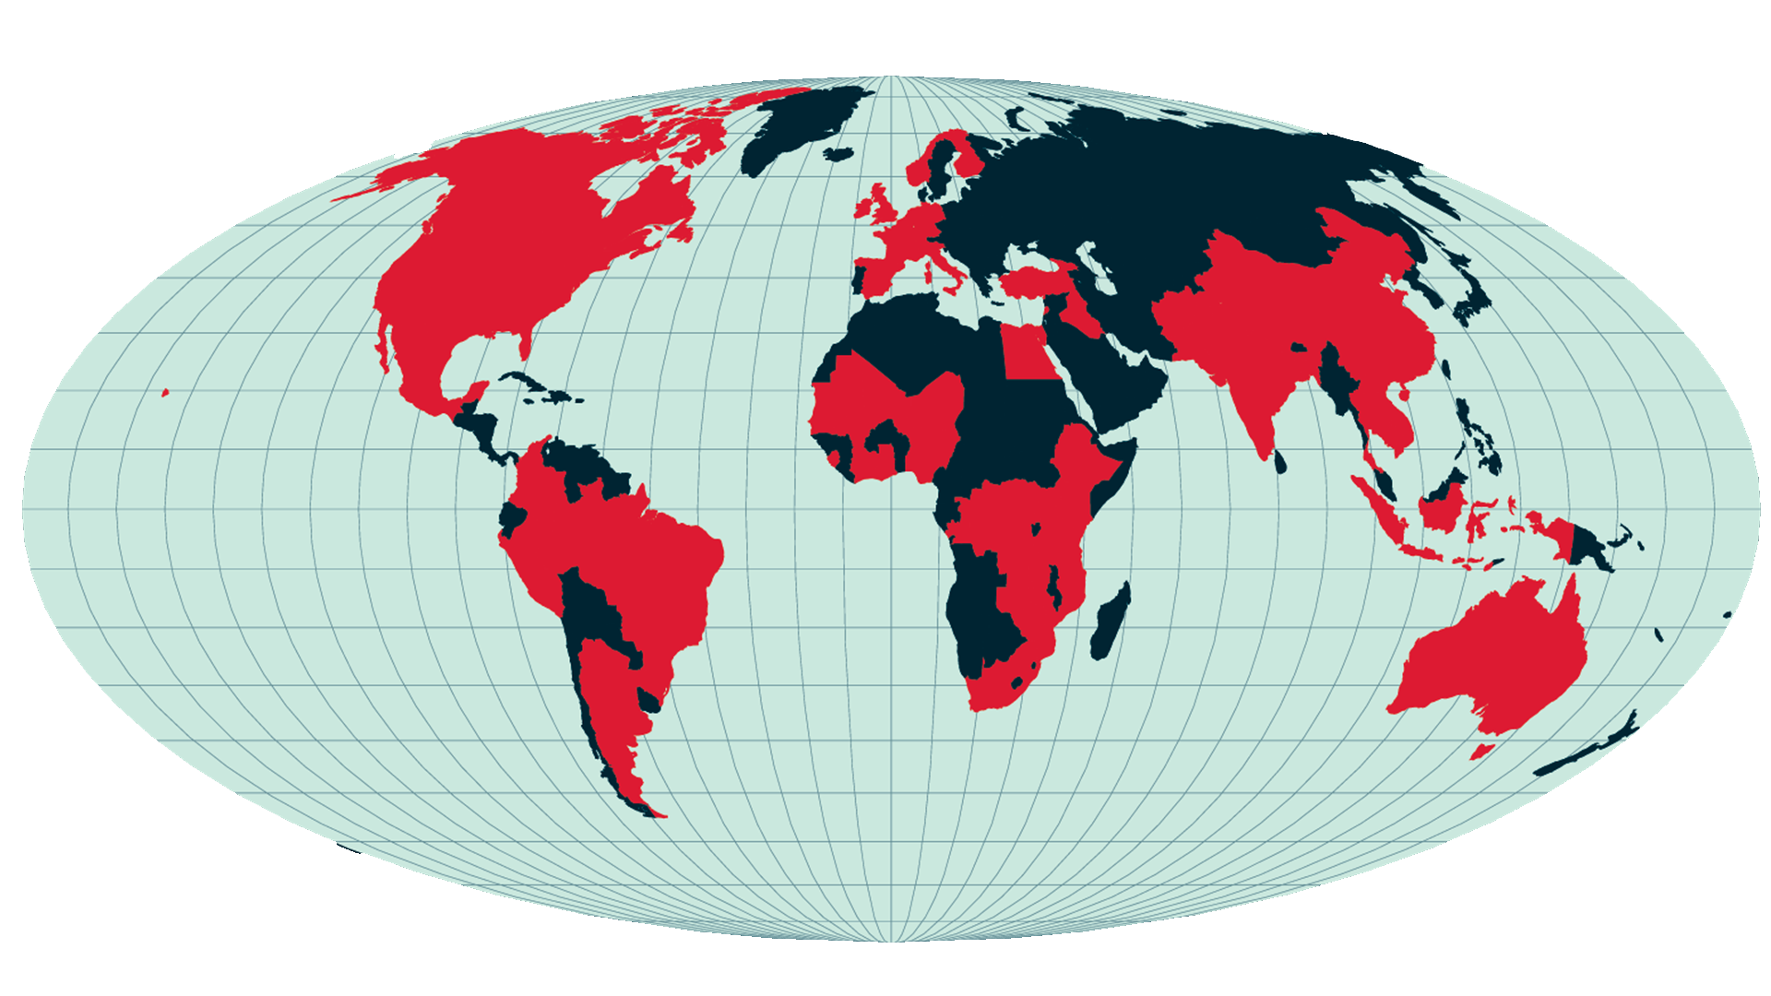
What about IDS Partnerships?
We work with:
Civil society organisations
Think tanks
Public sector bodies
Academic and research institutes
UN agencies
We currently have over 360 research, learning and funding partnerships in over 50 countries

Slide 15
IDS approach to partnership grounded in our values
“Our values are core to who we are, what we stand for and how we behave. They apply equally to how members (staff, students, alumni and associates) work together within the Institute and how IDS works with partners and sub-contractors.”
“We strive to be respectful, inclusive, resourceful and excellent”
But we need to do more – learning from experience with others, and strengthen our approach to partnerships

Slide 16
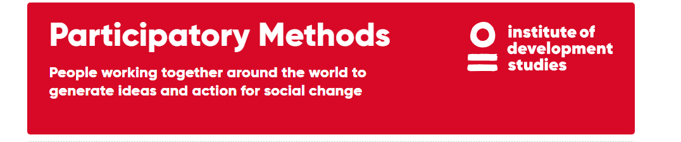
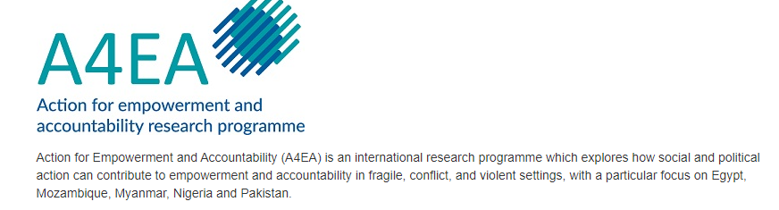
Prior work shaped IDS thinking and practice on partnerships
Pathways of Women’s Empowerment
- an international research and communications programme established in 2006 with the aim of understanding and influencing efforts to bring about positive change in women’s lives
Whose knowledge counts?

Slide 17

International Centre for Tax and Development
Partnering guidelines:
Clarity from beginning about what is on “offer” and expectations of projects
MOUs, contracts, remuneration
Data and confidentiality
Engagement, mutual learning, and communication throughout the project cycle
Publication and authorship
Coordination across projects and programmes within a portfolio
Take the time needed to put these building blocks in place

Slide 18
Practical areas for action
Revisit institutional arrangements and agenda setting:
  Reboot financial, legal, collaborative, risk management processes
  Provide evidence on what successful, authentic partnerships look like – and how they take shape over time
  Build in accountability mechanisms grounded in feedback and transparency
Be intentional and power-aware about research relationships:
  Enable co-design throughout
  Multi-directional knowledge and skill sharing, mutual learning
  Address publications, IP and work distribution issues
Enable knowledge co-creation:
  Support multi-stakeholder partnerships grounded in humility, trust, respect

Slide 19
Emerging ideas for further exploration
Steer away from equitable partnerships as aim, focus on purpose of collaboration
Work towards strengthening knowledge systems across the Global South, in turn, helping to strengthen global knowledge systems
Establish a foundation for partnerships in equity and inclusion, and awareness of the need to tackle power differentials
Tackle unequal policies, practices and norms in response to 3 key questions:
  How is research rewarded, valued and funded? (Setting rules of the game for agenda setting, co-creation, collaboration and catalysing change)
  How is research done? (Research processes, co-production, valuing a range of knowledges, puts leadership of southern researchers at centre)
  How is research used? (Publications, engagement, other forms of influence)

Slide 20
Power, Principles and Practices for Authentic Research Partnerships: Mobilizing for Change
Thank you for listening

