Slide 1
Fighting Corruption:
The IMD World Competitiveness Center Experience
Professor Arturo Bris Professor of Finance, IMD
Director, IMD World Competitiveness Center

Slide 2
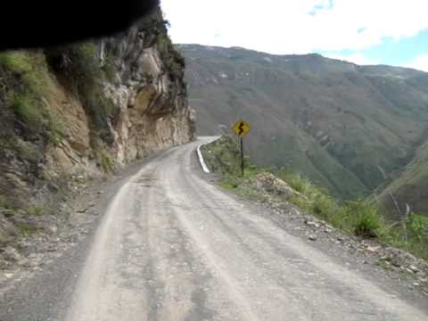
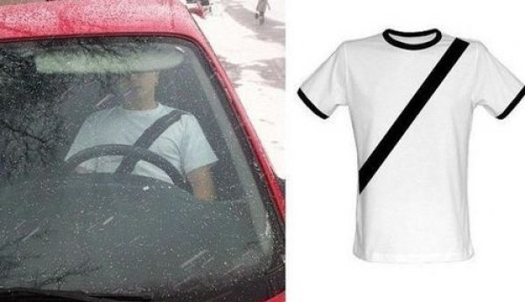
Regulation is Ineffective at Curtailing Corruption
Market Failures: Seatbelts in Peru

Slide 3
Regulation is Ineffective at Curtailing Corruption
Market Failures: Seatbelts in Peru

Slide 4
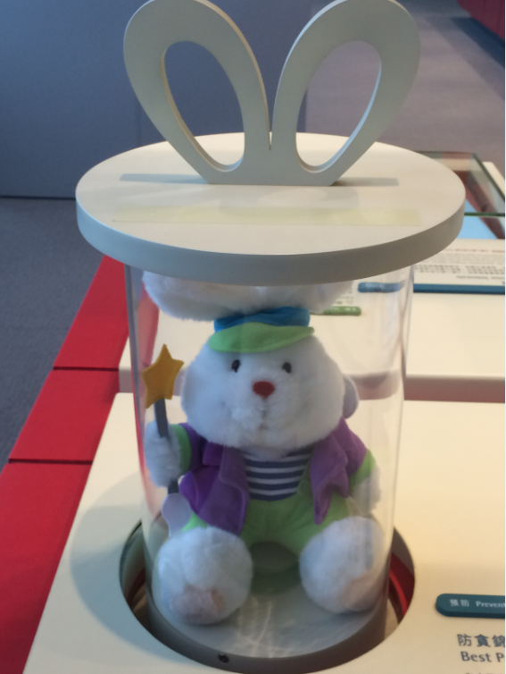
Three Main Drivers of Anti-Corruption Policies
1. Education
Gee Dor Dor in ICAC Museum
Independent Commission Against Corruption,
Hong Kong

Slide 5
Three Main Drivers of Anti-Corruption Policies
2. Technology as a tool
  Blockchain technology, transparency, cryptocurrencies
  Smart Cities
  Smart Technologies

Slide 6
Three Main Drivers of Anti-Corruption Policies
3. Public sector reform
  Public Sector Salaries
  Public Sector Processes and Culture

Slide 7
Moral Leadership*
Omnipotence
Cultural Numbness
Justified Neglect
* “The Psychology of Unethical Behaviour”, Merete Wedell-Wedellsborg

