Slide 1
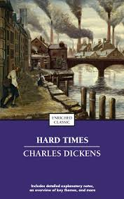


Pedagogies of Hope and Transformation
Julia Sutherland, University of Sussex,
UKLA Conference, 5-7 July, 2024
j.c.Sutherland@sussex.ac.uk
Notes:
SHOW THE PHOTOS – 800 libraries have closed since 2010 in the UK
I have the honour of summing up this fantastic conference on literacy – I’ve called this presentation in a rather grandiose/pretentious way - Pedagogies of Hope and Transformation we’ve seen so many of these innovative, creative, inspiring approaches to learning this weekend and I want us all to go home on a high, feeling we can ‘Make a Difference’ – go home to our contexts – teachers/teacher educators/researchers or all 3 –
I’m a SL, teacher educator, researcher and DTL in School of EWS but I am also at heart a TEACHER and I was a teacher in London mainly, e.g. Hounslow in brilliant, multi-ethic diverse, community secondary comprehensive. But it’s true to my belief in all of those roles, READER & as a critical theorist that we all have to strive to introduce Pedagogies of Hope – Paolo Freire’s phrase – that we collectively believe are in the best interests of the – often very marginalised - students we teach & for a more socially just, democratic, sustainable education system – and world.

Slide 2
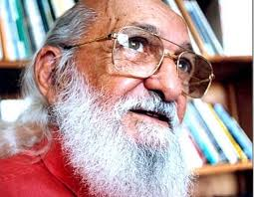
Hope is an ontological need. We need critical hope the way a fish needs unpolluted water. The idea that hope alone will transform the world…is an excellent route to hopelessness…
But the attempt to do without hope, in the struggle to improve the world … is a frivolous illusion.
(Freire, 1994; Fanon, 1952)
Notes:
Thanks to Arlette Willis for corrections - Hope AND struggle – are both relevant to this story… Arlette – your correction of Freire’s borrowing of critical consciousness from Franz Fanon – Arlette Willis
The idea-that hope alone will transform the world, and action undertaken in that kind of naiveté, is an excellent route to hopelessness, pessimism, and fatalism. But the attempt to do without hope, in the struggle to improve the world, as if that struggle could be reduced to calculated acts alone, or a purely scientific approach, is a frivolous illusion. To attempt to do without hope, which is based on the need for truth as an ethical quality of the struggle, is tantamount to denying that struggle one of its mainstays

Slide 3
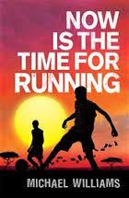
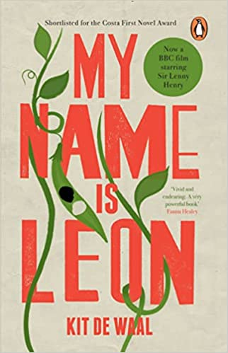

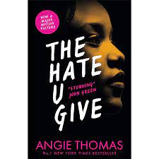

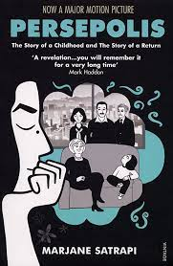
Aims
Identify how readers learn to comprehend and interpret whole texts, including in a second language
Explore implications for policy, pedagogy and practice, internationally
Use the case study of the Faster Read & its impact across 10 years on:
students’ reading & engagement
teachers’ knowledge & practices
Why teachers have adopted it, ‘transforming’ their practices?
What have we learnt from this conference:
What is reading?
What does a rich conceptualisation of reading mean for pedagogies of hope?
Notes:
ALWAYS 2 STRANDS to the FR – What interventions might support students’ reading comp & engagement AND as imp. How can we support
Tell the story of the Faster Read & its impact across 10 years – and I think it’s a hopeful story in a time of climate catastrophe, escalating poverty, continuing learning losses, post-Covid, 200,000 students in England no longer in school as the system does not suit their needs and a performative policy framework globally that is putting huge pressure on teachers/students and imposing prescriptive, one-size-fits all pedagogies – colleagues in Ohio in Science of Reading session were describing levels of prescription in the teaching of early reading and State surveillance of what is going on in schools and ITE courses in relation to reading - very disturbing
TEACHERS CHOOSING TO DO THE FR sometimes against initial opposition in their schools – but convert Heads to it -
Introduce - PI for the Faster Read, Univ of Sussex. Colleagues – Jo Westbrook in Ed, Jane Oakhill in Psych, and I – 1st created and researched the FR 10 years ago, 2014-15 & we have findings from the original study and from 2 subsequent ‘impact’ studies – 1st 3 yrs later (2017) & recently, 8 yrs later (summer, 2022). Quick recap on original research & its impact on students/esp struggling readers and teachers, and then focus on impact over time: WHY & how has the FR spread nationally, across the UK although more prevalent in London & SE & partic. WHY its longevity & teacher commitment?

Slide 4




The Story of the Faster Read, 2014-24. Dual Aims:
1) How can we support struggling and disadvantaged adolescent readers to develop reading comprehension and engagement of whole, fictional texts in class?
2) How can we support teachers to deepen understanding of reading, change practice & sustain any impact?
Notes:
2014 - Reading comprehension for adolescents – 11-14 yrs - was relatively under-researched compared with early reading and primary reading – Cinderalla in research – many seemingly promising studies failed to achieve significant growth in reading comprehension, despite research-informed interventions EG Burdumy et al
Teacher educators want interventions to become embedded in practice – so need to take teachers with you and ensure that any CPD enables deep knowledge & practising the new
20 years of international surveys: Education ‘fails’ 20% 15-yr olds, disproportionately from disadvantaged groups (EACEA, 2011; PISA, 2023)
Reading gap widens at secondary: 89% NC Level 4; 69% GCSE, A*-C (DfE, 2015)
Little research on adolescent comprehension, esp. in mainstream ‘low sets’. Persistent problem - recent studies - no measurable increases in comprehension (James-Burdumy et al. 2012; Vaughn et al, 2015; Baye et al, 2019)
Teachers have inadequate knowledge of cognitive processes of reading (Moats, 2011; Risko et al, 2008)
Policy UK & US - How much time spent on reading whole texts in English? Is reading for pleasure expected to occur elsewhere, e.g. DEAR?
30 years’ dense NC, 2001 National Strategy, GCSE changes & performative culture -focus on deconstructing extracts + written analysis – PETAL! Cf US critiques of ‘close reading’ policy (Swanson et al, 2016)
…..Cinderella of Research in Reading – under-researched
Our first research was conducted 10 years ago – focus on reading comprehension FICTION – so literature –
Adolescent reading comprehension – 11-14 years – Year 8 – but it has been adopted by many primary teachers
Reading comprehension in 2014 was relatively under-researched compared with early reading and primary reading – Cinderalla in research – many seemingly promising studies failed to achieve significant growth in reading comprehension, despite research-informed interventions EG Burdumy et al …..
Our first research was conducted 10 years ago – focus on reading comprehension FICTION – so literature –
Adolescent reading comprehension – 11-14 years – Year 8 – but it has been adopted by many primary teachers
– in 2014 – and my colleague Jo and 2 English teachers presented at this conference in this room - before we started the FR on other research…
So there’s a lovely circularity to this story – we’re back where we started – and one of the books that the teachers wanted to teach was the book they had voted for at the Book Awards – Now is the Time for Running – a story about two Zimbabwe brothers fleeing as refugees from Zimbabwe to South Africa
START at the end…. NON-LINEAR NARRATIVE -

Slide 5


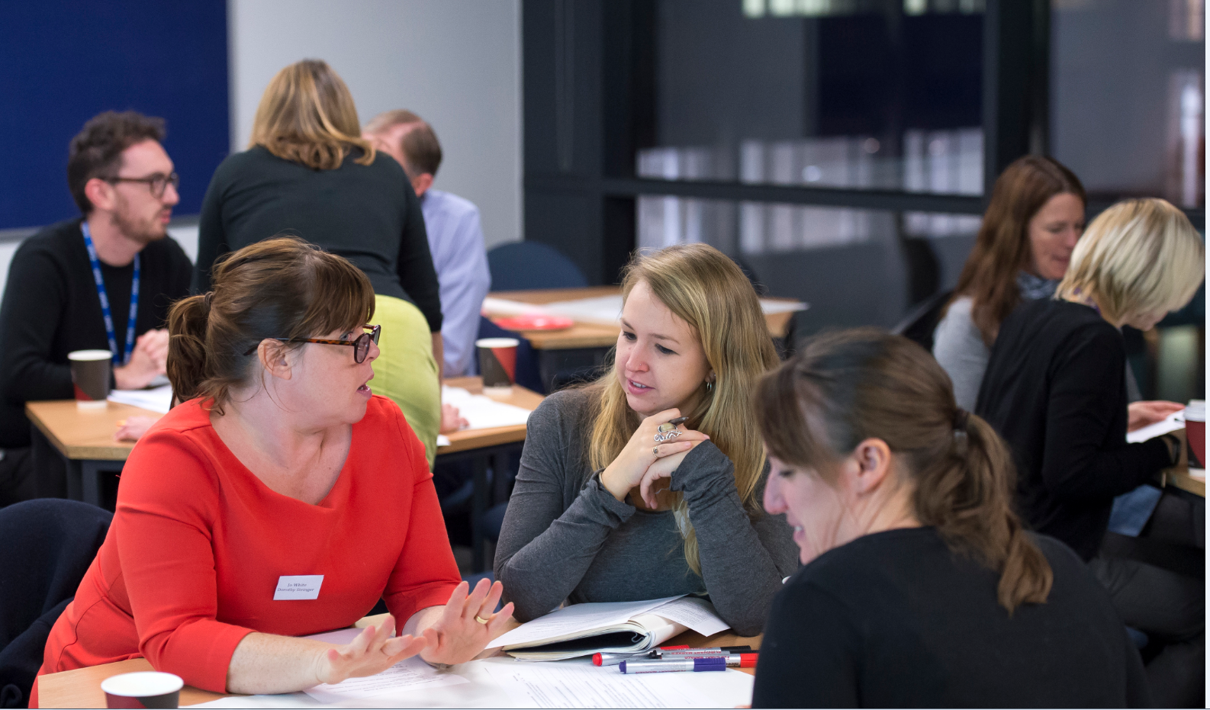
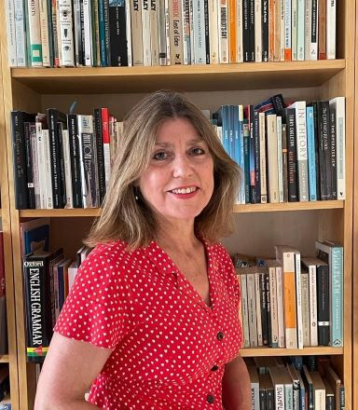
Decade of Dialogic Collaboration:
Researchers & Teachers
Across disciplines and paradigms & with teacher educators: robust research to influence policy (McMasters et al, 2014)
Jane Oakhill, Cognitive Psychology – processes of reading comprehension & inference; experienced in RCTs
Education: Sociocultural & Critical theories – social-constructionist: qualitative/mixed-method
Jo Westbrook – whole-text reading
Julia Sutherland – dialogic talk & group reading
Teacher participants & adopters of the FR, UK
Original Study, 2014-2015: mixed-method, tests & qualitative data
2 impact studies, 2017, 2022: mixed-method & qualitative
2015-2024 Waves of 40+ CPD & conferences
Webinar, July 16: Teachers share experiences
Notes:
Dialogic collaboration across disciplines and univ/school boundaries –
STRUGGLE – paradigm wars - RCTs, positivist – randomised sample, test a variable, eliminate others & keep things simple – Ohio colleagues’ frustration with teachers contaminating the study by introducing aspects that were not part of the condition being tested – totally right
But Sociocultural theorists – social-constructioninst designs big & multifaceted design an integrated multi-pronged intervention – over-complex - different elements may be hard to disentangle the different elements contributing to its success – Jane – very nice – Jo & I more argumentative – compromise – mixed-method
Prof Jane Oakhill – internationally renowned for her work in reading comprehension and the causes of failure to comprehend with students with learning difficulties – Primary
photo of our first impact case study in 2017 – colleagues presenting at this conference were there – Theresa Gooda – other colleagues have just presented at NATE – Cathy Savage – on Bucking the Trend in English A Level
This is original participants and those using the FR reviewing the FR after 3 years…
Jo has presented earlier this weekend on her international research on reading and the policy landscape on phonics.

Slide 6
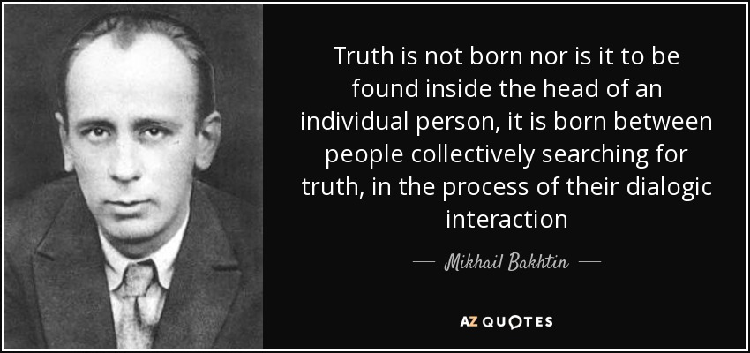
BAKHTIN
‘Any true understanding is dialogic in nature and … strives to match the speaker’s word with a counter word.
Life by its very nature is dialogic. To live means to participate in dialogue: to ask questions, to listen, to respond, to agree…
Consciousness is, in essence, multiple’
(Bakhtin, 1986: 95, 69; 1984:293)
1984: 110
Notes:
Oneness – countering policy that is not well-informed by the research – Dominic Wyse & Rachel
Non-linear narrative – disrupting convention – in the way that we’d want our students to do in their writing of stories – thought you might be more interested in the impact – esp if anyone has a train to catch.

Slide 7

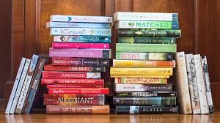
Chapter One – Why focus on 11-14 years’ reading comprehension & is it still relevant?
UK Poverty was deepening, then & now: 1 million children, 4 million people live in ‘destitution’ 2021-22, unable to meet basic human needs. (Fitzpatrick, 2023)
Being a successful reader is central to students’ academic success, progression to employment, HE, future life, health and human flourishing
But 20% 15-year-olds in OECD countries & 40-45% in the Global South STILL have inadequate reading literacy – consistent for 20 years – disproportionately from disadvantaged groups (OECD, 2023; Delprato & Shepard, 2023)
Secondary comprehension under-researched & few intervention studies show statistically significant growth (e.g. Baye et al, 2019); few on whole-text reading
Pre-pandemic research, but Covid has exacerbated reading losses in England for those in poverty (DfE, 2022)
UK Levels of reading enjoyment & amount of independent RfP were declining then and now: 60% FSM/boys, 8-18 yrs do not enjoy reading & prefer reading in school. Only 28% read daily, RfP - lowest ever - NLT (2023). But RfP at 10 years is a greater predictor of GCSE success than parents’ level of education (Sullivan & Brown, 2015). Access to books & extended reading can enhance comprehension for disadvantaged students (Allington et al, 2010)
Reciprocal relation between reading skill, exposure to print & reading comprehension – the Matthew Effect – the ‘rich’ get richer, the ‘poor’, poorer… (Cunningham & Stanovich, 1984; van Bergen et al, 2020; Mol & Bus, 2011)
Notes:
37/39 countries for child poverty – increasing – rate of 20.7% -
Reading for pleasure at 10 years helps overcome disadvantage - a stronger predictor of GCSE success than parents’ education (Sullivan & Brown, 2015).
Students need to read many whole, extended texts to improve their reading comprehension - the ‘Matthew Effect’ - strong relation between frequent reading, volume of words read & reading skill: the ‘rich’ [already good readers] get richer, the ‘poor’ [struggling readers], poorer (Cunningham & Stanovich, 1998)
Reading extended fiction, as opposed to other varieties of text, online or print, is particularly related to improvements in reading comprehension (Jerrim & Moss, 2019)
Struggling readers need to gain skills, experience of whole-text reading, motivation & confidence as ‘readers’ (Stanovich, 1986; Mol & Bus, 2011; van de Broek, 1997)
Students from disadvantaged backgrounds less likely to read for pleasure & enjoy reading BUT access to books & encouragement can change this (Clark & Akerman, 2011; Allington et al, 2010; Cremin et al, 2014)
SO Where did this research start and how relevant is the focus of our research today?
So, children from poorest backgrounds and struggling readers aren’t reading independently and aren’t experiencing engaged, pleasurable, whole-text reading
30 years’ dense NC, 2001 National Strategy, GCSE changes & performative culture -focus on deconstructing extracts + written analysis – PETAL!
US theorists critique ‘close reading’ for similar reasons – they lack prior background knowledge – and authenticated knowledge to read texst
England ranks 36/39 in Europe for child poverty – rate of 20.7% - highest increase across all 39 countries (UNICEF, Innocenti, 2023)
20 years of international surveys: Education ‘fails’ 20% 15-yr olds, disproportionately from disadvantaged groups (EACEA, 2011; PISA, 2023)
Reading gap widens at secondary: 89% NC Level 4; 69% GCSE, A*-C (DfE, 2015)
Little research on adolescent comprehension, esp. in mainstream ‘low sets’. Persistent problem - recent studies - no measurable increases in comprehension (James-Burdumy et al. 2012; Vaughn et al, 2015; Baye et al, 2019)
Teachers have inadequate knowledge of cognitive processes of reading (Moats, 2011; Risko et al, 2008)
Policy UK & US - How much time spent on reading whole texts in English? Is reading for pleasure expected to occur elsewhere, e.g. DEAR?
30 years’ dense NC, 2001 National Strategy, GCSE changes & performative culture -focus on deconstructing extracts + written analysis – PETAL! Cf US critiques of ‘close reading’ policy (Swanson et al, 2016)
Reading ability and motivation are related to reading comprehension
Early ideas – identifying the problem
These figures re poverty are from TODAY, 2024, because tragically, poverty has deepened since we started thinking about it
Reading literacy – broad definition – ability to function as a citizen in society, in terms of work, health literacy, etc
Our assumptions/theories:
Explore how secondary-school students might be supported to better read, comprehend and interpret whole texts in English classes – raise reading level and reading engagement.
Teachers of reading must position themselves as ‘intellectuals’ and ‘dialogical problem-posers’ (Giroux, 2011; Freire, 1972), using theorised pedagogy to develop students’ reading abilities, engagement and reader identities in a community of enthusiastic readers, at school and independently, ‘talking back’ to policy-makers, where necessary.
In England, 20% of students have inadequate reading literacy, measuring below Level 2, with 24% just reaching Level 2 itself according to the PISA 2022 results; the average score was significantly lower than that reported in PISA 2018 (Ingram et al., 2023). This means that 44% of students in England read at the lowest levels or below, within the PISA testing framework. This translates into 30% who do not gain a Level 4 in GCSE English, seen as a failure, in terms of being able to progress to GCE A Levels or Further Education (NLT, 2022). The gap in England between those who read well and those who do not has widened considerably, with 10% of students aged 15 years performing at the highest levels. Girls also significantly outperform boys. This gap relates to socioeconomic advantage as those with higher performances in reading come from households with higher annual incomes. As a marker of this economic gap in England, the reading score for PISA for those students receiving Free School Meals (FSM) - a proxy for social deprivation - was significantly lower than for those not on FSM, and 5% of students in England, who completed the PISA tests, responded that their families often did not have enough money to buy food and skipped meals, in comparison to the OECD average of 3% (Ingram et al., 2023).
‘destitution’ has been re-introduced, to accurately define the homelessness, hunger and cold that millions of children are currently enduring in the UK (Fitzpatrick et al., 2023). Since the pandemic, 200, 000 students remain out of school, ‘missing’, or being quietly home-schooled, in response to the inadequacies of education in the face of school closures.
Painting an even grimmer picture, the amount that students are reading, and their levels of enjoyment and engagement have also fallen (Clark et al., 2023; Cole et al., 2022). Yet being a successful reader is central to students’ academic success, progression to employment, Higher Education, future life and human flourishing. There are therefore potentially many more ‘struggling readers’ in - and out - of our schools now. While not the progenitors, but the inheritors of an inequitable world, it will be Gen A’s responsibility as adults to tackle the increasing levels of poverty and conflict in the UK and internationally; and to live with the existential threat of climate change and the unknown consequences of machine intelligence.

Slide 8

Chapters 2-4: Struggling to find a plot that ‘works’
1) How much extended, engaged reading of fictional texts occurs in secondary English classrooms? (Jerrim & Moss, 2019)
14.8% in Language Arts lessons, US (Swanson et al, 2016)
15 mins in 1 hour, including discussion - AI-generated lesson-plan for reading last week!
2) Teacher knowledge? Reading theories are complex – Have secondary teachers had opps. to develop required knowledge - for struggling & disadvantaged readers? How best to provide this? Moats, 2009; Risko et al, 2008; Korthagen, 2017)
3) Policy & practice – effect of performative, high-stakes assessment, focused on GCSE exam requirements at 16 on students of 11-14 years? What reading practices take place?
We started by thinking about what whole-text reading is…
HOLD THIS THOUGHT! What would you WANT the Faster Read to include as an intervention? Infer what we did…
Notes:
Reading extended fiction, as opposed to other varieties of text, online or print, is particularly related to improvements in reading comprehension (Jerrim & Moss, 2019)
Extended print – book – or whole book online – inverse relationship with reading
Reading for pleasure at 10 years helps overcome disadvantage - a stronger predictor of GCSE success than parents’ education (Sullivan & Brown, 2015).
Students need to read many whole, extended texts to improve their reading comprehension - the ‘Matthew Effect’ - strong relationship between frequent reading, volume of words read & reading skill: the ‘rich’ [already good readers] get richer, the ‘poor’ [struggling readers], poorer (Cunningham & Stanovich, 1998)
Reading extended fiction, as opposed to other varieties of text, online or print, is particularly related to improvements in reading comprehension (Jerrim & Moss, 2019)
Struggling readers need to gain skills, experience of whole-text reading, motivation & confidence as ‘readers’ (Stanovich, 1986; Mol & Bus, 2011; van de Broek, 1997)
Students from disadvantaged backgrounds less likely to read for pleasure & enjoy reading BUT access to books & encouragement can change this (Clark & Akerman, 2011; Allington et al, 2010; Cremin et al, 2014)
Engagement = comprehension skills, motivation to read & time spent reading (Guthrie & Wigfield, 2000; McGeown et al. 2015)
PERSISTENCE And PRACTICE in reading
The more children read, the more they develop their vocab., comprehension skills, cognitive abilities, motivation & persistence to read challenging texts
(Cunningham & Stanovich, 1998; Taboada et al, 2012)
What is reading? What are the implications for practice?
Why are we still failing so many struggling and disadvantaged adolescent readers? (11-14 years)
What is reading – in its many dimensions? What does it require to read a whole book? What’s the role of engagement in reading development?
Why do some students struggle with reading? Which reading experiences and pedagogy would support them?
Given how complex theories of reading are, how much knowledge do teachers have about what supports reading, particularly with struggling readers?
What’s missing in policy-makers & schools’ approach to the teaching of reading?
What intervention/s should we trial and how on earth can we combine our different theoretical starting points…?!
Why are we still failing so many struggling and disadvantaged adolescent readers? (11-14 years)
What is reading – in its many dimensions? What does it require to read a whole book? What’s the role of engagement in reading development?
Why do some students struggle with reading? Which reading experiences and pedagogy would support them?
Given how complex theories of reading are, how much knowledge do teachers have about what supports reading, particularly with struggling readers?
What’s missing in policy-makers & schools’ approach to the teaching of reading?
What intervention/s should we trial and how on earth can we combine our different theoretical starting points…?!

Slide 9

The End…Impact of the Faster Read?
How far has it spread?
N= 208 Teachers: Online survey (n= 183), targeting known FR users & via social media + 25 Teacher interviews + 12 Lesson-observations.
Headline Findings:
208+ schools, 40,000+ students & 1000+ teachers currently using it - whole UK
Primary, Secondary, Alternative Provision, Special Education
Estimated 10+ ITE courses teach the FR in reading curriculum
70% report all/most of English Department use FR; 99% recommend it
48% adopted it during/just post-Covid to avoid reading losses or as a ‘catch up’
22% have used it for 4-8 years
49% have used it with 11-32 classes – multiplier effects
Some MATs now spreading it across their schools, via agentive Head Teachers
Notes:
Non-linear narrative – to disrupt convention a bit in the spirit of disruptive pedagogies and because some of you may need to go to catch trains!
survey England, Scotland, Wales, N Ireland. International Interest: US, Australia, Tonga.
Quote from Georgette Ayling Head of BOHUNT

Slide 10
Impact after 10 years: survey & interviews: Majority of teachers say…
Strong impact on KS2, KS3, GCSE & even A Level, improving:
Reading comprehension levels, vocab, reading engagement, identity, confidence: ‘joy of reading’. Large gains for struggling and disadvantaged readers
Understanding whole novel aids complex interpretation, comparison, analysis of structure
Increased no. of texts read: 18 novels in KS3: 11-14 years; many read 9+ texts
Many also say:
Improved analytical or creative writing, & engagement with ‘Big ideas’
Rich oracy & community of readers at centre: develops students’ capacity to express complex ideas, empathy, social skills post-Covid (Oakhill et al, current work)
Therapeutic benefits for all during/post-Covid, especially those excluded from mainstream. Some say: raises attendance and engagement with school
Teachers’ version of FR similar to ours; some only read 1 longer text; some use visualiser, not books – cost of buying new diverse texts – variable impact; some use less group reading/talk – but some misconceptions
Notes:
Teachers often replicated their study in the schools and used standardised tests to measure comprehension
Quantitative data: Main impacts were on reading comprehension & reading engagement
Qualitative data, other impacts: analytical writing, memory (including recalling quotations from books), attendance, concentration, cultural capital, historical, social & political knowledge & interest in ‘big ideas’ for life: ‘Reading is power: students lack the confidence or ability to read these texts on their own. Empower your young people.’

Slide 11
Reading is power: students lack the confidence or ability to read these texts on their own. Empower your young people.
Give students the gift of a whole book, a whole journey for its characters, and this supports them in becoming better equipped for the world beyond school.
I justified reading for 30 minutes with Ofsted, by citing the research and they looked at students’ Lord of the Flies essays and were convinced.
A girl often excluded for poor behaviour now attends, sees herself as a reader, loves reading & asking questions of books!
I read to them in their own homes during Covid and one girl is dyslexic and it’s changed her mindset about what reading is, and she really enjoyed it. Their parents enjoyed being read to, too!
We’re bucking the national trend as many students do English Literature at A Level (Tower Hamlets & Sussex)
What if Ofsted come, what if my Head Teacher comes? What if I have an observation? So, we felt like reading was cheating…And I love that freedom to say to my new teachers now: ‘Reading is the work…Don’t worry about the theory behind it - Just try the Faster Read for yourself and see what happens.. in my class the impact was not just on their reading, which was phenomenal, but on their writing – it leapt ahead!’ (Head Teacher recollecting)
Notes:
Radical change to curriculum: will HoD/SMT support it, long-term? - GUSKEY – KORTHAGEN…
Getting through 2 whole novels in 1 term & maintaining reading engagement in longer lessons (100- minute); balance bet. reading aloud, discussing text & teaching reading strategies & vocab?
Curriculum constraints: how to fit in end-of-term written assessments?
In tension with KS3 ‘Mastery Curriculum’ & performative system, including Ofsted
Where’s the written evidence of progress? How much writing is in the books? Will writing suffer with a primary focus on reading & talk? (Evidence: many teachers report creative & analytical writing has improved with wider vocab used and more understanding of text-structure. One teacher showed Lord of Flies essays to Ofsted to justify spending 30-40 minutes reading, while they observed. Ofsted agreed essays showed strong impact of FR on quality of analytical writing)
Culture change: How to assess reading via talk as teachers not used to this? (Taping of group reading/talk; quick online quizzes; hot-seating; students use quick graphic organisers while discussing text, e.g. timelines, event maps, story mountains; use of 6 oral flashbacks on post-its at start of lesson to assess recall of plot/characters; quick blogs/tweets re characters)
Using reading groups & discussion more often: cultural change for teachers; some academies resist group talk
Cost of new books
‘Just reading, not!’ Recognise the need for rich CPD
Structural challenges – e.g. will SMT support this initiative? – remain, but teachers have largely resolved the other issues on this slide, by practising the model and adapting it to their contexts. E.g. most do it in the Autumn term so that every year group starts with the faster read and 2 novels, to kick-start the year and embed excellent reading and dialogic talk practices, but some teachers do the model in the Spring term.
NB Now that the FR is cited in the Ofsted paper on Research-informed approaches to English teaching, will policy gradually shift towards a recognition of the need for more whole-text focus on comp/interpretation at KS3 and less on the Naming of Parts – micro-analysis?

Slide 12
Pairs - What is reading?
How must we ‘teach’ it?
What is reading? What does it involve, feel like & demand of readers? Reflect on your recent reading of a whole novel to explore ‘reading’
Draw on this discussion & all you’ve learned at UKLA: How can teachers support all to read, especially struggling/reluctant or disadvantaged readers?
Notes:
Susssex buzz - 5 mins – FOCUS on COMPREHENSION
My name is Leon – What Maisie Knew? and To Kill a Mocking Bird, Chaucer Canterbury Tales – child narrator – naïve narrator
Birmingham and Brixton protests about police ‘stop and search’ – Anti-Nazi League marches

Slide 13

What is reading?
Cognitive – set of complex processes; decoding, oral/language comprehension, inference, fluency, role of memory (develops cognition)
Affective: emotional engagement, empathy; therapeutic, cathartic & embodied
Individual – lone reader & personal response (‘Reader response’)
Dialogic & sociocultural – co-constructed interpretations. Build on family/community reading practices/texts, storytelling, readers’ knowledge of multimodal texts/genres.
An imaginative act of enchantment & possible flight from reality, losing oneself in a narrative, being immersed or seduced, forgetting yourself (Felski, 2008)
BUT also - A deepening of engagement with ‘reality’ – other perspectives people, different worlds, historical times, cultures, ways of being
Critical, detached & political reading & analysis: what view of the world & ‘reality’ does this book present? What power dynamics are normalised? Practical Criticism, Materialist, etc…(Eagleton, 2008)
Notes:
W
Cognitive – set of processes; role of memory – complex/challenging; develops cognition)
Affective – emotional engagement, empathy; therapeutic, cathartic
Embodied – shuddering, hairs on back of neck, laughing, tensing up, willing a character to get out of a challenging situation – clenching hand (Come on…)
Individual – lone reader in their head – personal response (‘Reader response’)
Dialogic & sociocultural – co-constructed interpretations & Bakhtinian responsiveness. Builds on family/community reading practices & texts, storytelling, draws on readers’ knowledge of multimodal texts and genres.
An imaginative act of enchantment & possible flight from reality, losing oneself in a narrative, being immersed or seduced, forgetting yourself
A deepening of engagement with ‘reality’ – other perspectives/people, different worlds, historical times, cultures, ways of being
Critical, detached & political reading & analysis: what view of the world & ‘reality’ does this book present? Whose interests are represented & whose marginalised? What power dynamics are normalised? Which intersectional identities are represented or excluded?
56% 8-18 years do not enjoy reading, highest no. since 2005 NLT survey started
60% FSM
Aristotle’s catharsis – purging of the emotions of pity/sympathy and fear – live through intense emotions and emerge feeling better
Iser – pronounced ESER
Bakhtin (1981)hose interests and identities are represented marginalised? What power dynamics are normalised?

Slide 14
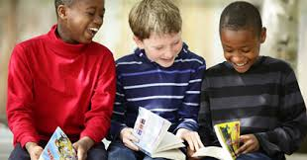
Implications for teaching in lessons?
Engagement – choice of text: culturally diverse, challenging YA novels
Whole texts in class – pleasurable reading in class, not just outside: experience narrative complexity – challenge of comprehending whole text
Many novels & time spent reading – engagement & exposure to print develops comprehension/interpretation, vocabulary & fluency
Faster reading aloud supports narrative arc, inference, making links across text, support for memory for struggling readers & fluency
Hand-over of reading strategies: inference, story-structure (use graphic organisers) comprehension-monitoring questioning, predicting, summarising, visualising, empathizing
Dialogic class & group talk to practise ‘being a reader’, engaging with & interpreting text, asking authentic questions, modelling how to read
Conditions: quiet space for concentration, support from role models, books that represent students’ identities (NLT, 2023) + noisy space for dialogic talk
Creative pedagogies, drama and visual

Slide 15
Experienced ‘Faster Read’ Teachers explain what they like about this approach:
Faster Read Sussex Website Teachers Talk about their Experiences
4.34 start
Two of the schools are in disadvantaged areas with above-average numbers of students in receipt of Free School Meals
Many thanks to:
Jonny Pearson, Head of Community and English Teacher, Sackville School, West Sussex
Emily Evans, Head of Staff Development and English Teacher, Bohunt, West Sussex
Lauren Haywood, Curriculum Leader for English and Lead Practitioner, Peacehaven Community School

Slide 16
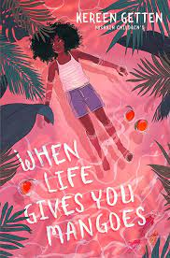

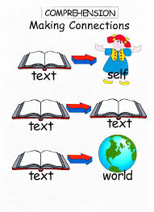
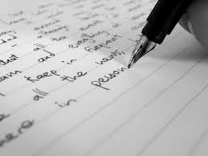
How is reading taught in 11-14 years classrooms?
Where is whole-text reading expected to take place?
We leapfrog over reading comprehension and move straight to analysis – I’ve only just realised this and I’ve been teaching for 11 years!
Practice, 2014…Now?
Faster Read
Slow, fragmented read of 1 text
Focus on written analysis, by reading extracts - & micro-analysis: the ‘Naming of Parts’
Text choice: Victorian, canonical, unrepresentative of student identities, no focus on engagement
Interrupted: short chunks: ‘read a bit, write a lot, read a bit, write a lot’ (Anna)
Whole-class or Individual; little group reading
Comprehension is ‘assumed’: little checking or teaching of whole-text comprehension for all, especially ‘struggling readers’
Literary criticism for GCSE testing at 16 years: Why has the author done X?
Increased amount & pace of whole-text reading: Faster, immersive read - 2+ whole texts
Focus on reading comprehension/interpretation AND reading engagement – pleasurable reading in lessons
Text choice: engaging, challenging, culturally diverse
Uninterrupted – reading like a ‘reader’: longer chunks read aloud & expressively
Group reading & dialogic class talk: questioning, meaning-making: develop reader identity & habits
Explicit teaching & group modelling of inference & reading strategies + Oral assessments
Whole-text comprehension; making connections across/beyond - Big themes & personal response
Inference to…. Analysis & Critical reading
Notes:
Teaching toolkits Pedagogy of Poverty – Haberman – Westbrook – Dominic Wyse and Rachel Heydonn
Science of reading – toolkits – link to Right wing and Right evangelism
Sarah McGeown and colleagues work in Edinburgh… motivation, engagement
Reading aloud – extensive evidence on importance for developing fluency
PISA OECD – 20% students have inadequate reading literacy – 2023 low scores in England for students enjoying reading, but reading comp. has increased over the years. Focus on who was esp. disadvantaged by current model – struggling readers
Collaboration of 3 researchers. Since Sec Nat Strat: 2001: focus on the micro – extracts, language analysis/grammar - 2 pages of novel read; then analyse language – spot literary devices and do PEE, PETAL… paragraphs, based on short extract – Readers, esp, struggling & disadvantaged readers lose comprehension of whole text – leapfrogging over comprehension to analysis
Grace/Teacher realised need to check vocab in pre-20C texts more – e.g. short story – her class did not understand 15-20 key words so missed whole point of story – led her to do more focused work on vocab-development & how to infer and analyse unfamiliar words – morphology, etc, to support reading comp. Grace described the FR, whole-text approach as an ‘epiphany’ – spent 11 years at KS3 assuming comprehension and moving straight to analysis – has radically changed her practice and is now Head teacher of a different school, still promoting the FR in her new school and MAT.

Slide 17
Who said this recently?
Knowing the text should be the first priority of students and the first priority of teaching. The stories that writers tell are fundamental to enjoyment and knowing what happens in those stories, and how events are sequenced, enables students to interpret the texts with authority and engage in discussion about genre and authorial method in a confident and meaningful way … the stories have to come first - they fire the imagination of readers – which is surely what English Literature primarily ought to do?
AQA A Level English Lit. Examiners’ Report, 2023
Notes:
Ironic as this is A Level examiners’ report, 10 years after we 1st created the FR as a group of 3 colleagues – Prof Jane Oakhill in Psych, Jo Westbrook and me. Jane is int expert in reading comp – researched in primary ed but thought full range of inferences not explicitly taught in primary and needed more focus on explicit reading strategies
I’d been researching group dialogic talk/guided reading for some time – reading as a collaborative activity, not individualised – shared meaning-making, listening to others’ perspectives, engagement, fun & based on extensive theory from ‘reader response’& transactional approaches – interaction bet reader/other readers/context/other texts, on. Like adult book groups. Jo – whole-text, faster reading.
What are we currently doing in lessons with reading? Who is falling behind?

Slide 18
Chapter 6: Can teachers transform their practice? Teacher Agency & Learning - our assumptions:
Global, performative education systems deny teachers agency – standardised, ‘scripted’ P/P lessons; little control over text/pedagogy (Biesta, 2014)
But teachers are knowledgeable professionals: ‘intellectuals’ and ‘dialogical problem-posers’, capable of transforming practice, engaged in critical reflection (Giroux, 2014; Freire, 1977; Korthagen, 2017)
Theory matters! No toolkits – CPD must enable teachers to critically reflect, build and challenge knowledge/practice & apply it to teaching
Our intervention must enable teachers to choose which novels to teach, with student identities & design schemes of work for their own classes (Compton et al, 2014; Moats, 2009; Risko et al, 2008; NLT, 2023)
Notes:
Teaching toolkits Pedagogy of Poverty – Haberman – Westbrook – Dominic Wyse and Rachel Heydon
Science of reading – toolkits – link to Right

Slide 19
Chapter 7: What must teachers know about reading?
How do readers read whole texts? Situation Models (Kintsch, 1998)
Why do some readers struggle to comprehend text?
Why is it important to read many whole texts? Reciprocal relation between reading amount & reading comprehension
Role of engagement & reader identity; Choice of texts - becoming a ‘reader’: diverse text representations: developing persistence, habits (Retelsdorf et al, 2011; Cremin et al, 2014, Cliff-Hodges, 2014; Guthrie & Klauda, 2014)
Role of inference, story-structure, self-monitoring, vocabulary, reading aloud (Oakhill & Cain, 2012 Oakhill et al, 2015, Duncan et al, 2015)
Compounding effect of disadvantage: language gap at 5 yrs & reading-experience gap magnifies over time (Blanden & Machin, 2010; Hart & Risley, 2003; NLT, 2022; Baye et al, 2019)
Community reading & dialogic talk: class/groups: reading aloud for interpreting, enjoyment, fluency & using reading strategies in a metacognitive way (e.g. Okkinga et al, 2014; Sutherland, 2015)
Notes:
How do ‘good’ readers read whole texts & construct meaning, creating mental models?
Most imp. 3 elements of reading: inference, monitoring comp – know when stuck – know how to apply a strategy and become unstuck/resolve comp problem; story-structure (Oakhill & Cain, 2012). Role inference at sentence, para, chapter & whole-text levels. Struggling readers: 1) weaknesses in working-memory – can’t retain sense of narrative from sentence to chapter, 2) compounded by slow decoding/weak fluency – strong expressive reader reading aloud, supports their fluency & comp.- weak inference even when they have relevant knowledge – can’t apply – must learn to question & apply that knowledge. 3) Weak comprehenders/inferers – must practise by reading/trying to infer
Why do some readers struggle to comprehend text? e.g. memory, language-processing, cognitive resources overloaded by weak decoding & fluency, problems with inference-making, lack of strategies & reading practice (Oakhill et al, 2015).
Why is it important to read many whole texts? Reciprocal relation between frequent reading, amount (exposure to print) & reading comprehension, esp. extended narratives: the ‘Matthew effect’ the ‘rich’ get ‘richer’, the ‘poor’ ‘poorer’ (Kintsch, 1998; Westbrook, 2013; Cunningham & Stanovich, 1998; Torppa et al, 2020; van Bergen et al, 2020; Mol & Bus, 2011). So, Students need to read many whole, extended texts to improve their reading comprehension.
Roles of reading engagement, inference, story-structure, self-monitoring & vocabulary (Guthrie & Klauda, 2014; Oakhill et al, 2015). Reading for pleasure at 10 years helps overcome disadvantage - a stronger predictor of GCSE success than parents’ education (Sullivan & Brown, 2015).
Compounding effect of disadvantage: language gap at 5 yrs & reading-experience gap magnifies over time. These students are less likely to read independently & do not gain adequate whole-text reading experience in school (Blanden & Machin, 2010; Hart & Risley, 2003; NLT, 2022; Baye et al, 2019) - BUT access to books & encouragement can change this(Clark & Akerman, 2011; Allington et al, 2010; Cremin et al, 2014). Need to place extended reading at heart of reading lessons, not expect extended reading to take place at home – exacerbates disadvantage – although of course RfP independently is another aim
Community reading & dialogic talk: class/groups: reading aloud for fluency, student/teacher questioning, self-monitoring, interpreting, enjoyment (Okkinga et al, 2014; Sutherland, 2006, 2015; Cremin et al 2014)
Choice of texts - becoming a ‘reader’: developing reading self-concept or identity, persistence & skills to overcome challenges (Retelsdorf et al, 2011; Cremin et al, 2014) – culturally diverse texts
Reading engagement: Reading for pleasure at 10 years helps overcome disadvantage - a stronger predictor of GCSE success than parents’ education (Sullivan & Brown, 2015).
Reading extended fiction, as opposed to other varieties of text, online or print, is particularly related to improvements in reading comprehension (Jerrim & Moss, 2019) Struggling readers need to gain skills, experience of whole-text reading, motivation & confidence as ‘readers’ (Stanovich, 1986; Mol & Bus, 2011; van de Broek, 1997)
How do ‘good’ readers read whole texts & construct meaning, creating mental models? (Kintsch, 1998)
Why do some readers struggle to comprehend text? e.g. memory, language-processing, cognitive resources overloaded by weak decoding & fluency, problems with inference-making, lack of strategies & reading practice (Oakhill et al, 2015)
Why is it important to read many whole texts? Reciprocal relation between reading amount & reading comprehension, esp. extended narratives: the ‘rich’ get ‘richer’, the ‘poor’ ‘poorer’ (Kintsch, 1998; Westbrook, 2013; Cunningham & Stanovich, 1998; Torppa et al, 2020; van Bergen et al, 2020; Mol & Bus, 2011)
Role of reading engagement, inference, story-structure, self-monitoring & vocabulary (Guthrie & Klauda, 2014; Oakhill et al, 2015)
Compounding effect of disadvantage: language gap at 5 yrs & reading-experience gap magnifies over time. These students are less likely to read independently & do not gain adequate whole-text reading experience in school (Blanden & Machin, 2010; Hart & Risley, 2003; NLT, 2022; Baye et al, 2019)
Community reading & dialogic talk: class/groups: reading aloud for fluency, student/teacher questioning, self-monitoring, interpreting, enjoyment (Okkinga et al, 2014; Sutherland, 2015; Cremin et al 2014)
Choice of texts - becoming a ‘reader’: developing reading self-concept or identity, persistence & skills to overcome challenges (Retelsdorf et al, 2011; Cremin et al, 2014)
How do ‘good’ readers read whole texts & construct meaning, creating mental models? (Kintsch, 1998)
Why do some readers struggle to comprehend text? e.g. memory, language-processing, cognitive resources overloaded by weak decoding & fluency, problems with inference-making, lack of strategies & reading practice (Oakhill et al, 2015)
Why is it important to read many whole texts? Reciprocal relation between reading amount & reading comprehension, esp. extended narratives: the ‘rich’ get ‘richer’, the ‘poor’ ‘poorer’ (Kintsch, 1998; Westbrook, 2013; Cunningham & Stanovich, 1998; Torppa et al, 2020; van Bergen et al, 2020; Mol & Bus, 2011)
Role of reading engagement, inference, story-structure, self-monitoring & vocabulary (Guthrie & Klauda, 2014; Oakhill et al, 2015)
Compounding effect of disadvantage: language gap at 5 yrs & reading-experience gap magnifies over time. These students are less likely to read independently & do not gain adequate whole-text reading experience in school (Blanden & Machin, 2010; Hart & Risley, 2003; NLT, 2022; Baye et al, 2019)
Community reading & dialogic talk: class/groups: reading aloud for fluency, student/teacher questioning, self-monitoring, interpreting, enjoyment (Okkinga et al, 2014; Sutherland, 2015; Cremin et al 2014)
Choice of texts - becoming a ‘reader’: developing reading self-concept or identity, persistence & skills to overcome challenges (Retelsdorf et al, 2011; Cremin et al, 2014)

Slide 20
Chapters 8-12: Is the plot tightly structured? Are the characters & settings convincing – and ‘true’?
Mixed-method, comparative: pre/post reading tests - 2 interventions – not a Randomised Control Trial. Volunteer sample – ethical concerns for schools.
Methods: Reading tests & qualitative data (40 observations and 40 interviews)
Data-analysis: multi-level modelling & thematic analysis (Braun and Clarke, 2023)
N=413 students; 20 teachers, 2 in each of 10 school
Diverse schools: attainment, Ofsted judgment; areas included significant disadvantage
44% struggling readers (Reading age 1+ year below age)
28% students in receipt of Free School Meals in last 6 years
Is there a measurable impact on students of 12-13 reading comprehension under two conditions:
A faster, read of two, challenging texts, back-to-back in 12 weeks (Read much more, but ‘business as usual’)
A faster read + theorised CPD on reading development and ‘best’ pedagogy?
How is any reading development achieved?
Group 1 received the same theorised CPD at end of project.
Climax and denouement coming…!

Slide 21
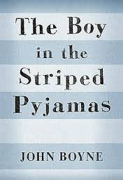

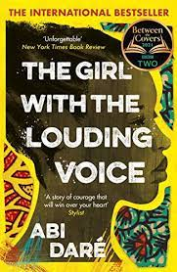
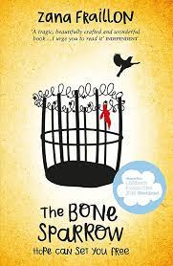



In both interventions, students unexpectedly made similar progress in reading. Qualitative Data showed why… Effect of extended reading, reading aloud & dialogic talk to support comprehension.
Comparison Group teachers unpredictably changed practice & mirrored the Target group, to to read 2 texts in 12 weeks. Would testing/data-collection after 6 months have shown any differences?
Reading at centre:2 whole, challenging, culturally diverse novels, read aloud back-to-back
Struggling readers: 16 months’ comprehension progress in 12 weeks; increased engagement, confidence, persistence, reader identity, enjoyment of English & group reading.
Dialogic class talk & reading groups: students read, enjoy, interpret, question & use reading strategies
Struggling/disadvantaged readers learn how to be readers; to enjoy a narrative, infer, persist & reach THE END…
Teacher Agency, reflection & theory: Best pedagogy to support comprehension & engagement in lessons, not outside.
I love it! It’s very liberating I've never in 27 years of teaching just read 2 texts back-to-back! (Anna, Teacher. FR)
Notes:
You can read our papers for actual findings and tables, effect sizes etc…
Starting point for Original research 2014-15 – 3 researchers – Positioning teachers as agentive professionals who have embodied knowledge re reading BUT need to build on this esp. for struggling/disadvantaged readers. So What do reading teachers need to know & how can they develop & apply this knowledge? – 1) whole-text reading & imp of multiple reading experiences of extended text + dialogic discourses that support reading, class/group + cognitive process of reading comp. Findings: Methods: standardised tests & qualitative data 2 obs & 2 teach. Ints IMPACT on Teachers and Students – YELLOW – improve comp, engagement attendance, etc + Teacher enthusiasm because ‘it works’!
The Faster, immersive read model of reading:
Why is it important now? Post-Covid context of reading & learning losses, esp. for disadvantaged students and struggling readers as no reading practice at home, whereas literacy-rich homes with books intensified their reading with students
The intervention group (half the teachers; 10 classes) did the entire model; the comparison group (the other half) only did the faster read of 2 novels and followed customary practice. NB The quantitative data showed that all 20 classes made similar progress on the reading tests, BUT the qualitative data showed that in the ‘intervention’ classes, where teachers focused on explicitly teaching reading strategies, including using guided reading and group work, the students appeared more engaged, confident about reading and independent in their approach: they independently used the strategies in groups, asked lots of good questions of the text, predicted, summarised, clarified, etc. Future studies will measure reading gains over time – we predict, but did not test, that children who are taught all the reading strategies and given plenty of time to practise these in groups will make greater gains in reading over time – e.g. after 6 months or a year than classes only reading the books. (NB one intriguing aspect of the quantitative data was that readers defined as ‘average’ or ‘good’ made better progress in the ‘intervention’ classes. Ie. The model appears to develop the reading of good readers, as well as of poor readers.)
There is strong evidence from this study and subsequent impact studies, that reading 2 books in a term enables all readers – poor, average and good readers – to make good progress. NB we also looked at the progress of other groups – SEND and PP. Again, the study showed that there was no difference, on average, with their progress than the other groups. Boys also made comparable progress with girls although the boys on average, started at a lower point (so ended on a lower level).
The reading model should support progress of all students in reading. Teachers in Brighton, Hove and Sussex are all still using the model (60+ schools nationally) 5 years later, which is further evidence that teachers believe this is the way to ensure progress in reading for KS3 students. Most schools are using this model in Yrs 7-9, many also in GCSE – ie reading the whole Victorian novel more quickly for comp. of a whole text, then going back over it to analyse, having got the plot firmly fixed in students’ minds. Many teachers using the model interviewed on 15/11/2017 reported that students are definitely remembering the texts more with this approach, particularly the plot, characters, etc, but also key quotations – ie it supports crucial memory skills that are needed in the new linear GCSE exams.
NB Texts chosen at KS3 should be highly engaging, challenging & culturally diverse so that students, esp. weaker readers, who are not used to reading and enjoying whole books, are motivated to read to the end and gain a rich reading experience. None of our teachers chose Victorian novels as these are unlikely to be engaging for struggling readers as the language demands are too great. Motivation in reading supports comprehension skills so it is essential to choose books that your particular class will enjoy so that they can become immersed in reading and practising the skills of whole-text reading that will turn them into ‘readers’ - develop their skills, make them feel more confident about reading because if they get stuck, they have some strategies to help them resolve their ‘block’ and given them the practise in reading whole texts that many students in our study said they had never experienced. Only 23% of adolescent students read for pleasure each day, the lowest figure since National Literacy Trust (2020) started doing annual surveys in the UK. So it is imperative that, as English teachers, we re-engage KS3 students, esp. weaker readers, with the pleasure of reading a whole, challenging text and wanting to know what happens next. Ofsted (2019) have urged schools to do a different curriculum at KS3 from KS4 so this study illustrated that text choice was very important. We should not see KS3 as all about a narrow ‘preparation’ for handling unseen Victorian extracts at GCSE and therefore having a diet of Victorian novels from Year 7. This will not develop the crucial reading skills, motivation and reading self-concept – ie belief that you are a capable reader & can tackle difficulties you encounter in reading – that all readers need. So choose contemporary and YA texts that will engage and challenge your KS3 readers.

Slide 22

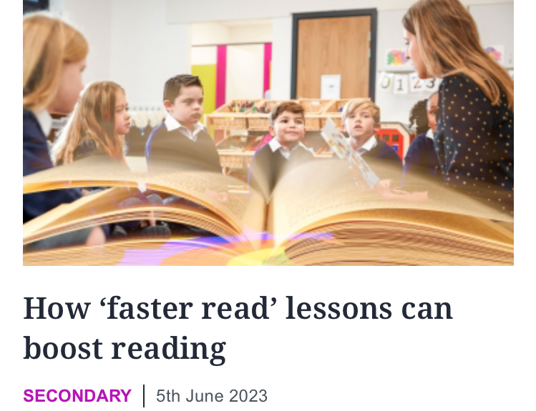
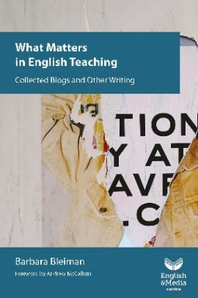

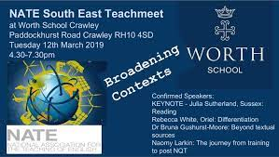

The End is in Sight…How has the FR spread? Collaboration across schools/UK
Agentive teacher pairs take FR to local/national networks; become HoDs English/Heads of Academies - spread it to their MATs
40+ conferences & CPD including online in Covid; UKLA, NATE Teachmeets, EMC. Recently spread via LA throughout Ayrshire, Scotland.
Prof Assocs; LA English Leads; Social media: B. Bleiman, M. Myatt, D. Wiliam;
Media: SE News, Wall Street Journal, Teacher articles in TES & at conferences
ITE courses; Related teacher MA/PhD research, building on the Faster Read
Our articles & book chapter/s; cited in other books
Ofsted (2022) English Review of the Curriculum
Notes:
This is our oneness – we can all be a group together – oneness and solidarity – Rachel Heydon
WHAT is it about our project that lit teachers’ imaginations? See the freedom image…. & quote from teachers…
Say it is all about collaboration – first between the 3 of us, then between us and teachers – ie 2 teachers per school – supported their knowledge or reading -
Pair of doves is the most imp. of these – symbolising teachers spreading the FR. Currently exploring why teachers have been so agentive in spreading the FR. Key reasons: FR always presented with theorised CPD as research-informed and requiring teachers to grapple with theories of reading comprehension and reading engagement so that they understand why they might need to challenge current practice, using critical reflection throughout their transition to a different kind of pedagogy – i.e. teachers positioned as Giroux’s ‘intellectuals’ not craftspersons. FR never presented as a generalisable ‘toolkit’, created by someone else for teachers unquestioningly ‘to deliver’ – but as something that could develop teachers’ theorised practice - original research required teachers to choose own novels & design own SoW for their particular students – they needed to think through how the FR could work in their own context, targeting needs of their students, but informed by our theorised CPD, exploring theories of reading comprehension, inference, whole-text reading, reading engagement, reading aloud and the role of group talk in reading development and engagement, esp. for struggling readers. Teachers positioned as agentive and knowledgeable, not empty ciphers ‘delivering’ yet another toolkit designed by ‘researchers’. Sociocultural approach, collaborating with teachers: original research started by asking teachers to reflect on their own reading practices as children/adults, reader identities, how they ‘read’ themselves, etc & then to compare this with students’ experience of ‘reading’ in English lessons at KS3. NB If students are doing voluntary reading (RfP) outside school, then they have a model of reading to counterbalance the rather thin diet of ‘reading experience’ they may be getting in lessons, which is typically aimed at the analytical requirements of GCSE, esp. in terms of micro-analysis of extracts. But our concern was particularly for disadvantaged and struggling readers, who did not benefit from other rich reading experiences outside school. How could they be enabled to develop their reading skills, while simultaneously experiencing an immersive, whole-text read that is engaging and encourages them to persevere with reading even when challenging, and to be able to comprehend the whole text? (NB whole-text comp. = cognitively challenging, so the FR is not suggesting teachers reduce the level of the reading lesson – but focus on the whole not just the parts).
Work by Guskey, and Korthagen on how teachers change their practice, against cultural resistance to change in schools, demonstrate how imp. it is for teachers to experience the impact of a given intervention on their students – i.e. to witness positive impact – & to have significant data to add to their conviction, as well as the imp. of teacher agency (e.g. Biesta, Priestley) and teachers being convinced by research-informed pedagogy and allowed to engage with this (e.g. Risko et al; McMasters, etc). Teacher participants described the ‘freedom’ and ‘liberation’ they experienced in being freed from curriculum/performance constraints and being able to place the book at the centre of the reading lesson and to focus on whether students were fully comprehending a complex narrative, plot, characters first, before considering whole-text analysis – they would do this after they had read the entire novel. All said that students’ responses were richer and more sophisticated because they could range across the text, rather than being restricted to focusing on much shorter chunks of text.

Slide 23
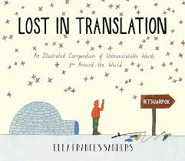
What were the Challenges?
Was it ever ‘Lost in Translation’?
Radical change to curriculum: will HoD/SMT support it?
Getting through 2 whole novels in 1 term - balance between reading aloud, discussing text, teaching reading strategies & vocabulary
Curriculum constraints: how to fit in end-of-term written assessments?
Tensions - ‘Mastery Curriculum’ – group reading/talk not accepted
Accountability: Little written ‘evidence’ of learning & fear of Ofsted
Culture change: How to assess reading via talk? How to do group reading?
Cost of new books
Wanted more CPD for new teachers, but many took on this role
It’s NOT ‘Just reading…’ but that’s a great starting point…
Notes:
Culture change - (Taping of group reading/talk; quick online quizzes; hot-seating; students use quick graphic organisers while discussing text, e.g. timelines, event maps, story mountains; use of 6 oral flashbacks on post-its at start of lesson to assess recall of plot/characters; quick blogs/tweets re characters)

Slide 24

Chapter 15, Why are teachers still using the FR?
It ‘works’ – holistic understanding of reading
Enriches teachers’ knowledge of reading, effects of disadvantage & social justice: moving between theory/practice (Korthagen, 2010)
Opens a space for teachers to re-think how they, as readers, read & how to teach reading. Freed from compliance & accountability – Knowledge empowers them to ‘Talk back’ to Ofsted, policy, SLT: (Biesta, 2014; bel hooks)
FR resonates with teachers’ beliefs & embodied knowledge re reading
Communities of practice – has triggered critical reflection, peer learning & teacher research in schools, developing practice & understanding: many cite own data BERA/RSA, 2014; Compton et al, 2014; Korthagen, 2010)
FR is flexible & situated: offers principles, not toolkit – teachers can adapt it to new contexts, e.g. Covid & renewed BLM imperative to use culturally diverse texts
Notes:
‘students do the FR in Years 7-9 here & are bucking the national trend & choosing to do A Level English Literature because they love reading!’(
Currently exploring why teachers have been so agentive in spreading the FR. Key reasons: FR always presented with theorised CPD as research-informed and requiring teachers to grapple with theories of reading comprehension and reading engagement so that they understand why they might need to challenge current practice, using critical reflection throughout their transition to a different kind of pedagogy – i.e. teachers positioned as Giroux’s ‘intellectuals’ not craftspersons. FR never presented as a generalisable ‘toolkit’, created by someone else for teachers unquestioningly ‘to deliver’ – but as something that could develop teachers’ theorised practice - original research required teachers to choose own novels & design own SoW for their particular students – they needed to think through how the FR could work in their own context, targeting needs of their students, but informed by our theorised CPD, exploring theories of reading comprehension, inference, whole-text reading, reading engagement, reading aloud and the role of group talk in reading development and engagement, esp. for struggling readers. Teachers positioned as agentive and knowledgeable, not empty ciphers ‘delivering’ yet another toolkit designed by ‘researchers’. Sociocultural approach, collaborating with teachers: original research started by asking teachers to reflect on their own reading practices as children/adults, reader identities, how they ‘read’ themselves, etc & then to compare this with students’ experience of ‘reading’ in English lessons at KS3. NB If students are doing voluntary reading (RfP) outside school, then they have a model of reading to counterbalance the rather thin diet of ‘reading experience’ they may be getting in lessons, which is typically aimed at the analytical requirements of GCSE, esp. in terms of micro-analysis of extracts. But our concern was particularly for disadvantaged and struggling readers, who did not benefit from other rich reading experiences outside school. How could they be enabled to develop their reading skills, while simultaneously experiencing an immersive, whole-text read that is engaging and encourages them to persevere with reading even when challenging, and to be able to comprehend the whole text? (NB whole-text comp. = cognitively challenging, so the FR is not suggesting teachers reduce the level of the reading lesson – but focus on the whole not just the parts).
Work by Guskey, and Korthagen on how teachers change their practice, against cultural resistance to change in schools, demonstrate how imp. it is for teachers to experience the impact of a given intervention on their students – i.e. to witness positive impact – & to have significant data to add to their conviction, as well as the imp. of teacher agency (e.g. Biesta, Priestley) and teachers being convinced by research-informed pedagogy and allowed to engage with this (e.g. Risko et al; McMasters, etc). Teacher participants described the ‘freedom’ and ‘liberation’ they experienced in being freed from curriculum/performance constraints and being able to place the book at the centre of the reading lesson and to focus on whether students were fully comprehending a complex narrative, plot, characters first, before considering whole-text analysis – they would do this after they had read the entire novel. All said that students’ responses were richer and more sophisticated because they could range across the text, rather than being restricted to focusing on much shorter chunks of text.
NB See Gibbons on English teachers as agentive professionals; and Biesta et al.

Slide 25


Many thanks for listening!
Where do we go from here?
Do join us for a free webinar to explore teachers’ experiences of & advice about using the Faster Read: 16 July, 4.30-6.00 online. Get your ticket here:
https://universityofsussex.zoom.us/j/93510325973?pwd=nlap45YmmDnlov5MCuE2bFvXiGV9eW.1
Sussex Website for the Faster Read, video & guidance for teachers:
https://www.sussex.ac.uk/research/centres/centre-for-international-education/projects/fasterread/impact
Do email me for more information:
jcs23@sussex.ac.uk Publications on next slide.

Slide 26
Authors’ publications on The Faster Read
Sutherland, J., Westbrook, J., Oakhill, J., & Sullivan, S. (2023) An immersive, ‘Faster Read’: a pilot, mixed-method study, developing whole-text reading comprehension and engagement with adolescent struggling readers, Research Papers in Education, No. ahead-of-print, 1-23 https://www.tandfonline.com/doi/epub/10.1080/02671522.2023.2238285?needAccess=true&role=button
Sutherland, J. and Westbrook, J. (2022) ‘Reading Comprehension’ in A. Watson & R. Newman (Eds), A Practical Guide to teaching English in the secondary school, London: Routledge.
Sutherland, J. and Westbrook, J. (2024) How do students read, interpret whole texts and become engaged readers? In Smith, L. Secondary English for Generation Alpha: Humane Pedagogy for Local, National and International Contexts, London: NATE/Routledge series
Westbrook, J., Sutherland, J., Oakhill, J. and Sullivan, S. (2019) ‘Just reading’: the impact of a faster pace of reading narratives on the comprehension of poorer adolescent readers in English classrooms. Literacy, 53(2) 61-68
For publication later this year:
Sutherland, J. and Westbrook, J. (2024) How do students read, interpret whole texts and become engaged readers? In Smith, L. Secondary English for Generation Alpha: Humane Pedagogy for Local, National and International Contexts, London: NATE/Routledge series
Sutherland, and J., Westbrook, (2024) ‘Not the Naming of Parts’: the impact of the Faster Read on teachers, students and reading practices in the UK after ten years (in draft)

Slide 27
Teachers replicating the Faster Read and talking about their experiences independently:
Gloucester Road Infant/Primary School https://films.myattandco.com/programs/a-faster-read-primary-project-part-1
Gayle Fletcher and Lauren Haines: 93% of pupils in Year 2 & 83% in Year 4 made more than six months progress after 12 weeks of FR
St Michael’s Church of England Primary School: https://marymyatt.substack.com/p/end-of-year-the-best-bits
Nene Park Academy, Peterborough – raises reading levels & encourages independent RfP & culture of reading
https://films.myattandco.com/programs/a-faster-read-nene-park-academy-case-study?category_id=123277
Scalby Secondary School, Huntingdon – raises reading levels & engagement
https://researchschool.org.uk/huntington/news/case-study-the-faster-read-programme-at-scalby-school

Slide 28
References
Allington, R.L., McGill-Franzen, A., Camilli, G., Williams, L., Graff, J., Zeig, J., Zmach, C. & Nowak, R. (2010). Addressing summer reading setback among economically disadvantaged elementary students. Reading Psychology, 31 (5), 411-427.
Applebee, A., Langer, J., Nystrand, M., & Gamoran, A. (2003). Discussion-based approaches to developing understanding: Classroom instruction and student performance in middle and high school English, American Education Research Journal, 40, 685–730.
Baye, A., C. Inns, A. Lake and R.E. Slavin. 2019. “A Synthesis of Quantitative Research on Reading Programs for Secondary Students.” Reading Research Quarterly, 54(2).133-166. doi:10.1002/rrq.229.
Black, J, Barnes, L, Oatley, K., Tamir, D, Dodell-Feder, D., Richter, T, Mar, R. ‘Stories and Their Role in Social Cognition’ in Handbook of Empirical Literary Studies (2021) Kuiken, D. and Jacobs, A. M. (Eds).Berlin:de Greyter https://doi.org/10.1515/9783110645958
Blanden, Jo and Stephen Machin (2010) “Changes in inequality and intergenerational mobility in early years assessments” in Kirstine Hansen, Heather Joshi and Shirley Dex (eds) Children of the 21st century: The first five years. Bristol, Polity.
Clarke and Akerman (2006) Social inclusion and reading: An exploration. London: National Literacy Trust..
Cliff Hodges, G. (2016) Researching and teaching reading: Developing pedagogy through critical enquiry. London, New York: Routledge.
Cunningham, A. & Stanovich, K. (1998) What Reading Does for the Mind in American Educator, Spring/Summer 1998
Duncan, S. (2015) Reading Aloud in Lewisham: An Exploration of Adult Reading Aloud-Practices, Literacy, Vol. 48, No 2. pp 84-90
Eagleton, T. (2008) Literary Theory: An Introduction, (2nd Ed.) Blackwell, Oxford
Education, Audiovisual and Culture Executive Agency of the European Commission ( 2011) Teaching Reading in Europe: Contexts, Policies and Practices, Brussels: EACEA, Eurydice
Felski, R. (2008) Uses of Literature. Oxford: Blackwell
Fitzpatrick, S, Bramley, G, Treanor, M, Blenkinsopp, J, McIntyre, J, Johnsen, S and McMordie, L (2023) Destitution in the UK 2023 [Online]. Available at: https://www.jrf.org.uk/report/destitution-uk-2023
Freire, P. (2021) Pedagogy of Hope, Reliving Pedagogy of the Oppressed, London: Bloomsbury Academic
Hart, B. and Risley, T. (2003) ‘The Early Catastrophe – The 30 Million Word Gap by Age 3’. American Educator. 27, pp.4-9
Guthrie, J. T., and S. L. Klauda. 2014. “Effects of Classroom Practices on Reading Comprehension, Engagement, and Motivations for Adolescents.” Reading Research Quarterly 49(4): 387–416. doi:10.1002/rrq.81.
International Reading Association (2007) Teaching Reading Well: a synthesis of IRA's research on teacher preparation for reading instruction, Newark, D.E. USA: International Reading Association

Slide 29
Joseph Rowntree Foundation (2024) UK Poverty, 2024, London: JR Foundation
Moats, L. 2009. “Knowledge Foundations for Teaching Reading and Spelling.” Reading & Writing 22 (4): 379–399. https://doi.org/10.1007/s11145-009-9162-1 .
Murphy, P, Wilkinson,I , Soter, A.,Hennessey, M., Alexander, J. (2009) Examining the effects of classroom discussion on students’ comprehension of text: A meta-analysis. Journal of Educational Psychology, Vol 101(3), 740-764. (argues for the importance of rich talk about texts in all classrooms, whole-class and group)
National Institute for Child Health and Human Development (2000) Report of the National Reading Panel. Teaching children to read: An evidence-based assessment of the scientific research literature on reading and its implications for reading instruction. Washington, DC: U.S. Government Printing Office. National Literacy Trust (2022)
National Literacy Trust, Children’s and young people’s reading engagement, 2022. https://literacytrust.org.uk/research-services/research-reports/children-and-young-peoples-reading-engagement-in-2022/
Oakhill, J.V., Cain, K. and Elbro, C. (2015) Understanding and teaching reading comprehension: a handbook, London: Routledge
Oakhill, J. , Banerjee, R., Garnham, A. (Research in progress on relationship between reading and empathy) Reading Feelings
Oxford University Press (2018) Why closing the word gap matters. Oxford University Press. oxford.ly/wordgap
Palincsar, A.S. and Brown, A.L. (1984) Reciprocal Teaching of Comprehension-Fostering and Comprehension-Monitoring Activities, Cognition and Instruction, 1 (2), 117-175 Pressley, M. (2006) Reading Instruction that Works: the Case for Balanced Teaching. London and New York: Guilford
Pinnick, S. (PhD Thesis in process) How might the use of drama-based pedagogy in the KS3 English classroom support the interpretation of prose and poetry? University of Sussex
Retelsdorf, J., O. Köller, and J. Möller. 2011. “On the Effects of Motivation on Reading Performance Growth in Secondary School.” Learning and Instruction 21(4): 550–559. doi.org/10.1016/j.learninstruc.2010.11.001
Risko, Victoria J., Roller, Cathy M. ,Carrice Cummins, Rita M. Bean, Cathy Collins Block, Patricia L. Anders, James Flood Source(2008) A Critical Analysis of Research on Reading Teacher Education Reading Research Quarterly, Vol. 43, No. 3, pp. 252-288
Rojas-Drummond, S. Mazón, N. & Littleton. K. (2014) Developing Reading Comprehension through Collaborative Learning. Journal of Research in Reading, Volume 37, Issue 2, 2014, pp 138–158

Slide 30
Rojas-Drummond, S. Mazón, N. & Littleton. K. (2014) Developing Reading Comprehension through Collaborative Learning. Journal of Research in Reading, Volume 37, Issue 2, 2014, pp 138–158
Rosenshine, B., Meister, C. and Chapman, S. (1996), Teaching Students to Generate Questions: a Review, Review of Educational Research, 66 (2), 181-221. Culture, Cognition and Pedagogy. London and New York: Routledge, Taylor & Francis.
Joseph Rowntree Foundation (2024) UK Poverty, 2024, London: JR Foundation
Soter, A.O. Wilkinson, I.A., Murphy, P.K., Rudge, L., Reninger,K. & Edwards, M. (2008) What the discourse tells us: Talk and indicators of high-level comprehension International Journal of Educational Research, 47 (2008) 372–391.
Stanovich, K. (1986) Matthew Effects in Reading: Some Consequences of Individual Differences in the Acquisition of Literacy, Reading Research Quarterly, Vol 21, (4) pp 360-407
Sullivan, A. & Brown, M. (2015) Reading for pleasure and progress in vocabulary and mathematics, British Educational Research Journal Vol. 41, No. 6, December 2015, pp. 971–991 DOI: 10.1002/berj.3180
Vaughn, S., G. Roberts, E.A. Swanson, E.A., J. Wanzek, A.M.
Sutherland (2006) Promoting Group Talk and Higher-thinking in pupils, by coaching secondary English trainee teachers, Literacy, 40: 2, pp. 106-114
Sutherland, J. (2015): ‘Going meta’: using a metadiscoursal approach to develop secondary students’ dialogic talk in small groups, Research Papers in Education, Vol. 30,(1), pp. 44–69
Taboada, A., S.M. Tonks, A. Wigﬁeld, and J.T. Guthrie, 2009. Effects of Motivational and Cognitive Variables on Reading Comprehension. Reading and Writing: An Interdisciplinary Journal 22 (2):85–106.DOI 10.1007/s11145-008-9133-y.
Torppa, M., Niemi, P., Vasalampi, K., Lerkkanen, M.K., Tolvanen, A., A-M. Poikkeus, A-M. 2020. “Leisure Reading (But Not Any Kind) and Reading Comprehension Support Each Other - A Longitudinal Study Across Grades 1 and 9”. Child Development, 91:3, 876–900.
Vaughn, S., G. Roberts, E.A. Swanson, E.A., J. Wanzek, A.M. Fall, and S.J. Stillman-Spisak. 2015. Improving Middle-School Students’ Knowledge and Comprehension in Social Studies: a Replication. Educational Psychology Review 27:31–50. DOI:10.1007/s10648-014-9274-2.
van den Broek, P. W.1997. Discovering the Cement of the Universe: The Development of Event Comprehension from Childhood to Adulthood. In Developmental Spans in Event Comprehension and Representation, edited by P. W. van den Broek, P. J. Bauer and T. Bourg: 321-342. Mahwah, NJ: Lawrence Erlbaum Associates.
van Bergen, E., K. Vasalampi, M. Torppa, M. 2020. “How Are Practice and Performance Related? Development of Reading From Age 5 to 15”, Reading Research Quarterly, 56(3) pp. 415–434. doi:10.1002/rrq.309
Westbrook, J. (2013) Reading as a Hermeneutical Endeavour: Whole-Class Approaches to Teaching Narrative with Low-Attaining Adolescent Readers, Literacy, Vol 47, (1), pp. 42-49.
Upchurch, D. (PhD thesis in process) Reclaiming reading: a participatory action research project exploring the pedagogic potential of young readers' relationships, talk and sociocultural diversity to raise reader engagement. University of Sussex.

