Slide 1
Week | Lesson 1/ hour 1 | Lesson 2/ hour 2 | Lesson 3/ hour 3 | Key reading aim for the week
1 | Read chapters 1-2 | Read chapters 3-5 | Read chapters 6-7 | - Explicit teaching of questioning, clarifying, summarising, predicting; - Explicit teaching of using vocabulary strategies -Modelling expressive reading

Slide 2



Learning Objective: To use predicting, questioning and clarifying skills in the early chapters of TDL.
In your books, read the following headline and make a prediction about our new text:
‘Steal or starve, cheat or be cheated.’
Not sure? Try this: What type of character might the text be about? What does the headline make us think about? Hint: will this character be like others we have read? I think this text will be about… | Too easy? Try this: Look at the two clauses; how do the juxtapose ideas? Where else in literature do we hear two opposing ideas right next to each other? What is the effect?

Slide 3


Learning Objective: To use predicting, questioning and clarifying skills in the early chapters of TDL.
This term, we are reading a new book by Akala:

Slide 4



Learning Objective: To use predicting, questioning and clarifying skills in the early chapters of TDL.
Let’s keep using our predicting skills and build on our starter task (see the two blurbs of the book):

Slide 5
Learning Objective: To use predicting, questioning and clarifying skills in the early chapters of TDL.
Let’s keep using our predicting skills and build on our starter task:
Read the blurb for The Dark Lady, and then discuss the following questions with your partner:
1. Was your initial prediction correct?
2. What extra information have you now got?
3. What do you predict the complication will be?
4. What type of character will our narrator be?
Sophisticated prediction: how will this novel link to other texts we have read (i.e. ___)?

Slide 6
This term is all about our reading skills. We will be focusing on what expert readers do every time they read.
Learning Objective: To use predicting, questioning and clarifying skills in the early chapters of TDL.
Expert readers…
- ask questions as they read
- clarify what certain things mean
- make predictions before and during their reading
- summarise what they have read
- infer hidden meanings
- connect chapters, characters and moments across the text
- monitor if they are understanding what they have read
- discuss their reading with others

Slide 7
Some of these skills may be new to you, others may be very familiar. Don’t worry if there are some that you’re not sure of yet. We will cover them in detail over the term.
Today, we will really be looking at questioning, predicting and clarifying skills.
Let’s look closely at each one.
Learning Objective: To use predicting, questioning and clarifying skills in the early chapters of TDL.
Questioning | Clarifying | Predicting | Summarising | Inferring | Connecting | Monitoring | Discussing

Slide 8

Questioning:
What has just happened?
What have I just learnt?
What don’t I understand?
What will happen next?
How does this link to earlier chapters?

Slide 9

Predicting:
Did I expect this would happen?
How will this scene affect the story?
Does the writer tell us everything here?
What do you think will happen next?
How does this link to earlier chapters?

Slide 10


Summarising:
What happened in this scene?
What happened in this chapter?
What the three most important things that have happened?
What is the character feeling, and why?
What is the author telling us here?

Slide 11

Learning Objective: To use predicting, questioning and clarifying skills in the early chapters of TDL.
We will now read chapters 1 and 2.
As you read, we will be really thinking about our questioning, predicting and clarifying skills.
Questioning | Clarifying | Predicting | Summarising | Inferring | Connecting | Monitoring | Discussing

Slide 12

Learning Objective: To use predicting, questioning and clarifying skills in the early chapters of TDL.
Final task:
We have now met Henry and the London of his time.
Make your predictions about this incident in your books.
Not sure? Try this: What do you think will happen to Henry and his friends next? Henry is able to read, but we don’t know how he was taught to read – why will this be important? | Too easy? Try this: These early scenes show the brutality of Henry’s London. How will the setting affect Henry and his friends? There are pages set on black and in italics that don’t appear to be connected to Henry’s narrative. What might these pages have to do with the text?

Slide 13

Learning Objective: To use predicting, questioning and clarifying skills in the early chapters of TDL.
Homework:
Reminders/house keeping notes:
Plenary/exit ticket:
Notes:
This slide has been left blank to allow for school/departmental policies. For example, your school may require an ‘exit ticket’ as students leave.

Slide 15
Week | Lesson 1/ hour 1 | Lesson 2/ hour 2 | Lesson 3/ hour 3 | Key reading aim for the week
1 | Read chapters 1-2 | Read chapters 3-5 | Read chapters 6-7 | - Explicit teaching of questioning, clarifying, summarising, predicting; - Explicit teaching of using vocabulary strategies -Modelling expressive reading

Slide 16
Learning Objective: To use clarifying and summarising skills in the early chapters of TDL.
In your books, complete the quiz from Akala:
Of the six quotes, decide if they are a line from a Hip Hop song, or from a Shakespearean play:
 | Akala’s pop quiz – | Hip-hop or Shakespeare?
1. | To destroy the beauty from which one came.
2. | Maybe it’s hatred I spew. Maybe it’s food for the spirit.
3. | Men would rather use their broken weapons than their bare hands.
4. | I was not born under a rhyming planet.
5. | The most benevolent king communicates in your dreams
6. | Socrates, philosophies and hypotheses can’t define.

Slide 17
Learning Objective: To use clarifying and summarising skills in the early chapters of TDL.
Check your answers!
Watch the first three minutes to reveal the answers of the quiz
The Hip-hop Shakespeare Company (hiphopshakespeare.com)
 | Akala’s pop quiz – | Hip-hop or Shakespeare?
1. | To destroy the beauty from which one came.
2. | Maybe it’s hatred I spew. Maybe it’s food for the spirit.
3. | Men would rather use their broken weapons than their bare hands.
4. | I was not born under a rhyming planet.
5. | The most benevolent king communicates in your dreams
6. | Socrates, philosophies and hypotheses can’t define.

Slide 18
Learning Objective: To use clarifying and summarising skills in the early chapters of TDL.
Check your answers!
Watch the first three minutes to reveal the answers of the quiz
The Hip-hop Shakespeare Company (hiphopshakespeare.com)
 | Akala’s pop quiz – Hip-hop or Shakespeare
1. | To destroy the beauty from which one came. (Jay Z – Can I live?)
2. | Maybe it’s hatred I spew. Maybe it’s food for the spirit. (Eminem – Renegade)
3. | Men would rather use their broken weapons than their bare hands. (Shakepseare- Othello)
4. | I was not born under a rhyming planet. (Shakespeare – Much Ado About Nothing)
5. | The most benevolent king communicates in your dreams. (The Rizza – Wu Tang Clan)
6. | Socrates, philosophies and hypotheses can’t define. (Inspector Dec – Triumph)

Slide 19
Today, we will be sharpening up our clarifying and summarising skills.
Let’s look closely at each one.
Learning Objective: To use clarifying and summarising skills in the early chapters of TDL.
Questioning | Clarifying | Predicting | Summarising | Inferring | Connecting | Monitoring | Discussing

Slide 20
Clarifying:
When the character says this, what does this mean?
What does this word mean?
What does this scene teach us?
Is this an important moment? Why?
What is the author telling us here?

Slide 21
Summarising:
What happened in this scene?
What happened in this chapter?
What the three most important things that have happened?
What is the character feeling, and why?
What is the author telling us here?

Slide 22
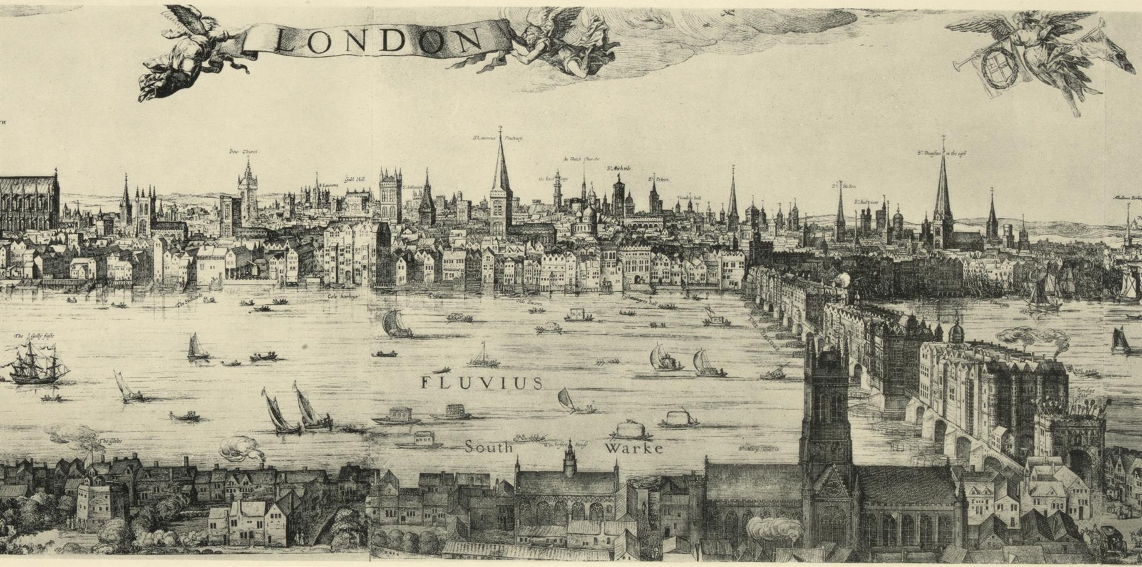
Learning Objective: To use clarifying and summarising skills in the early chapters of TDL.
With your partner, list at least TEN words London as described in The Dark Lady
Questioning | Clarifying | Predicting | Summarising | Inferring | Connecting | Monitoring | Discussing

Slide 23

Learning Objective: To use clarifying and summarising skills in the early chapters of TDL.
We will look at two new words that we could use to describe Henry’s experience so far.

Slide 24


Learning Objective: To use clarifying and summarising skills in the early chapters of TDL.
Poverty
Questioning | Clarifying | Predicting | Summarising | Inferring | Connecting | Monitoring | Discussing

Slide 25
Learning Objective: To use clarifying and summarising skills in the early chapters of TDL.
Poverty:
the state of being extremely poor.
Questioning | Clarifying | Predicting | Summarising | Inferring | Connecting | Monitoring | Discussing

Slide 26
Learning Objective: To use clarifying and summarising skills in the early chapters of TDL.
Poverty:
the state of being extremely poor.
In what ways does Henry’s London show extreme poverty?
Londoners live in poverty in The Gap.
Your turn: use poverty in your own sentence about The Dark Lady.
Questioning | Clarifying | Predicting | Summarising | Inferring | Connecting | Monitoring | Discussing

Slide 27
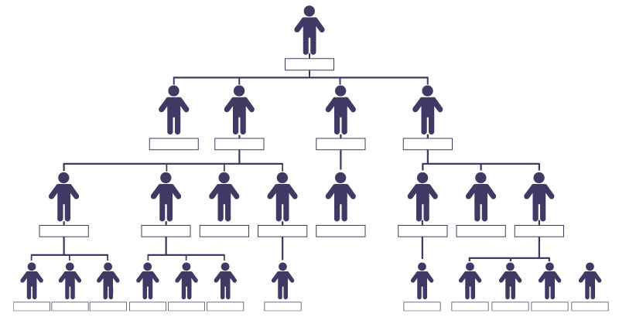
Learning Objective: To use clarifying and summarising skills in the early chapters of TDL.
Hierarchical
Questioning | Clarifying | Predicting | Summarising | Inferring | Connecting | Monitoring | Discussing

Slide 28
Learning Objective: To use clarifying and summarising skills in the early chapters of TDL.
Hierarchical
the nature of hierarchy; arranged in order of rank.
Questioning | Clarifying | Predicting | Summarising | Inferring | Connecting | Monitoring | Discussing

Slide 29
Learning Objective: To use clarifying and summarising skills in the early chapters of TDL.
Hierarchical
the nature of hierarchy; arranged in order of rank.
How is London hierarchical?
London has a clear hierarchical order, as shown in The Globe Theatre – the wealthy have seats above the pit.
Your turn: use hierarchical in your own sentence aboutThe Dark Lady.
Questioning | Clarifying | Predicting | Summarising | Inferring | Connecting | Monitoring | Discussing

Slide 30
Learning Objective: To use clarifying and summarising skills in the early chapters of TDL.
We will now read chapters 3-5.
As you read, we will be really thinking about our questioning, predicting and clarifying skills.
Questioning | Clarifying | Predicting | Summarising | Inferring | Connecting | Monitoring | Discussing

Slide 31
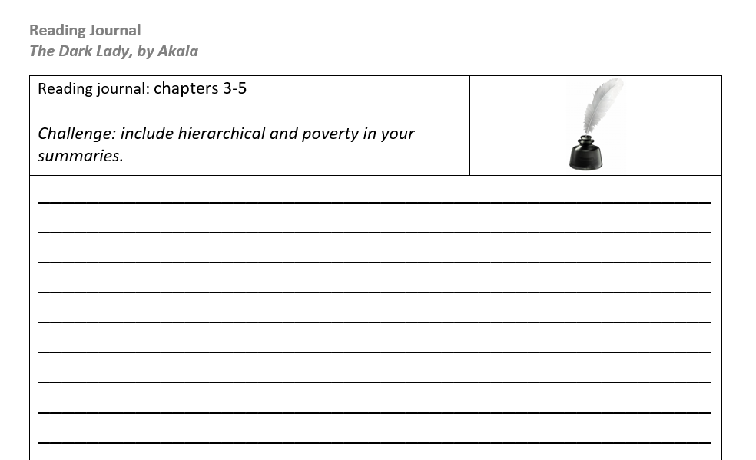
Learning Objective: To use clarifying and summarising skills in the early chapters of TDL.
Final task:
We will really look at our summary skills now and complete the plotting task.
Write a summary of what has happened in these chapters.
Stretch: use hierarchical and poverty in your summaries.

Slide 32
Learning Objective: To use clarifying and summarising skills in the early chapters of TDL.
Homework:
Reminders/house keeping notes:
Plenary/exit ticket:
Notes:
This slide has been left blank to allow for school/departmental policies. For example, your school may require an ‘exit ticket’ as students leave.

Slide 34
Week | Lesson 1/ hour 1 | Lesson 2/ hour 2 | Lesson 3/ hour 3 | Key reading aim for the week
1 | Read chapters 1-2 | Read chapters 3-5 | Read chapters 6-7 | - Explicit teaching of questioning, clarifying, summarising, predicting; - Explicit teaching of using vocabulary strategies -Modelling expressive reading

Slide 35
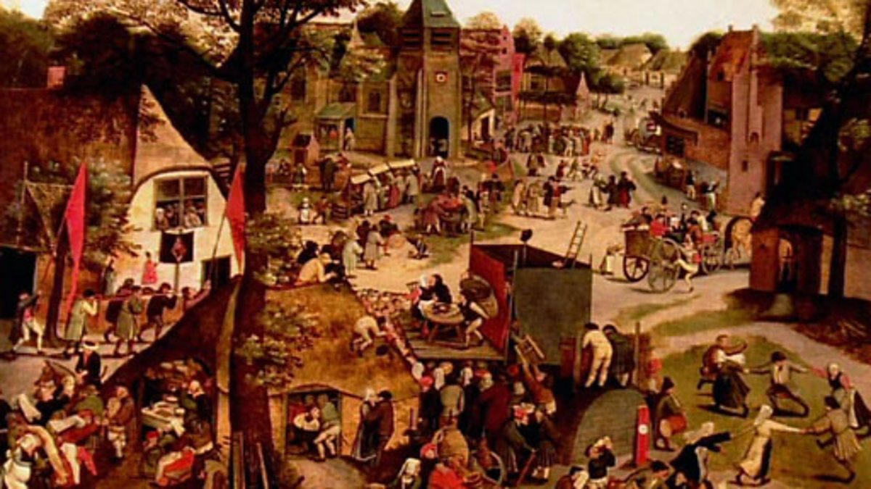
Learning Objective: To use clarifying and summarising skills in the early chapters of TDL.
Read the short overview of magic during Elizabethan England:
Witchcraft and magic - Popular culture in Elizabethan England - OCR B - GCSE History Revision - OCR B - BBC Bitesize
Not sure? Try this: - a few key features described here are… - Dark magic was considered to be… - Queen Elizabeth I had her own views about witches, such as… | Too easy? Try this: Now that you have summarised the points from the article, consider these questions: Is Joan a witch? Based on this article, does she match the descriptions? Or does she subvert these descriptions? Add your thoughts below your summaries.
Option: watch this short clip about women and witchcraft:
BBC Two - Curriculum Bites, History - Interpretations, Why were women more likely to be accused of witchcraft in Elizabethan times?

Slide 36
These aren’t new skills anymore, and this is how we will use them:
1. We will start with some key questions of the text to recap.
2. We will clarify a key moment in the text.
3. We will use our plotting sheets to summarise.
4. We will then finish with a prediction.
Learning Objective: To use clarifying and summarising skills in the early chapters of TDL.
Questioning | Clarifying | Predicting | Summarising | Inferring | Connecting | Monitoring | Discussing

Slide 37
Learning Objective: To use clarifying and summarising skills in the early chapters of TDL.
Before we start, let’s discuss a few clarifying questions.
We were introduced to Joan and Graham; what are their roles in the novel?
What have we learnt about Henry’s reading abilities?
What is Henry’s relationship with Mary and Matthew?
What do we know of Henry’s early childhood?
Questioning | Clarifying | Predicting | Summarising | Inferring | Connecting | Monitoring | Discussing

Slide 38
Learning Objective: To use clarifying and summarising skills in the early chapters of TDL.
We will now read chapters 6-7.
As you read, we will be really thinking about our questioning, predicting, summarising and clarifying skills.
We will read, and then use our journal to add key elements we see.
Questioning | Clarifying | Predicting | Summarising | Inferring | Connecting | Monitoring | Discussing

Slide 39
Learning Objective: To use clarifying and summarising skills in the early chapters of TDL.
Final task:
Next week, we will have a major turning point. What do you think it will be? How will it relate to the story so far?
Not sure? Try this: Will the story involve magic? Will the story involve Mary and/or Matthew? Will Henry be in danger? | Too easy? Try this: Akala has been carefully telling Henry’s story, but also telling us the story on the ‘black pages’, bit by bit. How will this second story weave into Henry’s narrative?

Slide 40
Learning Objective: To use clarifying and summarising skills in the early chapters of TDL.
Homework:
Reminders/house keeping notes:
Plenary/exit ticket:
Notes:
This slide has been left blank to allow for school/departmental policies. For example, your school may require an ‘exit ticket’ as students leave.

