Slide 1
Week | Lesson/hour 1 | Lesson/hour 2 | Lesson/hour 3 | Key aim for the week
1 | - Introduce the text - Introduce the character of Growls - Read chapters 1-4 | Read chapters 5-8 | Read chapters 9-13 | - Explicit teaching of questioning, clarifying, summarising, predicting; - Explicit teaching of using vocabulary strategies -Modelling expressive reading

Slide 2


Learning Objective: To use predicting, questioning and clarifying skills in the early chapters of SFT.
In your books, read the following headline and make a prediction about our new text:
‘Drop the Act. Drop the Beat. Drop the Mic.’
Not sure? Try this: What type of character might use music and microphone? What does it mean to ‘drop the act’? Hint: if we are acting, are we being ourselves? I think this text will be about… | Too easy? Try this: Look closely at the style of headline. Does the author give us any indication of the genre of this text? What techniques do you see here? How do they create feeling of urgency?

Slide 3

Learning Objective: To use predicting, questioning and clarifying skills in the early chapters of SFT.
This term, we are reading a new book by Nathanael Lessore:

Slide 4
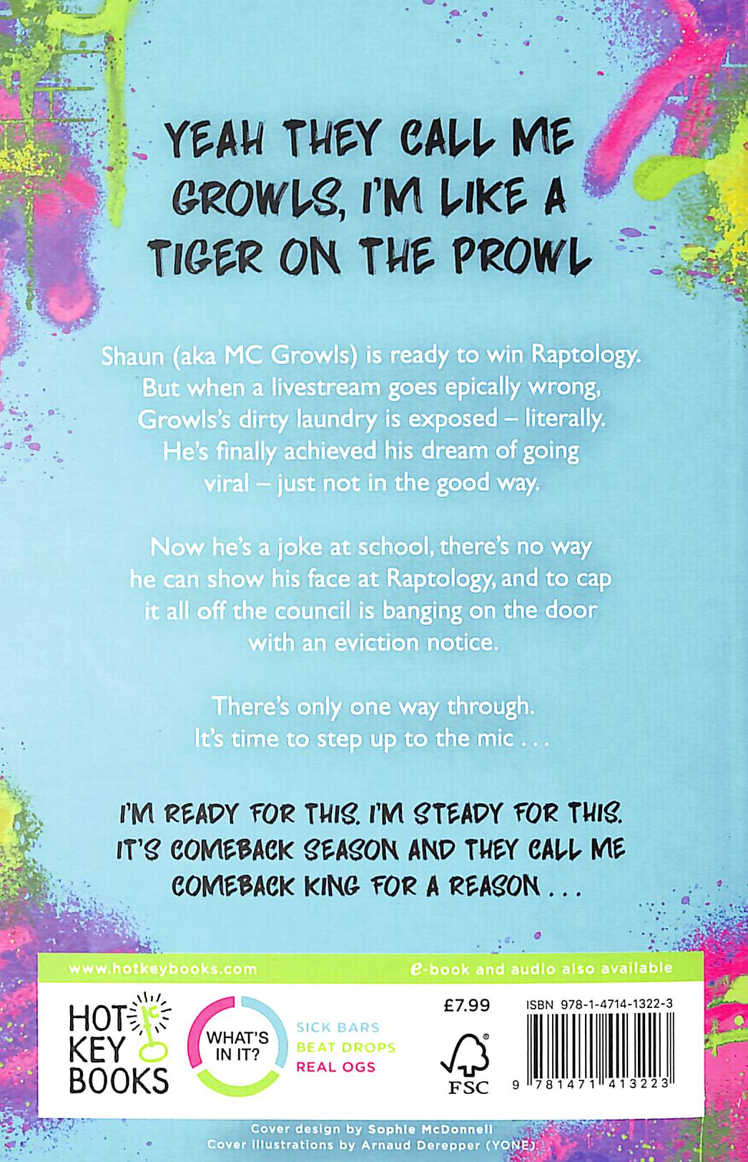

Learning Objective: To use predicting, questioning and clarifying skills in the early chapters of SFT.
Let’s keep using our predicting skills and build on our starter task:
Read the blurb for Steady for This, and then discuss the following questions with your partner:
1. Was your initial prediction correct?
2. What extra information have you now got?
3. What do you predict the complication will be?
4. What type of character will our narrator be?
Sophisticated prediction: how will this novel link to other texts we have read (i.e. ___)?

Slide 5
Learning Objective: To use predicting, questioning and clarifying skills in the early chapters of SFT.
This term is all about our reading skills. We will be focusing on what expert readers do every time they read.
Expert readers…
- ask questions as they read
- clarify what certain things mean
- make predictions before and during their reading
- summarise what they have read
- infer hidden meanings
- connect chapters, characters and moments across the text
- monitor if they are understanding what they have read
- discuss their reading with others

Slide 6
Learning Objective: To use predicting, questioning and clarifying skills in the early chapters of SFT.
Some of these skills may be new to you, others may be very familiar. Don’t worry if there are some that you’re not sure of yet. We will cover them in detail over the term.
Today, we will really be looking at questioning, predicting and clarifying skills.
Let’s look closely at each one.
Questioning | Clarifying | Predicting | Summarising | Inferring | Connecting | Monitoring | Discussing

Slide 7


Questioning:
What has just happened?
What have I just learnt?
What don’t I understand?
What will happen next?
How does this link to earlier chapters?

Slide 8

Predicting:
Did I expect this would happen?
How will this scene affect the story?
Does the writer tell us everything here?
What do you think will happen next?
How does this link to earlier chapters?

Slide 9


Summarising:
What happened in this scene?
What happened in this chapter?
What the three most important things that have happened?
What is the character feeling, and why?
What is the author telling us here?

Slide 10

Learning Objective: To use predicting, questioning and clarifying skills in the early chapters of SFT.
We will now read for the first four chapters.
As you read, we will be really thinking about our questioning, predicting and clarifying skills.
Option: use the free audio book snippet Steady for This by Nathanael Lessore - Audiobook - Audible.co.uk to ‘hear’ the voice of Growls
Questioning | Clarifying | Predicting | Summarising | Inferring | Connecting | Monitoring | Discussing

Slide 11
Learning Objective: To use predicting, questioning and clarifying skills in the early chapters of SFT.
We will now read for the first four chapters.
As you read, we will be really thinking about our questioning, predicting and clarifying skills.
Option: use the free audio book snippet Steady for This by Nathanael Lessore - Audiobook - Audible.co.uk to ‘hear’ the voice of Growls
Questioning | Clarifying | Predicting | Summarising | Inferring | Connecting | Monitoring | Discussing

Slide 12

Learning Objective: To use predicting, questioning and clarifying skills in the early chapters of SFT.
Clarifying questions:
Who is the narrator? Who is Shanks? Who is Tanisha? Why do Growls and Shanks have these nicknames? How do Shanks and Growls become friends? What does Growls mean by ‘writing bars’? Why does Tanisha agree to go on a date with Growls?
How does Growls feel about the date?
Inference questions:
What can you learn about Growls’ home life?
Why do you think Growls cares so much about money?
What indications do we get so far that Growls is clever?
What do we learn about Growls’ home?
How successful has Growls been in his ‘love life’ so far?
Why does Shanks lend Growls a shirt?
What might be happening with Growls’ mum?
Own opinion questions:
What are your first impressions of Growls?
Which word best fits Growls? Confident? Cocky? Self-conscious? Why?
What makes Shanks a good friend? How might we consider Growls to be oblivious?
An example of types of questions you may want to ask during/after reading.

Slide 13

Learning Objective: To use predicting, questioning and clarifying skills in the early chapters of SFT.
Final task:
We have now had our ‘inciting incident’; Growls and Shanks have now humiliated themselves online.
Make your predictions about this incident in your books.
How will this incident shape the rest of the novel?
Not sure? Try this: Will Growls and Shanks still be friends? How will those watching react towards Growls and Shanks? | Too easy? Try this: This is called the ‘inciting incident’ in the overall structure of the text. How does this incident compare to other inciting incidents you’ve read in other stories? This is clearly a comical story, but there may be some serious consequences. How does the author balance the humour and seriousness so far in the story?

Slide 14

Learning Objective: To use predicting, questioning and clarifying skills in the early chapters of SFT.
Homework:
Reminders/house keeping notes:
Plenary/exit ticket:
Notes:
This slide has been left blank to allow for school/departmental policies. For example, your school may require an ‘exit ticket’ as students leave.

Slide 16
Week | Lesson/hour 1 | Lesson/hour 2 | Lesson/hour 3 | Key aim for the week
1 | - Introduce the text - Introduce the character of Growls - Read chapters 1-4 | Read chapters 5-8 | Read chapters 9-13 | - Explicit teaching of questioning, clarifying, summarising, predicting; - Explicit teaching of using vocabulary strategies -Modelling expressive reading

Slide 17
Learning Objective: To use clarifying and summarising skills in the early chapters of SFT.
In your books, write a short paragraph addressing the following statement:
Rap music is poetry.
Not sure? Try this: What are the similarities between rap and poetry? What are the differences? If you agree, what examples can you give? If you disagree, what examples can you give? | Too easy? Try this: If you agree: take your argument a step further by showing an example of how rap music is poetry. Write a short poem that encompasses rap. If you disagree: take your argument a step further by linking to poetic forms that you believe do not exist in rap music.

Slide 18
Learning Objective: To use predicting, questioning and clarifying skills in the early chapters of SFT.
Today, we will be sharpening up our clarifying and summarising skills.
Let’s look closely at each one.
Questioning | Clarifying | Predicting | Summarising | Inferring | Connecting | Monitoring | Discussing

Slide 19
Clarifying:
When the character says this, what does this mean?
What does this word mean?
What does this scene teach us?
Is this an important moment? Why?
What is the author telling us here?

Slide 20
Summarising:
What happened in this scene?
What happened in this chapter?
What the three most important things that have happened?
What is the character feeling, and why?
What is the author telling us here?

Slide 21

Learning Objective: To use predicting, questioning and clarifying skills in the early chapters of SFT.
Learning Objective: To use clarifying and summarising skills in the early chapters of SFT.
With your partner, list at least TEN words to describe Growls.
Not sure? Try this:
Too easy? Try this:
Questioning | Clarifying | Predicting | Summarising | Inferring | Connecting | Monitoring | Discussing

Slide 22

Learning Objective: To use clarifying and summarising skills in the early chapters of SFT.
We will look at two new words that we could use to describe Growls.

Slide 23
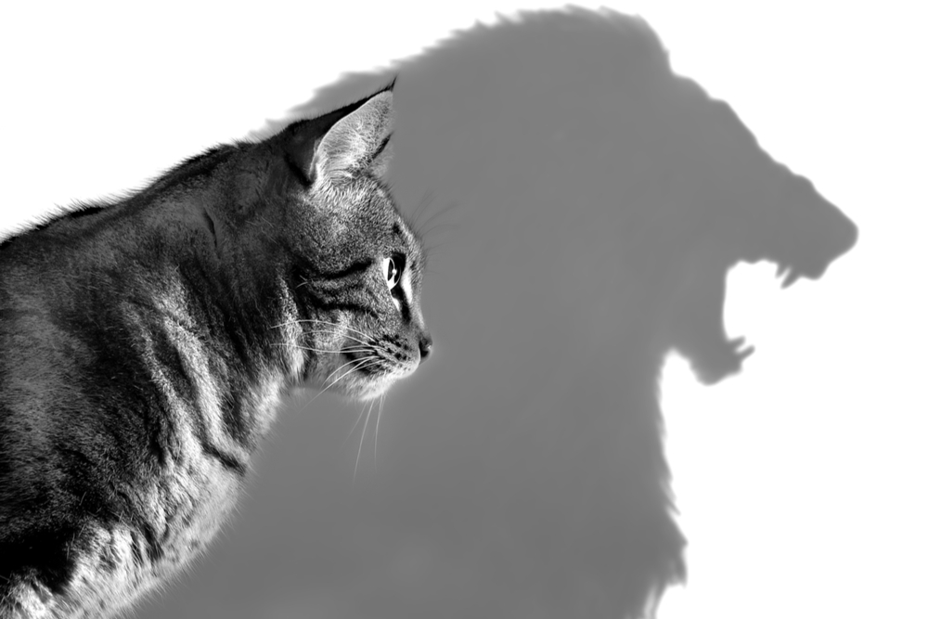
Learning Objective: To use clarifying and summarising skills in the early chapters of SFT.
Bravado
Questioning | Clarifying | Predicting | Summarising | Inferring | Connecting | Monitoring | Discussing

Slide 24
Learning Objective: To use clarifying and summarising skills in the early chapters of SFT.
Bravado:
a bold manner or a show of boldness intended to impress or intimidate.
Questioning | Clarifying | Predicting | Summarising | Inferring | Connecting | Monitoring | Discussing

Slide 25
Learning Objective: To use clarifying and summarising skills in the early chapters of SFT.
Bravado:
a bold manner or a show of boldness intended to impress or intimidate.
In what ways does Growls show bravado?
Growls is full of bravado when he is talking to Tanisha.
Your turn: use bravado in your own sentence about Growls.
Remember, it is to behave boldly to impress others.
Questioning | Clarifying | Predicting | Summarising | Inferring | Connecting | Monitoring | Discussing

Slide 26
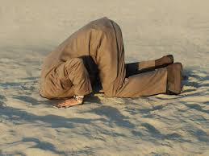
Learning Objective: To use clarifying and summarising skills in the early chapters of SFT.
Oblivious
Questioning | Clarifying | Predicting | Summarising | Inferring | Connecting | Monitoring | Discussing

Slide 27
Learning Objective: To use predicting, questioning and clarifying skills in the early chapters of SFT.
Learning Objective: To use clarifying and summarising skills in the early chapters of SFT.
Oblivious:
lacking active conscious knowledge or awareness.
Questioning | Clarifying | Predicting | Summarising | Inferring | Connecting | Monitoring | Discussing

Slide 28
Learning Objective: To use clarifying and summarising skills in the early chapters of SFT.
Oblivious:
lacking active conscious knowledge or awareness.
How is Growls oblivious?
Growls is oblivious to how unimpressed Tanisha is on her date with him.
Your turn: use oblivious in your own sentence about Growls.
Remember, it is to lack awareness about something.
Questioning | Clarifying | Predicting | Summarising | Inferring | Connecting | Monitoring | Discussing

Slide 29
Learning Objective: To use predicting, questioning and clarifying skills in the early chapters of SFT.
We will now read chapters 5 - 8.
Questioning | Clarifying | Predicting | Summarising | Inferring | Connecting | Monitoring | Discussing

Slide 30
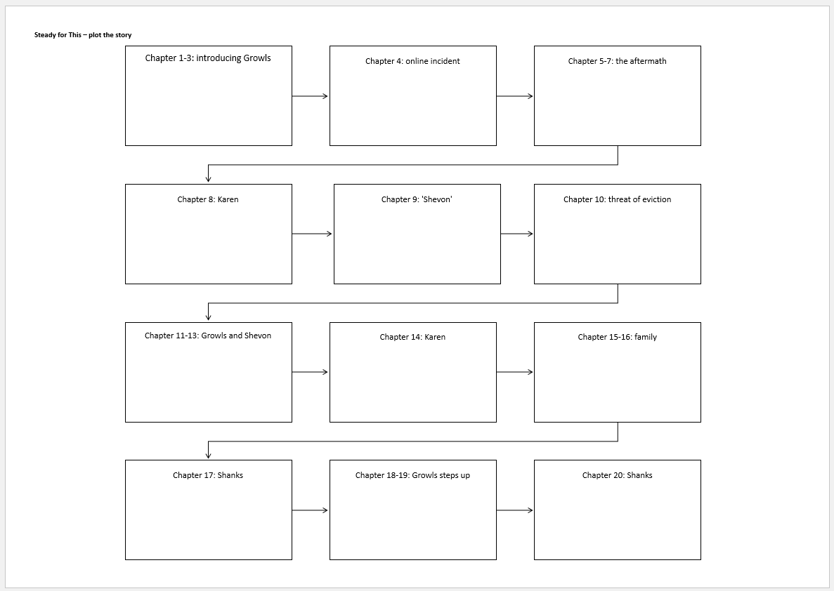
Learning Objective: To use predicting, questioning and clarifying skills in the early chapters of SFT.
Final task:
We will really look at our summary skills now and complete the plotting task.
In each box, list the five key elements from each chapter.
Stretch: use bravado/oblivious in your summary statements.

Slide 31
Learning Objective: To use predicting, questioning and clarifying skills in the early chapters of SFT.
Homework:
Reminders/house keeping notes:
Plenary/exit ticket:
Notes:
This slide has been left blank to allow for school/departmental policies. For example, your school may require an ‘exit ticket’ as students leave.

Slide 33
Week | Lesson/hour 1 | Lesson/hour 2 | Lesson/hour 3 | Key aim for the week
1 | - Introduce the text - Introduce the character of Growls - Read chapters 1-4 | Read chapters 5-8 | Read chapters 9-13 | - Explicit teaching of questioning, clarifying, summarising, predicting; - Explicit teaching of using vocabulary strategies -Modelling expressive reading

Slide 34
Learning Objective: To use clarifying and summarising skills in the early chapters of SFT.
All I need is a beat, with a continuous loop
And a live vibe, that'll hypnotize like the flute
Along with something that's rugged by nature like the forest
Composed like the symphony without a chorus
A place with the path and trail that you follow
With the wood, where you drive your nails, but too hollow
Far from reality, with a slim chance of getting back
Even if you narrowly escape the hidden traps
Nothing but the driven raps written in my notebook
Inspired by the cap and the gown, that's on the coat hook
Prepare for the chemical rush, something new to cause
Your heart to bass, but it's tangable to touch
Associate with those who are consumed with beats
Produce fire, until they melt the room with heat
You know my ink lay all over the sheets, let us gather around
And form words, everytime they meet
Look at the lyrics from GZA (of the Wu Tang Clan). As you read them, note any poetic devices you can identify.
Option: play the song alongside this task.

Slide 35
Learning Objective: To use predicting, questioning and clarifying skills in the early chapters of SFT.
These aren’t new skills anymore, and this is how we will use them:
1. We will start with some key questions of the text to recap.
2. We will clarify a key moment in the text.
3. We will use our plotting sheets to summarise.
4. We will then finish with a prediction.
Questioning | Clarifying | Predicting | Summarising | Inferring | Connecting | Monitoring | Discussing

Slide 36
Learning Objective: To use predicting, questioning and clarifying skills in the early chapters of SFT.
Before we start, let’s discuss a few clarifying questions.
So far, Growls has had an eventful few weeks. What has happened?
Who are the new characters that have been introduced, and what has been their significance?
What hints have there been about Shanks? Why has he effectively disappeared?
Questioning | Clarifying | Predicting | Summarising | Inferring | Connecting | Monitoring | Discussing

Slide 37
Learning Objective: To use predicting, questioning and clarifying skills in the early chapters of SFT.
Final task:
We will really look at our summary skills now and complete the plotting task.
In each box, list the five key elements from each chapter.
Stretch: use bravado/oblivious in your summary statements.

Slide 38
Learning Objective: To use predicting, questioning and clarifying skills in the early chapters of SFT.
Final task:
We now have our major predicament facing Growls: he is being threatened with eviction.
Make your predictions what will happen to Growls and his family.
Is he likely to remain acting with bravado and remain oblivious to his situation? Or will he mature?
Not sure? Try this: Will Shanks return? Will Tanisha return? What is the importance of Shevon, Karen and Mr Rix? | Too easy? Try this: Is it right that Growls needs to know about his family soon to be homeless? Or is that not his responsibility? Children should remain oblivious to these types of predicaments - how far do you agree or disagree?

Slide 39
Learning Objective: To use predicting, questioning and clarifying skills in the early chapters of SFT.
Homework:
Reminders/house keeping notes:
Plenary/exit ticket:
Notes:
This slide has been left blank to allow for school/departmental policies. For example, your school may require an ‘exit ticket’ as students leave.

