Slide 1
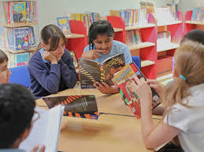
What is the Faster Read? 9/7/2025
Julia Sutherland, Jo Westbrook (& Jane Oakhill) 2014-2025
With Jo Tregenza, Claire Durrant and Deborah Upchurch
University of Sussex
Notes:
Many UK Primary schools are now using the FR, based on our survey and qualitative data of our impact study, June 2022, e.g. see final slides list of schools and the video of Gloucester Road Primary School at the end of the slides. Mary Myatt, a Literacy Consultant, highly recommends the Faster Read and has several videos of Primary teachers talking about how they use the Faster Read on her own subscription website, but the Gloucester Road one is available free.

Slide 2
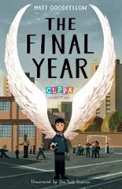

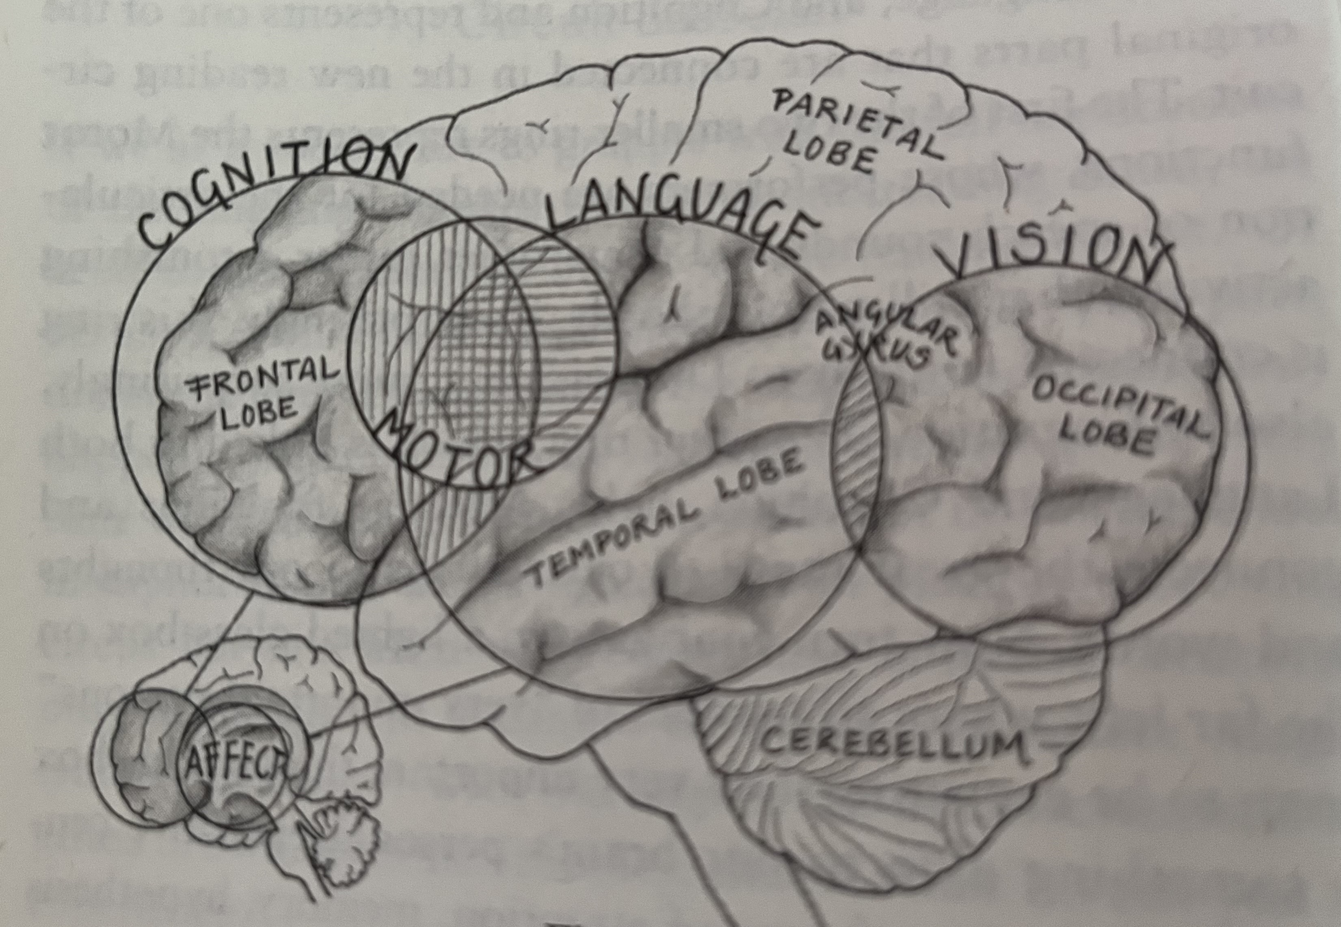
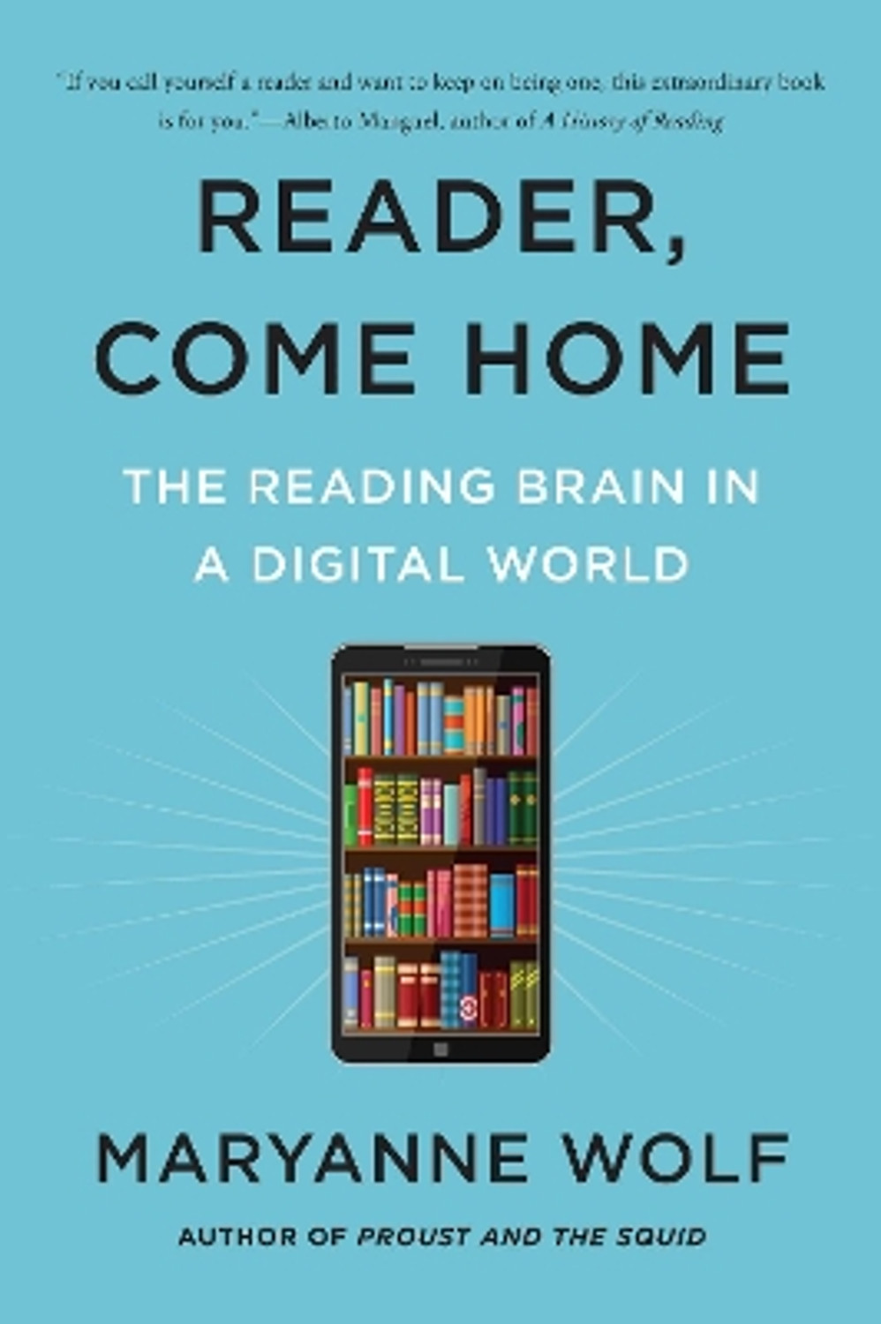
What is the Faster Read?
Welcome! Pls put details & any questions in the Chat:
Your name, email, school/workplace
How have you heard about the Faster Read?
Reflect on these questions…
How do children in school read and comprehend whole texts? (skills & experiences needed?)
How do you support them in developing reading comprehension?
NB This webinar is being recorded.

Slide 3
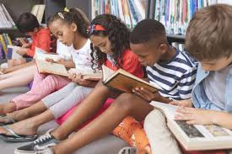
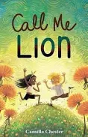
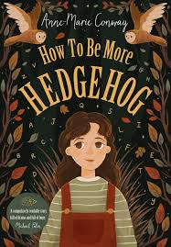
Aims of webinar
Outline our Faster Read pedagogy, rationale & impact in 10+ years
Explore how you, as Primary teachers, could draw on aspects of the Faster Read in your practice. Advantages? Challenges?
Only 1 in 3 children/young people enjoy reading, lowest ever score for 20 years
Fewer than 1 in 5 young people read a text/extended writing in their own time
Boys & FSM students – negative attitudes (NLT, 2025)
Notes:
Guidance on FR website: Teacher Guidelines & video – see link on final slides
Creating a network (Do give us your name, role, school, photo, your school email if you’d like to join, to gain support from other teachers using the Faster Read).
Sharing great, culturally diverse, engaging & challenging texts
Sharing ideas for schemes of work

Slide 4
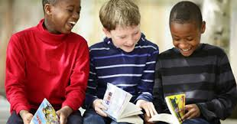
1) How do readers comprehend whole texts (skills & experiences needed?)
2) What approaches do you use to support students?

Slide 5


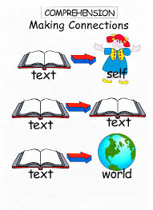

How do readers comprehend a whole text?
decode; reading fluently & automatically - effortless, unconscious
use vocab. knowledge (oral comprehension) & be able to infer new vocab
make sense of sentences – grammar, syntax, pronouns (Sally…she…)
Role of inference - infer at paragraph level – bring knowledge to text to add meaning & fill in in gaps: waves, bucket, decking = setting; use clues: chapter titles.
Infer at global/text level – apply knowledge of human behaviour to infer characters’ motivations; context (WWII, S. Africa), other texts?
Build a mental model of the text & adapt it as we read (e.g. Kintsch, 1998)
Make connections across the text – role of memory
Draw on understanding of story-structure/genre, predict & navigate our way, using knowledge of other books, films, etc
Monitor comprehension to remove confusion; choose/apply a reading strategy
Read quickly enough to maintain our model, recall & integrate details
Be motivated to persist/overcome challenges, reach the end; know it’s worth it!
Notes:
There is a reciprocal relation between reading skill, exposure to print/amount of reading & reading comprehension – the Matthew Effect – the ‘rich’ (initially better readers, with good vocab, etc) get richer (by reading more – get better at reading comprehension), the ‘poor’ (struggling readers), get poorer (relatively weaker at reading as they don’t practise these essential comprehension skills – e.g. Cunningham & Stanovich, 1984; van Bergen et al, 2020; Mol & Bus, 2011)
Reading for pleasure at 10 years helps overcome disadvantage - a stronger predictor of GCSE success than parents’ education (Sullivan & Brown, 2015).
RATIONALE for FR – 2 factors are crucial to developing reading comprehension:
Reading volume – see, e.g. Cunningham and Stanovich – students need to read/practise comprehending a large number of texts to improve their comprehension. There is a reciprocal relation between initial level of reading skill and developing reading comprehension, which is mediated by the number of books read. So, if you are a competent reader, you will typically read more books and thus improve your comprehension, compared with a weaker reader, who reads less independently or at all, therefore falling further behind. The more you read, the better you get at it! See all research on importance of reading independently or for pleasure – Allington et al, 2010; Cremin, Cliff-Hodges, etc – and Sullivan and Brown, 2015 (Reading for Pleasure at 10 years is a better predictor of success at GCSE level across subjects than parents’ level of education. Reading a lot/for pleasure supports good reading comprehension. See Stanovich’s virtuous reading circle.
Reading engagement (being engaged in the act of reading, which includes being motivated to keep reading). There is extensive evidence on the impact of reading engagement on comprehension. i.e. the more you read and are motivated to keep reading, even when it is difficult, the better you become at reading comp. and overcoming reading challenges. This is partly also because you develop the other essential aspects of reading: vocabulary, syntax and grammar, general knowledge (of the world, personal knowledge and textual knowledge) needed to be able to make good inferences, inference-making as a skill, an understanding of how narratives ‘work’ (called story-structure) and of different genres, etc – all of this knowledge helps readers to read subsequent books..
Research on the importance of motivation includes developing the reader’s ‘drive for coherence’ (van den Broek, 1997). i.e. readers need to be excited by the narrative and want to know what happens next. This makes them work hard at making sense of the text (Taboada et al, 2009) because they can anticipate the pleasure they will experience of knowing the ending when all threads are woven together.
Role of engagement & reader identity; Good readers, who read a lot develop positive reading self-concepts or reader identities. Ie they feel confident in their reading skill and so believe that they can overcome reading challenges by being persistent/applying strategies etc. So it’s important to make students feel they are competent readers with strong reader identities so that they persist. Research shows how important this positive reading self-concept is for developing persistence & good reading habits (Retelsdorf et al, 2011; Cremin et al, 2014, Cliff-Hodges, 2014; Guthrie & Klauda, 2014).
Choice of texts - becoming a ‘reader’: diverse text representations, where children see themselves represented is also important.
Fluency and reading aloud: Fluency of oral reading aloud improves skills of speed, effortlessness, autonomy and lack of conscious awareness – all of which strongly support comprehension. The teacher or a fluent peer reading aloud expressively, with appropriate intonation also supports fluency for other readers, not just the actual reader reading aloud (NICHHD 2000; Duncan 2015), but this should be supported by all students also practising reading aloud in groups.
NB Jane Oakhill & Cain (2012) found that the 3 skills that were the strongest predictors for developing reading comprehension are: inference, story-structure & self-monitoring of one’s
Compounding effect of disadvantage: there is a language gap of 18 months at 3 yrs between children from the wealthiest families in the UK and the most deprived & the reading-experience gap magnifies over time (Blanden & Machin, 2010; Hart & Risley, 2003; NLT, 2022; Baye et al, 2019)
Community reading & dialogic talk: class/groups: reading aloud for interpreting, enjoyment, fluency & using reading strategies in a metacognitive way (e.g. Okkinga et al, 2014; Sutherland, 2015)

Slide 6
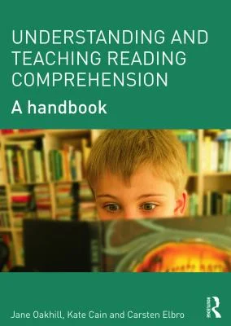


Why do struggling & disadvantaged readers have difficulties with reading comprehension?
Difficulties with language processing – all effort used on decoding
Weaknesses in working memory to process whole text, recall details from earlier chapters, knit text together to ‘make sense’ of it
More limited vocabulary
Difficulties with inference at all levels
Less background knowledge to make inferences thro’ lack of reading & fewer life opportunities to gain general knowledge
Lack of reading experience/exposure to print, motivation + reading anxiety: Extended whole-text reading, engagement & motivation are critical to reading development, persisting when there are challenges & being confident that you can overcome these
Notes:
How long do KS3 students spend reading whole texts in English lessons?
14.8%, according to one US study (Swanson et al): Is this enough if students are not reading outside school? The more students read linguistically accessible, challenging, but not canonical texts, the more they practise & develop comprehension, inference-making, vocab + gain world knowledge to read more challenging texts – the Matthew Effect (Stanovich and Cunningham, 1998; Mol & Bus, 2011; van Bergen et al, 2020; Guthrie & Klauda, 2014; van den Broek, 1997 – the ‘drive for coherence’, Retelsdorf et al, 2011; Taboada et al, 2009; Swanson et al, 2016 )
Students from disadvantaged backgrounds less likely to read for pleasure & enjoy reading BUT access to engaging books & encouragement can change this (Clark & Akerman, 2011; Allington et al, 2010; Cremin et al, 2014). We know that reading for pleasure supports learning across the curriculum: Reading for pleasure at 10 years helps overcome disadvantage - a stronger predictor of GCSE success than parents’ education (Sullivan & Brown, 2015).
BUT - Policy UK & US - How much time is actually spent on reading whole texts in English? Is reading for pleasure expected to occur elsewhere, e.g. DEAR?
So, schools are expecting too much of struggling readers to assume that reading practice must take place, volitionally, outside lessons. We need to reverse this and give struggling readers sufficient reading experience of extended texts to develop their reading comprehension INSIDE Lessons.
Struggling readers have difficulties with inference at all levels - inferring meaning of new words, making links across paragraphs & applying background knowledge to make inferences re setting, plot, character’s motivations
Struggling readers also have weaknesses in memory and language processing so need to gain reading skills (questioning, inferring, summarising, predicting, etc), through experience of whole-text reading, motivation & confidence as ‘readers’ (Stanovich, 1986; Mol & Bus, 2011; van de Broek, 1997) AND through explicit teaching of those reading strategies so that they internalise these and can use them independently.
Oakhill, Cain & Elbro (2015) – excellent book on reading comp, including struggling readers, written for teachers

Slide 7
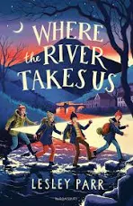



FR was developed as critical response to current practice in KS3 in 2014-2025…
Victorian GCSE texts taught from Year 7 with struggling & reluctant readers - not culturally diverse, engaging novels, where students see themselves represented
Little focus on extended, uninterrupted and engaging reading: short chunks: ‘read a bit, write a lot’ – unengaging (15 mins’ reading?)
Focus on written analysis of extracts to prepare for GCSE language analysis 4 years later
Whole-class or Individual; little group reading/discussion
Comprehension is ‘assumed’: little checking or focus of whole-text comprehension, especially with ‘struggling readers’
Notes:
Pedagogy for KS3 (and KS2) skewed towards the requirements of KS2 SATs or GCSE at 16. No focus on extended, whole-text reading, which is the only way that struggling readers will ever ‘catch up’ and gain sufficiently good reading comp skills to access the secondary curriculum.
Pedagogy all geared towards written analysis of small extracts with a focus on literary features like similes, etc. So struggling readers fall further behind as they lack experience of comprehending a whole text, which would greatly strengthen their comp. skills for future reading.
.

Slide 8
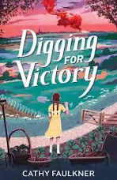
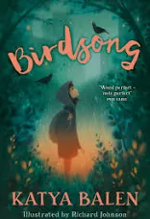
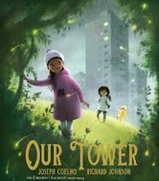
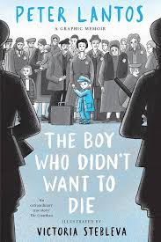

Slide 9

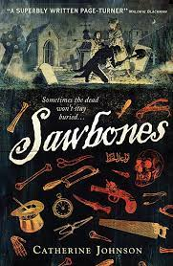
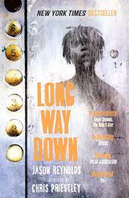
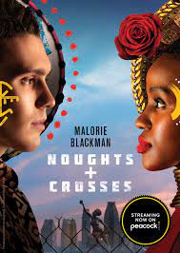
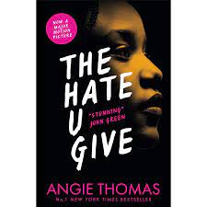


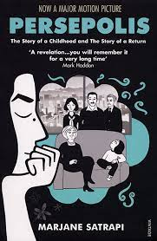
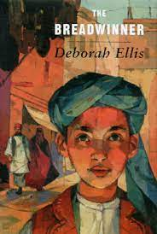
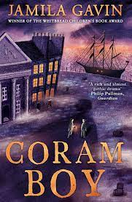
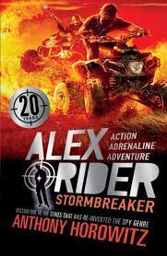

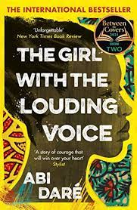

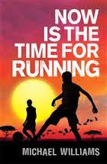

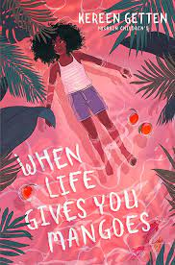
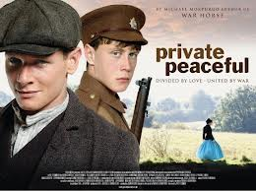
Notes:
Since BLM, teachers now are using more culturally diverse texts, but we started this recommendation in 2014 as part of engaging and motivating struggling readers, who are reluctant readers and need to be hooked into enthusiastic, motivated reading. Here’s some examples of text pairs from our original study AND from our impact study 10 years later
NB Texts chosen at KS3 should be highly engaging, challenging & culturally diverse so that students, esp. weaker readers, who are not used to reading and enjoying whole books, are motivated to read to the end and gain a rich reading experience. None of our teachers chose Victorian novels as these are unlikely to be engaging for struggling readers as the language demands are too great.
Motivation in reading supports comprehension skills so it is essential to choose books that your particular class will enjoy so that they can become immersed in reading and practising the skills of whole-text reading that will turn them into ‘readers’ - develop their skills, make them feel more confident about reading because if they get stuck, they have some strategies to help them resolve their ‘block’ and given them the practise in reading whole texts that many students in our study said they had never experienced.
Only 20% of adolescent students read for pleasure each day, the lowest figure since National Literacy Trust (2025) started doing annual surveys in the UK. So it is imperative that, as Primary teachers, we re-engage KS2 and KS3 students, esp. weaker readers, with the pleasure of reading a whole, challenging text and wanting to know what happens next.
Ofsted (2019) have urged schools to do a different curriculum at KS3 from KS4 so this study illustrated that text choice was very important. We should not see KS3 as all about a narrow ‘preparation’ for handling unseen Victorian extracts at GCSE and therefore having a diet of Victorian novels from Year 7. This will not develop the crucial reading skills, motivation and reading self-concept – ie belief that you are a capable reader & can tackle difficulties you encounter in reading – that all readers need. So choose contemporary and YA texts that will engage and challenge your KS3 readers.

Slide 10
3 components: (1) Faster, immersive reading aloud of 2 high-quality, whole, culturally diverse texts, well-paired in a term. Focus on comprehension & engagement, using dialogic talk & questions
(2) Explicit development of reading strategies: inference, story-structure (use graphic organisers), monitoring of comprehension, questioning, predicting, summarising, visualising, empathising
(3) Group reading aloud & dialogic discussion – to practise reading, asking authentic questions & enjoying a narrative with peers. Groups use reading strategies to resolve sticking points, developing habits, persistence & confident reader identities, across whole texts.
Notes:
What are the 3 components of the Faster Read?
Faster, immersive read of two whole, challenging, culturally diverse novels, back-to-back in a term: focus on reading comprehension & narrative engagement, including expressive, pacy reading aloud by teacher to support mental model & links being made across text
Explicit development of students’ reading strategies: inference, understanding of story-structure (with graphic organisers), self-monitoring of comprehension, questioning, predicting, summarising, visualising, empathising, to support comprehension at sentence/chapter/text level
Group reading and discussion to practise reading aloud, questioning & using other reading strategies to resolve sticking points, enjoy and engage with a narrative with peers, developing habits, practice, confidence and identity of ‘being a reader’
NB a 4th element is that teachers should have the knowledge and understanding of theories of reading comprehension to understand WHY some students struggle to comprehend text.
The Faster, immersive read model of reading: Why is it important now? Covid context of reading & learning losses, esp. for disadvantaged students and struggling readers as no reading practice at home, whereas literacy-rich homes with books intensified their reading with students
There is strong evidence from our original study and the impact studies 3 & 8 years later & now, in discussion with teachers 10 years later, that reading 2 books in a term enables all readers – poor, average and good readers – to make good progress. NB we also looked at the progress of other groups – SEND and PP. Again, the study showed that there was no statistical difference, on average, with their progress than the other groups. Boys also made comparable progress with girls, although the boys on average, started at a lower point (so ended on a lower level).

Slide 11
Struggling readers made 16 months’ comprehension progress in 12 weeks in reading tests. Students increased reading engagement, confidence, persistence, reader identity, enjoyment of English & group reading.
Some evidence of improving writing - even stronger in 10-year impact study!
FINDINGS, FIRST STUDY
Diverse schools, incl. deprived areas.
N=413 Year 8s, 20 English classes -
‘low-attaining’ & mixed-ability:
44% ‘struggling readers’
Mixed-method: standardised reading tests, observations, teacher interviews.
RQs: 1) Can the FR enhance reading levels?
2) Which factors contribute to any development?
Teachers need knowledge about struggling readers, strategies & reading experiences required to develop reading. Extended, pleasurable reading must occur inside lessons, not outside!
Notes:
Faster, immersive read of two whole, challenging, culturally diverse novels, back-to-back in a term: focus on reading comprehension & narrative engagement, including expressive, pacy reading aloud by teacher to support mental model & links being made across text
Explicit development of students’ reading strategies: inference, understanding of story-structure (with graphic organisers), self-monitoring of comprehension, questioning, predicting, summarising, visualising, empathising, to support comprehension at sentence/chapter/text level
Group reading and discussion to practise reading aloud, questioning & using other reading strategies to resolve sticking points, enjoy and engage with a narrative with peers, developing habits, practice, confidence and identity of ‘being a reader’
The Faster, immersive read model of reading: Why is it important now? Covid context of reading & learning losses, esp. for disadvantaged students and struggling readers as no reading practice at home, whereas literacy-rich homes with books intensified their reading with students
There is strong evidence from our original study and the impact studies 3 and 8 years later that reading 2 books in a term enables all readers – poor, average and good readers – to make good progress. NB we also looked at the progress of other groups – SEND and PP. Again, the study showed that there was no difference, on average, with their progress than the other groups. Boys also made comparable progress with girls although the boys on average, started at a lower point (so ended on a lower level).

Slide 12


Two Impact studies, latest 2022 after 8 years
I love it! It’s very liberating I've never in 27 years of teaching just read 2 texts back-to-back! (Anna, Teacher)
Mixed-method, N= 208 Teachers: Online survey, via social media + 25 Teacher interviews + 12 Lesson-observations.
Findings
208+ schools, 40,000+ students & 1000+ teachers currently using FR across whole UK. Primary, Secondary and Special Education schools
10+ Initial Teacher Education courses teach the FR in reading curriculum
99% of teacher respondents would recommend FR to other teachers
Multi-academy Trusts are spreading it across their schools, via agentive Head Teachers, former participants/early adopters of FR
Policy: FR is cited in latest Ofsted English Review of the Curriculum
Original teacher participant pairs have driven change, spreading it to networks, via conferences, social media, youtube videos discussing FR, articles in TES, etc

Slide 13
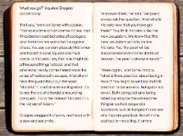


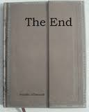
So how did teachers move students through the text?
Fast paced sustained reading for 20 - 40 minutes or even whole lesson
for 3-4 weeks, then 2 weeks to deepen understanding + analysis
Whole class: teacher or fluent readers reading aloud to maintain motivation
Lots of recaps & connections made across the book + timelines on wall, etc
‘Interruptions’ only to recap for 30 seconds, where there are ‘sticking points’, check understanding of plot, setting, vocabulary
Text experienced as a whole
Girl 1: Are we going to read for the entire lesson?
Boy 1: Are we going to finish it today?
Before, there’s been a massive dip in the middle of ‘The Curious Incident’ & we lost momentum – too many pointless writing tasks - but the faster read really helped to keep the enthusiasm going

Slide 14

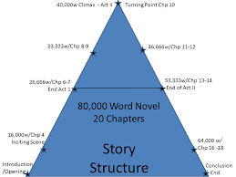
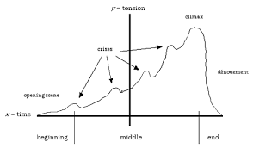
Teaching whole story structure
Timelines: dates, photos – dual narrative - Private Peaceful
Maps tracking characters’ journeys
Graphs – plot highs and lows, quotations
Event wheels
Family trees
Plot-sequencing: using sentences & images
Referencing up and down the whole text

Slide 15

Reading a second text back-to back
‘...it's very liberating for me. I've never in 27 years of teaching just read 2 texts back-to-back!
(Anna, Comparison Teacher)
Reinforced comprehension skills: questioning, predicting, clarifying, inferring, making connections - & practising these properly
Increases volume of text read over 12 weeks
Supports intertextuality and comparison
Students grew more competent, confident, Created an enthusiastic reading community
Raised teacher expectations of their students
I don’t think they have read this much in such a short space of time or ever and I didn’t for a minute expect that they would keep up. It’s going to help their reading enormously but I think we just have to keep on doing it. (Penny Intervention)
It’s a release for me, I love it! Its’ fantastic, amazing! (Jane, Comparison Teacher)

Slide 16
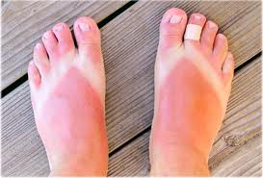
What is inference? What can we infer from this image?
What did you have to know about to be able to infer these things?
Notes:
Many thanks to Sussex teacher and reading expert, Claire Willis, for this slide on how to teach inference, using visual images, and for subsequent slides on The Curious Incident of the Dog in the Night-time

Slide 17
What inferences must you make to comprehend this at basic and higher levels?
I didn’t go to school next day.
I was having breakfast with Dad when I started trembling for no reason. He put his arm around me.
‘What about working with me today?’ he asked.
I nodded.
‘We’ll get it all done for them, eh?’ he said. ‘You and me together.’
Notes:
Necessary inferences

Slide 18
Global inferences: inferring across long chunks or the whole text
For sale: baby shoes, never worn
What inferences are you making? What are you visualising? What do you feel?
How do you use group reading to support comprehension/engagement?
Notes:
Hemmingway’s bet with his writing friends that he couldn’t write a story in 6 words. This is his response – he won the bet!

Slide 19

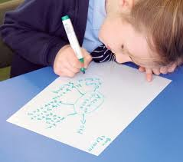
How did FR teachers use reading groups?
Every question is a good question!
To read whole chapters aloud in different ways: fluent reader maintains pace & reads expressively; others read dialogue
To enjoy and engage with a text, practising reading strategies - questioning, clarifying, inferring, predicting, summarising, making connections across text, visualising, empathising
Some used guided reading - teacher modelled, before groups became independent
Stable, mixed-ability groups 4-5, ‘complete reading circle’ of different reading strengths; trusting atmosphere: 15-20 mins
Rotating roles: leader, questioner, clarifier or vocab-monitor.
Mini whiteboards to take vocabulary & questions to class
Culture develops: What does it mean to be a reader? Dialogic space: readers model how to ask questions & have different interpretations
Allows time to practise & internalise reading strategies
What does xenophobia mean?
Why is Deo so upset here?
What happened earlier when…? This reminds me of…
Notes:
(Extensive evidence: Palincsar & Brown, 1984: Reciprocal Teaching, RT; Applebee et al, 2003; Sutherland, 2006, 2015. Reciprocal reading is a form of Guided reading.)
Spend time enabling rapport to develop with the GR groups – choose groups carefully to be supportive of each other’s needs and esp. of reading needs – e.g. personalities & reading strengths: balancing student who is a fluent & quite expressive reader with those who have other skills, e.g. good vocab, good knowledge to apply for understanding the context of the book, motivated in reading, good at keeping the group on task or asking questions, etc.
Ask groups to create their own ground-rules or guidelines for productive group talk about reading (see other Word doc: Guidelines for a Faster read for some examples) & encourage them to reflect on whether they are getting better at doing guided reading and being a supportive group, asking good questions, understanding and exploring the text well, as time goes on.
It’s much easier to do GR when you know your students well – ie avoid early in Autumn term – advice from teacher in School 21, London.

Slide 20





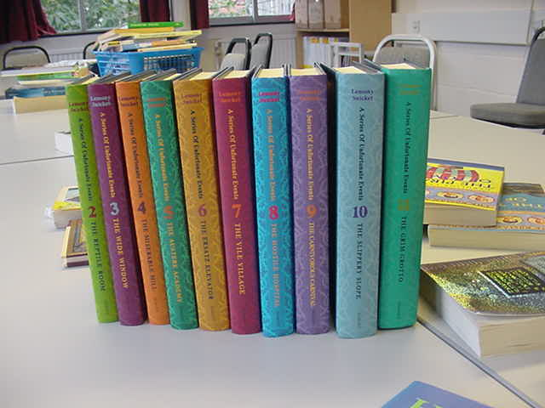
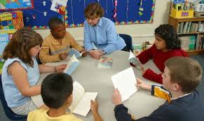

Reading strategies
Notes:
Reading Strategies keyring – all students made their own version of this and had it with them in lessons. When the class read, the teacher encouraged students to identify the strategy they were using – e.g. Today, we’ll particularly focus on inference or prediction, etc. This made the strategies very explicit so students knew they could use any of these to repair comprehension. From top left hand corner – crystal ball = prediction; question mark – student questions; globe = applying world knowledge; Me = remember to apply your personal knowledge to the book and have a personal response (empathise with the characters, discuss what it must feel like to be frightened for your brother, etc); Books = applying knowledge of other texts/intertextuality; group talk – remember to discuss ideas with peers to resolve comprehension; re-search picture = try to break words down/use knowledge of morphology to infer a word (militate – military) or infer what they mean from the context; Sherlock and his magnifying glass = inference, of course! Students need this metalanguage of key strategies, but these visual images on a keyring were very helpful in enabling the students to recall these.
Many thanks to Lauren Haywood, Director of English and reading expert, for this innovation – Peacehaven Community School – see the video with Lauren talking about the project with other teachers at the end of these slides

Slide 21
Who are ‘we’?
Modelling Inference questions
Is this a town or a village?
Is this a town or a village?
We walk to Bikita to see Captain Washington. He is the best policeman in the district. I will tell him what happened in Gutu, what happened to Amai and Grandpa Longdrop and the others. He will know what to do. Bikita is three hours’ walk on the normal path from Gutu, but we do not walk on that path. It is the road that the soldiers used. If they should come back they will see us. We walk the long way.
Why? What does this show about
his character? Relationship?
How far would you get if you walked for 3 hours out of Brighton? What does this show about the boys’ journey?
Why is Deo so scared of the soldiers? What happened earlier in the book?
Notes:
Many thanks to Brighton teacher and reading expert, Liz Uren for this slide, focusing on modelling to students HOW to ask useful questions to monitor their comprehension.

Slide 22
Any Questions? Discussion
What do you think of the Faster Read? Would it work for your children?
What are the challenges? How could these be overcome?
Would you like to join our Faster Read network? Reply to Claire Durrant
Our Website:
Video of teachers talking about their experiences
Guidance for teachers
https://www.sussex.ac.uk/research/centres/centre-for-international-education/projects/fasterread/impact
Gloucester Road Primary School video of FR:
https://films.myattandco.com/programs/a-faster-read-primary-project-part-1
Notes:
What were the challenges for teachers
Radical change to curriculum: will HoD/SMT support, long-term?
Getting through 2 whole novels, back-to-back, in one term
Fear of being caught ‘just reading’ by Learning walks & Ofsted
Will writing suffer with a primary focus on reading with talk? (Teachers’ fears were not justified; many said writing had improved with this focus on reading because students had wider vocabs & greater understanding of text structure, which they transferred to their own writing.)
Assessing reading through talk – how to record this? Teachers found creative ways to do quick comprehension quizzes or discussion and recaps at start/middle of lesson to ensure that students were comprehending the text and monitored the groups during group reading to assess their comprehension – e.g. use of good questioning, etc (the reading strategies) and discussion of the text, etc.
Where’s the evidence of progress? How much writing is in the books?
Daring to focus on whole-text comprehension, not analysis/PETAL paragraphs. Will students perform well in written, analysis assessments?
Using guided reading & group work more often/every lesson
Getting through 2 whole novels in 1 term & maintaining reading engagement in longer lessons (100- minute); balance bet. reading aloud, discussing text & teaching reading strategies & vocab?
Curriculum constraints: how to fit in end-of-term written assessments?
In tension with KS3 ‘Mastery Curriculum’ & performative system, including Ofsted
Where’s the written evidence of progress? How much writing is in the books? Will writing suffer with a primary focus on reading & talk? (Evidence: many teachers report creative & analytical writing has improved with wider vocab used and more understanding of text-structure. One teacher showed Lord of Flies essays to Ofsted to justify spending 30-40 minutes reading, while they observed. Ofsted agreed essays showed strong impact of FR on quality of analytical writing)
Culture change: How to assess reading via talk as teachers not used to this? (Taping of group reading/talk; quick online quizzes; hot-seating; students use quick graphic organisers while discussing text, e.g. timelines, event maps, story mountains; use of 6 oral flashbacks on post-its at start of lesson to assess recall of plot/characters; quick blogs/tweets re characters)
Using reading groups & discussion more often: cultural change for teachers; some academies resist group talk
Cost of new books
‘Just reading, not!’ Recognise the need for rich CPD
Structural challenges – e.g. will SMT support this initiative? – remain, but teachers have largely resolved the other issues on this slide, by practising the model and adapting it to their contexts. E.g. most do it in the Autumn term so that every year group starts with the faster read and 2 novels, to kick-start the year and embed excellent reading and dialogic talk practices, but some teachers do the model in the Spring term.
NB Now that the FR is cited in the Ofsted paper on Research-informed approaches to English teaching, will policy gradually shift towards a recognition of the need for more whole-text focus on comp/interpretation at KS3 and less on the Naming of Parts – micro-analysis?

Slide 23
Primary Teachers replicating the Faster Read and talking about their experiences independently
Watch this video:
Gloucester Road Infant & Primary teachers talking about using the Faster Read:
https://films.myattandco.com/programs/a-faster-read-primary-project-part-1
Gayle Fletcher and Lauren Haines: 93% of pupils in Year 2 & 83% in Year 4 made more than six months progress after 12 weeks of FR
Here is another Primary teacher recommending the Faster Read:
https://theliteracyleader.com/2024/07/21/faster-reading/

Slide 24
Reading is power: students lack the confidence or ability to read these texts on their own. Empower your young people.
Give students the gift of a whole book, a whole journey for its characters, and this supports them in becoming better equipped for the world beyond school.
I justified reading for 30 minutes with Ofsted, by citing the research and they looked at students’ Lord of the Flies essays and were convinced.
A girl often excluded for poor behaviour now attends, sees herself as a reader, loves reading & asking questions of books!
I read to them in their own homes during Covid and one girl is dyslexic and it’s changed her mindset about what reading is, and she really enjoyed it. Their parents enjoyed being read to, too!
We’re bucking the national trend as many students do English Literature at A Level (Tower Hamlets & Sussex)
What if Ofsted come, what if my Head Teacher comes? What if I have an observation? So, we felt like reading was cheating…And I love that freedom to say to my new teachers now: ‘Reading is the work…Don’t worry about the theory behind it - Just try the Faster Read for yourself and see what happens.. in my class the impact was not just on their reading, which was phenomenal, but on their writing – it leapt ahead!’ (Head Teacher recollecting)
Notes:
These are teacher quotations from the survey and interviews in our impact study after 8 years.

Slide 25
Authors’ publications on The Faster Read
Sutherland, J., Westbrook, J., Oakhill, J., & Sullivan, S. (2024) An immersive, ‘Faster Read’: a pilot, mixed-method study, developing whole-text reading comprehension and engagement with adolescent struggling readers, Research Papers in Education, Vol. 39: 5, pp 774-798- https://doi.org/10.1080/02671522.2023.2238285
Sutherland, J. and Westbrook, J. (2022) ‘Reading Comprehension’ in A. Watson & R. Newman (Eds), A Practical Guide to teaching English in the secondary school, London: Routledge.
Sutherland, J. and Westbrook, J. (2025) How do students read, interpret whole texts and become engaged readers? In Smith, L. Secondary English for Generation Alpha: Humane Pedagogy for Local, National and International Contexts, London: NATE/Routledge series
Westbrook, J., Sutherland, J., Oakhill, J. and Sullivan, S. (2019) ‘Just reading’: the impact of a faster pace of reading narratives on the comprehension of poorer adolescent readers in English classrooms. Literacy, 53(2) 61-68
For publication in 2026:
Sutherland, and J., Westbrook, ‘Not the Naming of Parts’: the impact of the Faster Read on teachers, students and reading practices in the UK after ten years (in draft)

Slide 26
References
Allington, R.L., McGill-Franzen, A., Camilli, G., Williams, L., Graff, J., Zeig, J., Zmach, C. & Nowak, R. (2010). Addressing summer reading setback among economically disadvantaged elementary students. Reading Psychology, 31 (5), 411-427.
Applebee, A., Langer, J., Nystrand, M., & Gamoran, A. (2003). Discussion-based approaches to developing understanding: Classroom instruction and student performance in middle and high school English, American Education Research Journal, 40, 685–730.
Baye, A., C. Inns, A. Lake and R.E. Slavin. 2019. “A Synthesis of Quantitative Research on Reading Programs for Secondary Students.” Reading Research Quarterly, 54(2).133-166. doi:10.1002/rrq.229.
Black, J, Barnes, L, Oatley, K., Tamir, D, Dodell-Feder, D., Richter, T, Mar, R. ‘Stories and Their Role in Social Cognition’ in Handbook of Empirical Literary Studies (2021) Kuiken, D. and Jacobs, A. M. (Eds).Berlin:de Greyter https://doi.org/10.1515/9783110645958
Blanden, Jo and Stephen Machin (2010) “Changes in inequality and intergenerational mobility in early years assessments” in Kirstine Hansen, Heather Joshi and Shirley Dex (eds) Children of the 21st century: The first five years. Bristol, Polity.
Clarke and Akerman (2006) Social inclusion and reading: An exploration. London: National Literacy Trust..
Cliff Hodges, G. (2016) Researching and teaching reading: Developing pedagogy through critical enquiry. London, New York: Routledge.
Cunningham, A. & Stanovich, K. (1998) What Reading Does for the Mind in American Educator, Spring/Summer 1998
Duncan, S. (2015) Reading Aloud in Lewisham: An Exploration of Adult Reading Aloud-Practices, Literacy, Vol. 48, No 2. pp 84-90
Eagleton, T. (2008) Literary Theory: An Introduction, (2nd Ed.) Blackwell, Oxford
Education, Audiovisual and Culture Executive Agency of the European Commission ( 2011) Teaching Reading in Europe: Contexts, Policies and Practices, Brussels: EACEA, Eurydice
Felski, R. (2008) Uses of Literature. Oxford: Blackwell
Fitzpatrick, S, Bramley, G, Treanor, M, Blenkinsopp, J, McIntyre, J, Johnsen, S and McMordie, L (2023) Destitution in the UK 2023 [Online]. Available at: https://www.jrf.org.uk/report/destitution-uk-2023
Hart, B. and Risley, T. (2003) ‘The Early Catastrophe – The 30 Million Word Gap by Age 3’. American Educator. 27, pp.4-9
Guthrie, J. T., and S. L. Klauda. 2014. “Effects of Classroom Practices on Reading Comprehension, Engagement, and Motivations for Adolescents.” Reading Research Quarterly 49(4): 387–416. doi:10.1002/rrq.81.
International Reading Association (2007) Teaching Reading Well: a synthesis of IRA's research on teacher preparation for reading instruction, Newark, D.E. USA: International Reading Association

Slide 27
Joseph Rowntree Foundation (2024) UK Poverty, 2024, London: JR Foundation
Moats, L. 2009. “Knowledge Foundations for Teaching Reading and Spelling.” Reading & Writing 22 (4): 379–399. https://doi.org/10.1007/s11145-009-9162-1 .
Murphy, P, Wilkinson,I , Soter, A.,Hennessey, M., Alexander, J. (2009) Examining the effects of classroom discussion on students’ comprehension of text: A meta-analysis. Journal of Educational Psychology, Vol 101(3), 740-764. (argues for the importance of rich talk about texts in all classrooms, whole-class and group)
National Institute for Child Health and Human Development (2000) Report of the National Reading Panel. Teaching children to read: An evidence-based assessment of the scientific research literature on reading and its implications for reading instruction. Washington, DC: U.S. Government Printing Office. National Literacy Trust (2022)
National Literacy Trust, Children’s and young people’s reading engagement, 2022. https://literacytrust.org.uk/research-services/research-reports/children-and-young-peoples-reading-engagement-in-2022/
Oakhill, J.V., Cain, K. and Elbro, C. (2015) Understanding and teaching reading comprehension: a handbook, London: Routledge
Oakhill, J. , Banerjee, R., Garnham, A. (Research in progress on relationship between reading and empathy) Reading Feelings
Oxford University Press (2018) Why closing the word gap matters. Oxford University Press. oxford.ly/wordgap
Palincsar, A.S. and Brown, A.L. (1984) Reciprocal Teaching of Comprehension-Fostering and Comprehension-Monitoring Activities, Cognition and Instruction, 1 (2), 117-175 Pressley, M. (2006) Reading Instruction that Works: the Case for Balanced Teaching. London and New York: Guilford
Pinnick, S. (PhD Thesis in process) How might the use of drama-based pedagogy in the KS3 English classroom support the interpretation of prose and poetry? University of Sussex
Retelsdorf, J., O. Köller, and J. Möller. 2011. “On the Effects of Motivation on Reading Performance Growth in Secondary School.” Learning and Instruction 21(4): 550–559. doi.org/10.1016/j.learninstruc.2010.11.001
Risko, Victoria J., Roller, Cathy M. ,Carrice Cummins, Rita M. Bean, Cathy Collins Block, Patricia L. Anders, James Flood Source(2008) A Critical Analysis of Research on Reading Teacher Education Reading Research Quarterly, Vol. 43, No. 3, pp. 252-288
Rojas-Drummond, S. Mazón, N. & Littleton. K. (2014) Developing Reading Comprehension through Collaborative Learning. Journal of Research in Reading, Volume 37, Issue 2, 2014, pp 138–158

Slide 28
Rojas-Drummond, S. Mazón, N. & Littleton. K. (2014) Developing Reading Comprehension through Collaborative Learning. Journal of Research in Reading, Volume 37, Issue 2, 2014, pp 138–158
Rosenshine, B., Meister, C. and Chapman, S. (1996), Teaching Students to Generate Questions: a Review, Review of Educational Research, 66 (2), 181-221. Culture, Cognition and Pedagogy. London and New York: Routledge, Taylor & Francis.
Joseph Rowntree Foundation (2024) UK Poverty, 2024, London: JR Foundation
Soter, A.O. Wilkinson, I.A., Murphy, P.K., Rudge, L., Reninger,K. & Edwards, M. (2008) What the discourse tells us: Talk and indicators of high-level comprehension International Journal of Educational Research, 47 (2008) 372–391.
Stanovich, K. (1986) Matthew Effects in Reading: Some Consequences of Individual Differences in the Acquisition of Literacy, Reading Research Quarterly, Vol 21, (4) pp 360-407
Sullivan, A. & Brown, M. (2015) Reading for pleasure and progress in vocabulary and mathematics, British Educational Research Journal Vol. 41, No. 6, December 2015, pp. 971–991 DOI: 10.1002/berj.3180
Vaughn, S., G. Roberts, E.A. Swanson, E.A., J. Wanzek, A.M.
Sutherland (2006) Promoting Group Talk and Higher-thinking in pupils, by coaching secondary English trainee teachers, Literacy, 40: 2, pp. 106-114
Sutherland, J. (2015): ‘Going meta’: using a metadiscoursal approach to develop secondary students’ dialogic talk in small groups, Research Papers in Education, Vol. 30,(1), pp. 44–69
Taboada, A., S.M. Tonks, A. Wigﬁeld, and J.T. Guthrie, 2009. Effects of Motivational and Cognitive Variables on Reading Comprehension. Reading and Writing: An Interdisciplinary Journal 22 (2):85–106.DOI 10.1007/s11145-008-9133-y.
Torppa, M., Niemi, P., Vasalampi, K., Lerkkanen, M.K., Tolvanen, A., A-M. Poikkeus, A-M. 2020. “Leisure Reading (But Not Any Kind) and Reading Comprehension Support Each Other - A Longitudinal Study Across Grades 1 and 9”. Child Development, 91:3, 876–900.
Vaughn, S., G. Roberts, E.A. Swanson, E.A., J. Wanzek, A.M. Fall, and S.J. Stillman-Spisak. 2015. Improving Middle-School Students’ Knowledge and Comprehension in Social Studies: a Replication. Educational Psychology Review 27:31–50. DOI:10.1007/s10648-014-9274-2.
van den Broek, P. W.1997. Discovering the Cement of the Universe: The Development of Event Comprehension from Childhood to Adulthood. In Developmental Spans in Event Comprehension and Representation, edited by P. W. van den Broek, P. J. Bauer and T. Bourg: 321-342. Mahwah, NJ: Lawrence Erlbaum Associates.
van Bergen, E., K. Vasalampi, M. Torppa, M. 2020. “How Are Practice and Performance Related? Development of Reading From Age 5 to 15”, Reading Research Quarterly, 56(3) pp. 415–434. doi:10.1002/rrq.309
Westbrook, J. (2013) Reading as a Hermeneutical Endeavour: Whole-Class Approaches to Teaching Narrative with Low-Attaining Adolescent Readers, Literacy, Vol 47, (1), pp. 42-49.
Upchurch, D. (PhD thesis in process) Reclaiming reading: a participatory action research project exploring the pedagogic potential of young readers' relationships, talk and sociocultural diversity to raise reader engagement. University of Sussex.

Slide 29

Remaining slides show…
Teaching of vocabulary in context, using etymology & inference
Using graphic organisers for story-structure
Using maps to track characters’ progress
Teaching contextual information to support Now is the Time for Running
A bit more on the rationale/theory for doing the Faster Read

Slide 30
Example of strategies for developing vocabulary, using inference, when you come across a new word in a text
Can you say this word?
pneumonoultramicroscopicsilicovolcanoconiosis
Pairs - What does it mean? Have a ‘go’ at breaking it down…
Break word into chunks of meaning – morphemes
Link those to words you’ve seen or heard before (‘pneu’)
Use the context of the word in its sentence/paragraph/text
Use ALL these clues to guess or infer overall meaning
Notes:
Many thanks to Sussex Hod English, Georgette Ayling, for these slides on vocabulary-development.

Slide 31
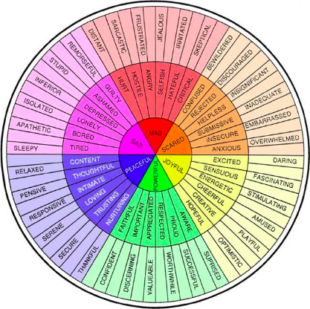
What happened?
Where did it happen?
When did it happen?
EVENT MAP
Who was involved in the event?
How did it happen?
Why did it happen?
Using your emotions wheel, surround your map with words to show how you think Deo might be feeling at this point.
Notes:
Using graphic organisers – see Hodder examples online. Pupils to decide on a key event in chapters 1-5 and complete chart in their books. Pupils should then scatter character emotions around the outside of the organiser.
Add emotions! Pupils will need to justify the emotions they have chosen. The aim is to use the words correctly, so they should look up words that they are unsure of. For those that need an extension, they could add a brief sentence below the words explaining why they chose them.
Thanks very much to Claire Houslop, Brighton teacher and reading expert for this slide.

Slide 32
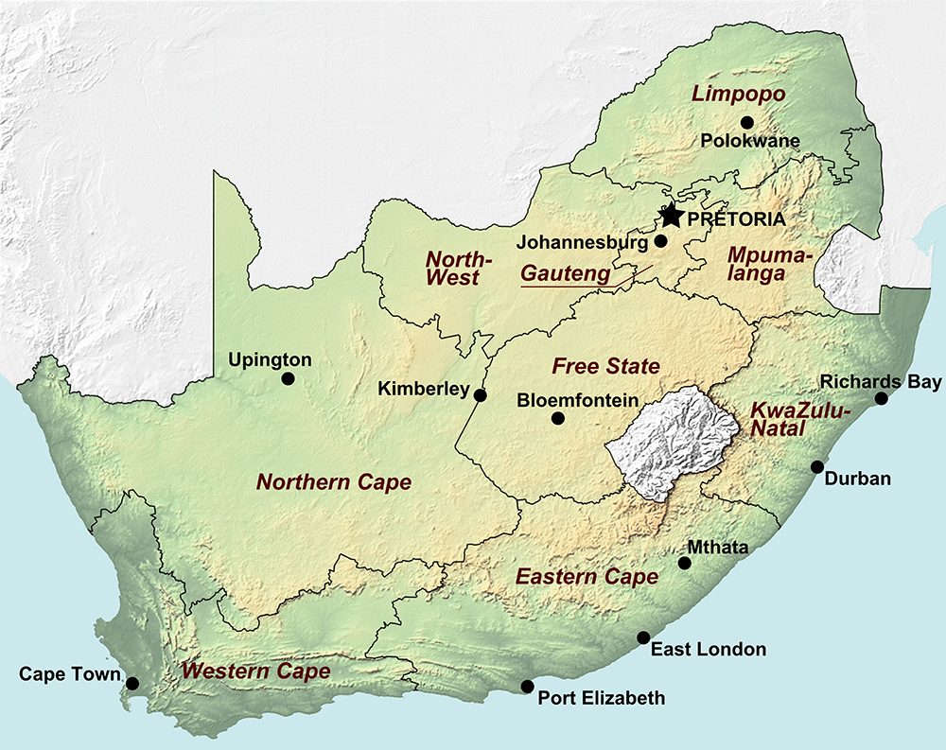
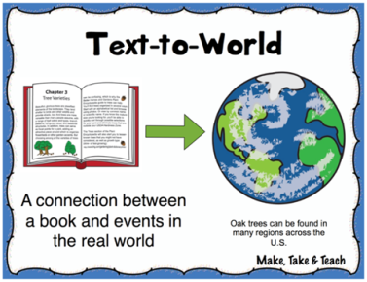
Cape town is the capital city of the Western Cape. This is where Deo joins the Homeless Football team.
Can you find Cape town on the map and label it?
Notes:
Thanks very much to a local, Brighton teacher and reading expert, Claire Houslop, for these slides: Plot Cape Town after you have read chapter 22 of Now is the Time for Running.

Slide 33
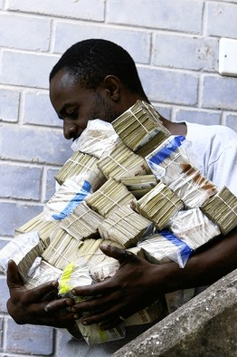
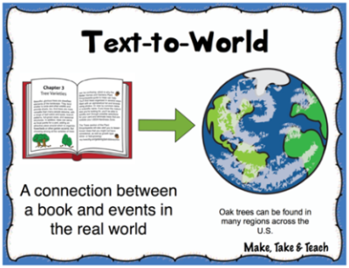
Now is the Time for Running: applying Text-World knowledge
‘a football stuffed with a billion worthless dollars’
The Zimbabwean dollar (ZW$) is the official currency and it is one of the least valued currencies in the world.
In 2007 the exchange hit
ZW$ 200,000,000 to US$ 11
US$1 to £1.98
Can you work out how much money Deo and Innocent have in their football?
Billion = 9 noughts
Million = 6 noughts
A man in Harare, Zimbabwe, carried cash for groceries in 2008
Notes:
Explain that to solve the financial crisis, Mugabe authorised the printing of more money (the trillion dollar bill was introduced) and this devalued the currency. Make links with inflation crisis in Germany – wheelbarrows of money to buy bread.
Ask pupils to work out how much 1billion ZW$ is in US$ then in £
Billion = 9 noughts
Million = 6 noughts (so 200million)
1,000,000,000 / 200,000,000 x 11 = US$55 x £1.98 = £108.90
Stage one: We need to work out how many 200,000,000 there are in a billion.
Stage two: we times that number by 11 US dollars.
Stage three: times that by £1.98 to convert to sterling.
NB See youtube examples of the 2008 riots in South Africa
Thanks very much to Claire Houslop, Brighton teacher and reading expert for this slide.

Slide 34
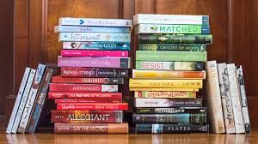
What must teachers know about reading? A bit more theory in these last 2 slides
How do readers read whole texts? Situation Models (Kintsch, 1998)
Why do some readers struggle to comprehend text?
Why is it important to read many whole texts? Reciprocal relation between reading amount & reading comprehension
Role of engagement & reader identity; Choice of texts - becoming a ‘reader’: diverse text representations: developing persistence, habits (Retelsdorf et al, 2011; Cremin et al, 2014, Cliff-Hodges, 2014; Guthrie & Klauda, 2014)
Role of inference, story-structure, self-monitoring, vocabulary, reading aloud (Oakhill & Cain, 2012 Oakhill et al, 2015)
Compounding effect of disadvantage: language gap at 5 yrs & reading-experience gap magnifies over time (Blanden & Machin, 2010; Hart & Risley, 2003; NLT, 2022; Baye et al, 2019)
Community reading & dialogic talk: class/groups: reading aloud for interpreting, enjoyment + fluency, questioning, self-monitoring… (e.g. Okkinga et al, 2014; Sutherland, 2015)
Notes:
How do ‘good’ readers read whole texts & construct meaning, creating mental models?
Most imp. 3 elements of reading: inference, monitoring comp – know when stuck – know how to apply a strategy and become unstuck/resolve comp problem; story-structure (Oakhill & Cain, 2012). Role inference at sentence, para, chapter & whole-text levels. Struggling readers: 1) weaknesses in working-memory – can’t retain sense of narrative from sentence to chapter, 2) compounded by slow decoding/weak fluency – strong expressive reader reading aloud, supports their fluency & comp.- weak inference even when they have relevant knowledge – can’t apply – must learn to question & apply that knowledge. 3) Weak comprehenders/inferers – must practise by reading/trying to infer
Why do some readers struggle to comprehend text? e.g. memory, language-processing, cognitive resources overloaded by weak decoding & fluency, problems with inference-making, lack of strategies & reading practice (Oakhill et al, 2015).
Why is it important to read many whole texts? Reciprocal relation between frequent reading, amount (exposure to print) & reading comprehension, esp. extended narratives: the ‘Matthew effect’ the ‘rich’ get ‘richer’, the ‘poor’ ‘poorer’ (Kintsch, 1998; Westbrook, 2013; Cunningham & Stanovich, 1998; Torppa et al, 2020; van Bergen et al, 2020; Mol & Bus, 2011). So, Students need to read many whole, extended texts to improve their reading comprehension.
Roles of reading engagement, inference, story-structure, self-monitoring & vocabulary (Guthrie & Klauda, 2014; Oakhill et al, 2015). Reading for pleasure at 10 years helps overcome disadvantage - a stronger predictor of GCSE success than parents’ education (Sullivan & Brown, 2015).
Compounding effect of disadvantage: language gap at 5 yrs & reading-experience gap magnifies over time. These students are less likely to read independently & do not gain adequate whole-text reading experience in school (Blanden & Machin, 2010; Hart & Risley, 2003; NLT, 2022; Baye et al, 2019) - BUT access to books & encouragement can change this(Clark & Akerman, 2011; Allington et al, 2010; Cremin et al, 2014). Need to place extended reading at heart of reading lessons, not expect extended reading to take place at home – exacerbates disadvantage – although of course RfP independently is another aim
Community reading & dialogic talk: class/groups: reading aloud for fluency, student/teacher questioning, self-monitoring, interpreting, enjoyment (Okkinga et al, 2014; Sutherland, 2006, 2015; Cremin et al 2014)
Choice of texts - becoming a ‘reader’: developing reading self-concept or identity, persistence & skills to overcome challenges (Retelsdorf et al, 2011; Cremin et al, 2014) – culturally diverse texts
Reading engagement: Reading for pleasure at 10 years helps overcome disadvantage - a stronger predictor of GCSE success than parents’ education (Sullivan & Brown, 2015).
Reading extended fiction, as opposed to other varieties of text, online or print, is particularly related to improvements in reading comprehension (Jerrim & Moss, 2019) Struggling readers need to gain skills, experience of whole-text reading, motivation & confidence as ‘readers’ (Stanovich, 1986; Mol & Bus, 2011; van de Broek, 1997)
How do ‘good’ readers read whole texts & construct meaning, creating mental models? (Kintsch, 1998)
Why do some readers struggle to comprehend text? e.g. memory, language-processing, cognitive resources overloaded by weak decoding & fluency, problems with inference-making, lack of strategies & reading practice (Oakhill et al, 2015)
Why is it important to read many whole texts? Reciprocal relation between reading amount & reading comprehension, esp. extended narratives: the ‘rich’ get ‘richer’, the ‘poor’ ‘poorer’ (Kintsch, 1998; Westbrook, 2013; Cunningham & Stanovich, 1998; Torppa et al, 2020; van Bergen et al, 2020; Mol & Bus, 2011)
Role of reading engagement, inference, story-structure, self-monitoring & vocabulary (Guthrie & Klauda, 2014; Oakhill et al, 2015)
Compounding effect of disadvantage: language gap at 5 yrs & reading-experience gap magnifies over time. These students are less likely to read independently & do not gain adequate whole-text reading experience in school (Blanden & Machin, 2010; Hart & Risley, 2003; NLT, 2022; Baye et al, 2019)
Community reading & dialogic talk: class/groups: reading aloud for fluency, student/teacher questioning, self-monitoring, interpreting, enjoyment (Okkinga et al, 2014; Sutherland, 2015; Cremin et al 2014)
Choice of texts - becoming a ‘reader’: developing reading self-concept or identity, persistence & skills to overcome challenges (Retelsdorf et al, 2011; Cremin et al, 2014)
How do ‘good’ readers read whole texts & construct meaning, creating mental models? (Kintsch, 1998)
Why do some readers struggle to comprehend text? e.g. memory, language-processing, cognitive resources overloaded by weak decoding & fluency, problems with inference-making, lack of strategies & reading practice (Oakhill et al, 2015)
Why is it important to read many whole texts? Reciprocal relation between reading amount & reading comprehension, esp. extended narratives: the ‘rich’ get ‘richer’, the ‘poor’ ‘poorer’ (Kintsch, 1998; Westbrook, 2013; Cunningham & Stanovich, 1998; Torppa et al, 2020; van Bergen et al, 2020; Mol & Bus, 2011)
Role of reading engagement, inference, story-structure, self-monitoring & vocabulary (Guthrie & Klauda, 2014; Oakhill et al, 2015)
Compounding effect of disadvantage: language gap at 5 yrs & reading-experience gap magnifies over time. These students are less likely to read independently & do not gain adequate whole-text reading experience in school (Blanden & Machin, 2010; Hart & Risley, 2003; NLT, 2022; Baye et al, 2019)
Community reading & dialogic talk: class/groups: reading aloud for fluency, student/teacher questioning, self-monitoring, interpreting, enjoyment (Okkinga et al, 2014; Sutherland, 2015; Cremin et al 2014)
Choice of texts - becoming a ‘reader’: developing reading self-concept or identity, persistence & skills to overcome challenges (Retelsdorf et al, 2011; Cremin et al, 2014)

Slide 35

Our Year 7s are telling us – for the first time - they’ve never read a whole book! Primary teachers are under such pressure with the KS2 tests that they often focus on extracts now. (Teachers interviewed in 1st Impact Case Study for Faster Read, 15/11/2017)
14-yr olds who read often & independently know 26% more words than those who never read. Those from book-loving homes know 42% more words (Sullivan, 2017)
The more texts you read, the better your vocab, comprehension and cognitive skills. The gap opens up at secondary, where the reading challenge intensifies and the gap between ‘rich’ and ‘poor’ readers widens...(Cunningham & Stanovich, 1998; the Faster Read, Sutherland, Westbrook, Oakhill and Sullivan, 2024)
Notes:
Cunningham and Stanovich, 1998 and our study – Sutherland et al, 2023 – the more you read, the better you get at comprehending as you are forced to tackle and overcome comprehension difficulties – this improves your skills for the next book AND gives you the motivation and self-belief to know you can do this – ie enhances your identity as a reader.
Allington et al, - gave disadvantaged students, also weak readers, 15 books over the summer holidays, which they chose themselves and were allowed to keep, and they maintained their comprehension levels along with more advantaged peers, whereas normally, a gap opens up across the summer holidays, with more advantaged and typically stronger readers reading a lot during the summer and disadvantaged students not reading – optimistic study!! ie simply giving children from more disadvantaged backgrounds easy access to books and encouragement to read will help them keep up their reading comp. skills. See many libraries’ campaigns to get children reading in the summer – schools should try to promote these initiatives & join forces with local libraries.
So, there is huge evidence that children need to read a lot and be exposed to a volume of print to develop their reading skills, but the question is: how much reading of whole books are they doing in their actual English lessons? This was our focus in the research – if children read 2 whole books in a term & teachers focus on engagement/motivation, as well as strategies, this should give poorer, reluctant readers the experience of ‘being a reader’ & enjoying a whole book, as well as the feeling of confidence (and satisfaction) that comes with getting to the end of a novel. Will this reading model develop poor readers’ reading comp. skills? In future studies, we would also want to investigate whether the model also stimulated students to do more independent reading (NB our teacher participants reported that they did, but this was not a specific focus of this study).

