Slide 1
‘
‘A Faster, Immersive Read’: engaging students with reading and enhancing their progress
Julia Sutherland and Jo Westbrook
University of Sussex
Contact: Jcs23@sussex.ac.uk

Slide 2

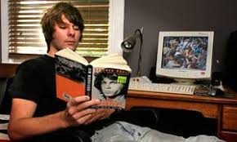
Aims today
Explore, using authentic examples:
the Faster Read pedagogy - 3 elements - and theoretical rationale
benefits 10+ years on, challenges & how to overcome these
your own reading pedagogy: how might you develop this, especially for struggling and disadvantaged readers?
‘Good readers’ typically read more, thus improving their vocab, comprehension, knowledge & ability to read more challenging texts. Weaker readers experience failure & typically read less, widening the reading gap: The ‘rich get richer…’
(Cunningham & Stanovich, 1998)
Reading for pleasure at 10 years is a better predictor of cognitive progress at 16 years than parents’ educational level (Sullivan,Brown, 2015)
Notes:
Cunningham & Stanovich’s (1998) Matthew Effect: a reciprocal relationship between existing reading skill, amount you read/how much extended text you are exposed to, and reading comprehension.
There is extensive research evidence that teachers need theorised knowledge & understanding of how readers comprehend whole texts (e.g. IRA, 2000; Risko et al, 2008; Compton et al, 2015); why some students struggle with reading comprehension; & of which teaching and learning approaches best support reading development for all readers. Causes of difficulty with comprehending text are varied and include cognitive weaknesses (e.g. in short-term memory & ability to process language); and lack of experience & practice in reading whole texts, thus developing students’ vocab, syntax/grammar, general knowledge and ability to infer, question, clarify, overcome comprehension difficulties, and make connections across the text, strengthening their ability to feel confident in tackling subsequent, more challenging texts – i.e. their reader identity (or reading self-concept). Teachers should be able to ‘go meta’ and reflect on the reading experiences & skills students need to have and to develop, to be able to read a book – i.e. to be metacognitive in their approach to reading. They must look carefully at their students, identifying which of them may struggle with their reading, why and therefore how to address their weaknesses.
Readers must be able to decode, be fluent/automatic enough in their reading aloud/in heads to hold the meaning in their heads/+ be able to comprehend words (i.e. have adequate vocabulary), while also using other skills, e.g. they must infer, drawing on knowledge provided by the text and on general knowledge assumed + integrate meaning across text. There are several different kinds of inference: local cohesion inferences enable readers to apply knowledge between and across sentences – e.g. lexical & pronominal inferences – e.g. Sally – s/he… Knowledge-based inferences require the reader to apply knowledge to ‘make sense’ of the text at the level of paragraphs, chapters & whole text. The reader must also integrate the inferences and meanings across chapters to achieve global coherence – making the model cohere & make sense, by checking back/reading backwards and forwards – i.e. making predictions, drawing on an understanding of story-structure and genre, revising your model as you read to achieve global coherence at the end. Applebee et al (2014) call this process the ‘flexible envisionment’ of text. This active process is what makes reading so exciting, but also challenging for some readers.

Slide 3

What do all students need to be able to do, in order to read and comprehend a whole text?
What reading experiences & teaching do you find develops students’ reading comprehension?
10% of all children are poor comprehenders & struggle to infer, but have adequate decoding skills (Oakhill et al, 2015)

Slide 4

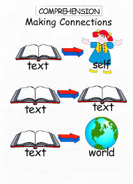

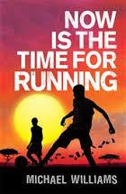

How do we comprehend a whole text?
Decode + read fluently & automatically - effortless, unconscious
understand vocabulary (oral comprehension)
make sense of sentences – grammar, syntax, pronouns (Sally…she…)
Infer at paragraph level – bring knowledge to text to add meaning & fill in in gaps: waves, bucket, decking = setting; use clues: chap. titles
Infer at global/text level – apply knowledge of: human behaviour to infer characters’ motivations; context (WWII, S. Africa), other texts?
Use short/long-term memory to build a mental model of the text, adapting as we read
Make connections across the text
Draw on understanding of text structure/genre, predict & navigate our way…
Monitor our comprehension when ‘stuck’ & apply a strategy: ask a question, clarify vocab, recap or re-read for missing details or recall names/places/plot
Read quickly enough to maintain our model, recall details, integrate
Be engaged with the story to overcome challenges & reach the end – PERSIST -
& know, from reading many books, that the view is worth it!
Have a positive reader identity/reading self-concept – believe we can succeed!
Notes:
Fluency and reading aloud:
Fluency of oral reading aloud improves skills of speed, effortlessness, autonomy and lack of conscious awareness – all of which strongly support comprehension. The teacher or a fluent peer reading aloud expressively, with appropriate intonation also supports fluency for other readers, not just the actual reader reading aloud (NICHHD 2000; Duncan 2015).
There is extensive evidence on the impact of reading engagement on comprehension. i.e. the more you read and are motivated to keep reading, even when it is difficult, the better you become at reading comp. and overcoming reading challenges. This is partly also because you develop other essential ingredients of reading: vocabulary, syntax and grammar, general knowledge needed to be able to make good inferences, an understanding of how narratives ‘work’ (called story-structure) and of different genres, etc – all of this knowledge helps readers to read subsequent books.
Research on the importance of motivation includes developing the reader’s ‘drive for coherence’ (van den Broek, 1997). i.e. readers need to be excited by the narrative and want to know what happens next. This makes them work hard at making sense of the text (Taboada et al, 2016) because they can anticipate the pleasure they will experience of knowing the ending when all threads are woven together.
See all research on importance of reading independently or for pleasure – Allington et al, 2010; Cremin, Cliff-Hodges, etc – this experience supports good reading comprehension. See Stanovich’s virtuous reading circle.

Slide 5
Who said this?
Knowing the text should be the first priority of students and the first priority of teaching. The stories that writers tell are fundamental to enjoyment and knowing what happens in those stories, and how events are sequenced, enables students to interpret the texts with authority and engage in discussion about genre and authorial method in a confident and meaningful way. But the stories have to come first.
There is little point writing about intradiegetic narrators if students haven’t got inside the stories that the narrators are telling. There is also little point in writing about genre elements if students haven’t grasped the story that is being told. It is stories which fire the imagination of readers – which is surely what English Literature primarily ought to do.
AQA A Level English Lit. Examiners’ Report, 2023
Notes:
This is the AQA A Level examiners’ annual report, 10 years after we 1st created the FR as a group of 3 colleagues – Prof Jane Oakhill in Psych, Jo Westbrook and me. Jane is int expert in reading comp – researched in primary ed but thought full range of inferences not explicitly taught in primary and needed more focus on explicit reading strategies
I’d been researching group dialogic talk/guided reading for some time – reading as a collaborative activity, not individualised – shared meaning-making, listening to others’ perspectives, engagement, fun & based on extensive theory from ‘reader response’& transactional approaches – interaction bet reader/other readers/context/other texts, on. Like adult book groups. Jo – whole-text, faster reading.
What are we currently doing in lessons with reading? Who is falling behind? Why do we need to return to a focus on whole-text reading and comprehending the narrative at KS3? Remember that struggling readers and reluctant ones (often from more disadvantaged backgrounds or with weaknesses in language processing, memory, inference-making, etc) do not do much/any reading outside school. So we need to do much more reading of whole texts inside classrooms as the more you read, the better you get at it (Cunningham & Stanovitch, 1998) – because you practise the skills you need to be a good reader (questioning, inferring, etc) and encounter much new vocab, which will enhance vocab as it’s much easier to infer the approx meaning of new vocab in the rich context of sentence/para and engaging narrative.

Slide 6
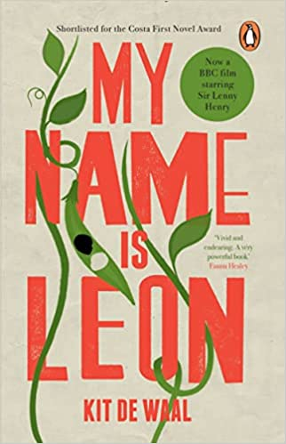
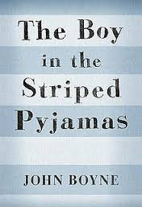
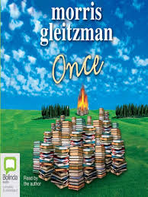
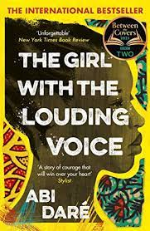
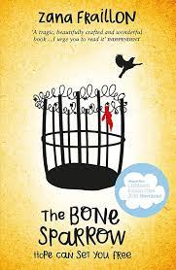
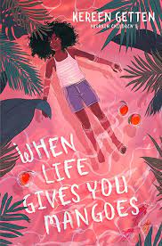
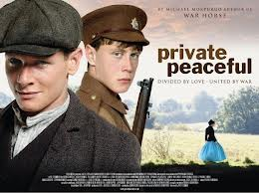


Struggling readers: 16 months’ comprehension progress in 12 wks + increased engagement, independent reading, reader identity, attendance, enjoyment of English & grp reading.
Diverse schools, incl. deprived areas.
413 Year 8s, 20 English classes
‘low-attaining’ & mixed-ability:
44% ‘struggling readers’.
Social-constructionist, mixed-method: standardised reading tests, 40 observations, 40 teacher interviews
Reading at centre:2 whole, challenging, culturally diverse novels, read aloud back-to-back,
Dialogic class talk & reading groups: students read, enjoy, interpret, question & use reading strategies
Struggling & disadvantaged readers learn how to be a reader: to enjoy a narrative, monitor comprehension & overcome sticking points
Teacher Agency, reflection & theory: How do all readers comprehend text?
Reading challenges?
Best pedagogy for reading & engagement?
Teacher commitment:
I love it! It’s very liberating I've never in 27 years of teaching just read 2 texts back-to-back! (Anna, Teacher)
Notes:
Starting point for Original research 2014-15 – 3 researchers – Positioning teachers as agentive professionals who have embodied knowledge re reading BUT need to build on this esp. for struggling/disadvantaged readers. So What do reading teachers need to know & how can they develop & apply this knowledge? – 1) whole-text reading & imp of multiple reading experiences of extended text + dialogic discourses that support reading, class/group + cognitive process of reading comp. Findings: Methods: standardised tests & qualitative data 2 obs & 2 teach. Ints IMPACT on Teachers and Students – YELLOW – improve comp, engagement attendance, etc + Teacher enthusiasm because ‘it works’!
The Faster, immersive read model of reading:
Why is it important now? Post-Covid context of reading & learning losses, esp. for disadvantaged students and struggling readers as no reading practice at home, whereas literacy-rich homes with books intensified their reading with students
The intervention group (half the teachers; 10 classes) did the entire model; the comparison group (the other half) only did the faster read of 2 novels and followed customary practice. NB The quantitative data showed that all 20 classes made similar progress on the reading tests, BUT the qualitative data showed that in the ‘intervention’ classes, where teachers focused on explicitly teaching reading strategies, including using guided reading and group work, the students appeared more engaged, confident about reading and independent in their approach: they independently used the strategies in groups, asked lots of good questions of the text, predicted, summarised, clarified, etc. Future studies will measure reading gains over time – we predict, but did not test, that children who are taught all the reading strategies and given plenty of time to practise these in groups will make greater gains in reading over time – e.g. after 6 months or a year than classes only reading the books. (NB one intriguing aspect of the quantitative data was that readers defined as ‘average’ or ‘good’ made better progress in the ‘intervention’ classes. Ie. The model appears to develop the reading of good readers, as well as of poor readers.)
There is strong evidence from this study and subsequent impact studies, that reading 2 books in a term enables all readers – poor, average and good readers – to make good progress. NB we also looked at the progress of other groups – SEND and PP. Again, the study showed that there was no difference, on average, with their progress than the other groups. Boys also made comparable progress with girls although the boys on average, started at a lower point (so ended on a lower level).
The reading model should support progress of all students in reading. Teachers in Brighton, Hove and Sussex are all still using the model (60+ schools nationally) 5 years later, which is further evidence that teachers believe this is the way to ensure progress in reading for KS3 students. Most schools are using this model in Yrs 7-9, many also in GCSE – ie reading the whole Victorian novel more quickly for comp. of a whole text, then going back over it to analyse, having got the plot firmly fixed in students’ minds. Many teachers using the model interviewed on 15/11/2017 reported that students are definitely remembering the texts more with this approach, particularly the plot, characters, etc, but also key quotations – ie it supports crucial memory skills that are needed in the new linear GCSE exams.
NB Texts chosen at KS3 should be highly engaging, challenging & culturally diverse so that students, esp. weaker readers, who are not used to reading and enjoying whole books, are motivated to read to the end and gain a rich reading experience. None of our teachers chose Victorian novels as these are unlikely to be engaging for struggling readers as the language demands are too great. Motivation in reading supports comprehension skills so it is essential to choose books that your particular class will enjoy so that they can become immersed in reading and practising the skills of whole-text reading that will turn them into ‘readers’ - develop their skills, make them feel more confident about reading because if they get stuck, they have some strategies to help them resolve their ‘block’ and given them the practise in reading whole texts that many students in our study said they had never experienced. Only 23% of adolescent students read for pleasure each day, the lowest figure since National Literacy Trust (2020) started doing annual surveys in the UK. So it is imperative that, as English teachers, we re-engage KS3 students, esp. weaker readers, with the pleasure of reading a whole, challenging text and wanting to know what happens next. Ofsted (2019) have urged schools to do a different curriculum at KS3 from KS4 so this study illustrated that text choice was very important. We should not see KS3 as all about a narrow ‘preparation’ for handling unseen Victorian extracts at GCSE and therefore having a diet of Victorian novels from Year 7. This will not develop the crucial reading skills, motivation and reading self-concept – ie belief that you are a capable reader & can tackle difficulties you encounter in reading – that all readers need. So choose contemporary and YA texts that will engage and challenge your KS3 readers.
The Faster, immersive read model of reading: Why is it important now? Covid context of reading & learning losses, esp. for disadvantaged students and struggling readers as no reading practice at home, whereas literacy-rich homes with books intensified their reading with students
The intervention group (half the teachers; 10 classes) did the entire model; the comparison group (the other half) only did the faster read of 2 novels and followed customary practice. NB The quantitative data showed that all 20 classes made similar progress on the reading tests, BUT the qualitative data showed that in the ‘intervention’ classes, where teachers focused on explicitly teaching reading strategies, including using guided reading and group work, the students appeared more engaged, confident about reading and independent in their approach: they independently used the strategies in groups, asked lots of good questions of the text, predicted, summarised, clarified, etc. Future studies will measure reading gains over time – we predict, but did not test, that children who are taught all the reading strategies and given plenty of time to practise these in groups will make greater gains in reading over time – e.g. after 6 months or a year than classes only reading the books. (NB one intriguing aspect of the quantitative data was that readers defined as ‘average’ or ‘good’ made better progress in the ‘intervention’ classes. Ie. The model appears to develop the reading of good readers, as well as of poor readers.)
There is strong evidence from this study that reading 2 books in a term enables all readers – poor, average and good readers – to make good progress. NB we also looked at the progress of other groups – SEND and PP. Again, the study showed that there was no difference, on average, with their progress than the other groups. Boys also made comparable progress with girls although the boys on average, started at a lower point (so ended on a lower level).
The reading model should support progress of all students in reading. Teachers in Brighton, Hove and Sussex are all still using the model (60+ schools nationally) 5 years later, which is further evidence that teachers believe this is the way to ensure progress in reading for KS3 students. Most schools are using this model in Yrs 7-9, many also in GCSE – ie reading the whole Victorian novel more quickly for comp. of a whole text, then going back over it to analyse, having got the plot firmly fixed in students’ minds. Many teachers using the model interviewed on 15/11/2017 reported that students are definitely remembering the texts more with this approach, particularly the plot, characters, etc, but also key quotations – ie it supports crucial memory skills that are needed in the new linear GCSE exams.
NB Texts chosen at KS3 should be highly engaging, challenging & culturally diverse so that students, esp. weaker readers, who are not used to reading and enjoying whole books, are motivated to read to the end and gain a rich reading experience. None of our teachers chose Victorian novels as these are unlikely to be engaging for struggling readers as the language demands are too great. Motivation in reading supports comprehension skills so it is essential to choose books that your particular class will enjoy so that they can become immersed in reading and practising the skills of whole-text reading that will turn them into ‘readers’ - develop their skills, make them feel more confident about reading because if they get stuck, they have some strategies to help them resolve their ‘block’ and given them the practise in reading whole texts that many students in our study said they had never experienced. Only 23% of adolescent students read for pleasure each day, the lowest figure since National Literacy Trust (2020) started doing annual surveys in the UK. So it is imperative that, as English teachers, we re-engage KS3 students, esp. weaker readers, with the pleasure of reading a whole, challenging text and wanting to know what happens next. Ofsted (2019) have urged schools to do a different curriculum at KS3 from KS4 so this study illustrated that text choice was very important. We should not see KS3 as all about a narrow ‘preparation’ for handling unseen Victorian extracts at GCSE and therefore having a diet of Victorian novels from Year 7. This will not develop the crucial reading skills, motivation and reading self-concept – ie belief that you are a capable reader & can tackle difficulties you encounter in reading – that all readers need. So choose contemporary and YA texts that will engage and challenge your KS3 readers.

Slide 7




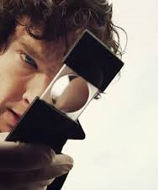

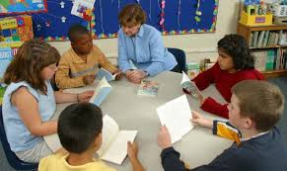
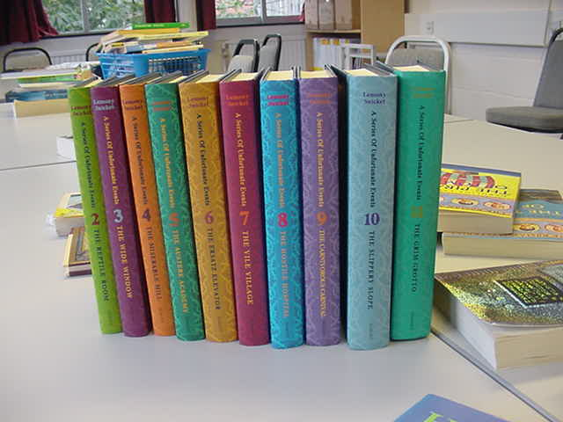

Reading strategies
Notes:
Reading Strategies keyring – all students made their own version of this and had it with them in lessons. When the class read, the teacher encouraged students to identify the strategy they were using – e.g. Today, we’ll particularly focus on inference or prediction, etc. This made the strategies very explicit so students knew they could use any of these to repair comprehension. From top left hand corner – crystal ball = prediction; question mark – student questions; globe = applying world knowledge; Me = remember to apply your personal knowledge to the book and have a personal response (empathise with the characters, discuss what it must feel like to be frightened for your brother, etc); Books = applying knowledge of other texts/intertextuality; group talk – remember to discuss ideas with peers to resolve comprehension; re-search picture = try to break words down/use knowledge of morphology to infer a word (militate – military) or infer what they mean from the context; Sherlock and his magnifying glass = inference, of course! Students need this metalanguage of key strategies, but these visual images on a keyring were very helpful in enabling the students to recall these.
Many thanks to Lauren Haywood, English teacher and reading expert, for this innovation!

Slide 8

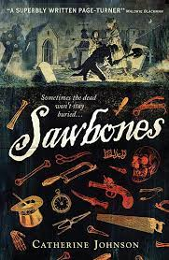
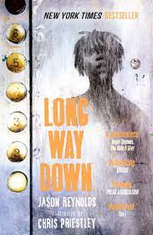
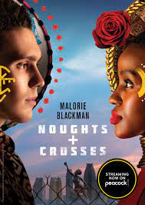
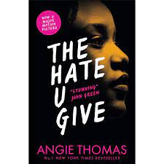
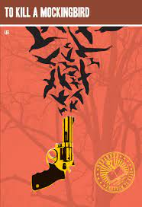

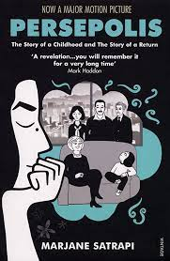
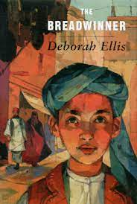
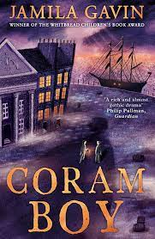
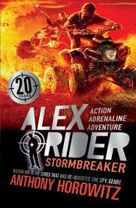
Join UKLA & shadow its Children’s Book Award with local teachers: https://ukla.org/news/ukla-book-awards-2023
Notes:
Teachers now are using ever more culturally diverse texts, as originally recommended by our study but influenced by, e.g. BLM imperatives in recent years.

Slide 9

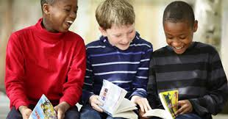
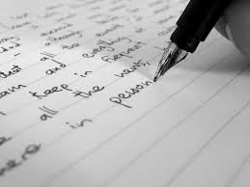
Chapter 1: Rationale: How was reading taught and how could it be more research-informed?
KS3 practice, 2014…Now?
Faster Read
Slow, fragmented read of 1 text
Focus on written analysis, by reading extracts - & micro-analysis: the ‘Naming of parts’
Text choice: Victorian, canonical, abridged
Interrupted: short chunks: ‘read a bit, write a lot, read a bit, etc’
Whole-class or Individual
Assumption of comprehension: little checking or teaching of whole-text comprehension for all, especially ‘struggling readers’
Literary criticism for GCSE: Why has the author done X?
Collaboration: Jane Oakhill, Psychology Jo Westbrook and Julia Sutherland
Increased amount & pace of whole-text reading: Faster, immersive read - 2+ whole texts
Focus on reading comprehension/interpretation AND reading engagement – pleasurable reading in lessons
Text choice: engaging, challenging, culturally diverse
Uninterrupted – reading like a ‘reader’: longer chunks read aloud & expressively - not ‘popcorn’
Group reading & dialogic class talk: questioning, meaning-making: develop reader identity & habits
Explicit teaching & group modelling of inference & reading strategies + Oral assessments
Whole-text comprehension; making connections across/beyond - big themes & personal response
Inference to…. Analysis/Lit Criticism
Notes:
PISA OECD – 20% students have inadequate reading literacy – 2023 low scores in England for students enjoying reading, but reading comp. has increased over the years. Focus on who was esp. disadvantaged by current model – struggling readers
Collaboration of 3 researchers. Since Sec Nat Strat: 2001: focus on the micro – extracts, language analysis/grammar - 2 pages of novel read; then analyse language – spot literary devices and do PEE, PETAL… paragraphs, based on short extract – Readers, esp, struggling & disadvantaged readers lose comprehension of whole text – leapfrogging over comprehension to analysis
Grace/Teacher realised need to check vocab in pre-20C texts more – e.g. short story – her class did not understand 15-20 key words so missed whole point of story – led her to do more focused work on vocab-development & how to infer and analyse unfamiliar words – morphology, etc, to support reading comp. Grace described the FR, whole-text approach as an ‘epiphany’ – spent 11 years at KS3 assuming comprehension and moving straight to analysis – has radically changed her practice and is now Head teacher of a different school, still promoting the FR in her new school and MAT.

Slide 10
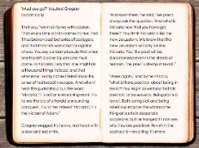


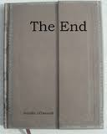
So how did teachers move students through the text?
Fast paced sustained reading for 20 - 40 minutes or even whole lesson
for 3-4 weeks, then 2 weeks to deepen understanding + analysis
Whole class: teacher or fluent readers reading aloud to maintain motivation
Lots of recaps & connections made across the book + timelines on wall, etc
‘Interruptions’ only to recap, where there are ‘sticking points’, check understanding of plot, setting, vocabulary
Text experienced as a whole
Girl 1: Are we going to read for the entire lesson?
Boy 1: Are we going to finish it today?
Before, there’s been a massive dip in the middle of ‘The Curious Incident’ & we lost momentum – too many pointless writing tasks - but the faster read really helped to keep the enthusiasm going
Notes:
Students also silently read parts of the non-fiction booklets/newspaper articles from 2008 re Zimbabwe in uninterrupted chunks of 15-20 minutes at a time, highlighting relevant parts to and reading aloud paragraphs, commenting on how articles related to the novel.

Slide 11
What did teachers do to achieve this?
A faster read…
In my experience they hate reading for five minutes and then doing a diary entry for 40 minutes, they hate it; they just want to know the next bit of the story (Jane FR ).
Fast-paced, sustained reading for 20-40 minutes or even whole lesson for 2-3 weeks by teacher or fluent readers reading aloud with prosody and gesture
‘in-the-moment-of-reading’ instruction,
And then we get into it much quicker because once we’ve hit that half way point of the book, as they have with The Boy in the Striped Pyjamas, they wanted to read it, they like it a lot […] they are not used to looking at the whole and not fully understanding it until they’ve pieced it together (Helen FR+T).
Those who have got ahead, I asked them to go away and present a one minute drama on everything that has happened so far so we had a quick summary ( Anna FR+T) + reading in pairs & reading groups, silent reading, library, reading homework
Harry came in the other day and said ‘I can’t wait to read today, I’m so excited’ and for a child like him, that’s huge… They’ve remembered the text well because we’ve read so much and never been taken away from the text for a long time (Intervention teacher)
Notes:
Fluency or automaticity of oral reading improves, effortlessness, autonomy and lack of conscious awareness, all strongly supporting comprehension (Kuhn et al 2010)
Effortless recognition of words and phrases, stored/retrieved in long term memory, creates greater cognitive capacity for comprehension (Cain et al. 2001).
By Iistening/following a text read aloud by a more capable reader, who provides scaffolding, a less fluent reader experiences autonomy and fluency
Bypasses ‘sticking points’ (Wood et al 1976; Kuhn et al., 2010). Harry came Students also silently read parts of the booklets in uninterrupted chunks of 15-20 minutes at a time, highlighting parts salient to them and reading aloud paragraphs, commenting on how it related to the novel. They were thus physically and visually making knowledge-based inferences to the BSP.

Slide 12
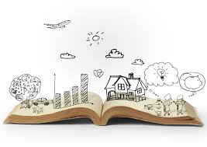
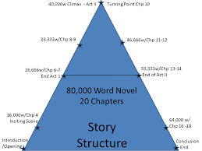
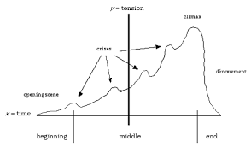
Teaching whole story structure
Time lines: dates, photos – dual narrative - Private Peaceful
Maps tracking characters’ journeys
Graphs – highs and lows, quotations
Event wheels
Family trees
Plot-sequencing: using sentences & images
Referencing up and down the whole text
Notes:
Use graphic organisers to support students in understanding the narrative structure – examples can be found online – and making connections between different parts of the book – i.e. significance of key events, characters, etc.

Slide 13
Reading a second text back-to back
Reinforced comprehension skills: questioning, predicting, clarifying, inferring, making connections
Students grew more competent, confident, etc
Created an enthusiastic reading community
Raised teacher expectations of their students – e.g. parent comments
Teachers freed from restrictions of curriculum & assessment that inhibit whole-text reading engagement & practice
Just because it's very liberating for me. I've never in 27 years of teaching just read 2 texts back-to-back!
(Anna, Comparison Teacher)
I don’t think they have read this much in such a short space of time or ever and I didn’t for a minute expect that they would keep up. It’s going to help their reading enormously but I think we just have to keep on doing it. (Penny Intervention)
It’s a release for me, I love it! Its’ fantastic, amazing! (Jane, Comparison Teacher)

Slide 14
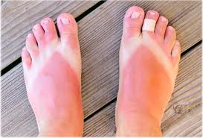
What is inference? What can we infer from this image?
What did you have to know about to be able to infer these things?
Notes:
Many thanks to Sussex teacher and reading expert, Claire Willis, for this slide on how to teach inference, using visual images, and for subsequent slides on The Curious Incident of the Dog in the Night-time

Slide 15
1) What inferences must you make to comprehend this text? Which parts might confuse weak readers?
2) What kinds of knowledge are you drawing on to help you?
There were a lot of wreaths delivered to the church and Father was proud of the fact that one of them had been sent by the Fury, but when Mother heard, she said that Grandmother would turn in her grave if she knew it was there.

Slide 16
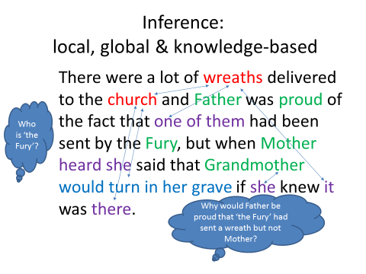

Slide 17
Reading and talking in small groups
Why does reading & talking about a text in guided & other reading groups support comprehension?
How much group reading do you do at KS3/KS2?
Which activities are helpful? Why?

Slide 18

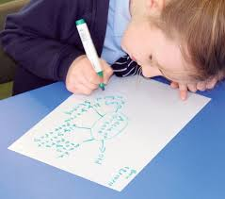


Group & Guided Reading: Why important?
What does xenophobia mean?
Students practise reading aloud for fluency & engagement in trusting dialogic space, developing culture: what is a reader? All questions are ‘good’; comprehension + different interpretations
Experiment with different models of reading, e.g. play-script. Use roles: Fluent Reader maintains pace; Clarifier/Vocab-monitor; Questioner asks WHY? & makes connections to earlier chapters
GR models to struggling readers how to read expressively, monitoring comprehension to internalise strategies: to question, clarify, infer, predict, recap, summarise, visualise, make connections.
Induct stds into group talk with group guidelines; use structured tasks 1st, then more open as they become independent
Stable, reading-ability groups 4-5: mixed-ability, ‘complete reading circle’: 15-20 mins
Why is Deo so upset here?
What happened earlier when…? This reminds me of…
Notes:
(Extensive evidence: Palincsar & Brown, 1984: Reciprocal Teaching, RT; Okkinga et al, 2016; Applebee et al, 2003; Sutherland, 2006, 2015. Reciprocal Teaching is a form of Guided reading.)
Spend time enabling rapport to develop with the GR groups – choose groups carefully to be supportive of each other’s needs and esp. of reading needs – e.g. personalities & reading strengths: balancing student who is a fluent & quite expressive reader with those who have other skills, e.g. good vocab, good knowledge to apply for understanding the context of the book, motivated in reading, good at keeping the group on task or asking questions, etc.
Explicitly model all reading strategies – questioning, clarifying, predicting, summarising, inferring, making links across the text, visualising, empathising – and students sit in groups, read a chapter of the class reader aloud and use those strategies after they’ve read it, to make sense of it. Ie they can start by recapping on the plot/story so far, then read their chapter and pause at times spontaneously, if people are stuck/want things clarifying, etc. Students should take ownership of this stage of the lesson although you might start off by giving them some prompt questions, a quick task (e.g. a graphic organiser – timeline or visual to check that they have understood key plot elements or key events, or characters, etc to scaffold them into it). They should practise having different roles in groups but they can also just explore ideas spontaneously as a group – with a group leader – to ensure that they have comprehended the key ideas – the plot, any character development, etc – and of course, any difficulties with vocab, etc.
When you start using small reading groups, ask groups to create their own ground-rules or guidelines for productive group talk about reading (see other Word doc: Guidelines for a Faster read for some examples) & encourage them to reflect on whether they are getting better at doing guided reading and being a supportive group, asking good questions, understanding and exploring the text well, as time goes on.
It’s much easier to do GR when you know your students well – ie avoid early in Autumn term – advice from teacher in School 21, London.

Slide 19

Language is most effectively learned in the context of use, through interaction & hearing words spoken and read in affectively engaging situations that prompt desire to use it for one’s own purposes. Explicit attention to vocab. can [follow], to close the word gap. (Cremin, 2018)
14-yr olds who read often & independently know 26% more words than those who never read. Those from book-loving homes know 42% more words (Sullivan, 2017)
Most new vocab is learnt incidentally through reading. Reading & practising comprehension develops vocab, comp. & ability to read harder texts. Covid has increased the reading gap between advantaged students with literacy-rich homes, and disadvantaged students without. (Oakhill 2015; DfE,2022)
Vocabulary via reading
Notes:
Vocabulary knowledge is a key part of being able to comprehend a text and is in a reciprocal relationship with reading – i.e. having ‘good’ vocabulary knowledge helps develop comprehension skills and the act of practising comprehension further develops vocabulary knowledge as readers are constantly exposed to new words in written texts since they contain a wider, more sophisticated vocabulary than spoken language.
Cunningham and Stanovich, 1998 and our study – Westbrook et al, 2019 – the more you read, the more you are exposed to new vocabulary, which extends your thinking and enables you to read ever more challenging books. Reading also develops your comprehension abilities as you are forced to tackle and overcome comprehension difficulties – this improves your skills for the next book AND gives you the motivation and self-belief to know that reading can be enjoyable and that you can read – i.e. enhances your reader identity and belief that you will be able to overcome any reading difficulties that all readers experience.
At secondary school, the expectation is that the dense curriculum will not allow extended reading to take place in lessons – one study suggested only 18% of lesson-time was spent reading. Instead, there is a focus on students reading at home – many Reading for pleasure initiatives, e.g. DEAR. But although this is also important, this expectation of reading taking place outside the English lessons leaves struggling readers and disadvantaged readers, who have never read whole texts, further disadvantaged. They particularly need this exposure to whole texts and will not improve their reading & vocabulary without it. Reading underpins the entire curriculum so English teachers need to spend time in lessons reading and developing vocab, not assuming it will take place outside school.
Allington et al (2010) gave disadvantaged students, also weak readers, 15 books over the summer holidays, which they chose themselves and were allowed to keep, and they maintained their comprehension levels along with more advantaged peers, whereas normally, a gap opens up across the summer holidays, with more advantaged and typically stronger readers reading a lot during the summer and disadvantaged students not reading – optimistic study!! ie simply giving children from more disadvantaged backgrounds easy access to books and encouragement to read will help them keep up their reading comp. skills. See many libraries’ campaigns to get children reading in the summer – schools should try to promote these initiatives & join forces with local libraries.
So, there is huge evidence that children need to read a lot and be exposed to a volume of print to develop their reading skills, but the question is: how much reading of whole books are they doing in their actual English lessons? This was our focus in the research – if children read 2 whole books in a term & teachers focus on engagement/motivation, as well as strategies, this should give poorer, reluctant readers the experience of ‘being a reader’ & enjoying a whole book, as well as the feeling of confidence (and satisfaction) that comes with getting to the end of a novel. Will this reading model develop poor readers’ reading comp. skills? In future studies, we would also want to investigate whether the model also stimulated students to do more independent reading (NB our teacher participants reported that they did, but this was not a specific focus of this study).

Slide 20

Strategies for developing vocab: practising inference, via morphology to develop semantic webs
Can you say this word?
pneumonoultramicroscopicsilicovolcanoconiosis
What does it mean? Have a ‘go’ at breaking it down…
Break word into chunks of meaning – morphemes
Link those to words you’ve seen or heard before.
Use these clues to guess or infer overall meaning.
Notes:
Many thanks to Sussex Hod English, Georgette Ayling, for these slides on vocabulary-development.

Slide 21
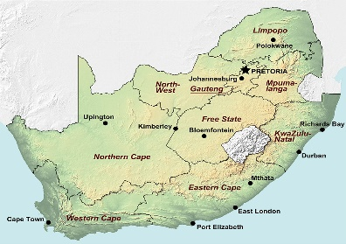
Think aloud:
What does xenophobia mean?
Modelling Vocab. & Inference questions
Who are ‘we’?
Is this a town or a village?
Is this a town or a village?
We walk to Bikita to see Captain Washington. He is the best policeman in the district. I will tell him what happened in Gutu, what happened to Amai and Grandpa Longdrop and the others. He will know what to do. Bikita is three hours’ walk on the normal path from Gutu, but we do not walk on that path. It is the road that the soldiers used. If they should come back they will see us. We walk the long way.
Why? What does this show re the Captain’s
character?
How far would you get if you walked for 3 hours from Brighton? What does this show about the boys’ journey?
Why is Deo so scared of the soldiers? What happened earlier in the book?
Notes:
Many thanks to Brighton teacher and reading expert, Liz Uren for this slide, focusing on modelling to students HOW to ask useful questions to monitor their comprehension – you’re going to have a go at a similar task with a short story shortly

Slide 22
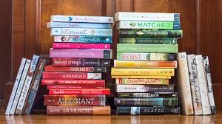
Impact 10 yrs on: 200+ UK teachers use FR, half for 4+ yrs & during Covid. Majority say…
FR has huge impact on KS2, KS3, GCSE & even A Level, improving:
Comprehension levels, vocab, reading engagement, identity, confidence, ‘joy of reading’.GCSE/A: understanding whole novel supports sophisticated analysis.
Large gains for struggling and disadvantaged readers
Increased texts read: 1 disadvantaged sch: 18 novels in KS3; many read 9+ texts
Others say it improved writing, memory (& quotes), attendance, concentration, cultural capital, knowledge & ‘big ideas’ for life: ‘Reading is power: students lack the confidence or ability to read these texts on their own. Empower your young people.’
‘Give students the gift of a whole book, a whole journey for its characters, and this supports them in becoming better equipped for the world beyond school.’
Rich oracy & community of readers at centre of FR: develops students’ language, empathy, social skills, post-Covid, & interest in current issues, ideas, politics.
Texts typically inclusive & culturally diverse; contemporary, challenging YA with ‘big themes’, but many GCSE texts still used at KS3!
A girl often excluded for poor behaviour now attends, sees herself as a reader, loves reading & asking questions of books!

Slide 23
What do teachers say they found challenging, but have overcome, with this reading approach?
Impact data after 3 years, then 10 years:
Radical change to curriculum: will HoD/SMT support it, long-term?
Getting through 2 whole novels in 1 term & maintaining reading engagement in 100-minute lessons; balance bet. reading aloud, discussing text & explicit vocab teaching?
In tension with KS3 ‘Mastery Curriculum’ & Ofsted
Will writing suffer with a primary focus on reading with talk? (others say writing improved with wider vocab & more understanding of text structure)
Curriculum constraints: how to fit in end-of-term written assessments?
Where’s the written evidence of progress? How much writing is in the books?
Culture change: How to assess reading via talk as teachers not used to this?
Fear students will not perform well in written analysis assessments.
Using GR/group work more often: cultural change, time-consuming
Cost of new books
Non-specialist English teachers find it challenging because no training
Notes:
Structural challenges – e.g. will SMT support this initiative? – remain, but teachers have largely resolved the other issues on this slide, by practising the model and adapting it to their contexts. E.g. most do it in the Autumn term so that every year group starts with the faster read and 2 novels, to kick-start the year and embed excellent reading and dialogic talk practices, but some teachers do the model in the Spring term.

Slide 24
Finding new ways to assess reading progress…
e.g. Google-doc forms & online quizzes as groups read, self- or peer-marked, then essay at end of term
6 ‘flashbacks’ orally, then written in books to show comprehension – start of lesson to secure plot & character-development, etc before reading
recording of on-going group-talk on mobile phone; tweet about a character
Teacher notes on post-its while listening to students in group talk, recording evidence of reading comprehension
Group oral task: e.g. ‘Discuss how a character develops from beginning to end of the novel’ formally assessed Or Hot-seating assessed
Final essays on Lord of the Flies (Yr 8) were ‘very sophisticated’ & shown to Ofsted – proof that focusing on discussion & reading, not ‘pointless writing tasks’ to ‘evidence progress’ resulted in higher-quality writing at end of term
Notes:
These strategies emerged and are being used by teachers doing the Immersive read, 3 years after the project finished.
Robin Alexander, 2010, 2012– English Education system needs to use more forms of oral assessment to assess progress, not always assess everything through writing – he contrasts this with very good oral practices & oral assessment in e.g. France, Russia, etc.

Slide 25
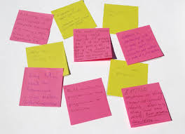
Your thoughts on this model of reading? Use CHAT & unmute!
How does this fit with your existing approach to developing reading at KS2/KS3?
How much opportunity do students have to read whole, challenging & engaging YA novels in Years 7-9? Or 4-6?
What benefits and challenges do you anticipate in your schools? Any questions?
Thank you for engaging!

Slide 26
References
Allington, R.L., McGill-Franzen, A., Camilli, G., Williams, L., Graff, J., Zeig, J., Zmach, C. & Nowak, R. (2010). Addressing summer reading setback among economically disadvantaged elementary students. Reading Psychology, 31 (5), 411-427. (All this study did was to give the poorest secondary students, in a large study, 15 books to choose & keep over the summer holidays and measured the effect of this simple ‘intervention’. These children sustained their reading levels across the summer hols in relation to their more advantaged peers, whereas similar children who were not given access to books across the summer holiday fell further behind more advantaged children during this long gap away from school. Powerful study to show the importance of simply reading a lot!)
Applebee, A., Langer, J., Nystrand, M., & Gamoran, A. (2003). Discussion-based approaches to developing understanding: Classroom instruction and student performance in middle and high school English, American Education Research Journal, 40, 685–730.
Baye, A., C. Inns, A. Lake and R.E. Slavin. 2019. “A Synthesis of Quantitative Research on Reading Programs for Secondary Students.” Reading Research Quarterly, 54(2).133-166. doi:10.1002/rrq.229.
Blanden, Jo and Stephen Machin (2010) “Changes in inequality and intergenerational mobility in early years assessments” in Kirstine Hansen, Heather Joshi and Shirley Dex (eds) Children of the 21st century: The first five years. Bristol, Polity.
Clarke and Akerman (2006) Social inclusion and reading: An exploration. London: National Literacy Trust. (Look up research, such as this, on the NLT website, which shows that students from socioeconomically disadvantaged backgrounds are far less likely to read for pleasure, i.e. independently at home, than those from advantaged ones. This is why projects such as Drop Everything and Read are also important to support the reading model described in this P/P – ie students need to read a great deal, both in English lessons and, ideally at home, to develop their reading skills.)
Cliff Hodges, G. (2016) Researching and teaching reading: Developing pedagogy through critical enquiry. London, New York: Routledge.
Cunningham, A. & Stanovich, K. (1998) What Reading Does for the Mind in American Educator, Spring/Summer 1998 (‘Reading makes you smarter’ by developing not just reading skills for use across the curriculum, but also cognitive skills – ie increased vocab, understanding of sentence structure and ability to think conceptually – these authors show how important it is for students to read a lot as it is the volume of print that readers encounter that increases their reading comprehension skills, by challenging their comprehension skills and developing them).
Duncan, S. (2015) Reading Aloud in Lewisham: An Exploration of Adult Reading Aloud-Practices, Literacy, Vol. 48, No 2. pp 84-90 (shows benefits of children being read to)

Slide 27
References
Education, Audiovisual and Culture Executive Agency of the European Commission ( 2011) Teaching Reading in Europe: Contexts, Policies and Practices, Brussels: EACEA, Eurydice (Major European report on reading, identifying a fifth of students in Europe as below the expected reading level. The section on reading comprehension lists the most important reading strategies students must develop, which formed part of the reading model used and reported on by Sutherland et al, in earlier slides)
Guthrie, J. T., and S. L. Klauda. 2014. “Effects of Classroom Practices on Reading Comprehension, Engagement, and Motivations for Adolescents.” Reading Research Quarterly 49(4): 387–416. doi:10.1002/rrq.81.
Hart, B. and Risley, T. (2003) ‘The Early Catastrophe – The 30 Million Word Gap by Age 3’. American Educator. 27, pp.4-9
Hurry, J. Parker, M. (2007) Teachers’ Use of Questioning and Modelling Comprehension Skills in Primary Classrooms. Educational Review, 59 (3), pp. 229–314 (Although set in primary context, this research demonstrates how important teacher modelling of how to read and comprehend texts is)
International Reading Association (2007) Teaching Reading Well: a synthesis of IRA's research on teacher preparation for reading instruction, Newark, D.E. USA: International Reading Association (Read the summary or the section on reading comprehension - another major US report, showing the importance of students being taught explicit reading strategies including self-monitoring of comprehension)
Murphy, P, Wilkinson,I , Soter, A.,Hennessey, M., Alexander, J. (2009) Examining the effects of classroom discussion on students’ comprehension of text: A meta-analysis. Journal of Educational Psychology, Vol 101(3), 740-764. (argues for the importance of rich talk about texts in all classrooms, whole-class and group)
National Institute for Child Health and Human Development (2000) Report of the National Reading Panel. Teaching children to read: An evidence-based assessment of the scientific research literature on reading and its implications for reading instruction. Washington, DC: U.S. Government Printing Office. (available online – read section on reading comprehension)
National Literacy Trust, Children’s and young people’s reading engagement, 2022. https://literacytrust.org.uk/research-services/research-reports/children-and-young-peoples-reading-engagement-in-2022/
Oakhill, J.V., Cain, K. and Elbro, C. (2015) Understanding and teaching reading comprehension: a handbook, London: Routledge (book designed for teachers)
Oxford University Press (2018) Why closing the word gap matters. Oxford University Press. oxford.ly/wordgap

Slide 28
Palincsar, A.S. and Brown, A.L. (1984) Reciprocal Teaching of Comprehension-Fostering and Comprehension-Monitoring Activities, Cognition and Instruction, 1 (2), 117-175 Pressley, M. (2006) Reading Instruction that Works: the Case for Balanced Teaching. London and New York: Guilford
Retelsdorf, J., Köller, & Möller. 2011.“On the Effects of Motivation on Reading Performance Growth in Secondary School.”Learning & Instruction 21(4): 550–559.
Risko, Victoria J., Roller, Cathy M. ,Carrice Cummins, Rita M. Bean, Cathy Collins Block, Patricia L. Anders, James Flood Source(2008) A Critical Analysis of Research on Reading Teacher Education Reading Research Quarterly, Vol. 43, No. 3, pp. 252-288
Rojas-Drummond, S. Mazón, N. & Littleton. K. (2014) Developing Reading Comprehension through Collaborative Learning. Journal of Research in Reading, Volume 37, Issue 2, 2014, pp 138–158
Soter, A.O. Wilkinson, I.A., Murphy, P.K., Rudge, L., Reninger,K. & Edwards, M. (2008) What the discourse tells us: Talk and indicators of high-level comprehension International Journal of Educational Research, 47 (2008) 372–391.
Stanovich, K. (1986) Matthew Effects in Reading: Some Consequences of Individual Differences in the Acquisition of Literacy, Reading Research Quarterly, Vol 21, (4) pp 360-407
Sullivan, A. & Brown, M. (2015) Reading for pleasure and progress in vocabulary and mathematics, British Educational Research Journal Vol. 41, No. 6, December 2015, pp. 971–991 DOI: 10.1002/berj.3180
Sutherland (2006) Promoting Group Talk and Higher-thinking in pupils, by coaching secondary English trainee teachers, Literacy, 40: 2, pp. 106-114
Sutherland, J. (2015): ‘Going meta’: using a metadiscoursal approach to develop secondary students’ dialogic talk in small groups, Research Papers in Education, Vol. 30,(1), pp. 44–69
Sutherland, J. & Westbrook, J. (2021) ‘Reading comprehension of whole texts’ In A. Watson & R. Newman (Eds) The Practical Guide to Teaching English (2nd Ed) London: Routledge
Sutherland, J., Westbrook, J., Oakhill, J. and Sullivan, S. (2023) An immersive, ‘Faster Read’: a pilot, mixed-method study, developing whole-text reading comprehension and engagement with adolescent struggling readers, Research Papers in Education, Accepted July 9, 2023: in production).
Sutherland, J., Westbrook, J., Oakhill, J. and Roberts, L. (2023) Teachers as agents and all students as ‘readers’: the impact of the ‘Faster Read’ after eight years (in process, based on impact study, 2022)
Torppa, M., P. Niemi, K. Vasalampi, M.K. Lerkkanen, A. Tolvanen, A-M. Poikkeus. 2020. “Leisure Reading (But Not Any Kind) and Reading Comprehension Support Each Other - A Longitudinal Study Across Grades 1 and 9”. Child Development, 91:3, 876–900.
van Bergen, E., K. Vasalampi, M. Torppa, M. 2020. “How Are Practice and Performance Related? Development of Reading From Age 5 to 15”, Reading Research Quarterly, 56(3) pp. 415–434.
Westbrook, J. (2013) Reading as a Hermeneutical Endeavour: Whole-Class Approaches to Teaching Narrative with Low-Attaining Adolescent Readers, Literacy, Vol 47, (1), pp. 42-49.
Westbrook, J., Sutherland, J., Oakhill, J. and Sullivan, S. (2019) ‘Just reading’: the impact of a faster pace of reading narratives on the comprehension of poorer adolescent readers in English classrooms. Literacy, 53(2) 61-68
Unrau, N.J., & Quirk, M. (2014) Reading motivation and reading engagement: Clarifying commingled conceptions. Reading Psychology, 35(3), 260-284

Slide 29

Pre-reading Group task on ‘The Flowers’ to teach inference. Groups are given 3 clusters of words, in succession, extracted from the story
1) What can you infer about the story from the 1st cluster? Be prepared to share your reasons:
Plot, characters, narrator
Setting
Mood, atmosphere
Themes
2) Ask yourselves the same questions about Cluster 2. Has your view changed? How?
3) Repeat task for Cluster 3 - What additional knowledge are you bringing to the story to make inferences in the 3rd cluster? Where is your knowledge from? How important is it if you don’t already know what the last two words mean?
4) What have you learnt about how to infer meaning in a short story?
Notes:
These next few slides contain clusters extracted from The Flowers by Alice Walker. For the purpose of this activity, the title of the short story should not be given until students have explored all three extracts and made lots of inferences about the whole text. Then all can be revealed!

Slide 30
Word cluster 1
golden surprise
skipped
tat-de-ta-ta-ta-ta
light and good
silver ferns
harvesting

Slide 31
Word cluster 2
strangeness
spinning restlessly
gloomy
noose
naked grin
snakes

Slide 32
Word cluster 3: What contextual knowledge are you bringing to story to infer its location?
sharecropper cabin, plowline
smokehouse
sweetsuds bush, squash, cotton,
benignly
myopia

Slide 33
Vocabulary strategies & semantic maps
Extensive reading aloud in class/groups means new vocab is experienced in an engaging, affective context, motivating vocab-learning
Practise exploring & inferring meanings of new vocab, using context
Story-retelling and telling; performing poetry (rich for inference)
Use drama to act out new words; display them as pictures/videos
Encourage use of new word at once to cement it: orally, then in writing
Support breadth & depth of vocab., e.g. showing how a word can be used with different meanings: (a table, table a motion…). Create semantic maps.
Students handed different synonyms & line up to show shades of meaning
Model how to ask good inference & clarifying questions
Use group mini-whiteboards & a vocab. wall to display new words
Use morphology: model how to break words into prefix, root + suffix
Notes:
Language Knowledge: language acquisition involves a process of children developing a semantic map/web with phonological and grammatical associations (Oakhill et al, 2015) This is a mental representation of their existing language knowledge. As they encounter a new word, the child must connect it with their existing mental representation of words. If you visualise this as a spider’s web, the more connections and denser the web is already, the more the web can ‘catch’ a new word/insect. i.e. children with dense semantic maps will be able to relate the new word to other similar words they already know. However, weaker readers with more limited vocabulary will find inference harder, so the new word may not be ‘caught’, becoming part of their web, but may simply pass through the larger holes in their less developed semantic web.

Slide 34
The following slides include examples of work from teachers using the FR. Many thanks to all who generously shared their teaching ideas!

Slide 35
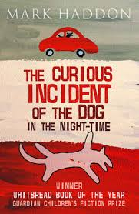
Task 1: Teaching the difference between stated facts and inference: Before reading the book, students are given envelopes with key phrases/sentences extracted from P. 1 of this novel
Based only on these phrases, groups discuss what they can infer:
What do you think this novel might be about, based on these clues? Why?
Who is the narrator? Why? Any clues?
What genre do you think this novel is? Why?
All inferences are discussed & saved on IWB to see if students’ predictions are correct as they read on

Slide 36
TASK 2: After reading Chapter 1 of Curious Incident of the Dog in the Night-time, groups are given this graphic organiser and must:
Find 4 facts from Chap. 1 & write them in the middle square.
Write 4 Things we can infer in the next box.
Write 3+ questions in the outer square: What is puzzling you about this story so far, its narrator, plot, setting, etc?
3+ Questions that are puzzling us (about narrator? setting? plot?...)
4 Things we can infer
4 Things we know: facts

Slide 37
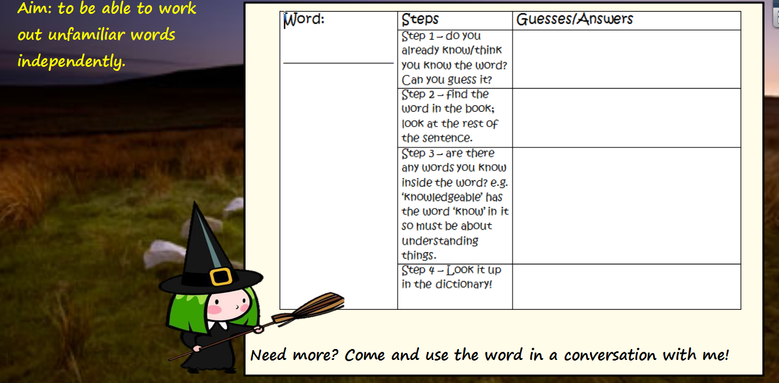
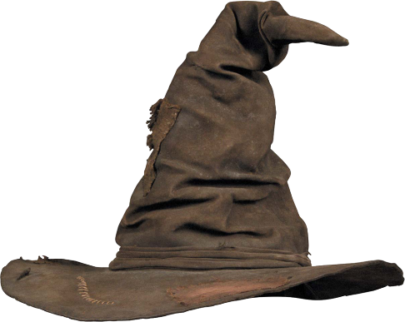
Teaching how to infer new vocab. after reading a challenging short story. Teacher extracts 20 difficult/new words & puts them in a hat. Stds select a new word & do this task…
Take a word from sorting hat, from the story we’ve just read…
Have you ever heard anyone use it? How?
Step 5: Practise using the word: create a new sentence with the word in it and test it out on your partner or me, in conversation!

Slide 38
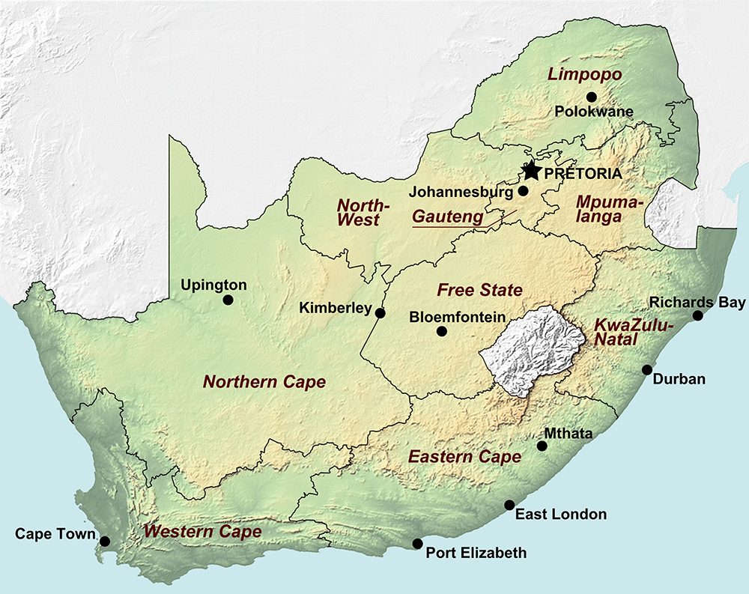
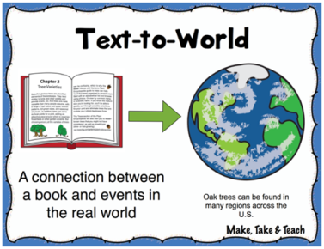
Teachers use maps to plot refugee boys’ journey from Zimbabwe to S. Africa: Now is Time for Running
Cape town is the capital city of the Western Cape. This is where Deo joins the Homeless Football team.
Can you find Cape town on the map and label it?
Notes:
Thanks very much to a local, Brighton teacher and reading expert, Claire Houslop, for these slides: Plot Cape Town after you have read chapter 22.

Slide 39
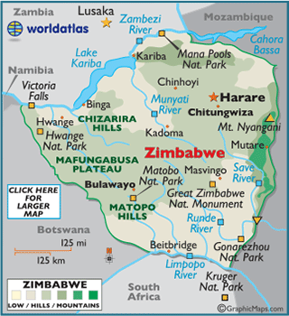

Where are Deo and Innocent?
Deo and Innocent are in the truck heading towards Beitbridge.
Can you find it on the map and label it?
Why do they need to get to Beitbridge?
Notes:
Beginning of chapter 8, plot Beitbridge.

Slide 40
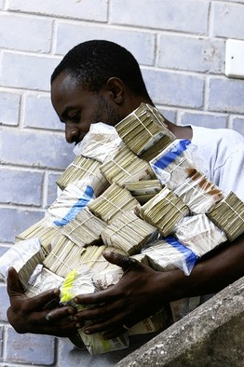
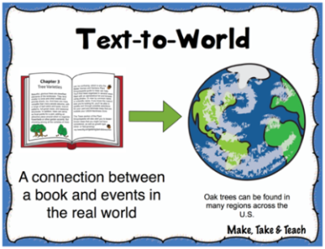
Now is the Time for Running: applying Text-World knowledge
‘a football stuffed with a billion worthless dollars’
Teaching context knowledge
The Zimbabwean dollar (ZW$) is the official currency and it is one of the least valued currencies in the world.
In 2007 the exchange hit
ZW$ 200,000,000 to US$ 11
US$1 to £1.98
Can you work out how much money Deo and Innocent have in their football?
Billion = 9 noughts
Million = 6 noughts
A man in Harare, Zimbabwe, carried cash for groceries in 2008
Notes:
Explain that to solve the financial crisis, Mugabe authorised the printing of more money (the trillion dollar bill was introduced) and this devalued the currency. Make links with inflation crisis in Germany – wheelbarrows of money to buy bread.
Ask pupils to work out how much 1billion ZW$ is in US$ then in £
Billion = 9 noughts
Million = 6 noughts (so 200million)
1,000,000,000 / 200,000,000 x 11 = US$55 x £1.98 = £108.90
Stage one: We need to work out how many 200,000,000 there are in a billion.
Stage two: we times that number by 11 US dollars.
Stage three: times that by £1.98 to convert to sterling.
Thanks very much to Claire Houslop, Brighton teacher and reading expert for this slide.

Slide 41
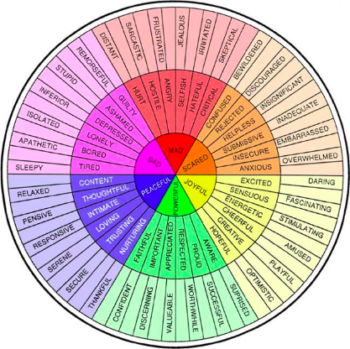
What happened?
Using graphic organisers for plot structure, plot & empathy
Where did it happen?
When did it happen?
EVENT MAP
Who was involved in the event?
How did it happen?
Why did it happen?
Using your emotions wheel, surround your map with words to show how you think Deo might be feeling at this point.
Notes:
Pupils to decide on a key event in chapters 1-5 and complete chart in their books. Pupils should then scatter character emotions around the outside of the organiser.
Add emotions! Pupils will need to justify the emotions they have chosen. The aim is to use the words correctly, so they should look up words that they are unsure of. For those that need an extension, they could add a brief sentence below the words explaining why they chose them.
Thanks very much to Claire Houslop, Brighton teacher and reading expert for this slide.

Slide 42
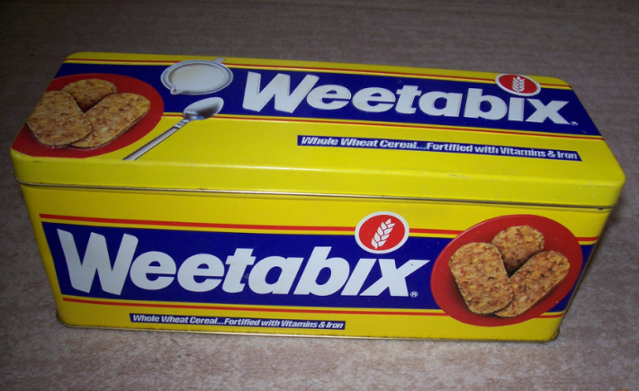
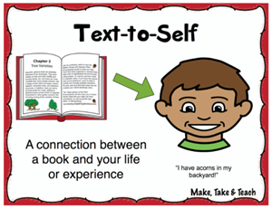
Innocent’s Bix-Box
Developing empathy & making connections between students’ and characters’ lives
‘I had forgotten about Innocent’s Bix-box. Years ago, Amai went into Harare with Innocent and bought a two-for-one packet of Weet-Bix cereal. The shop gave a rectangular tin box with the two packets of Weet-Bix – for free. Innocent thought it was Christmas when Amai gave the box to him. From that day onward, his Bix-box was all that mattered. He put everything he loved in his Bix-box, the main treasure being his precious radio.’
Do you have an item that is really important to you?
If you had a Bix-box, what would you keep in it?
Why do you think Innocent keeps a radio in his Bix-box?
Do you think Deo was right to go back for the Bix-box?
Notes:
Keep referring back to Innocent’s Bix Box throughout the novel. Pupils could keep a list of the different items he has in there. You could ask them why they think Innocent may have kept them.

Slide 43
Looking back and making connections Page 12
Your grandfather is a survivor, she said to me. He survived his birth, the liberation war, running the white man’s farm, and now old age – he can survive anything.
Having read to the end of chapter five, why is this description of Grandpa Longdrop so tragic?

Slide 44
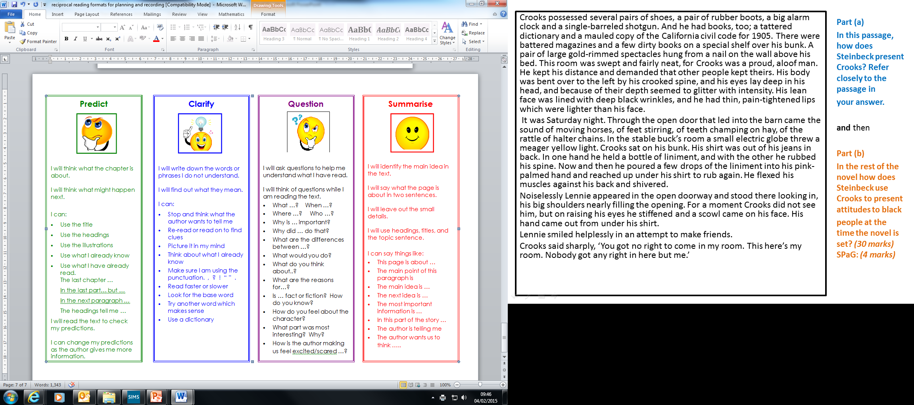
Refugees defy crocodiles to cross border
Reading non-fiction alongside the novel to develop context knowledge: newspapers & youtube clips of Zimbabwe in 2008
Refugees from Zimbabwe wade across the crocodile-infested Limpopo river in search of safety on the South African side.
Ten days after President Robert Mugabe re-elected himself, there has been a huge surge in the number of impoverished Zimbabweans fleeing their country. Farmers and human traffickers have confirmed that hundreds are braving the crocodile-infested Limpopo river daily and cutting through three razor-wire fences spanning 200km on the South African side.
'For the Beit Bridge area alone we're now talking of 400 people every 24 hours,' said Ronnie, a former border fence repairer who turned to human trafficking last year. 'For myself, I barely have time to bring one group over and another 30 people are waiting for me on the Zimbabwean side.' The standard charge for each 'jumper' is 40 rands (£2.50).
Among Ronnie's latest crop, Mkhumbuleni Sibanda, 30, emerged bruised and scruffy from a tunnel under the South African fence with a huge smile on his face. 'I'm so relieved to be out of there,' he said. 'Until last week I was one of the people saying, "We have to stay, never mind if we eat roots. The first round of the election went all right, it will soon be over." But now there is no reason to remain in Zimbabwe.'
After bribing Zimbabwean officials and braving the river, the 'jumpers' know they face the worst of what South Africa can offer. The 'guma-guma' - criminals who prey on the newly arrived - scour the length of the border fence to rob them of their meagre belongings and rape the women.
'We have heard all the stories. But if I have to die, I might as well die in South Africa,' said Sipho Mujuru, 40, who had come through unscathed, except for losing a shoe.
Notes:
Pupils should now write a summary at the bottom of the article. Encourage them to use the sentence starters on the ppt.

Slide 45
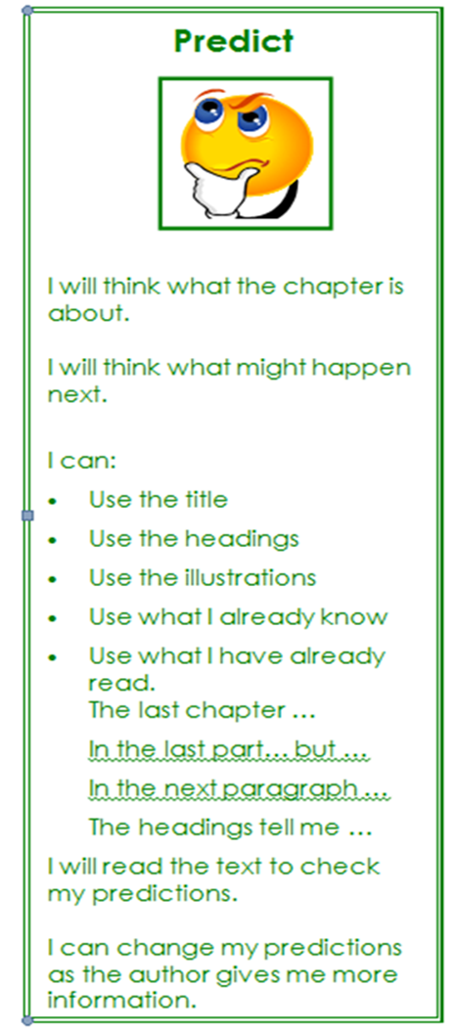
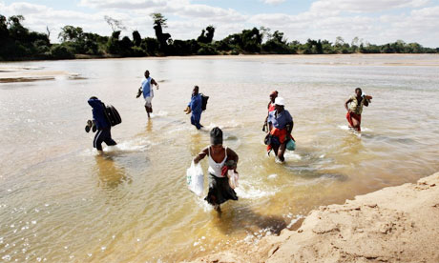
Refugees defy crocodiles to cross border
Refugees from Zimbabwe wade across the crocodile-infested Limpopo river in search of safety on the South African side.
Reading the headline, can you predict what the article is about?

Slide 46
Comments from teachers using the Faster Read on following slides

Slide 47
Why are teachers still using the FR, 3 or 7 years later?
Laura: Year 8’s final essays on Lord of the Flies were so sophisticated that I could justify focusing mainly on reading and rich talk with less time spent on writing
Chloe: In groups, they’ve become well versed in the reading strategies & able to tell me what strategy they’ve used … we still use the key-rings, but they’ve moved so far beyond them!
Penny: It’s changed my beliefs that, with low-ability pupils, it’s better to give them a DVD or simplified text & then focus on analysis. I’ve read the whole of Jane Eyre with this class purely for comprehension and […] they were booing and cheering as the plot unfolded! English is now their ‘favourite subject’ & they never enjoyed it before. [It] comes from them feeling they can actually understand [the book], rather than just being given the ‘dummies’ guide

Slide 48
We interleave questions from the first novel to the second one and this is developing those long-term memory skills that they need at KS4 – the ability to read and remember the whole plot and details. What is incredible is that they know the quotes – they’ve remembered them: how on earth do they know? They just know the books. We’ve done no PEA or PETAL this year – none! - but in Year 7 lessons they are quoting lines and metaphors that they’ve remembered as they love this book, so the talk in lessons is so rich - the kids have an unbelievably insightful observation of the text.
Benefits, 3 years later.
Notes:
Brighton, Hove and Sussex teachers reflect on the model in a ‘reunion’ meeting, Sussex University, 15/11/2017. This is a quotation from a school that has adopted the Faster read model for all KS3 classes and they use a similar model for GCSE texts.

Slide 49
Grace, English teacher participant in FR research, now Head Teacher, who has introduced the FR to whole English Dept:
We [English teachers] skip comprehension and go straight to analysis […] we teach KS3 students how to analyse [texts] for three years but we rarely spend time on that close comprehension - that's not even a phrase I've ever heard anyone say (laughs) - which is crazy! I've been doing this for nearly 11 years.
The Faster Read is so important for comprehension that I just say to all my new English teachers, ‘Try it once, and you’ll be convinced, just by your experience of doing it, even without knowing all the theory!’ All English teachers do the FR in Years 7-9. (7 years later)

Slide 50
Engagement with Accelerated Reader didn’t get students wanting to read books in their own time, whereas with this project […] they wanted to finish them & know what happened so they went home and read ahead. They would never have read ahead before, but they actually went home and read! They had reading ages of 7 and terrible behaviour records - one of them rarely came to school - but he started coming & he would always want to read aloud.
Notes:
Teacher in coastal school with significant deprivation – 42% of students are PP – comment on impact of the project on her Year 8 students

