Slide 1
Empowering and supporting people to be the best they can be, to deliver to the highest standards and to identify with the values of our University
Organisation development at Sussex
Sarah engineer – od consultant

Slide 2






Slide 3
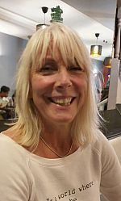
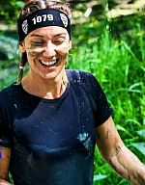
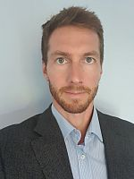
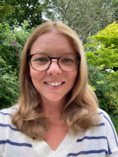
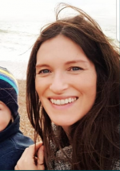
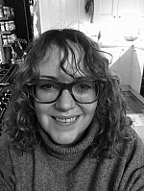
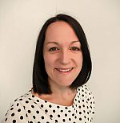
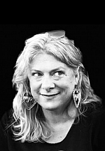
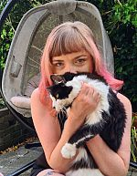
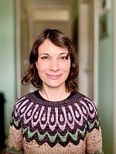
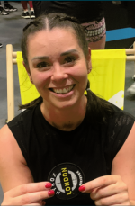
Meet the OD Team
Kelly Barnard
OD Coordinator
Sam Bates
OD Consultant
Sarah Engineer
OD Consultant
Chris Hamilton
Apprenticeships Officer
Vicki Love
OD Consultant
Cathy McDonnell
Asst. Director, Culture, OD and Wellbeing
Sarah O’Malley
OD Consultant
Jo Robinson
HR & OD Coordinator
Kaye Tilbury
OD Graduate Associate
Alice White
OD Team Leader
Lisette Whittaker
OD Coordinator

Slide 4
We are dedicated to empowering our staff to achieve their very best.
Our offer includes: eLearning, apprenticeship qualifications, facilitation of workshops, OD consultancy and defined learning pathways – all designed to enhance the skills, knowledge and experience of our people. Our work includes university-wide initiatives, such as transformative leadership, supporting development of high performing teams and championing equality and diversity.

Slide 5
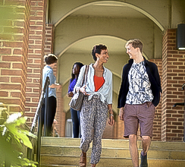
Setting you up to succeed
New starter pages on OD website
Managers’ induction pages
Online training – hosted on Learn Upon
Induction meetings
Find a buddy and/or join a network!

Slide 6
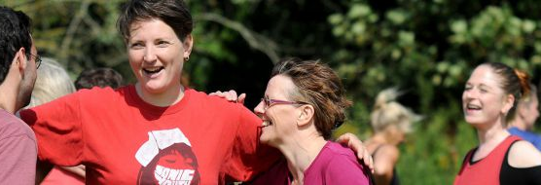
Performing at your best
Appraisals a
n:1s
Mentoring scheme
Job shadowing
Online learning
Workshops and events hosted by the OD team
Apprenticeships

Slide 7
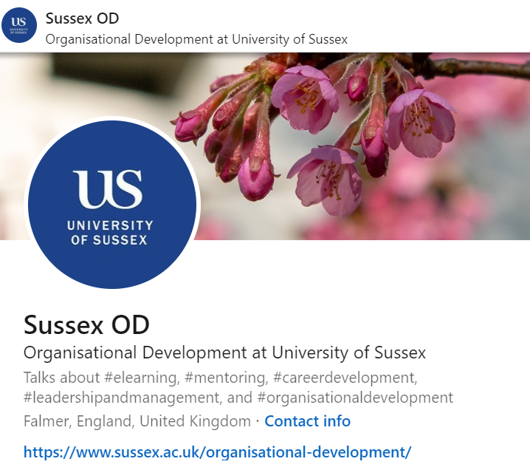
Online Learning
LinkedIn Learning
Learn Upon
OD webpages
Managers toolkit

Slide 8

Support for Managers
Management Essentials workshops
Leaders and Managers Network
Managers toolkit
Leadership programmes
Sussex Leader resource

Slide 9
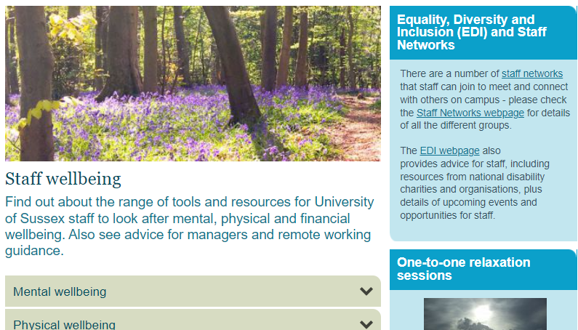
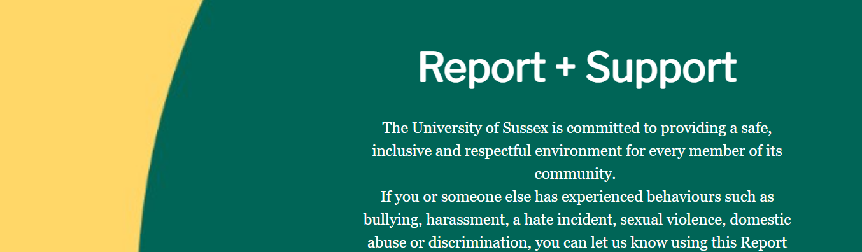
Support and Resources
Your line manager or supervisor
Report and Support
Wellbeing Hub
Mental Health First Aiders
Dignity & Respect Champions
EDI Champions
OD team
HR colleagues

Slide 10
Reward, Benefits & Pensions

Slide 11
Pensions; more than simply income in retirement
Income in retirement
Life assurance and other benefits payable on death
Contributions, free from tax.
The primary reason for contributing to a pension is to provide an income in retirement.
Whether you are in the USS, or the USPSS pension plan you have life assurance to the value of at least 3 times your annual salary.
So peace of mind, at no additional cost to you.
Contributions to our pension plans are both tax free and, in most circumstances, result in lower national insurance
Tax free lump sum
When you take your pension (any time after you are 55 years old) you can take some of it as a tax free lump sum.
In some cases there are also additional benefits payable, you should refer to your pensions documentation to check the detail.
So for example, if you earn £30,000 per annum and contribute 8% of your salary, your salary only reduces by c6%

Slide 12
Pensions and Life Assurance;
What you need to do
1. Nominate a Beneficiary
2. Keep it up to date
3. Pay additional contributions.
4. Keep in touch.
This is the person whom you nominate to receive the benefits payable in the event of your death while employed by the University. The ultimate decision on who receives your benefits is made by the people accountable for the scheme.
You can nominate anyone that you would like to receive the benefit, but you might want to think about who would be impacted financially by your death, e.g. spouse, civil partner, sibling, children or friend.
You can pay more into your pension, and that will be tax free too.
If you are a member of USS, and you move to another USS institution, with less than one month between employments, your pension carries on uninterrupted.
In either case, you’ll need to let us know so that we can help.
Contact the pensions team if you haven’t nominated your beneficiary/ies yet.
If you are in USPSS you will have several choices, including paying into your pension pot independently, or transferring the pension pot to another registered arrangement.

Slide 13
Thank you

