Slide 1
Digital accessibility
Ben Proctor-Rogers – Digital and Creative Media
Contact – dcm@Sussex.ac.uk

Slide 2

What is digital accessibility?

Slide 3
What is digital accessibility?
The inclusive practice of ensuring there are no barriers that prevent interaction with, or access to, websites or digital media.

Slide 4
What is digital accessibility?
We need to show empathy and understanding of all needs in the design of our digital content

Slide 5
What is digital accessibility?
Accessibility does not mean sacrificing aesthetics or our message
Inclusive design is good design
Inclusive content is good content

Slide 6
Digital accessibility
How might users be impaired by the design of a website or digital content?

Slide 7
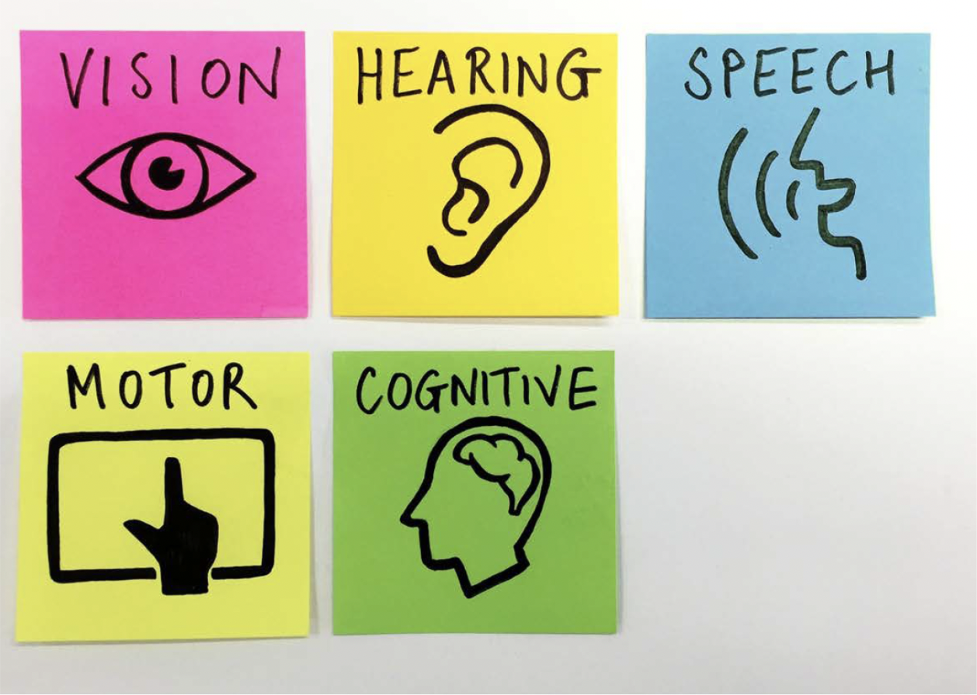
Impairments to digital accessibility

Slide 8
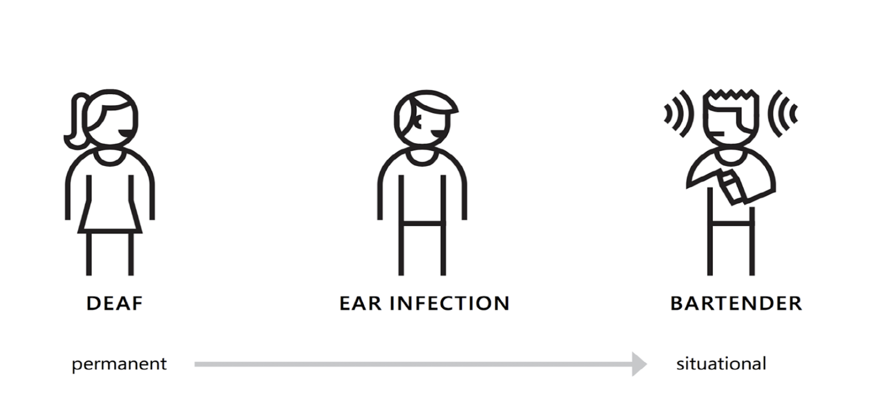
Impairments to digital accessibility

Slide 9
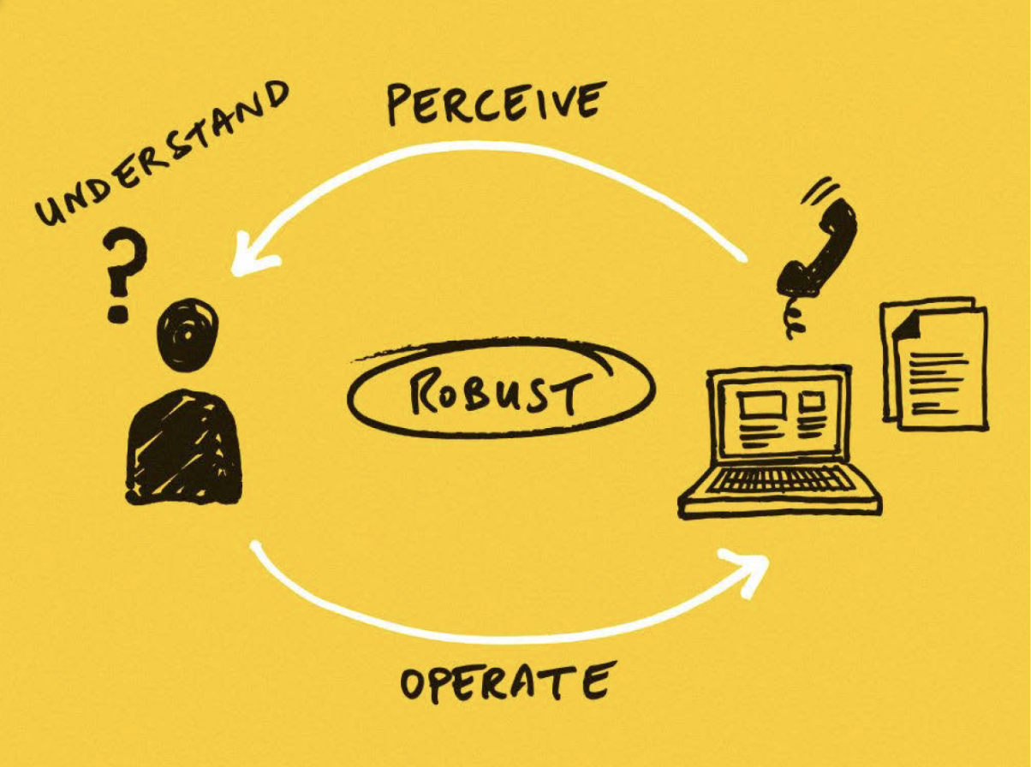
What needs to happen?

Slide 10

The legal bit
Access to information and communications technologies is defined as a basic human right in the United Nations Convention on the Rights of Persons with Disabilities (UN CRPD)

Slide 11
The legal bit
Public Sector Bodies (Websites and Mobile Applications) (No. 2) Accessibility Regulations 2018.
WCAG 2.1 guidelines
Failing to meet these means we will be in breach of the Equality Act 2010 and the Disability Discrimination Act 1995

Slide 12
Assistive technologies
Does anybody in the room use assistive technology to browse the internet or access digital content?

Slide 13
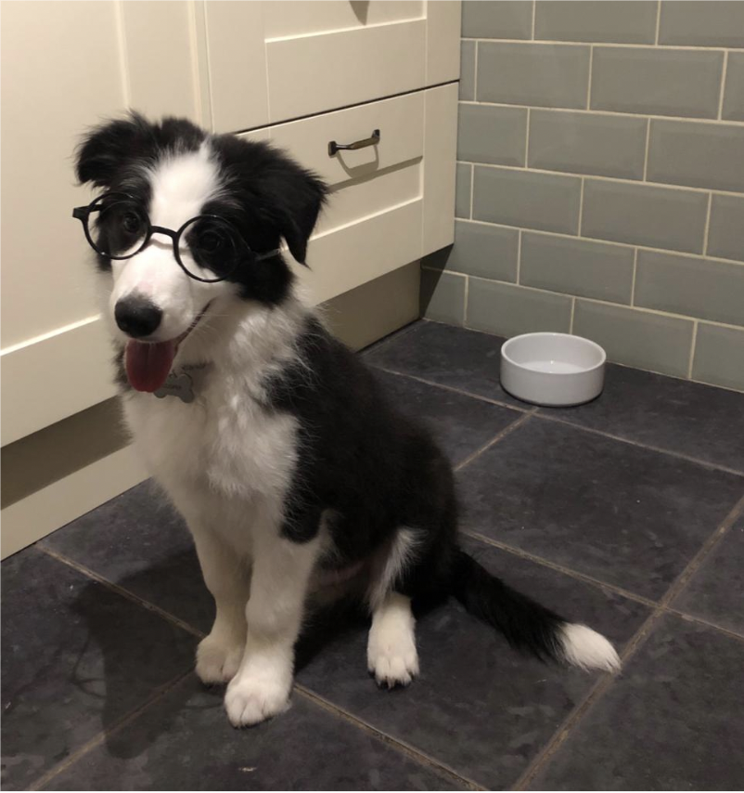
Assistive technologies
Does anyone here wear glasses/contact lenses when looking at a screen?

Slide 14
Assistive technologies
Screen readers
Braille keyboards / screen readers
Screen magnifiers
Head pointers
Eye/motion trackers
Single switch entry devices
Mouth stick
Sip and puff switch
Oversized trackball mouse
Adaptive keyboard
Voice recognition software
Hearing aids
Headphones

Slide 15
Digital accessibility
What is the biggest challenge towards creating 100% accessible content?

Slide 16
Accessible web pages
Readability of content (avoid large chunks of text)
Structure of content (tagging content appropriately)
Link text (must be descriptive)
Page layout (must follow a logical order)
Colour contrast (must be 4.5:1 between text and background)
Images (must have alt-text)
Video (must have captions and a transcript with audio descriptions)

Slide 17
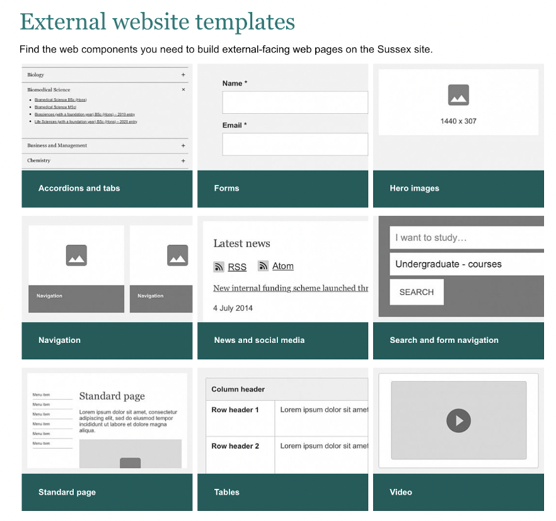
Accessible web pages
The web components library provides web editors with tools to build their pages.
These components are designed to be accessible.
This is a finite list accessed via the WCM.

Slide 18
Page layout
Ensure that the page follows a logical reading order
Tag sections of text appropriately (heading, paragraph, list etc)
Headings are hierarchical. Each page/document has only one h1. Following this must be h2's. Subheadings of h2 must be h3 etc.
Use accordions for small sections of non-essential text. If the text is essential do not hide it in an accordion

Slide 19
Readability
Break large sections of text down to smaller paragraphs
Avoid ambiguous language
Avoid technical language (unless explained clearly)
Bullet points are great
For web pages use the inbuilt readability checker in the WCM

Slide 20
Link text
Hyperlinks are used to connect information online
Link text must be descriptive and let the user know where the link will take them and what to expect
Do not use the link URL
Do not use "Click here", "here" and "this"

Slide 21
Colour contrast
All text elements must have a colour contrast ratio of 4.5:1 with the background
If you have text on an image the same rule applies. You will need a coloured background for the text, or for it to be in negative space
Poor colour contrast
Good colour contrast

Slide 22
Images
Ensure that the image is relevant
Ensure that the image is good quality and high resolution. Check how it looks on both mobile and on large screens

Slide 23
Images
All images must have alt-text
This is descriptive text read out by screen readers (or other assistive technology) for visually impaired users
If you have created an infographic, you must ensure that the details and information are also covered in the page text

Slide 24
Images
Images must also meet colour contrast standards
If there is text on the image place it in negative space (e.g. sky) or place a coloured background behind, then ensure that the text colour passes.

Slide 25



Images

Slide 26
Video
All video must have captions and a transcript that includes audio descriptions (this includes unsaid text and descriptions of items such as graphs and tables)
See our video accessibility page or contact our video team for more information

Slide 27
Audio
All audio (podcasts etc) must have also a transcript. These follow the same guidance as video transcripts

Slide 28
Files
Everything mentioned previously also applies to all files hosted on our website
PDF
Word (there is a Word template available)
PowerPoint (there is a PowerPoint template available)
Excel

Slide 29
Files
When creating a file for publication online please first ask whether it would work better as a web page.
Web pages are much easier to make accessible.

Slide 30
Procurement
When procuring any digital content/app/software that will be accessed online ensure digital accessibility is in the brief
Ask whether they can meet standards outlined in WCAG 2.1
Let the provider know that compliance is a legal requirement for UK universities
For support in including accessibility in the brief, contact DCM
Ask for a test/sample/example so that this can be tested by us in house
Any non-compliant services must legally be listed in our accessibility statement

Slide 31
Working with agencies
Include digital accessibility in the brief
Ask whether they can meet standards outlined in WCAG 2.1
Let the agency know that it is a legal requirement for UK universities
For support in including accessibility in the brief, contact DCM

Slide 32
Contact
The Digital Development and Content teams are happy to help with any accessibility questions you may have
We prefer to be contacted before a project rather than afterwards
Contact dcm@sussex.ac.uk

Slide 33
Training
Specific training sessions can be arranged for teams/departments on any areas covered today.
Contact dcm@sussex.ac.uk

Slide 34
Useful links
Text over image checker
Webaim colour contrast checker
Web Content Accessibility Guidelines (WCAG) 2.1 outline
Microsoft how-to videos
Government pages on web accessibility
Brand homepage
Staff guides to the website
Creating accessible content (how-to guides)
Our accessibility statement

