Slide 1


How to use Appreciative Inquiry as an approach to Mentoring

Slide 2
What this session covers
What is Appreciative Inquiry (AI)
Why some problems benefit from a strengths based approach
Three principles for successful change
The ‘5 D’ format
How to use AI within mentoring

Slide 3
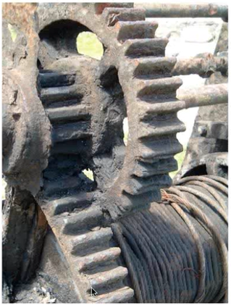
Traditional approach to Change Management
Look for the problem
Do a diagnosis
Prescribe a solution

Slide 4
IDENTIFY THE PROBLEM
FOCUS IS ON PROBLEMS TO BE SOLVED
IMPLEMENT BEST SOLUTION
ANALYSE POSSIBLE CAUSES
GENERATE SOLUTIONS

Slide 5


Slide 6
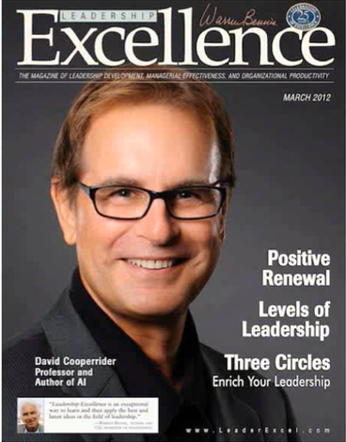
What is Appreciative Inquiry?
“Appreciative Inquiry is the co-operative search for the best in people, their organisations and in the world around them”
- Appreciative Inquiry by David Cooperider and Diana Whitney

Slide 7
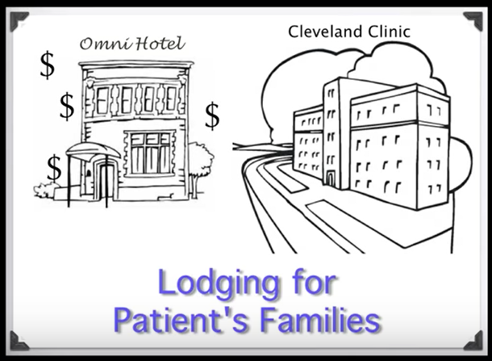

Slide 8
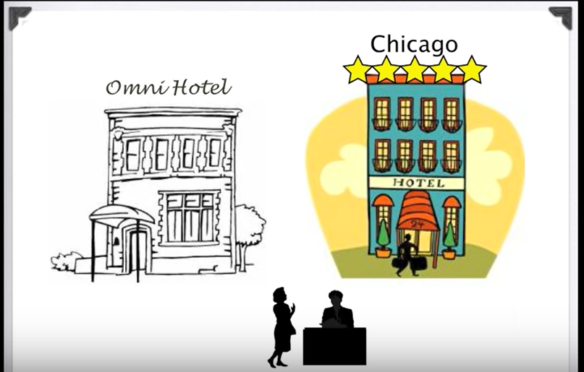

Slide 9
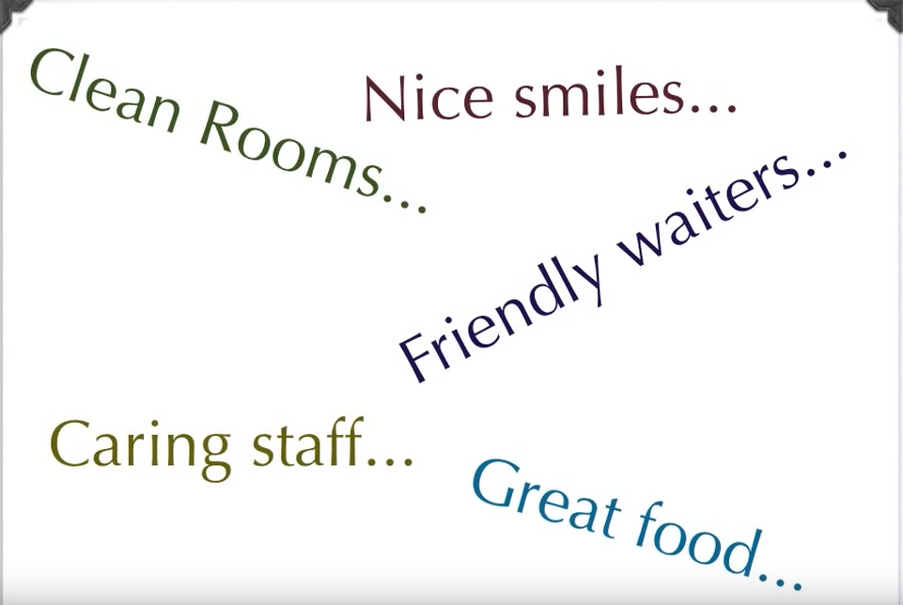

Slide 10
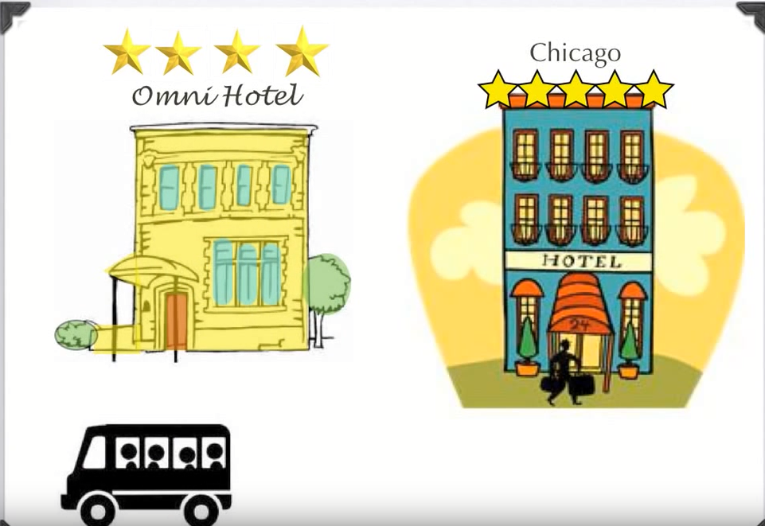

Slide 11
What’s different about Appreciative Inquiry?
Chooses the positive as the focus of inquiry
Inquires into stories of life-giving forces
Locates themes that appear in the stories and selects topics for further inquiry
Creates shared images of a preferred future
Finds innovative ways to create that future.

Slide 12
Let’s start with what’s already working
INQUIRE INTO WHAT WORKS
FOCUS IS ON OPPORTUNITIES WAITING TO HAPPEN
COMMIT TO WHAT WILL BE
IMAGINE HOW GOOD IT COULD BE
AGREE HOW GOOD IT SHOULD BE

Slide 13
Appreciative Inquiry results compared to Problem Solving
Restoration
Generation
Poor results
Acceptable results
Exceptional results
Problem Solving
Status Quo
Appreciative Inquiry
New possibilities
Notes:
AI not just about ignoring problems, rose coloured spectabcles.
Not about sweeping under carpet
Addressing known problems in a more realistic way. Giving people into a better frame of mind to come up with creative solutions.
Einstein – we cannot solve a problem with the same level of thinking that led to that thinking in the first place. AI about getting people to a different way of thinking.

Slide 14

Three principles for successful change
“In every human situation something works.”

Slide 15

Three principles for successful change
“Organisational reality is shaped by conversations. Change starts as soon as you ask a question.”
Notes:
2/ a lot of what we deal with in an org are social facts.
Things that are true because we agree theyre true. Ie money - because everyone agrees, if you stop its worthless. Accounting conventions – change and overnight co.s can become more or less profitable.
Reinforced and kept going by conversations. Change happens as soon as you ask a question – place attention in a particular direction maybe where they haven’t looked before. So may as well be asking questions that show hey can work well together. Helps people to think differently. Hange can happen very rapidly. Can’t diagnose a problem without altering how people think about it.
Use energy question as an example.

Slide 16

Three principles for successful change
“We have more confidence in the future when we rediscover and bring forward achievements of the past”

Slide 17
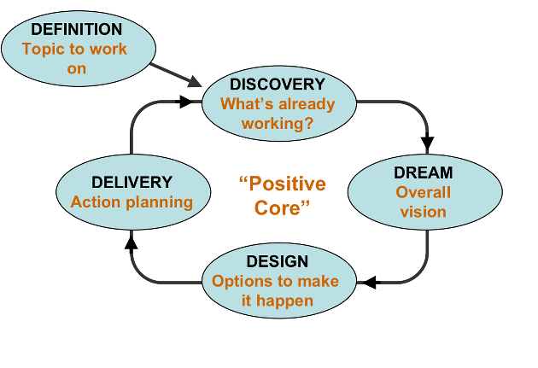
The ‘5 D’ model
“In every human situation something works.”

Slide 18
Defining
Affirmative Topics
Positively stated
Relevant
Within the power of the people in the room to do something about
…so rather than “Why is my time management so bad?” The topic might be “How do I make best use of my time?”
Tip: start with “How can I…” “ How do I….”

Slide 19
Discovery:
Appreciative Interviews
Look for best experiences rather than benchmarking average performance
The inquiry is the intervention
It’s not just the questions, it’s how you ask them
You’re after stories, not opinions or analysis

Slide 20
Discovery:
Appreciative Interview Questions
What has been your best experience in relation to this topic?
What’s really important about this experience. What do you value most about it?
What enabling factors made this experience possible?
If you had one wish for yourself, your team or your organisation for this topic what would it be?

Slide 21
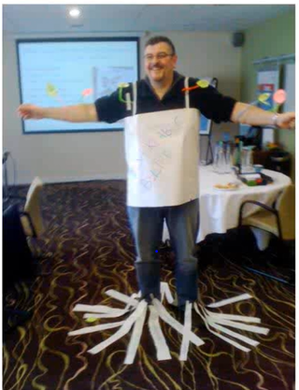
Dream: What would the perfect achievement of your topic be like?
First,
Imagine the ideal….
“What I would love to see is…”
Then :
Think about what the future would be like with a perfect outcome for your particular topic.

Slide 22
Design:
How to turn the dream into reality
Think back to what you ‘Discovered’ about important to you in terms of this topic
Which aspects of the ‘Dream’ do you have most energy to take forward?
Together, generate ideas (for actions, processes, systems, changes) that could bring your Dream into reality.

Slide 23
Delivery
How will you take your topic forward?
How will you measure success?
How will you learn from what you do?
This is where you would formulate a high level action plan

Slide 24
Let’s have a go!

Slide 25
An Appreciative Interview
DISCOVER
In pairs – conduct an appreciative interview using the questions given.
Decide which of you will be the interviewer and which the interviewee

Slide 26
Think about the work you do each day. Tell me a story about an exciting and rewarding experience you have had in your work – a time when you felt creative, connected, and successful.
What happened? Who was involved? What made it exciting?
What was the outcome for you?
What do you value most about your work?
What three wishes do you have for your organisation in the future and for your work?

