Slide 1



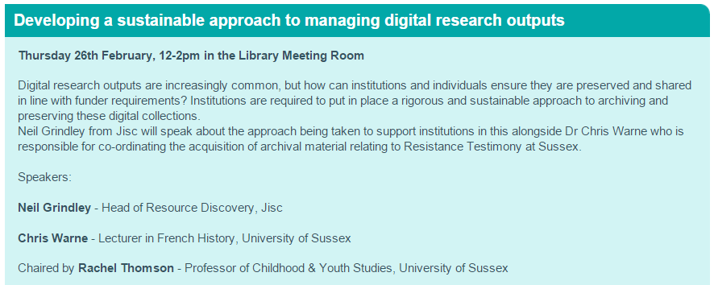

Collaboration to Clarify the Costs of Curation
Sussex Research Hive
Thanks for inviting me …
Managing, archiving, curating, preserving and sustaining digital [research] outputs …
      neil.grindley@jisc.ac.uk
      Head of Resource Discovery & 4C Project Coordinator

Slide 2
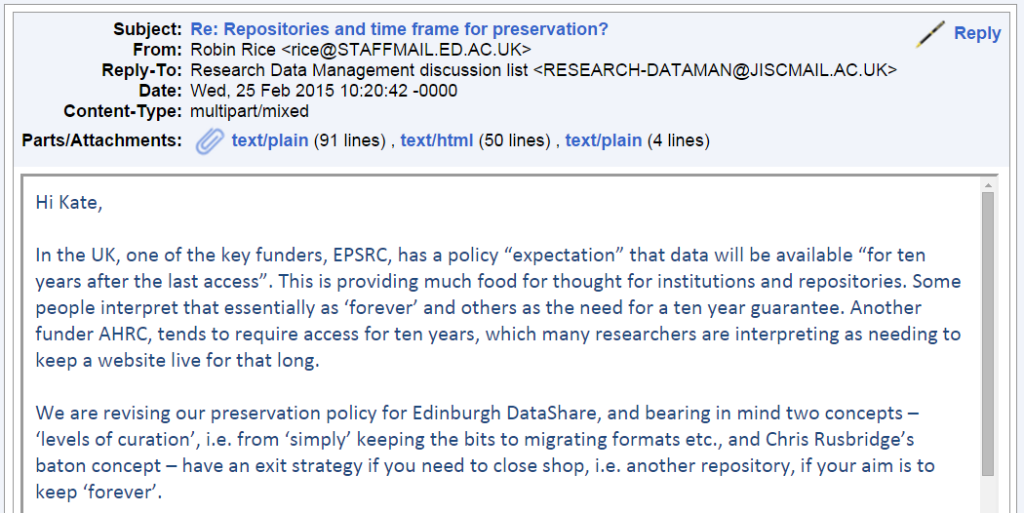
Collaboration to Clarify the Costs of Curation
It couldn’t be a more current issue …

Slide 3
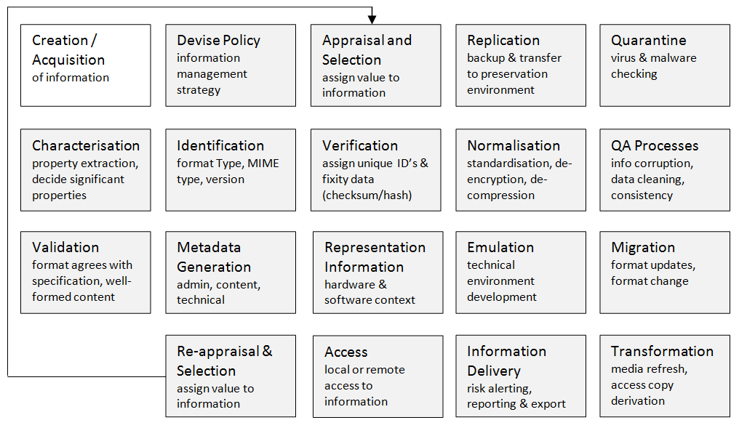
Collaboration to Clarify the Costs of Curation
There are a lot of technical considerations …
But sustainability is not [really] a technical issue…

Slide 4
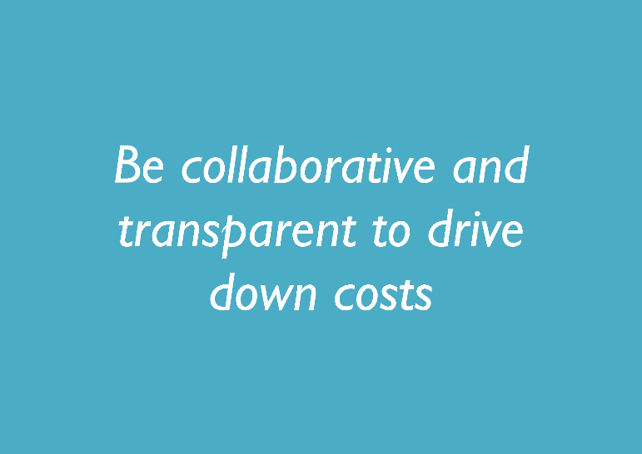
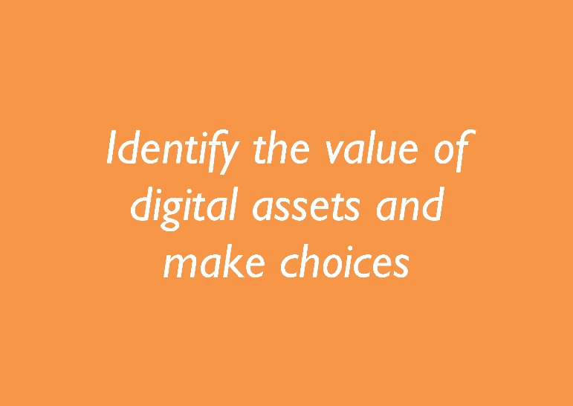
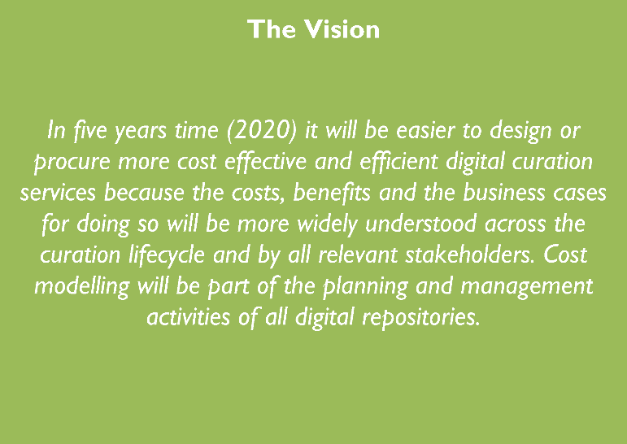
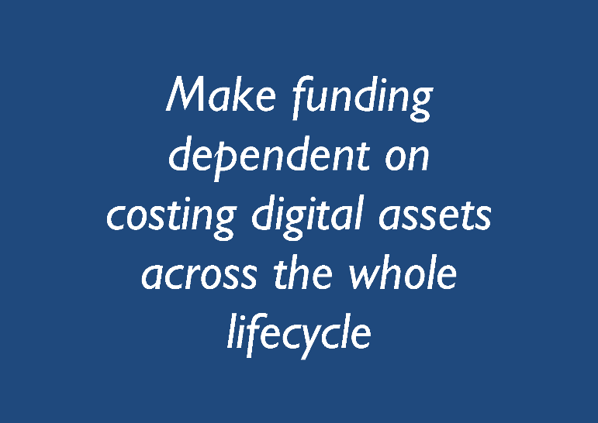
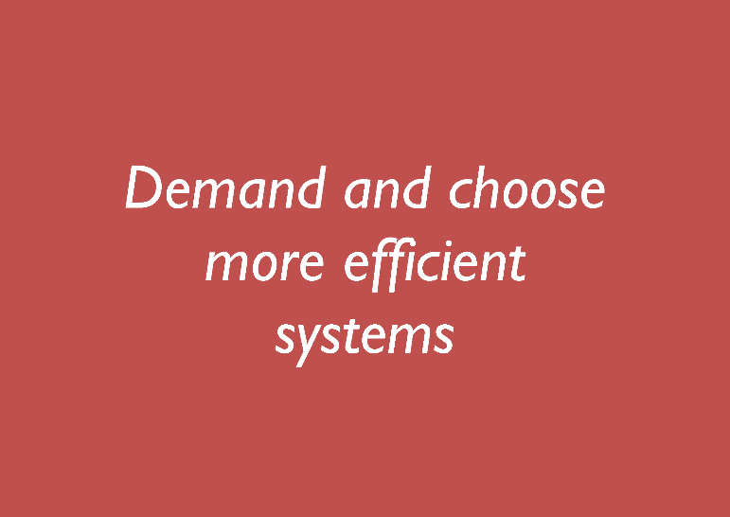
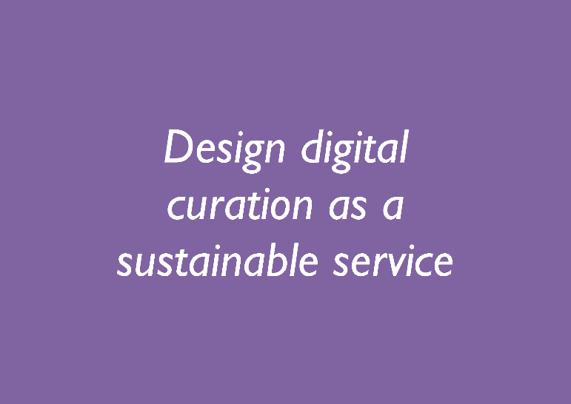

Collaboration to Clarify the Costs of Curation
The 4C Project Roadmap
Investing in Curation – A Shared Path to Sustainability
http://4cproject.eu/d5-1-draft-roadmap

Slide 5
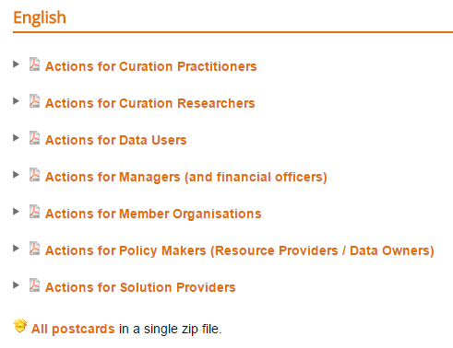
Collaboration to Clarify the Costs of Curation
The 4C Project Roadmap
Investing in Curation – A Shared Path to Sustainability
http://4cproject.eu/roadmap-resources#English

Slide 6
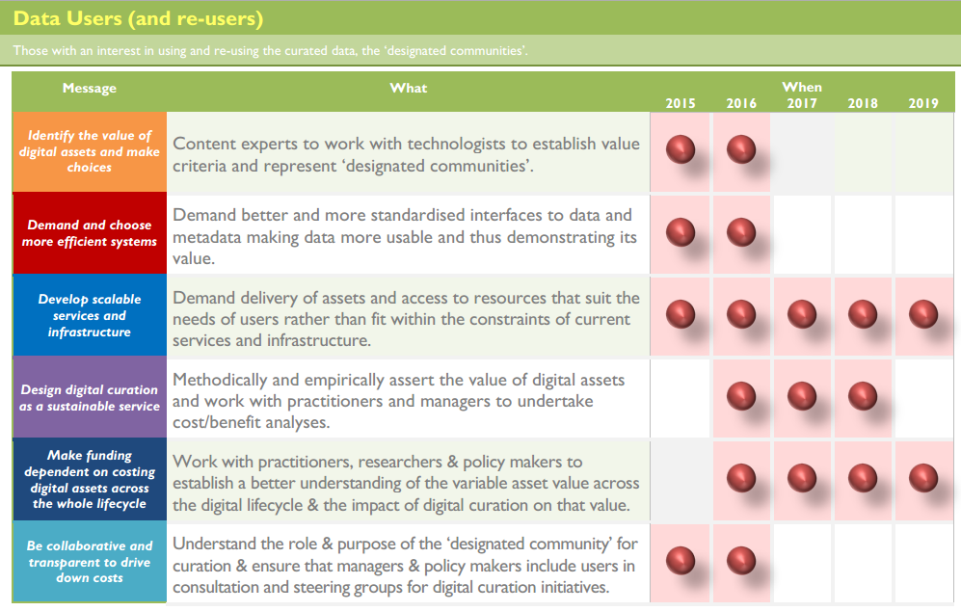
Collaboration to Clarify the Costs of Curation

Slide 7
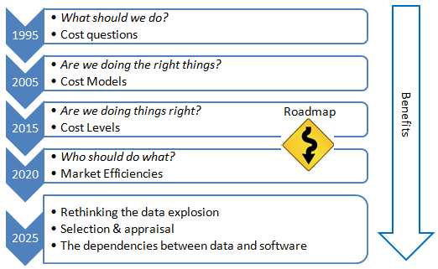
Collaboration to Clarify the Costs of Curation
The 4C Project Roadmap

Slide 8
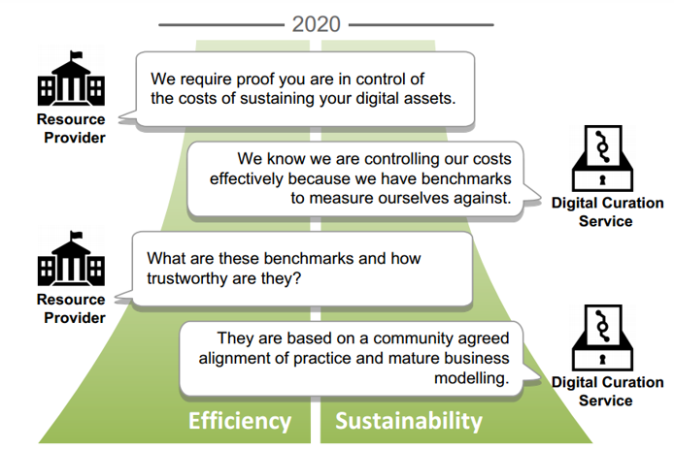
Collaboration to Clarify the Costs of Curation

Slide 9

Collaboration to Clarify the Costs of Curation
http://www.curationexchange.org/

Slide 10



Practitioners
Strategists
Operational Staff
Operational Managers
Perspective ...
Senior Managers
Funders & Investors
Focusing on ...
Digital Assets
Value Proposition
Activity and Process
Effort and
Resources
Risk Management
Black
Box
Curation as ...

Slide 11
Collaboration to Clarify the Costs of Curation
ECONOMIC MODEL
Maintaining stakeholder incentives and the flow of resources to sustain assets
COSTS MODEL
BENEFITS MODEL
Digital Assets
Value Proposition
Activity and Process
Effort and Resources
Risk Management
Curation as Black Box

Slide 12




Collaboration to Clarify the Costs of Curation
Why do modelling …?
Reality
Reality
Time
Modelling Tools
Change Management
Reflection
Model
Model

Slide 13
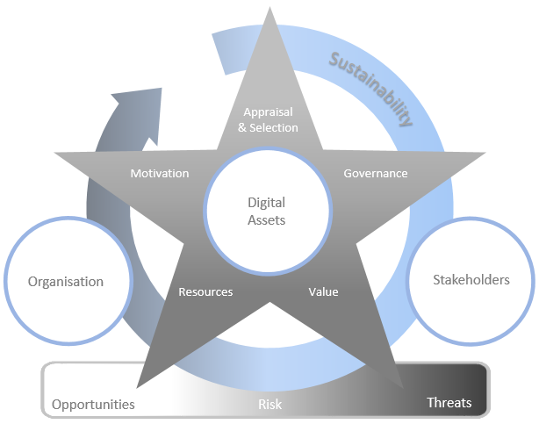
Collaboration to Clarify the Costs of Curation
Digital Curation Sustainability Model
http://www.curationexchange.org/understand-your-costs/75-sustainability-planning
http://www.4cproject.eu/component/docman/doc_download/152-d4-2-assessment-of-community-validation-of-the-esrm

Slide 14
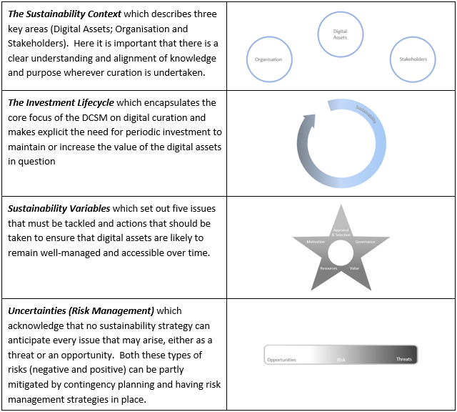
Collaboration to Clarify the Costs of Curation

Slide 15
Links and resources
Research Data mailing list
https://www.jiscmail.ac.uk/cgi-bin/webadmin?A0=RESEARCH-DATAMAN
Digital Curation Centre
http://www.dcc.ac.uk/resources
Research Data Spring
http://www.jisc.ac.uk/rd/projects/research-data-spring
The 4C Project
http://4cproject.eu/
4C Roadmap – Investing in Curation: A Shared Path to Sustainability
http://4cproject.eu/roadmap
The Curation Costs Exchange
http://www.curationexchange.org/
Sustainability Planning On the Curation Costs Exchange
http://www.curationexchange.org/understand-your-costs/75-sustainability-planning
The Digital Curation Sustainability Model
http://www.4cproject.eu/component/docman/doc_download/152-d4-2-assessment-of-community-validation-of-the-esrm

Slide 16
Thank you for listening!
Neil Grindley
Head of Resource Discovery
Jisc
neil.grindley@jisc.ac.uk

