Slide 1
Attribution (CC BY)
Commercial and derivative restrictions (CC BY-NC +ND)
Share Alike restrictions (CC BY-SA)
Open Access
Gratis - free to view
Libre - free to view AND free to use
Reuse of Manuscript
Manuscript Versions and Embargo
Yellow (version 1)
Green (version 2 w/embargo)
Gold (version 3 immediately)
Hybrid
Full
2002
HINARI
Creative Commons
2004
SAGE and Hindawi co-launch a series of fully OA journals for global access initiative
2010
SAGE Choice on majority of journals
2015
SHERPA and RoMEO
2007
SAGE becomes RoMEO Green Compliant
SAGE Open
SAGE publishes around 35 OA journals, offers hybrid across 90% of its titles
2008
SAGE to participate in SOAP
Founding member of OASPA
Budapest Conference

Slide 2
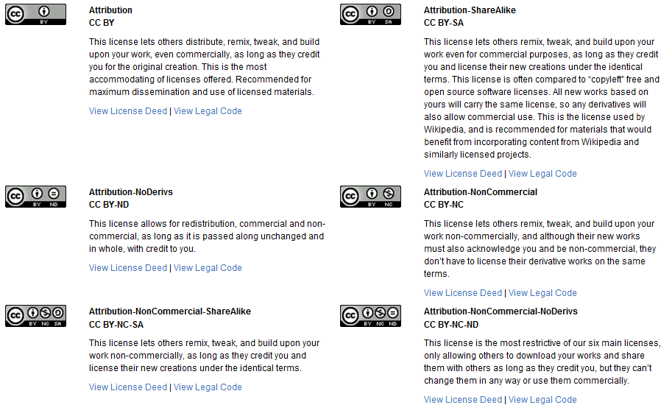
From http://creativecommons.org/licenses/

Slide 3

The learning curve…

Slide 4
3 tips for navigating OA
Funding Compliance
- Confirm the funder's OA requirements and/or APC assistance.
- RCUK and Wellcome specifically require a CC BY license for any research output.
- NGOs and government agencies often require output to be OA under green or gold schemes but don't mandate a specific license.
Uni/Department Expectations
- Most institutions have a self-archiving requirement. This is usually covered in a publishing agreement.
- Many disciplines have global repositories. This isn’t always covered in a publishing agreement.
- Prepaid APC opportunities.
Personal Preference
- What do you want to achieve with your research?
- What are your funding constraints for APCs?
- What (if any) concerns do you have about others republishing your work?

Slide 5

Questions? Get in touch:
Katherine Ryan
Senior Rights and Licensing Manager, SAGE Publications Ltd. email: katherine.ryan@sagepub.co.uk

