Slide 1
Funding your research: scholarships, grants and contracts that enable your research
Professor Michael C R Davies
Pro-Vice-Chancellor (Research)
Research Hive Seminars 2016
1 March 2016

Slide 2
Scope
Why seek funding for your research?
A career example
  Research funding history
  Sources of funding
  Examples of research activity
  Funding at different stages of a research career
  Conclusions and discussion

Slide 3
Why seek funding for your research?
Facilitate networking
Purchase major equipment
Access to facilities
Fund direct and indirect costs of a research project
Fund doctoral students
Fund postdoctoral researchers and research fellows
Fund own research activity through fellowships or “bought out time”
Reduce amount of cross subsidy from student tuition fees to faculty research activity

Slide 4
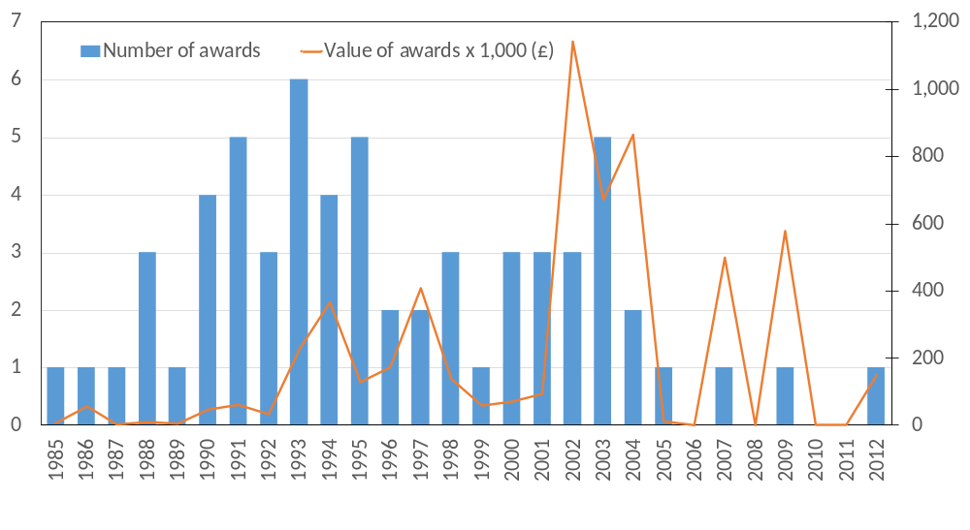
Research funding history
Appointment as Executive Dean at University of Auckland
Appointment as Professor at University of Dundee
First award after appointment as Lecturer at Cardiff University in 1983

Slide 5
Sources of research funding
Research Councils (RCUK)
EPSRC
NERC
MRC/EPSRC/BBSRC (Discipline Hopping)
Charitable funding bodies
The Leverhulme Trust
National, regional and local government
Scottish Funding Council
Rhymney Valley District Council
Blaina Gwent County Council
Ministry of Business, Innovation and Employment (New Zealand)
Tertiary Education Commission (New Zealand)
European Union
Erasmus programme
Groupment de Recherches Coordonnees (GRECO)
European Commission, Competitive and Sustainable Growth Programme
European Community (DG XII Science, Research and Development)
European Regional Development Fund
UK government research agencies (current and former)
Welsh Development Agency
Cardiff Bay Development Corporation
Transport Research Laboratory
Building Research Establishment
Ministry of Defence
Defence and Evaluation Research Agency
Coal Research Establishment
Industry
Network Rail
British Coal
Wallace Evans and Partners
Ryan International
Soil Nailing limited
Keller Colcrete
Stolt Offshore

Slide 6
Examples
Technique of geotechnical centrifuge modelling
Ground improvement
Masonry arch bridges
Permafrost and cold regions engineering
Earthquake engineering

Slide 7
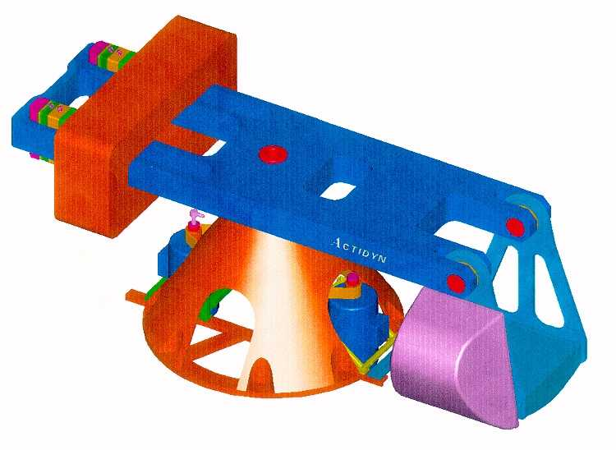
Geotechnical Centrifuge Modelling

Slide 8
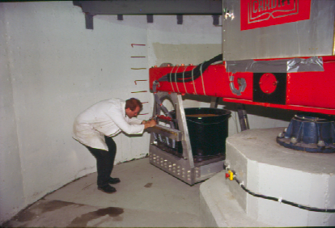

Slide 9
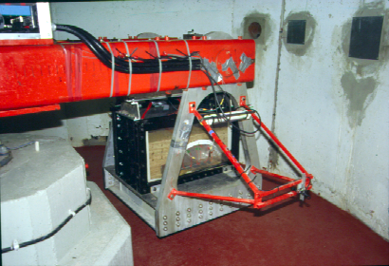

Slide 10
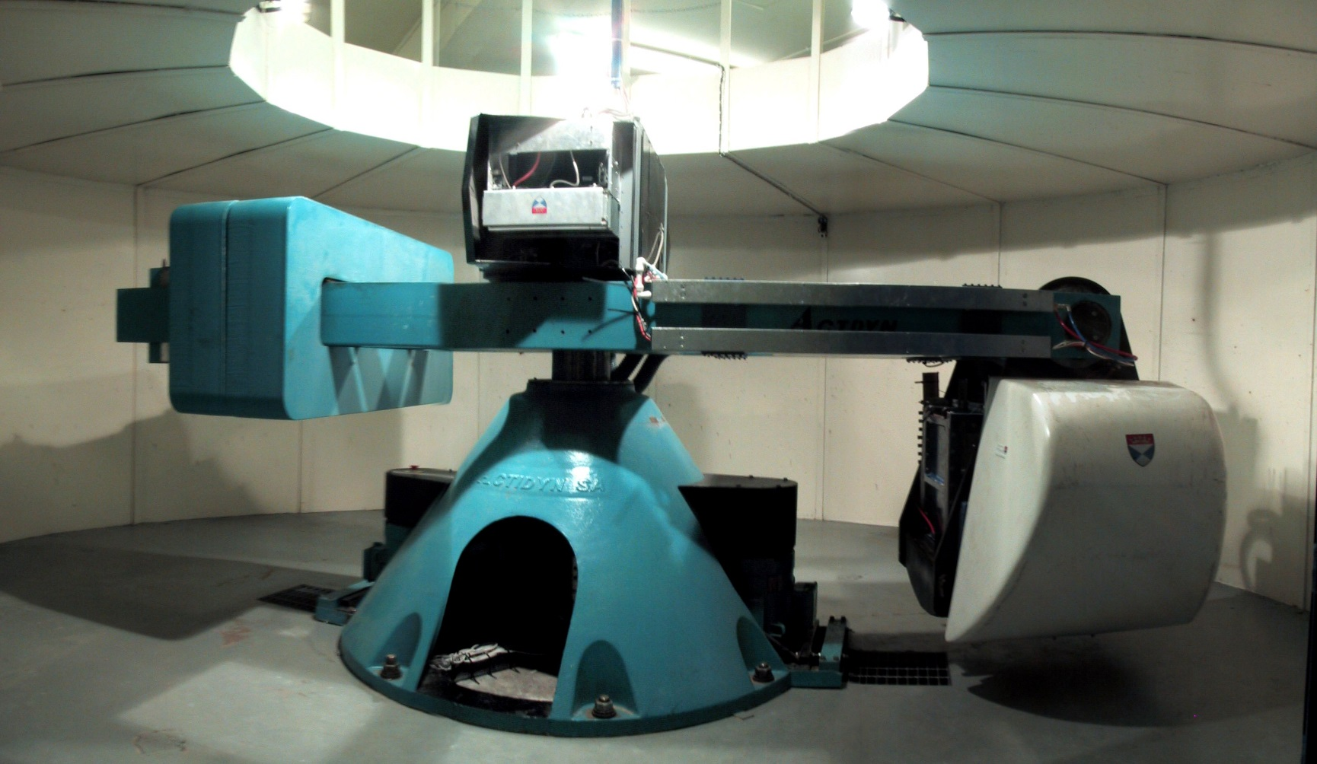
Dundee 100 g-tonne Geotechnical Centrifuge

Slide 11
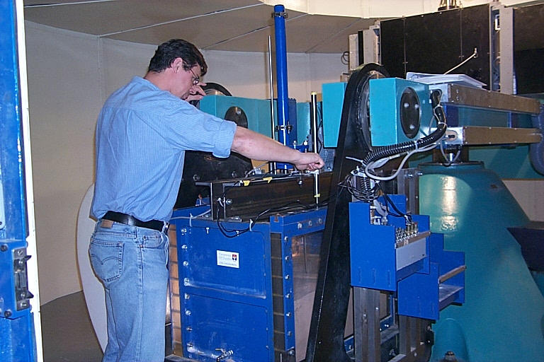

Slide 12
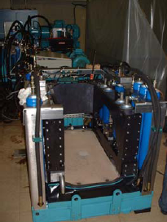
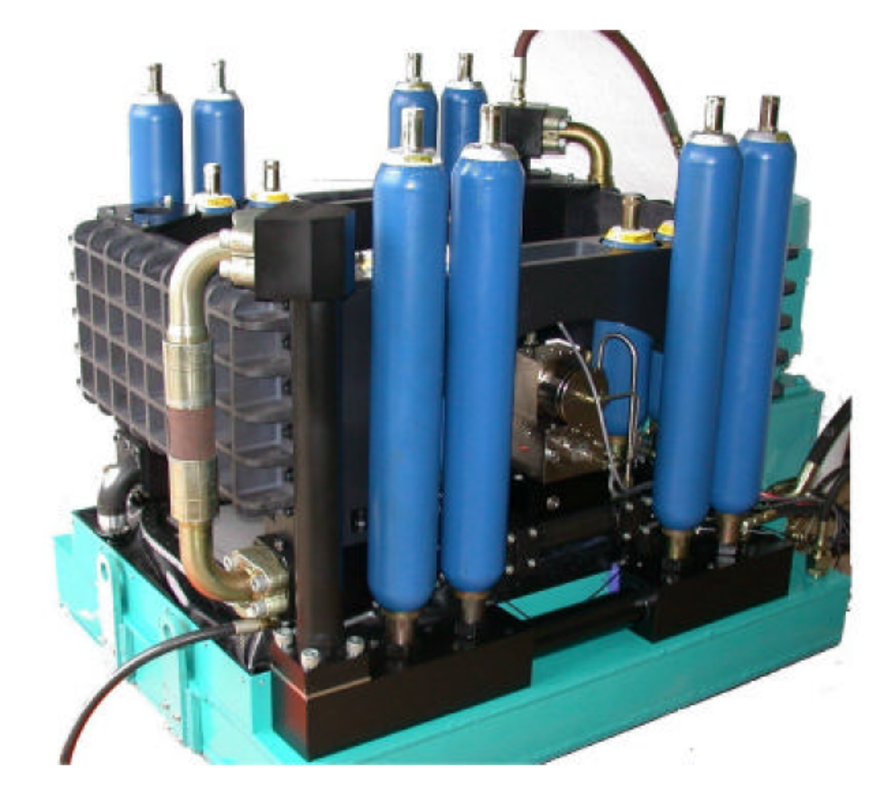
Earthquake actuator

Slide 13

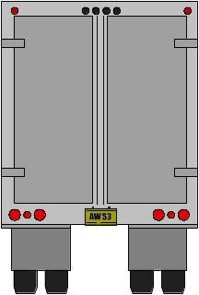
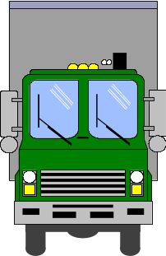
Ground Improvement –
Soil Nailing

Slide 14
Ground Improvement –
Soil Nailing

Slide 15
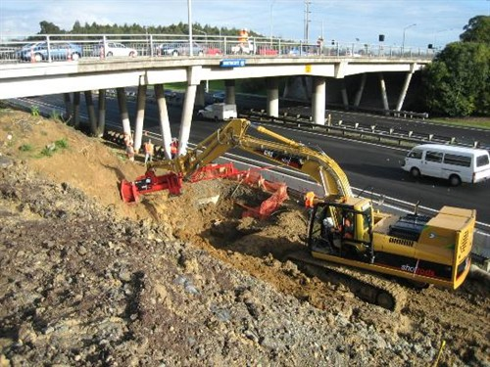
Ground Improvement –
Soil Nailing

Slide 16
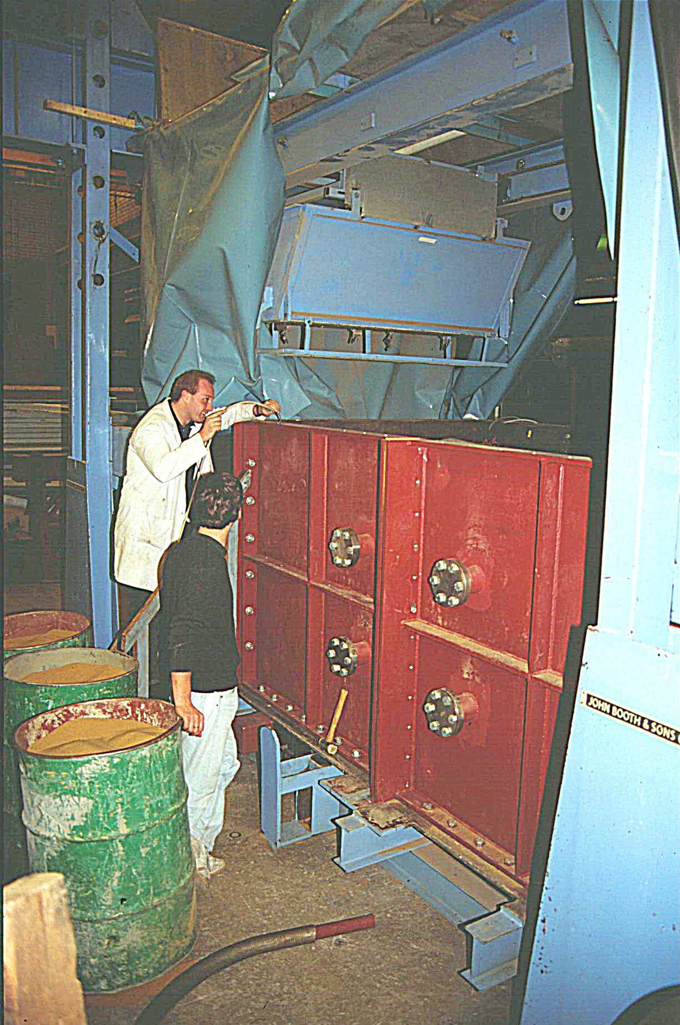
Ground Improvement –
Soil Nailing
Cardiff Large Shear Box
Length 3.0 m
Shear plane 1.5 m x 1.5 m
Variable confining pressure
Tests to investigate:
- nail surface properties
- inclination of nail

Slide 17
Ground Improvement –
Soil Nailing

Slide 18
Ground Improvement –
Soil Nailing

Slide 19
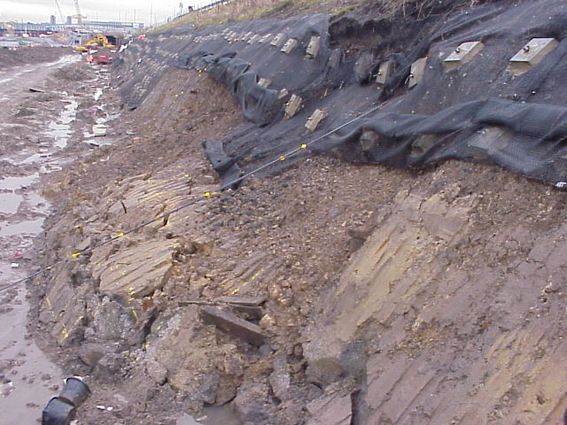
Soil nailing construction problems

Slide 20
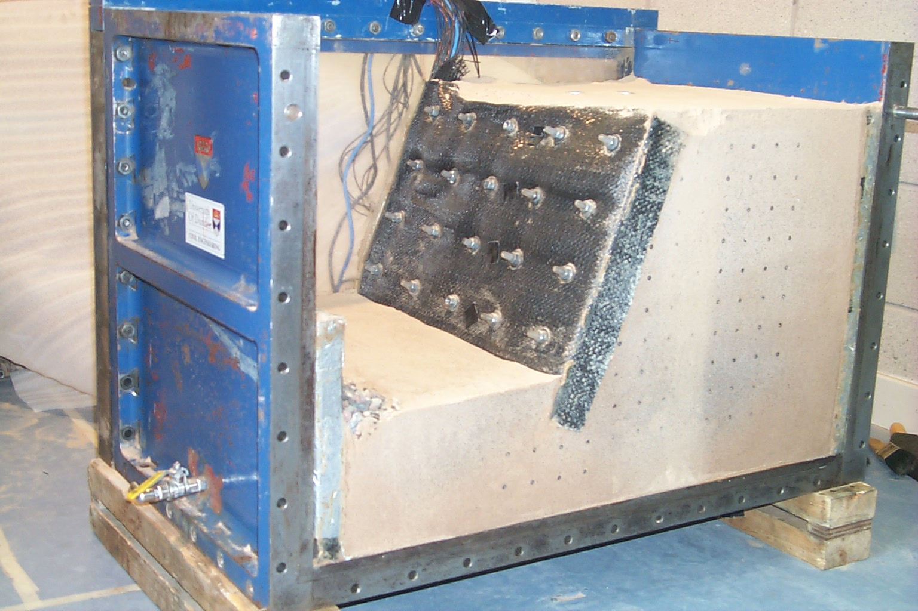
Soil nailing construction problems

Slide 21
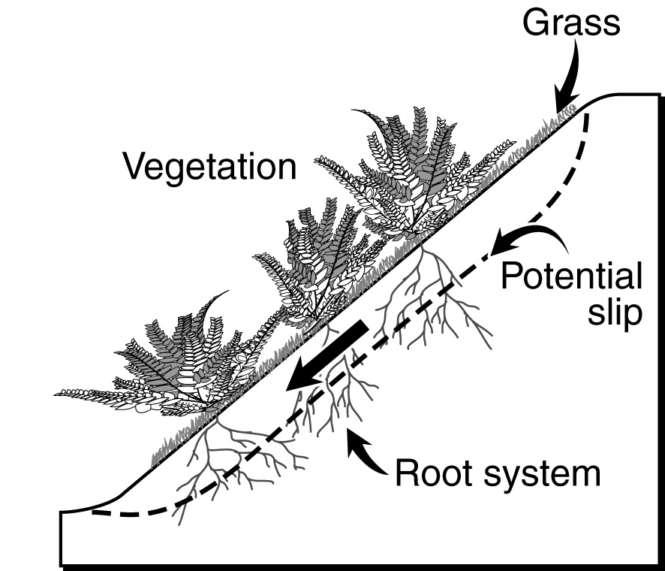
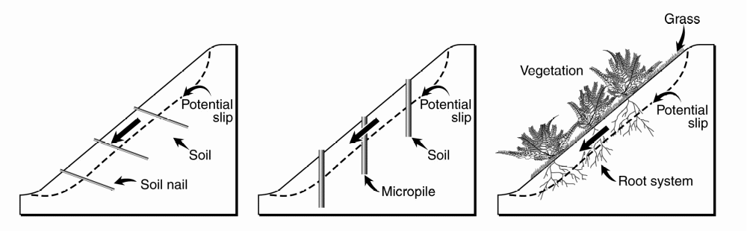
Soil nailing versus vegetation
for slope stabilisation

Slide 22
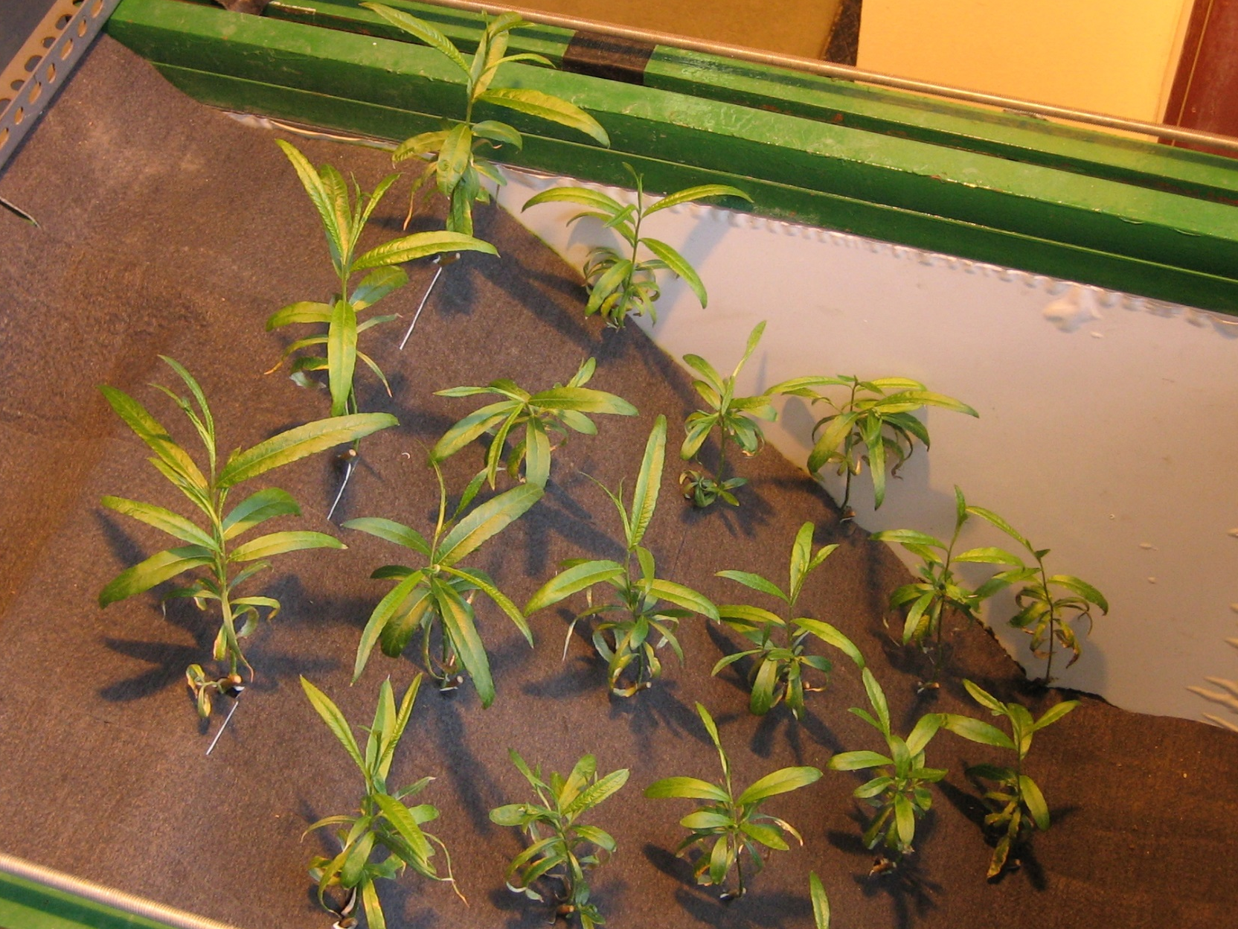
Plant root reinforcement –
grown willow
Notes:
- Using real roots leads to more realistic models.

Slide 23
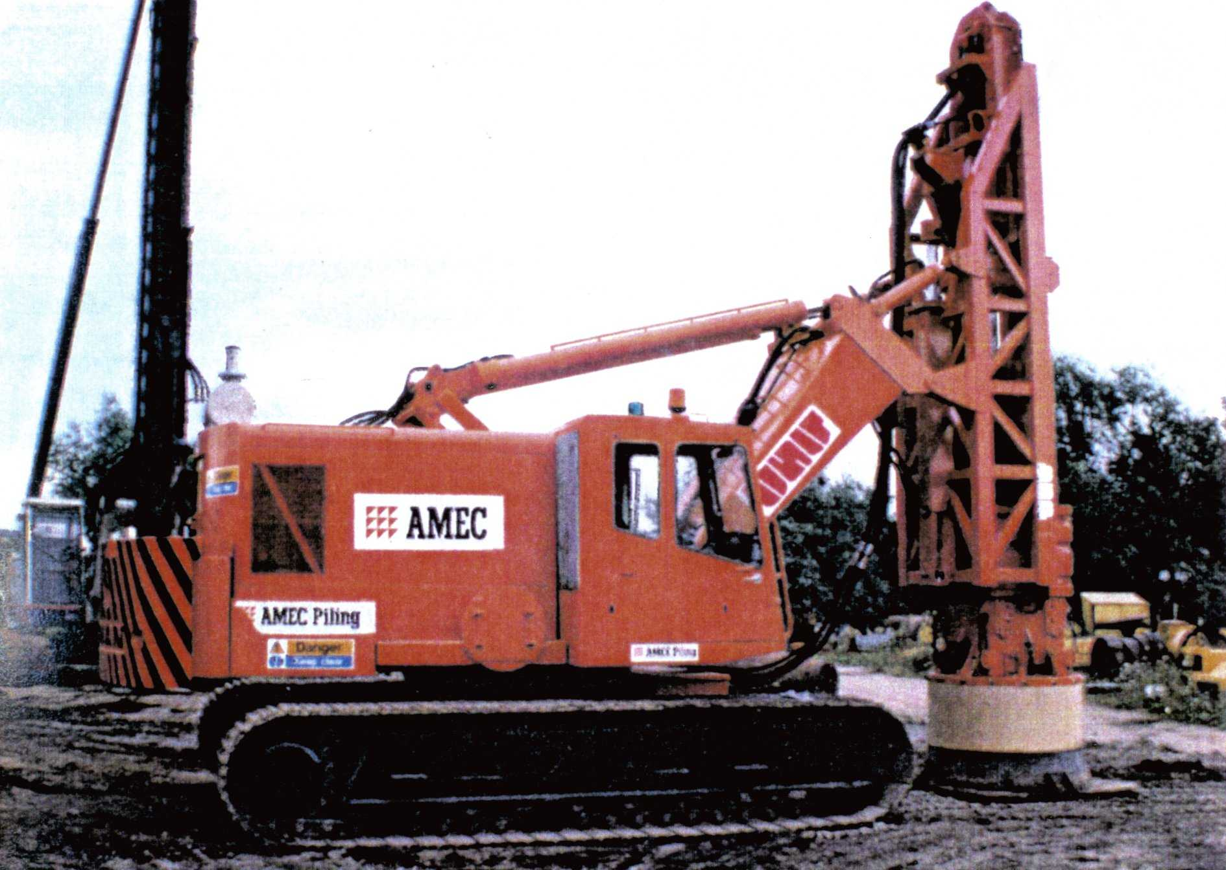
Ground Improvement –
Dynamic compaction

Slide 24
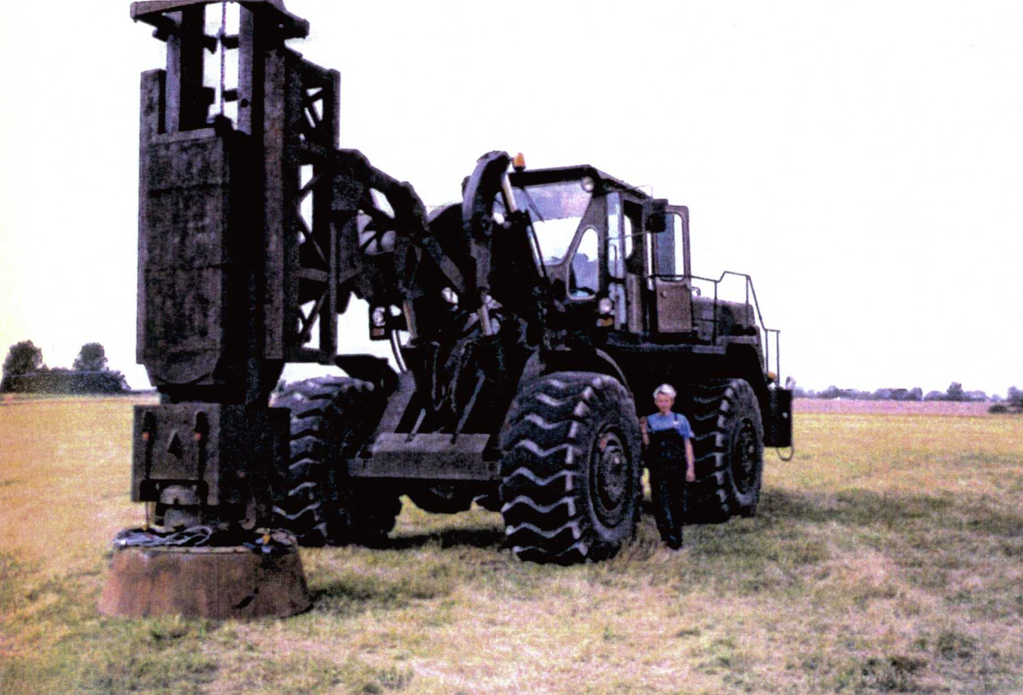
Ground Improvement –
Dynamic compaction

Slide 25
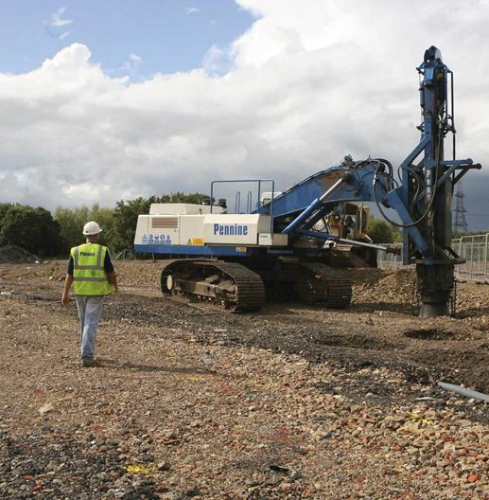
Ground Improvement –
Dynamic compaction

Slide 26
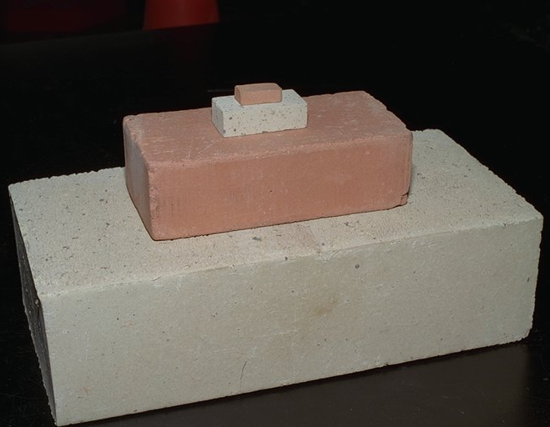
Masonry arch bridges

Slide 27
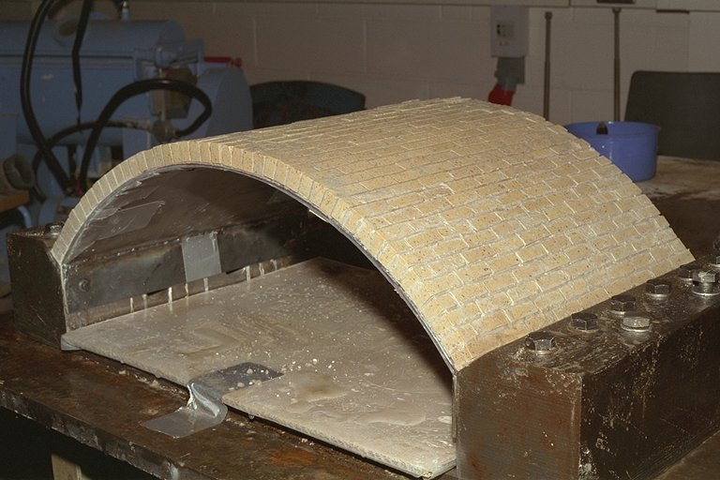

Slide 28
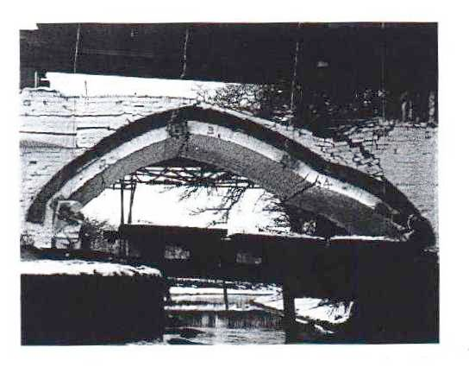

Slide 29
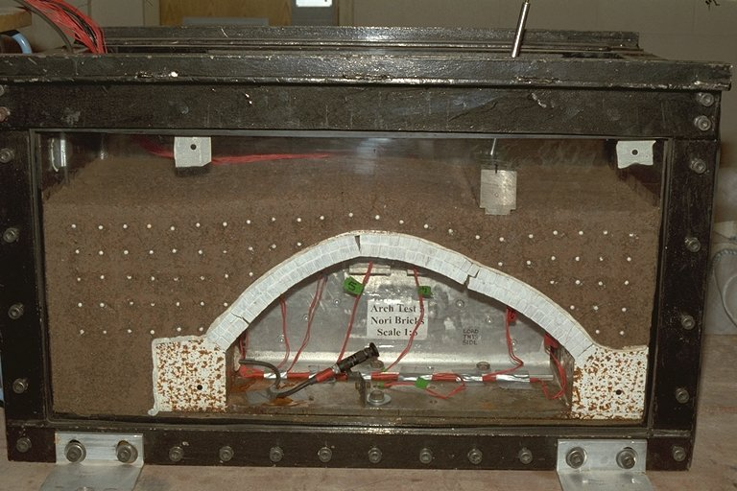

Slide 30
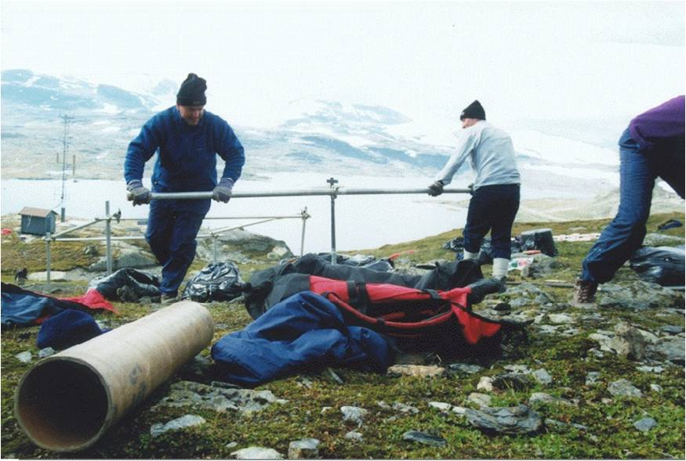
Permafrost and cold regions engineering

Slide 31
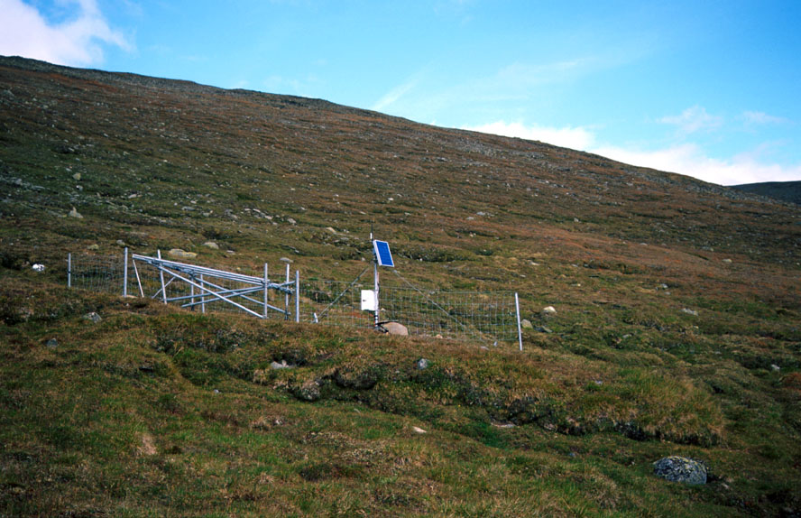
Field monitoring - Finse, Norway

Slide 32
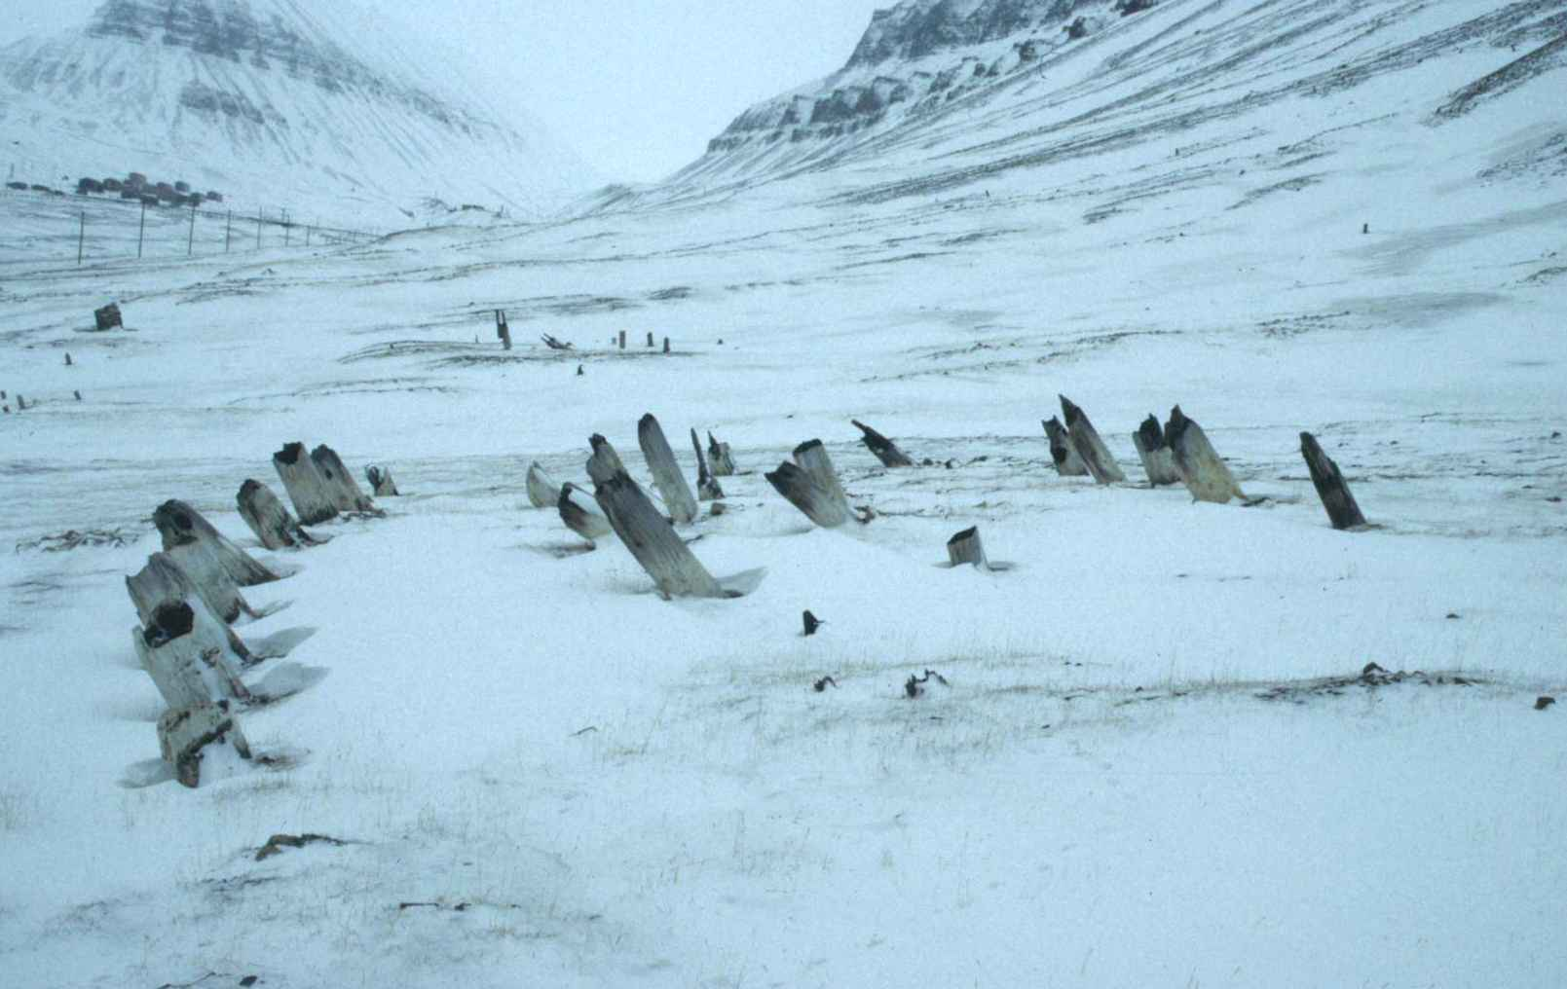
Field monitoring - wooden piles displaced in Longyearbyen, Svalbard

Slide 33
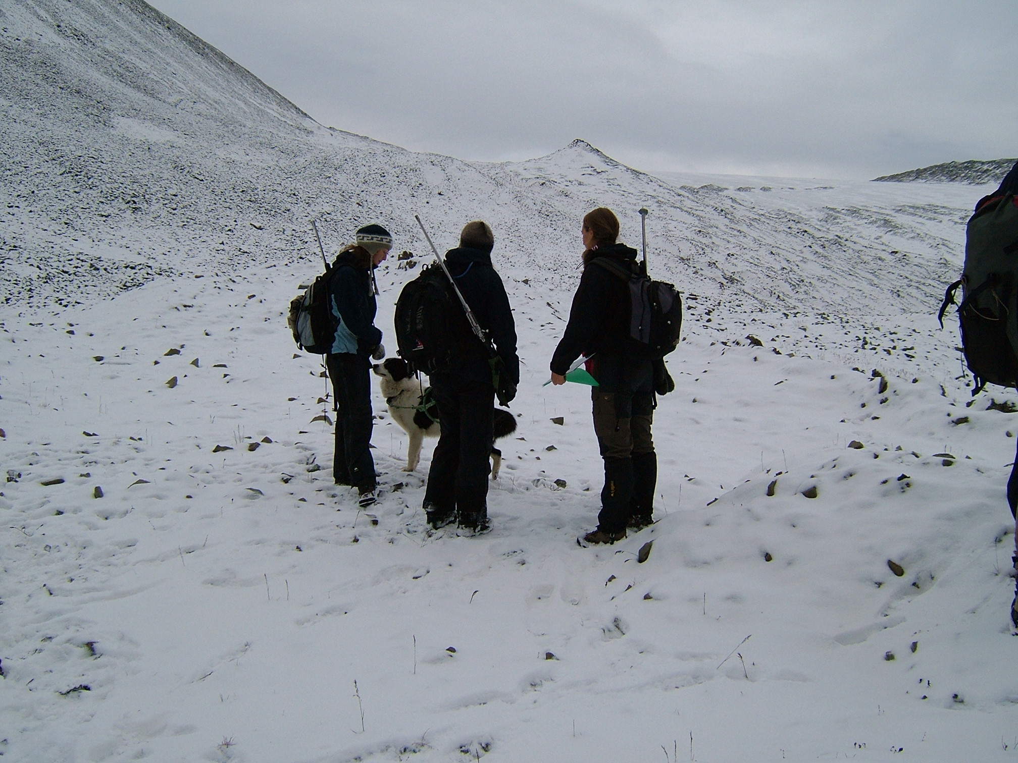

Slide 35
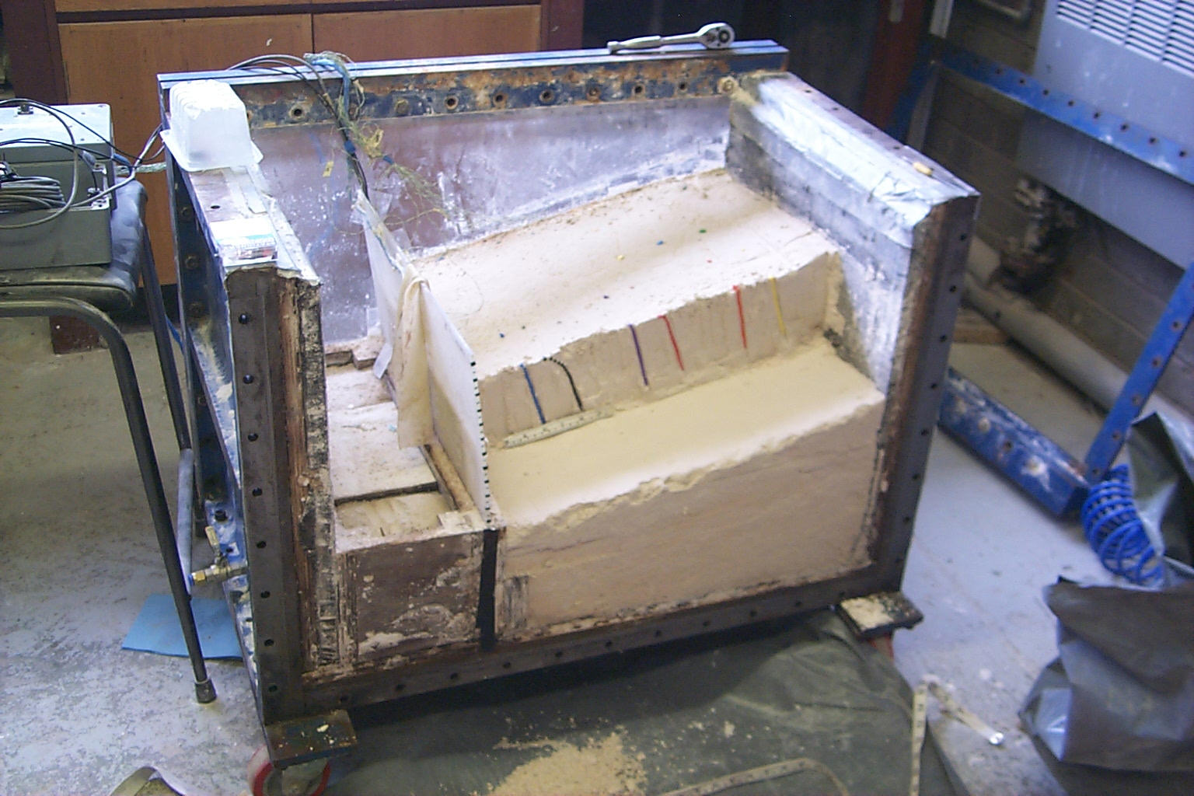

Slide 36
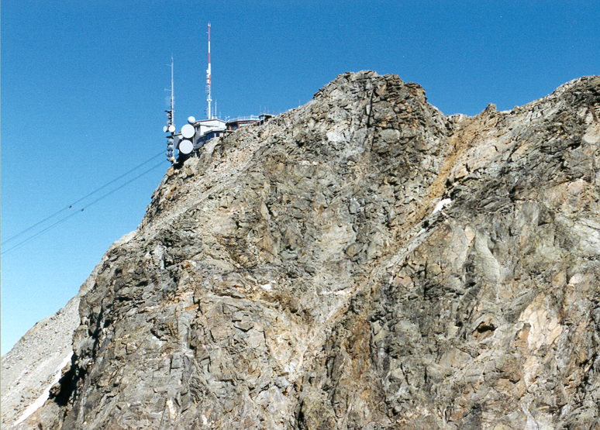
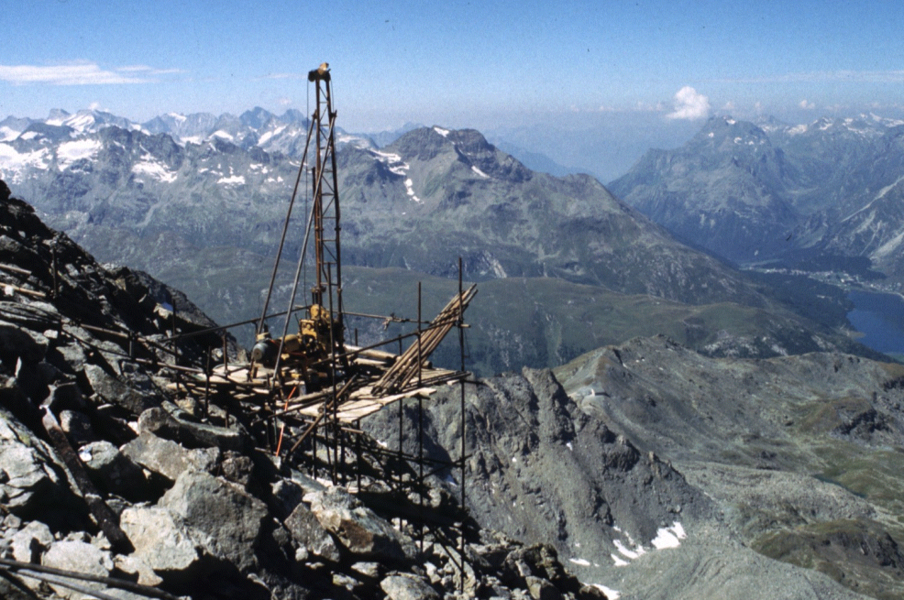
Rock slope stability - Piz Corvatsch in the Swiss Alps

Slide 37
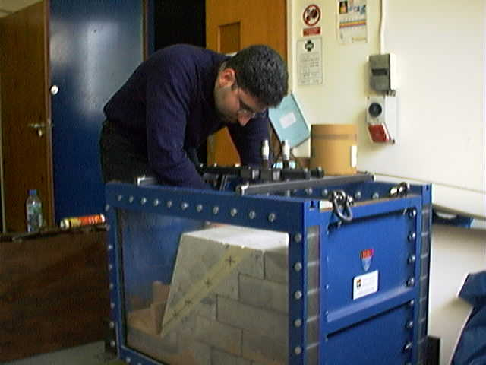

Slide 38
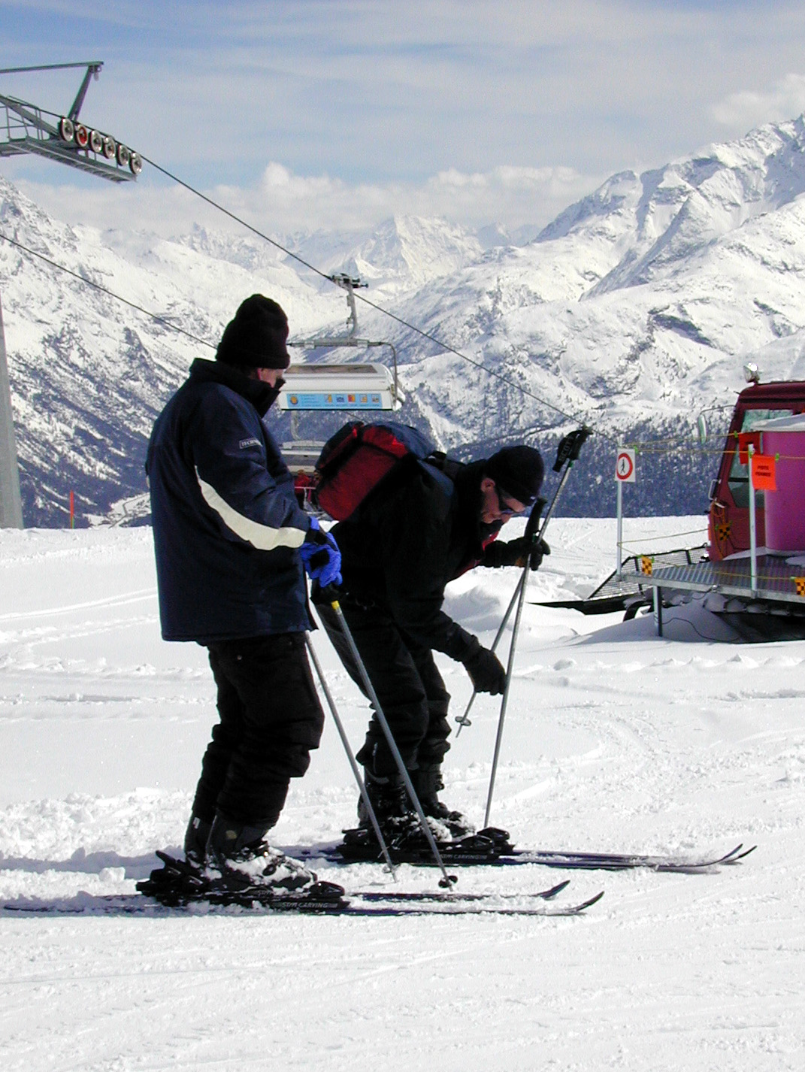
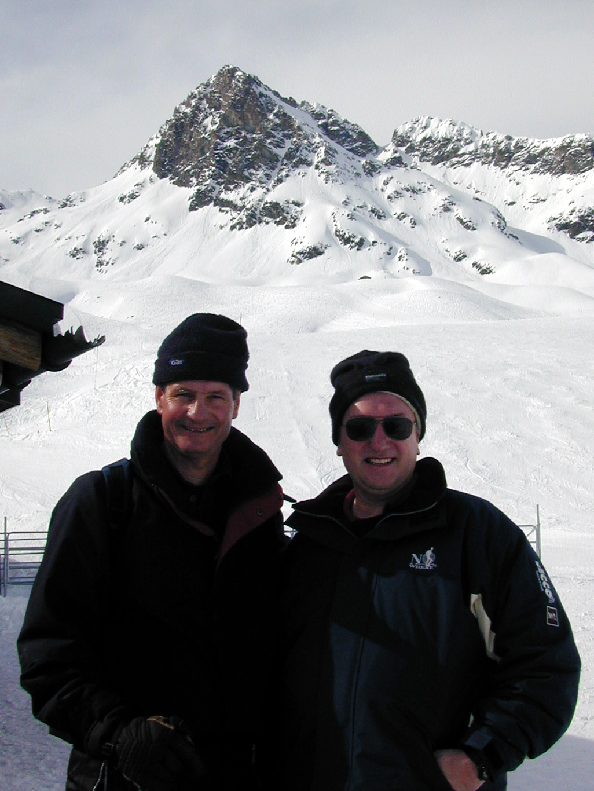

Slide 39
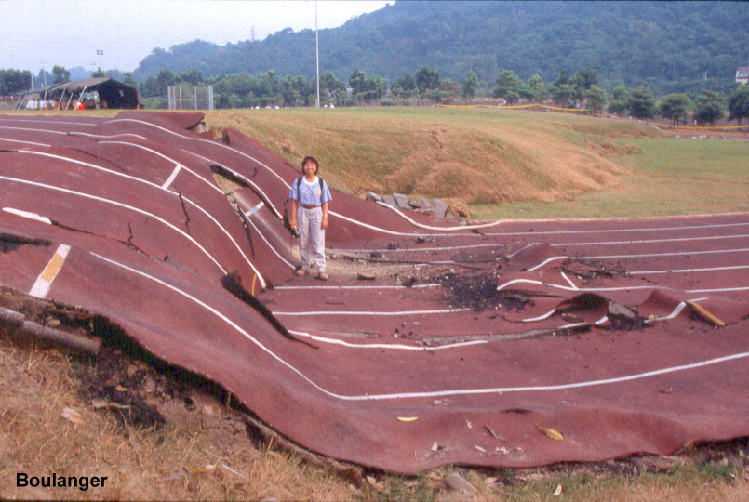

Earthquake engineering
Surface ruptures during the 1999 Chi-Chi earthquake

Slide 40
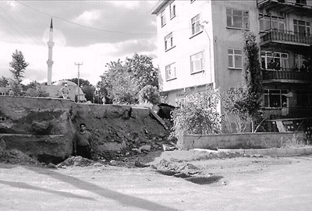
Izmit Earthquake - August 17, 1999 (M7.4)

Slide 41
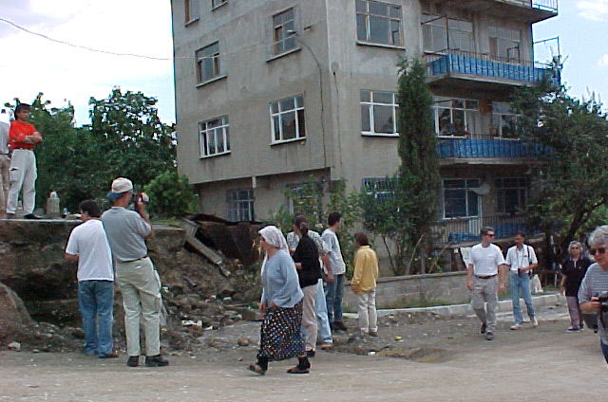

Slide 42
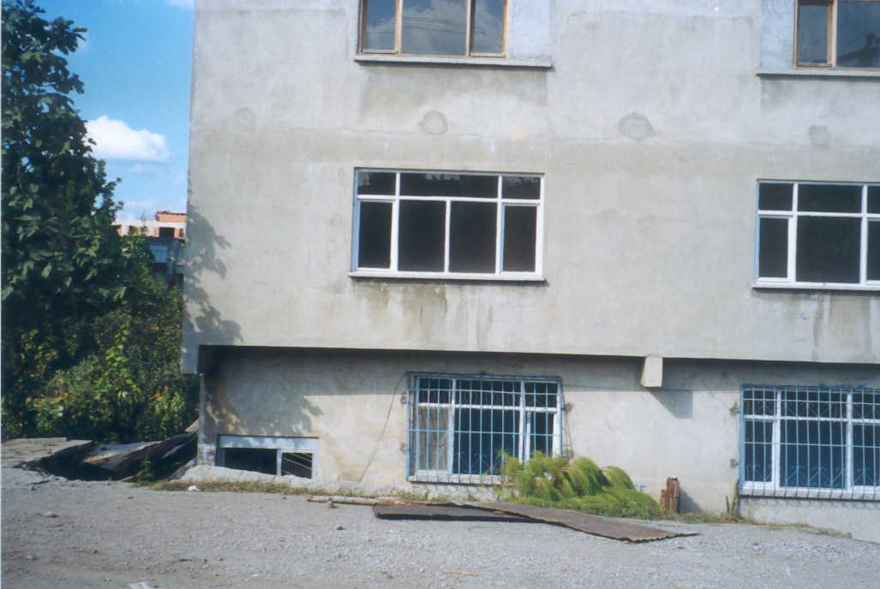
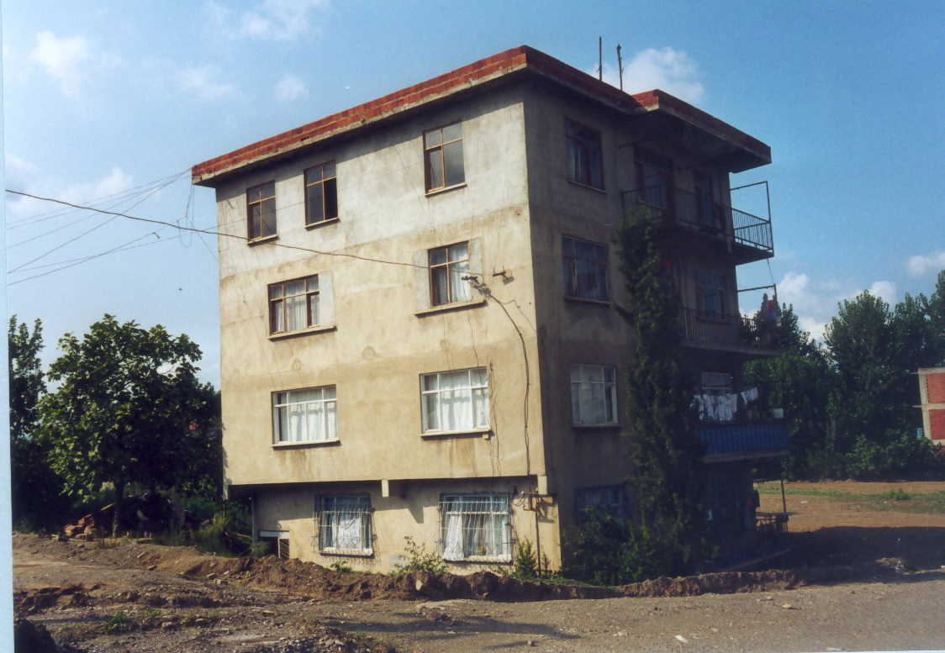
2.30 m
?

Slide 43
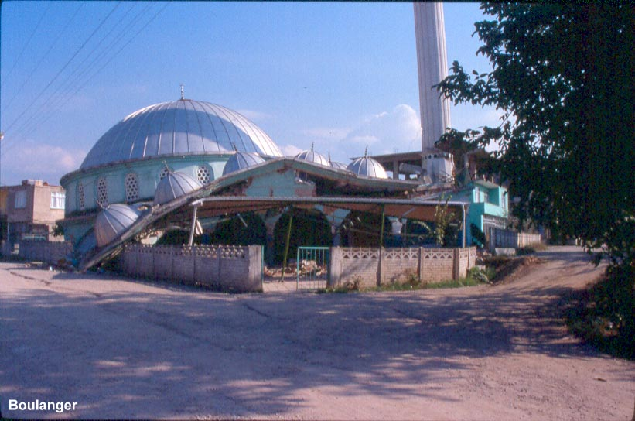

Slide 44
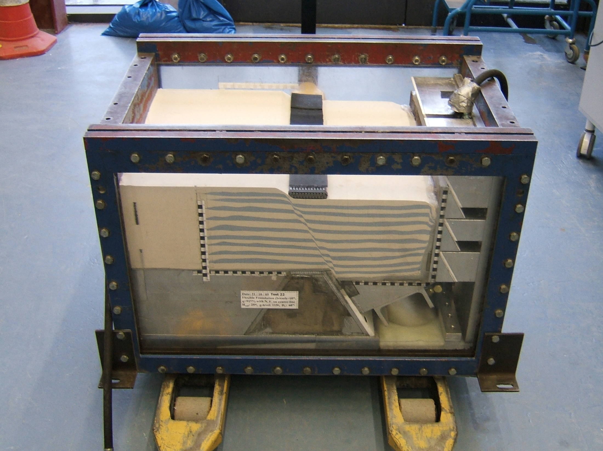

Slide 45
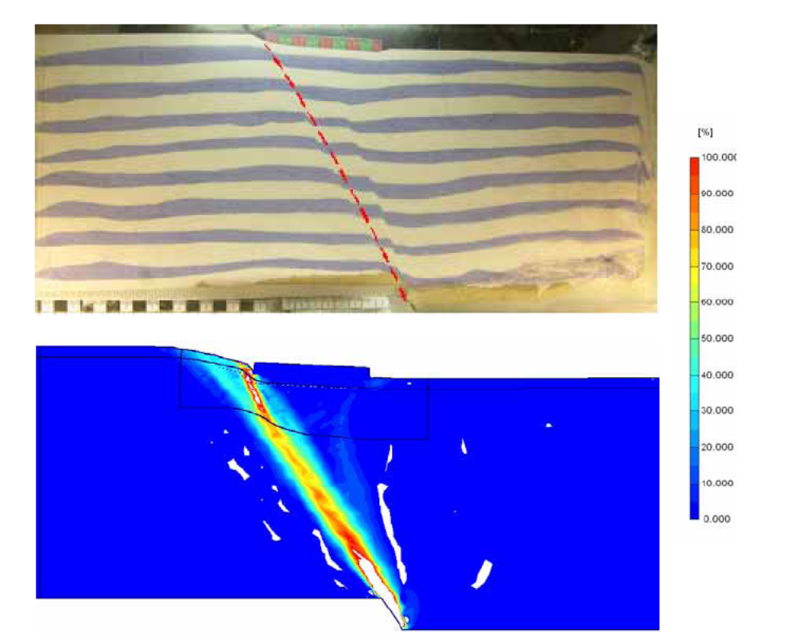
Physical and numerical modelling of normal fault/foundation interaction
experimental results
(Dundee)
Shear strains from numerical analysis
(NTUA)

Slide 46
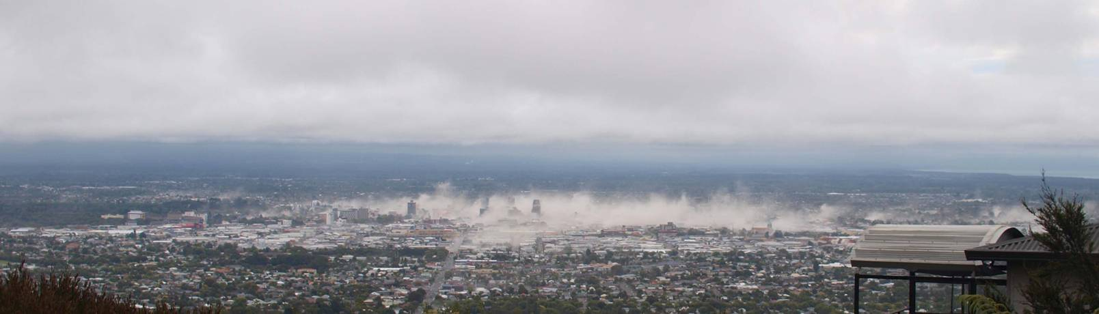
Dust cloud over Christchurch CBD on 22 February 2011
Christchurch earthquake –
Christchurch CBD

Slide 47
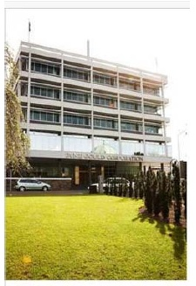
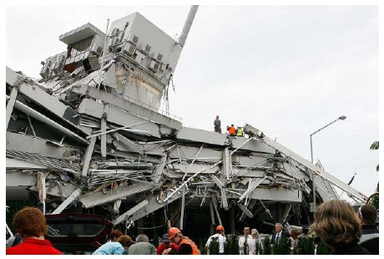
Pyne Gould Building
233 Cambridge Terrace
Christchurch earthquake –
Christchurch CBD

Slide 48
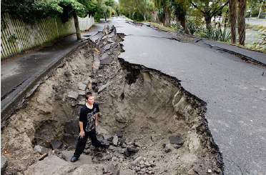
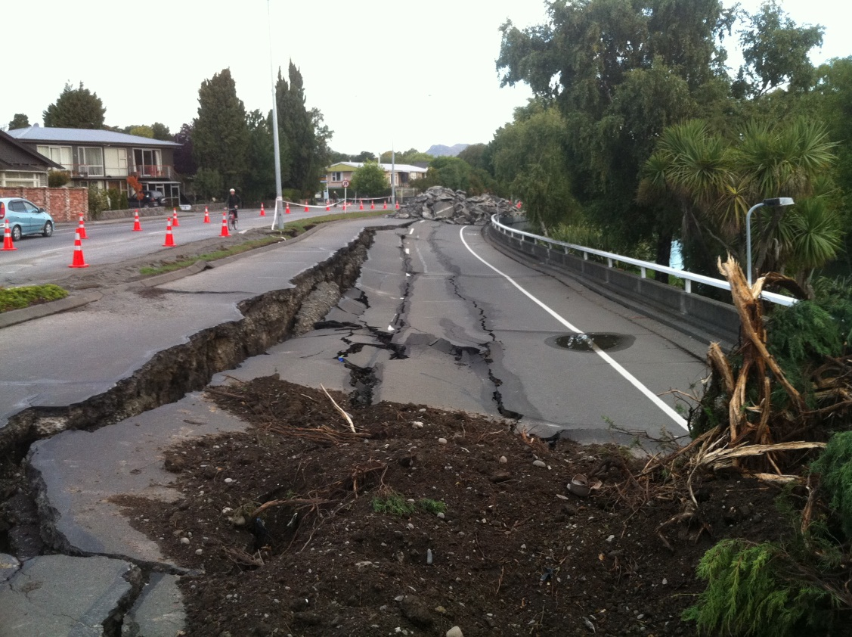
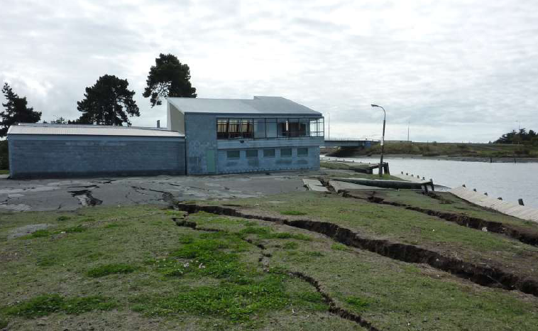
Lateral spreading

Slide 49
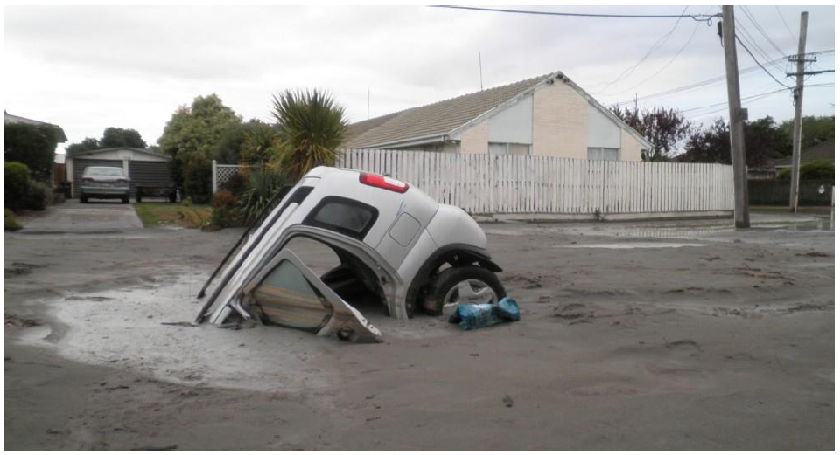
Liquefaction
Example of severe liquefaction
(after Geotechnical Extreme Event Reconnaissance Team report, 2011)

Slide 50
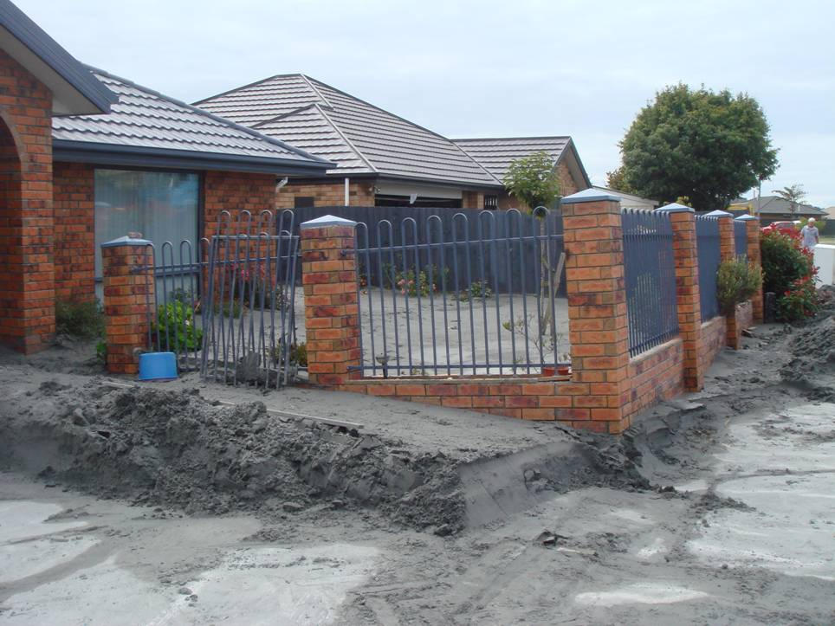

Slide 51


Liquefaction & lateral spreading: Christchurch earthquake
Damage to residential properties in Bexley

Slide 52

South Brighton Bridge – lateral spreading near bridge
(after Geotechnical Extreme Event Reconnaissance Team report, 2011)

Slide 53

South Brighton Bridge

Slide 54
Research funding history

Slide 55
Funding at different stages of a research career
Doctoral Student
  Studentships
  Research costs, e.g. lab costs, field work, specialist training
  Conference attendance, networking, specialist training
Postdoctoral Fellow
  Fellowships e.g. British Academy, Wellcome Trust; Royal Academy of Engineering; Royal Society; Cancer Research UK
  Funding from PI’s research grant
  Networking/conferences
Early career researcher
  Networking/conferences
  Fellowships (as above)
  First grants e.g. AHRC Early Career (< £250k); Leverhulme Trust; (< £74k); ESRC Future Research Leaders (< £230k); ERC Starter grants (< €1.5M); Royal Society
  Industry
  Government, e.g. DFID; NIHR; Innovate UK
Returning researcher
  Daphne Jackson Trust
  Dorothy Hodgkin Fellowship (Royal Society)
Established researcher
as early career researcher +
  RCUK – responsive mode and directed calls
  EU Framework Programme – Horizon 2020
  Investigator awards MRC, Wellcome Trust; Royal Society Leverhulme Trust Fellowship
  Project funding from charities e.g. Leverhulme Trust, CRUK, Wellcome Trust Seed Awards
  ERC Consolidator grants (< €2.0M)
  Industry
  Government, e.g. DFID; NIHR; Innovate UK
Senior researcher
as established researcher +
  ERC Advanced grants (< €2.5M)
  Platform grants – EPSRC; MRC; BBSRC

Slide 56
Conclusions
At any stage of a researcher’s career and irrespective of discipline, funding from external sources will enhance opportunities for conducing high quality research.
For some disciplines external funding is essential to facilitate world class research activity (e.g. purchasing equipment; providing access to specialist facilities or archives).
Clearly, the amount of external funding required to support research will depend on the nature of the activity and will vary between and within disciplines (one size does not fit all!).
External research funding allows researchers to build teams (where appropriate) and create the space for themselves that facilitates high quality research.
In some disciplines – particularly those in which research is conducted in groups – more senior researchers have a greater incentive to seek funding for research platforms and partnerships.
External research funding allows you to do some really interesting things!

