Slide 1
Launching and Marketing of Andy’s New Textbook
Mark Kavanagh – Executive Publisher

Slide 2
What a textbook!!! I could not refrain myself from taking a few pictures and sending to friends …That is how I wish I was introduced to statistics back in my early days. A masterpiece!
Perfect for everyone that finds stats difficult, pointless or boring, this book proves them wrong!
The way the concepts are explained is so easy to grasp and it makes it even entertaining to learn!! I wish I had discovered this sooner!
I personally love it to pieces. I wish I had a textbook like this one when I learned statistics during my undergraduate years. It would have made a world of difference.
Really well written and a novel idea to get students reading about statistics and research in general.
This book is a little light in the darkness in my mind.
Guaranteed to engage students like nothing else before it... a pedagogic masterpiece.
Notes:
Lots of feedback received
Most of it has been really positive so far. These are just some of the comments we’ve had from students and lecturers with the final one from Leeds confirming our first core adoption.

Slide 3
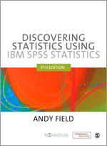
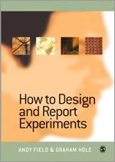
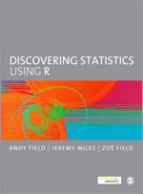
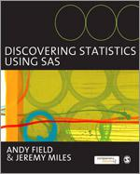
Why agree to publish a “crazy” idea by our best selling author?
Andy’s our best selling author
A market we know well
An established model re-thought
A marriage of SAGE’s strategic aims and a (more than) proven author
A unique opportunity to learn

Slide 4
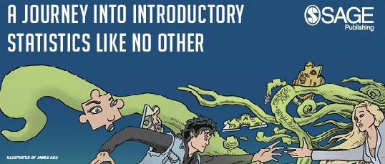
A journey into launching a textbook like no other...

Slide 5

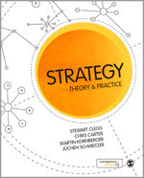
Market-driven development model
Online resources agreed
Online resources started
Online resources finalised
LIVE!
Project start!
Sign author!
Writing begins
Draft completed
Final draft
P r o d u c t i o n
Course area research
Online Surveying
Calling
Current edition/Proposal reviewing
Top target list
Author search
Proposal reviews
Individual chapter reviews
Project document created
Chapter batch reviews and follow-up
Project Document sent
Draft Manuscript reviews and follow-up
Editorial symposia?
Reviewer thanks
Completed project document sent
Sample chapters sent
eMarketing
Author letters
IC
Key Potential Adopters – THE MARKET!
Notes:
Just to show how project development works in line with market development.
We are going to be focussing primarily on different approaches to market development/seeding both before and after a manuscript has been transmitted.

Slide 6
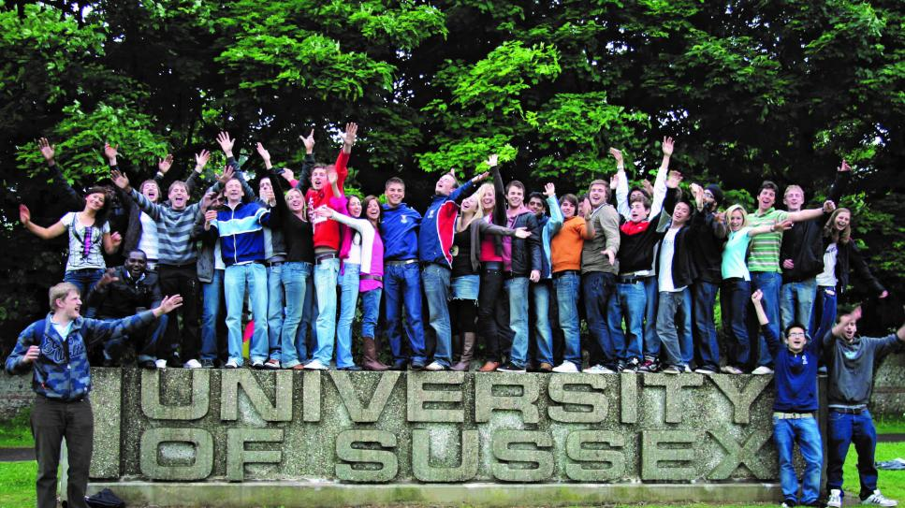
What have we done differently?
Strong Focus on Student Engagement
Flipped traditional development/marketing models
“Ground up” approach – focus on student feedback rather than faculty
Students as peer reviewers/influencers – pre-pub reviewing/surveys to start building testimonials

Slide 7
Student Engagement: Our Goals
“I would recommend this book to my lecturer as it will help other students to understand the basics they do not have time to go over. Lecturers’ time is expensive and for them to go over basic information on a one to one basis with struggling students seems to be pointless. It makes sense for lecturers to recommend this book to the students before having to tutor on a one-to-one basis.”
Karla, Bangor University, Psychology with Child and Language Development
Notes:
To try and convert as many of these supplementary or recommended adoption promises as possible over the next 2 years to essential adoptions and to try and maximize sell-through where we do get adoptions, our sales and marketing activities won’t just focus on attracting the attention of and convincing lecturers directly...
It’s also about engaging the student to influence adoption decisions, to maximize sell-through and act as advocates on campus.
Such is the novelty of Andy’s approach, it requires us doing things differently and I’ll give you a quick overview of the things we are and will be doing over the first and second year of the book’s life, starting with our online activities...

Slide 8
Instead of just memorising the concepts I actually understand them now and can apply them to other situations.
Student testimonial strategy helps us to:
Influence module leader decisions
Influence peers
Build initial word-of-mouth momentum
This is a completely unique way to learn stats! It is perfect for everyone that finds stats difficult, pointless or boring, this book proves them wrong! The way they explain the concepts is so easy to grasp and it makes it even entertaining to learn!! I wish I had discovered this sooner!!
This book is the perfect companion for an undergraduate course because you can read it before or after lectures to enhance your reading and understanding. I recommend this book as a core book for a psychology course, as it will help you learn in a fun and exciting way, unlike other boring stats books.

Slide 9


Online
#StatsAdventure
Social Media
@SAGE_Methods
DiscoveringStatisticsWithAndyField
Andy’s own networks
Pinterest
Notes:
So looking at online activities first, so far social media activity has been a big part of the student engagement piece and will continue to play a big part:
Regular posts and tweets via SAGE Methods and our dedicated Field page as well as the author’s own online channels have and will be set to coincide with availability of elements including: reviews, student endorsements, case studies from class-testing, videos, sample preview content, buzzfeed questionnaires etc
All designed to engage the student and to spread the word among their peers.

Slide 10
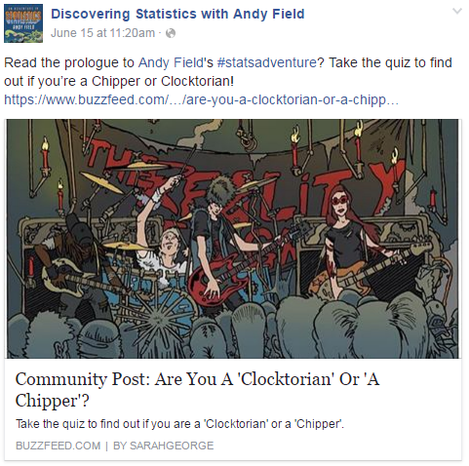
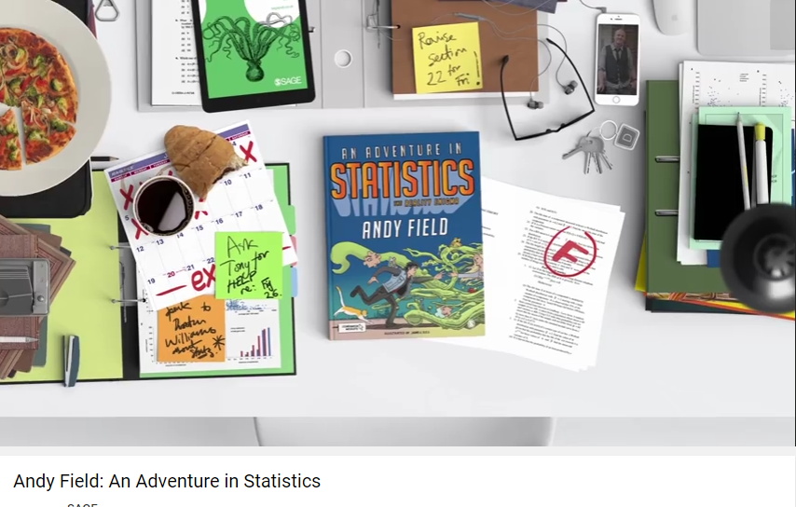
Online
Social Media
Video
Notes:
Here’s just one example of the kind of content we’re posting to engage students
Here you can see a link to a buzzfeed quiz asking readers to respond to early content in the book, asking them whether they are a clocktorian or a chipper – or in other words a technophobe or a tech-geek/nerd.

Slide 11
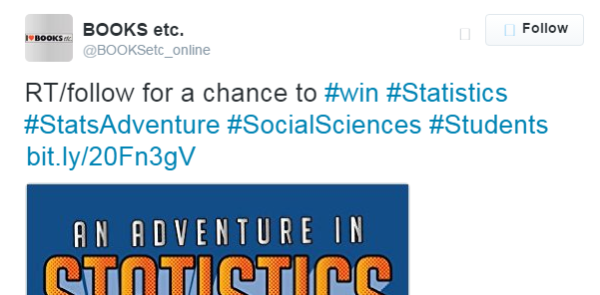
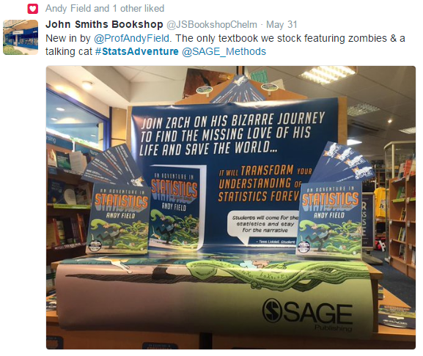
Retailers
Sales rep strategy:
Asking (sceptical) module leaders to get their students to review
Leaving flyers/colouring books on campus
From my brief read through it seems that she has done a thorough job for you. I was surprised that she was so positive – I don’t think she thought it was that good an idea before she took a look.
Notes:
We’ve also been enlisting the help of our partners in the trade to create some buzz and excitement to draw students in…
Books Etc ran a competition to win a free copy via their blog arranged by Despina, while over over 30 UK bricks and mortar shops have also got into the spirit of things by tweeting pictures of their displays using the campaign’s hashtag
The plan is also to host a webinar with Andy Field allowing students and fans to engage with the author and discuss the creation and use of An Adventure in Statistics.
Phases of the email campaign also continue to encourage lecturers to promote our social media sites to students as another way of seeking to engage them.

Slide 12
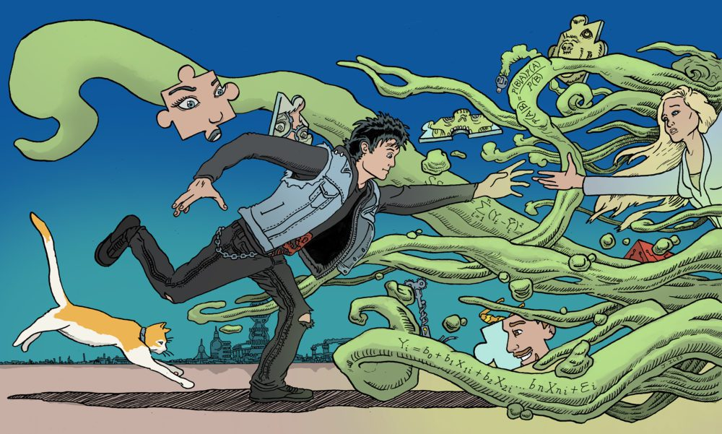
What’s next…
Long game...
- Of course we want “individual” purchases, but… Focus on winning new adoptions or getting onto recommended reading lists
- More content to share: a game?
- Using research
More student engagement innovation from SAGE…

Slide 13
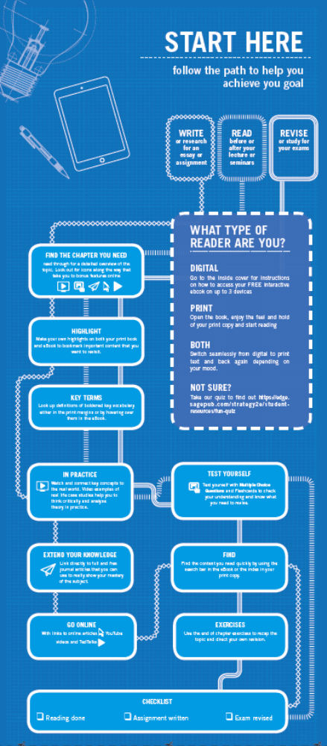
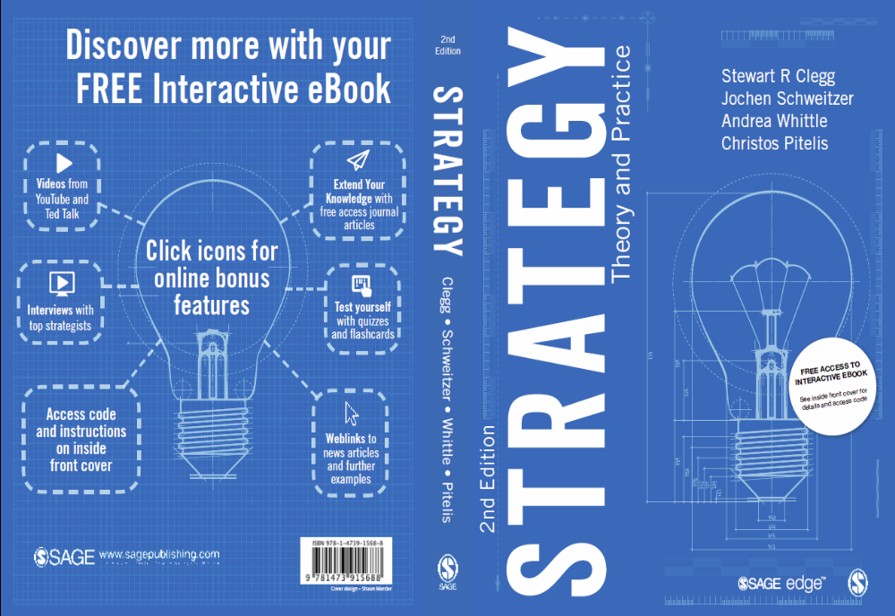
Backcover “designed by students”
Pull out preface – successful studying

Slide 14
#StatsAdventure
@SAGE_Methods
DiscoveringStatisticsWithAndyField
Notes:
Don’t forget you can keep up to date with developments on social media at the channels listed on this slide.
If you have any questions on the Field or anything else to do with Research Methods, Jai and I will see you after the coffee break for the break out sessions.

