Slide 1
Using Conifer to capture websites
Helen Webb (Research data management librarian)
Research-data@sussex.ac.uk

Slide 2
Plans for the session
Introduction to website capture
What is Conifer?
Setting up a recording session
Capturing a website
Managing the capture
Accessing the capture
Try it out!

Slide 3

Why capture a website?
See how a website changes over time
Capture a one-off event on a website
Comparison of several websites on a specific day
Capturing a website that will soon disappear
Preserving your own website

Slide 4
Why Conifer?
Simple to use and doesn’t require technical knowledge
Can capture media and dynamic elements
Manual approach lets you browse and capture what you want
Accounts are free but have a maximum 5GB storage

Slide 5
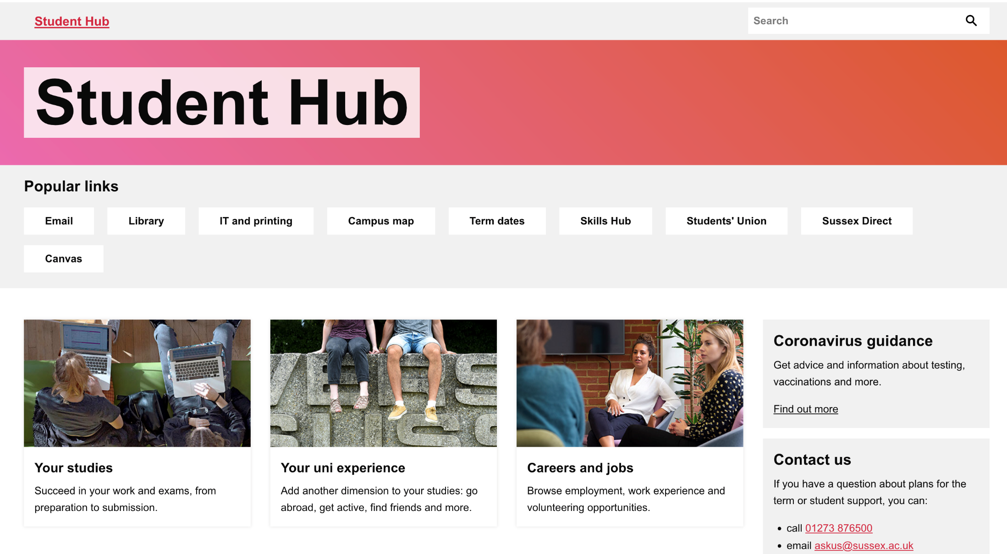
Example: StudentHub in 2020

Slide 6
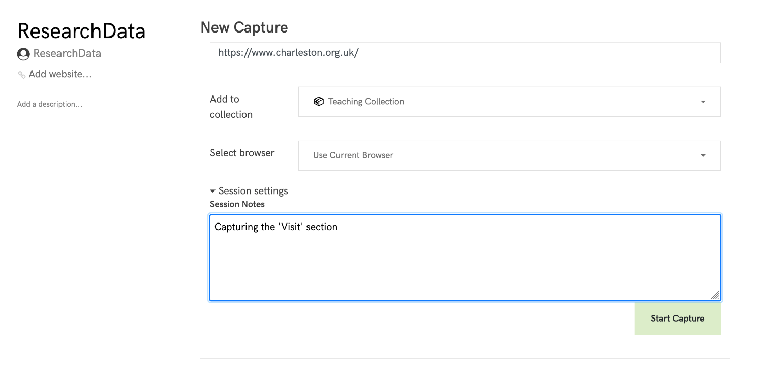
Starting to capture
Go to Conifer and set up an account
Set up a collection for the website(s) that you want to capture
Select your browser/leave as current
Add any notes about the session – perhaps reason for capturing or anything you might find useful in future.
Add your URL, press record and off you go!

Slide 7
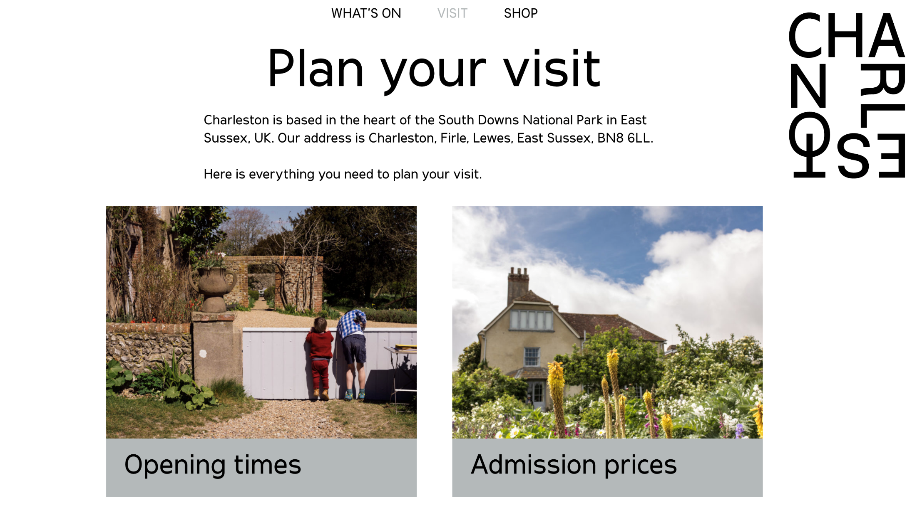
Capture demo

Slide 8
Reviewing and patching
Check your capture to see what you have and what is missing
Go to any of your capture pages and have a click around – you’ll soon see what you’ve got and what you haven’t
Add multiple new pages by starting another session in the same collection
If it’s just one or two odd pages that have been missed, or if an image or video is missing from a captured page – use the Conifer ‘patch’ function
Click on the drop-down by ‘browse’ and click on ‘patch’

Slide 9
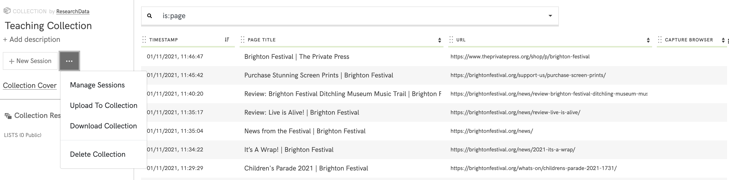

Slide 10
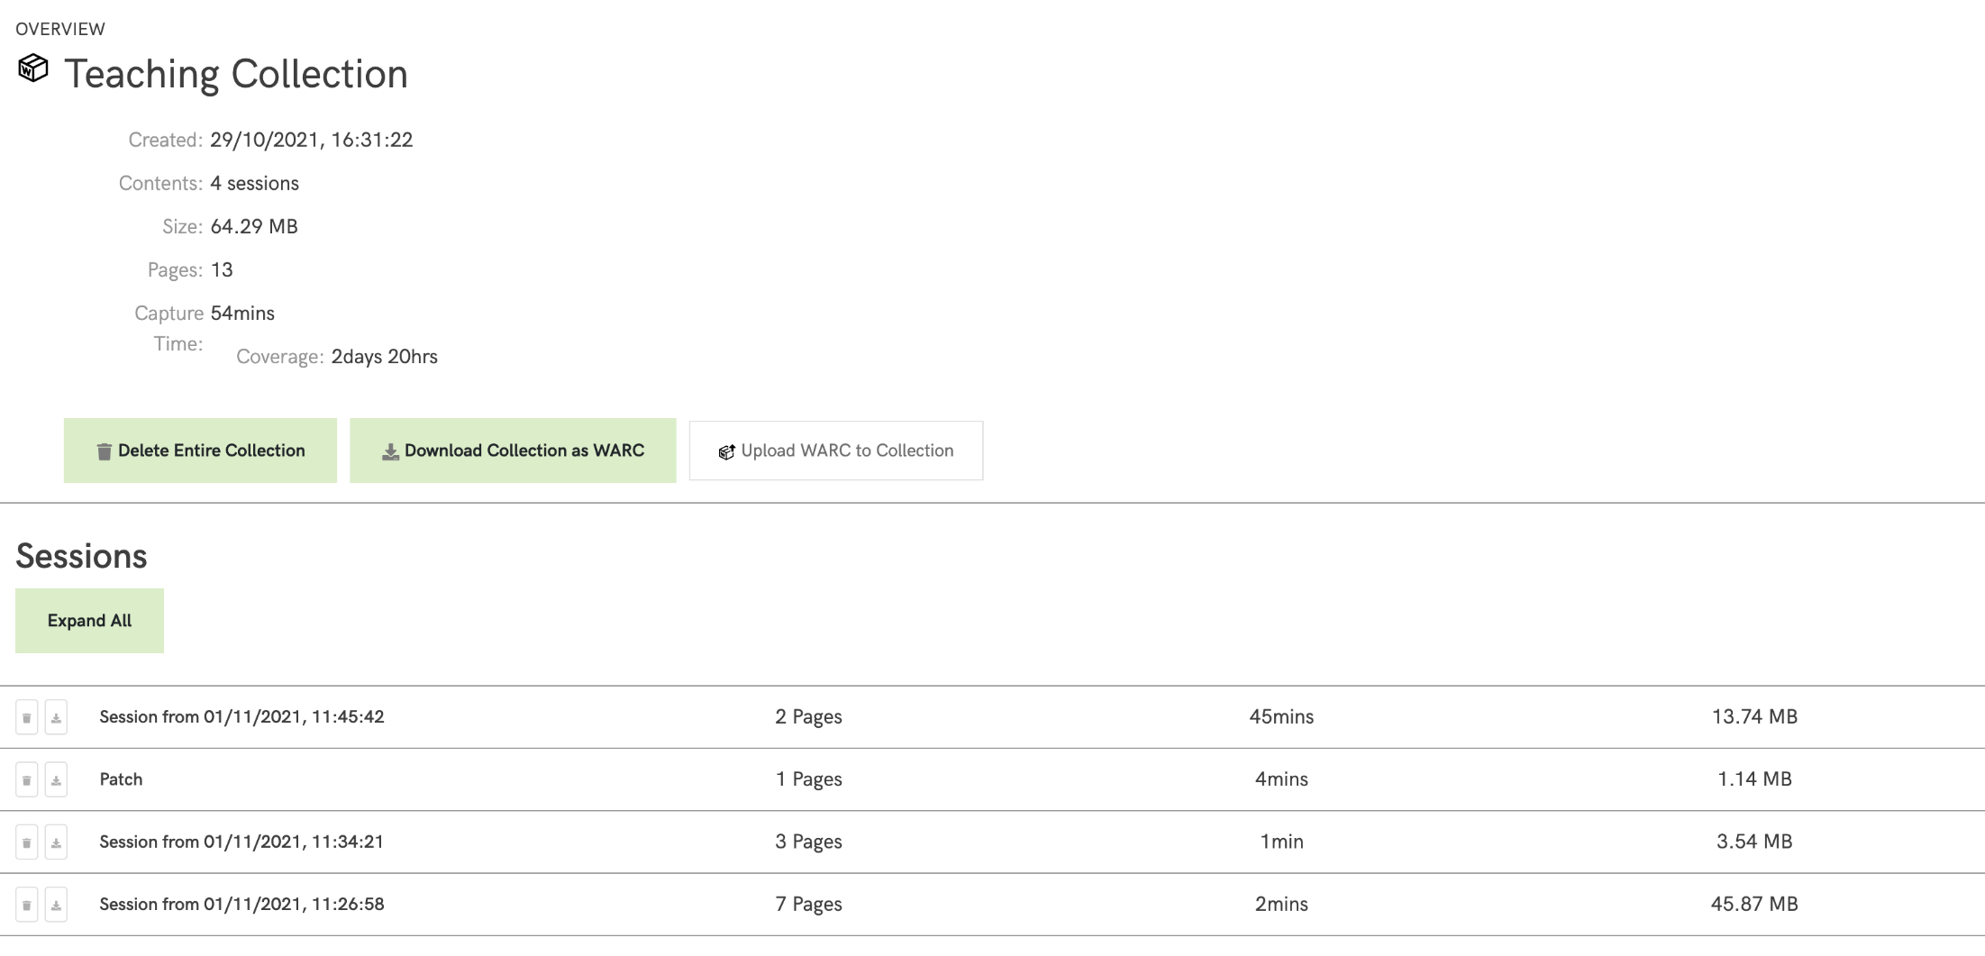

Slide 11
Managing the collection
View an overview of what you’ve got in that collection
You can’t delete individual pages, but can delete sessions
On this page you can also Upload some files (eg shared by someone else or that you’d previously downloaded and deleted)
Download your collection or an individual session

Slide 12
Key points
Conifer captures interactions so you may need to watch embedded videos and open accordions in order to capture them
Sessions start with you logged out of any website accounts – be careful about logging in while capturing as your login details can be captured
Websites might be captured differently depending on your browser and location
Flash content can be captured using a remote browser

Slide 13
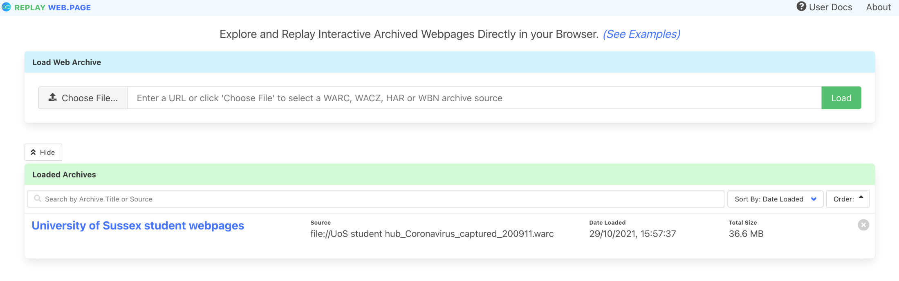
Accessing captures outside Conifer
Downloaded WARC files can be played in various resources
Try https://replayweb.page (created by original Conifer developers)

Slide 14
Try it yourself
Go to Conifer at https://conifer.rhizome.org
Register for an account
Set up a collection for the website that you want to collect
Select your browser or leave as default
Add any notes about the session – perhaps reason for capturing or anything you might find useful in future.
Select a webpage to capture and add your URL, press record and off you go!

