Slide 1
Identifying researchers
University of Sussex Library, 14 March 2016
Josh Brown
J.Brown@orcid-eu.org
http://orcid.org/0000-0002-8689-4935

Slide 2

Names are Messy
Notes:
We all know that names are messy. This is a universal problem that is only increased in its impact as more and more scholarship moves to digital venues. Searching the Internet using someone’s name is not going to give you the desired result.
One of the panelists shares a name with a biologist and an alien abduction specialist. I can’t imagine how much fun that must be,

Slide 3
Can names be cleaned up?
Of course they can!
We need to use digital names:
persistent identifiers that uniquely specify the person, organization, or object to which a name refers
Notes:
Can we address this problem? Yes!
It requires a community effort. First, is an appropriate naming strategy: A unique persistent digital name for each person.
Then, the journal editors need to establish guidelines for including these digital names in publications.
And editors and reviewers need to remind authors to pay attention to the guidelines.
We can do this. We are doing this!

Slide 4


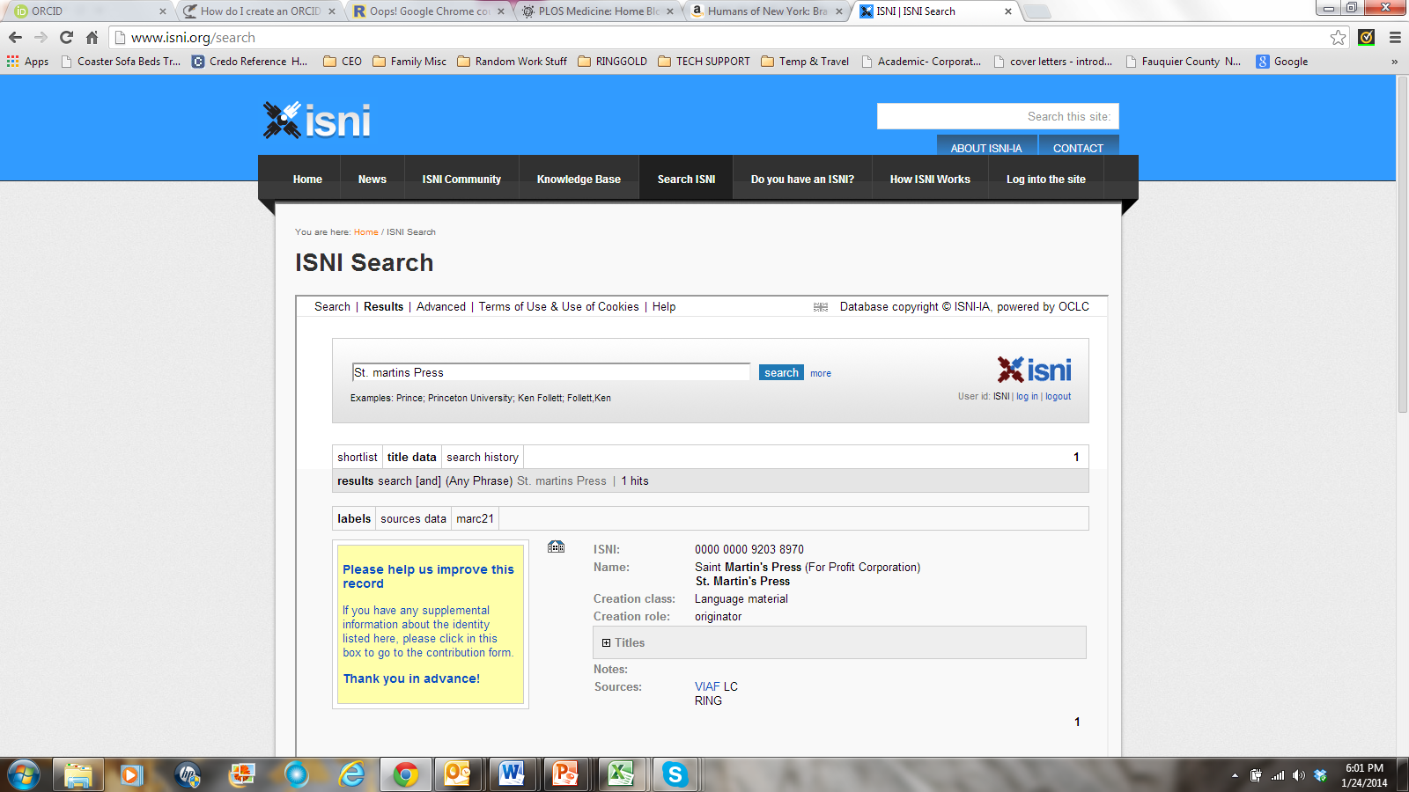







There are many useful IDs

Slide 5


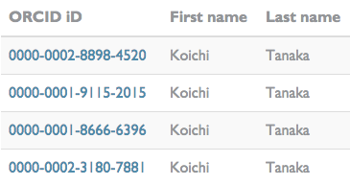
ORCID provides persistent digital identifiers that distinguish researchers from each other

Slide 6
Who uses ORCID iDs?
2M live iDs, 400+ members, 4 national consortia, and 200+ integrations in every region and sector of the international research community.

Slide 7
ORCID is Open
Non-proprietary and platform-neutral
International service that integrates with other researcher identifiers
Registry use is free for individuals
Independent non-profit membership organization
Open data, software, APIs, and documentation

Slide 8


Researchers and ORCID
To benefit, researchers need only do 2 things
  Register for an iD
  Use it!

Slide 9
Changing Role of Researcher
Use of ORCID iDs is pushing a conversation about the role of researchers in information management:
Passive → Active
Who owns the data?
Data privacy and consent
Demonstrate benefits to researcher

Slide 10
Universities
“We want to use ORCIDs to simplify the life of Oxford’s researchers for working with institutional systems and publishers’ systems by re-using already available information for publication data management and reporting.
The motto is: Input once – re-use often.”
Wolfram Horstmann, Assoc. Director, Bodleian Libraries, University of Oxford
http://orcid.org/0000-0001-8673-6104

Slide 11
Funder adoption in the UK
NIHR and Wellcome Trust mandate ORCID iDs for grant submissions.
The Research Councils are implementing ORCID in the grant application system.
HEFCE are exploring how encourage the use of ORCID iDs.

Slide 12
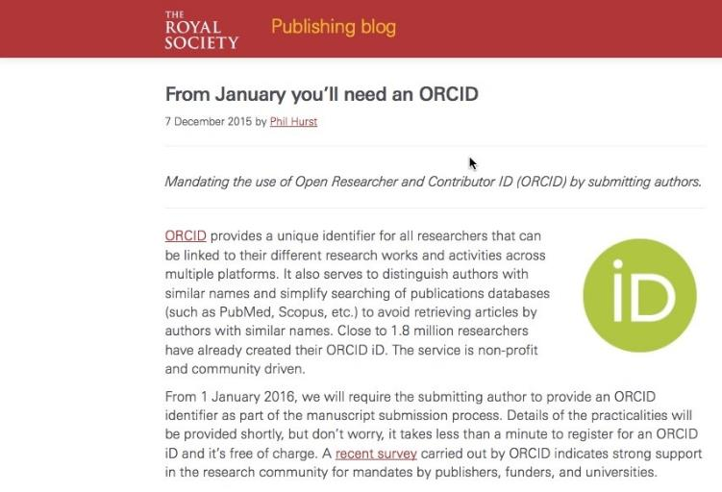
Publisher Requirements
Other publishers requiring ORCID iDs in 2016: PLOS, eLIFE, Science, Hindawi, IEEE, AGU…

Slide 13






Connecting people and works
submit manuscript
notifications to member systems
University Library
submit metadata
Faculty Profiles
update author ORCID record
ORCID Record
Funders
http://crosstech.crossref.org/2015/09/orcid-auto-update.html
Notes:
It is the researchers that benefit greatly from ORCID iDs. They can use them throughout their career, and can already use them to distinguish themselves in publications and grants. And many are starting to see the benefits of using ORCID records in outcome tracking. For example, researchers in Portugal who receive federal funding provide their ORCID iD, and benefit from coordinated outcomes reporting by using the ORCID registry as a hub.

Slide 14
Where are we?
Peer Review
Journals starting to collect ORCID iDs from reviewers; funders planning workflows
ORCID has launched UI and APIs
F1000, AGU, Publons and others have implemented iD connectors

Slide 15

Peer Review Workflow
submit review
Verify review via editorial management system
Post review citation to ORCID
Publisher
ORCID Record
notifications to external repositories

Slide 16

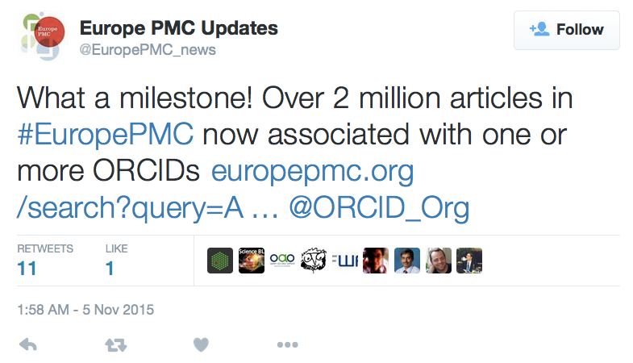

Connected articles

Slide 17
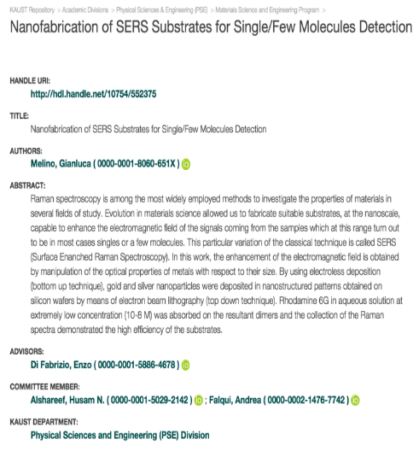
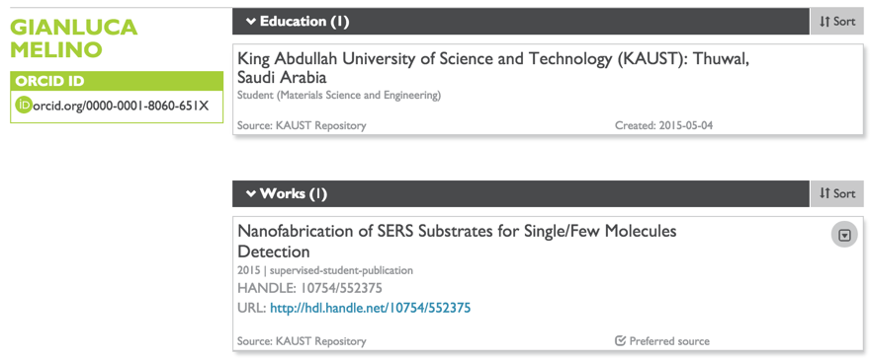
A connected career

Slide 18
Thank you for your attention.

