Slide 1
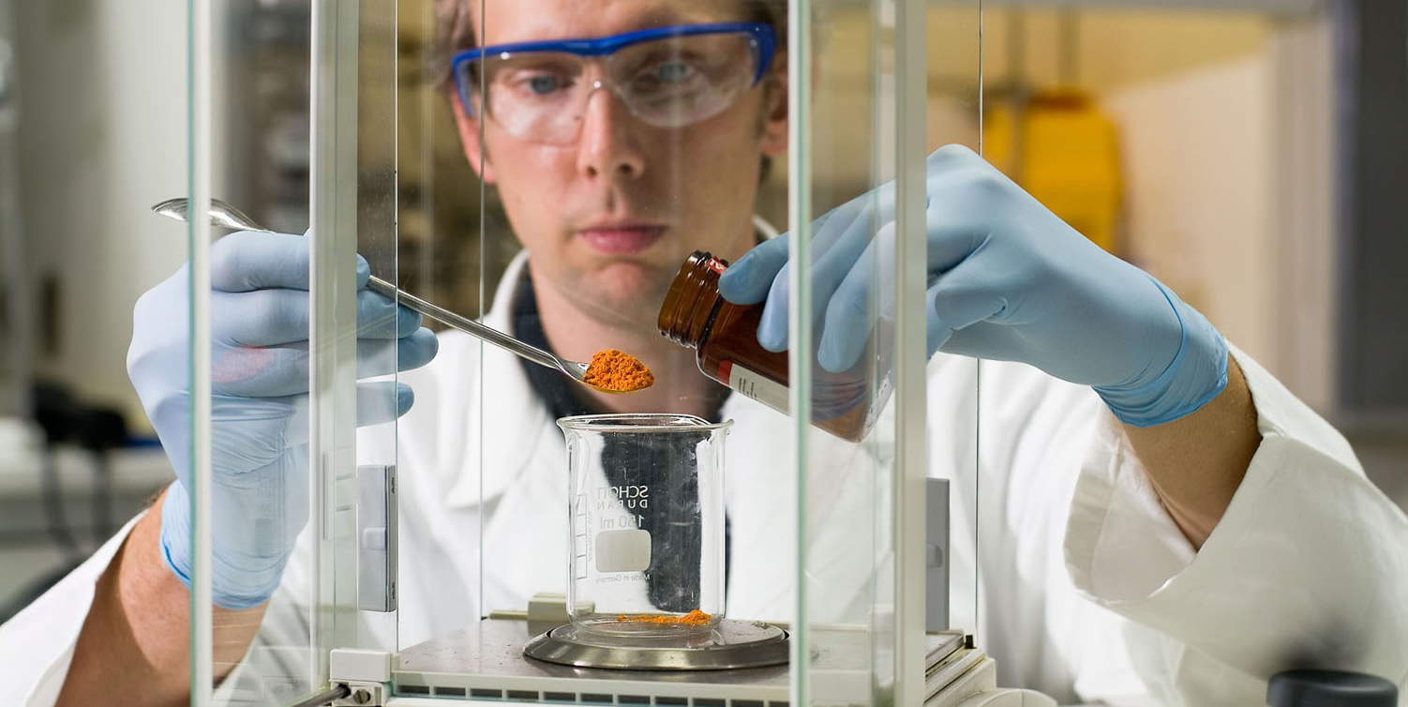
Pharmaceuticals and Global Health: Successes, Challenges and Outlook
Pharmaceuticals and Global Health: Inequalities and Innovation in the 21st Century

Slide 2
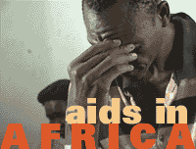
Access to Medicines: The South African Lawsuit
The South African Lawsuit – An Ill-Conceived Battle
  Lawsuit: Started in 1998, when AIDS was not an issue.
  Debate: „Profits” versus „lives”.
  Focus: „Big pharma“ and „Access to Medicines“.
  What went wrong?
  Unprecedented Industry PR disaster!
  Patents and prices were seen as main barriers to AIDS treatment.
  Industry allowed itself to be put into a corner.
  Result:
  Amicable settlement.
  Dialogue rather than confrontation.
  Promote public-private partnerships (GAVI, AAI, MMV).

Slide 3
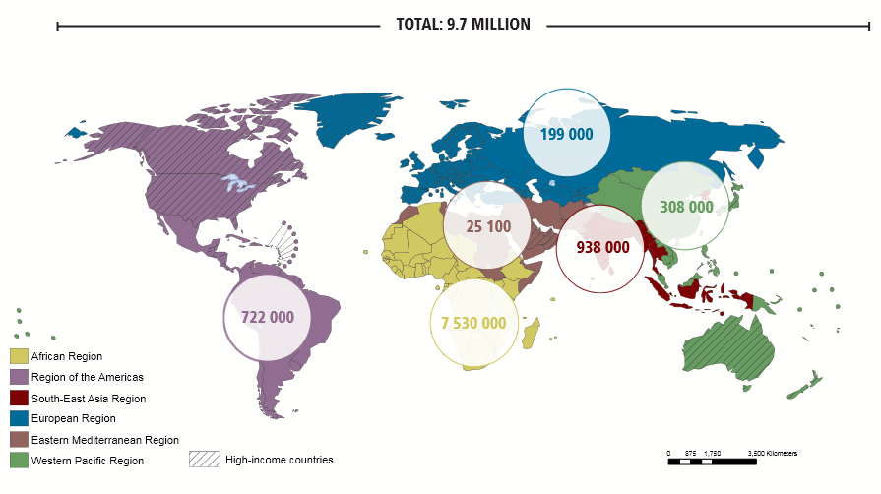
Number of people receiving antiretroviral therapy in low- and middle-income countries by WHO region, 2012
Source: 2013 Global AIDS Response Progress Reporting (WHO/UNICEF/UNAIDS).

Slide 4
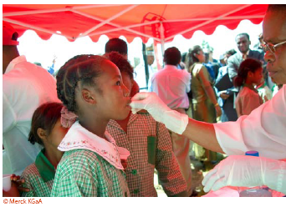
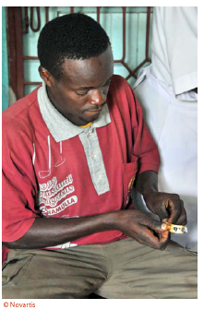
Access to Medicines: An Industry Perspective
The industry supports…
  Access programs featuring donation, capacity building, education & training, preferential pricing schemes, voluntary licenses, non-assert declarations and transfer of technology
  Research & development of new medicines and vaccines alone or in partnership
  Good governance: good manufacturing practices, ethical standards, guarantee high quality, safety & efficacy of medicines and vaccines, comply with regulatory requirements
  Numerous multinational initiatives: Global Fund, GAVI, WHO, UNITAID, Expansion of Philanthropic Initiatives are important examples of the work being done
  Company programs (examples): African Comprehensive HIV/AIDS Partnerships (ACHAP) in Botswana by Merck and the Bill & Melinda Gates Foundation; Takeda Initiative on HIV/AIDS in Nigeria; AmpliCare by Roche for strengthening laboratory systems
Source: Technology Transfer: a Collaborative Approach to Improve Global Health, IFPMA ,2011.

Slide 5
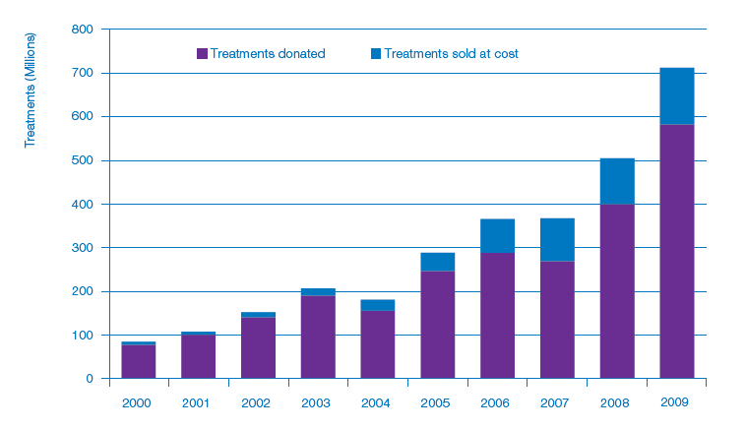
Access to Medicines – A Complex Picture
Treatments donated and sold at cost in developing countries
1400 Mio.
by 2020
Source: IFPMA Health Partnerships Survey, in: International Federation of Pharmaceutical Manufacturers and Associations (IFPMA):
The Pharmaceutical Industry and Global Health: Facts and Figures. Issue 2012.

Slide 6
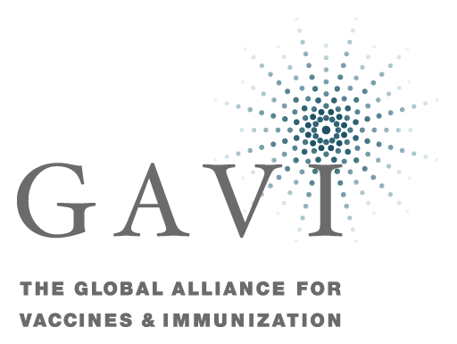


Successful multi-stakeholder initiatives
  Many different factors working together in often complex ways:
    Political commitment to HIV/AIDS has played a significant role
    International funding is a key part of increased access for the lowest income countries
    Holistic programs are needed allowing the different components to reinforce each other
    Collaboration between the generic industry and the innovator industry contribute to addressing the epidemic
Notes:
*Quelle: UNAIDS, WHO, UNDP: Using TRIPS flexibilities to improve access to HIV treatment, Policy Brief, Genf 2011.
**Quelle: World Bank
Many other challenges clearly remain:
there is a large under-served population
types of patient that are still particularly badly served
uncertainty about the speed at which mutations will create resistant strains of HIV.

Slide 7

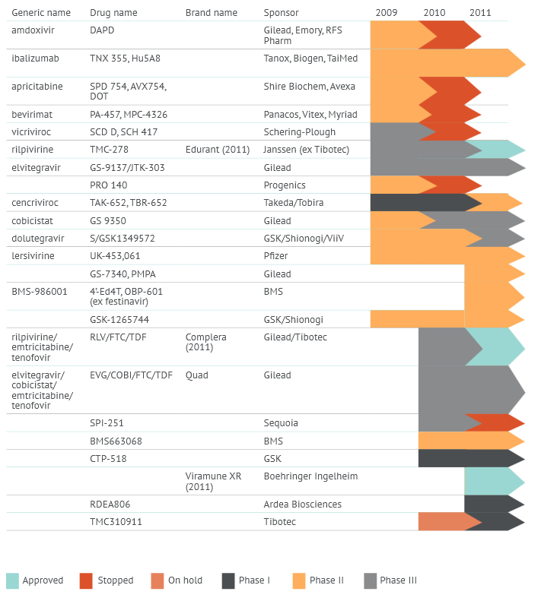





Investment in antiretroviral therapy (ART)
Pharma pipeline: 2009–2011
Source: Funding Science Innovation: Global Investements in HIV Treatment Research and Development in 2010 and 2011,
Treatment Action Group, 2013.

Slide 8
Undifferentiated pricing restricts access
Social value
e.g. Germany
Access
e.g. Romania
Unique price
e.g. Vietnam
No access

Slide 9
The role of differentiated pricing:
Can we find the middle ground?
Social value
Solidarity
within EU
e.g. Germany
International
Solidarity
Access
e.g. Romania
Access
e.g. Vietnam
Solidarity
within the country
Access

Slide 10
  Access to Drugs:
  One of the top political priorities
For industrialized countries and pharmaceutical industry:
  Supporting R&D, sound regulatory conditions and increase efficiency
  Addressing access barriers through partnerships and individual company programs
  Supporting financing through solidarity model (e.g differentiated pricing)
For emerging countries:
  Partnership Working clearly most effective and efficient way forward
  Creating the right innovation friendly environment (e.g. intellectual property protection)
For developing countries:
  Collaboration with originators and other partners has proven to be successful
  Other routes are also available – Global Fund, Philanthropic Initiatives, Member state capacity building programs, WHO, NGOs

