Slide 1
Discovery of new medicines through new models of collaboration
Simon Ward
Professor of Medicinal Chemistry & Director of Translational Drug Discovery Group
University of Sussex, Brighton, UK
Pharmaceuticals and Global Health: Inequalities and Innovation in the 21st Century
July 2013

Slide 2
Where is the problem?
Years 0-4
Years 4-6
Years 7-11
Years 12+
Hypothesis Generation
Drug Research
Drug Development
Commercialization
Target
Identification
and
Validation
Assay
Development
Lead
Generation
Lead Optimization
First Human Dose
Phase IA
Phase IB/II
Launch
Phase III
Submit
Global Launch
Global Optimization
Launch

Slide 3
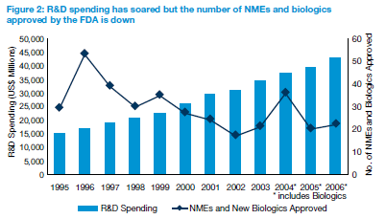
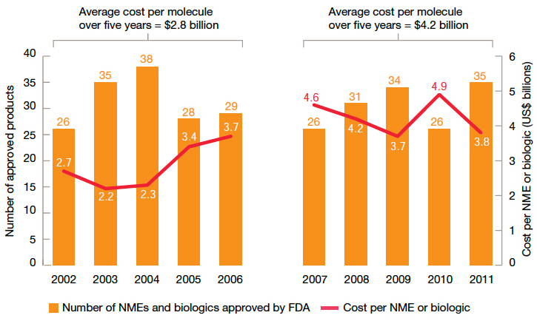
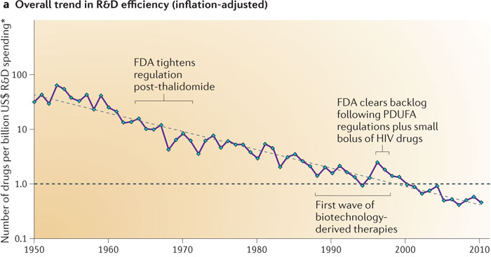
Can we afford to discover new medicines?
Sources: pwc Pharma 2020: From vision to decision; Nature Reviews Drug Discovery, Scannell et al 2012

Slide 4
Can we afford to discover new medicines?
Fewer than 1 in 10,000 novel molecules become approved new medicines.
Clinical stage molecules have only a 16% approval rate.
Innovative new medicines take 10-15 years to develop, costing between $1.2bn and $3.4bn to develop.
Only 2 in 10 new approved drugs recover the cost of their development.
Source: PhRMA Profile 2013
4

Slide 5
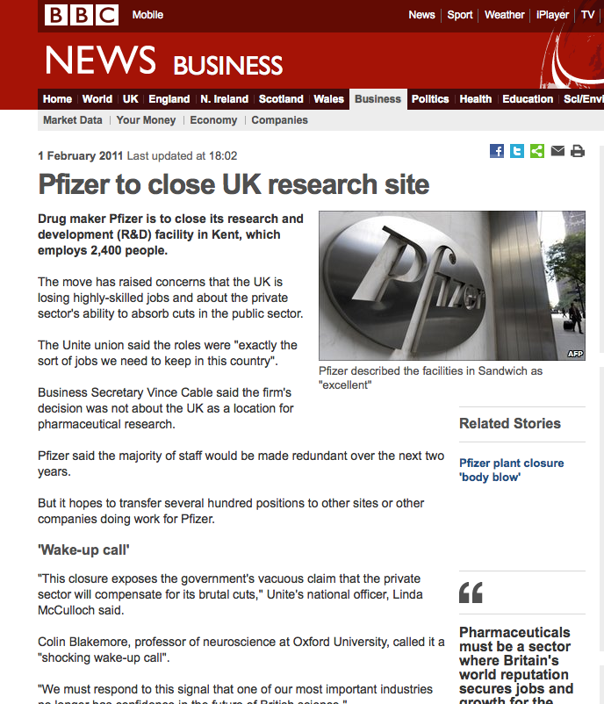
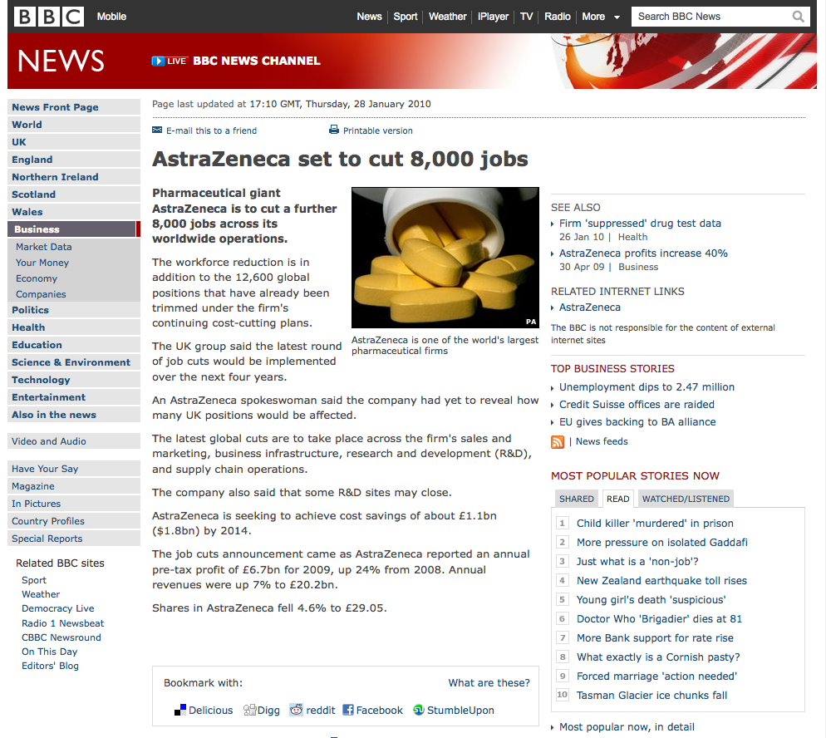
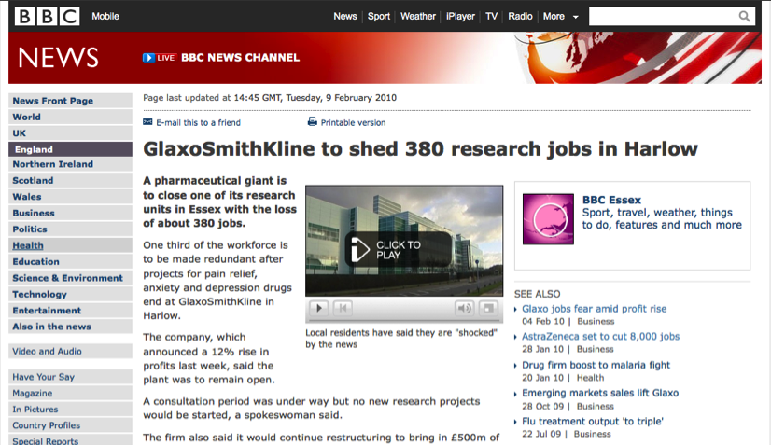
Is traditional ‘big pharma’ model broken?

Slide 6
Challenges and Opportunities
Improve understanding of disease biology
Late stage failure in clinical trials
Duplication of early stage activities
Pre-competitive approach to chemical tools
More drug discovery outside big pharma
Pharma in-licensing 50% of clinical portfolio
Pharma downsizing = fewer trained drug R&D scientists
Training within new academic research centres

Slide 7
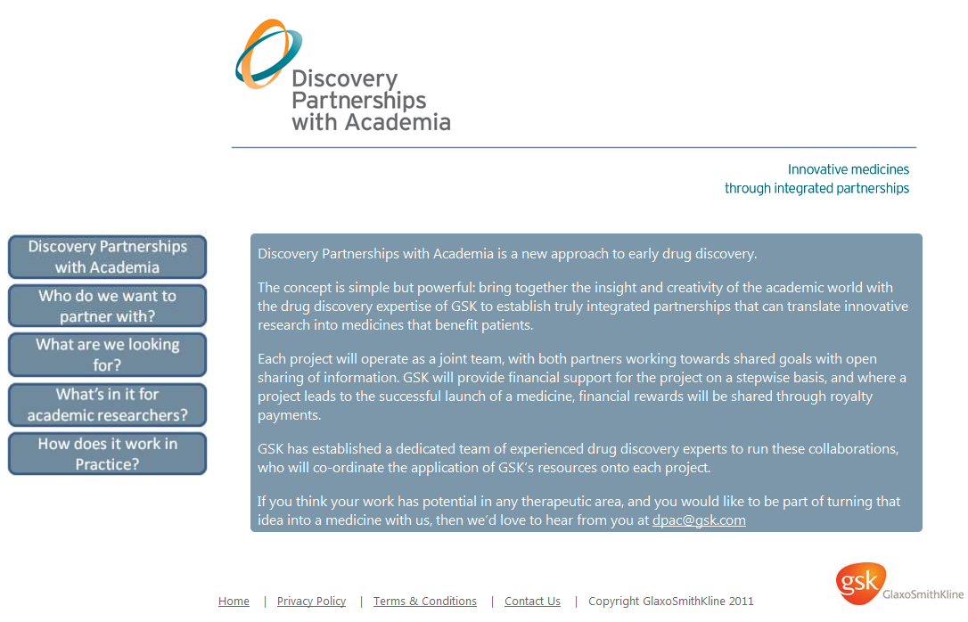
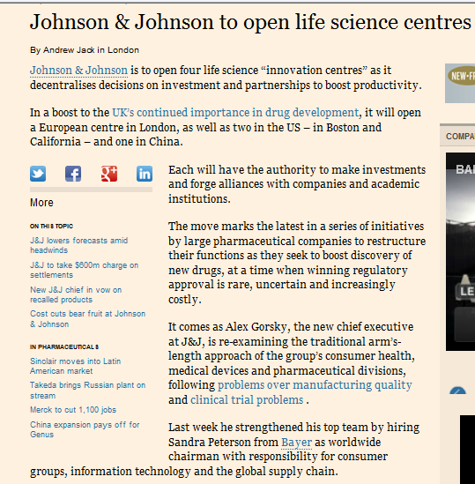
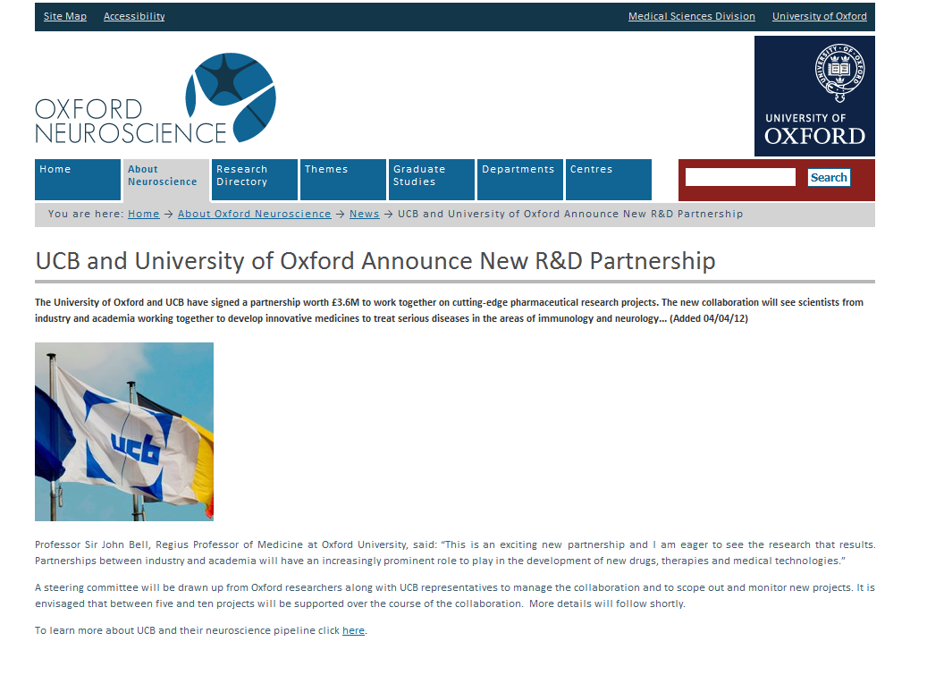
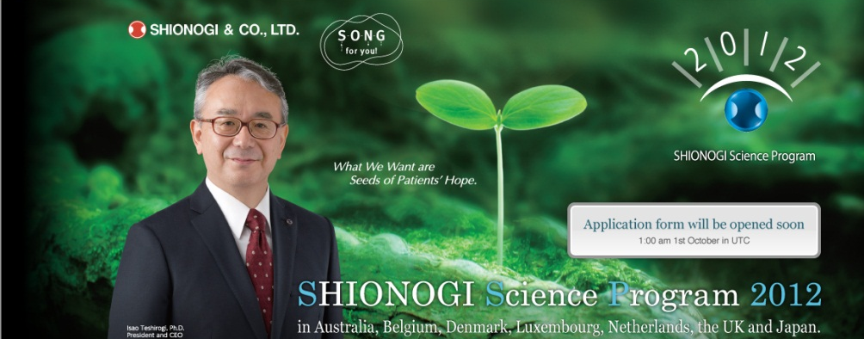
Sustainability through industry-academia collaborations

Slide 8

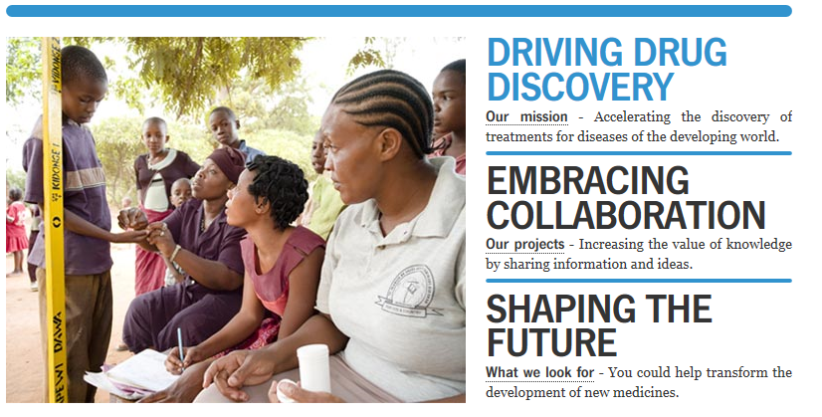

Slide 9

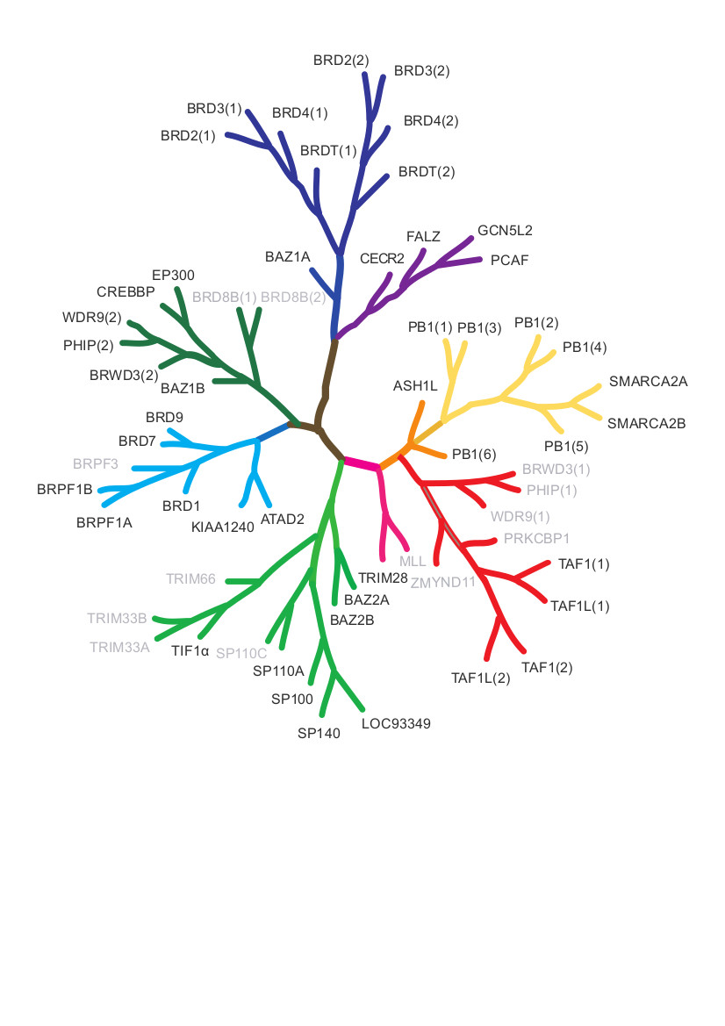

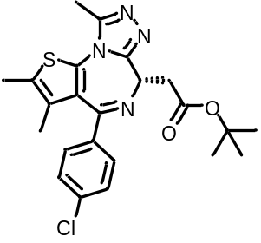
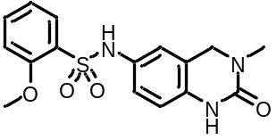


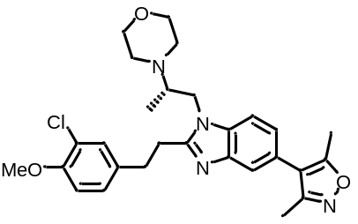




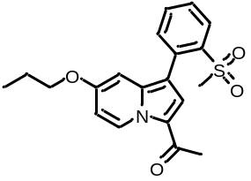


Structural Genomics Consortium
Pre-Competitive Epigenetic Probes

Slide 10
Translational Drug Discovery Group at Sussex
Drug Discovery
Pathway biology
Clinical
Bio-informatics
Protein structure
Chemistry
Experienced industry professionals
Track record of drug design
Successfully led multidisciplinary projects
http://www.sussex.ac.uk/lifesci/drugdiscovery/

Slide 11
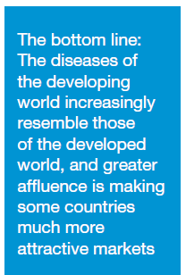
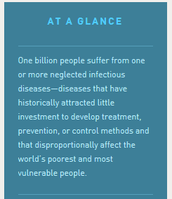
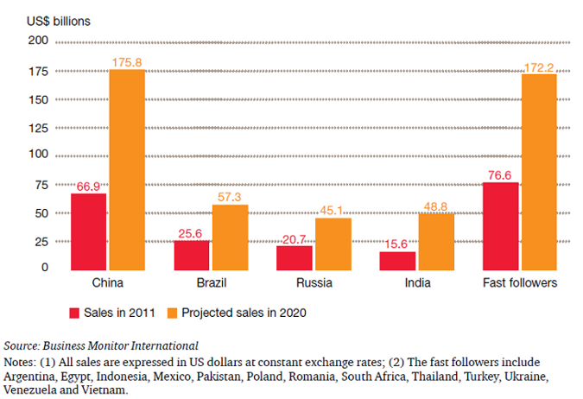
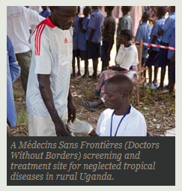
Different opinions on ‘Global health’?
pwc Pharma 2020
Gates Foundation 2013

